Slide 1
Food Chains and Food Webs

Slide 2
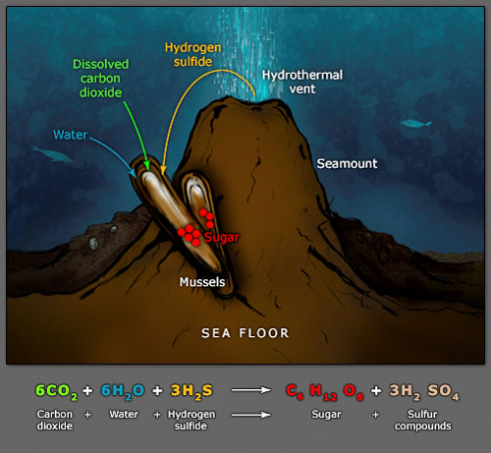
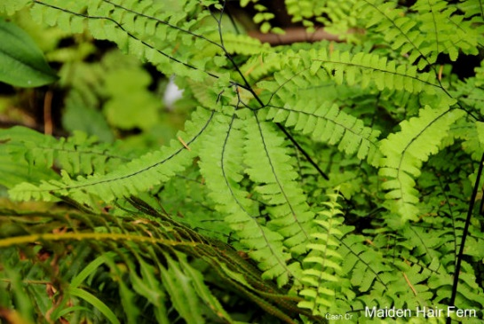
Autotrophs=Producers
Organisms that can make their own organic compounds from inorganic compounds are called producers. Producers are all autotrophs.
Some are photosynthetic autotrophs; they use light energy provided mainly by the sun to convert inorganic compounds (eg. carbon dioxide and water) into organic compounds (eg. glucose).
A few are chemosynthetic autotrophs; they use energy from chemicals to convert inorganic compounds into organic compounds. (e.g sulphur bacteria)

Slide 3
Consumers
Organisms that don’t make their own food are call consumers. There are many categories of consumers. These include herbivores, omnivores, carnivores, scavengers, detritivores and decomposers.
A variety of terms can be used to describe consumers.

Slide 4
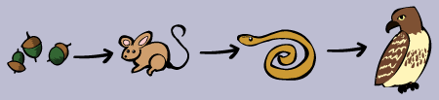
An order to dining!
A food chain is a linear sequence showing the passage of energy from producer organisms to the top consumer. It is a sequential “who eats who” diagram. Arrows connect the organisms within a food chain and show the direction of energy flow. The position of an organism in a food chain/web is called the trophic level. Producers form the first tropic level in a food chain.
Each living thing in an ecosystem is likely to be part of a many different food chains.

Slide 5
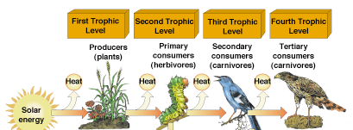
Trophic level
The trophic level of an organism is the position it
holds in a food chain.
However, food chains are not able to reflect the complexity of energy transfer that occurs in an ecosystem
Fig. 4–18

Slide 6
Components of food chains
Type | Acquires energy through | Example
Producer/autotroph | Photosynthesis or chemosynthesis | Green plants and algae Chemosynthetic bacteria
Consumer/heterotroph | Feeds off other organisms | All animals, all fungi
Herbivore | Feeds of autotrophs | Cow, grasshopper, zooplankton
Omnivore | Feeds of both autotrophs and heterotrophs | Bear, pig
Carnivore | Feeds of other animals | Lion, spiders
Scavenger | Feed off dead animals/remains they haven’t killed themself | Tasmanian devil
Detritivore | Feeds off detritius (decomposing plant or animal remains or waste matter) | Worms, woodlice, dung flies, fiddler crabs
Parasite | Obtains nutrients from another organism to their detriment | Tape worm(endo-parasite) Flea(ecto-parasite) Mistletoe(parasitic plant)
Decomposer | Breaks down dead matter | Bacteria

Slide 7
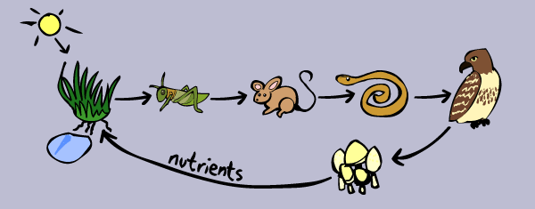
Decomposers
Decomposers, like fungi and bacteria, complete the food chain.
Decomposers turn organic waste, such as decaying organisms, into inorganic materials, such as nutrient-rich soil. They complete the cycle of life, returning nutrients to the soil or oceans for use by autotrophs.

Slide 8
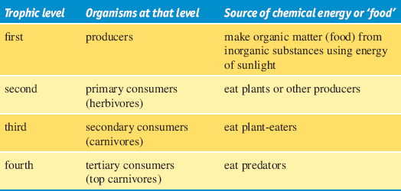
Why is it difficult to include decomposers in this table?

Slide 9
Decomposers
Decomposers are often left off food chains and webs. If included they would be best placed at the end of a food chain or the top of a food web arranged in trophic levels.
This means that food chains start with producers and end with decay and decomposers. Since decomposers recycle nutrients, leaving them so they can be reused by producers, they are sometimes regarded as occupying their own trophic level and are sometimes placed to the side of ecological pyramids.

Slide 10
Food WEB
A diagram showing some or all of the food chains in an ecosystem is called a food web(also called a feeding cycle).
A particular organism can be at multiple trophic levels within a food web as it can have a different role in each food chain that it is a part of.
Ecology is full of different terms that mean almost the same thing.

Slide 11
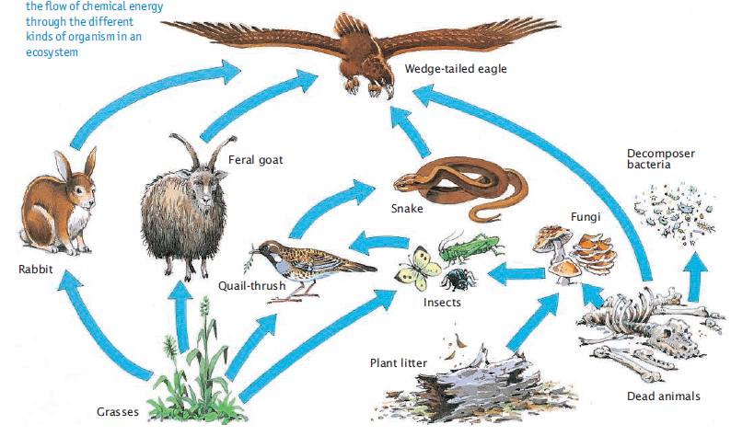
Food Webs
Food webs are multiple food chains that are interconnected. More complex than food chains.

Slide 12
Feeders LINGO |  |  | Topic levels | Example food Chain
 |  |  |  | Grassland Biome | Pond Biome | Ocean Biome
Producer | Producer | Autotroph | 1st | Grass | Algae | Phytoplankton
Primary consumer | First order consumer | herbivore | 2nd | Grasshopper | Mosquito larvae | zooplankton
Secondary consumer | Second order consumer | Carnivore or omnivore | 3rd | Rat | Dragon fly larvae | fish
Tertiary consumer | Third order consumer | Carnivore | 4th | Snake | fish | Seal
Quaternary consumer | Fourth order consumer | Carnivore | 5th | hawk | racoon | Shark

Slide 13
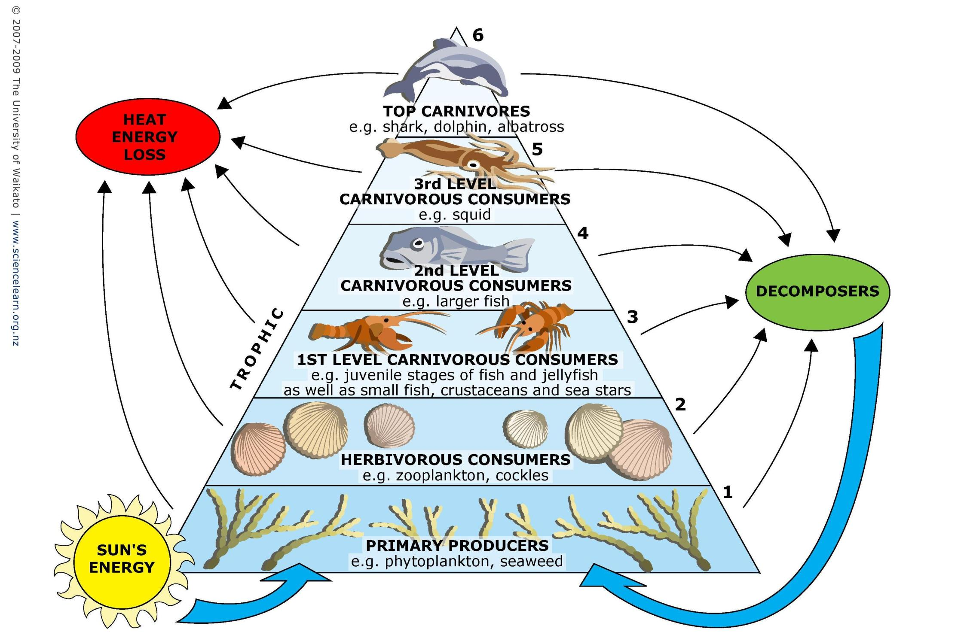

Slide 14
Top level consumer/top carnivore/top predator in a food chain/web is the consumer that no other organism feeds off. (it is prey for no other organism). The top level consumer may be at a different tropic level in one food chain within a web, compared to another.(it may be at the 3rd ,4th or 5th trophic level depending of the food chain they are a part of)

Slide 15
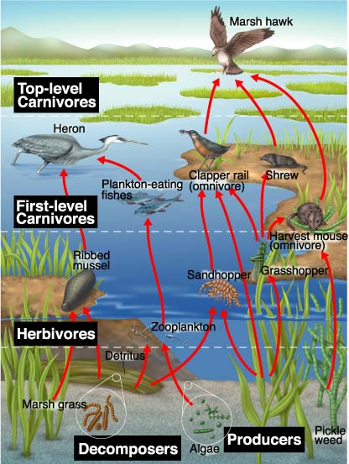

Slide 17
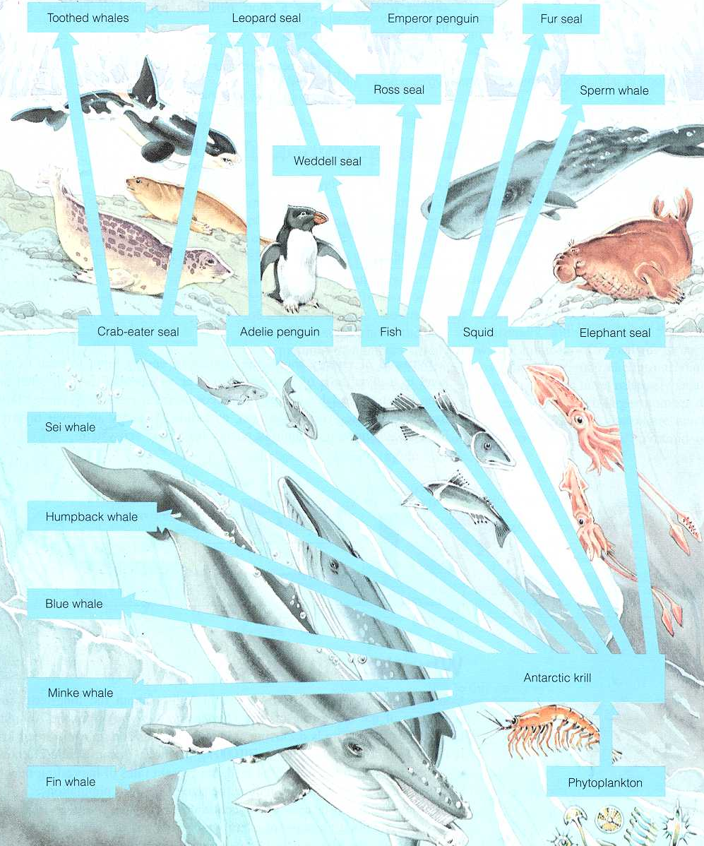
Toothes whale
Leopard seal
Emperor penguin
Fur seal
T-5
Toothes whale
Ross seal
Sperm whale
T-4
Leopard seal
Weddel seal
T-3
Adelie penguin
T-2
Antarctic Krill
Crab eater seal
Adelie penguin
Fish
Squid
Elephant seal
T-1
phytoplankton
Sei Whale
T-4
Toothes
whale
Humpback Whale
T-3
Crab eater seal
Blue Whale
T-2
Antarctic Krill
Mink Whale
Antarctic Krill
T-1
phytoplankton
Fin Whale
phytoplankton

Slide 18
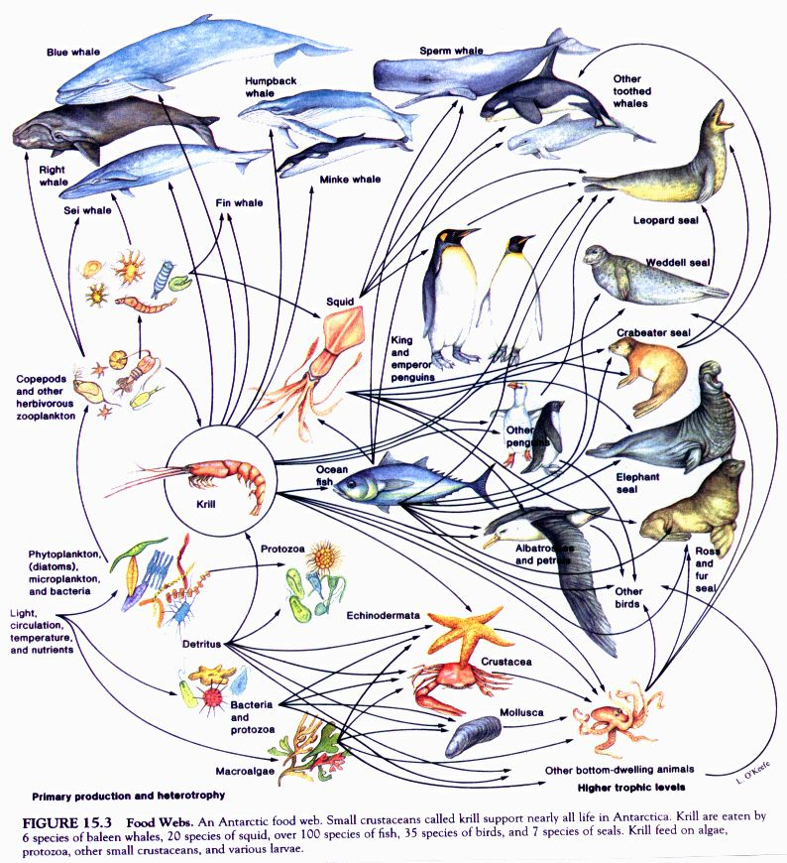

Slide 19
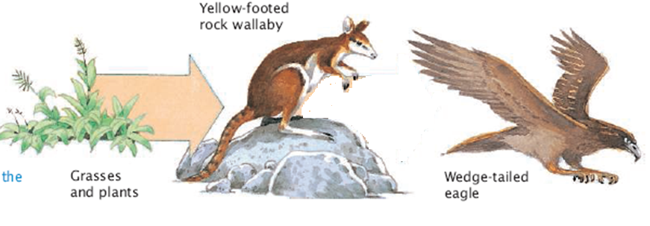
Energy Transfer In a food chain
Why are the arrows getting smaller?
Less energy being passed on

Slide 20
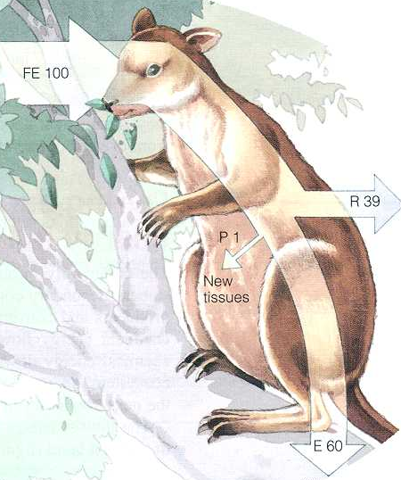
Energy ‘Loss’ from a mammal
Energy in food eaten
100units
Energy used in metabolism
39 units
Energy in organic matter in new tissue
1 unit
‘lost’ when converted to heat energy OR
Kinetic energy
60 units
Energy in matter egested or excreted

Slide 21
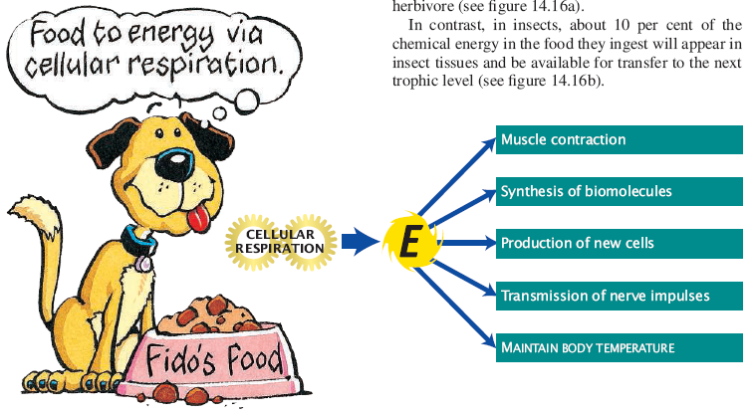
Energy flows through an ecosystem
Organisms use energy from the food they ingest for many purposes.
A large proportion of energy is also lost as heat
Because of this, not all the energy consumed is able to be passed on

Slide 22
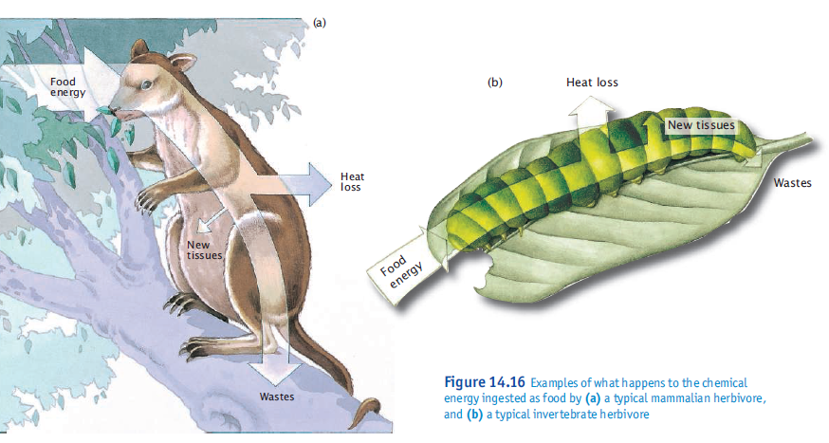
Proportion of Chemical energy passes on to next tropic level isn’t the same for all organisms

Slide 23
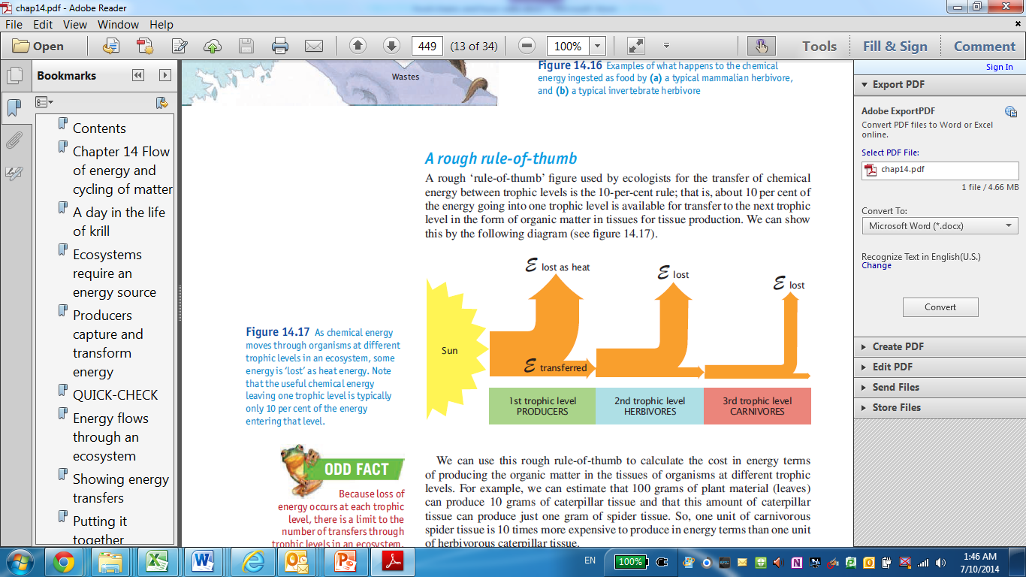
10% Rule of thumb for energy transfer
100 grams leaf tissue
10 grams caterpillar tissue
1 gram spider tissue

Slide 24
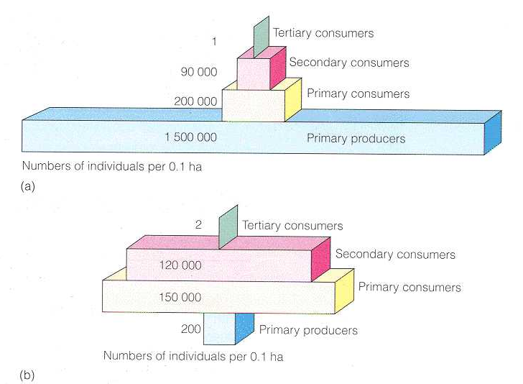
Number Pyramid
Shows the number of organisms at each tropic level per unit area at a certain time.
Most of the time a healthy food web has an abundance of producers, many herbivores, and few carnivores and omnivores.
This will however depend on the size of the organisms at each level.
Which is Which?
Pyramid of numbers for a forest ecosystem
Pyramid of numbers for a Grassland ecosystem

Slide 25
Biomass Pyramid
Biomass is the dry weight of a given species/trophic level at a particular time.
Autotrophs, the producers in a food web, convert the suns energy into biomass.
Biomass usually decreases with each trophic level unless producers reproduce quickly and are very productive. There is usually more biomass in lower trophic levels than in higher ones.
Because biomass usually decreases with each trophic level, there is more biomass in producers than in first order consumers/herbivores in a healthy food web. There will be more biomass in second order consumers than tertiary consumers and so on. This balance helps the ecosystem maintain and recycle biomass.

Slide 26
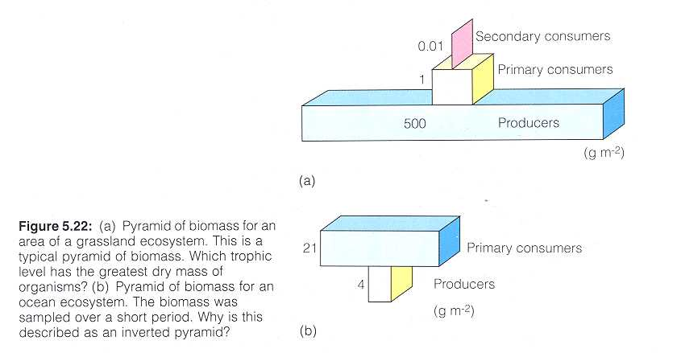
Biomass Pyramids
Which is Which?
BiomassPyramid of for a forest ecosystem
Biomass Pyramid for an open ocean ecosystem

Slide 27
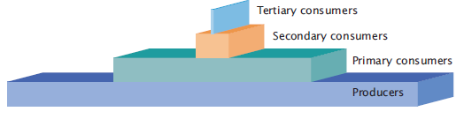
Energy Pyramid
River Ecosystem

Slide 28
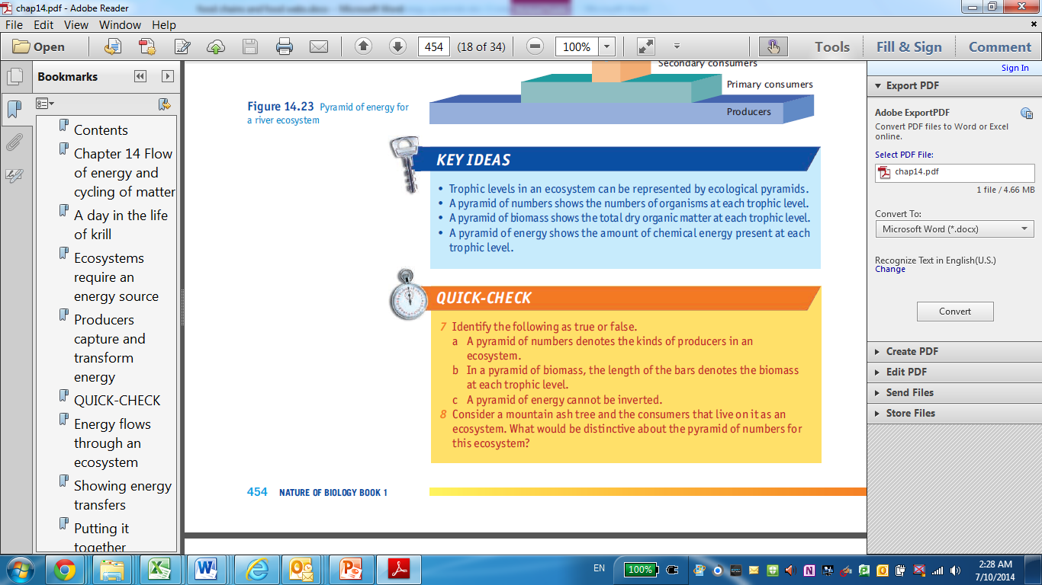
Quick Check

Slide 29
3 conclusions
The number of trophic levels in ecosystems is limited, with many ecosystems having only 3 levels
The higher the trophic level of organisms, the greater the energy cost of production of their organic matter
Energy must be continually supplied to an ecosystem, because it flows in a one way direction and is not recycled.

Slide 30
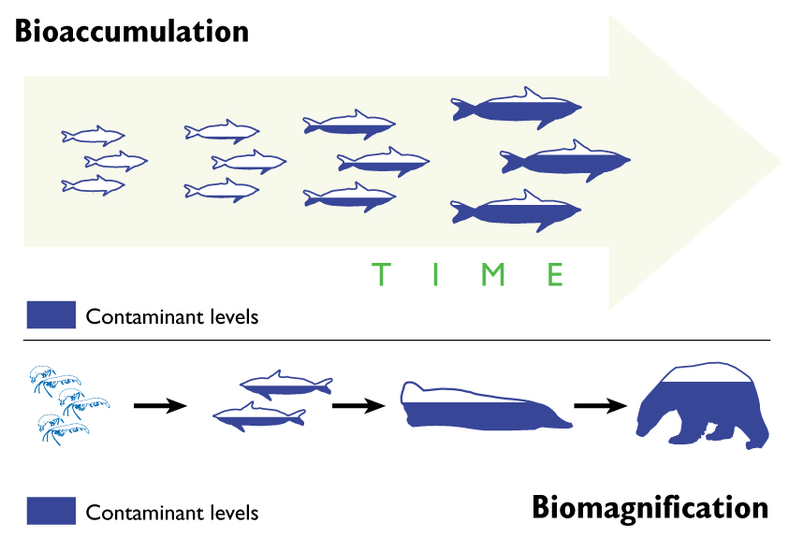
Bioaccumulation vs Biomagnification
Bioaccumulation: increase in concentration of a substance(s)(pollutants/toxins) in an organism or a part of that organism. The affected organism has a higher concentration of the substance than the concentration in the organism's surrounding environment
Biomagnification: increase in concentration of a pollutant from one link in a food chain to another

Slide 31
Bioaccumulation vs Biomagnification
Together they mean that even small concentrations of chemicals in the environment can find their way into organisms in high enough dosages to cause problems.
In order for these processes to occur, the pollutant must be:
  long-lived,
  Mobile
  soluble in fats
  and biologically active

Slide 32
Case Study DDT
DDT=dichloro-diphenyl-trichloroethane
Pesticide used in the 1940s and 1950s, to kill insects that spread diseases .
    eg. mosquitos that transmit the parasite responsible for malaria.
DDT accumulates in soil and water
It is taken up by grasses and algae and accumulates in their tissues
It is passed onto consumers in a food chain.
Through biomagnification along food chains the DDT level in some top order consumers are dangerously high.
DDT break down very slowly. Its half life is about 15 years.
Notes:
was widely used to kill insects that spread diseases such as the mosquitos that transmit the parasite responsible for malaria

Slide 33
Case Study DDT
So if you use 100 kg of DDT, it will break down as follows
Year | Amount Remaining
0 | 100 kg
15 | 50 kg
30 | 25 kg
45 | 12.5 kg
60 | 6.25 kg
75 | 3.13 kg
90 | 1.56 kg
105 | 0.78 kg
120 | 0.39 kg
Notes:
was widely used to kill insects that spread diseases such as the mosquitos that transmit the parasite responsible for malaria

Slide 34
Effects of DDT in humans
DDT at concentration of 6-10 mg/kg leads to such symptoms as headache, nausea, vomiting, confusion, and tremors
Above 236 mg per kg of body weight it can cause death

Slide 35
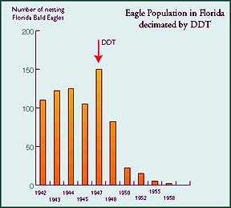
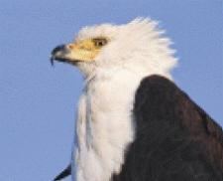
Decline in Bald Eagle Population
Notes:
Prior to DDT use as an insecticide eagle population were in recovery and steadily growing. (prior they were at risk The decline of the bald eagle throughout the late 1800s was noted on the western plains and experts speculate that this drop in population could have been due to the decimation of the bison and the complete extinction of the passenger pigeon. Both herds of bisons and flocks of pigeons must have supplied a plentiful food source for the bald eagle at one time.
http://www.eagles.org/vu-study/recovery/status.php
This is number of eagles(not pairs). Following graph is the number of nesting pairs.

Slide 36
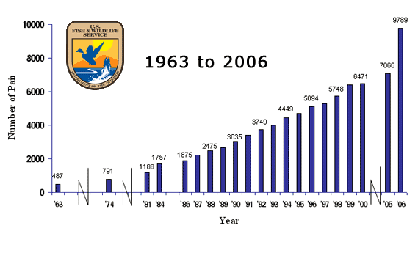
Bald Eagle
Notes:
Bald Eagle Recovery
The most accurate data on the recovery of the bald eagle population in the United States are taken from sightings of nesting pairs
http://www.eagles.org/vu-study/recovery/status.php
Between the early 1980s and 2000, most States conducted annual bald eagle surveys. Since then, many states recognized that annual surveys were no longer necessary. That is why you will not see annual data after 2000.

Slide 37
Top predators have highest amounts of DDT in their bodies
eg. Eagle
Birds with high amounts of DDT in their bodies lay eggs with extremely thin shells.
Thin shells: often break before the baby birds were ready to hatch.
Thin shells also made it easier for predators such as snakes and other birds to consume the eggs and embryos inside.
DDT was a major reason for the decline of the bald eagle.
Notes:
In the 1940s and 1950s, a pesticide called DDT (dichloro-diphenyl-trichloroethane) was widely used to kill insects that spread diseases such as the mosquitos that transmit the parasite responsible for malaria. Unfortunately, DDT accumulates in soil and water and it taken up into grasses and algae and passed onto consumers in a food chain. Through bioaccumulation along food chains the DDT level in some top order consumers are dangerously high. Some forms of DDT may not decompose for 20 years. Apex predators, such as eagles, had highest amounts of DDT in their bodies, accumulated from the fish and small mammals they prey on. Birds with high amounts of DDT in their bodies lay eggs with extremely thin shells. These shells would often break before the baby birds were ready to hatch. Thin shells also made it easier for predators such as snakes and other birds to consume the eggs and embryos inside. DDT was a major reason for the decline of the bald eagle, an apex predator that feeds primarily on fish and small rodents. Today, the use of DDT has been restricted. The food webs of which it is a part have recovered in most parts of the country.

Slide 38
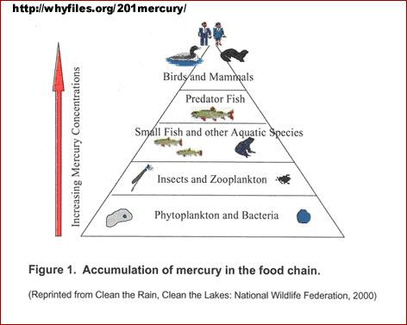
Risk of bioaccumulation of heavy metals for humans
High concentrations of:
  lead in pregnant mothers can cause miscarriages and stillbirths.
  Mercury can cause paralysis.
Notes:
http://www.angelfire.com/anime5/ans123/HgInFish.htm

Slide 39
What is being done now?
The Stockholm Convention is a legally binding international agreement finalized in 2001.
participating governments agreed to take actions to reduce or eliminate the production, use, and/or release of certain pollutants
Persistent organic pollutants (POPs) are toxic chemicals that adversely affect human health and the environment around the world.
Many of these chemicals proved beneficial in pest and disease control, crop production, and industry and so were extensively used
Notes:
http://www2.epa.gov/international-cooperation/persistent-organic-pollutants-global-issue-global-response#thedirtydozen
Because they can be transported by wind and water, most POPs generated in one country can and do affect people and wildlife far from where they are used and released.

Slide 40
Operation Cat drop
https://www.youtube.com/watch?v=RwJ3CRdmbaI
https://www.youtube.com/watch?v=17BP9n6g1F0
Notes:
In the early 1950s, the Dayak people in Borneo suffered from malaria. The World Health Organization had a solution: they sprayed large amounts of DDT to kill the mosquitoes which carried the malaria. The mosquitoes died the malaria declined; so far, so good. But there were side-effects. Among the first was that the roofs of people’s houses began to fall down on their heads. It seemed that the DDT was also killing a parasitic wasp which had previously controlled thatch-eating caterpillars. Worse, the DDT-poisoned insects were eaten by geckoes, which were eaten by cats. The cats started to die, the rats flourished, and the people were threatened by outbreaks of sylvatic plague and typhus. To cope with these problems, which it had itself created, the World Health Organization was obliged to parachute live cats into Borneo. (McShaffrey, 1999)

Slide 41
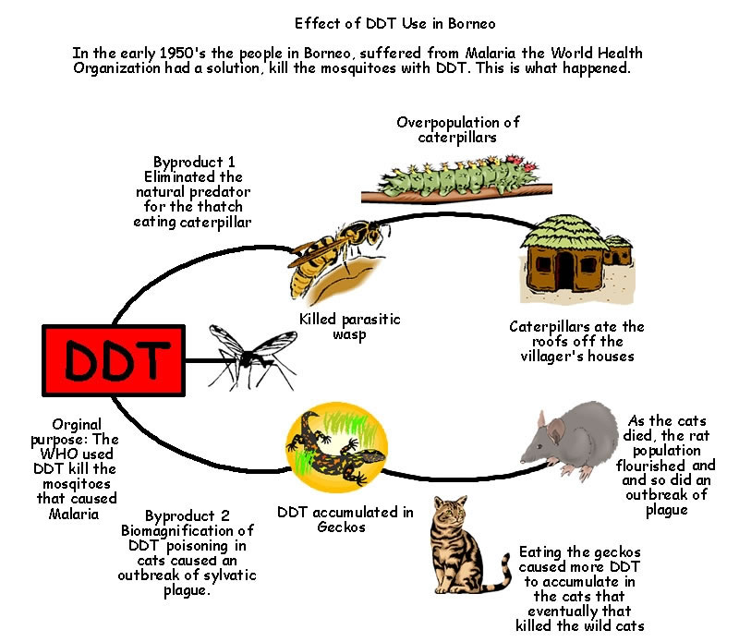
Operation Cat drop
Notes:
In the early 1950s, the Dayak people in Borneo suffered from malaria. The World Health Organization had a solution: they sprayed large amounts of DDT to kill the mosquitoes which carried the malaria. The mosquitoes died the malaria declined; so far, so good. But there were side-effects. Among the first was that the roofs of people’s houses began to fall down on their heads. It seemed that the DDT was also killing a parasitic wasp which had previously controlled thatch-eating caterpillars. Worse, the DDT-poisoned insects were eaten by geckoes, which were eaten by cats. The cats started to die, the rats flourished, and the people were threatened by outbreaks of sylvatic plague and typhus. To cope with these problems, which it had itself created, the World Health Organization was obliged to parachute live cats into Borneo. (McShaffrey, 1999)

Slide 42
Factors affecting the abundance and distribution of organisms
Abiotic characteristic of environment
Biotic characteristics of organisms
Biotic Interactions between organism

Slide 43
What is Competition??
Occurs when individuals use a shared resource in short supply.
Results of competition:
  Birth rates lower, death rates higher, or both.
  Maximum growth/size achieved by organisms can be lowered
  In ecological terms, population growth rates decrease and population size is lower at equilibrium
  In evolutionary terms, an individuals fitness is lower.
Notes:
There may not be enough of the resource for any given individual to survive or to reproduce as well as when more resources are present.

Slide 44
Intra-Specific Competition
Competition for resources between members of the same species
i.e. – parrots of the same species compete for suitable hollows in old trees for nesting sites.
Competition can be for food, shelter etc

Slide 45
Inter-specific Competition
Competition in a ecosystem between individuals of different species.
One species will be more efficient than another at gaining access to a limited resource.
Notes:
i.e – water, light or territory

Slide 46
Predation

