Slide 1
TechnoSynergy in the Foreign Language Classroom
TecnoSinergía en el salón de clases
Martha E. Rodriguez

Slide 2
Diigo
http://www.diigo.com/education

Slide 3
VoiceThread
Interactive and engaging
Upload a document
Pictures
video
Oral or written assessment
http://voicethread.com/?#u821789

Slide 4
Timeline Makers
Sports
Family
Artists
Cities
Famous People
Authors
Websites:
Dipity
www.dipity.com
You can add text/pictures/audio, etc.
Capzles
www.capzles.com
user friendly, many options.

Slide 5
Polling
Check if students understood the material.
Review for a quiz.
Evaluate a presentation
Website: www.polleverywhere.com
Participants: Go to: www.poll4.com to respond

Slide 6
On-Line Voice Recorder
Embed your instructions using an on-line voice recorder. VOCAROO
http://www.vocaroo.com/
Example: http://vocaroo.com/?media=vzrfr8Fj3qsVMQ2eQ

Slide 7
Picture slide show
Vocabulary
Events
Art Gallery
Website:
www.Animoto.com
Example

Slide 8
Excel
A versatile tool for the classroom.

Slide 9
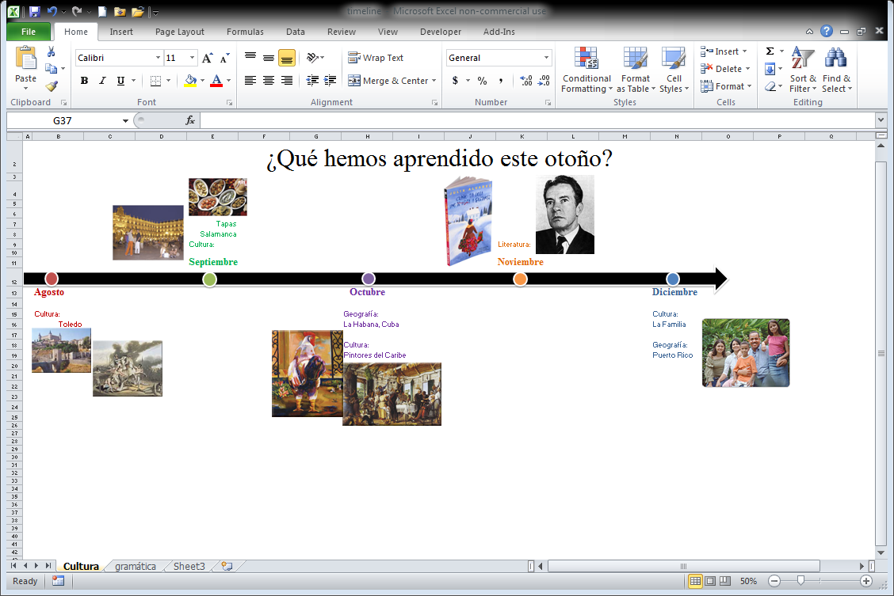
Timelines

Slide 10
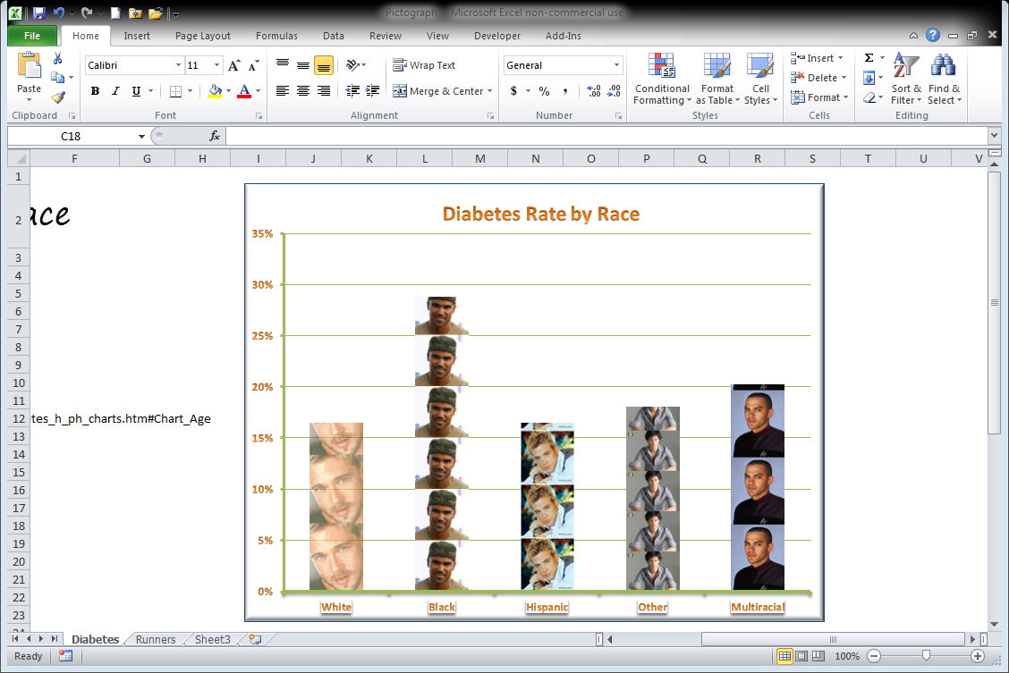
Pictographs

Slide 11
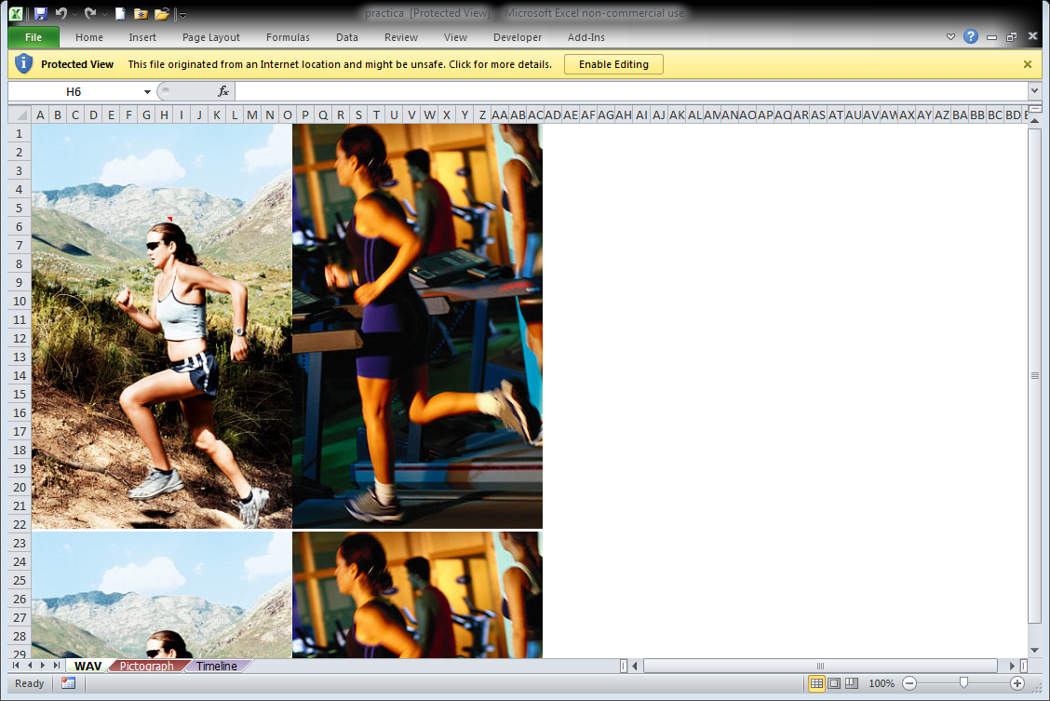
WAV document (written/audio/visual)

Slide 12
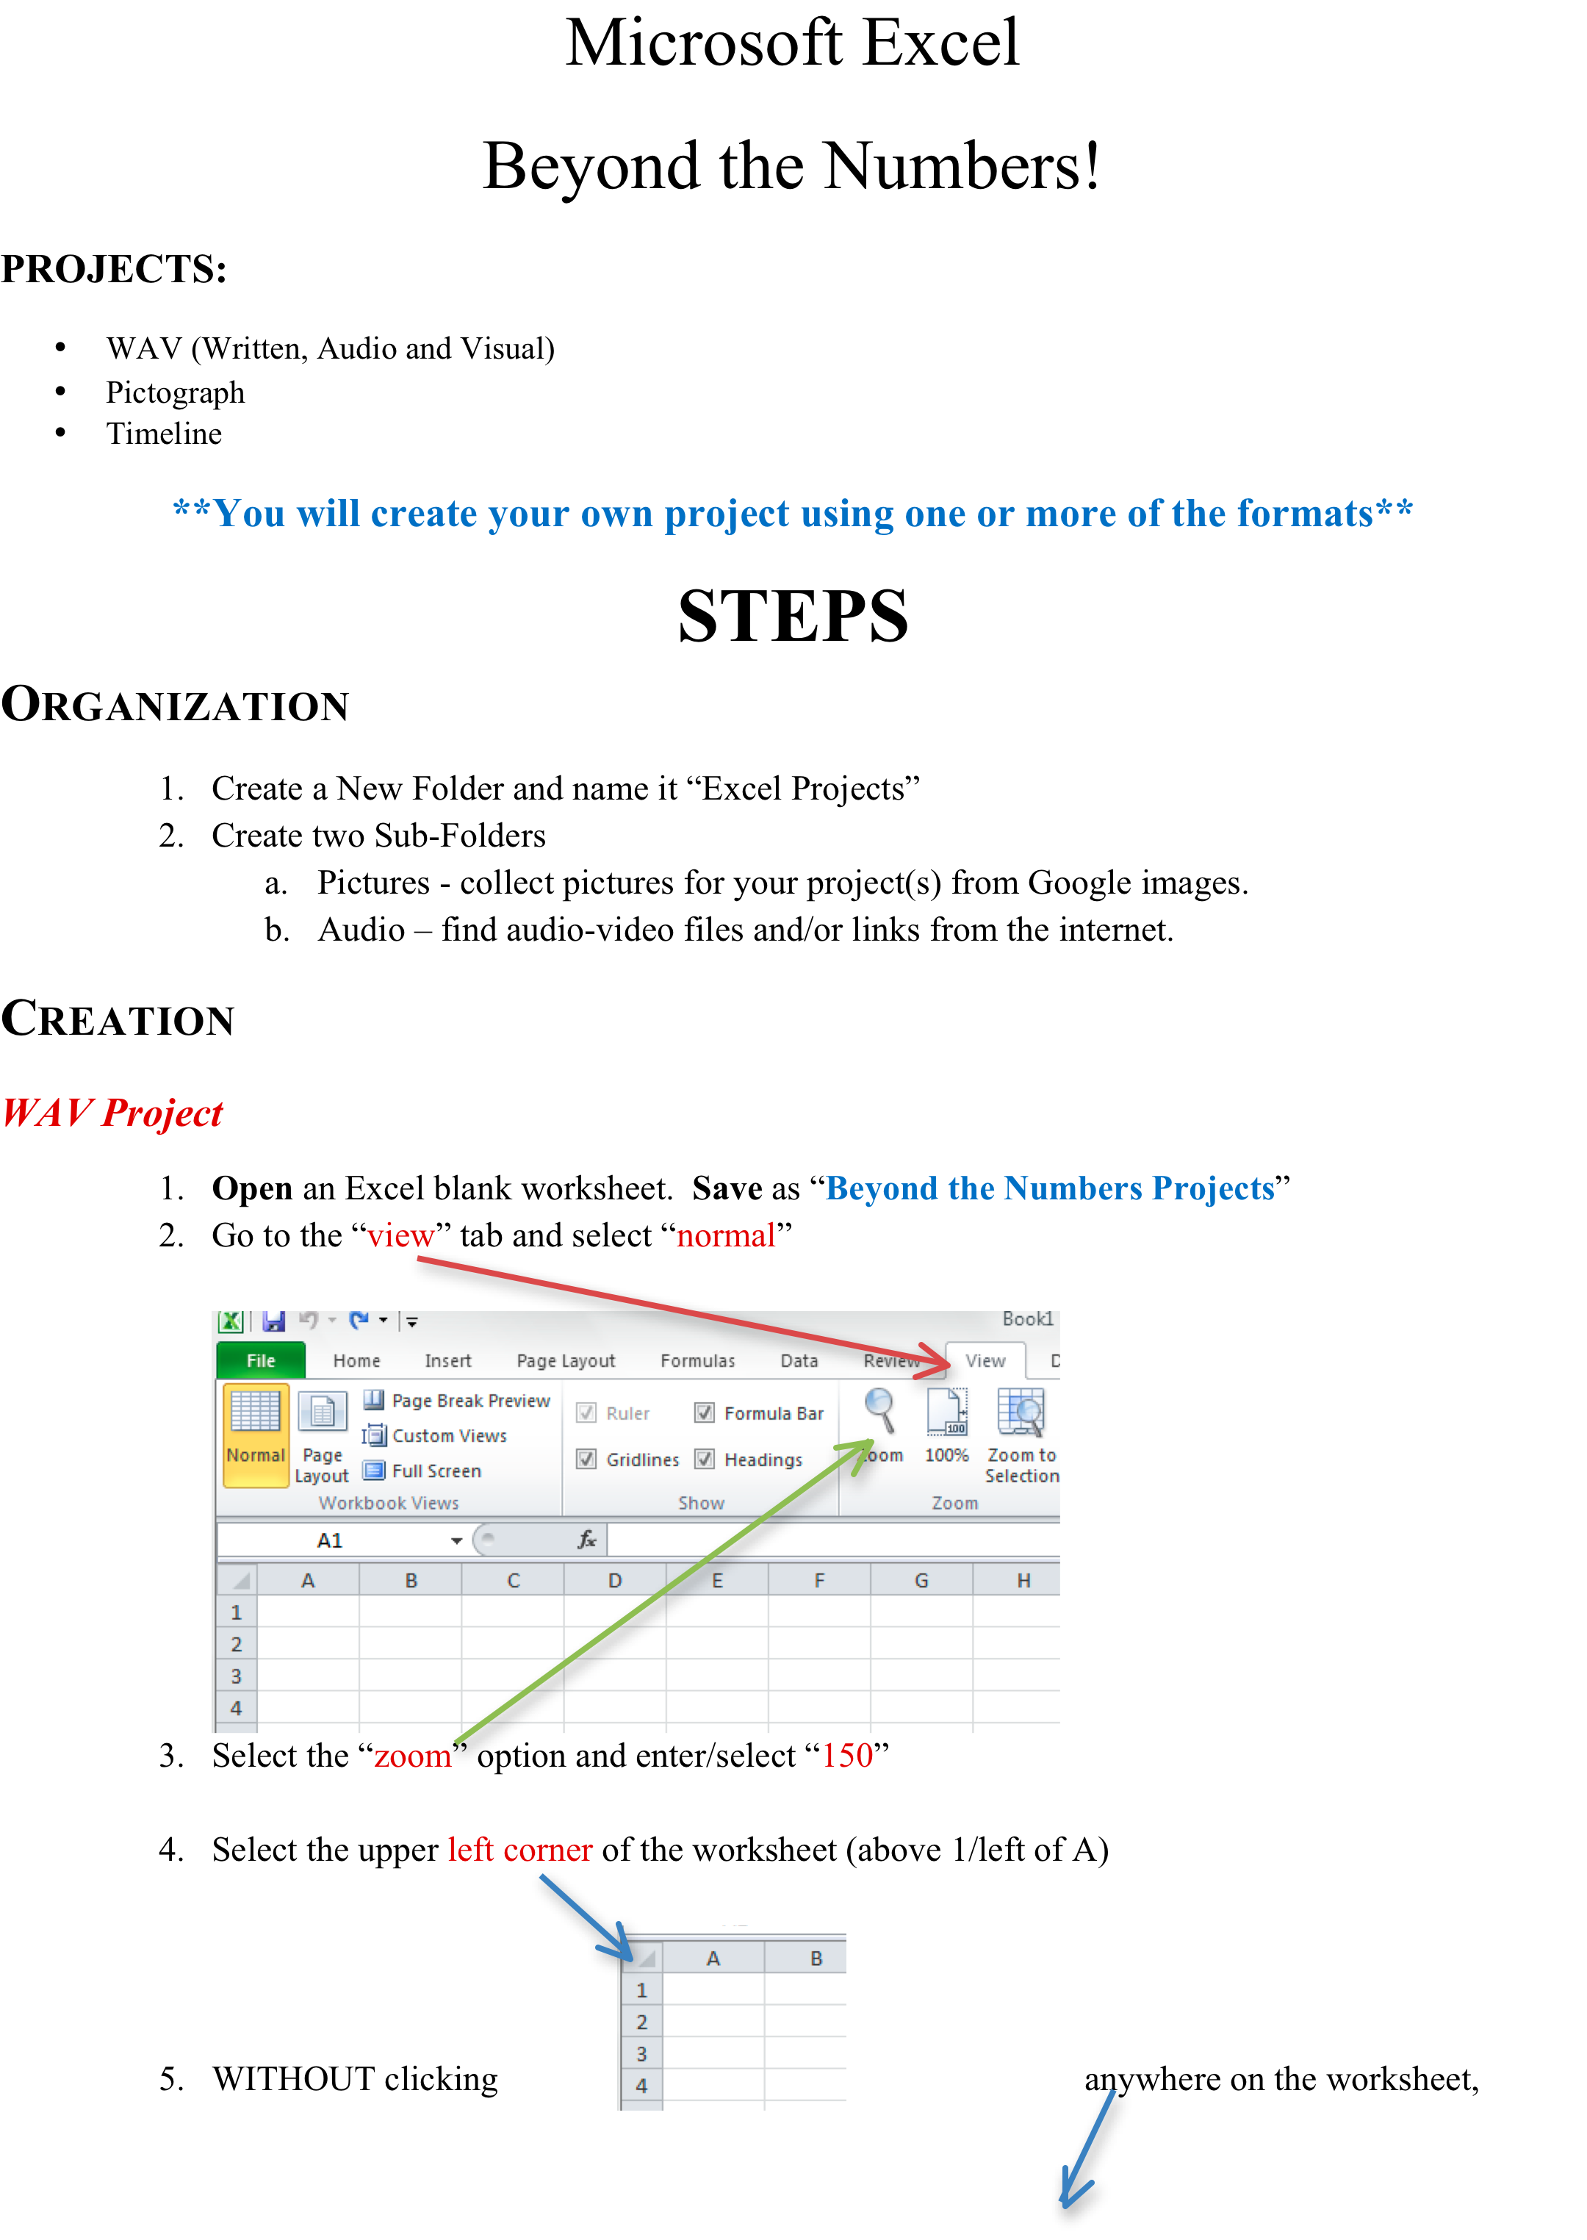
Instructions

