Slide 1
QR Code Scavenger Hunt
Animal Fact Scavenger Hunt

Slide 2
What are QR codes?
Quick Response Code is a two-dimensional barcode for web addresses or URLs.
This activity requires a device with a QR Code reader installed on an iPad, iPhone, or similar device. Several free readers are available.

Slide 3
Animal Fact Scavenger Hunt
Each location in this hunt will display 2 QR codes.
The code on top will go to a website which will provide an answer to the site question.
The the QR code on the bottom will be a clue to locate the next question location.

Slide 4
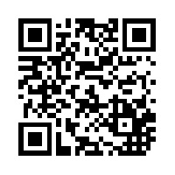
Scavenger Hunt Clue 1

Slide 5
Creating a QR Code Scavenger Hunt
Location clues can be created using the free online recorder at www.recordmp3.org/ .
QR codes were created at QR Stuff (www.qrstuff.com/) on a laptop.
Codes can also be created on iPads.

Slide 6
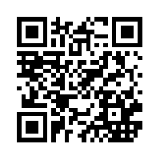
QR Codes in the Classroom
Direct students to a webpage
Access teacher created materials.

