Slide 1
Graphic Design Elements

Slide 2
Lines
Line can be considered in two ways. The linear marks made with a pen or brush or the edge created when two shapes meet.

Slide 3
Shape
A shape is a self contained defined area of geometric or organic form. A positive shape in a painting automatically creates a negative shape.

Slide 4
Mass
Mass is one of the basic elements of design. Mass equals size.
Each piece you create has a physical mass.
Additionally, each element within the design (graphics, photos, lines, text blocks) have their own mass relative to the whole piece.

Slide 5
Texture
Texture is the surface quality of a shape - rough, smooth, soft hard glossy etc. Texture can be physical (tactile) or visual.

Slide 6
Color
Color is seen either by the way light reflects off a surface, or in colored light sources.
Color and particularly contrasting color is also used to draw the attention to a particular part of the image.

Slide 7
Balance
Balance in design is similar to balance in physics .
A large shape close to the center can be balanced by a small shape close to the edge.
A large light toned shape will be balanced by a small dark toned shape (the darker the shape the heavier it appears to be)

Slide 8
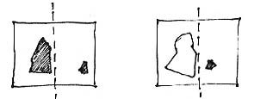
Balance Example

Slide 9
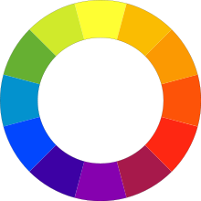
Contrast
Contrast is the juxtaposition of opposing elements .
Opposite colors on the color wheel - red / green, blue / orange etc.

Slide 10
Contrast Continued
Contrast in direction - horizontal / vertical.
The major contrast in should be located at the center of interest.
Contrast in tone or value - light / dark

Slide 11
Contrast Continued
Unless a feeling of chaos and confusion are what you are seeking, it is a good idea to carefully consider where to place your areas of maximum contrast.

Slide 12
Unity
Relating the design elements to the idea being expressed in a design reinforces the principal of unity.
A design with an active aggressive subject would work better with a dominant oblique direction, course, rough texture, angular lines etc.

Slide 13
Unity Continued
When a quiet passive subject is used, it would benefit from horizontal lines, soft texture and less tonal contrast.
Unity in a painting also refers to the visual linking of various elements of the work.

Slide 14
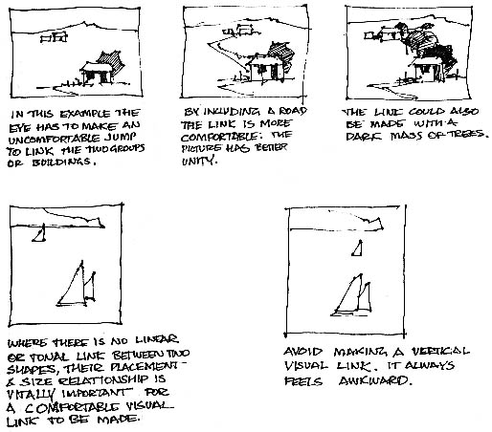

Slide 15
Rhythm
Rhythm in design is also called repetition.
Rhythm allows your designs to develop an internal consistency that makes it easier for your customers to understand.

Slide 16
Rhythm Continued
Once the brain recognizes the pattern in the rhythm it can relax and understand the whole design.

Slide 17
Proportion
is the comparative harmonious relationship between two or more elements in a composition with respect to size, color, quantity, degree, setting, etc.; i.e. ratio.

Slide 18
Harmony
Harmony in design is the visually satisfying effect of combining similar, related elements.
adjacent colors on the color wheel, similar shapes etc.

Slide 19
Dominance
Dominance gives a design interest, counteracting confusion and monotony.
Dominance can be applied to one or more of the elements to give emphasis

Slide 20
Questions?
Questions?
Questions?
Questions?

