Slide 1
Hormones

Slide 2
Hormones
Insulin – converts glucose to glycogen
Glucagon- converts glycogen to glucose
Epinephrine (neurotransmitter)
Thyroid – regulates all metabolism

Slide 3
Male Hormones
- Called androgens
- make embryo male
- surge about age 10
- testosterone
- main androgen - causes:
secondary sex characteristics
- spermatogenesis

Slide 4
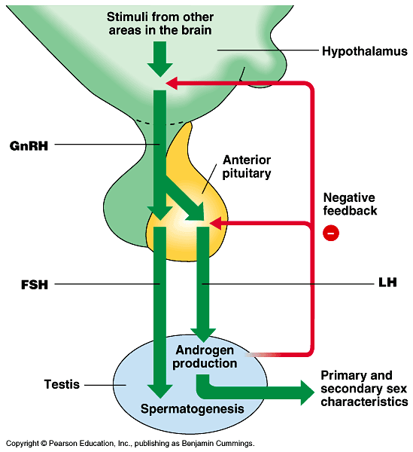
Male Hormones

Slide 5
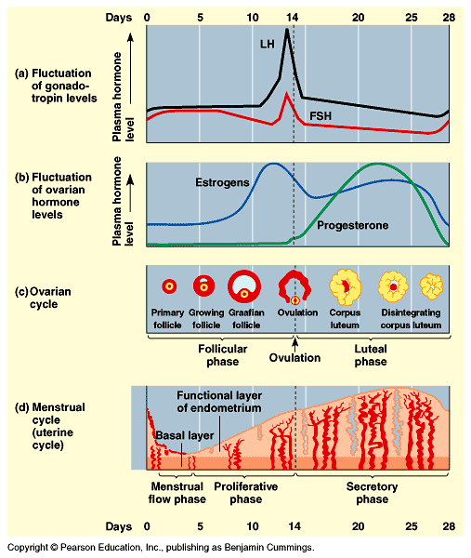

Slide 6
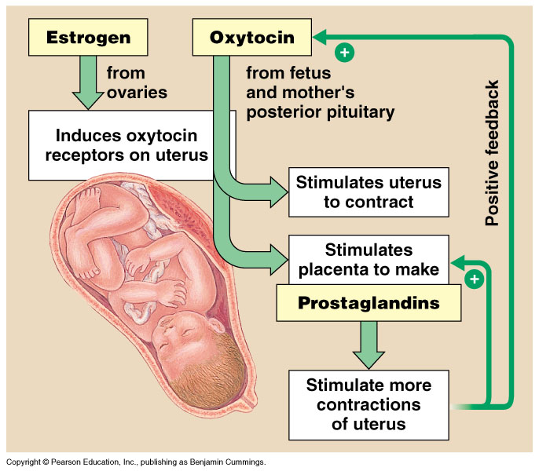

Slide 7
Plant Hormones pg.808
Auxins
- produced in response to sunlight & gravity
- cause cell walls to become more flexible thus allowing cells to elongate & grow
- promotes root, stem, & fruit growth
- inhibits budding from middle of plant thus allowing budding only at top – called apical dominance

Slide 8
Plant Hormones
Cytokinin
- stimulates cell division
Ethylene
- hydrocarbon gas
- causes ripening
- causes leaves to fall

Slide 9
Plant Hormones
Abscisic acid
- induces dormancy
Gibberellins
- produces hyperelongation of stem
- causes flowering

Slide 10
Photoperiodism – pgs. 821-822
Response to change in daylight
Circadian rhythm – internal clock with 24 hour cycle
Affect of light on circadian rhythm involves two types of phytochrome pigments
- P_{r} – absorbs red light absorbs λ 660
- P_{fr} – absorbs far red light λ 730

Slide 11
Phytochromes
P_{r} found in leaves
P_{fr} triggers flowering and resets the clock
In daylight P_{r} is converted to P_{fr}
At night, when no light present P_{fr} changes back to P_{r}
When will flowering occur?

Slide 12
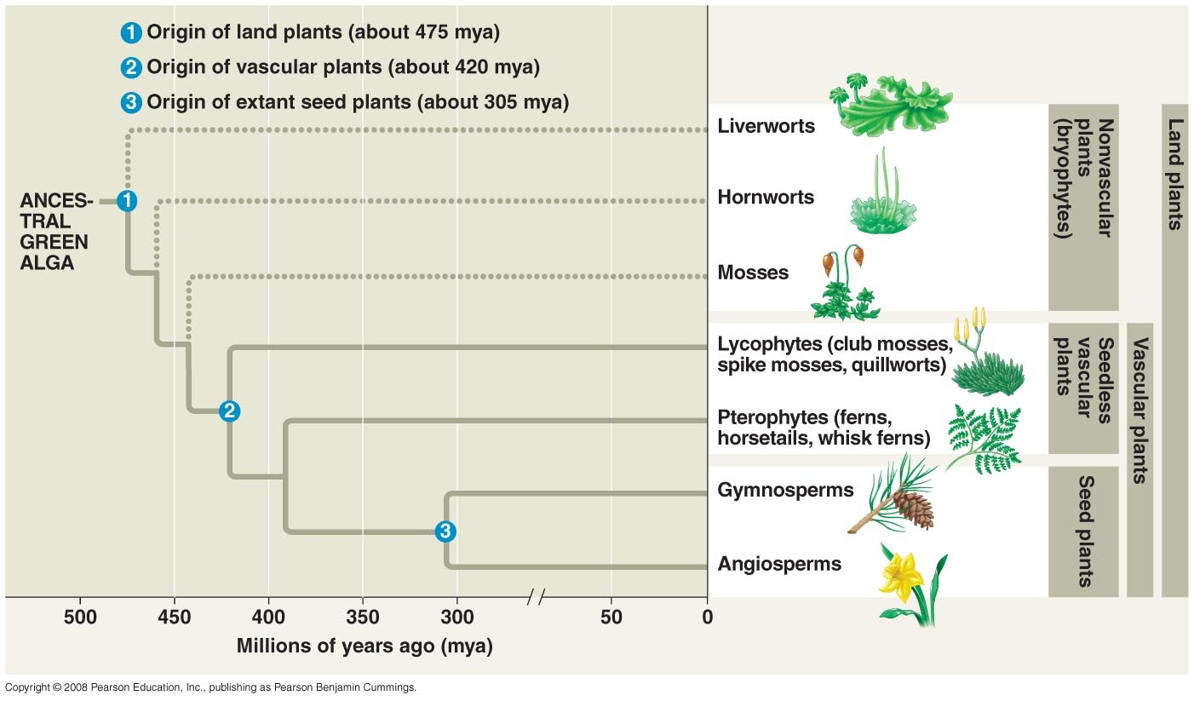

Slide 13
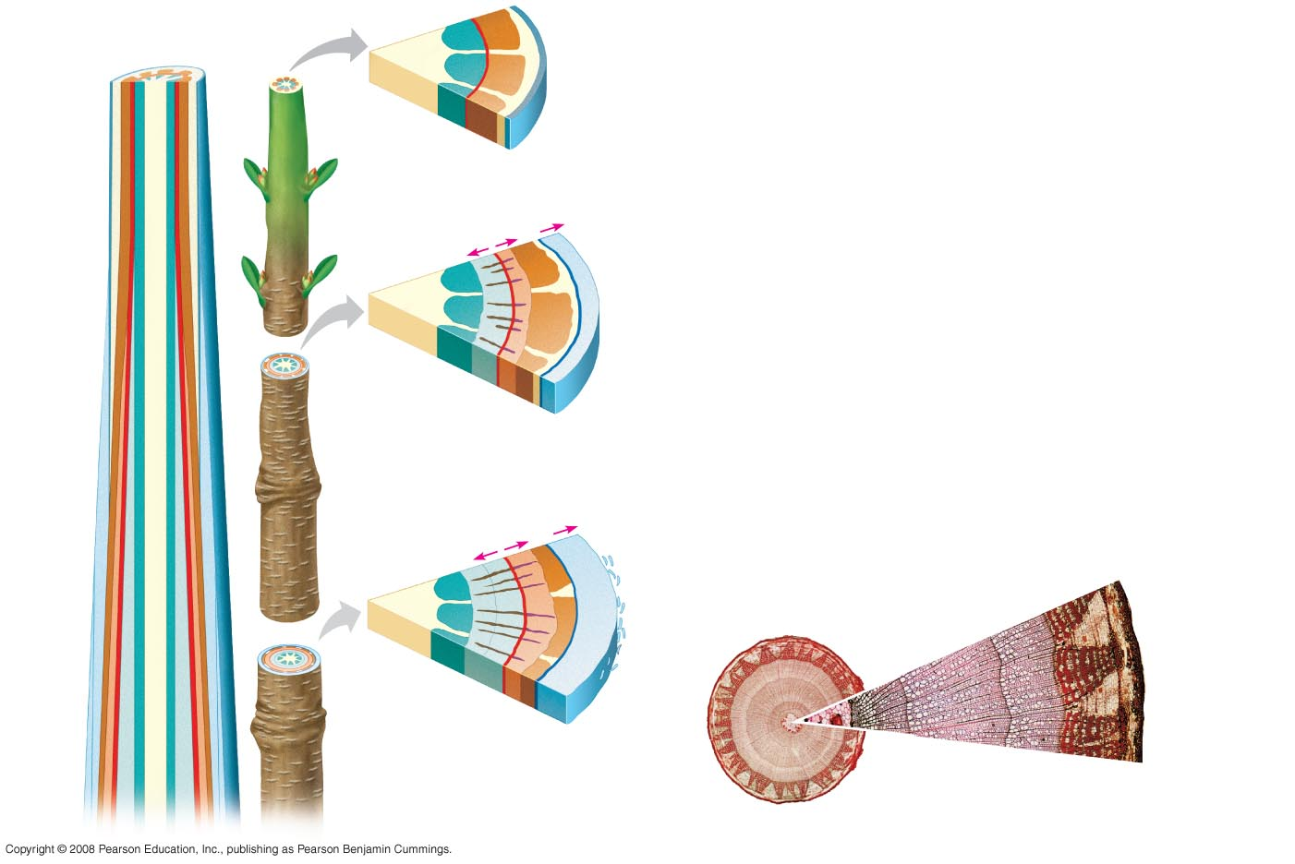
Fig. 35-19
(a)
Primary and secondary growth
in a two-year-old stem
Epidermis
Pith
Cortex
Primary xylem
Primary
phloem
Vascular cambium
Epidermis
Vascular
cambium
Primary phloem
Cortex
Primary
xylem
Growth
Pith
Vascular
ray
Primary
xylem
Secondary xylem
Vascular cambium
Secondary phloem
Primary phloem
Cork
First cork cambium
Periderm
(mainly cork
cambia
and cork)
Growth
Secondary phloem
Bark
Vascular cambium
Cork
cambium
Primary
phloem
Secondary xylem
Late wood
Early wood
Periderm
Secondary
phloem
Secondary
Xylem (two
years of
production)
Cork
Vascular
cambium
Secondary
xylem
Vascular cambium
0.5 mm
Secondary phloem
Bark
Primary
xylem
Most recent
cork cambium
Cork
Layers of
periderm
Vascular ray
Growth ring
(b)
Cross section of a three-year-
old Tilia (linden) stem (LM)
Pith
0.5 mm

Slide 14
