Slide 1
Components of Life

Slide 2
Hierarchy of Life
Multicellular levels
cells → tissues → organs → systems → organisms → populations → community → ecosystem

Slide 3
Hierarchy of Life
Cell – lowest level
Cell types
1. Prokaryotic (bacteria)
- no internal membranes therefore no nucleus
2. Eukaryotic
- internal membranes and more complex

Slide 4
Hierarchy of Life
Organisms – next level
1. Unicellular organisms
ie. Amoeba
2. Multicellular
- Division of labor
*** Form fits function

Slide 5
Biological Systems
Emergent properties develop from interactions at each level
- ie. molecules have properties different from its component atoms (NaCl)
Regulation****
1. Enzymes regulate chemical reactions
2. Feedback mechanisms
pg. 11 fig. 1.13

Slide 6
Regulation
Homeostasis

Slide 7
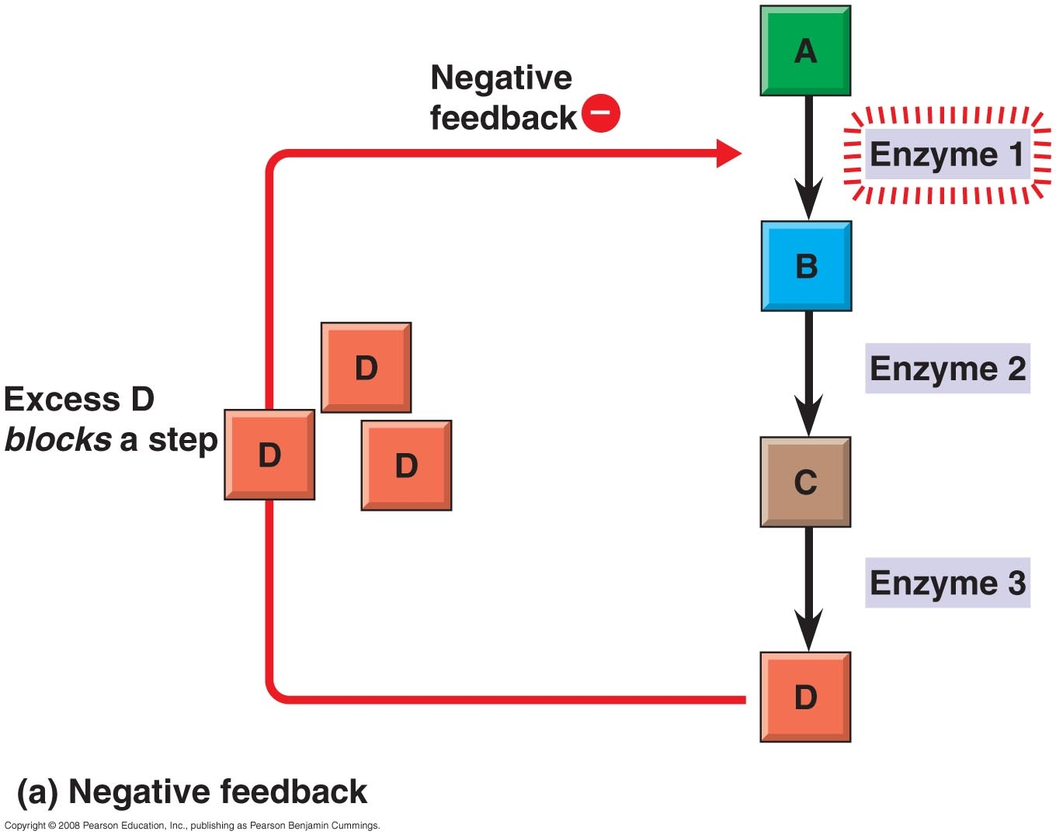

Slide 8
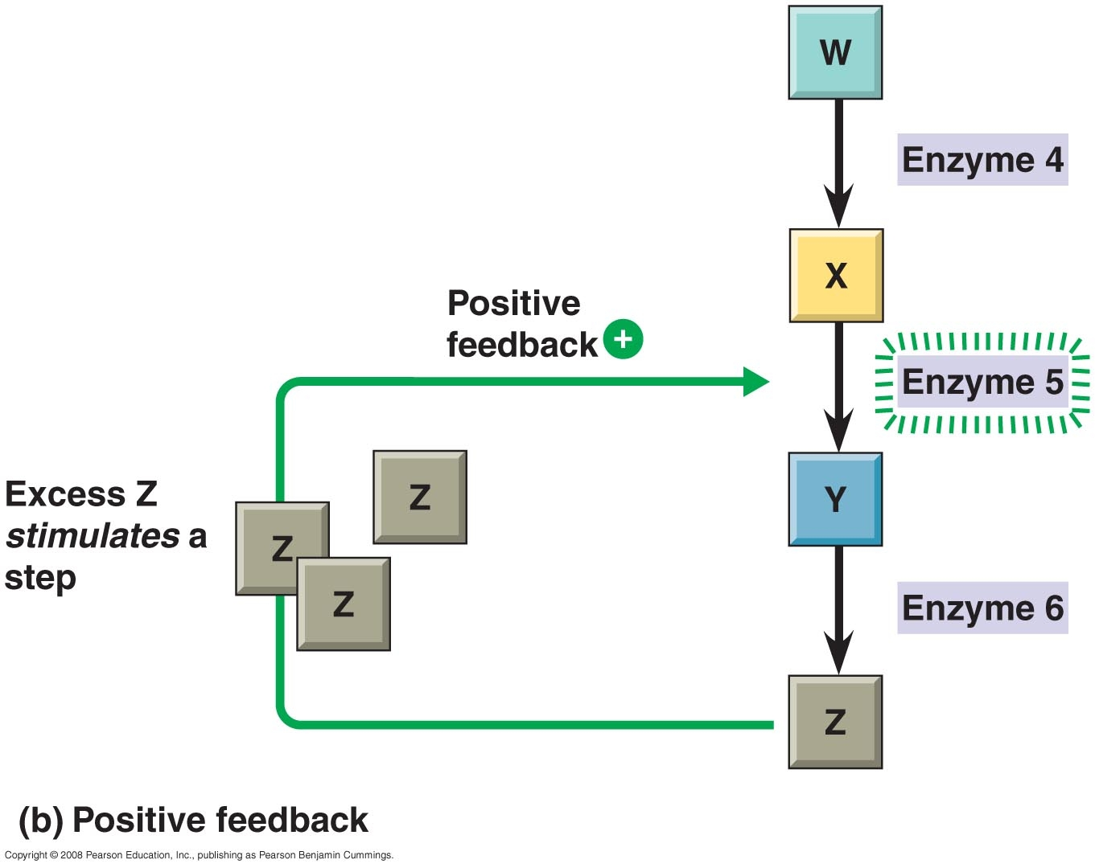

Slide 9
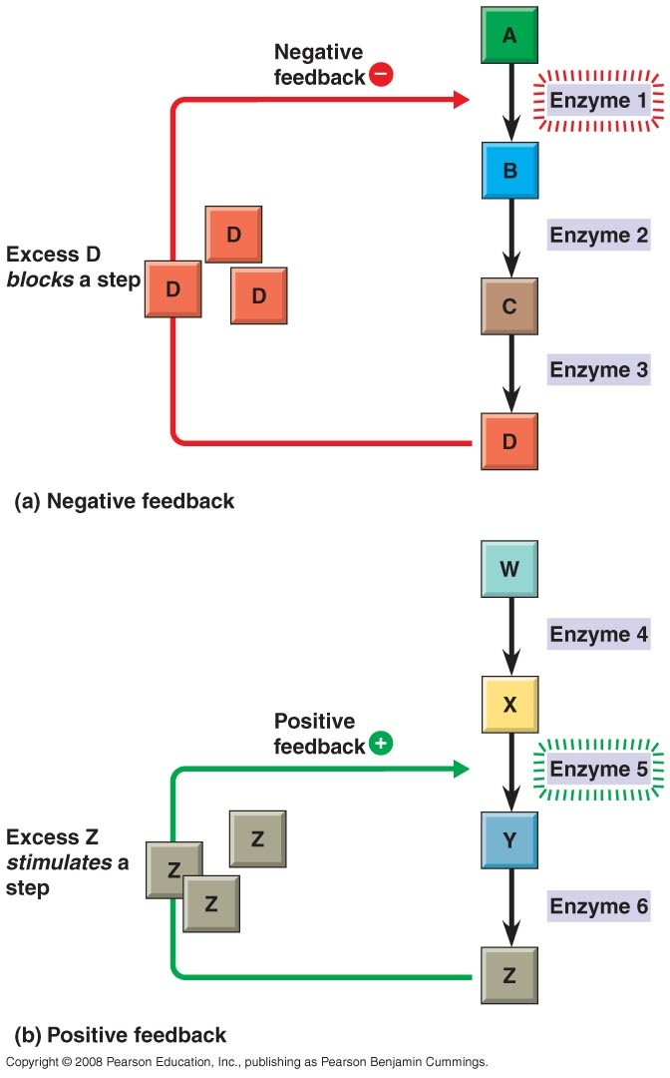

Slide 10
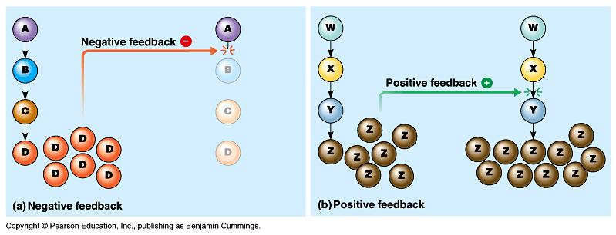

Slide 11
Paul Anderson on Homeostasis - Bozeman
Feedback Mechanisms

Slide 12
Chemical make-up of life

Slide 13
Elements of life
Element – substance that can’t be broken down by chemical reaction.
C, H, O, N make up 99% of our bodies and 96% of living matter
P, S, Ca, K the other 4%

Slide 14
Elements are made of atoms
Protons +
Electrons -
Neutrons no charge
If neutral - # of electrons = # of protons
Atomic number = # of protons
Atomic weight = # of protons and neutrons
Isotope – atomic form where #P ≠ #N (proton number stays the same – neutrons change)

Slide 15
Isotopes
Radioactive isotopes (unstable)
- nucleus decays spontaneously & particles are given off
- when # of protons changes it becomes a different element
- C¹⁴ changes to N

Slide 16
Atoms and energy
Each atom has ability to do work (chemical reactions)
Electrons responsible for these reactions
All e-’s do not possess the same amount of energy
Energy depends on energy level
See fig. 2.8

Slide 17
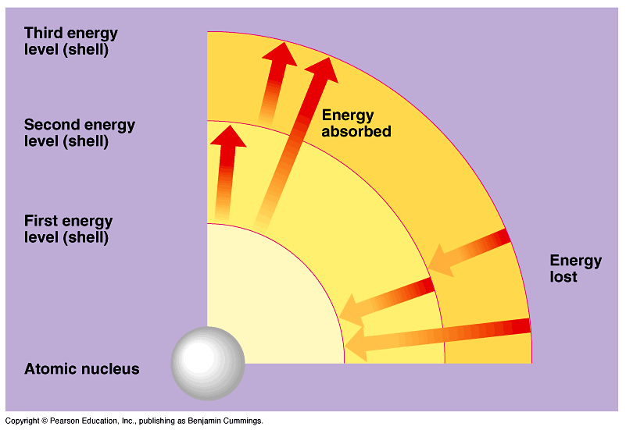

Slide 18
Atoms and energy cont’d
Electron shells
- first shell holds 2 electrons
- shells after that hold 8
He² and C⁶ - see diagram
C has more electrons that are farther from the nucleus therefore more PE
Outer shell – valence shell with valence e’s
C makes 4 bonds

Slide 19
Balancing Equations
Number of atoms on left side must equal number on right.
Equilibrium means that the forward and the reverse rate are equal.
Practice Balancing Equations

Slide 20
Bonds
Bonds are formed by electrons interactions between atoms
If the reaction loses energy (usually released as heat) it is Exergonic
If the reaction gains energy it is Endergonic

Slide 21
Three main types of bonds
Ionic
Covalent
Hydrogen

Slide 22
Ionic bonds
- Transfer of electrons from one atom to another - form ions (charged atom)
- Cation loses electrons and is +
- Anion gains electrons and is –
- the + and – attract each other

Slide 23
Covalent bonds
- Sharing of electrons between atoms
- usually found between like atoms
H¹-H¹ O⁸-O⁸
- can exist among different atoms too when one atom is more electronegative than the other – this forms a polar covalent bond
- see fig. 2.13

Slide 24
Structural Formulas and Bonds

Slide 25
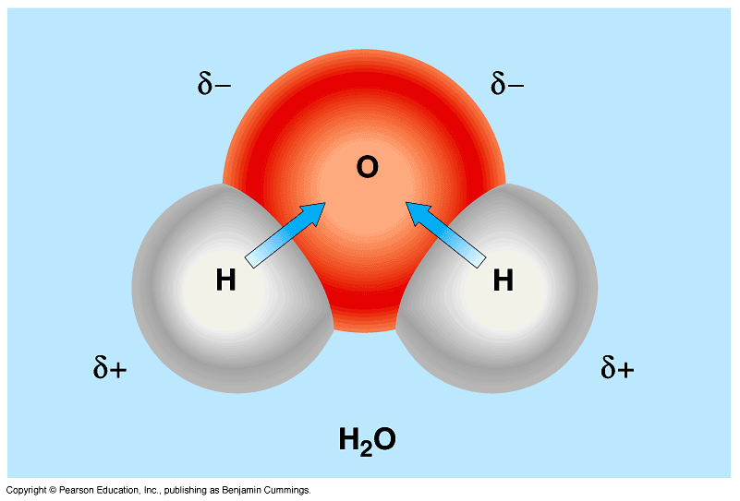

Slide 26
Hydrogen bonds
Hydrogen bond
- between 2 water molecules
- between the H of one and the O of the other
- also found in DNA between N -H

Slide 27
WATER

Slide 28
Structure
Polar molecule
Hydrogen bonds form between 2 water molecules
Hydrogen bond is weak but together have great strength

Slide 29
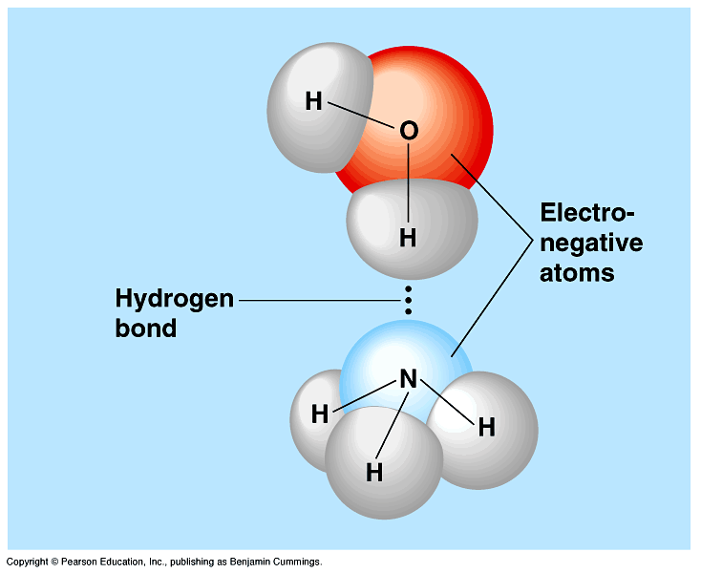

Slide 30
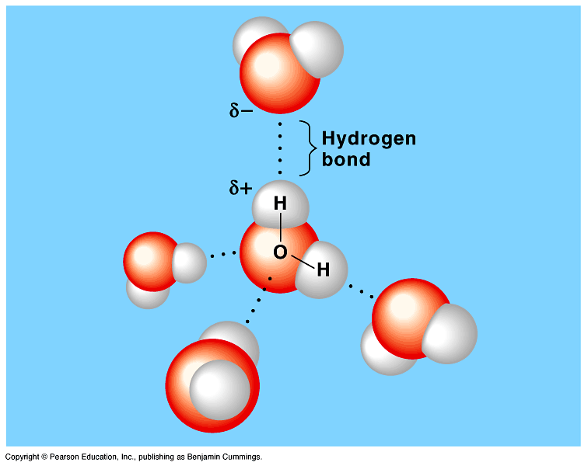

Slide 31
Properties of water due to hydrogen bonds
1. Liquid H₂O is very cohesive (sticks to like molecules) and adhesive (sticks to unlike molecules)
- creates great surface tension
- responsible for capillary action

Slide 32
Properties of water
2. Water has high specific heat (amount of heat needed to raise 1g of a substance 1°C)
- water resists changing its temp.
- ↑heat needed to break H bonds
- when H bonds reform heat is released
ie. Lake – night/day
- pg. 49

Slide 33
Heat must be absorbed in order to break hydrogen bonds, and heat is released when hydrogen bonds form. A calorie of heat causes a relatively small change in the temperature of water because much of the heat is used to disrupt hydrogen bonds before the water molecules can begin moving faster. And when the temperature of water drops slightly, many additional hydrogen bonds form, releasing a considerable amount of energy in the form of heat.

Slide 34
Properties of water
3. Water has a high heat of vaporization
- liquid to gas

Slide 35
Properties of water
4. Water expands when it freezes
- as temp ↓ density ↑ - D = m/v
mol’s slow down & move closer
- at 4°C H₂O mol’s need to spread out a bit to make room for more H bonds
- Benefits & Hazards
ponds – ice floats
water pipes in winter or pop cans in freezer

Slide 36
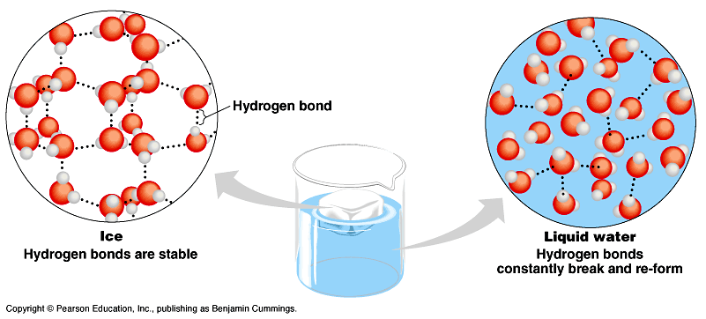

Slide 37
Properties of water
5. Water is a versatile solvent
solvent – does dissolving
solute – gets dissolved
- hydrophilic – will dissolve in water
polar substances
- hydrophobic – won’t dissolve in water
nonpolar substances

Slide 39
Dissociation of H₂O and pH
A. H₂O is neutral & polar
B. H is very unstable so can shift from one H₂O mol. to another
- can be H₃O + OH⁻ or H⁺ + OH⁻
C. H₂O can become more acidic when the H⁺ outnumber the OH⁻
ie. Add HCl
HCl → H⁺ + Cl

Slide 40
Dissociation of H₂O and pH
D. H₂O can become more basic when the H⁺‘s are reduced in a solution
H⁺ < OH⁻
ie. NaOH → Na ⁺ + OH –
excess H⁺‘s combine with OH –
ie. NH₃ + H⁺ → NH₄ ⁺
(NH₃ ammonia) ( NH₄ ⁺ammonium)

Slide 41
Buffer System in Body
Buffer minimizes changes in solutions
Blood buffer system in humans
- usually pH 7.4
- fig. 3.9

Slide 42
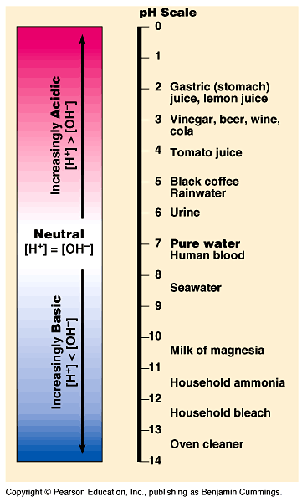

Slide 43
Blood buffer system
- H₂CO₃ ⇔ HCO₃⁻ + H⁺
- when H⁺ ↓ H₂CO₃ dissociates to replace H⁺
- when H⁺ ↑ HCO₃⁻ combines with H⁺
- if too many OH⁻, H₂CO₃ dissociates to form H₂O
- H₂CO₃ can also do this
H₂CO₃ ⇔ H₂O + CO₂

Slide 44
Organic Compounds
Molecules that contain carbon

Slide 45
Carbon
Able to make 4 covalent bonds simultaneously
- 4 valence electrons
Compatible with many different elements
- C, H, O, N
Able to make long complex molecules
- hydrocarbon chains

Slide 46
Functional Groups
Determine the chemical properties of organic molecules
Pg. 64-65 table 4.10

Slide 47
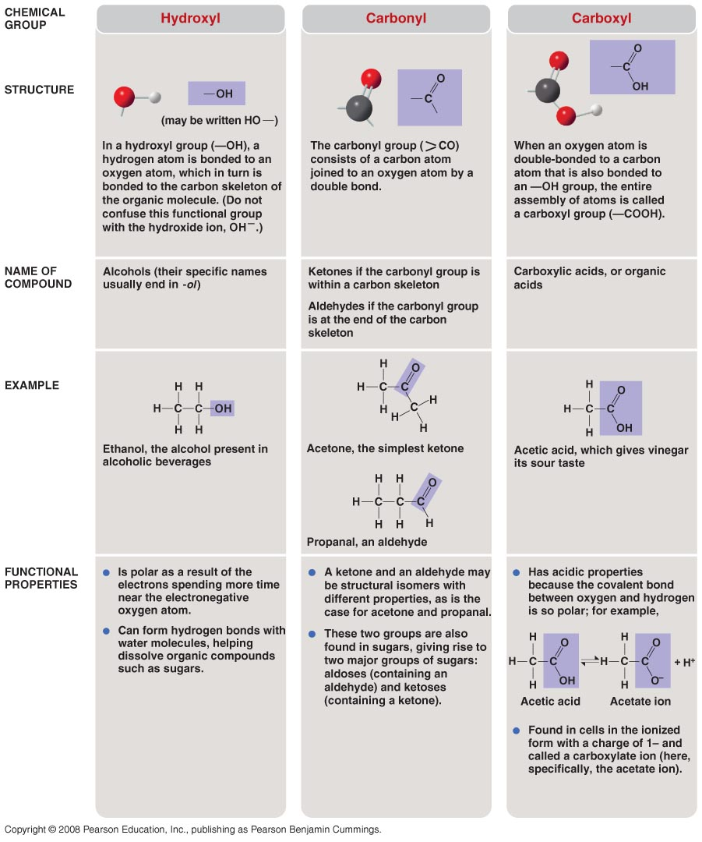

Slide 48
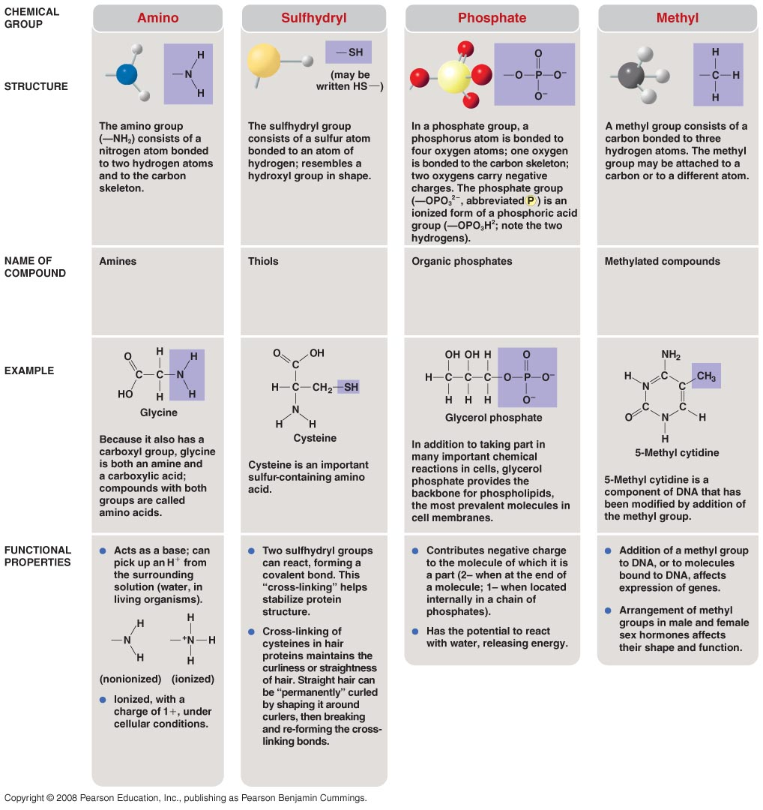

Slide 49
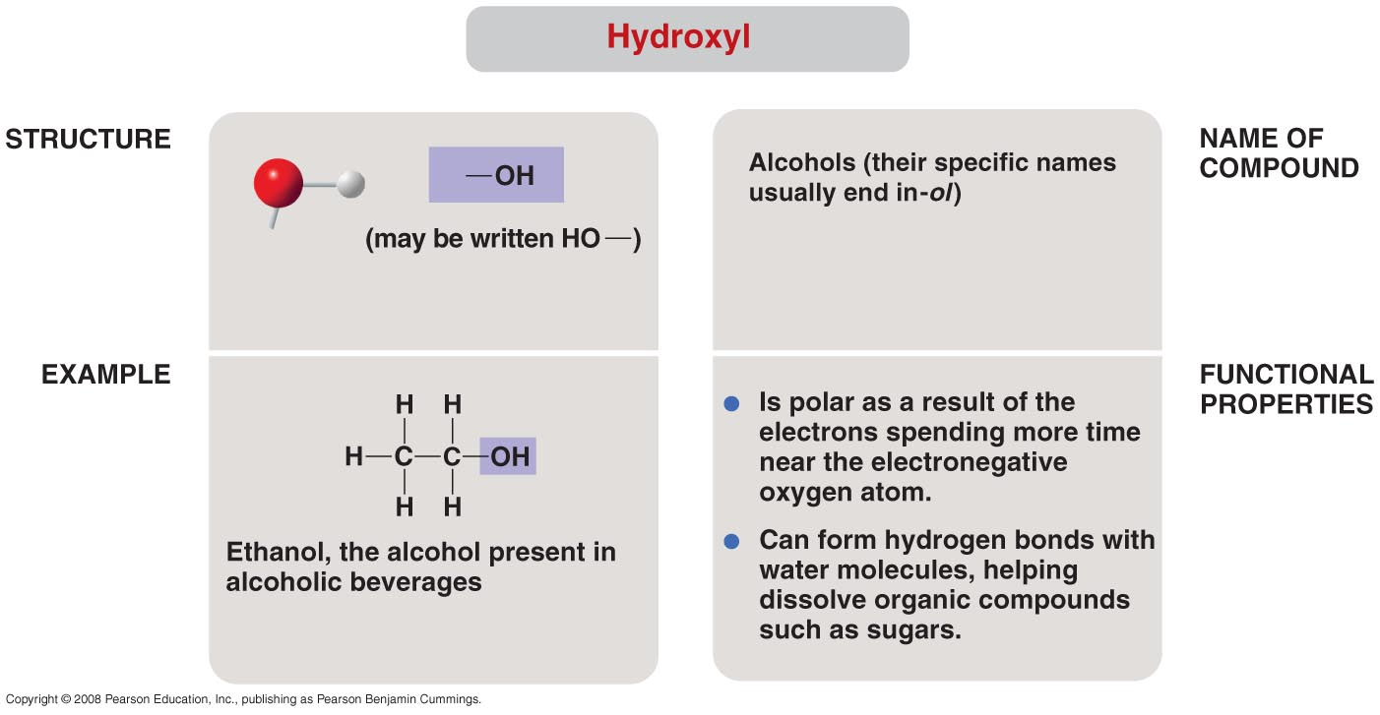

Slide 50
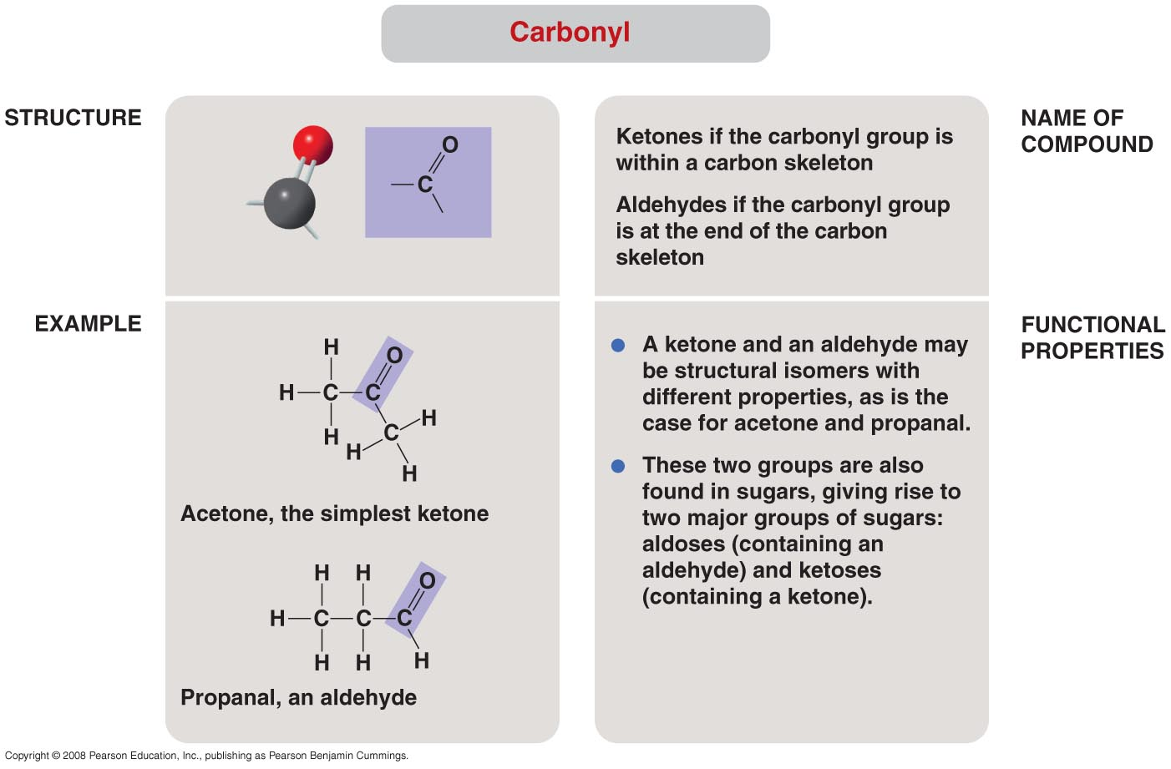

Slide 51
Functional Groups
Carbonyl group C=O bonded to at least two other C’s
- aldehyde
C=O found at the end
ie. propanol
- ketone
C=O found internally in mol.
ie. acetone

Slide 52
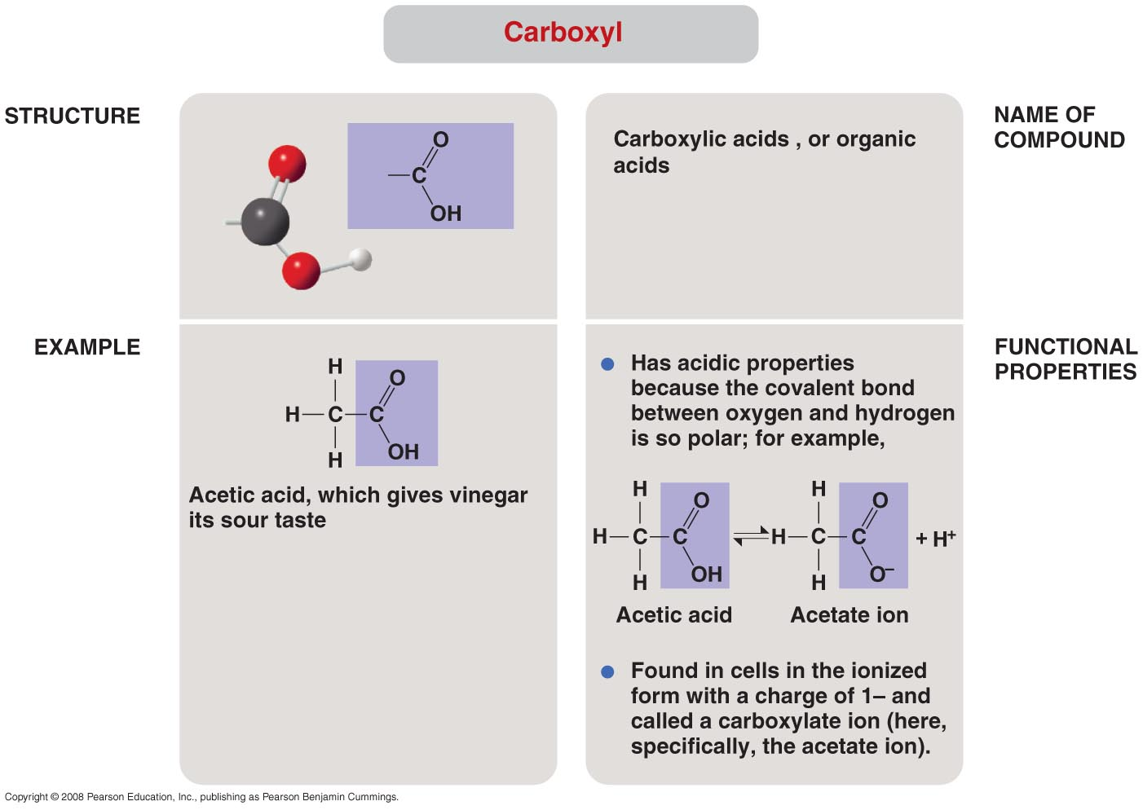

Slide 53
Functional Groups
Carboxyl group
- COOH
- weak acid b/c COOH → COO + H⁺
- polar molecule dissociates in water
- carboxylic acid

Slide 54
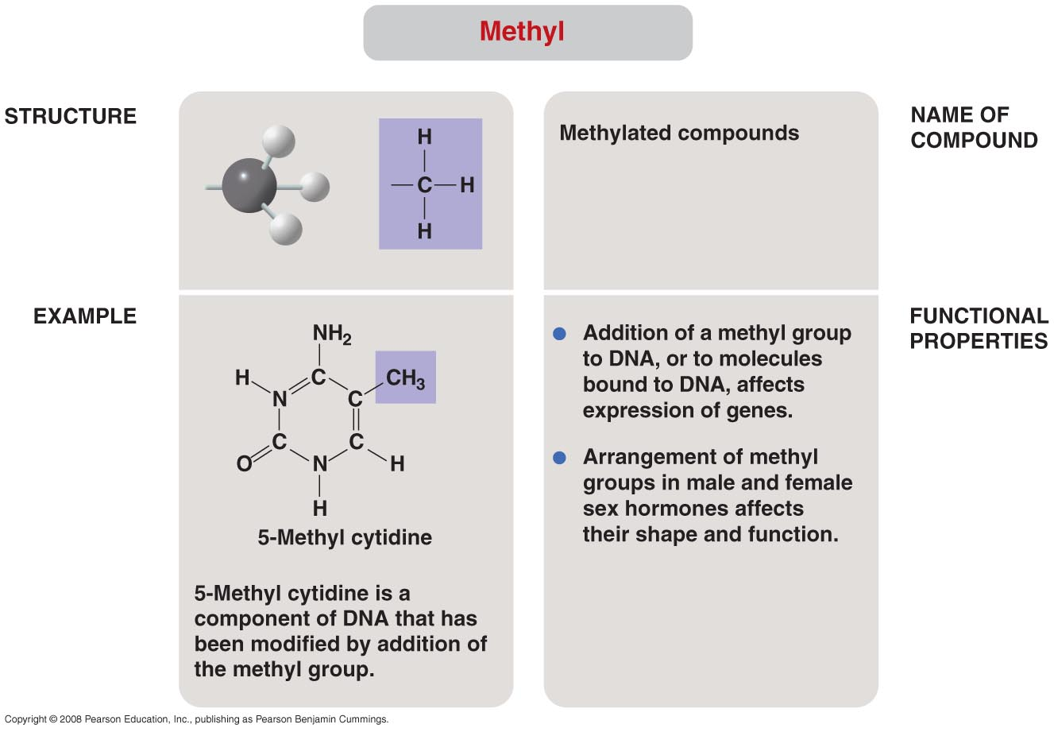

Slide 55
Functional Groups
Methyl group CH₃
- nonpolar – can’t dissolve in water
- found in lipids and petroleum

Slide 56
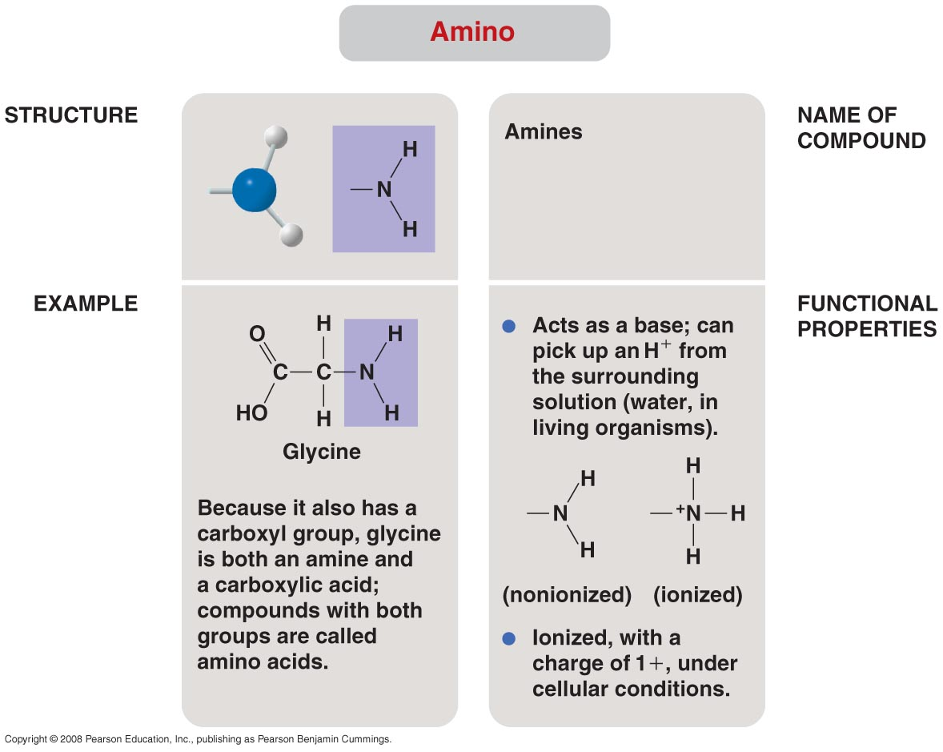

Slide 57
Functional Groups
Amino group
- also called amines
- ie. glycine
- attached to R-group to make amino acids
- R-groups are different

Slide 58
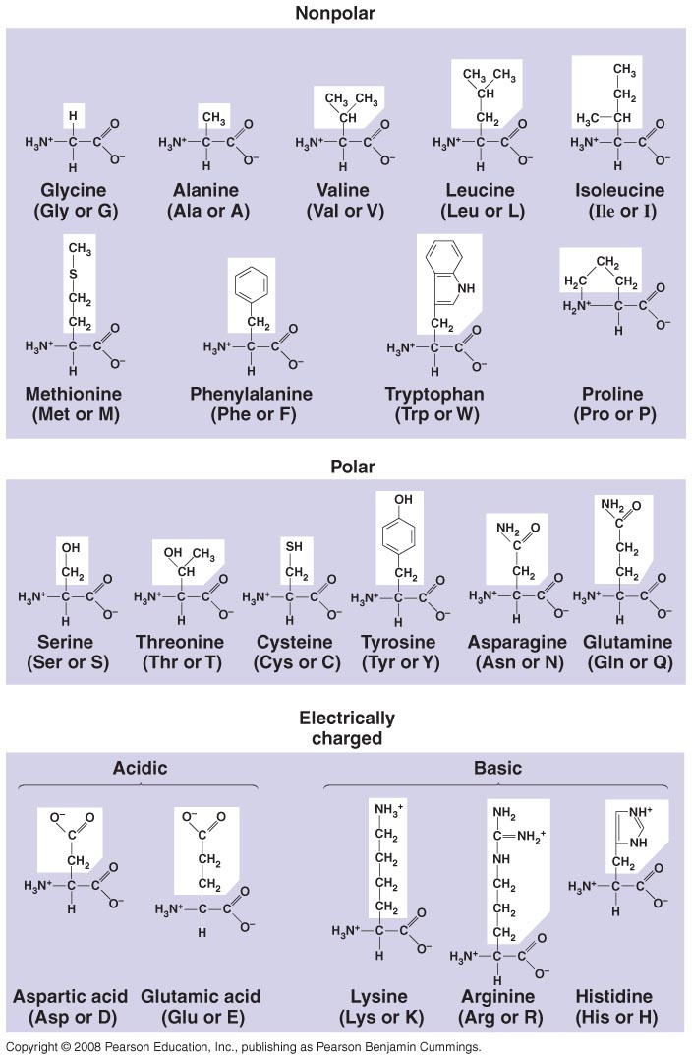

Slide 59
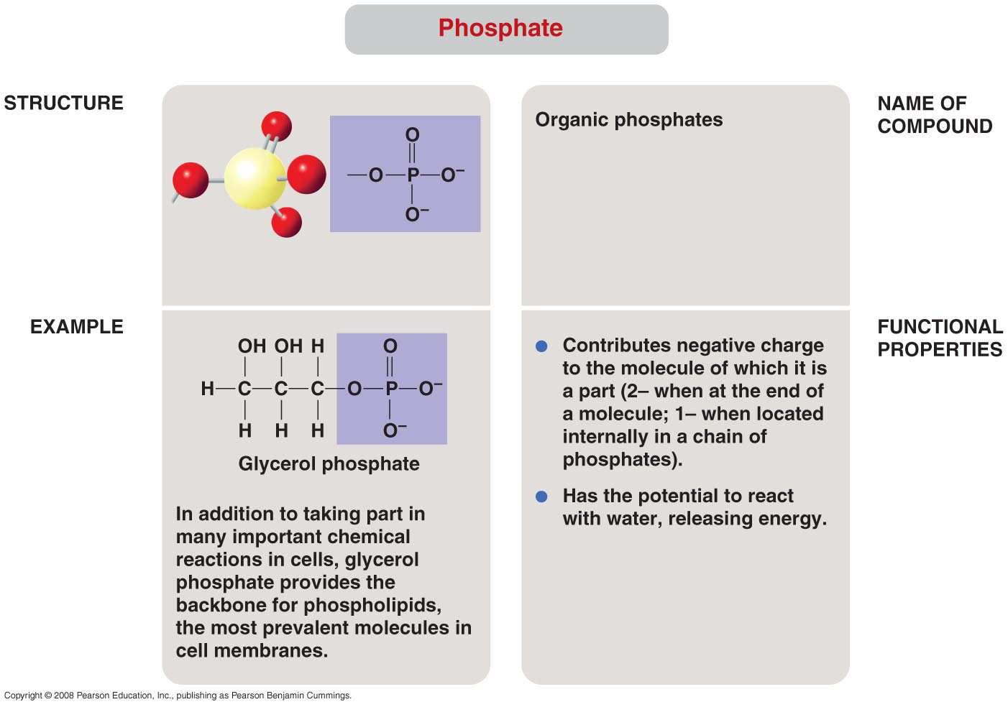

Slide 60
Functional Groups
Phosphate group
- PO₄⁻
- HPO₄ loses H by dissociation – polar
- almost always has neg. charge - anion

Slide 61
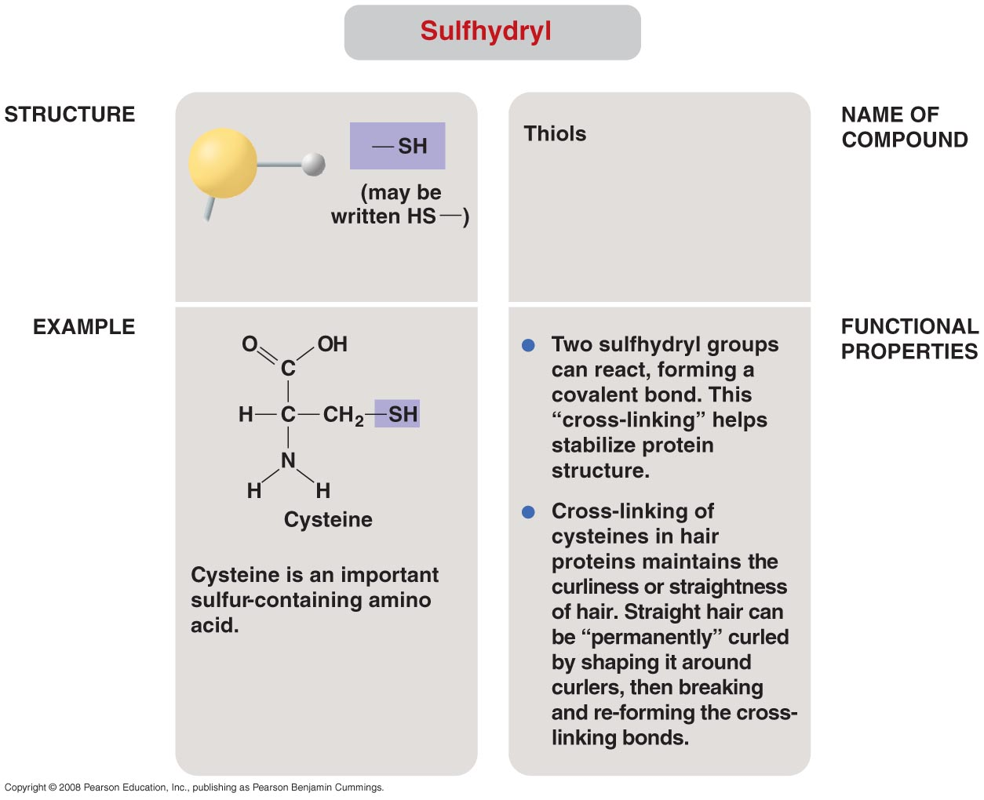

Slide 64
Four types of Organic Molecules
Carbohydrates – contain CHO
Lipids – CHO~P
Proteins – CHON~P
Nucleic acids – CHOPS
- DNA and RNA

Slide 65
Carbohydrates
Three sizes
- monosaccharides – simple sugars
- disaccharides – double sugars
- polysaccharides – starches, complex carb’s

Slide 66
Monosaccharides
Primary energy source
Simple formula – CH₂O
Glucose, fructose, galactose, ribose
In water it forms a ring fig. 5.4 & 5.5

Slide 67
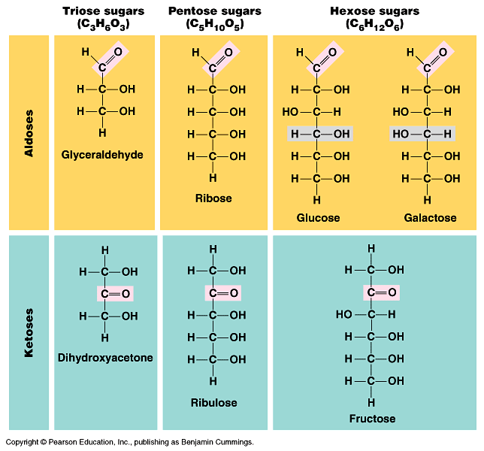

Slide 68
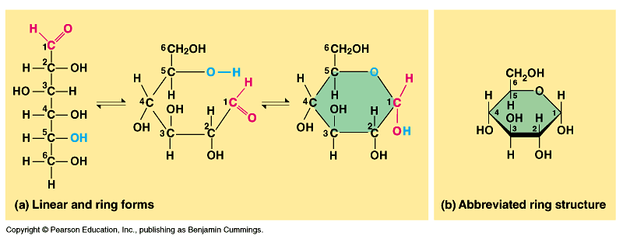

Slide 69
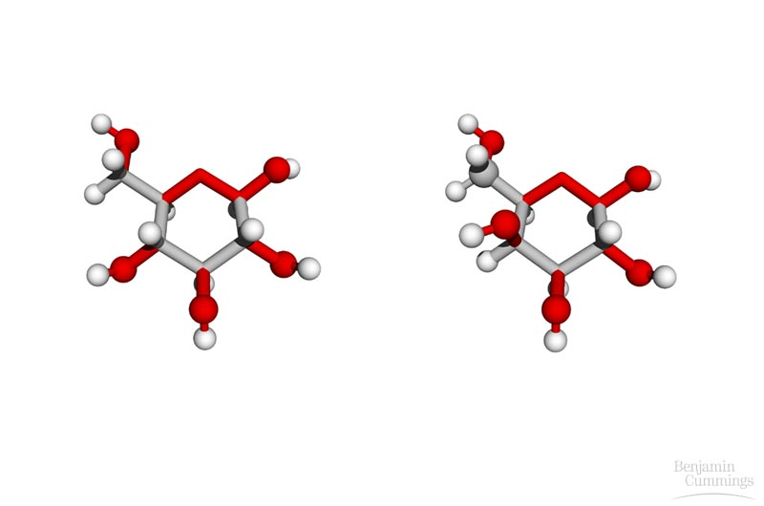
isomer

Slide 70
isomer
– same formula diff. structure

Slide 71
Monosaccharides
Benedicts solution tests for reducing sugars
- sugars with free carbonyl groups like all monosaccharides and some di’s

Slide 72
Disaccharides
Two mono’s bonded by a covalent bond called glycosidic linkage
Bond formed by process of dehydration synthesis – takes water out
energy in - endergonic
Fig. 5.2 & 5.5

Slide 73
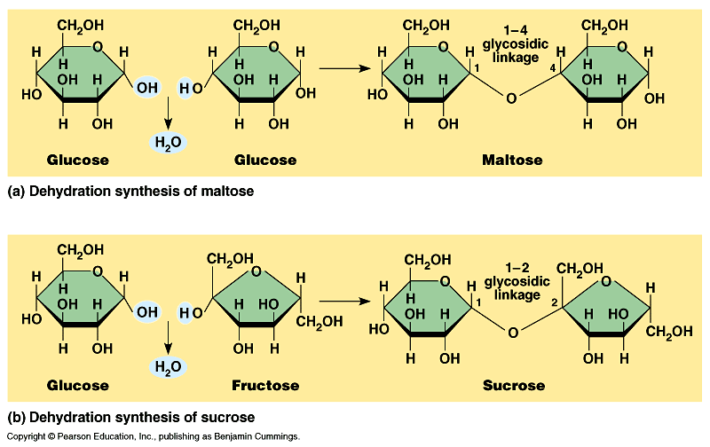

Slide 74
Disaccharides
Bond broken by hydrolysis – puts water in energy out – exergonic
Fig. 5.2

Slide 75
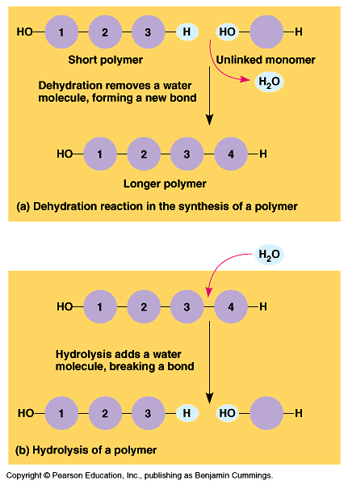

Slide 76
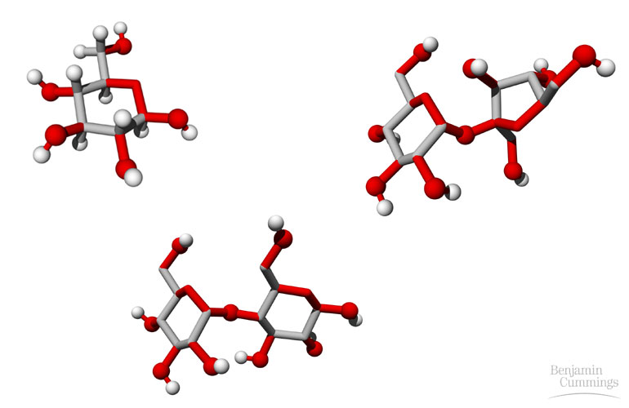

Slide 77
Disaccharides
Can be used for energy or storage – plants use them to carry carb’s around
Some react w/Benedicts b/c they have a free carbonyl group
Lactose, maltose, sucrose

Slide 78
Polysaccharides
3-1,000 mono’s joined together
Many uses
Plants store starch as amylose in plastids
Animals store starch as glycogen in liver & muscles
glucose → glycogen (dehydration) insulin
glycogen → glucose (hydrolysis) glucagon

Slide 79
Polysaccharides
Structural polysaccharides
- cellulose in plant cell walls
- chitin in invertebrate exoskeletons
- Lugols’ iodine tests for starch
rust color → blue/black

Slide 80
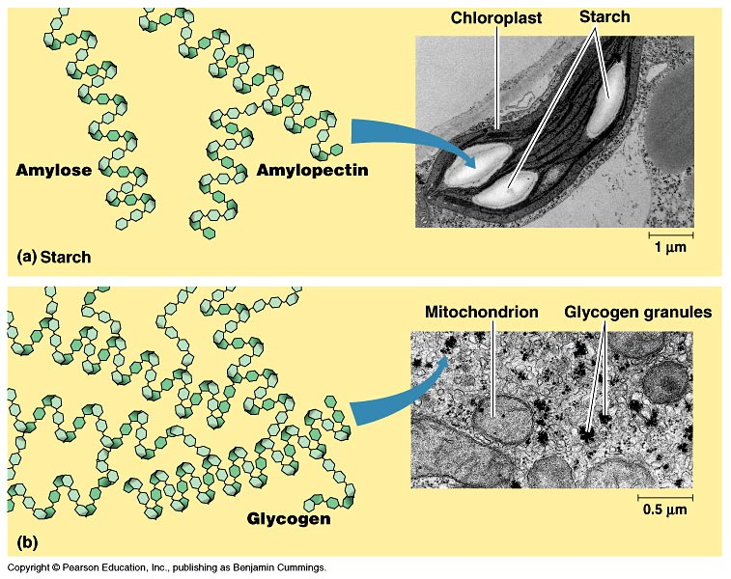

Slide 81
Lipids
Three types
- fats
- phospholipids
- steroids

Slide 82
Fats
1 molecule of glycerol C₃H₈O₃
3 molecules of fatty acids
- long hydrocarbon chain w/16-30 C’s
- ends in CH₃ and COOH
- nonpolar due to methyl group
- hydrophobic
- fig. 5.10

Slide 83
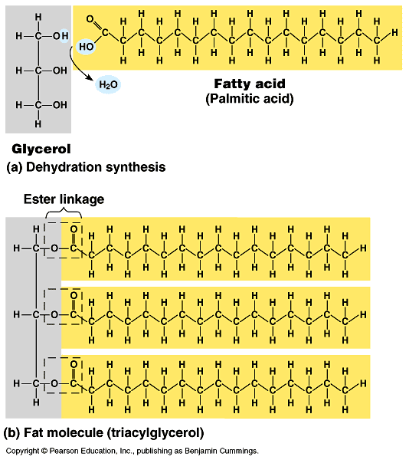

Slide 84
Two types of Fats
Saturated
- no double bonds
- straight shape
- solid at room temp.
- bacon, lard, butter
Unsaturated
- double bonds
- kinks
- liquid at room temp.
- oils

Slide 85
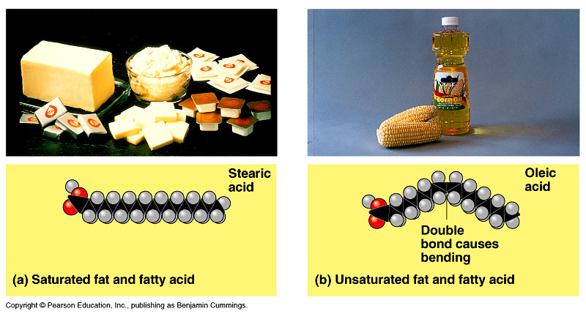

Slide 86
Phospholipids
1 glycerol
2 fatty acids
1 PO₄⁻
Major component of cell membrane
pg. 70 –71 Fig. 5.12
Hydrophilic head
Hydrophobic tail

Slide 87
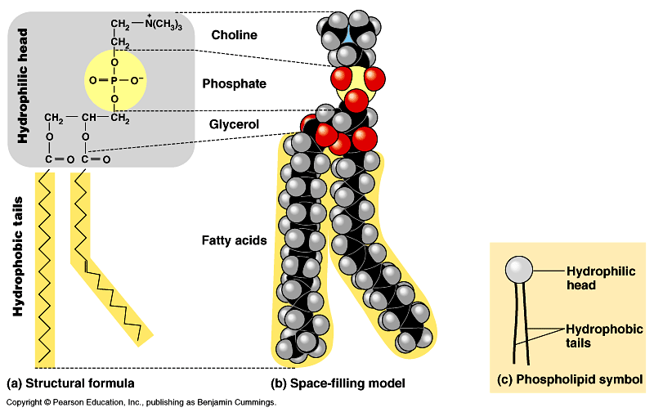

Slide 88
Steroids
Carbon skeleton w/4 interconnected rings
Fig. 5.14
Cholesterol
- in animal cell membranes

Slide 89
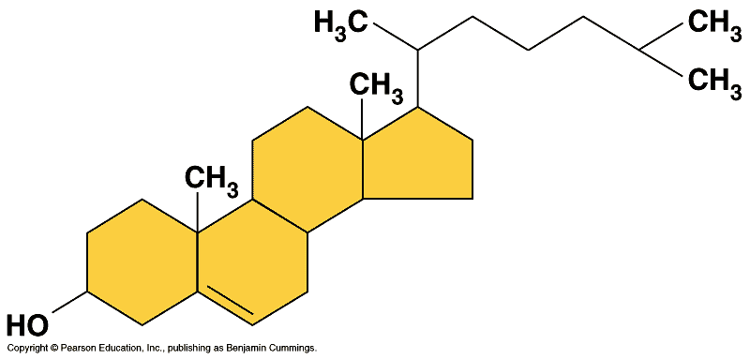

Slide 90
Uses and tests for Fats
Uses
- Structure
- Insulation
- Protection
- Energy storage 6x’s more than glycogen
Tests
- brown bag
- Sudan IV dye

Slide 91
Proteins
Most abundant of org. mol’s
Amino acids are building blocks of polypeptides
Polypeptides make up protein (yarn/sweater)
General structure of amino acids fig. 5.15
- amino group NH₃
- carboxyl group COOH
- R group – variable side chain

Slide 92
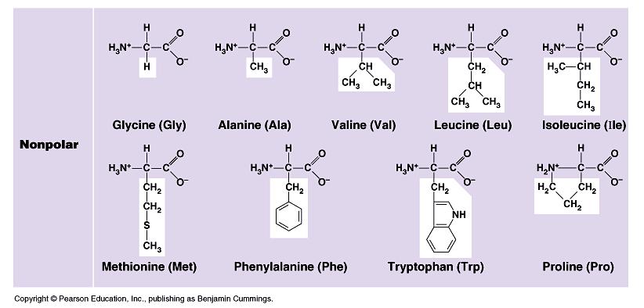

Slide 93
Proteins
Amino acids are joined when dehydration synthesis forms peptide bonds
Fig. 5.16

Slide 94
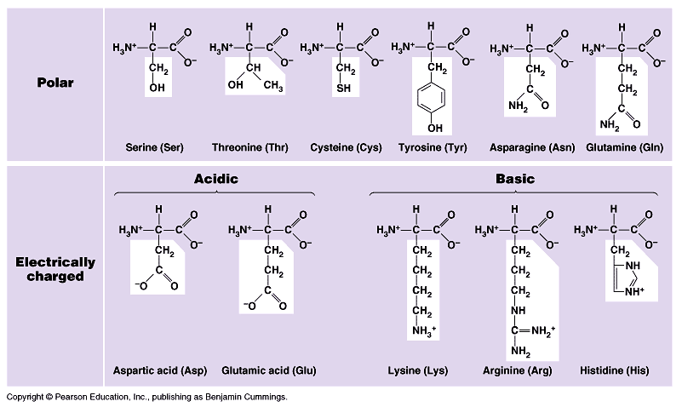

Slide 95
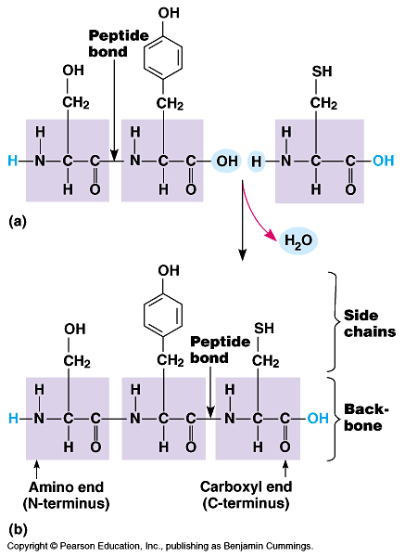

Slide 96
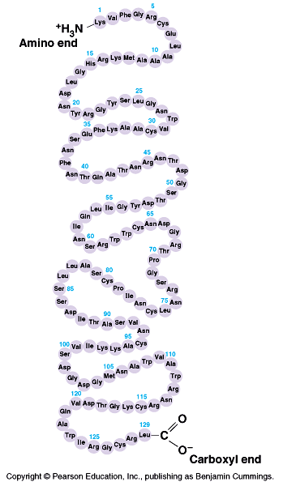

Slide 97
Four Levels of Protein Structure
1. Primary
- linear sequence of a.a. dictated by DNA
- gly – ala – phen – val ….

Slide 99
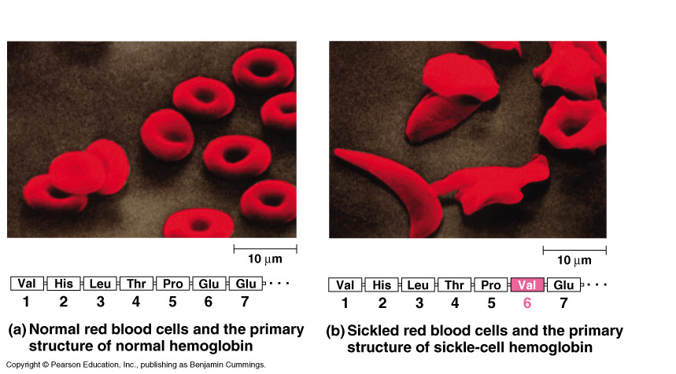

Slide 100
Structure
2. Secondary
- as primary structure lengthens H bonding occurs causing 2 formations:
α helix
β beta pleated sheet
fig. 5.20

Slide 101
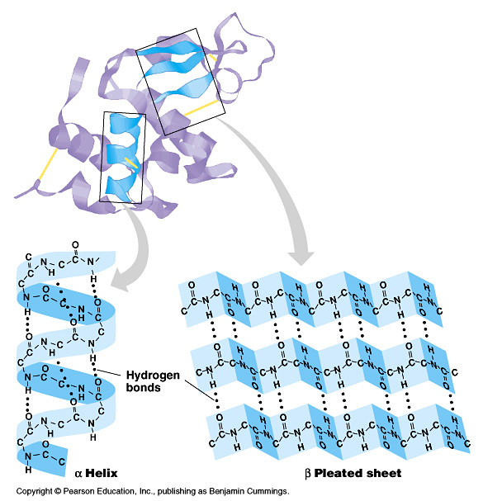

Slide 102
Structure
3. Tertiary
- as polypeptide lengthens R groups begin to interact
- hydrophobic interactions cause van der Waals interactions which are weak but give shape
- disulfide bridges form if SH groups interact - strong

Slide 103
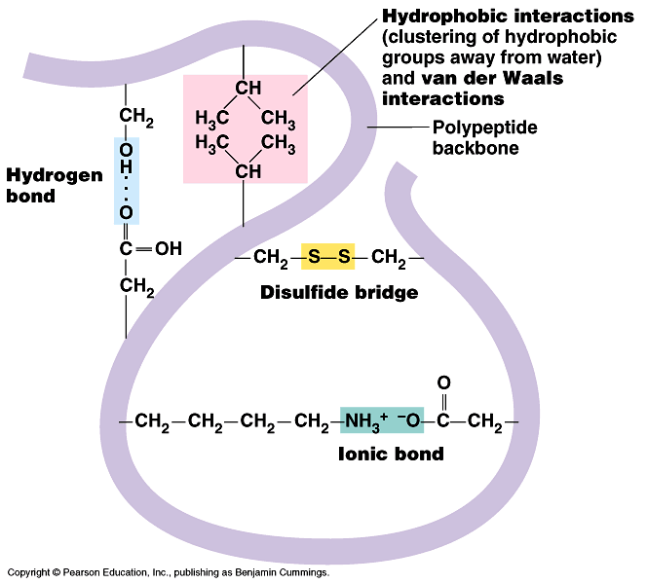

Slide 104
Structure
4. Quaternary
- consists of 2 or more polypeptide chains
- super coiled structure
- hormones, hemoglobin, collagen

Slide 105
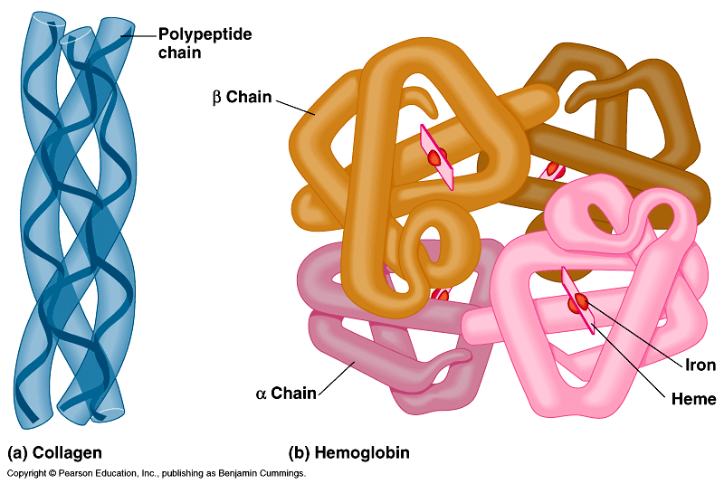

Slide 106
Protein Folding
Go through many states before stable
Chaperonins assist in proper folding – keep protein segregated from “bad influences” (just like the chaperones at St. Viator)
Fig. 5.26

Slide 107
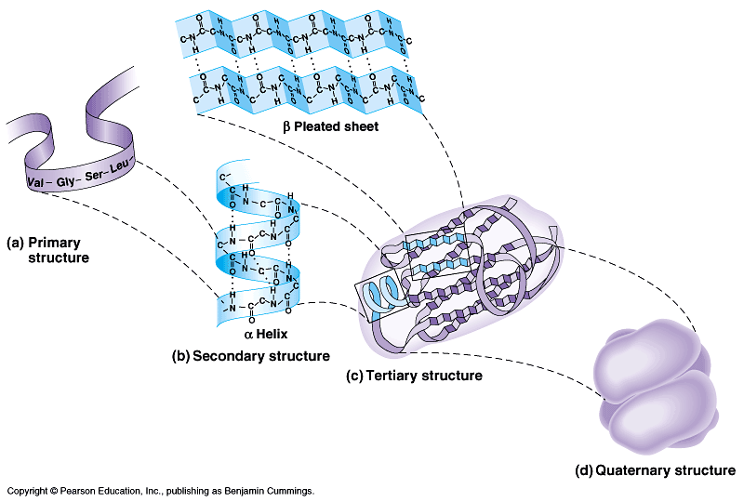

Slide 108
Consequences of Protein Structure
Change in environment may cause protein to unravel or lose its shape – denature
can be caused by:
Δ pH
Δ salinity
Δ temp.
Protein is then inactive
Fig. 5.25

Slide 109
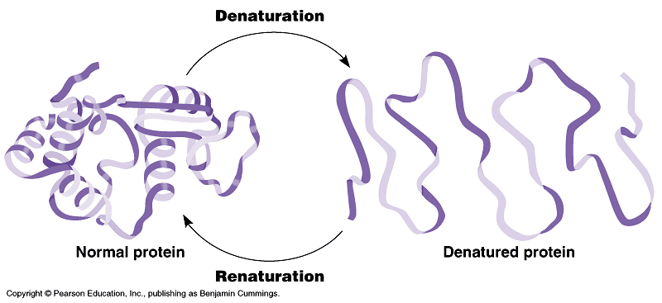

Slide 110
Uses for Proteins
Structure – collagen
Storage – albumin (egg white)
Transport – hemoglobin
Hormones
Enzymes
Antibodies

Slide 111
Proteins – Lab tests
Biurets solution – reacts w/peptide bonds
Ninhydrin - tests for amino acids with free amino groups
X-Ray crystallography

Slide 112
Enzymes
Proteins that change the rate of reactions without being consumed by the reaction
Catalysts
Work by lowering the activation energy of the reaction (initial E needed to break bonds)

Slide 113
Specificity of Enzymes
Part of protein (active site) is able to bond temporarily to reactant (substrate)
While joined, substrate is converted to product
Fig. 6.15
Suffix “ase”
sucrase breaks down sucrose

Slide 114
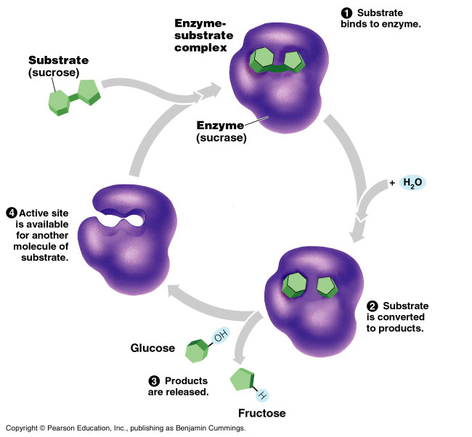

Slide 115
http://glencoe.mcgraw-hill.com/sites/9834092339/student_view0/chapter6/how_enzymes_work.html

Slide 116
Specificity
Active site – active part of enzyme
- Must have compatible fit to substrate
- Induced fit hypothesis
like lock & key or hands shaking

Slide 117
Factors affecting enzyme activity
pH
Temp
Amount of substrate
Amount of enzyme

Slide 118
More Factors
Cofactors – inorganic subs. that attach to enzyme to insure close fit
- ions like Ca⁺⁺, Mg⁺⁺
Coenzymes – organic mol’s that insure close fit
- ie. vitamins
Inhibitors – stop or slow reaction

Slide 119
Enzyme Inhibitors
Chemicals which selectively inhibit action of enzyme – 2 types pg. 101
- competitive
compete for active site & block enzyme
- allosteric inhibitor aka noncompetitive
bind to another part of enzyme causing it to change shape
the other part is called the allosteric site

Slide 120
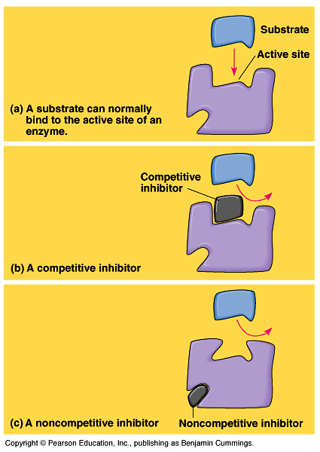

Slide 121
Feedback Mechanisms
Negative
Positive
Pg. 9 fig. 1.8

Slide 124
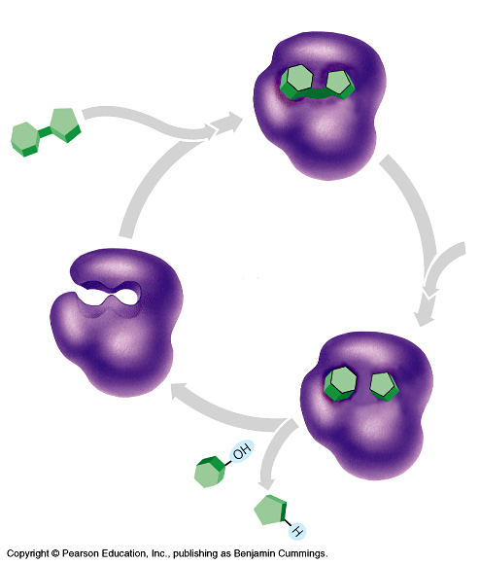

Slide 125
