Slide 1
Nervous & Immune Systems
Nervous System

Slide 2
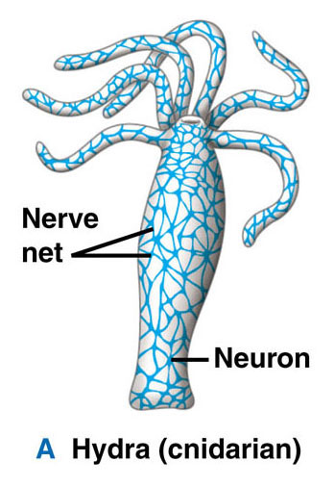
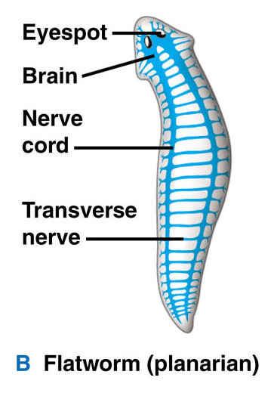

Slide 3
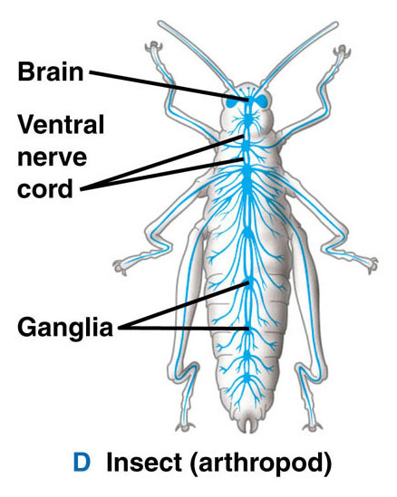
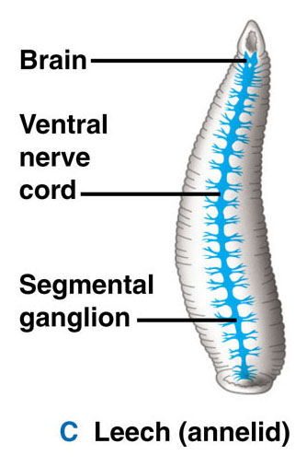

Slide 4
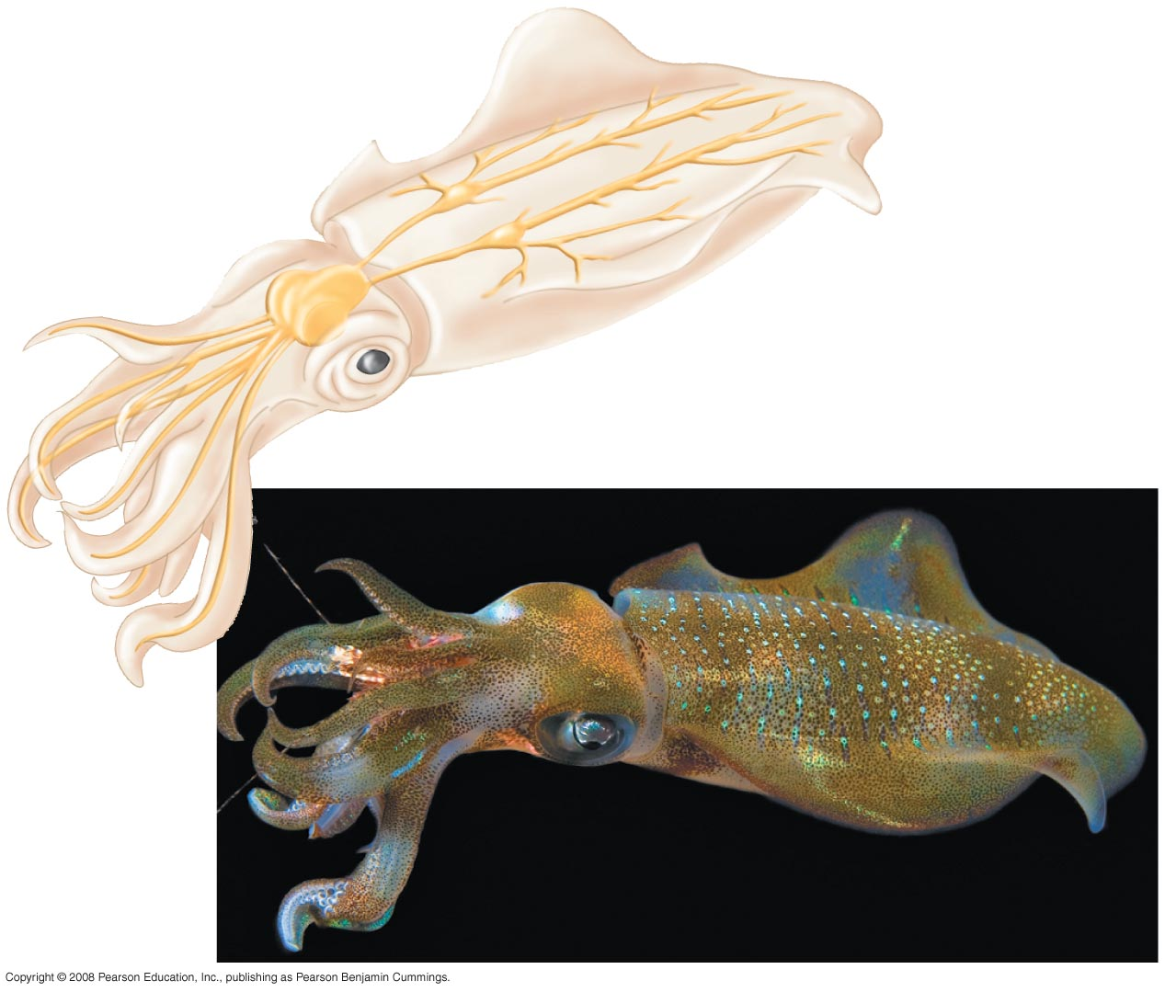
Fig. 48-2
Nerves
with giant axons
Ganglia
Brain
Arm
Eye
Mantle
Nerve

Slide 5
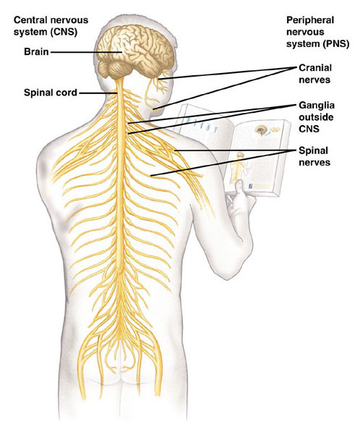

Slide 6
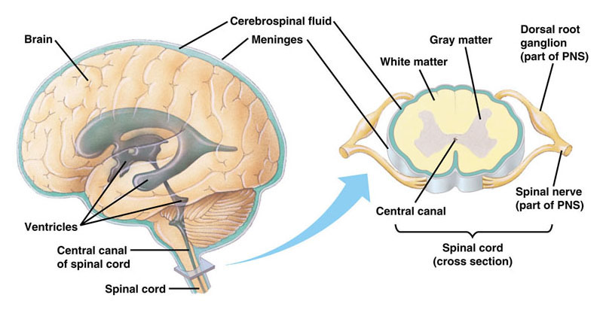

Slide 7
3 Functions
1. Sensory input - conductions from sensory receptors to integration center
- i.e. Eye & ear
2. Integration – info read & response identified
- brain & spinal cord
3. Motor output – conduction from integration center to effector cells (muscles & glands)

Slide 8
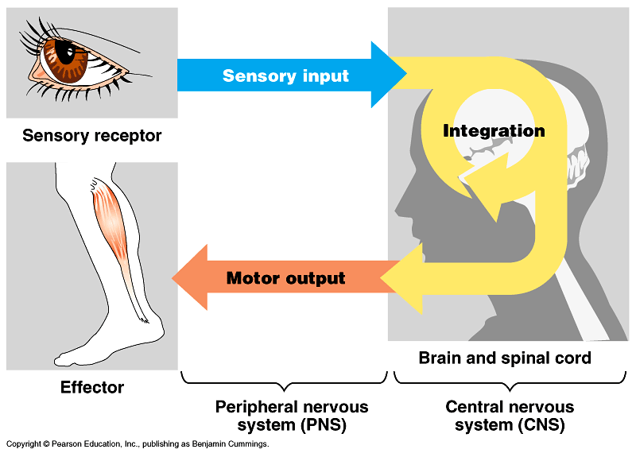

Slide 9
2 main parts of nervous system
1. Central Nervous system – CNS
brain & spinal cord
2. Peripheral Nervous system – PNS
carries sensory input to CNS & motor output away from CNS

Slide 10
Cell types
Neurons conduct messages – fig. 48-4
Supporting cells

Slide 11
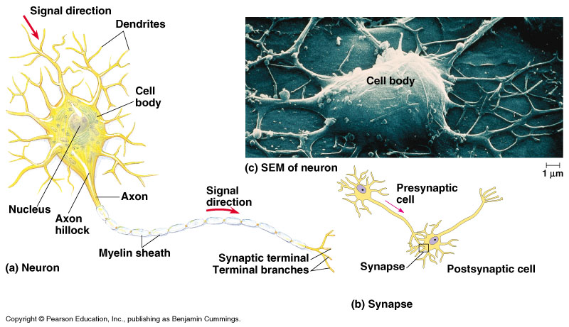

Slide 12
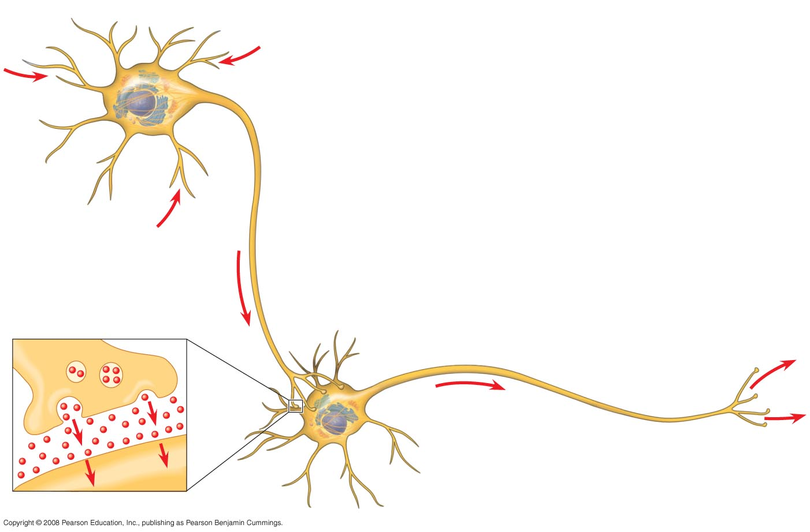
Fig. 48-4
Dendrites
Stimulus
Nucleus
Presynaptic
cell
Axon
hillock
Cell
body
Axon
Synapse
Synaptic terminals
Postsynaptic cell
Neurotransmitter

Slide 13
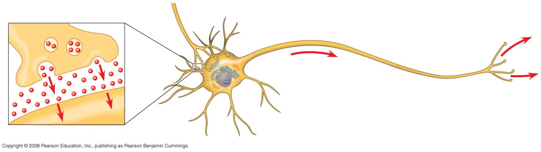
Fig. 48-4a
Synapse
Synaptic terminals
Postsynaptic cell
Neurotransmitter

Slide 14
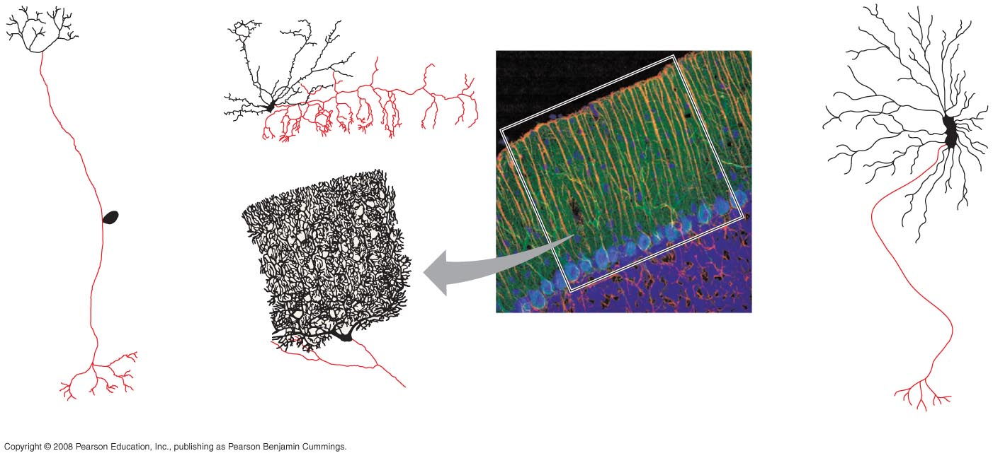
Fig. 48-5
Dendrites
Axon
Cell
body
Portion
of axon
80 µm
Cell bodies of
overlapping neurons
Sensory neuron
Interneurons
Motor neuron

Slide 15
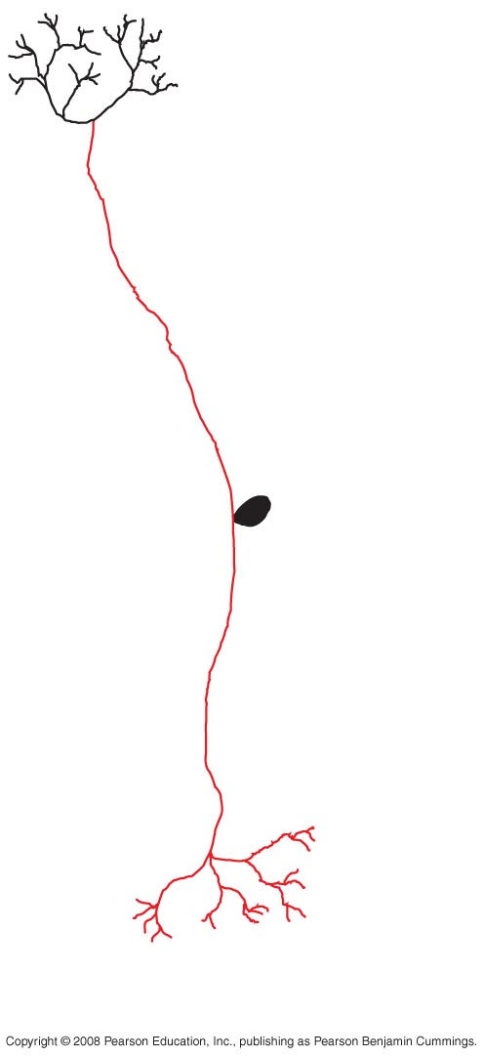
Fig. 48-5a
Dendrites
Axon
Cell
body
Sensory neuron

Slide 16
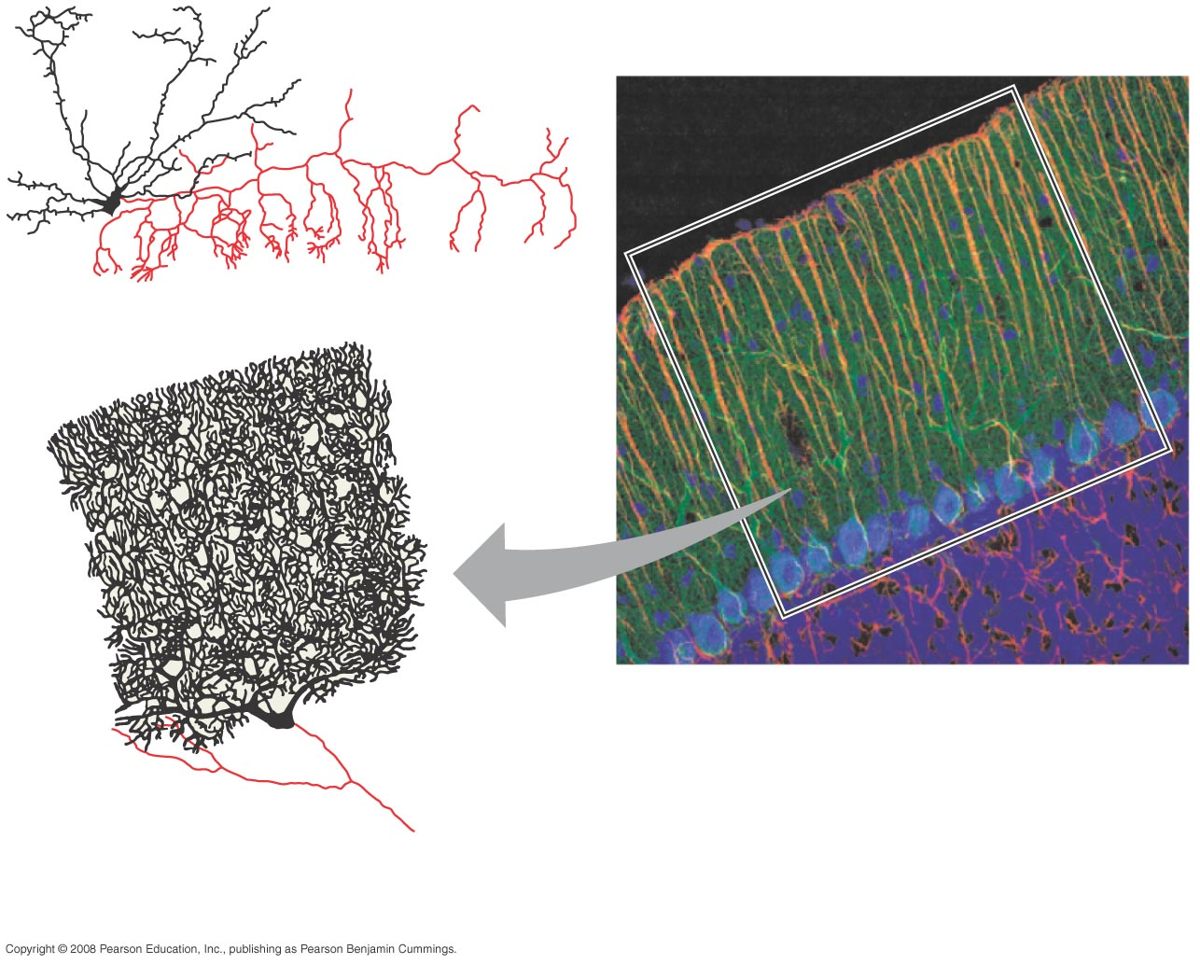
Fig. 48-5b
Portion
of axon
80 µm
Cell bodies of
overlapping neurons
Interneurons

Slide 17
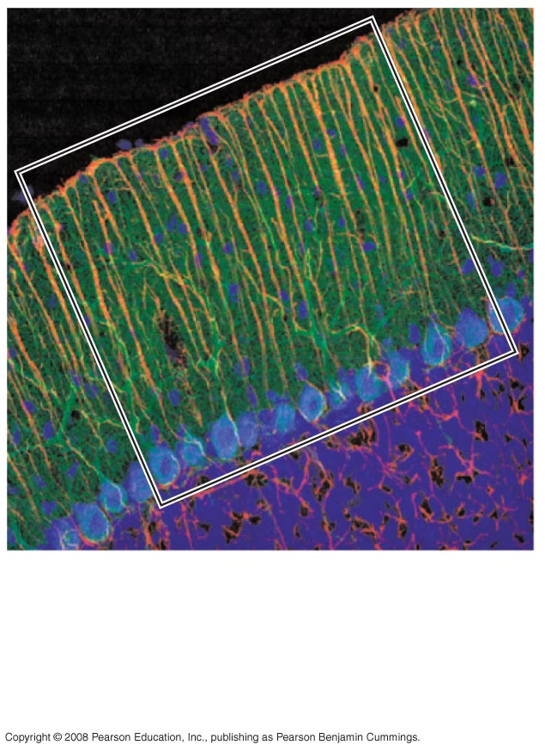
Fig. 48-5c
80 µm
Cell bodies of
overlapping neurons

Slide 18
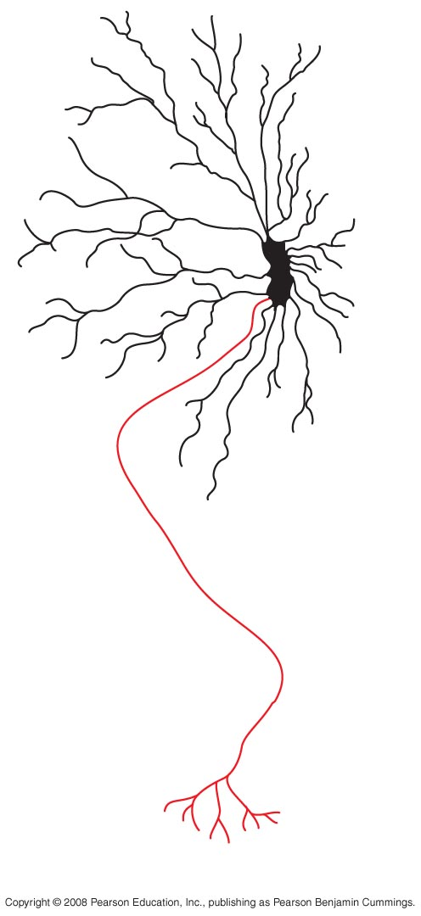
Fig. 48-5d
Motor neuron

Slide 19
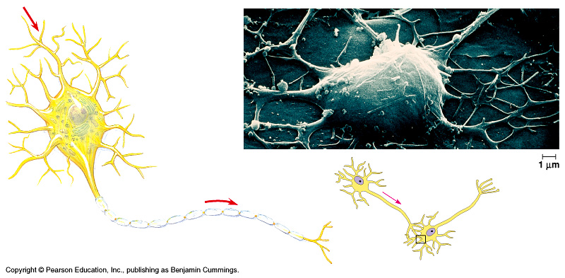

Slide 21
Structure of a neuron
Dendrites – ↑ surface area at receiving end
Axon – conducts message away from cell body
Schwann cells – supporting cells that surround axon & form insulating layer called myelin sheath
Axon hillock – impulse generated

Slide 22
Structure of a neuron
Axon branches & has 1,000’s of synaptic terminals that release neurotransmitters (chemicals that relay inputs)
Synapse – space between neurons or neuron & motor cell

Slide 23
3 types of neurons
Sensory – information to CNS
Motor – information from CNS
Interneuron – connect sensory to motor

Slide 24
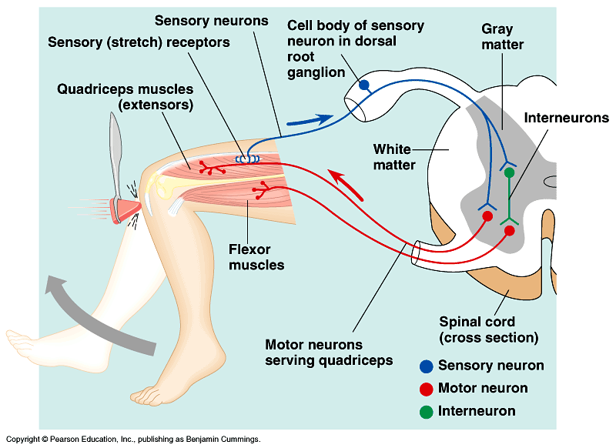

Slide 25
Supporting Cells - glial cells
Astrocytes circle capillaries in the brain to form a blood-brain barrier which keeps control of materials entering the brain from the blood
Oligodendrocytes in CNS and Schwann cells in PNS
- form myelin sheaths around axons
- their plasma membrane rolls around axon thus insulating it – why?

Slide 26
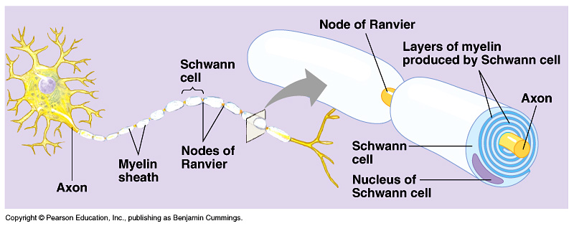

Slide 27
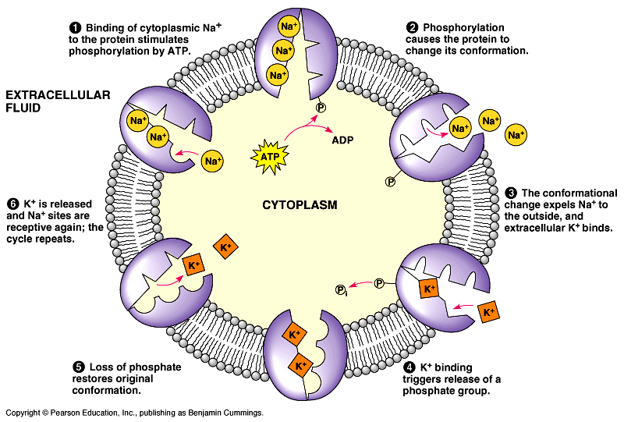

Slide 28
Transmission
Signal is electric and depends on ion flow across the membrane
All cells have a membrane potential – difference in electric charge between cytoplasm and extracellular fluid
- external more ⁺ and internal more –
- resting potential - the membrane potential of a nontransmitting cell (around – 70mV)

Slide 29
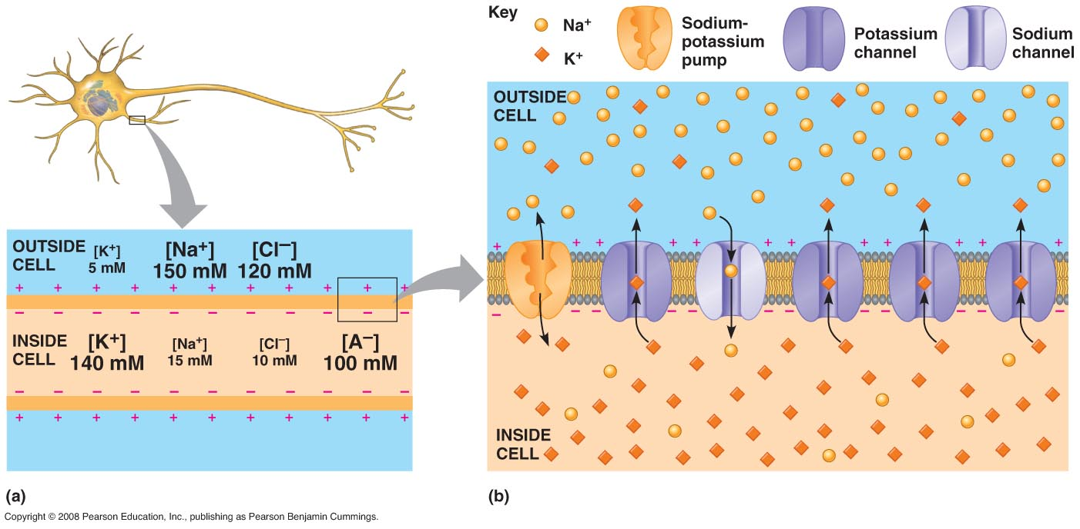

Slide 30
Transmission
Neurons have gated ion channels
At rest the Na⁺ and K⁺ gates are closed and membrane potential is – 70mV
If gates for K⁺ open K⁺ rushes out – why out? (review Na⁺ and K⁺ pump)
Because ⁺ ions leave, the membrane potential becomes more negative inside thus -hyperpolarization

Slide 31
Transmission
Hyperpolarization and depolarization are referred to as graded potentials because the magnitude of the change varies with strength of the stimulus (what caused the opening of gates)
If Na⁺ gates open the membrane potential becomes less negative thus - depolarization
Other ion gates can also open and change the membrane potential

Slide 32
Transmission
Threshold
Potential that must be reached to cause an action potential
Threshold potential is ⁻50mV
Once the threshold is met a series of changes takes place and cannot be stopped – this is called the action potential

Slide 33
Action Potential
Rapid change in the membrane potential cause by a stimulus (if the stimulus reaches the threshold)
All cells have a membrane potential but only excitable cells, like neurons and muscles can change it. Why?

Slide 34
Action Potential

Slide 35
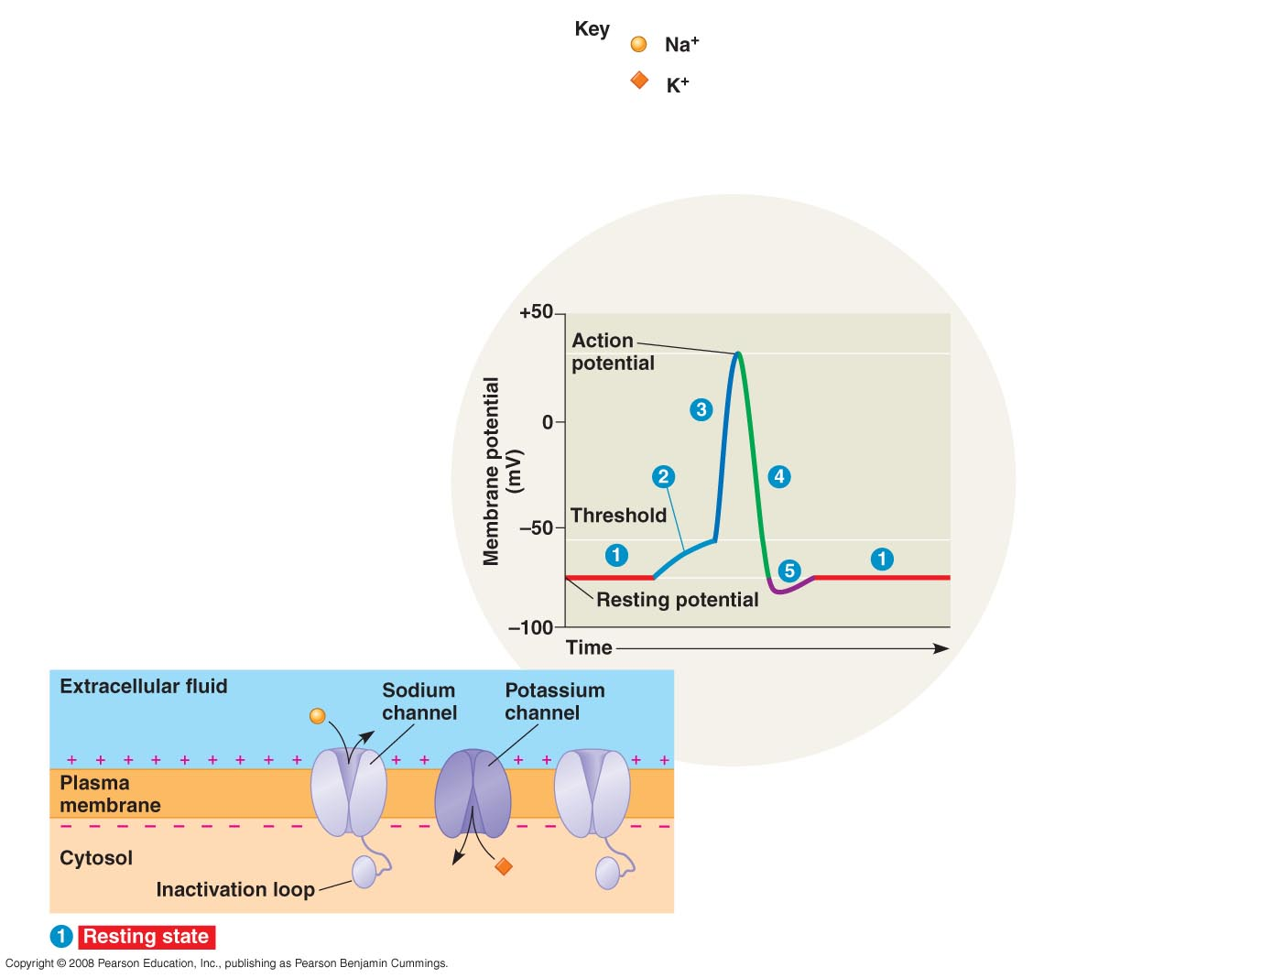

Slide 36
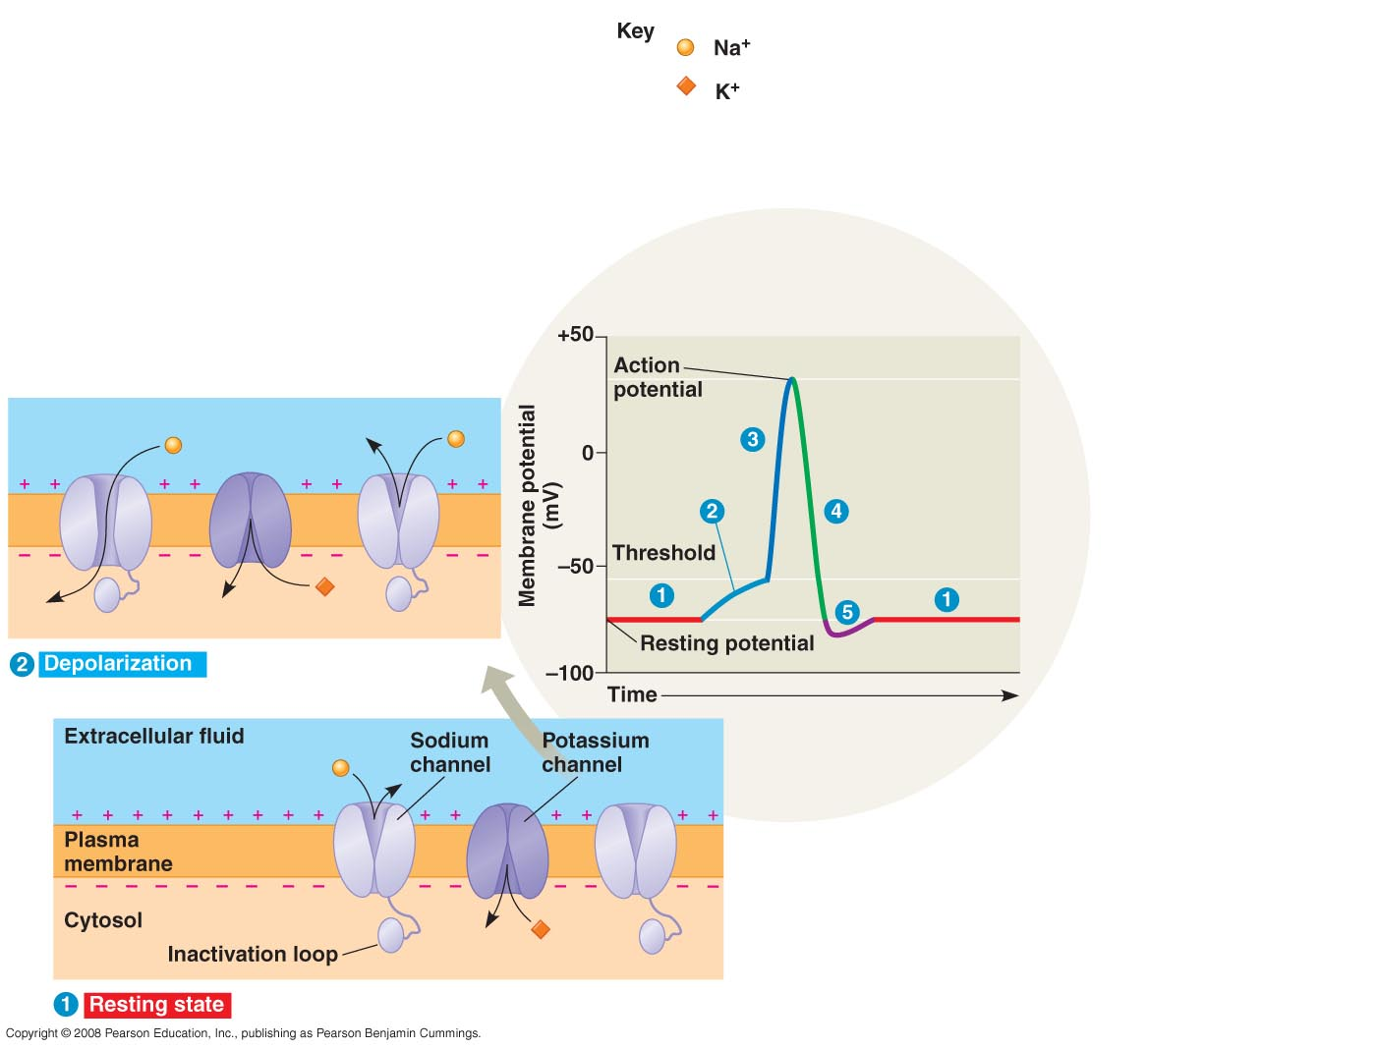

Slide 37
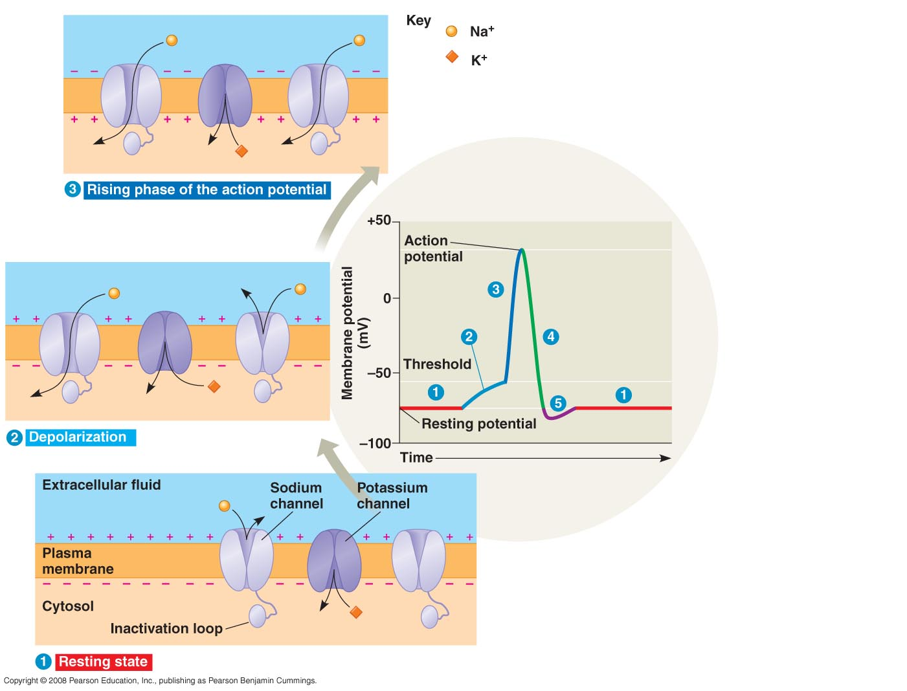

Slide 38
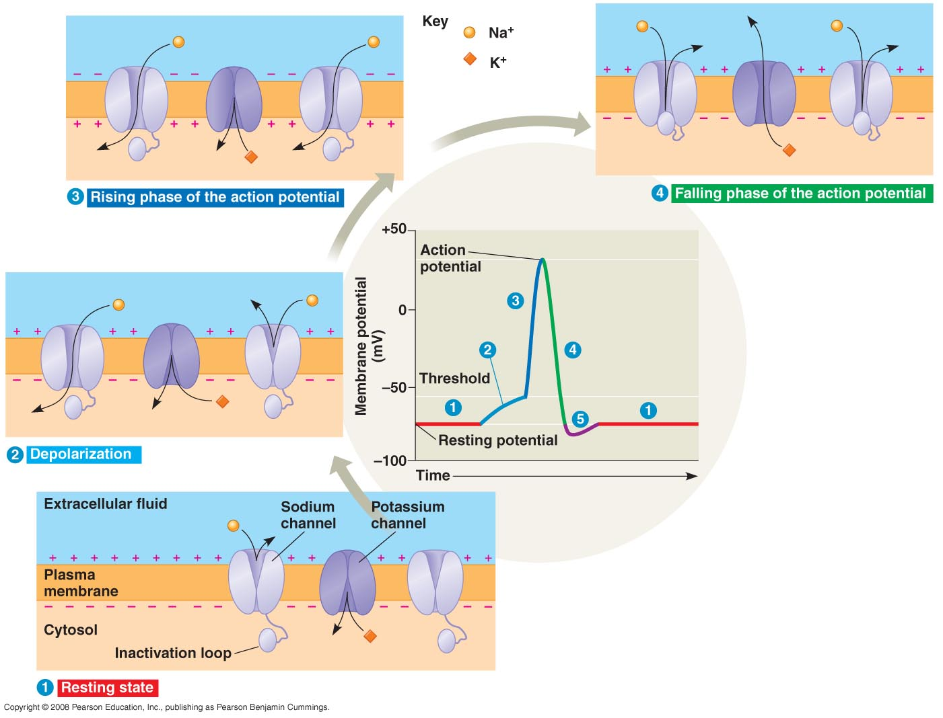

Slide 39
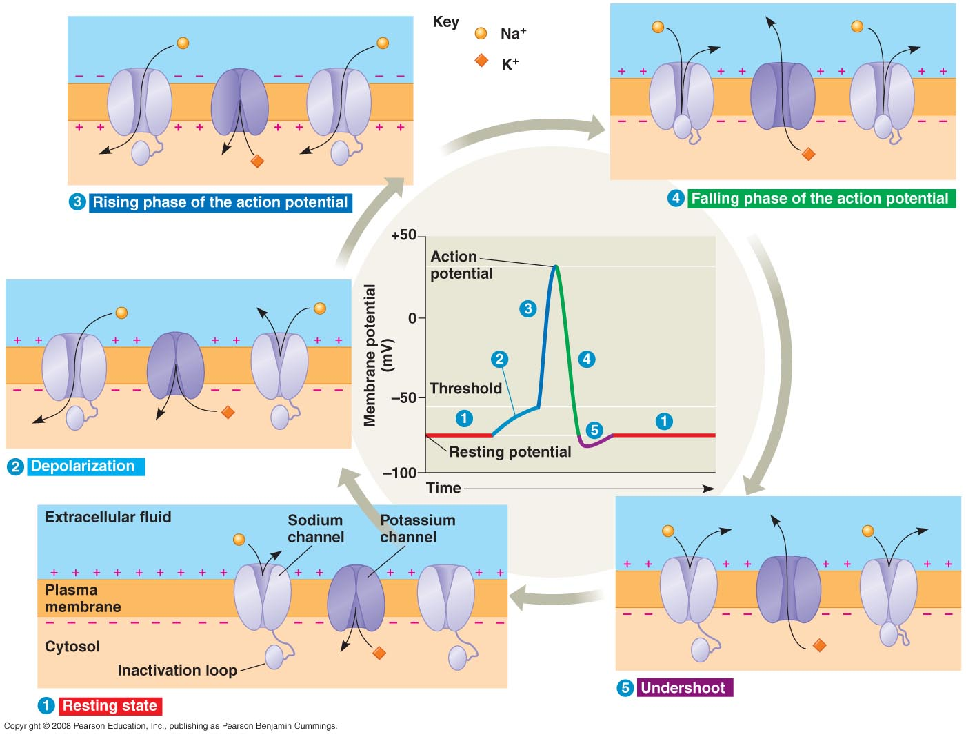

Slide 40
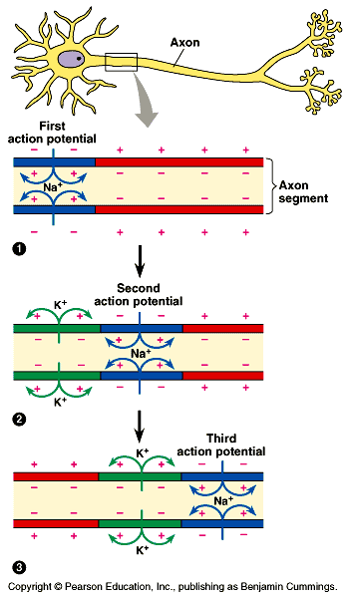

Slide 41
5 Phases of Action Potential
1. Resting – no channels open
2. Depolarizing - threshold is met
- NA⁺ channels open
- +’s going in
- inside becomes more ⁺ or less⁻
3. Rising phase - more Na ⁺ gates open thus depolarizing continues

Slide 42
Action Potential Phases
4. Falling Phases - repolarizing
- NA⁺ channels closed
- K ⁺ channels open
- +’s going out
- inside more negative

Slide 43
Action Potential Phases
5. Undershoot
- inside is more negative than resting stage because NA⁺ channels still closed & K ⁺ gates still open. It takes time (millisecond) to respond to repolarization
- resting state is restored
- refractory period - during undershoot when activation gates not open yet
- neuron is insensitive to depolarization
- sets limits on maximum rate of activation of action potential

Slide 45
http://www.youtube.com/watch?v=SCasruJT-DU action potential
http://www.youtube.com/watch?v=DJe3_3XsBOg Schwan cells

Slide 46
The Synapse
Space between neurons
Terms:
- presynaptic cell – transmitting cell
- postsynaptic cell – receiving cell
2 types of synapse:
- electrical
- chemical

Slide 47
Synapse
Electrical synapse
- less common
- action potential spreads directly from pre - to postsynaptic cells via gap junctions
Chemical synapse
- a synaptic cleft separates pre – post synaptic cells so they’re not electrically coupled

Slide 48
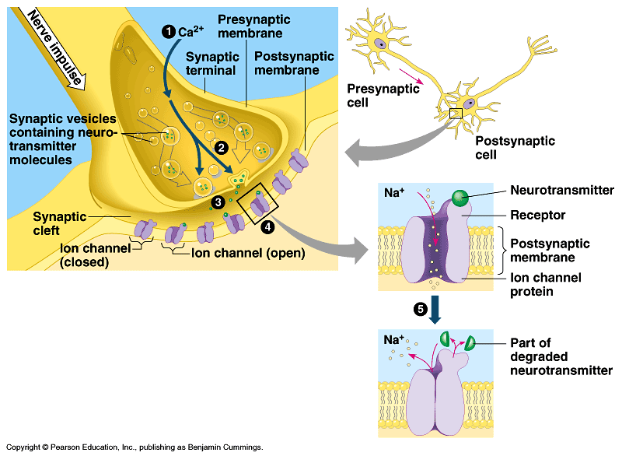

Slide 49
Steps of Chemical Synapse
1. Action potential depolarizes presynaptic membrane causing Ca⁺⁺ to rush into synaptic terminal through gates
2. ↑ Ca⁺⁺ causes synaptic vesicles to fuse thus releasing neurotransmitters

Slide 50
Types of neurotransmitters
EPSP – excitatory
NA⁺ in
K⁺ out
(more Na⁺ in than K⁺ out because of voltage and concentration gradient) thus
depolarization
IPSP – inhibitory
K⁺ out
Cl⁻ in
hyperpolarization

Slide 51
Neurotransmitters
Each can trigger different responses at different sites.
- Depends on receptors on different postsynaptic cells
Bind chemically to gated ion channels thus changing the permeability of the chemical at the postsynaptic cell

Slide 52
Neurotransmitters
Acetylcholine – most common
- for muscle contraction
Dopamine – usually EPSP but some sites IP
Epinephrine “ “
Norepinephrine “ “
Serotonin – made from tryptophan usually inhibitory

Slide 53
Vertebrate Nervous Systems

Slide 54
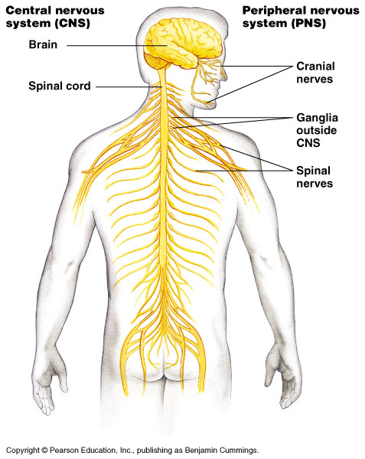

Slide 55
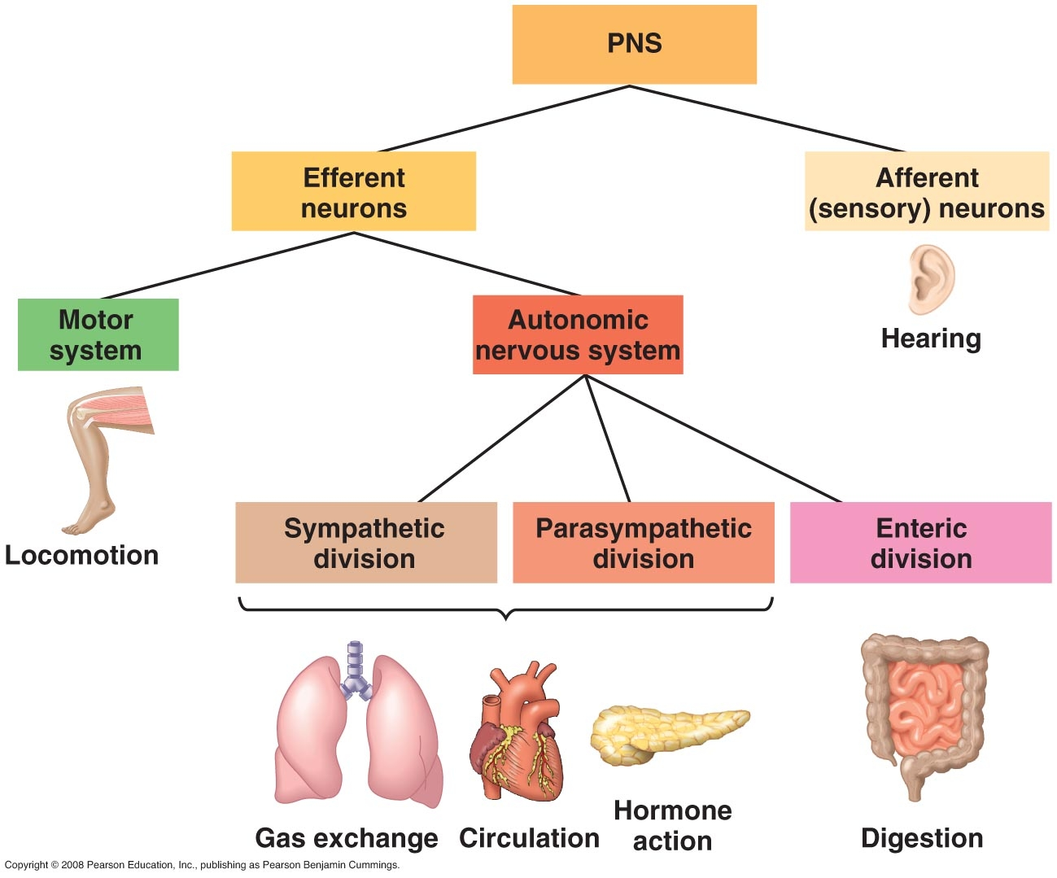
somatic

Slide 56
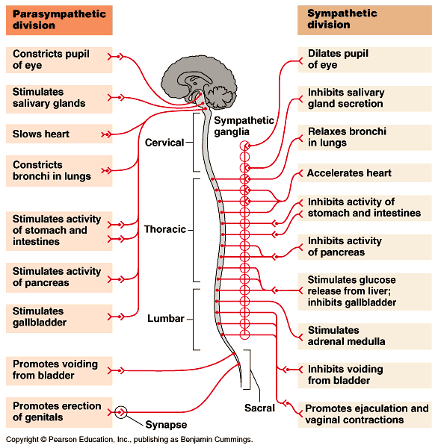

Slide 57
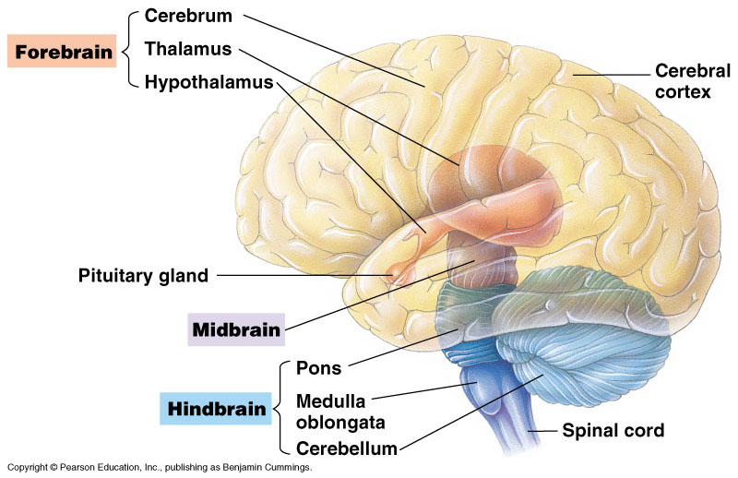

Slide 58
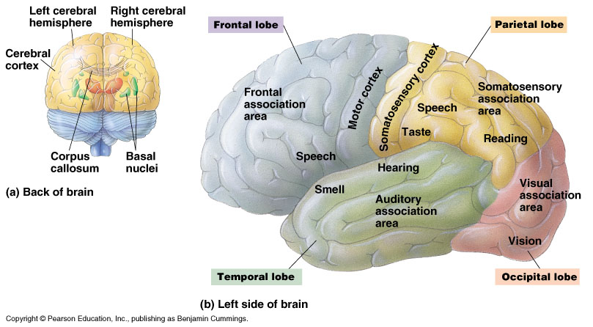

Slide 59
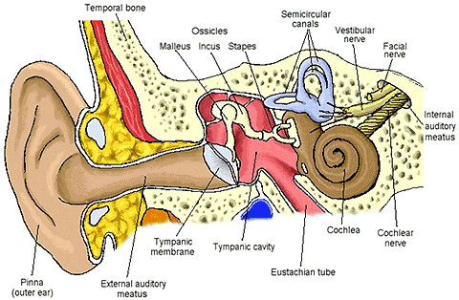

Slide 60
The Body’s Defense

Slide 61
Two Mechanisms
Nonspecific
Specific

Slide 62
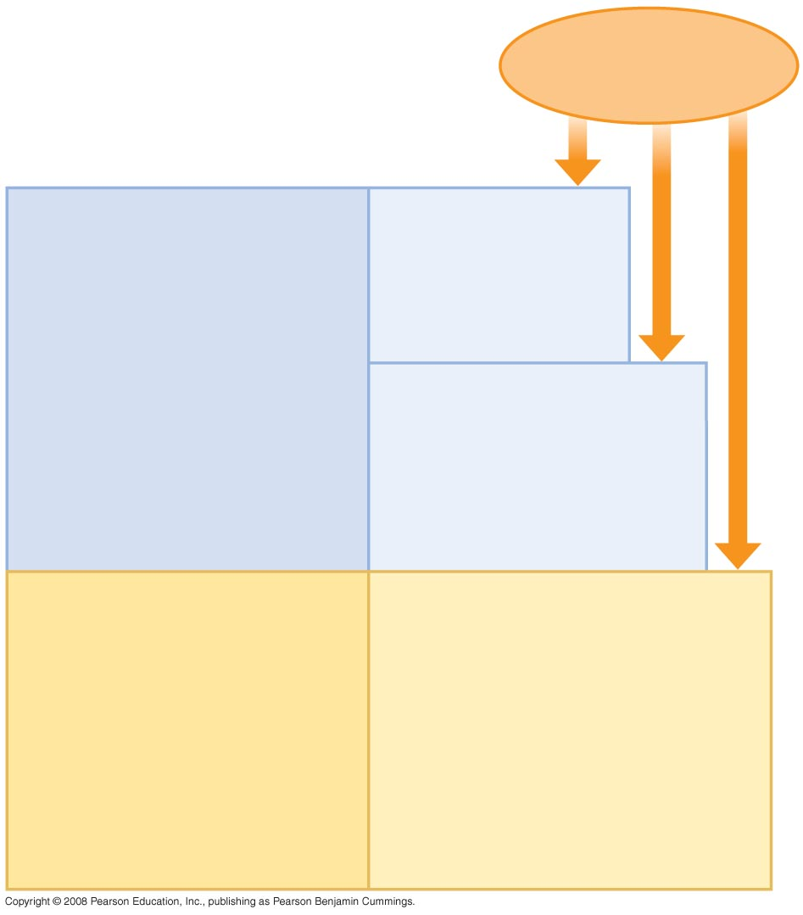
Fig. 43-2
Pathogens
(microorganisms
and viruses)
INNATE IMMUNITY
Barrier defenses:
Skin
Mucous membranes
Secretions
•
Recognition of traits
shared by broad ranges
of pathogens, using a
small set of receptors
Internal defenses:
Phagocytic cells
Antimicrobial proteins
Inflammatory response
Natural killer cells
•
Rapid response
ACQUIRED IMMUNITY
Humoral response:
Antibodies defend against
infection in body fluids.
•
Recognition of traits
specific to particular
pathogens, using a vast
array of receptors
Cell-mediated response:
Cytotoxic lymphocytes defend
against infection in body cells.
•
Slower response

Slide 63
Nonspecific
1st line
skin
mucous membranes
secretions like lysosyme

Slide 64
Nonspecific cont’d
- 2nd line
a. phagocytic WBC’s (eat & use digestive enzymes) - 3 kinds
1. Neutrophils
- attracted by chemicals (chemotaxis)
- amoeboid movements
- short life b/c self destruct

Slide 65
Phagocytic WBC’s cont’d
2. Monocytes which become macrophages
have long pseudopods & long life
3. Eosinophils – defend against lg. parasites like fluke

Slide 66
2nd line cont’d
b. Natural Killer Cells
- destroy bodies own cells that are infected by virus or may cause tumors
- not phagocytic but cause lyseing

Slide 67
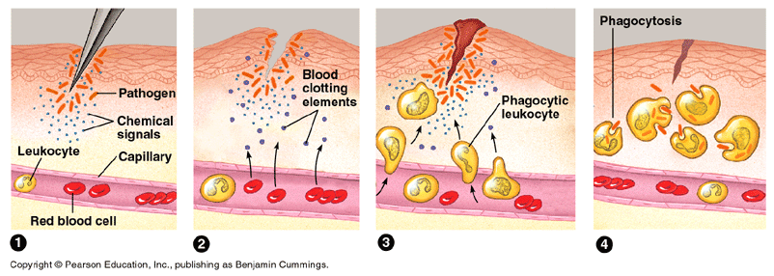
c. Inflammatory Response

Slide 68
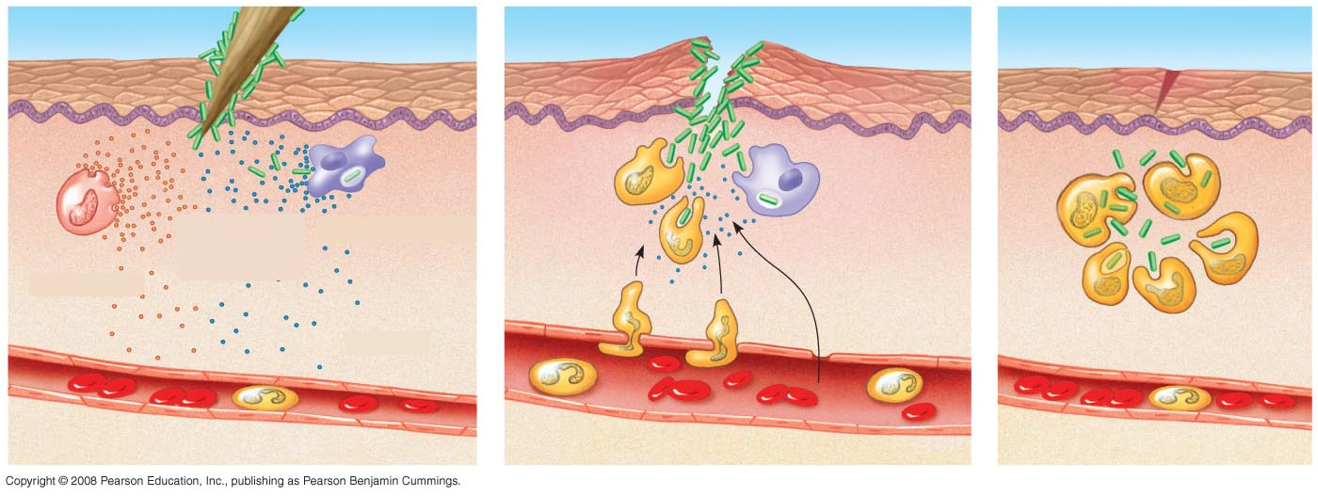
Fig. 43-8-3
Pathogen
Splinter
Chemical
signals
Macrophage
Mast cell
Fluid
Capillary
Phagocytosis
Red blood cells
Phagocytic cell

Slide 69
2nd line cont’d
c. Inflammatory response pg. 935
- wounded cells release histamine
- local vasodilation (capillaries dilate) causing more leaks
- signals phagocytic WBC’s
- more WBC’s to area (pus is dead phagocytes & fluids)
- local temperature ↑
- fever

Slide 70
2nd line cont’d
d. Antimicrobial proteins
* Interferon
- emitted from virus infected cell
- warns neighbors
- neighbors block entry by changing cell proteins
- prevents cell proliferation

Slide 71
2nd line cont’d
* Complement system
- 30 proteins interact in steps resulting in lysis of invader
- activated by substances on surface of many microbes
- some work w/chemotaxins

Slide 72
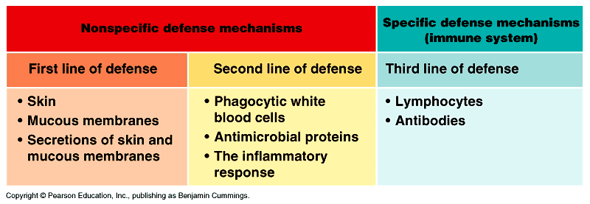

Slide 73
Fig. 43-2
Pathogens
(microorganisms
and viruses)
INNATE IMMUNITY
Barrier defenses:
Skin
Mucous membranes
Secretions
•
Recognition of traits
shared by broad ranges
of pathogens, using a
small set of receptors
Internal defenses:
Phagocytic cells
Antimicrobial proteins
Inflammatory response
Natural killer cells
•
Rapid response
ACQUIRED IMMUNITY
Humoral response:
Antibodies defend against
infection in body fluids.
•
Recognition of traits
specific to particular
pathogens, using a vast
array of receptors
Cell-mediated response:
Cytotoxic lymphocytes defend
against infection in body cells.
•
Slower response

Slide 74
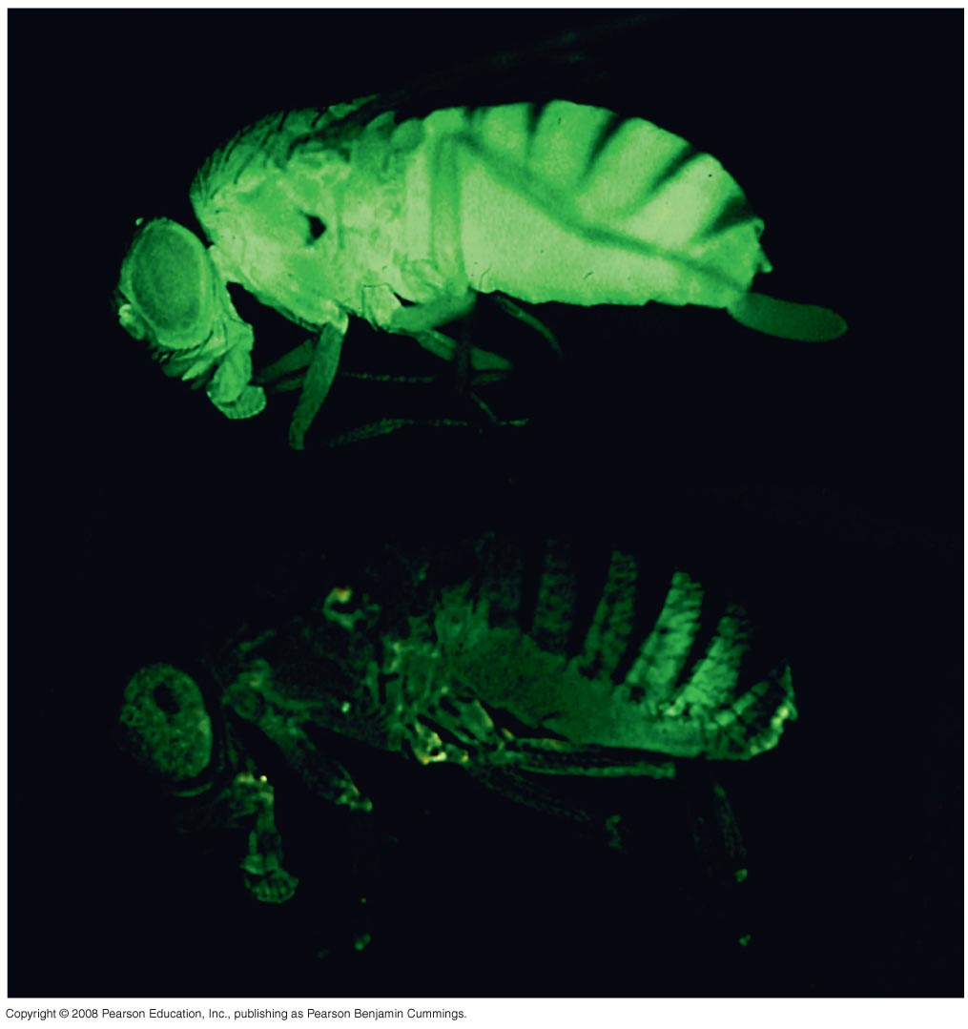
Fig. 43-4

Slide 75
Specific Defense – 3rd line
Also known as the immune system
Utilizes lymphocytes & antibodies
Four features of immune system
1. Specificity
2. Diversity
3. Self/nonself recognition
4. Memory

Slide 76
Specificity
Recognizes & eliminates antigens
Antigens are any foreign invader that trigger an immune response
- antibody generating

Slide 77
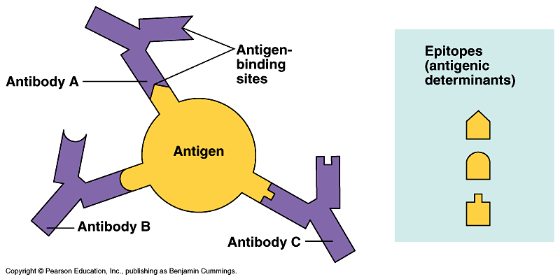

Slide 78
Diversity
Responds to millions of types of invaders

Slide 79
Self/Nonself Recognition
Is a problem for transplants
A breakdown here is an Autoimmune Disorder & results in attacking self cells

Slide 80
Memory
Remembers antigens previously encountered
Responds quicker & more effectively on 2nd or 3rd exposure

Slide 81
Acquired Immunity
Active Immunity
Body builds its own antibodies to fight invader
2 types
1. Natural as in chickenpox
2. Stimulated by a vaccine

Slide 82
Acquired Immunity
Passive
Antibodies given from one organism to another
2types
1. Take antibiotics
2. From mother to child
Immunity persists only as long as the antibodies are present

Slide 83
How specific immunity arises
Lymphocytes provide the specificity & diversity
1. originate from stem cells in marrow – mature elsewhere
ie. T-cells in thymus
B-cells in bone marrow

Slide 84
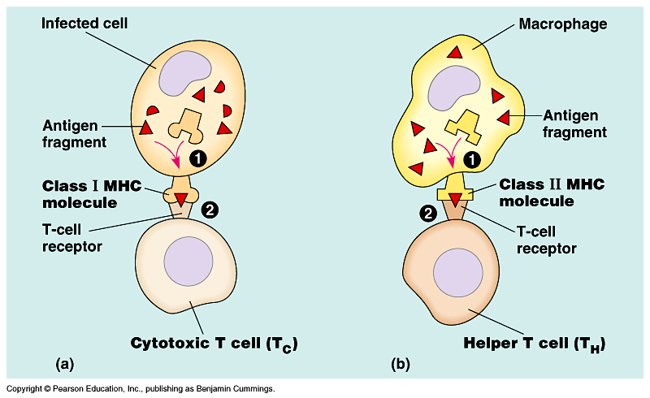

Slide 85
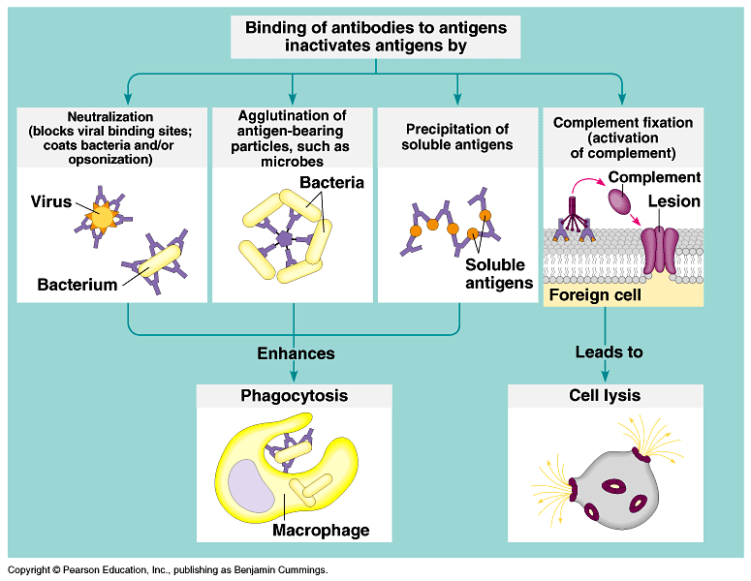

Slide 86
2. Travel through lymph vessels & concentrate in nodes & spleen
3. Antigen receptors on cell membrane

Slide 87
Antigens interact w/lymphocytes inducing immune response & memory (clonal selection)
Fig. 43.14 pg. 934

Slide 88
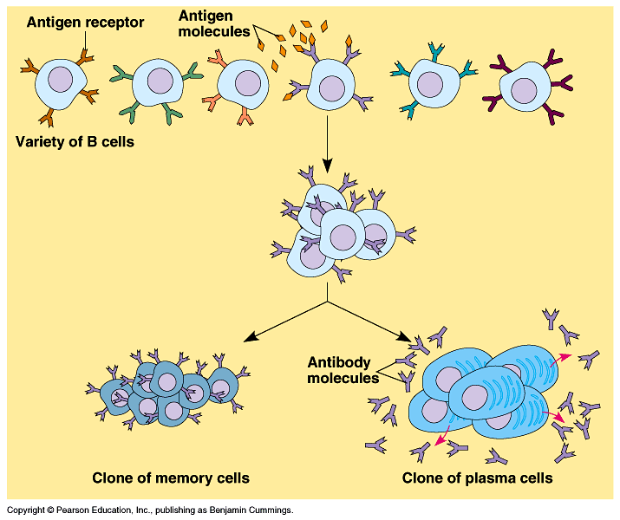

Slide 89
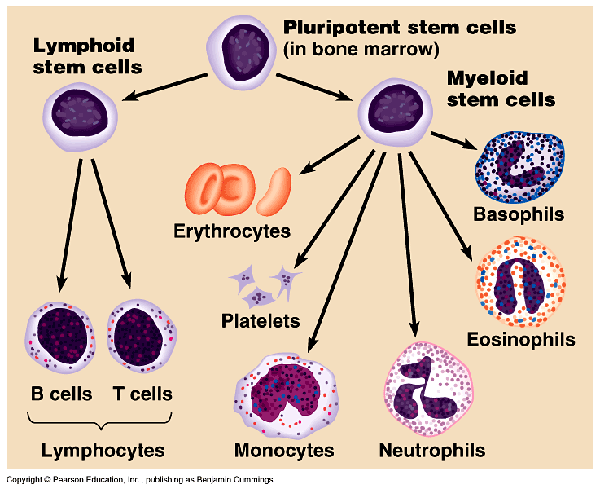

Slide 90
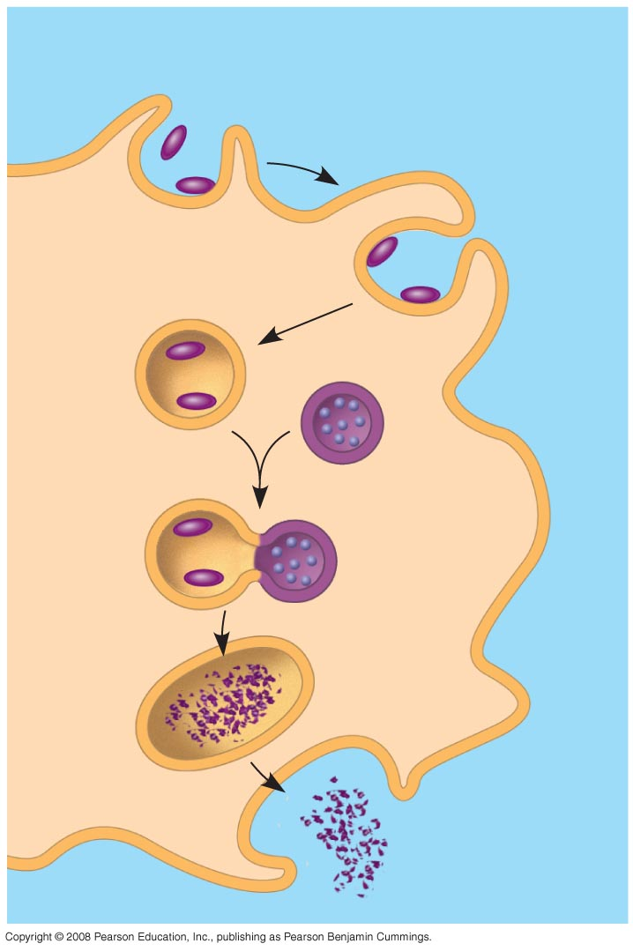
Fig. 43-3
Microbes
PHAGOCYTIC CELL
Vacuole
Lysosome
containing
enzymes

Slide 91
Immune Responses – 2 types
Humoral Immunity
Cell-Mediated

Slide 92
Humoral Immunity
- works on bacteria, viruses & toxins that are free in the body fluids (blood)
- produces antibodies
- uses B-cells

Slide 93
Cell – Mediated Immunity
- works on bacteria or viruses inside of cells
- also on Protists, parasites, worms, transplants, cancer cells (nonself cells)
- uses direct action of lymphocytes
- uses T-cells
Diagram pg. 942

Slide 97
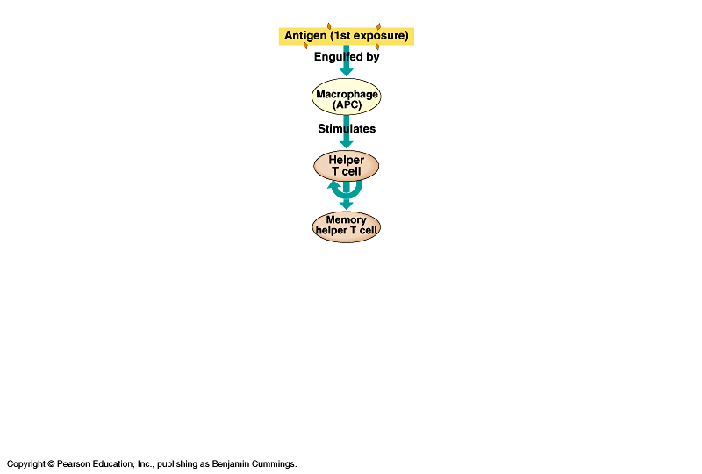

Slide 98
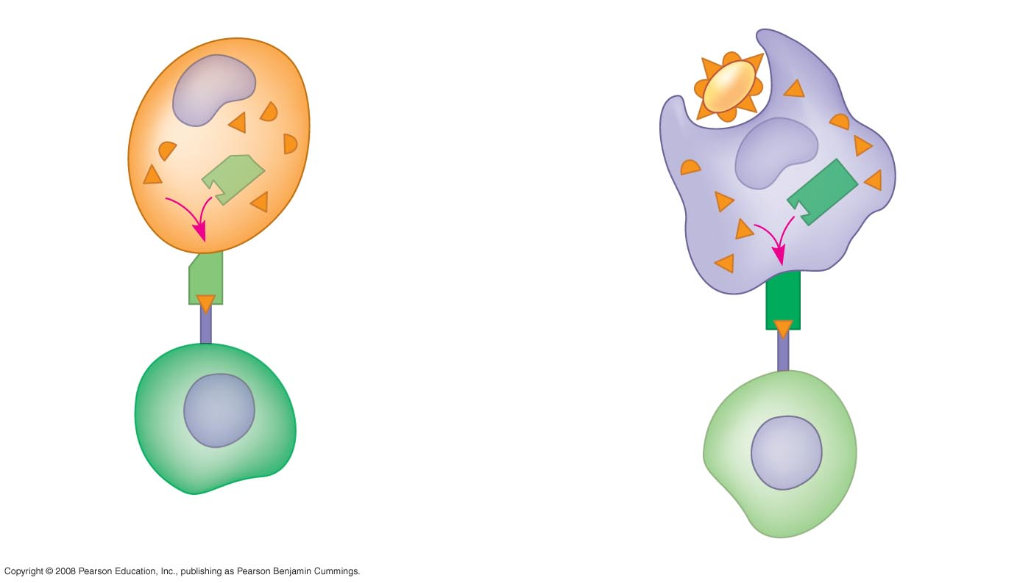
Fig. 43-12
Infected cell
Microbe
Antigen-
presenting
cell
1
Antigen
associates
with MHC
molecule
Antigen
fragment
Antigen
fragment
1
1
Class I MHC
molecule
Class II MHC
molecule
2
2
T cell
receptor
T cell
receptor
2
T cell
recognizes
combination
(a)
Cytotoxic T cell
(b)
Helper T cell

Slide 100
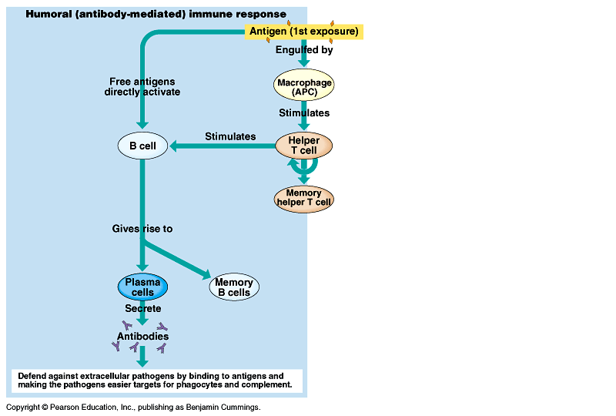

Slide 101
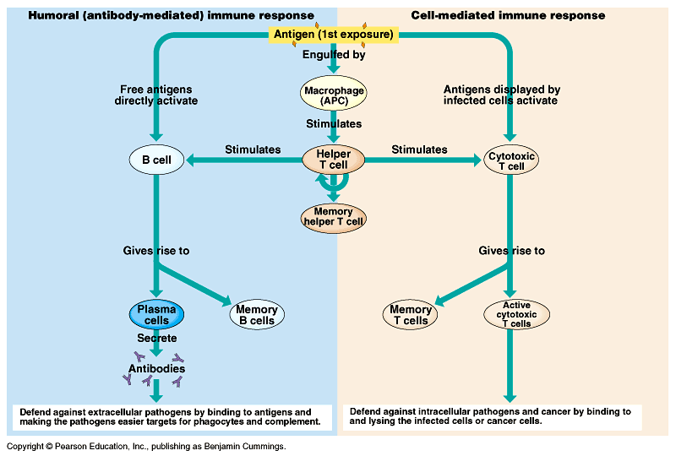

Slide 102
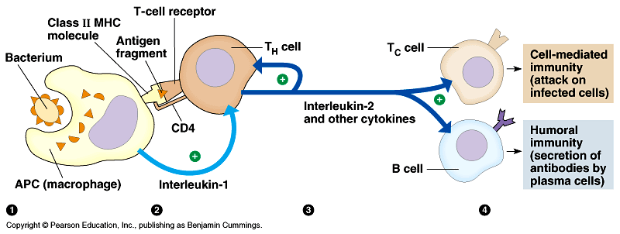
Role of Helper T Cells

Slide 103
Interleukins
Chemicals signal released by macrophages
Makes body supersensitive (aches and pain)
Call for more natural killer cells
Causes brain to increase body temperature
Increased temperature causes blood vessels to swell – pressure, throbbing, headache

Slide 104


Slide 105


Slide 106


Slide 107


Slide 108


Slide 109
Antigen/Antibody
Antigen – macromolecule that causes immune response
Antibody - Y-shaped quaternary protein
1. Called immunoglobulins
2. Antigen binding sites at tips – pg. 937
3. Types – IgM, IgA, IgG, IgB, IgE

Slide 111


Slide 112
Rh Factor
Protein on RBC’s
Rh⁺ means you have this protein
Rh⁻ means you don’t have it
Important during pregnancy – Why?

Slide 113
Mom is negative and baby positive
All is fine until delivery because baby’s red blood cells do not enter the mom
Upon delivery of child some + blood cells are introduced to mom
This triggers her immune system to produce Anti Rh antibodies and memory cells
Next baby would be a problem if mom is not given anti-Rh antibodies before delivering her next child

Slide 114
Why not the same problem with proteins for types A and B?
Anti – A antibodies and Anti – B antibodies are IgM
Anti Rh antibodies are IgG
IgM can’t fit across the membrane but IgG can

Slide 115
Disorders of Immune System
Autoimmune disease
- fails to recognize self
- lupus
- rheumatic fever

Slide 116
Disorders cont’d
Allergies
- hypersensitivity of defense
- similar to defense against some parasitic worms
- hayfever – IgE recognizes pollen as invader

Slide 117
Disorders cont’d
Immunodeficiency
- Depressed humoral or cell-mediated response
- Causes
a. cancer – Hodgkin's
b. genetic – missing a component of immunity
c. AIDS Acquired Immunodeficiency Syndrome

Slide 118
Disorders cont’d
- AIDS cause by HIV virus
a. infects cells with CD₄ receptors (but also needs the CCR₅ receptor for proper attachment)
- T-cells (including helper T’s)
- some B-cells
- some macrophages

Slide 119


Slide 120
AIDS cont’d
b. Immune system responds ok at first then as more HIV’s accumulate imm. sys. can’t keep up
c. See graph pg 951
↑ HIV
↓T-cells
d. Eventually imm. sys. can’t fight off invaders

Slide 121
HIV and CCR₅ receptors
Both CCR₅ and Cd₄ receptors are for inflammatory response
Some people are deficient in CCR₅ receptors (genotype cc)
CC Rapid HIV Cc slow HIV
Bubonic Plague in 1350 Ad – people with CCR5 deficiency were resistant
Why is this a promising area of research?
cc protection from HIV

Slide 123
Fig. 43-2
Pathogens
(microorganisms
and viruses)
INNATE IMMUNITY
Barrier defenses:
Skin
Mucous membranes
Secretions
•
Recognition of traits
shared by broad ranges
of pathogens, using a
small set of receptors
Internal defenses:
Phagocytic cells
Antimicrobial proteins
Inflammatory response
Natural killer cells
•
Rapid response
ACQUIRED IMMUNITY
Humoral response:
Antibodies defend against
infection in body fluids.
•
Recognition of traits
specific to particular
pathogens, using a vast
array of receptors
Cell-mediated response:
Cytotoxic lymphocytes defend
against infection in body cells.
•
Slower response

Slide 124
Fig. 43-3
Microbes
PHAGOCYTIC CELL
Vacuole
Lysosome
containing
enzymes

Slide 127
Role of Helper T Cells

