Slide 1
Plants

Slide 2
What is a plant?
Multicellular
Eukaryotic
Photosynthetic
Autotroph
Nearly all are terrestrial – some exceptions as in water lily

Slide 3
Evolution of plants
Ancestors – green algae (charophytes)
- contain chlorophyll a & b
- store food as starch
- cell walls composed of cellulose
- cytokinesis seen w/cell plate
- similar chloroplast structure
Notes:
Discuss algae

Slide 4
Evolution of plants cont’d
Movement from water to land – Why?
- more light
- CO₂ more abundant
- no competing life forms

Slide 5
Evolution of plants cont’d
Land Problem
- loss of water
- reproduction
Solution
- Cuticle & stomata
- Fert. Internal

Slide 6
Plant Taxonomy
Plant kingdom uses Division category rather than phyla
See chart pg. 605 fig. 29.7

Slide 7
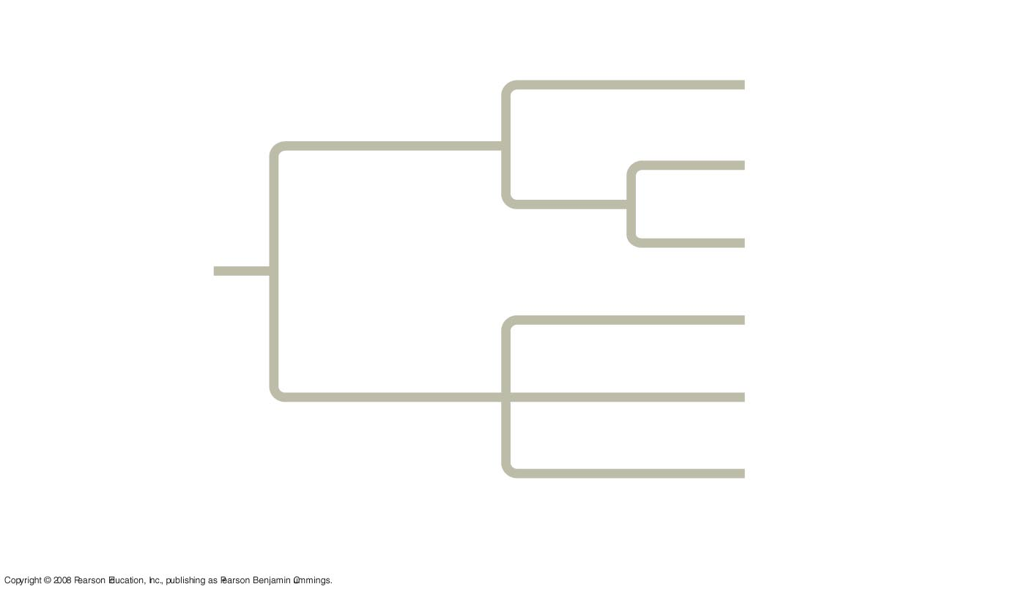
Fig. 26-5
Branch point
(node)
Taxon A
1.
Taxon B
Sister
taxa
Taxon C
ANCESTRAL
LINEAGE
Taxon D
Taxon E
Taxon F
Common ancestor of
taxa A–F
Polytomy

Slide 8
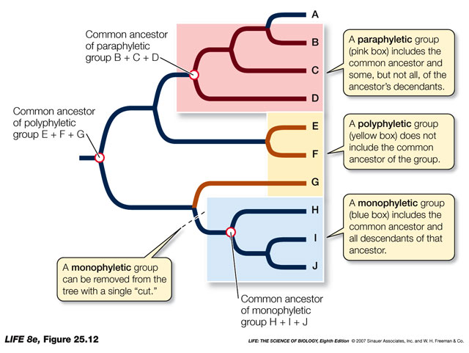

Slide 9
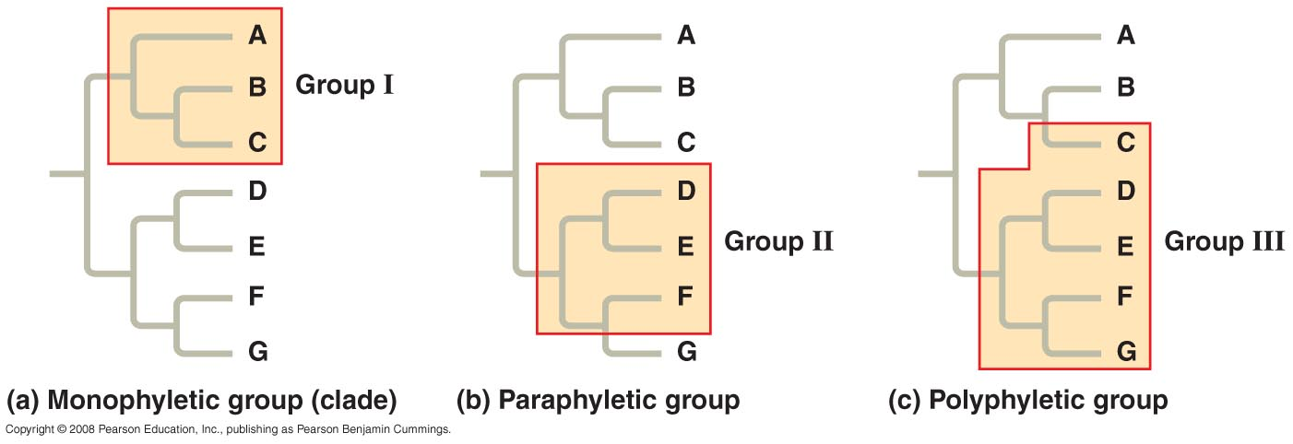

Slide 10
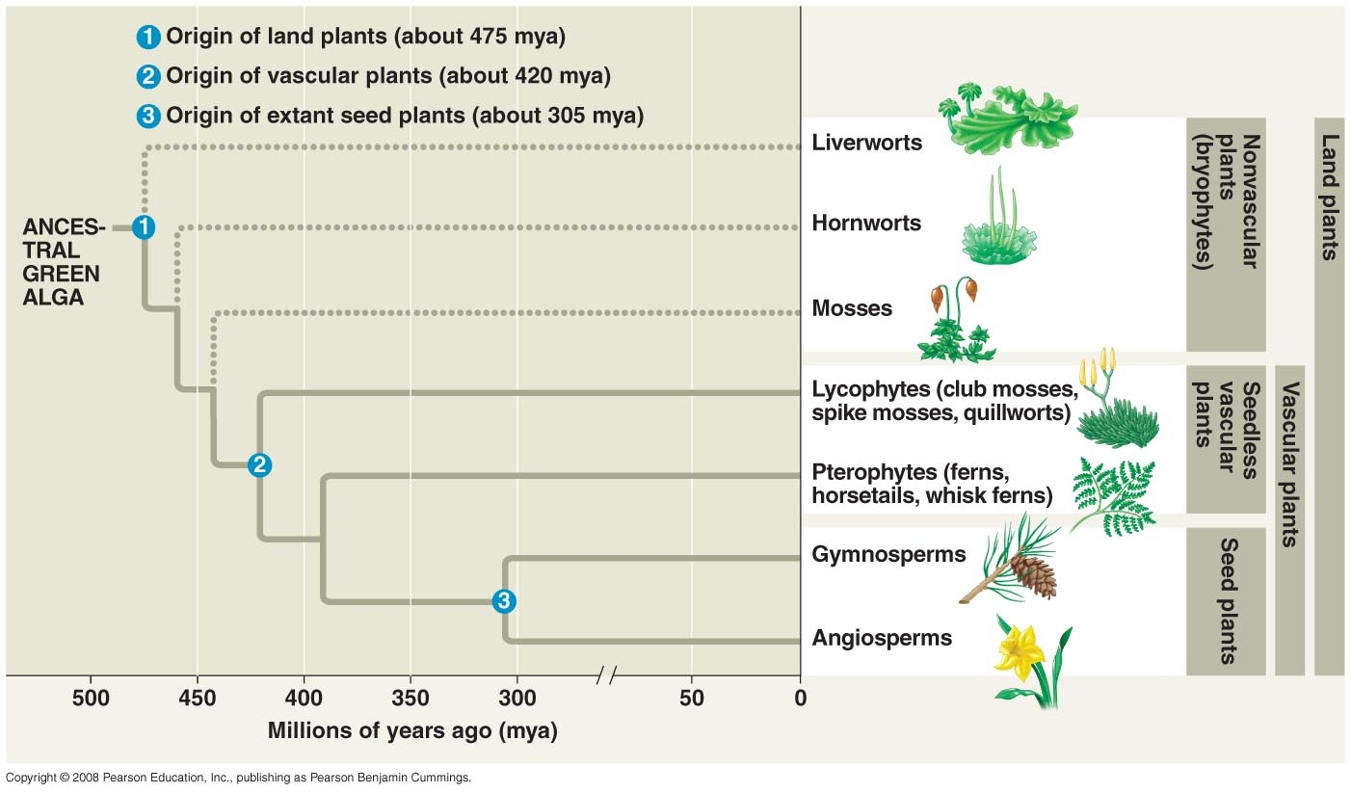

Slide 11
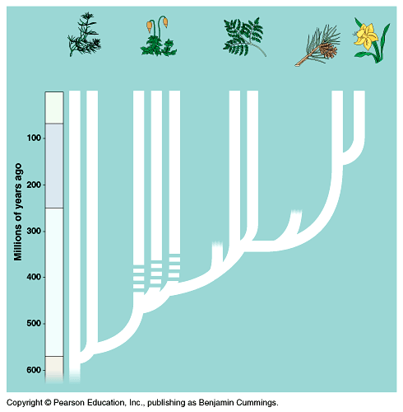

Slide 12
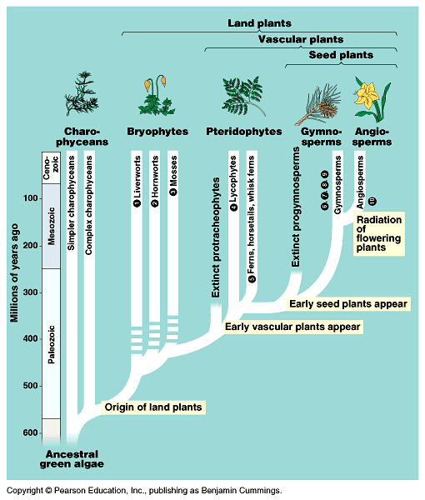

Slide 13
Plant Taxonomy cont’d
Bryophytes
non-vascular
mosses, liverworts, hornworts
Tracheophytes
vascular
all other plants

Slide 14
Taxonomy - Tracheophytes
Seedless vascular
- Pteridophyta
- ferns, horsetails
Seeds
- gymnosperms
- angiosperms

Slide 15
Taxonomy - Gymnosperms
Unprotected – naked seeds
Produce cones - conifers
Pines, cycads

Slide 16
Taxonomy - Angiosperms
Flowering plants
Protected seeds
Most plants

Slide 17
Taxonomy - Angiosperms
Monocots
- one cotyledon
- grasses
- lilies
- orchids
- parallel veins
- parts in 3’s
- no woody growth
Eudicots
- two cotyledons
- most trees
- shrubs
- herbs
- net-like veins
- parts in 4’s or 5’s
- woody growth

Slide 18
Detailed Divisions

Slide 19
Bryophyta
No vascular tissues – xylem & phloem
Lack true leaves, stems & roots
Contain rhizoids
- anchor plant to substrate
- grow laterally
Small leaf-like structures for photosynthesis
No specialized cells

Slide 20
Bryophyta
Absorb H2O from above ground structures
Grow best in moist shady places
Short plant
Gametophyte generation is dominant life form
Asexual rep. common
Sexual rep. requires water
Moss life cycle pg.607 fig. 29.8

Slide 21
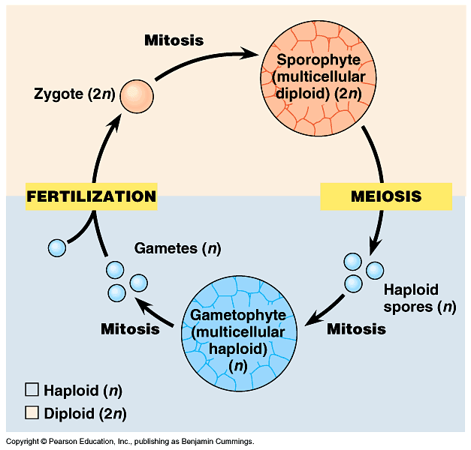
Alternation of Generation

Slide 24
Inter-, intra-
The prefix inter- means between or among. The prefix intra- means within. So, for example, an interstate highway is a highway that goes between or among states, while an intrastate highway is one that exists only within a single state.

Slide 25
Redraw the following phylogeny assuming bryophytes are a monophyletic group in which liverworts diverged first.

Slide 27
liverworts
hornworts
moss
1
2
The rest of the diagram is the same

Slide 28
Alternation of Generation

Slide 30
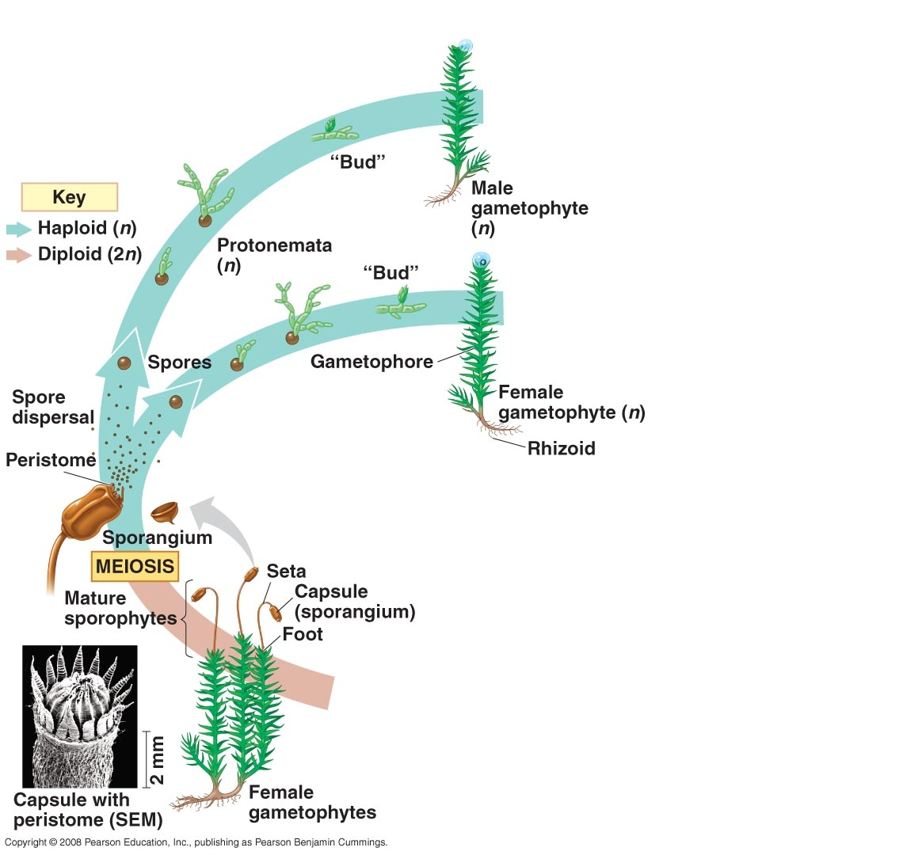

Slide 31
Homosporous vs. Heterosporous
Moss is _________

Slide 32
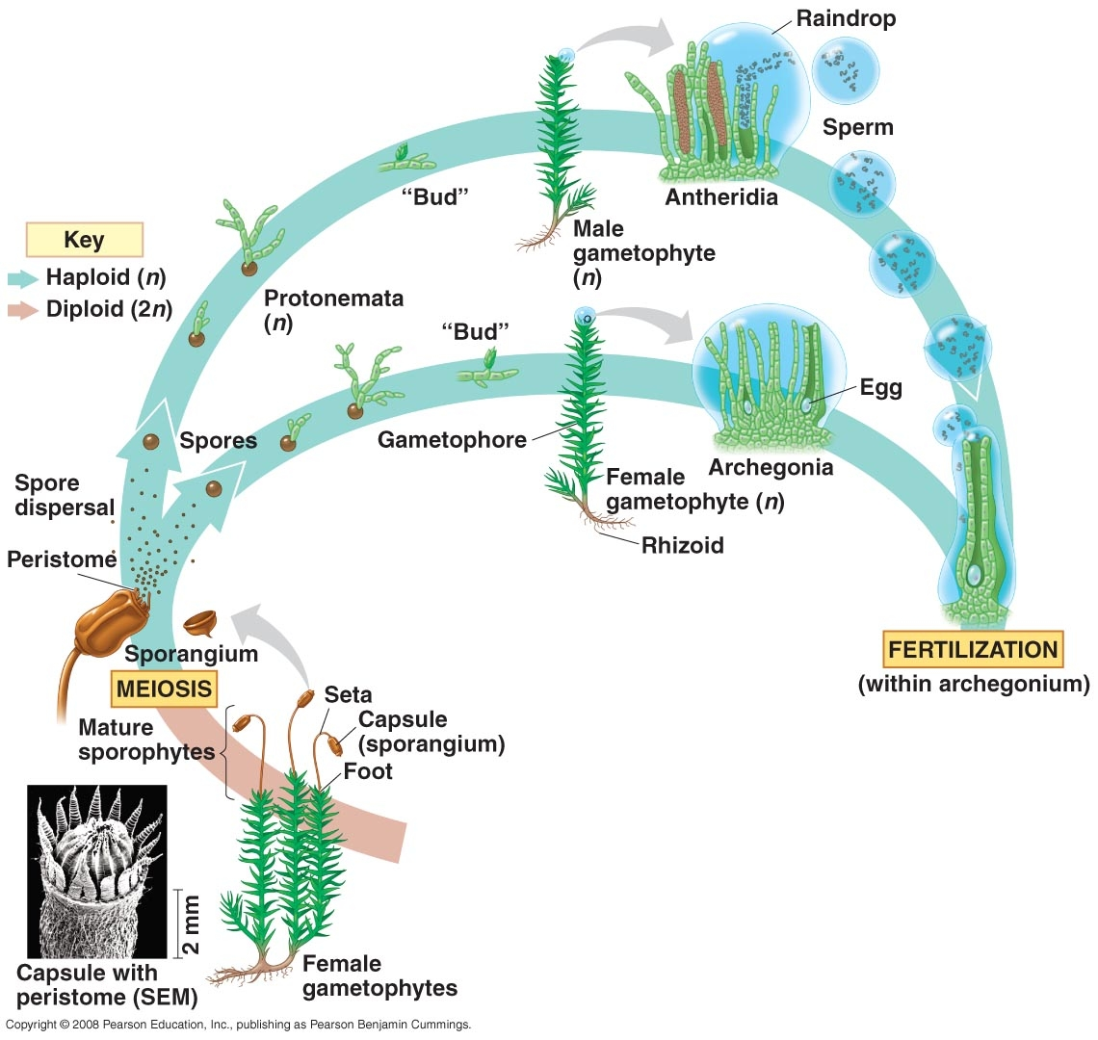

Slide 33
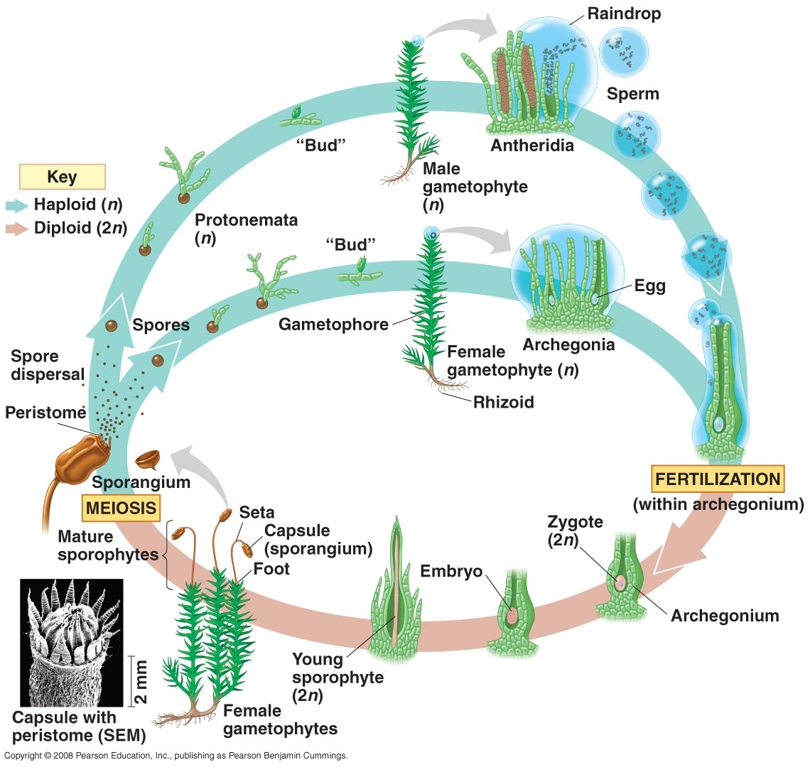

Slide 34
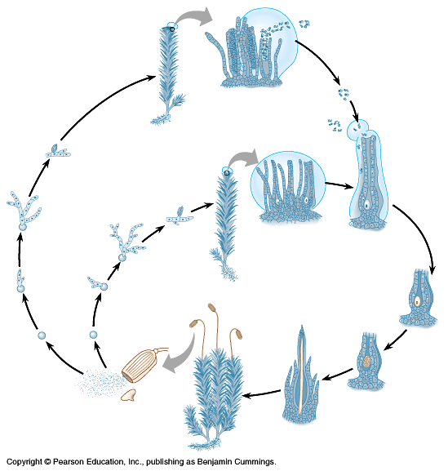

Slide 35
Tracheophyta - vascular plants
Roots specialized for absorption
Leaves – many cells thick & specialized for p-syn
Vascular system
- xylem – transports water & ions
made of tracheid cells
- phloem – transports p-syn products
made of sieve cells

Slide 36
Tracheophyta
Sporophyte generation is dominant life form (in seed plants – gametophyte is microscopic)
Development of seed (except fern)
Seed Parts:
seed coat
embryo
nutrition

Slide 37
Seedless Vascular Plants
Ferns & horsetails
Most primitive vascular plants
Fern life cycle pg 611 fig. 29.13
Dependent on H₂O
Gametophyte visible
Most ferns are homosporous

Slide 38
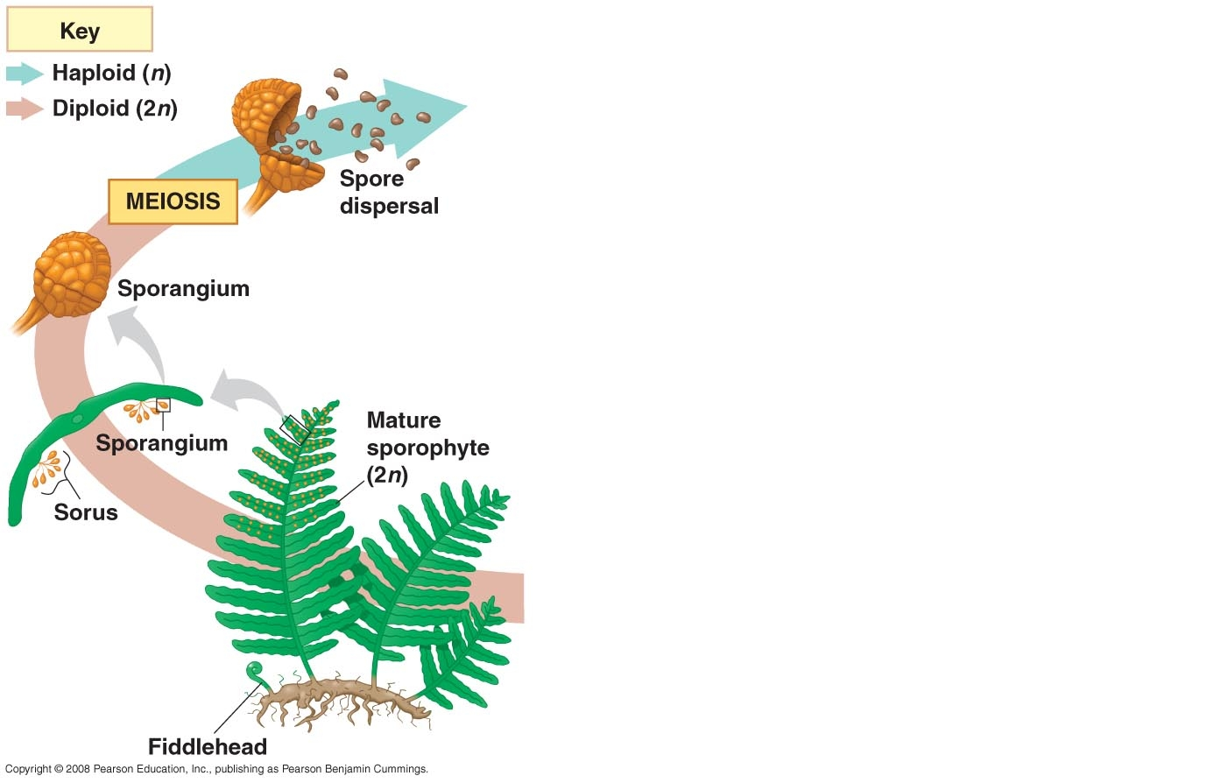

Slide 39
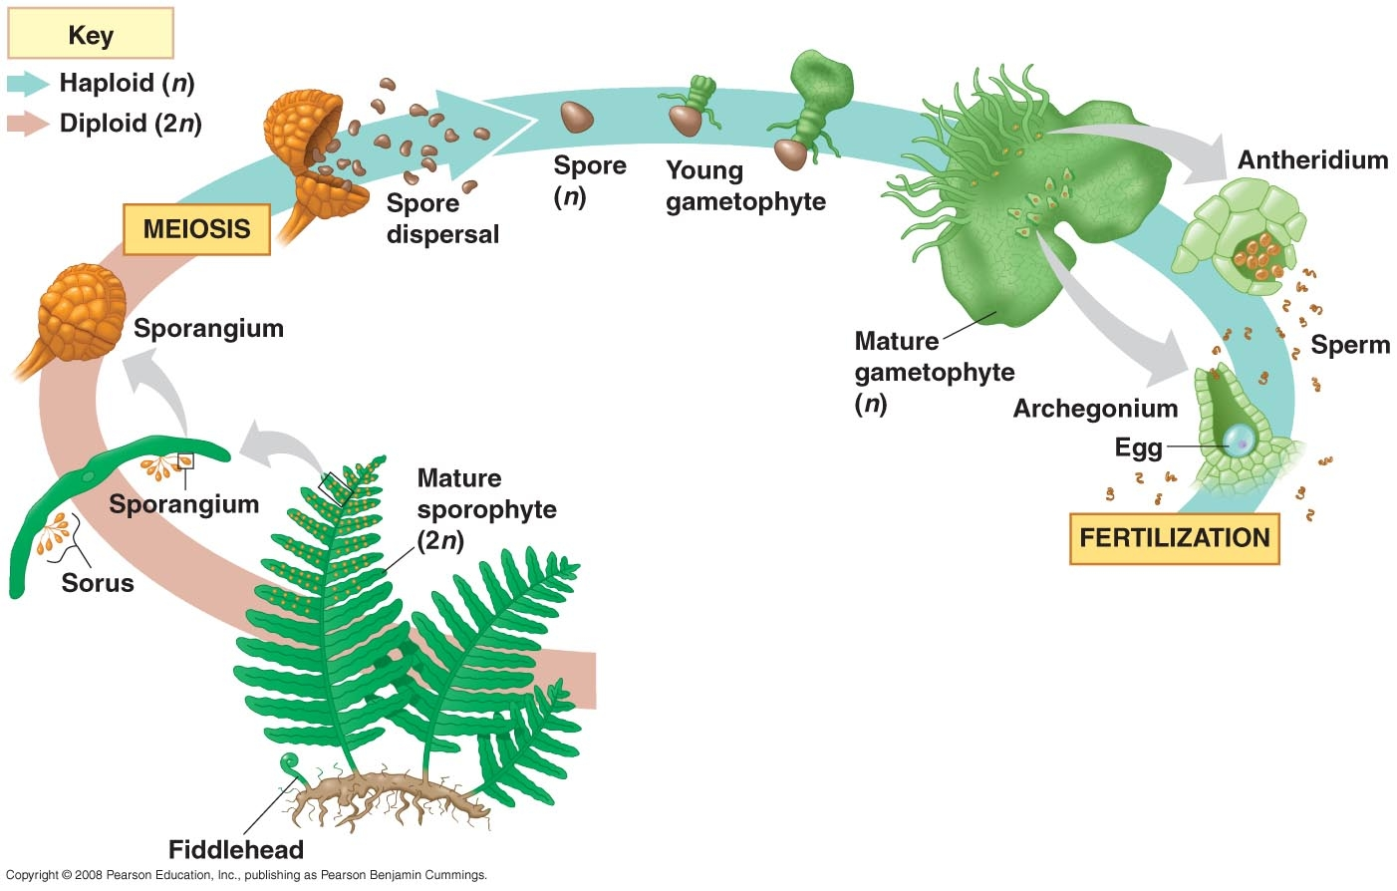

Slide 40
Homosporous vs. Heterosporous
Fern is _________

Slide 41
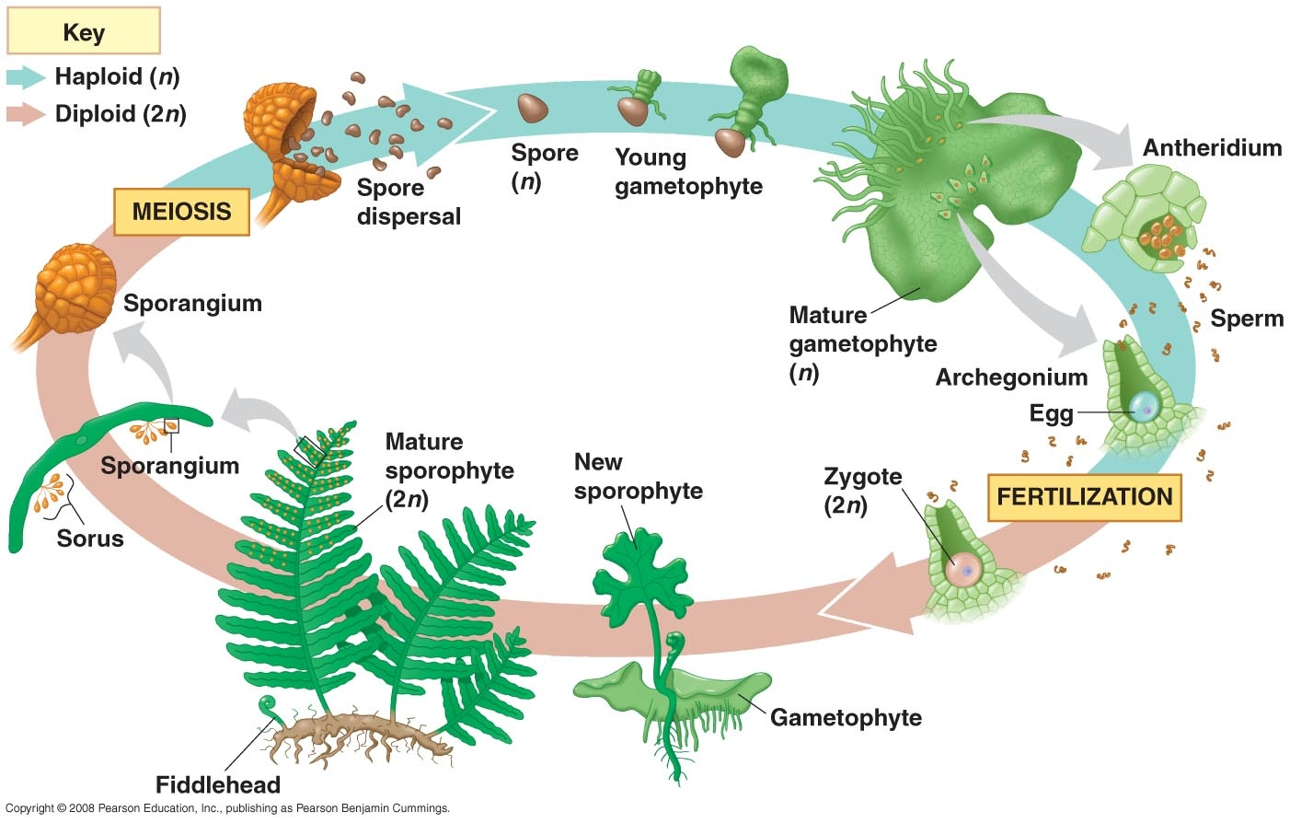

Slide 42
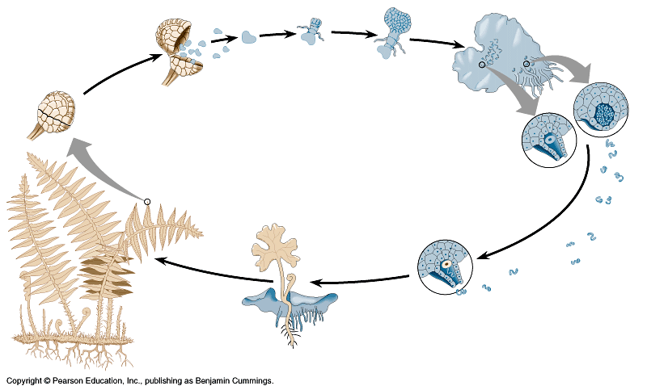

Slide 43
Seeded vascular plants
Gymnosperms
Angiosperms

Slide 44
Gymnosperms
Gametophyte generation greatly reduced
Pine life cycle page 624 fig. 30.6

Slide 45
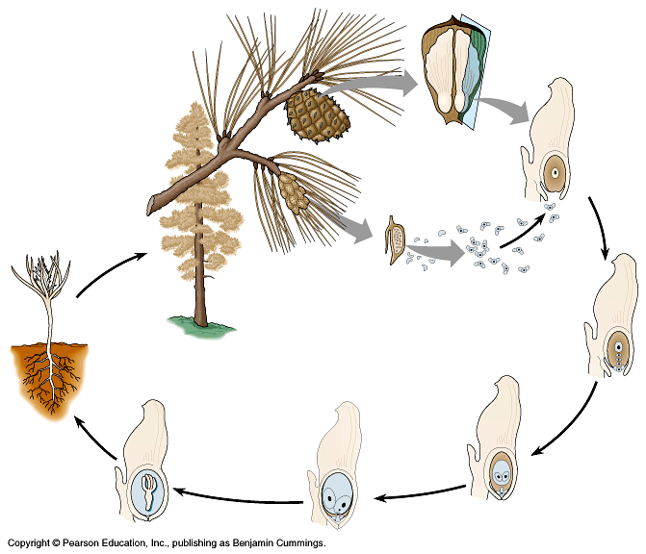

Slide 46
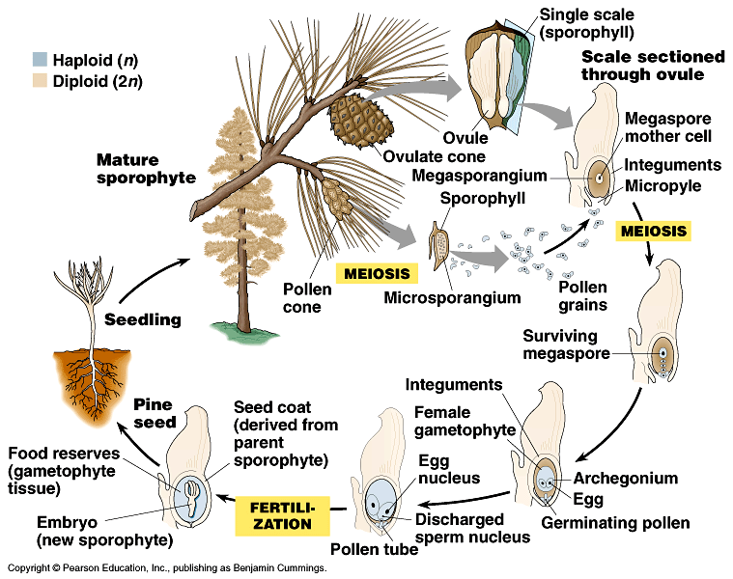

Slide 47
Angiosperms
Flowering plants
90% of earths plants
Protected seeds
Flower parts diagram
Life cycle page 627 fig. 30.10

Slide 48
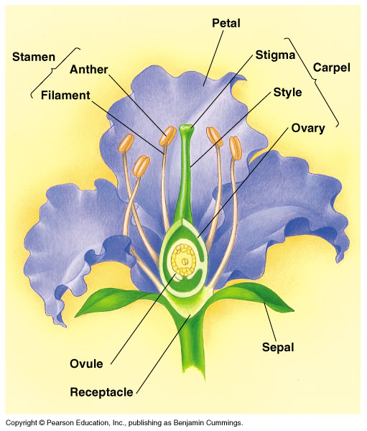

Slide 49
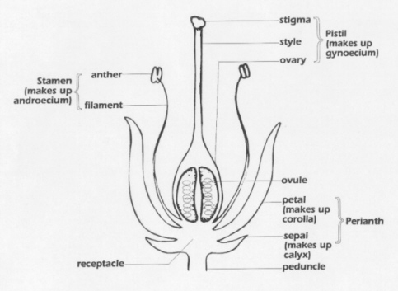

Slide 51
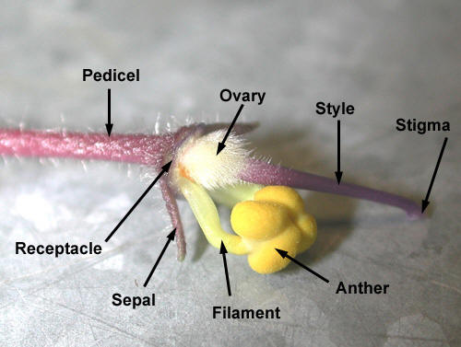
A
B
C
D
E
F
H
G

Slide 53
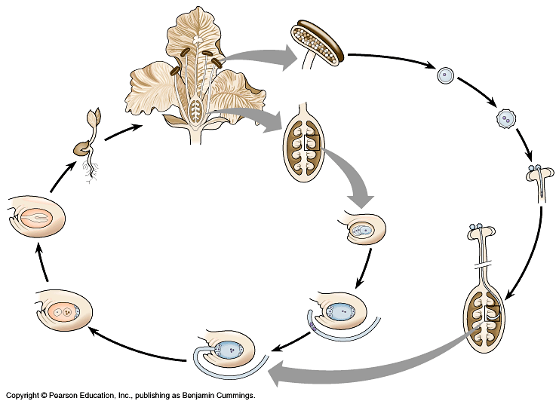

Slide 54
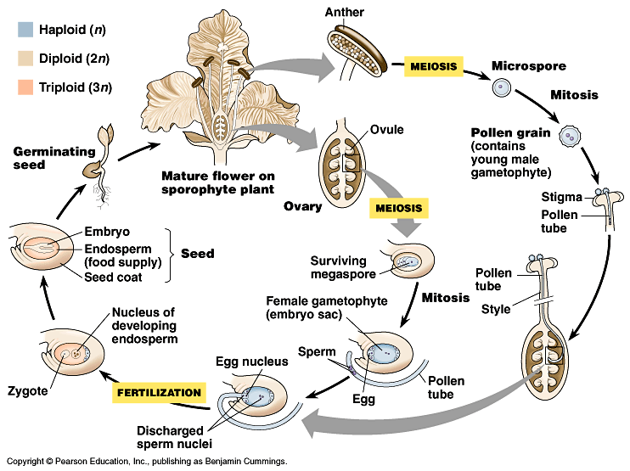

Slide 55
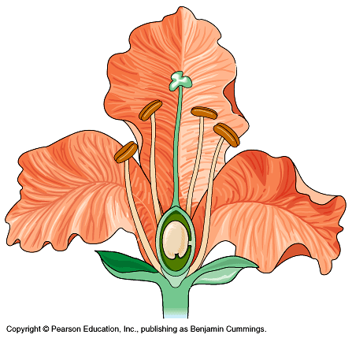

Slide 56
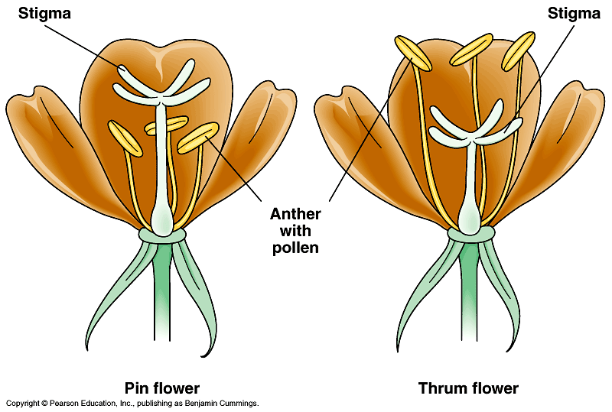

Slide 57
Pin and Thrum
Two types of flowers on different individuals
Thrums – short styles and long stamens
Pins – long styles an short stamens
Insects collect pollen on different parts of their body so thrum pollen is deposited on pin stigmas and vice versa
Increases variation

Slide 58
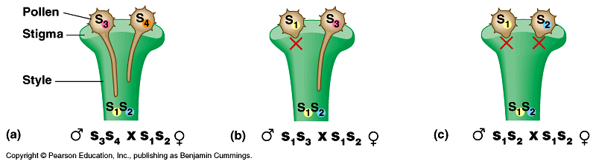
Self- incompatibility
S- genes control self recognition
Self recognition blocks pollen tube growth

Slide 59
Angiosperm Life Cycle
Mature sporophyte w/flower
Pollen carried to stigma
- cross pollination – most
- self pollination – some
Pollen grain germinates producing pollen tube (in style)
Two sperm enter ovule

Slide 60
Angiosperm Life Cycle cont’d
Double fertilization
- 1 sperm joins egg → zygote
- 1 sperm fuses w/2 polar nuclei → 3n endosperm for nutrition
Ovule → seed coat
Zygote → embryo → mature sporophyte
Ovary → fruit

Slide 61
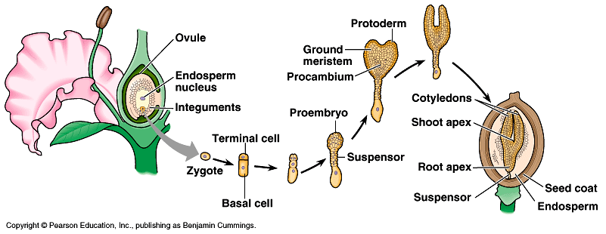

Slide 62
Why Angiosperm Success?
Protected ovule
Insect pollination
- more specific
- less waste
Lure insects
- colorful petals
- nectars
- fruit

Slide 63
Success
Defensive techniques
- toxins
- bad taste – noxious
- thorns
- i.e. nicotine, caffeine, mustard

Slide 64
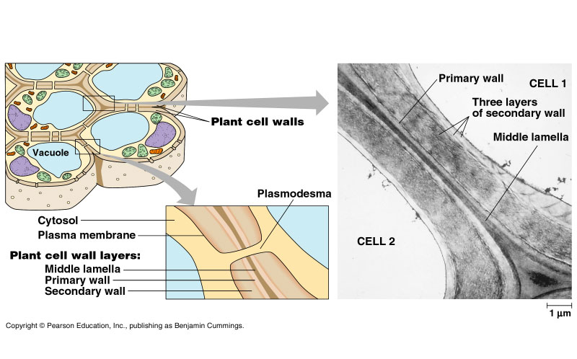
Review – plant cell junctions

Slide 65
Know leaf diagram pg 751

Slide 66
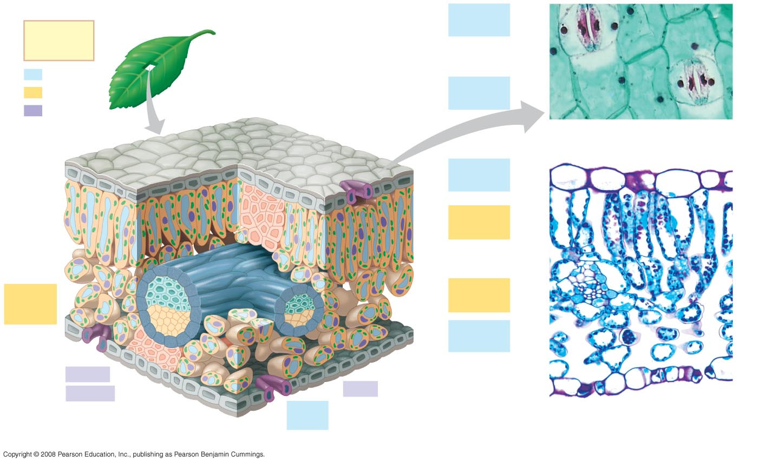
Fig. 35-18
Guard
cells
Key
to labels
Stomatal
pore
Dermal
50 µm
Ground
Epidermal
cell
Vascular
Cuticle
Sclerenchyma
fibers
Stoma
(b)
Surface view of a spiderwort
(Tradescantia) leaf (LM)
Upper
epidermis
Palisade
mesophyll
Bundle-
sheath
cell
Spongy
mesophyll
Lower
epidermis
100 µm
Xylem
Cuticle
Phloem
Vein
Guard
cells
Vein
Air spaces
Guard cells
(a) Cutaway drawing of leaf tissues
(c)
Cross section of a lilac
(Syringa)) leaf (LM)

Slide 67
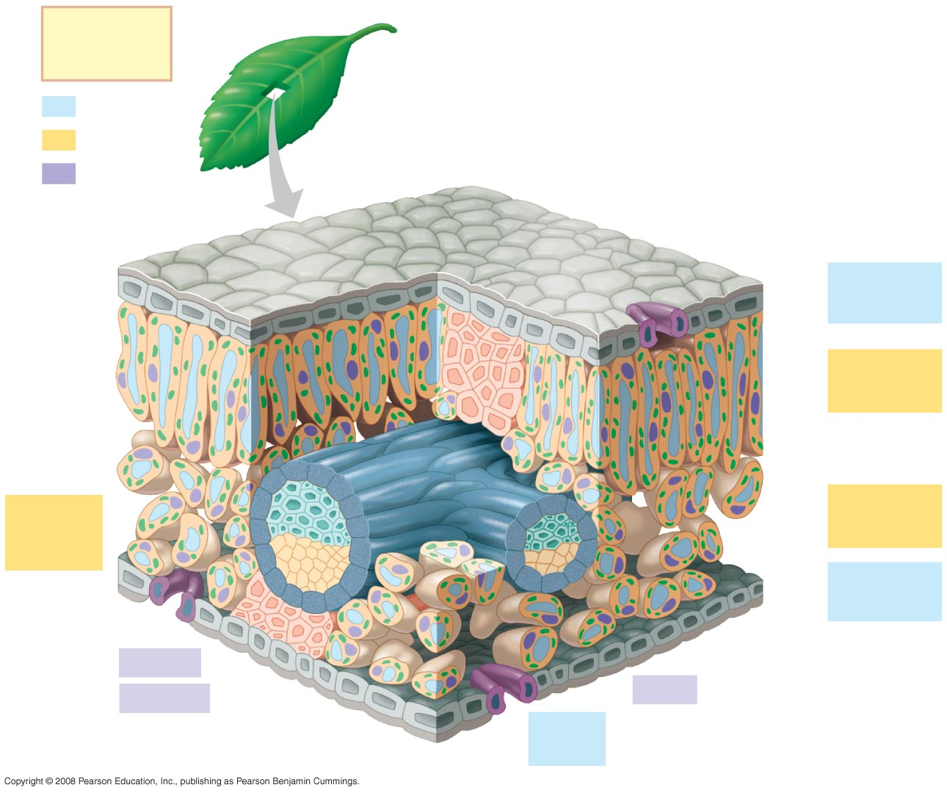
Fig. 35-18a
Key
to labels
Dermal
Ground
Cuticle
Sclerenchyma
fibers
Vascular
Stoma
Upper
epidermis
Palisade
mesophyll
Bundle-
sheath
cell
Spongy
mesophyll
Lower
epidermis
Xylem
Cuticle
Phloem
Vein
Guard
cells
(a) Cutaway drawing of leaf tissues

Slide 68
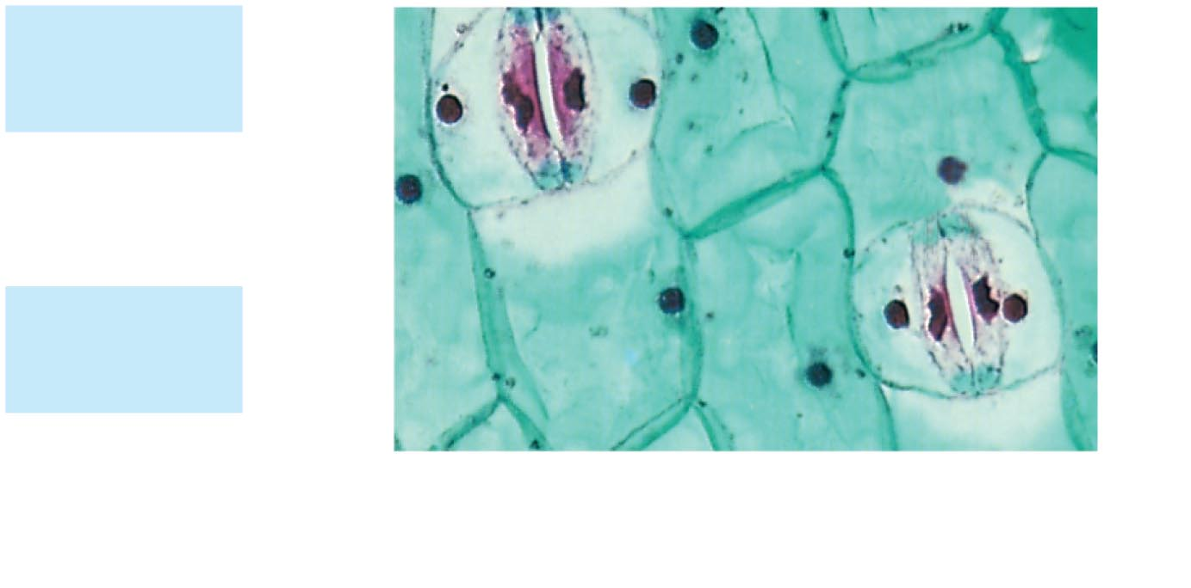
Fig. 35-18b
Guard
cells
Stomatal
pore
50 µm
Epidermal
cell
(b)
Surface view of a spiderwort
(Tradescantia) leaf (LM)

Slide 69
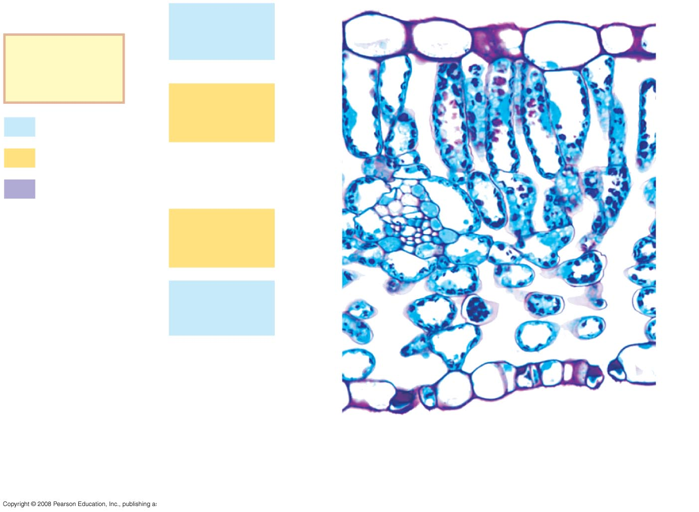
Fig. 35-18c
Upper
epidermis
Key
to labels
Palisade
mesophyll
Dermal
Ground
Vascular
Spongy
mesophyll
Lower
epidermis
100 µm
Vein
Air spaces
Guard cells
(c)
Cross section of a lilac
(Syringa) leaf (LM)

Slide 70
Cell types
Parenchyma cells
Collenchyma cells
Schlerenchyma cells

Slide 71
Parenchyma cells
Typical plant cell
Primary cell wall – no secondary wall
Least specialized – perform all functions

Slide 72
Collenchyma cells
Thicker primary wall – no secondary
Uneven thickness for support and growth (allows for support without constraint for growth)
Young plants have lots of collenchyma

Slide 73
Schlerenchyma cells
Thick secondary walls with lignin
Specialized for support and transport
Tracheid cells are schlerenchyma
Mature cells
Can’t elongate
Most are dead

Slide 74
Structure & Growth
Primary Growth – initiated by apical meristem (tips of roots and buds of shoots)
Secondary Growth – increase in girth (diameter) of stems & roots especially in woody, perennial eudicots initiated by lateral meristems

Slide 75
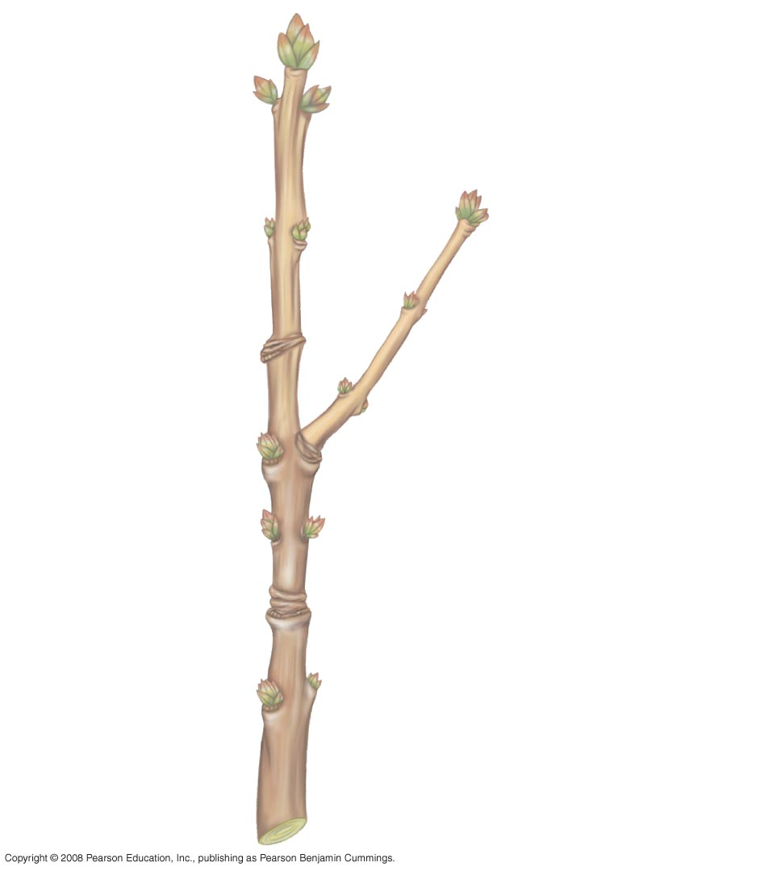
Fig. 35-12
Apical bud
Bud scale
Axillary buds
This year’s growth
(one year old)
Leaf
scar
Bud
scar
Node
One-year-old side
branch formed
from axillary bud
near shoot tip
Internode
Last year’s growth
(two years old)
Leaf scar
Stem
Bud scar left by apical
bud scales of previous
winters
Growth of two
years ago
(three years old)
Leaf scar

Slide 76
Primary Growth
In herbaceous (nonwoody) plants this produces all of the plant body.
Results form apical meristem
Shoots system – aerial part of plant: stems and leaves including flower

Slide 77
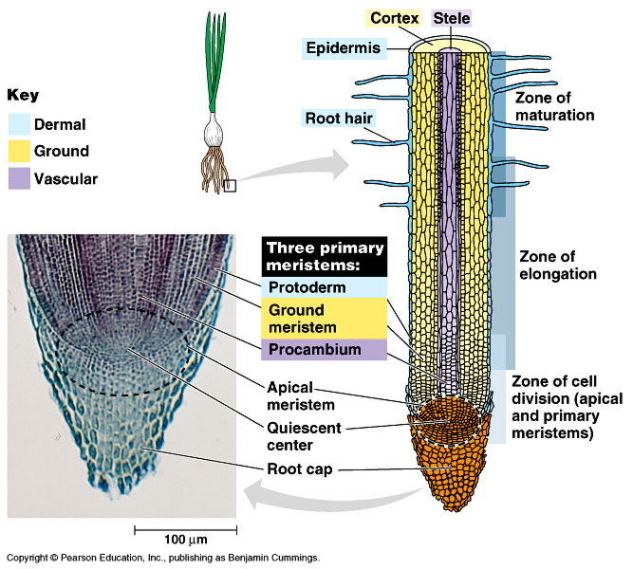
Root Structure

Slide 78
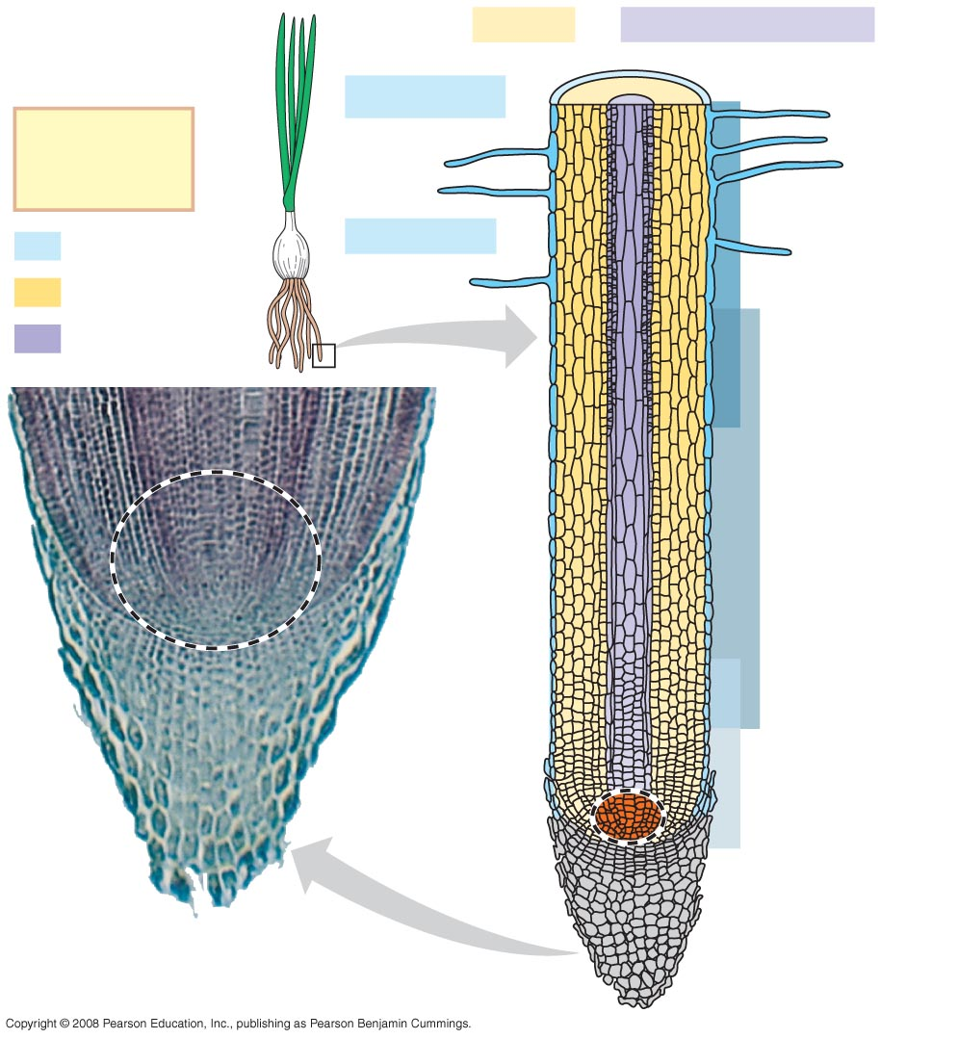
Fig. 35-13
Cortex
Vascular cylinder
Epidermis
Key
to labels
Zone of
differentiation
Dermal
Root hair
Ground
Vascular
Zone of
elongation
Apical
meristem
Zone of cell
division
Root cap
100 µm

Slide 79
Secondary Growth
Caused by lateral meristems aka vascular cambium and cork cambium
Vascular cambium adds layers of vascular tissue called secondary xylem (wood) and secondary phloem.
Cork cambium replaces the epidermis with periderm which is thicker and tougher.

Slide 80
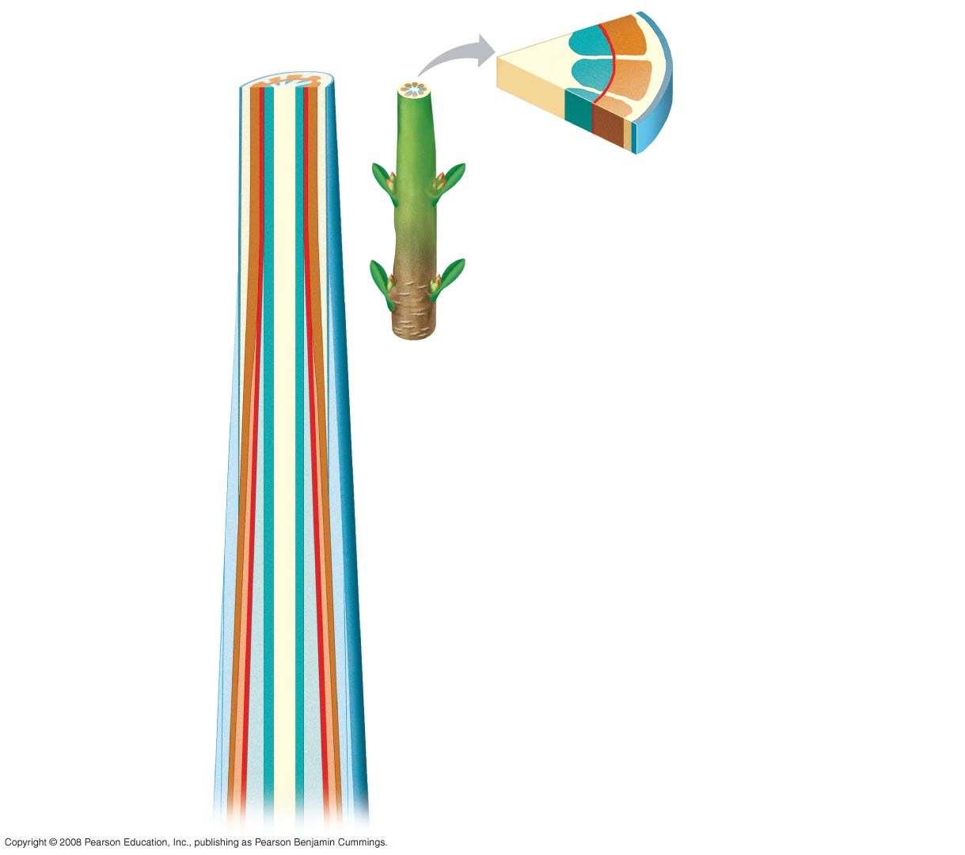
Fig. 35-19a1
(a)
Primary and secondary growth
in a two-year-old stem
Pith
Primary xylem
Vascular cambium
Epidermis
Primary phloem
Cortex
Cortex
Primary phloem
Epidermis
Vascular cambium
Primary xylem
Pith
Periderm (mainly
cork cambia
and cork)
Secondary phloem
Secondary
xylem

Slide 81
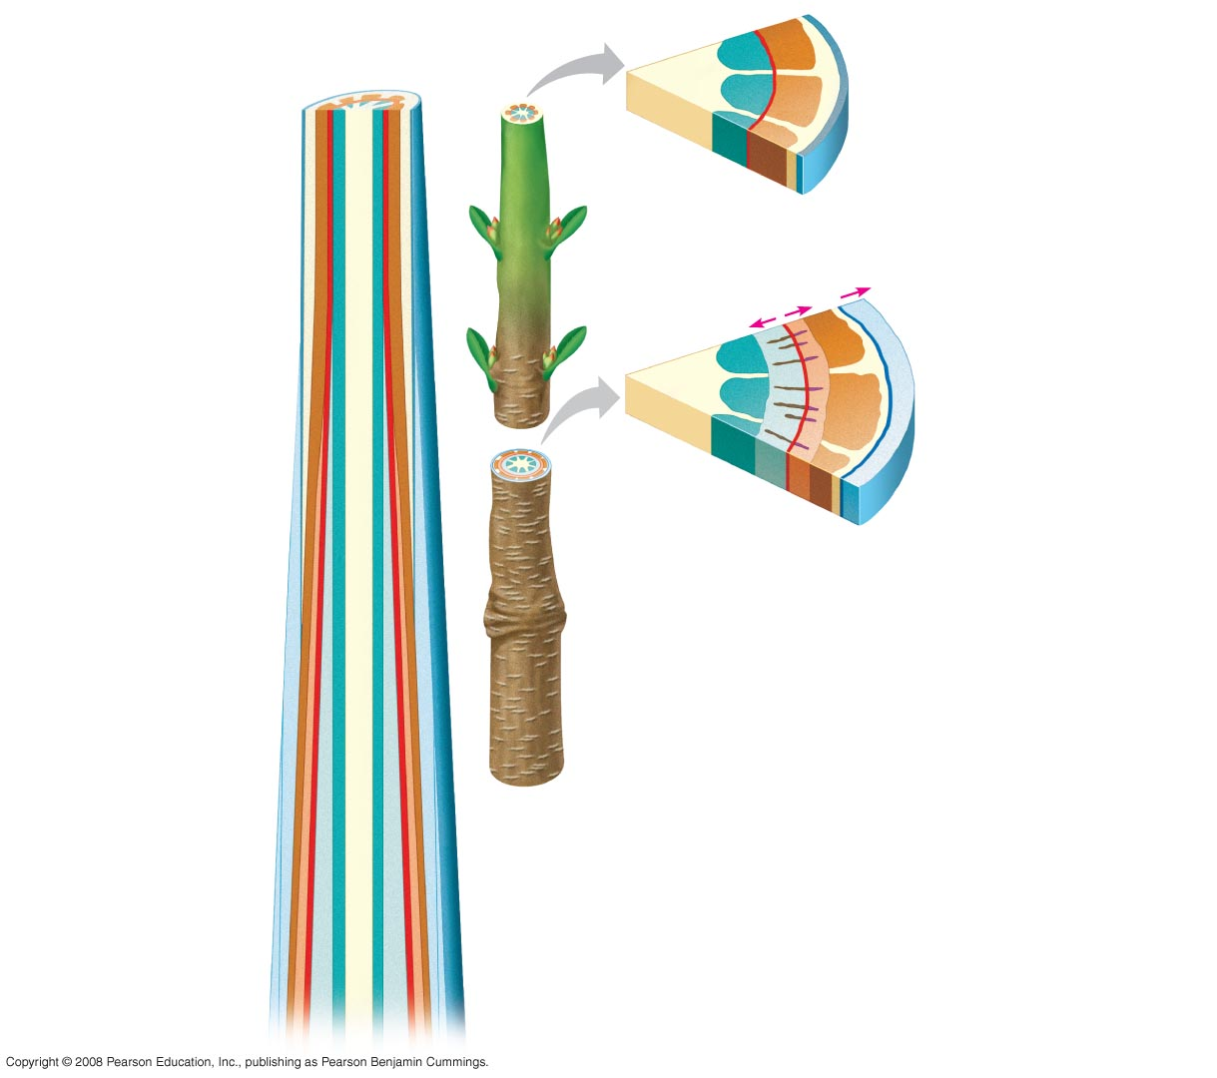
Fig. 35-19a2
(a)
Primary and secondary growth
in a two-year-old stem
Pith
Primary xylem
Vascular cambium
Epidermis
Primary phloem
Cortex
Cortex
Primary phloem
Epidermis
Vascular cambium
Growth
Vascular ray
Primary xylem
Pith
Secondary xylem
Secondary phloem
First cork cambium
Cork
Periderm (mainly
cork cambia
and cork)
Secondary phloem
Secondary
xylem

Slide 82
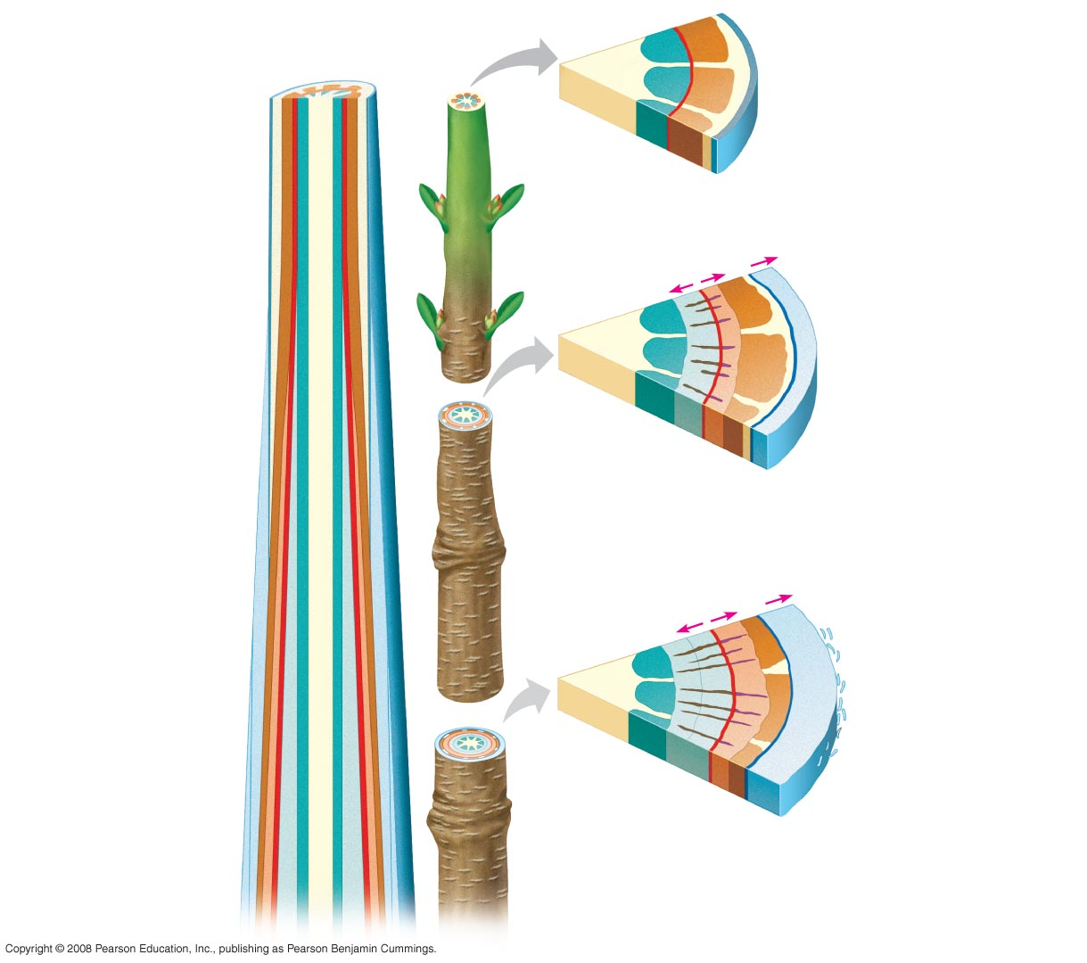
Fig. 35-19a3
(a)
Primary and secondary growth
in a two-year-old stem
Pith
Primary xylem
Vascular cambium
Epidermis
Primary phloem
Cortex
Cortex
Primary phloem
Epidermis
Vascular cambium
Growth
Vascular ray
Primary xylem
Pith
Secondary xylem
Secondary phloem
First cork cambium
Cork
Periderm (mainly
cork cambia
and cork)
Most recent cork
cambium
Cork
Secondary phloem
Bark
Layers of
periderm
Secondary
xylem

Slide 83
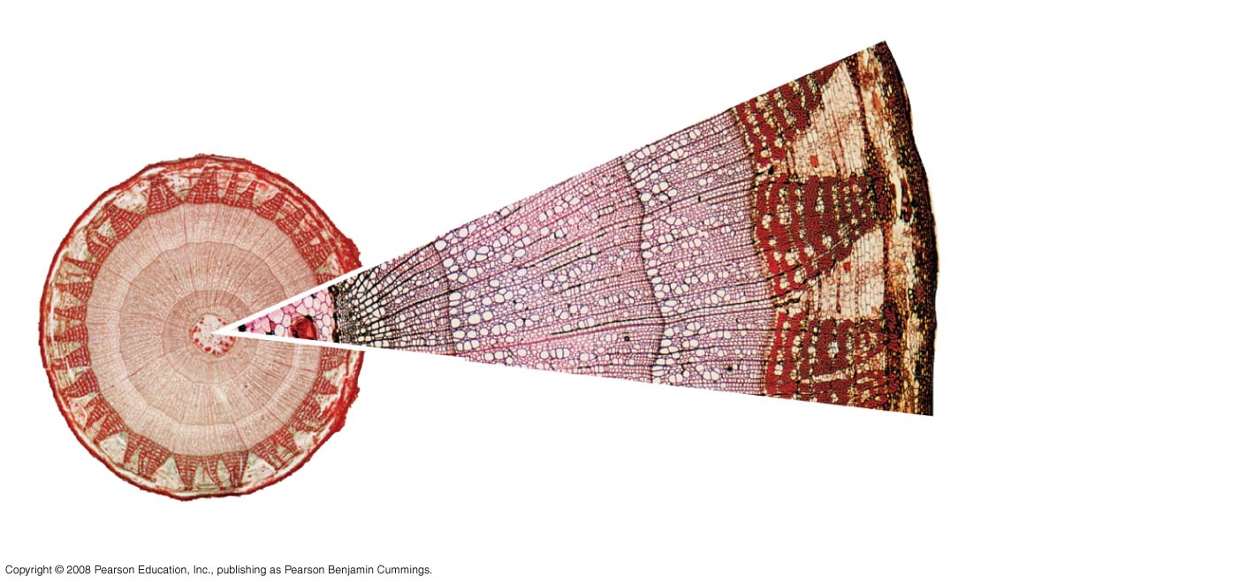
Fig. 35-19b
Secondary phloem
Bark
Vascular cambium
Late wood
Cork
cambium
Secondary xylem
Periderm
Early wood
Cork
0.5 mm
Vascular ray
Growth ring
(b)
Cross section of a three-year-
old Tilia (linden) stem (LM)
0.5 mm

Slide 84
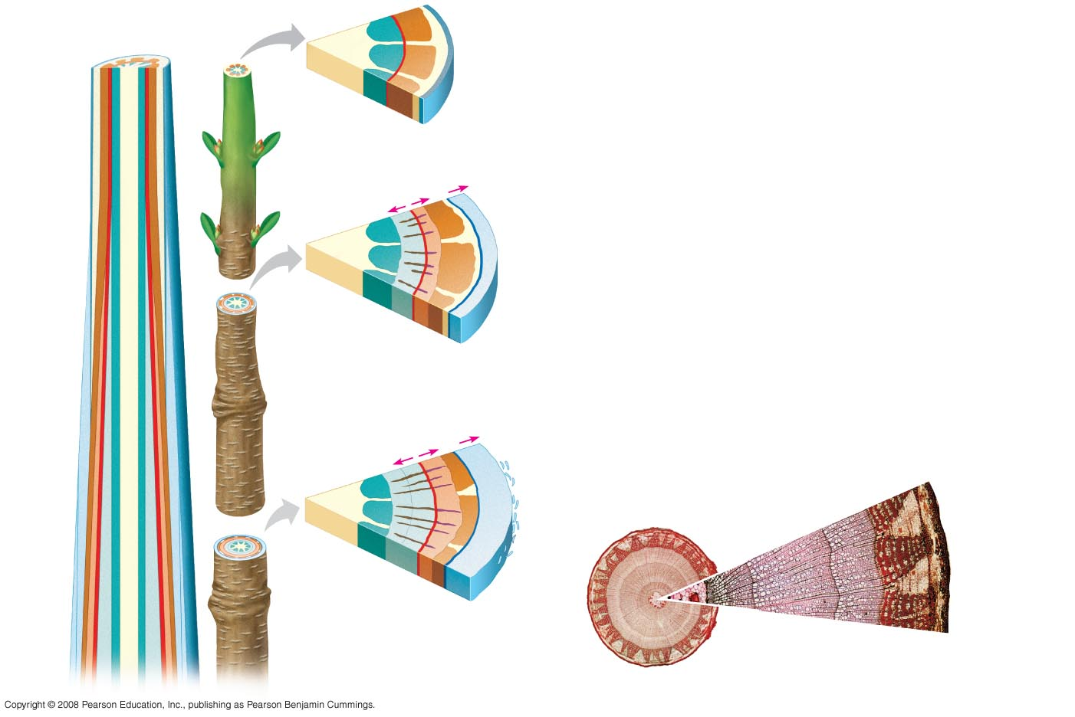
Fig. 35-19
(a)
Primary and secondary growth
in a two-year-old stem
Epidermis
Pith
Cortex
Primary xylem
Primary
phloem
Vascular cambium
Epidermis
Vascular
cambium
Primary phloem
Cortex
Primary
xylem
Growth
Pith
Vascular
ray
Primary
xylem
Secondary xylem
Vascular cambium
Secondary phloem
Primary phloem
Cork
First cork cambium
Periderm
(mainly cork
cambia
and cork)
Growth
Secondary phloem
Bark
Vascular cambium
Cork
cambium
Primary
phloem
Secondary xylem
Late wood
Early wood
Periderm
Secondary
phloem
Secondary
Xylem (two
years of
production)
Cork
Vascular
cambium
Secondary
xylem
Vascular cambium
0.5 mm
Secondary phloem
Bark
Primary
xylem
Most recent
cork cambium
Cork
Layers of
periderm
Vascular ray
Growth ring
(b)
Cross section of a three-year-
old Tilia (linden) stem (LM)
Pith
0.5 mm

Slide 85
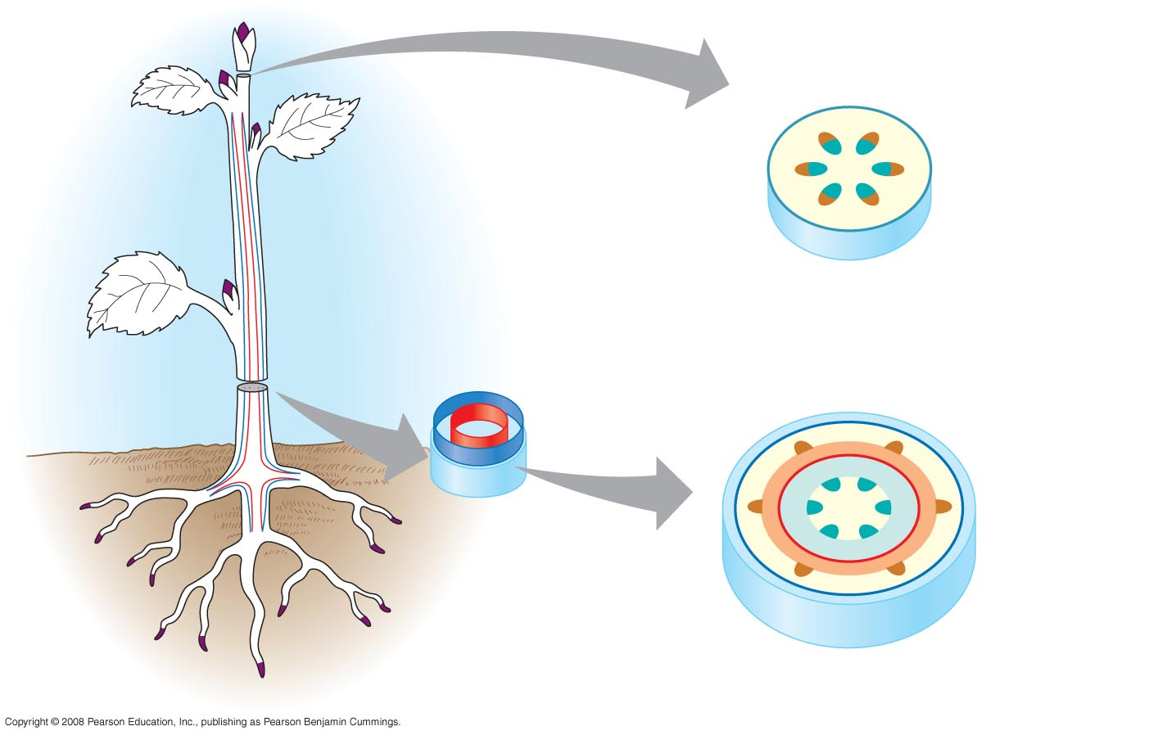
Fig. 35-11
Primary growth in stems
Epidermis
Cortex
Shoot tip (shoot
apical meristem
and young leaves)
Primary phloem
Primary xylem
Pith
Lateral meristems:
Vascular cambium
Secondary growth in stems
Cork cambium
Axillary bud
meristem
Periderm
Cork
cambium
Cortex
Pith
Primary
phloem
Primary
xylem
Root apical
meristems
Secondary
phloem
Secondary
xylem
Vascular cambium

Slide 86
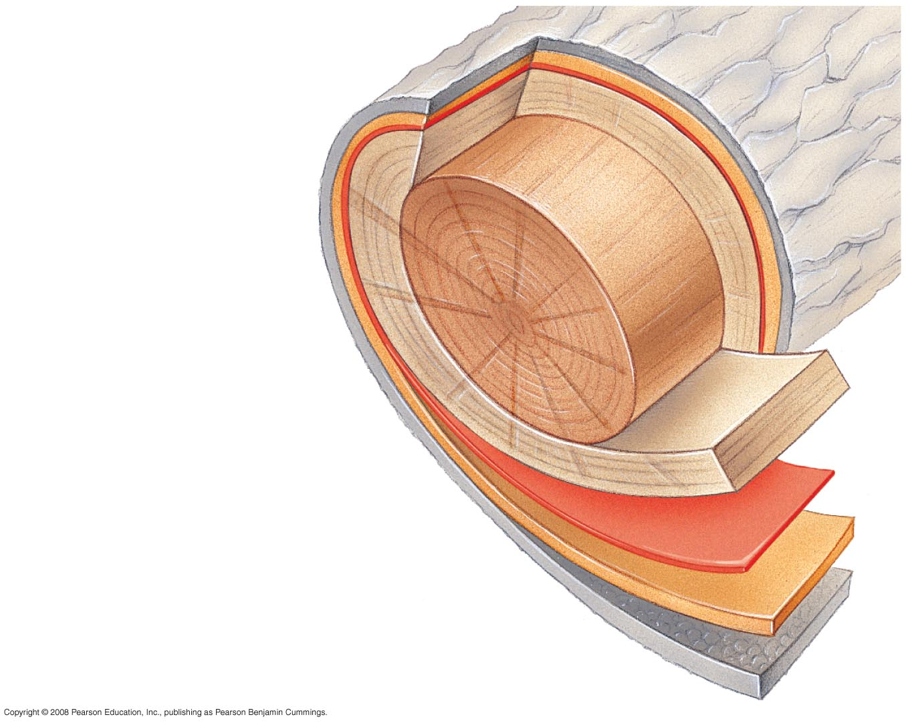
Fig. 35-22
Growth
ring
Vascular
ray
Heartwood
Secondary
xylem
Sapwood
Vascular cambium
Secondary phloem
Bark
Layers of periderm

Slide 87
Page 752 summary of secondary growth

Slide 88
Transport in Plants

Slide 89
Movement of water and ions
Xylem – vascular tubes for water movement
Structure:
- tracheid cells
- thick walls with lignin

Slide 90
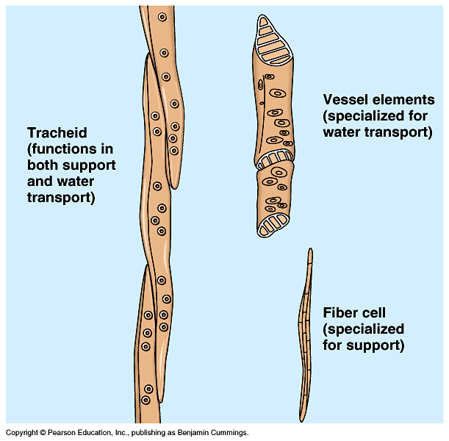

Slide 91
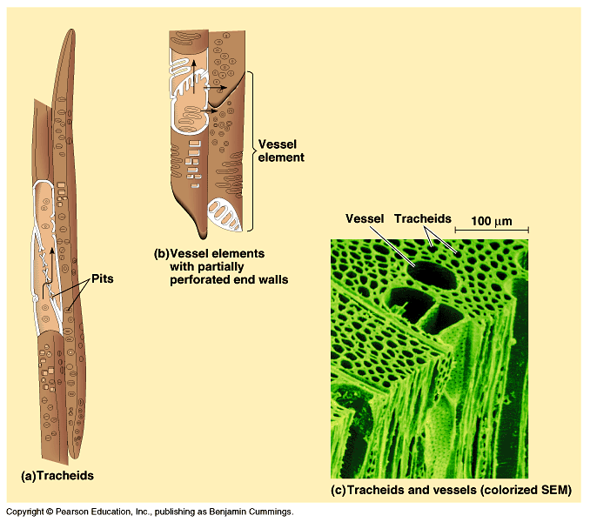

Slide 92
Water Gain through roots
Root hairs increase surface area
If plants are watered – inside cells has greater solute therefore hypertonic and water enters by osmosis
Water in root causes greater pressure – this resulting pressure is called root pressure

Slide 93
Water movement
Root pressure causes water to move up due to negative pressure in xylem
Why negative pressure in xylem?
- transpiration which works as suction & pulls water up --- This is called:
Cohesion – Tension Theory
involves properties of water such as adhesion, cohesion & H - bonding

Slide 94
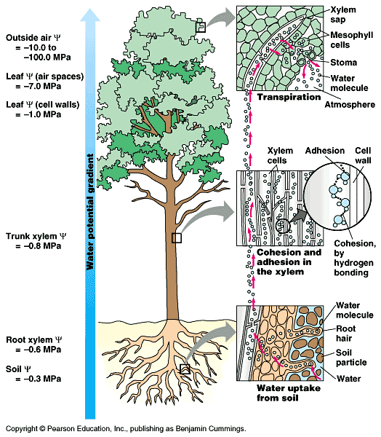

Slide 95
Water Loss - Transpiration
Loss of water vapor usually by open stomata
90% of water coming in is lost here
Factors affecting transpiration
- See Lab #9

Slide 96
Factors affecting transpiration
↑Temperature → ↑water loss
↑ Humidity → ↓water loss
↑ Wind → ↑water loss
Action of stomata
- stomata surrounded by guard cells
- guard cells fill with water & bow out causing stomata to open
- when guard cells lose water they relax & close

Slide 97
Translocation
Movement of sugars within plant
Sugars dissolved in water and move through phloem
Contents of phloem
- 90% sucrose
- 10% amino acids and water
Phloem structure:
- sieve tube cells

Slide 98
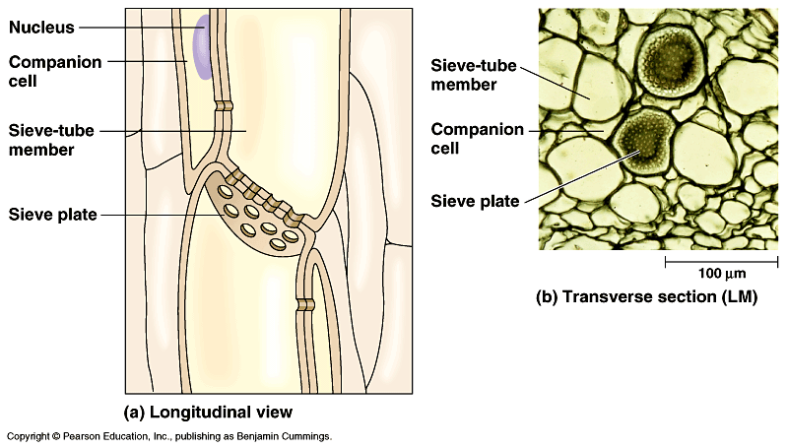

Slide 99
Pressure Flow Hypothesis
Bulk flow – movement of water due to pressure differences between two areas i.e. sap movement within trees
Solutes move in solutions that move due to differences in water potential

Slide 100
Pressure Flow Hypothesis
Water moves into cells from xylem
Solution moves from “source to sink”
sink – organ that stores the sugar
Speed of movement depends on differences in concentrations between source and sink (gradient)

Slide 101
Regulation of Plant Growth

Slide 102
External Factors
Water and temperature
Phototropism – response to light
Gravitropism – response to gravity
- roots – positive, shoots – negative
Thigmotropism – response to touch
Photoperiodism – response to change in day length

Slide 103
Internal Factors
Plant Hormones
Photoperiodism

Slide 104
Plant Hormones
Pg.827 Fig. 39.1

Slide 105
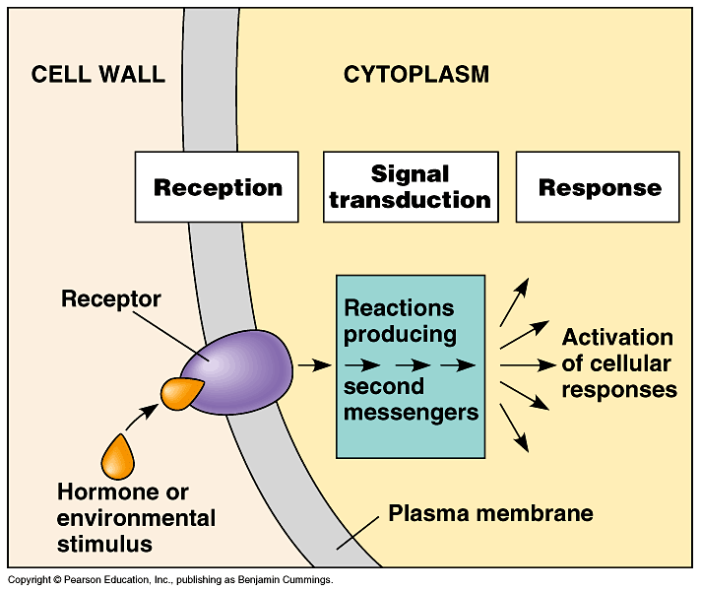

Slide 106
Plant Hormones pg.808
Auxins
- produced in response to sunlight & gravity
- cause cell walls to become more flexible thus allowing cells to elongate & grow
- promotes root, stem, & fruit growth
- inhibits budding from middle of plant thus allowing budding only at top – called apical dominance

Slide 107
Plant Hormones
Cytokinin
- stimulates cell division
Ethylene
- hydrocarbon gas
- causes ripening

Slide 108
Plant Hormones
Abscisic acid
- induces dormancy
Gibberellins
- produces hyperelongation of stem
- causes flowering

Slide 109
Photoperiodism – pgs. 821-822
Response to change in daylight
Circadian rhythm – internal clock with 24 hour cycle
Affect of light on circadian rhythm involves two types of phytochrome pigments
- P_{r} – absorbs red light absorbs λ 660
- P_{fr} – absorbs far red light λ 730

Slide 110
Phytochromes
P_{r} found in leaves
P_{fr} triggers flowering and resets the clock
In daylight P_{r} is converted to P_{fr}
At night, when no light present P_{fr} changes back to P_{r}
When will flowering occur?

Slide 111
Long day plants – flower in early summer/spring due to ↑ light
Short day plant – flower late summer/fall due to ↓ light
Day neutral – no response to light

Slide 112
Root Structure

Slide 113
Terms
Aquaporin – Channel protein facilitates osmosis in plants or animals
Stele – vascular tissue of stem or root
Casparian Strip – water impermeable ring of wax in endoderm cells of plants that blocks passive flow of water and solutes into the stele through cell walls

Slide 114
Terms
Cork cambium – cylinder of meristematic tissue in woody plants that replaces the epidermis with thicker, tougher cork cells
Mycorrhizae – mutualistic association of plant roots and fungus
Pericycle – the outermost layer of the vascular cylinder of a root where lateral growth originates.
Endemic plant – species found in one place of the world

