Slide 1
Nervous & Excretory Systems
Nervous System

Slide 2
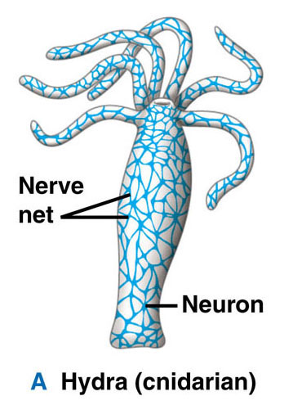

Slide 3
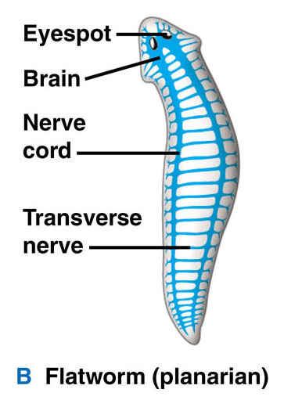

Slide 4
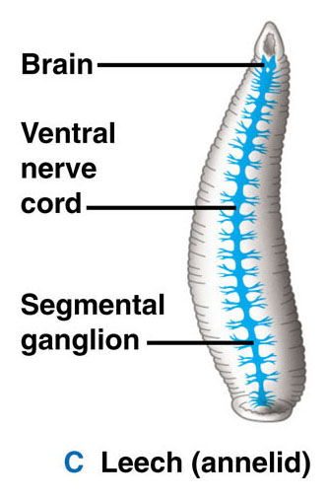

Slide 5
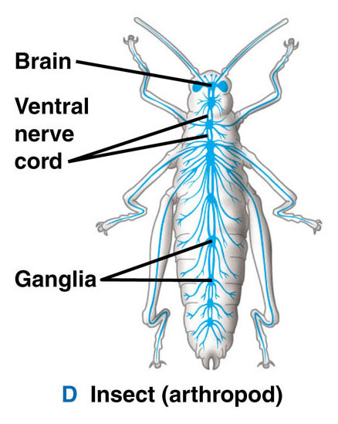

Slide 6
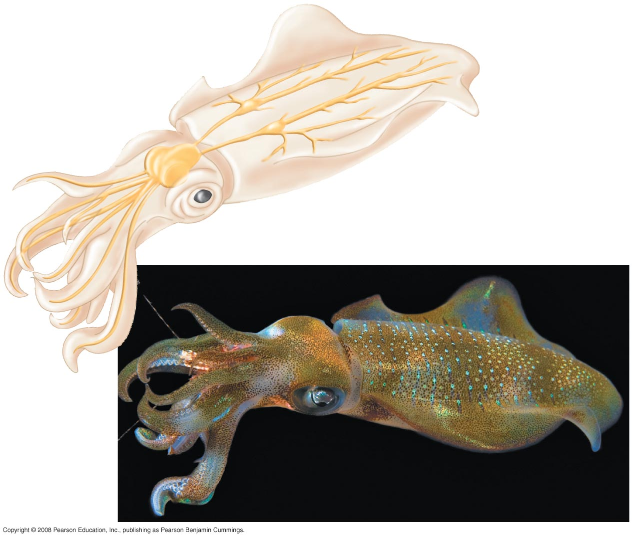
Fig. 48-2
Nerves
with giant axons
Ganglia
Brain
Arm
Eye
Mantle
Nerve

Slide 7
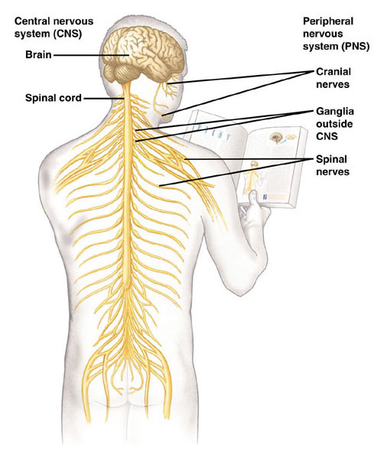

Slide 8
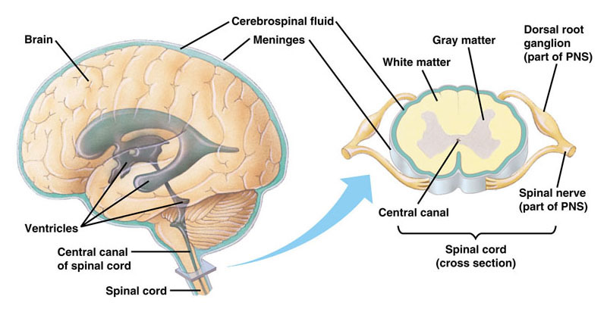

Slide 9
3 Functions
1. Sensory input - conductions from sensory receptors to integration center
- i.e. Eye & ear
2. Integration – info read & response identified
- brain & spinal cord
3. Motor output – conduction from integration center to effector cells (muscles & glands)

Slide 10
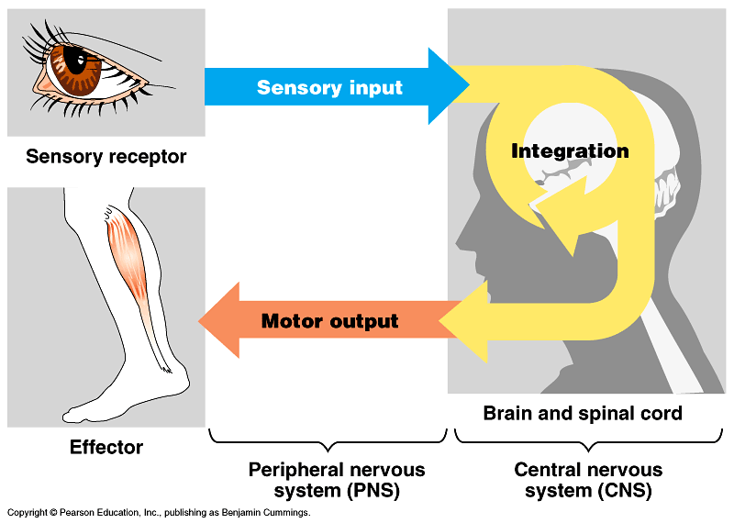

Slide 11
2 main parts of nervous system
1. Central Nervous system – CNS
brain & spinal cord
2. Peripheral Nervous system – PNS
carries sensory input to CNS & motor output away from CNS

Slide 12
Cell types
Neurons conduct messages – fig. 48-4
Supporting cells

Slide 13
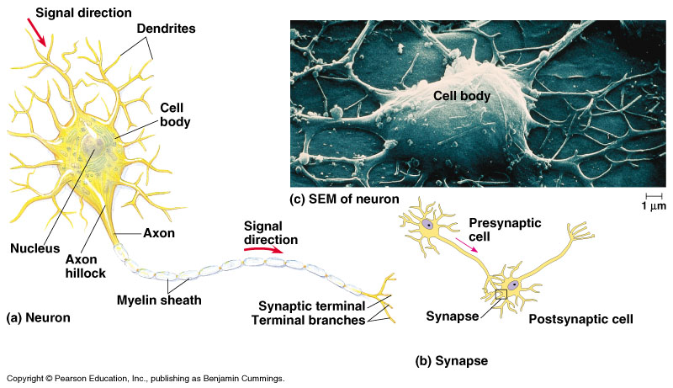

Slide 14
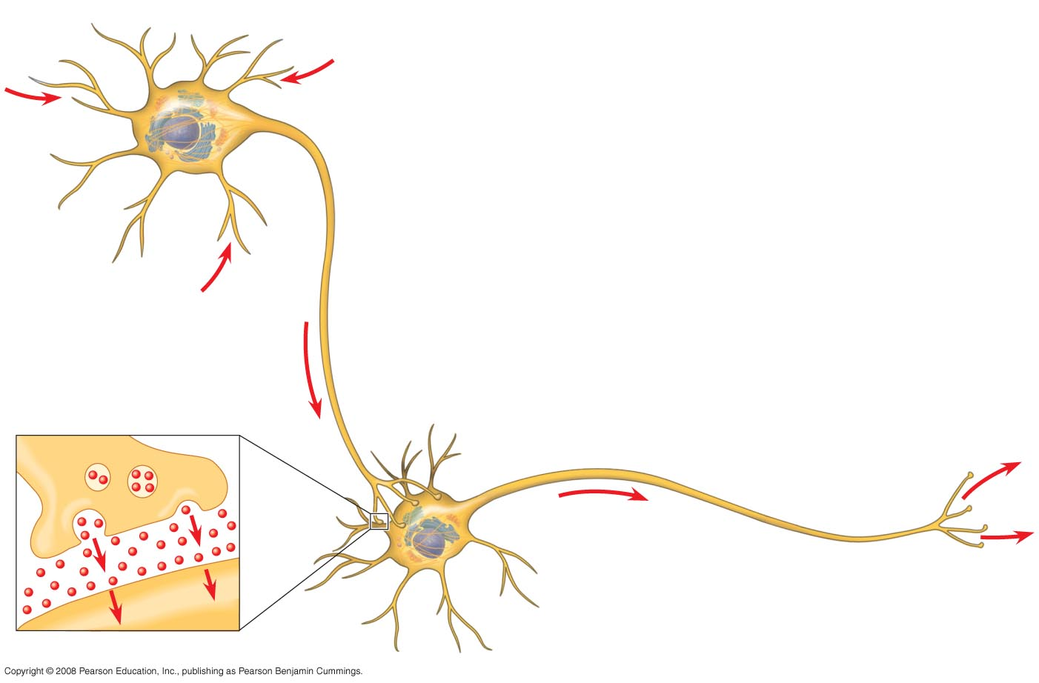
Fig. 48-4
Dendrites
Stimulus
Nucleus
Presynaptic
cell
Axon
hillock
Cell
body
Axon
Synapse
Synaptic terminals
Postsynaptic cell
Neurotransmitter

Slide 15
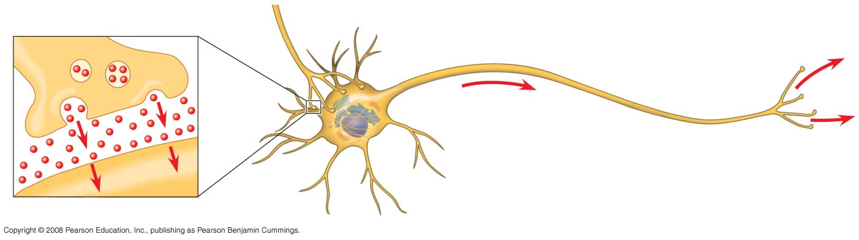
Fig. 48-4a
Synapse
Synaptic terminals
Postsynaptic cell
Neurotransmitter

Slide 16
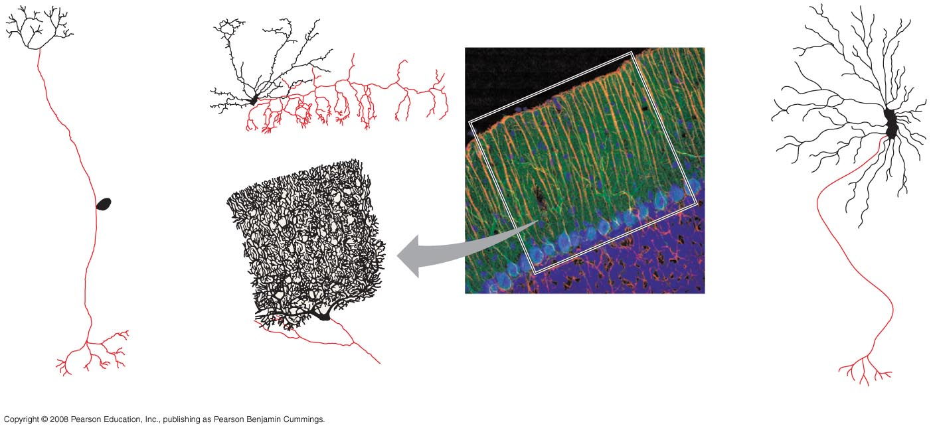
Fig. 48-5
Dendrites
Axon
Cell
body
Portion
of axon
80 µm
Cell bodies of
overlapping neurons
Sensory neuron
Interneurons
Motor neuron

Slide 17
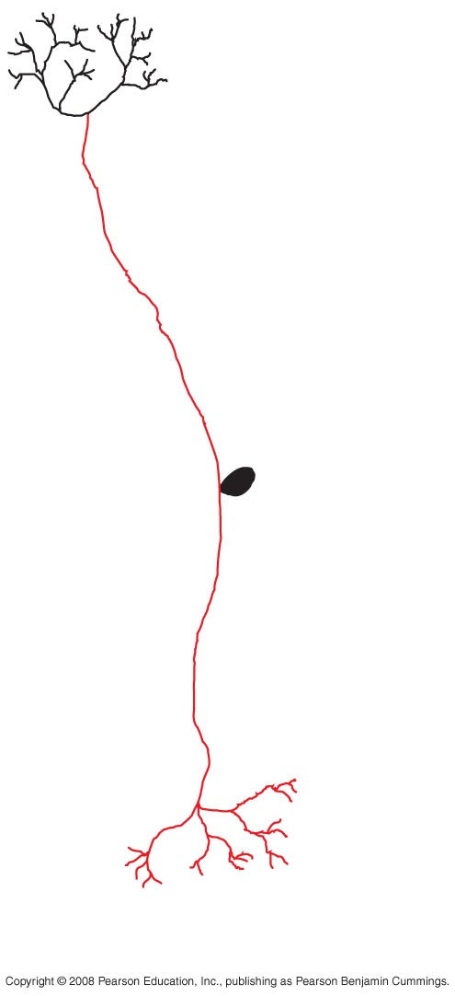
Fig. 48-5a
Dendrites
Axon
Cell
body
Sensory neuron

Slide 18
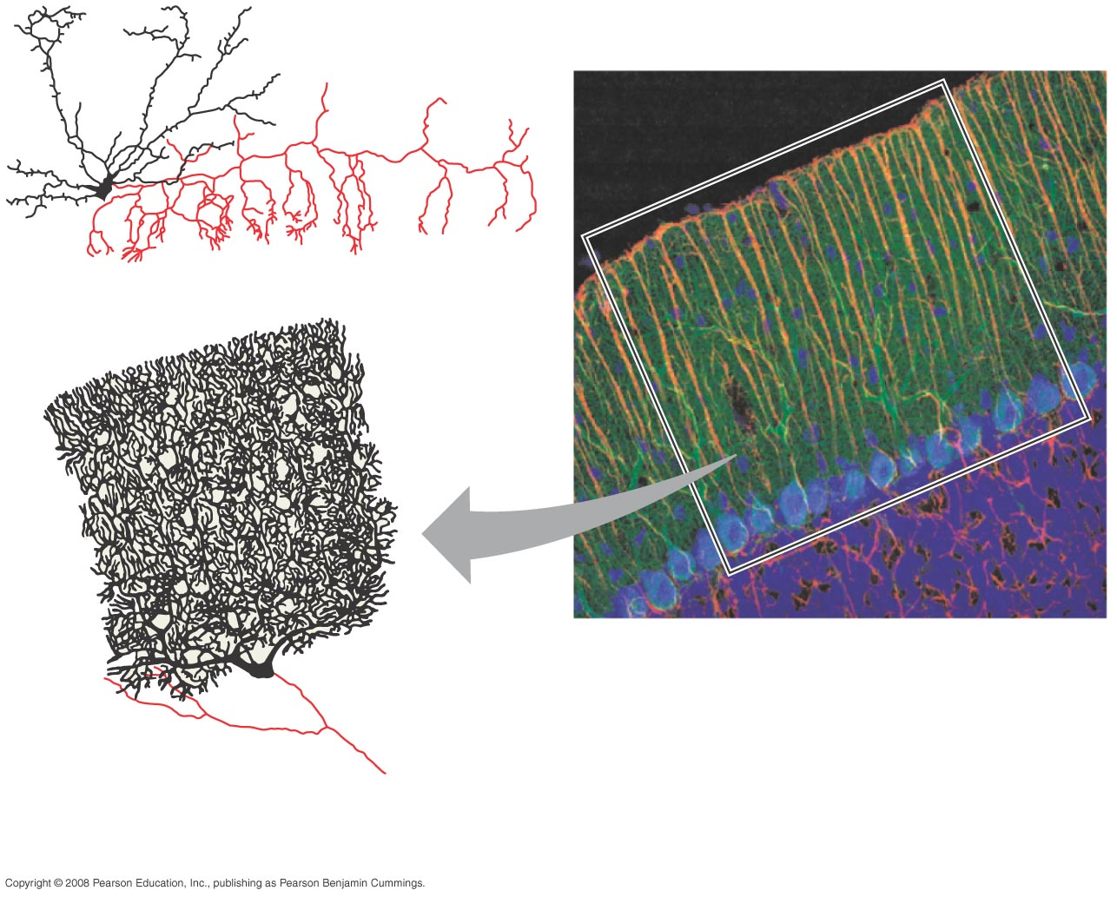
Fig. 48-5b
Portion
of axon
80 µm
Cell bodies of
overlapping neurons
Interneurons

Slide 19
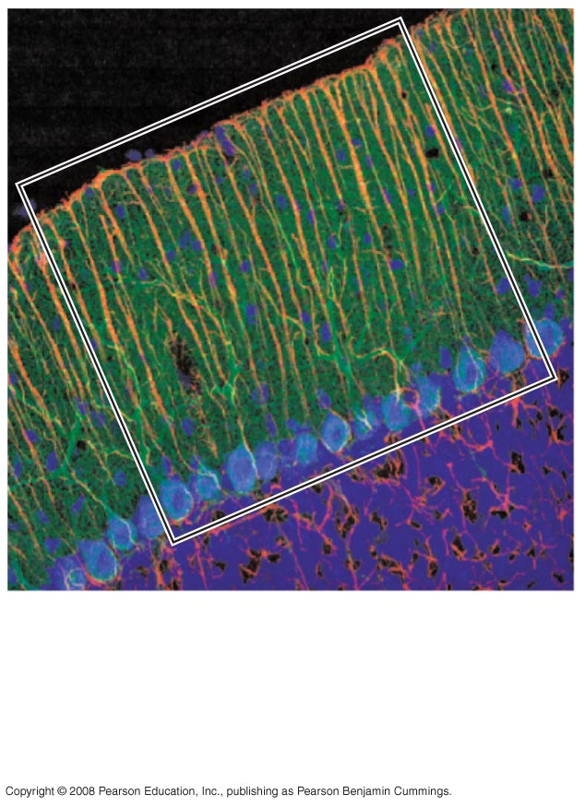
Fig. 48-5c
80 µm
Cell bodies of
overlapping neurons

Slide 20
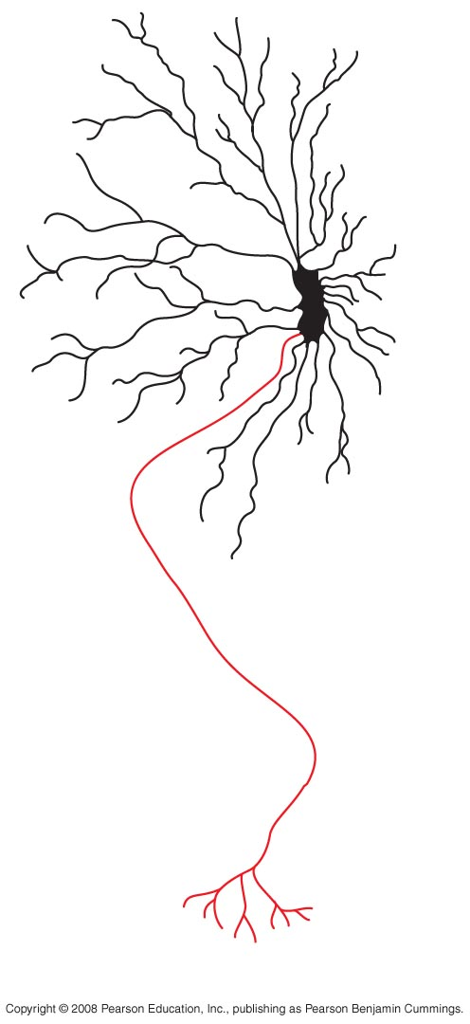
Fig. 48-5d
Motor neuron

Slide 21
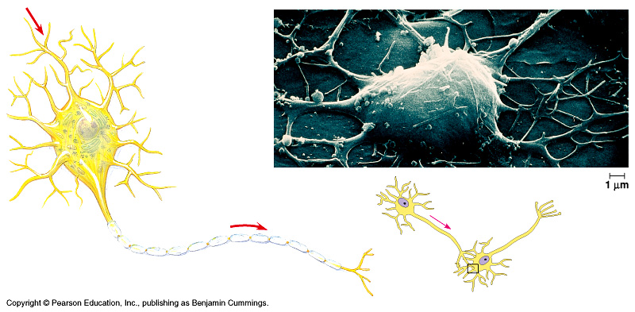

Slide 23
Structure of a neuron
Dendrites – ↑ surface area at receiving end
Axon – conducts message away from cell body
Schwann cells – supporting cells that surround axon & form insulating layer called myelin sheath
Axon hillock – impulse generated

Slide 24
Structure of a neuron
Axon branches & has 1,000’s of synaptic terminals that release neurotransmitters (chemicals that relay inputs)
Synapse – space between neurons or neuron & motor cell

Slide 25
3 types of neurons
Sensory – information to CNS
Motor – information from CNS
Interneuron – connect sensory to motor

Slide 26
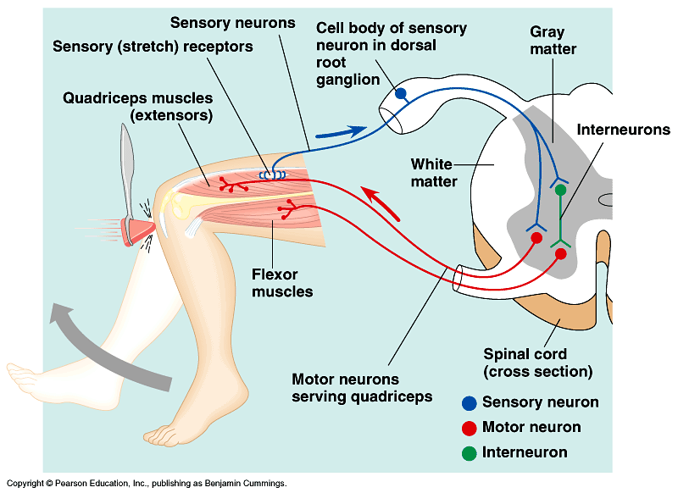

Slide 27
Supporting Cells - glial cells
Astrocytes circle capillaries in the brain to form a blood-brain barrier which keeps control of materials entering the brain from the blood
Oligodendrocytes in CNS and Schwann cells in PNS
- form myelin sheaths around axons
- their plasma membrane rolls around axon thus insulating it – why?

Slide 28
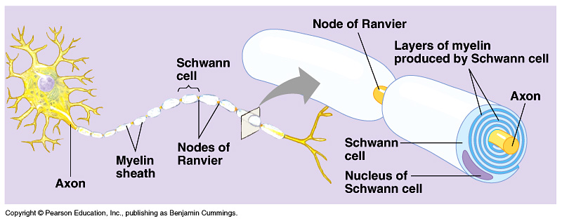

Slide 29
Transmission
Signal is electric and depends on ion flow across the membrane
All cells have a membrane potential – difference in electric charge between cytoplasm and extracellular fluid
- external more ⁺ and internal more –
- resting potential - the membrane potential of a nontransmitting cell (around – 70mV)

Slide 30
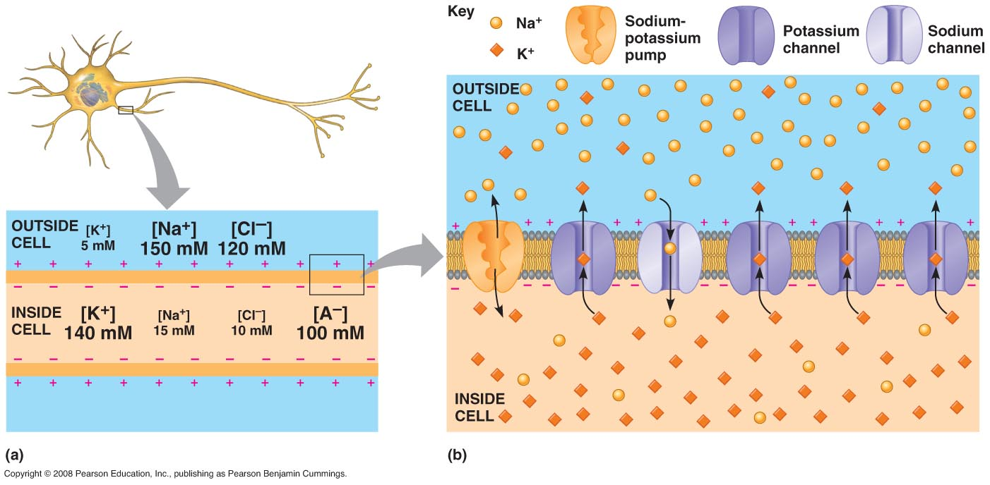

Slide 31
Transmission
Neurons have gated ion channels
At rest the Na⁺ and K⁺ gates are closed and membrane potential is – 70mV
If gates for K⁺ open K⁺ rushes out – why out? (review Na⁺ and K⁺ pump)
Because ⁺ ions leave, the membrane potential becomes more negative inside thus -hyperpolarization

Slide 32
Transmission
Hyperpolarization and depolarization are referred to as graded potentials because the magnitude of the change varies with strength of the stimulus (what caused the opening of gates)
If Na⁺ gates open the membrane potential becomes less negative thus - depolarization
Other ion gates can also open and change the membrane potential

Slide 33
Transmission
Threshold
Potential that must be reached to cause an action potential
Threshold potential is ⁻50mV
Once the threshold is met a series of changes takes place and cannot be stopped – this is called the action potential

Slide 34
Action Potential
Rapid change in the membrane potential cause by a stimulus (if the stimulus reaches the threshold)
All cells have a membrane potential but only excitable cells, like neurons and muscles can change it. Why?

Slide 35
Action Potential

Slide 36
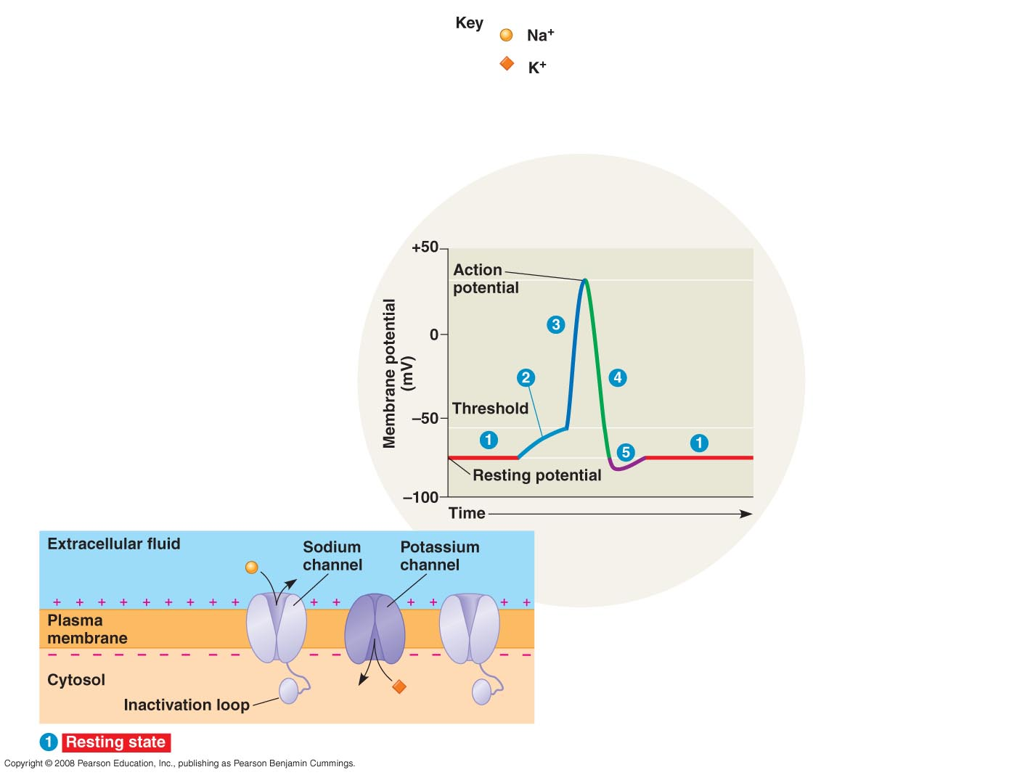

Slide 37
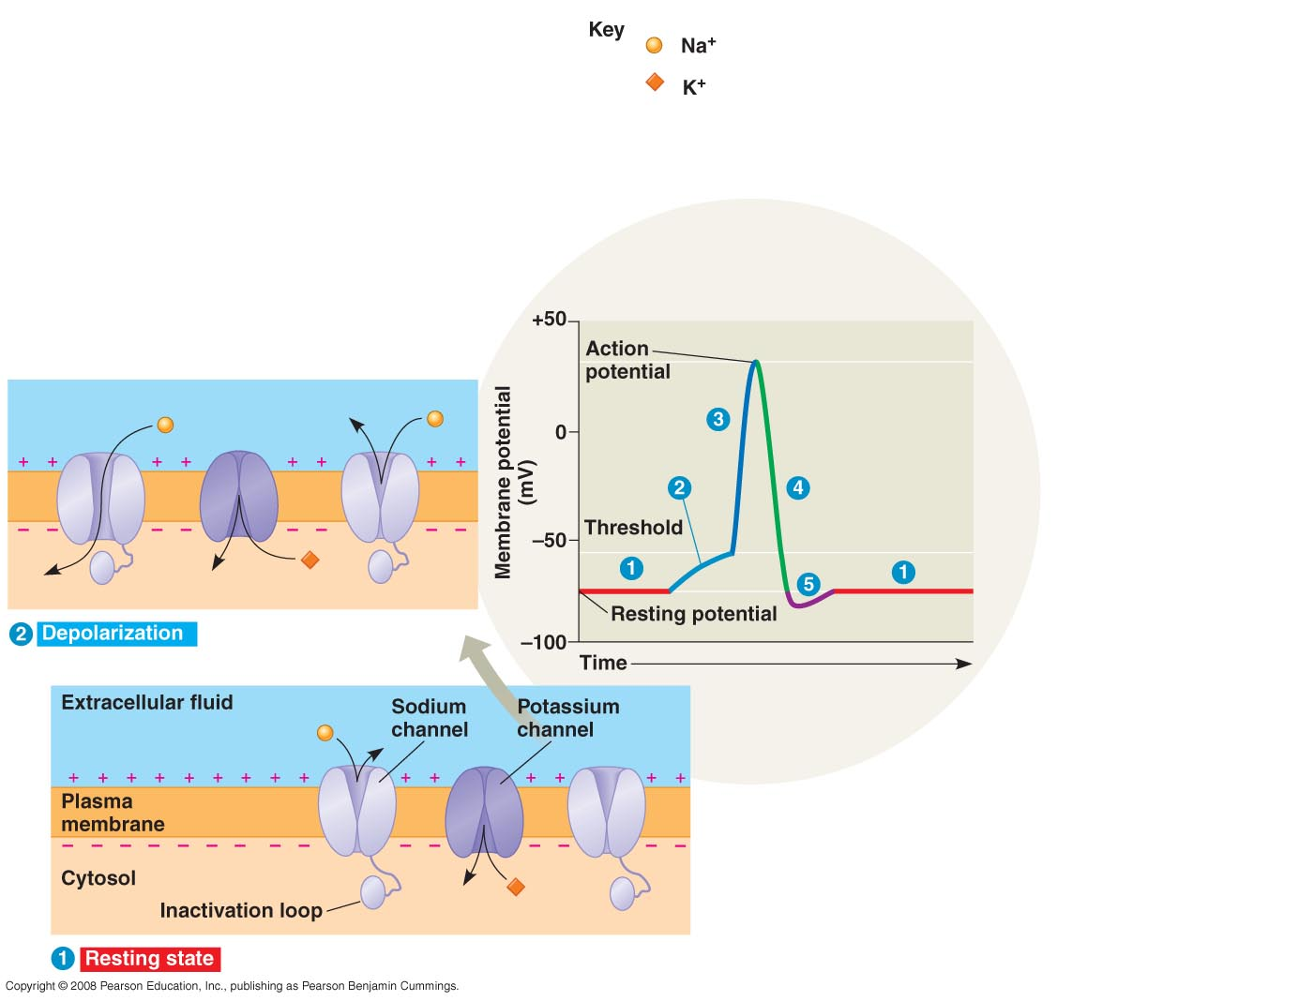

Slide 38
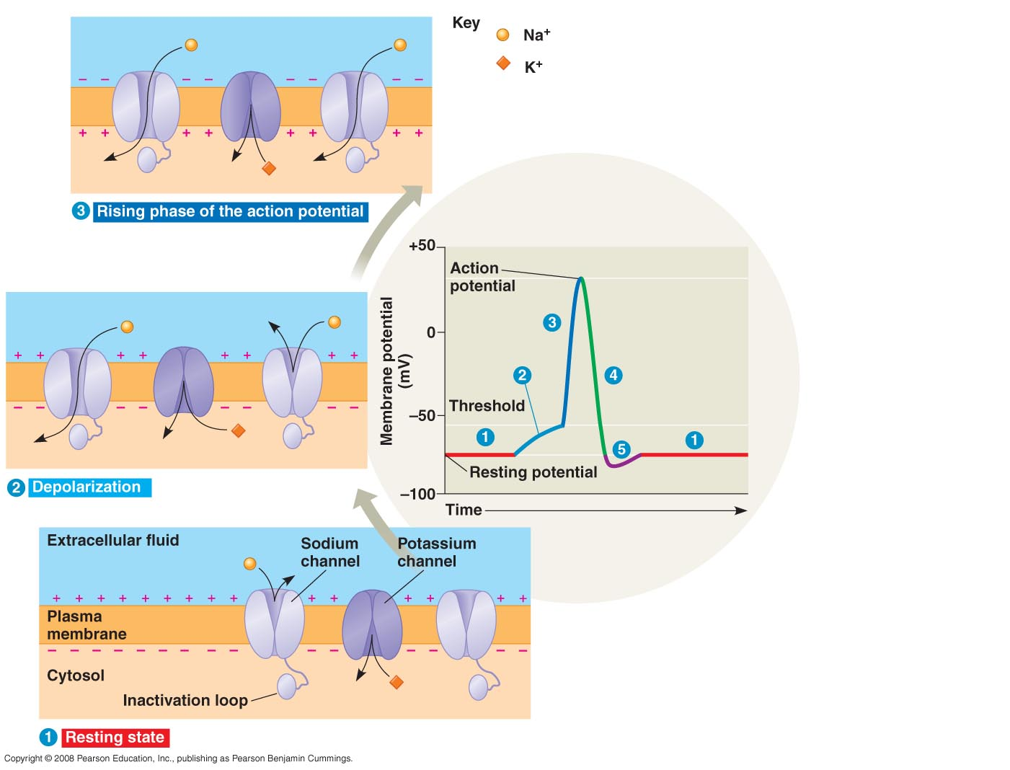

Slide 39
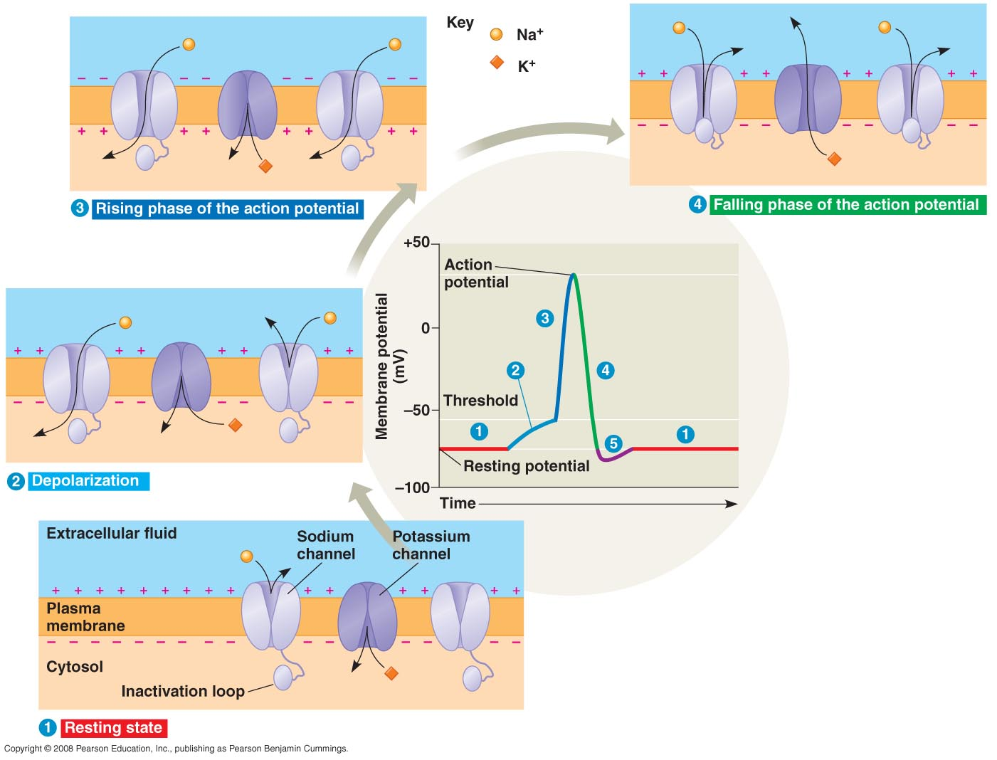

Slide 40
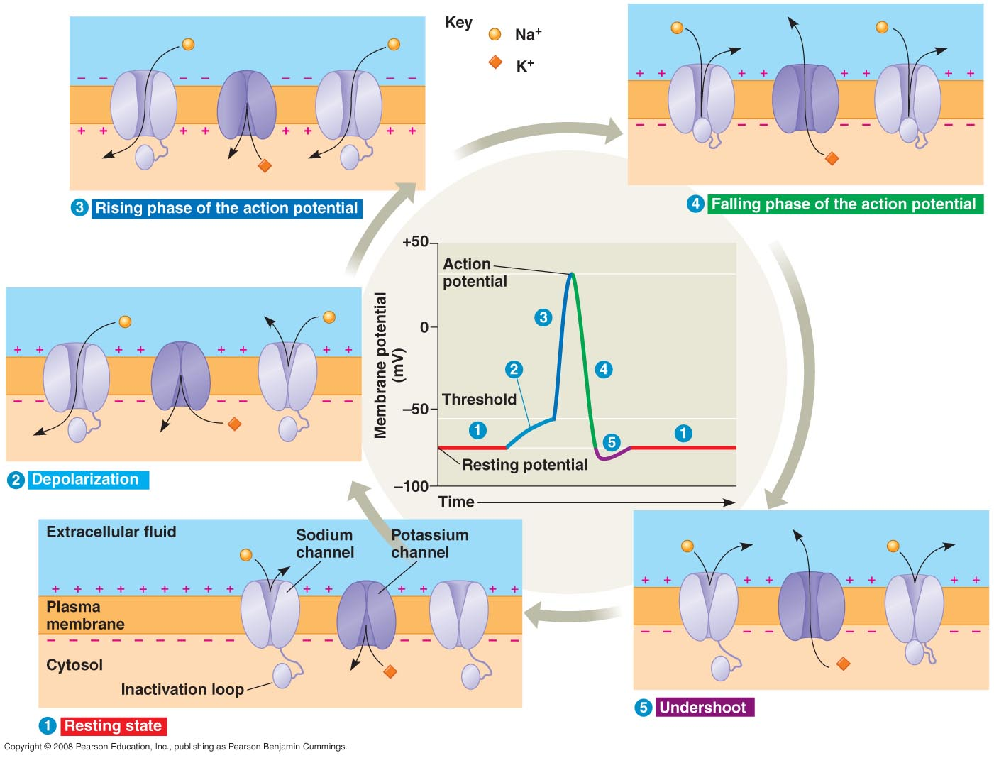

Slide 41
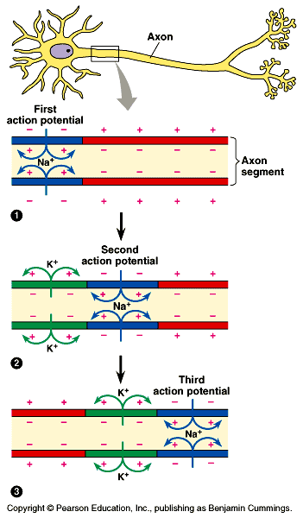

Slide 42
5 Phases of Action Potential
1. Resting – no channels open
2. Depolarizing - threshold is met
- NA⁺ channels open
- +’s going in
- inside becomes more ⁺ or less⁻
3. Rising phase - more Na ⁺ gates open thus depolarizing continues

Slide 43
Action Potential Phases
4. Falling Phases - repolarizing
- NA⁺ channels closed
- K ⁺ channels open
- +’s going out
- inside more negative

Slide 44
Action Potential Phases
5. Undershoot
- inside is more negative than resting stage because NA⁺ channels still closed & K ⁺ gates still open. It takes time (millisecond) to respond to repolarization
- resting state is restored
- refractory period - during undershoot when activation gates not open yet
- neuron is insensitive to depolarization
- sets limits on maximum rate of activation of action potential

Slide 46
http://www.youtube.com/watch?v=SCasruJT-DU action potential
http://www.youtube.com/watch?v=DJe3_3XsBOg Schwan cells

Slide 47
The Synapse
Space between neurons
Terms:
- presynaptic cell – transmitting cell
- postsynaptic cell – receiving cell
2 types of synapse:
- electrical
- chemical

Slide 48
Synapse
Electrical synapse
- less common
- action potential spreads directly from pre - to postsynaptic cells via gap junctions
Chemical synapse
- a synaptic cleft separates pre – post synaptic cells so they’re not electrically coupled

Slide 49
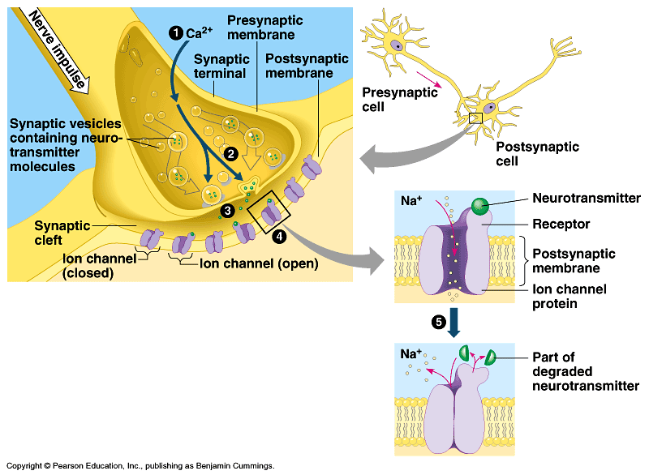

Slide 50
Steps of Chemical Synapse
1. Action potential depolarizes presynaptic membrane causing Ca⁺⁺ to rush into synaptic terminal through gates
2. ↑ Ca⁺⁺ causes synaptic vesicles to fuse thus releasing neurotransmitters

Slide 51
Types of neurotransmitters
EPSP – excitatory
NA⁺ in
K⁺ out
(more Na⁺ in than K⁺ out because of voltage and concentration gradient) thus
depolarization
IPSP – inhibitory
K⁺ out
Cl⁻ in
hyperpolarization

Slide 52
Neurotransmitters
Each can trigger different responses at different sites.
- Depends on receptors on different postsynaptic cells
Bind chemically to gated ion channels thus changing the permeability of the chemical at the postsynaptic cell

Slide 53
Neurotransmitters
Acetylcholine – most common
- for muscle contraction
Dopamine – usually EPSP but some sites IP
Epinephrine “ “
Norepinephrine “ “
Serotonin – made from tryptophan usually inhibitory

Slide 54
Vertebrate Nervous Systems

Slide 55
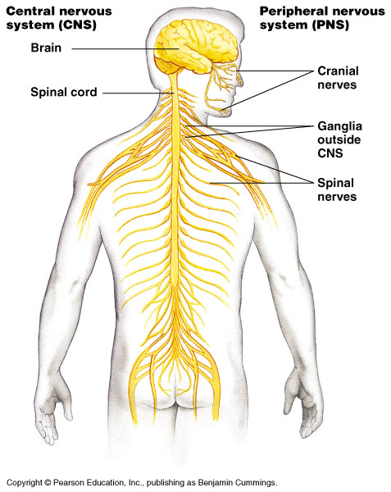

Slide 56
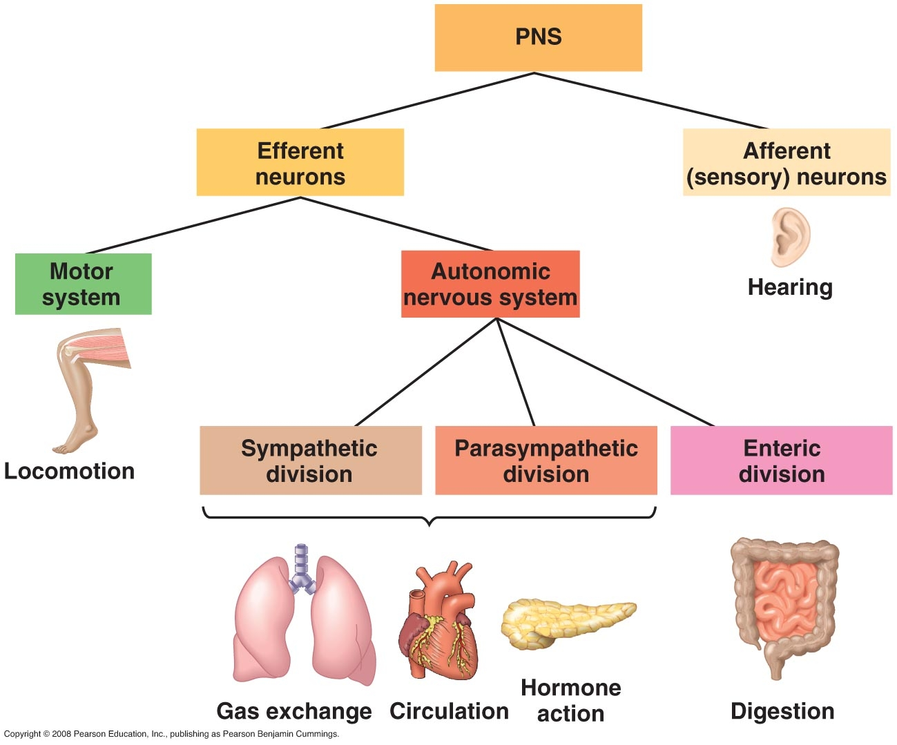

Slide 57
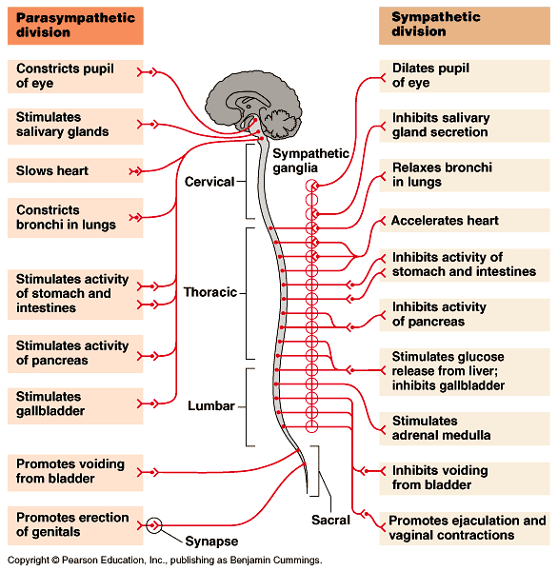

Slide 58
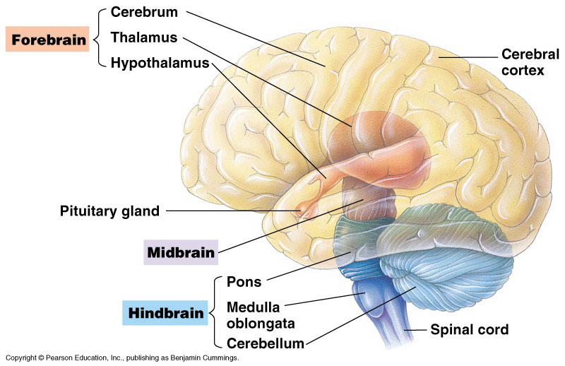

Slide 59
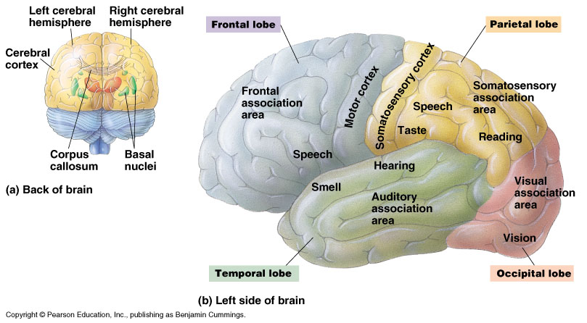

Slide 60
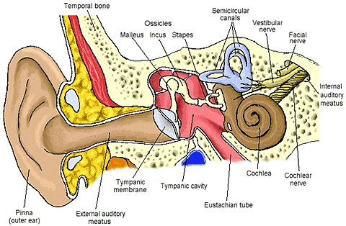

Slide 61
Excretion

Slide 62
Functions
Excretion of N waste
Water balance
Regulates ionic concentrations

Slide 63
Excretion of N waste
Most aquatic animals excrete ammonia - NH₃
- very soluble in water
- diffuses across whole body surface
- diffuses across gills
Birds & reptiles excrete a uric acid paste

Slide 64
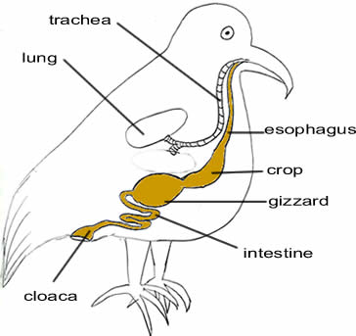

Slide 65
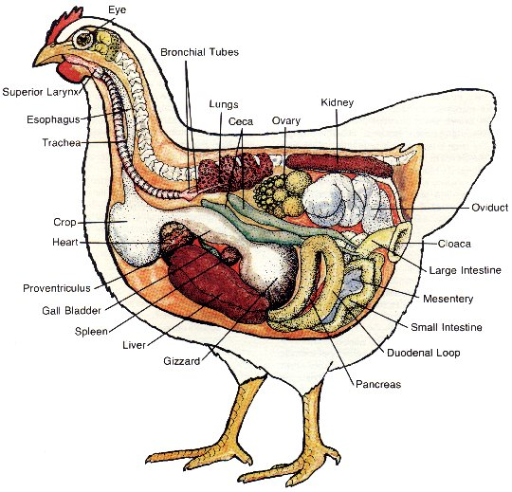

Slide 66
Excretion of N waste
Amphibians & mammals change NH₃ to urea in liver
- urea diffuses into blood & is dissolved in water & excreted

Slide 67
2 methods of Water Balance
Osmoconformers
- doesn’t adjust internal osmolarity & is isotonic with surrounding water
Osmoregulators
- not isotonic to surrounding so must take in or discharge water
- uses energy to maintain a gradient that allows water movement in or out

Slide 68
Regulation of Ions
Na ⁺ K ⁺ H ⁺ Mg ⁺ ⁺ Ca ⁺ ⁺

Slide 69
Evolution of excretory system
Diffusion
Flame cells
Nephridia – many segments
Metanephridia
Malpighian tubules – few segments
Kidneys – special location

Slide 70
Kidney
Filters wastes from blood, regulates H₂O content, produces urine
Each kidney contains approx. 500,000 nephrons tubule
Diagram pg. 944
cortex, medula, renal pelvis, ureter, nephron

Slide 71
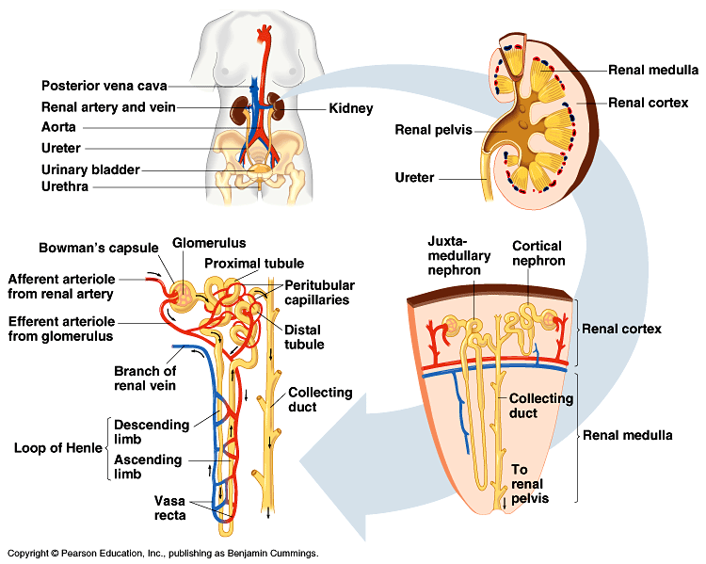

Slide 72
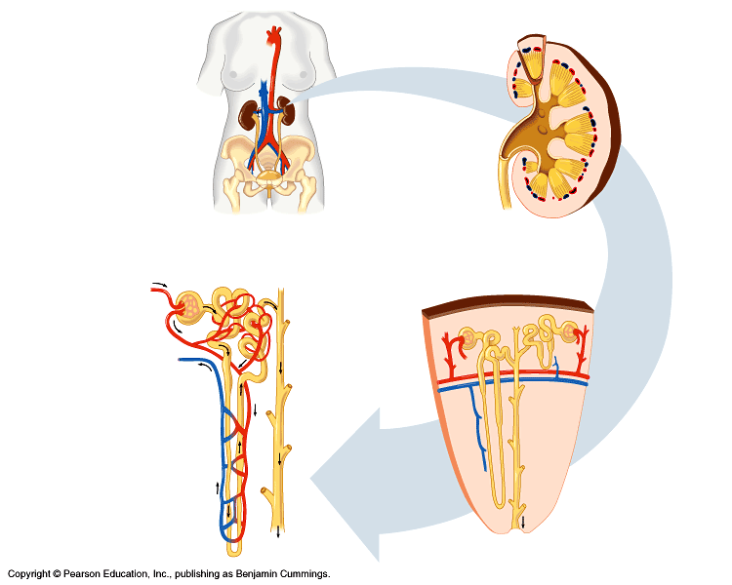

Slide 73
Pathway of blood pg. 963
Aorta to renal arteries
Afferent arteriole (inside kidney)
Glomerulus – ball of capillaries – some things diffuse out of blood
Efferent arteriole
Peritubular capillaries
Venules
Renal vein
Inferior vena cava

Slide 74
Path of filtrate
Filtrate is what diffuses from blood at glomerulus – What does it contain?
- water
- small solutes like glucose, urea, salt, vitamins, ions, hormones
Filtrate will eventually become urine

Slide 75
Path of filtrate
Bowmans capsule
Proximal convoluted tubule
Loop of Henle
Distal convoluted tubule
Collecting duct
Renal pelvis
Ureter

Slide 76
Formation of Urine – 3 steps
Filtration
Secretion
Reabsorption

Slide 77
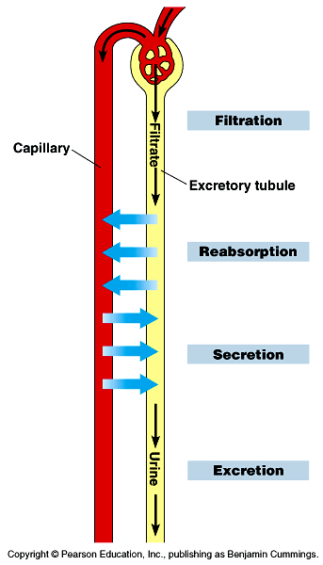

Slide 78
Filtration
Bowmans capsule filters filtrate from blood
Nonselective process – anything small enough passes

Slide 79
Secretion
Selective process involving active & passive transport from capillaries to tubule
Occurs at proximal & distal tubules

Slide 80
Reabsorption
Selective process where substances return to capillaries from tubule
Occurs at convoluted tubules, Loop of Henle, & collecting duct
Nearly all sugars, vitamins, H₂O & other organic nutrients are reabsorbed

Slide 81
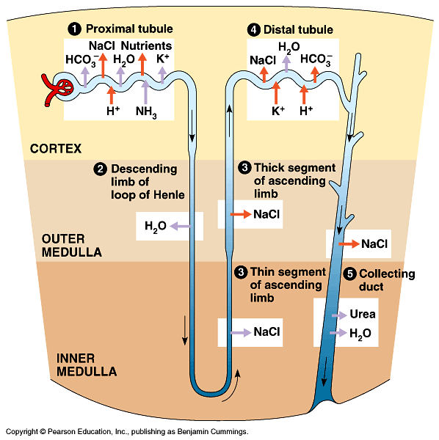

Slide 82
Conservation of Water
Water concentration measured in milliosmoles per Liter (mosm) – this is a measurement of osmolarity (solute concentration)
Range of water concentration is 300 mosm/L to 1200 mosm/L
To maintain this concentration urine can be hypertonic or hypotonic

Slide 83
Regulation
2 systems operating
ADH system
- responds to osmolarity of blood
RAAS – renin-angiotensin-aldesterone system
- responds to blood volume and pressure

Slide 84
ADH – antidiuretic hormone
Monitors water concentration
Produced by hypothalamus
Stored in pituitary
Osmoreceptor cells in hypothalamus monitor osmolarity of blood

Slide 85
Blood too hypertonic?
Triggers thirst
ADH secreted
- causes increased permeability of water at distal tubule and collecting duct
- thus water is conserved

Slide 89
Blood too hypotonic?
ADH inhibited
- decreased permeability of water at distal tubule and collecting duct
- thus more water is excreted

Slide 90
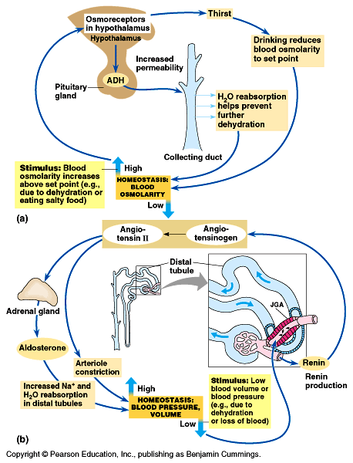

Slide 91
RAAS
JGA – juxtaglomerular apparatus located near afferent arterial releases renin when blood pressure drops
Renin causes release of angiotensin II
- causes constriction of arterioles
- causes stimulation of aldosterone
Aldosterone causes distal tubules to reabsorb more Na ⁺ and water thus increasing blood volume

Slide 92
Alcohols affect on ADH
Inhibits ADH
Excessive water loss

Slide 93
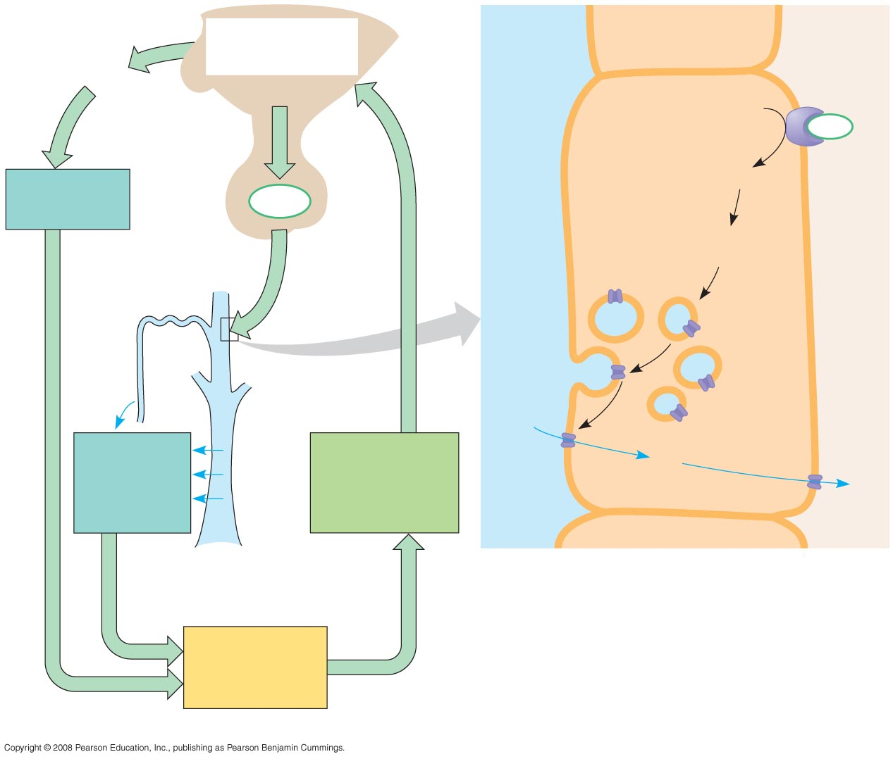
Fig. 44-19
Osmoreceptors in
hypothalamus trigger
release of ADH.
COLLECTING
DUCT
LUMEN
INTERSTITIAL
FLUID
Thirst
Hypothalamus
COLLECTING
DUCT CELL
ADH
ADH
receptor
Drinking reduces
blood osmolarity
to set point.
cAMP
ADH
Pituitary
gland
Second messenger
signaling molecule
Increased
permeability
Distal
tubule
Storage
vesicle
Exocytosis
Aquaporin
water
channels
H₂O
H₂O reab-
sorption helps
prevent further
osmolarity
increase.
H₂O
STIMULUS:
Increase in blood
osmolarity
Collecting duct
(b)
Homeostasis:
Blood osmolarity
(300 mOsm/L)
(a)

Slide 94
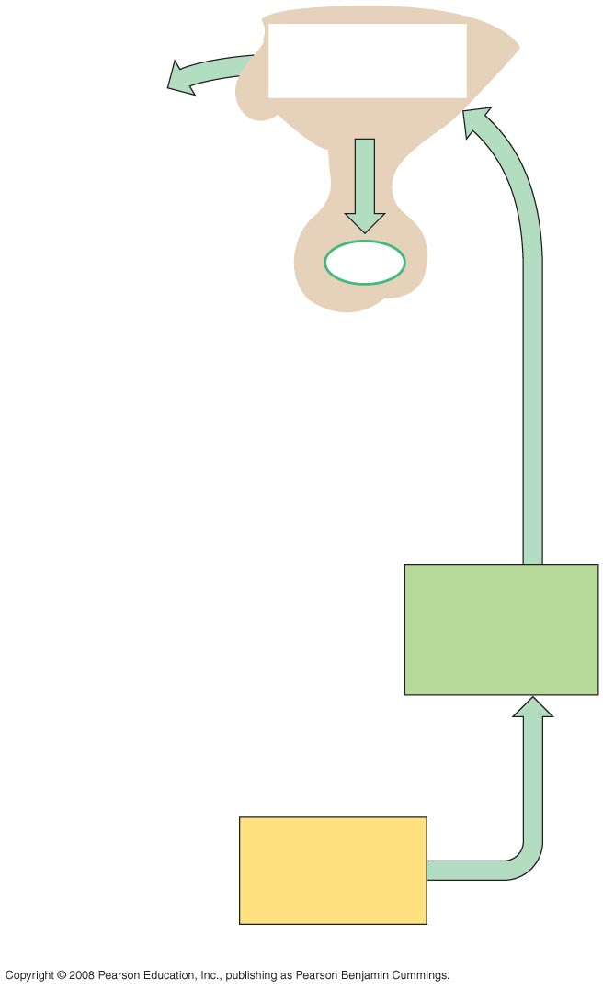
Fig. 44-19a-1
Osmoreceptors in
hypothalamus trigger
release of ADH.
Thirst
Hypothalamus
ADH
Pituitary
gland
STIMULUS:
Increase in blood
osmolarity
Homeostasis:
Blood osmolarity
(300 mOsm/L)
(a)

Slide 95
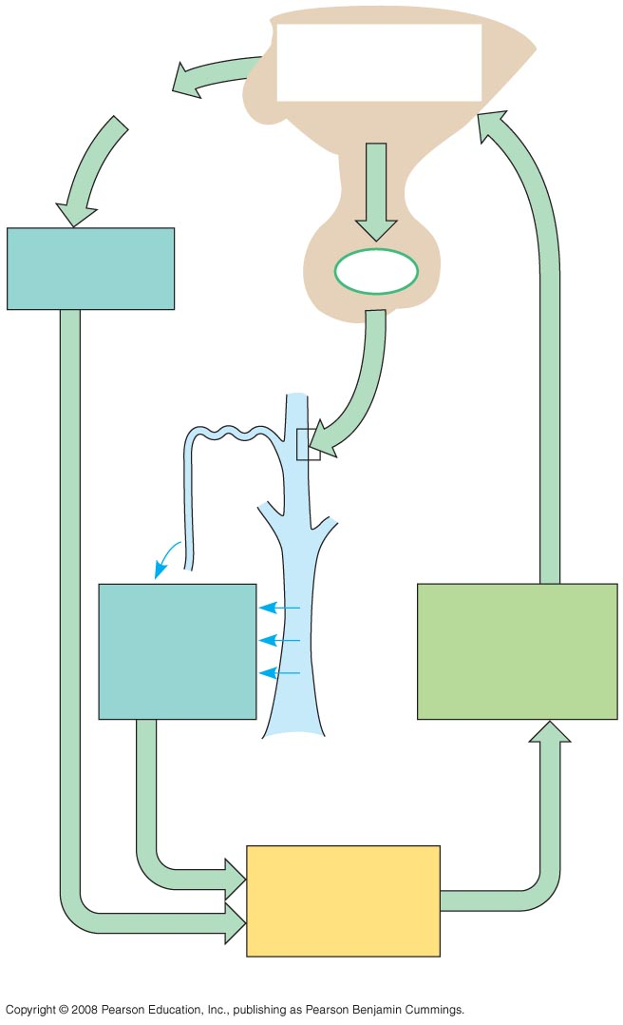
Fig. 44-19a-2
Osmoreceptors in
hypothalamus trigger
release of ADH.
Thirst
Hypothalamus
Drinking reduces
blood osmolarity
to set point.
ADH
Increased
permeability
Pituitary
gland
Distal
tubule
H₂O reab-
sorption helps
prevent further
osmolarity
increase.
STIMULUS:
Increase in blood
osmolarity
Collecting duct
Homeostasis:
Blood osmolarity
(300 mOsm/L)
(a)

Slide 96
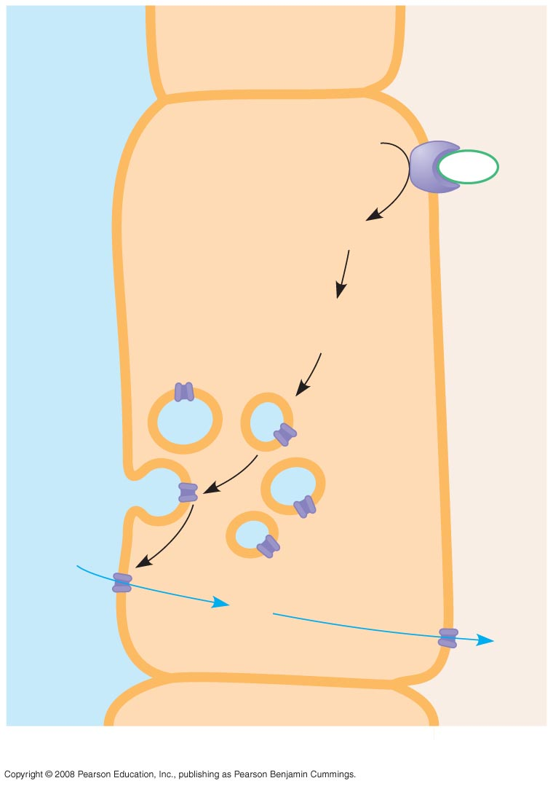
Fig. 44-19b
COLLECTING
DUCT
LUMEN
INTERSTITIAL
FLUID
COLLECTING
DUCT CELL
ADH
ADH
receptor
cAMP
Second messenger
signaling molecule
Storage
vesicle
Exocytosis
Aquaporin
water
channels
H₂O
H₂O
(b)

Slide 97
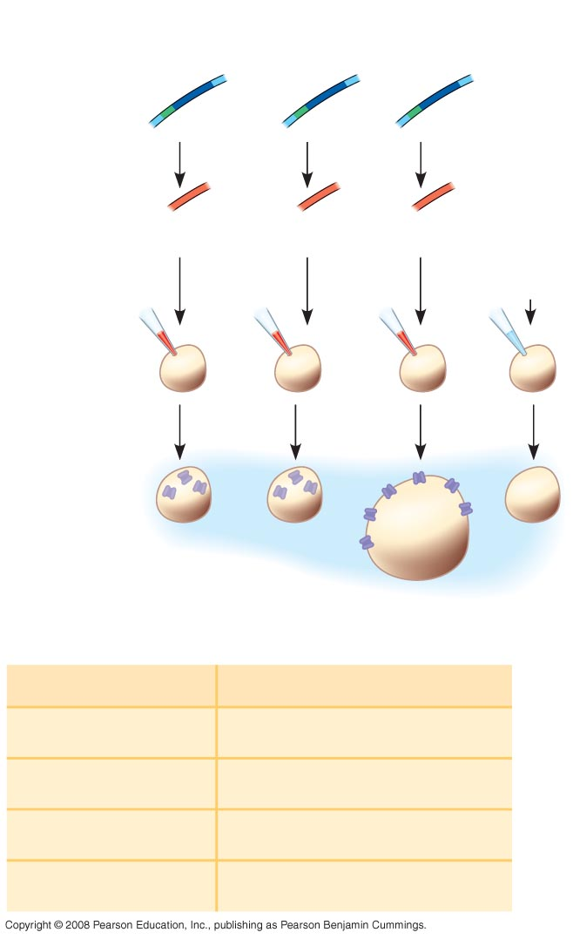
Fig. 44-20
EXPERIMENT
Prepare copies
of human aqua-
porin genes.
Aquaporin
gene
Promoter
Synthesize
RNA
transcripts.
Mutant 1
Mutant 2
Wild type
H₂O
(control)
Inject RNA
into frog
oocytes.
Transfer to
10 mOsm
solution.
Aquaporin
protein
RESULTS
Injected RNA
Permeability (µm/s)
Wild-type aquaporin
196
None
20
Aquaporin mutant 1
17
Aquaporin mutant 2
18

Slide 98
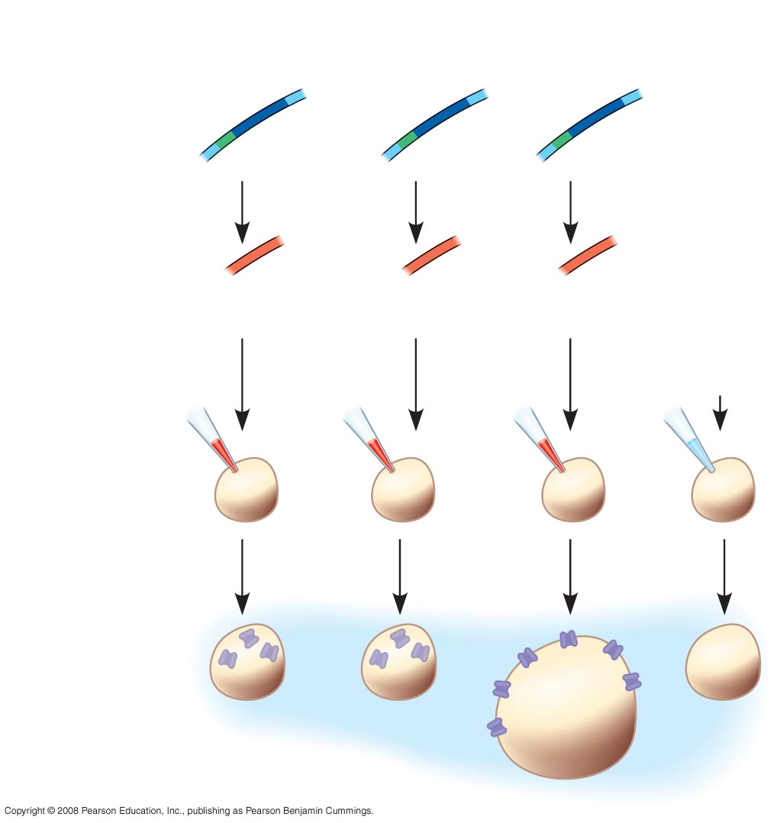
Fig. 44-20a
EXPERIMENT
Prepare copies
of human aqua-
porin genes.
Aquaporin
gene
Promoter
Synthesize
RNA
transcripts.
Mutant 1
Mutant 2
Wild type
H₂O
(control)
Inject RNA
into frog
oocytes.
Transfer to
10 mOsm
solution.
Aquaporin
protein

Slide 99
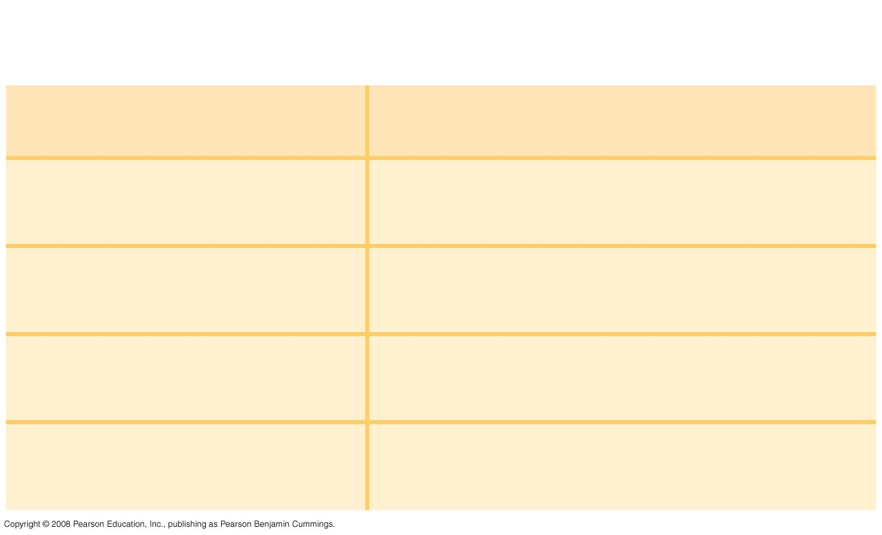
Fig. 44-20b
RESULTS
Injected RNA
Permeability (µm/s)
Wild-type aquaporin
196
None
20
Aquaporin mutant 1
17
Aquaporin mutant 2
18

Slide 100
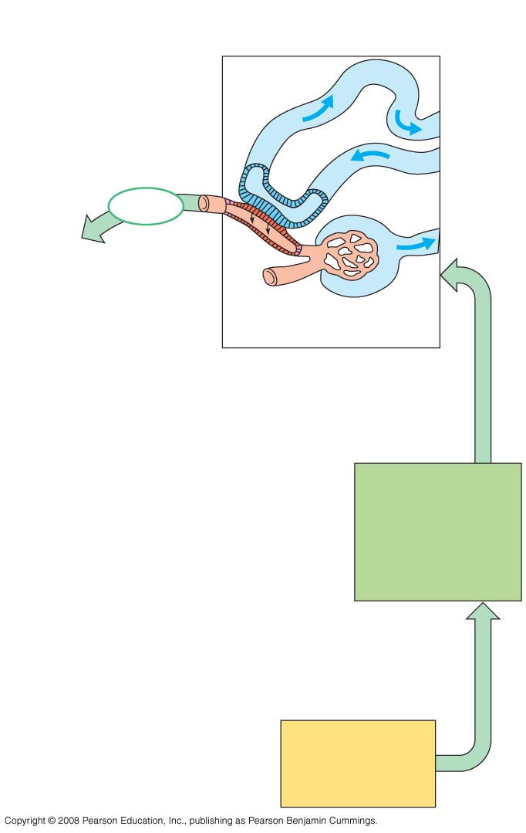
Fig. 44-21-1
Distal
tubule
Renin
Juxtaglomerular
apparatus (JGA)
STIMULUS:
Low blood volume
or blood pressure
Homeostasis:
Blood pressure,
volume

Slide 101
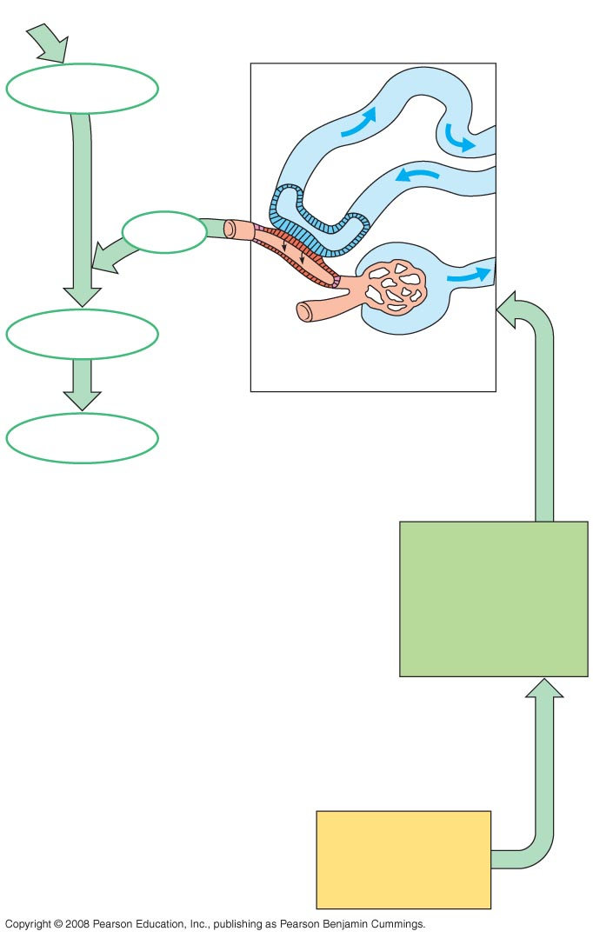
Fig. 44-21-2
Liver
Angiotensinogen
Distal
tubule
Renin
Angiotensin I
Juxtaglomerular
apparatus (JGA)
ACE
Angiotensin II
STIMULUS:
Low blood volume
or blood pressure
Homeostasis:
Blood pressure,
volume

Slide 102
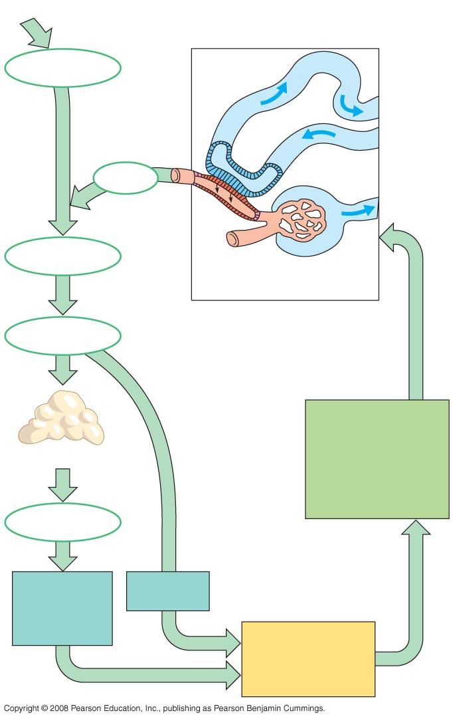
Fig. 44-21-3
Liver
Angiotensinogen
Distal
tubule
Renin
Angiotensin I
Juxtaglomerular
apparatus (JGA)
ACE
Angiotensin II
STIMULUS:
Low blood volume
or blood pressure
Adrenal gland
Aldosterone
Increased Na⁺
and H₂O reab-
sorption in
distal tubules
Arteriole
constriction
Homeostasis:
Blood pressure,
volume

Slide 103

Fig. 44-UN1
Animal
Inflow/Outflow
Urine
Freshwater
fish
Does not drink water
Large volume
of urine
Salt in
H₂O in
(active trans-
port by gills)
Urine is less
concentrated
than body
fluids
Salt out
Bony marine
fish
Drinks water
Small volume
of urine
Salt in
H₂O out
Urine is
slightly less
concentrated
than body
fluids
Salt out (active
transport by gills)
Terrestrial
vertebrate
Drinks water
Moderate
volume
of urine
Salt in
(by mouth)
Urine is
more
concentrated
than body
fluids
H₂O and
salt out

Slide 104

Fig. 44-UN1a
Animal
Inflow/Outflow
Urine
Freshwater
fish
Does not drink water
Large volume
of urine
Salt in
H₂O in
(active trans-
port by gills)
Urine is less
concentrated
than body
fluids
Salt out

Slide 105

Fig. 44-UN1b
Animal
Inflow/Outflow
Urine
Bony marine
fish
Drinks water
Small volume
of urine
Salt in
H₂O out
Urine is
slightly less
concentrated
than body
fluids
Salt out (active
transport by gills)

Slide 106

Fig. 44-UN1c
Animal
Inflow/Outflow
Urine
Terrestrial
vertebrate
Drinks water
Moderate
volume
of urine
Salt in
(by mouth)
Urine is
more
concentrated
than body
fluids
H₂O and
salt out

Slide 107

Fig. 44-UN2

