Slide 1
ENERGY

Slide 2
Metabolism
Sum total of all the chemical reactions within an organism

Slide 3
Anabolism
Putting molecules together to create polymers
Energy in – endergonic
_________________
_________________

Slide 4
Catabolism
Releases energy by breaking bonds
energy out – exergonic
_____________________

Slide 5
Three kinds of work by cells
1. Mechanical – cilia, flagella, muscle contractions
2. Transport work – pumping mol.’s across membranes against the gradient
3. Chemical work – pushing endergonic rxn’s that wouldn’t occur spontaneously
  Ie. Synthesis of polymers from monomers

Slide 6
ATP
Adenosine triphosphate
- Adenosine -- nitrogen base and a ribose
- Triphosphate -- 3 phosphate groups
ATP produced during cellular respiration
Immediate & usable form of energy needed for work
Cell uses this energy to drive chemical reactions.

Slide 7
ATP continued
- A---P-----P-----P
- Hydrolysis breaks bond - energy out
- ATP + water →P_{i} + E + ADP

Slide 8
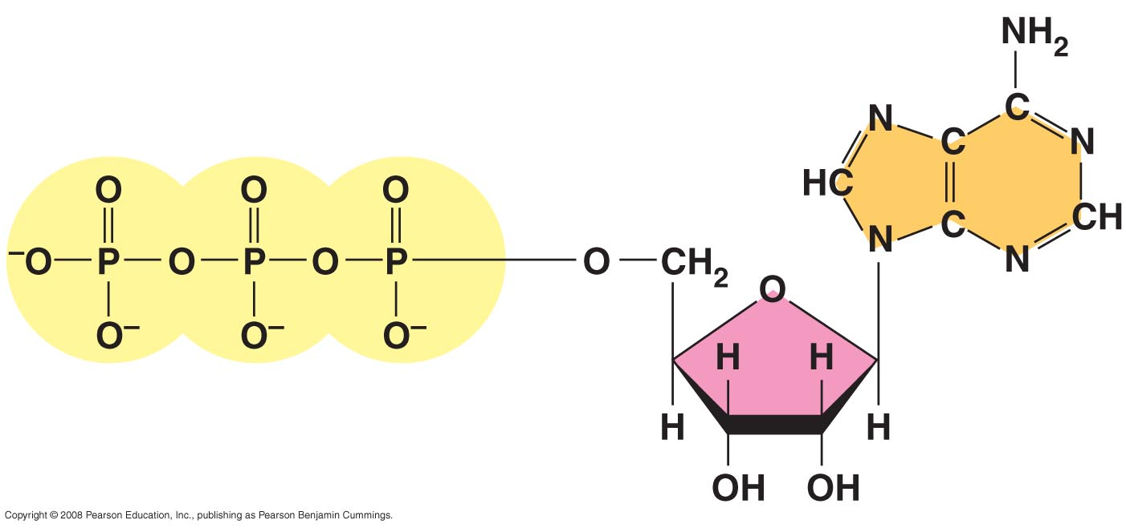
Fig. 8-8
Adenine
Phosphate groups
Ribose

Slide 9
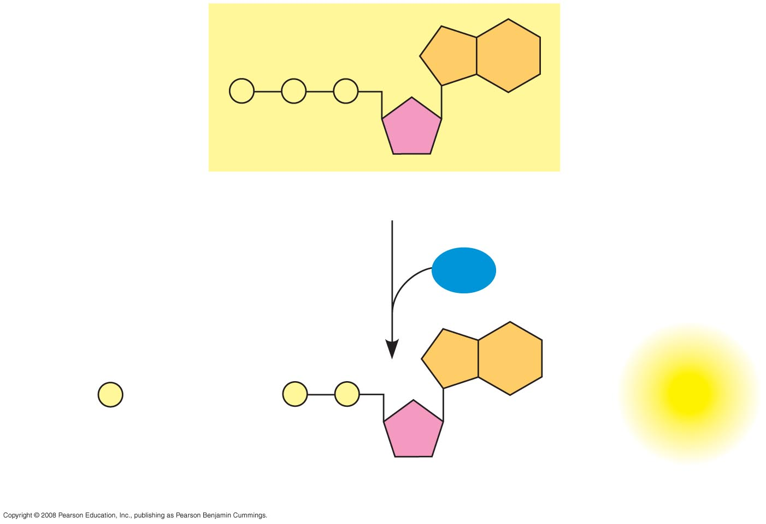
Fig. 8-9
P
P
P
Adenosine triphosphate (ATP)
H₂O
P
+
P
P
+
Energy
i
Inorganic phosphate
Adenosine diphosphate (ADP)

Slide 10
Coupled Reactions
If ∆G of an endergonic reaction is less than the amount of energy released by ATP hydrolysis then the 2 reactions can be coupled so that overall it’s exergonic.

Slide 11
Types of reactions
Oxidation – reduction reactions
AKA Redox reactions
2. Phosphorylation

Slide 12
Redox Reactions
Reduction – gain of electron
(reduces the charge)
Oxidation – loss of electrons
  Pg. 163

Slide 13
Phosphorylation
Transfer of a phosphate group from ATP to some other molecule.
The recipient of the phosphate group is said to be phosphorylated.
Two types:
- Oxidative phosphorylation
- Substrate level phosphorylation

Slide 14
Substrate Level Phosphorylation
Enzymes transfer a P from a substrate to ADP thus making ATP

Slide 15
Oxidative Phosphorylation
Producing ATP using energy from redox reactions of an electron transport chain

Slide 16
Cellular Respiration
Catabolic pathways that break down organic molecules for the production of ATP
Overall energy gain from 1 mol. of glucose
1. Equation for complete breakdown of glucose
C₆H₁₂O₆ + 6O₂ → 6CO₂ + 6H₂ O + 36 ATP
2. AKA oxidation of glucose
3. Rate is 40% efficient

Slide 17
Stages of Cellular Respiration
Glycolysis
Citric acid cycle aka Krebs
Oxidative Phosphorylation: electron transport and chemiosmosis
  The citric acid cycle and oxidative phosphorylation are often referred to as Aerobic respiration and both occur in the mitochondria

Slide 18
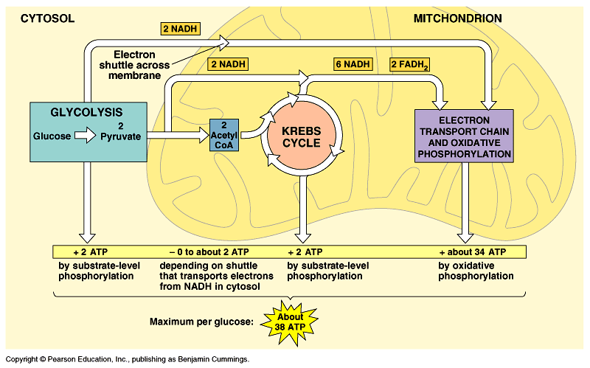

Slide 19
Glycolysis
Splitting of the 6C glucose into two 3C compounds (pyruvate)
Occurs in cytoplasm
Anaerobic process – no oxygen required

Slide 20
Steps of glycolysis
- Each step changes glucose & is catalyzed by a specific enzyme
- Some steps are rearrangement steps thus producing isomers
- Some are redox or phosphorylation reactions.

Slide 21
Glycolysis is divided into 2 parts
Energy investment phase
Energy payoff phase

Slide 22
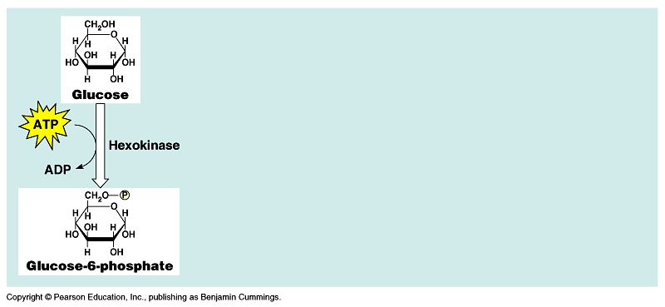
Energy investment

Slide 23
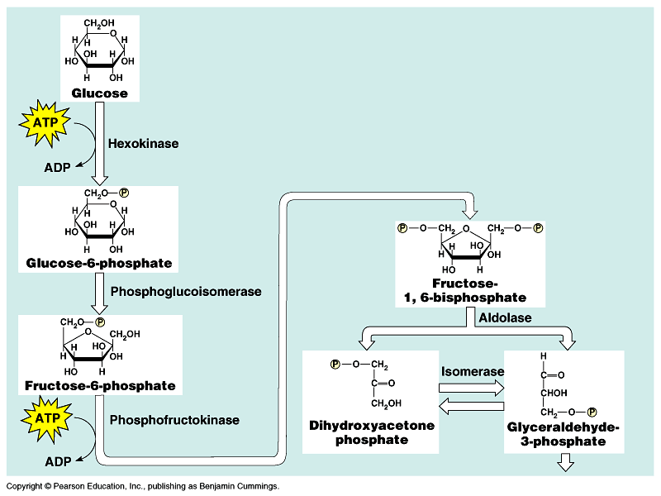
Energy investment
(PFK)

Slide 24
Step 3 -- Regulatory step
- Uses enzyme PFK
- ATP is an allosteric inhibitor of PFK
- Therefore if ATP is abundant this step
will be inhibited thus glycolysis stops
- Is this a good thing?

Slide 25
Energy investment
PGAL

Slide 26
End of energy investment phase
2 ATP invested
Glucose is now 2 PGAL molecules

Slide 27
Energy investment
PGAL

Slide 28
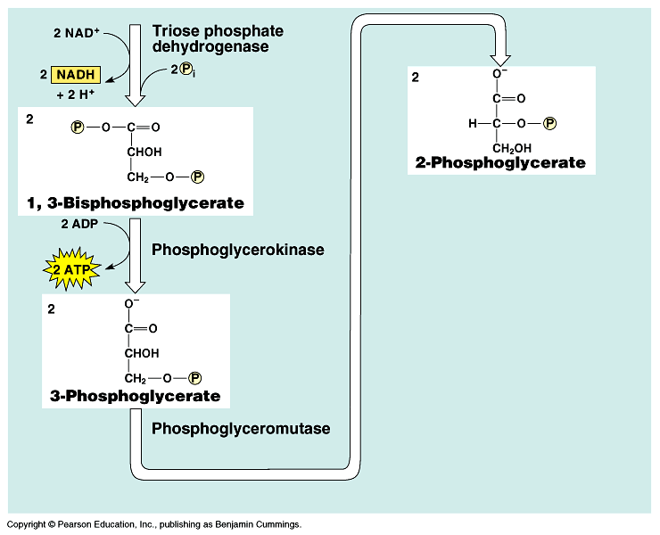
Energy payoff phase

Slide 29
Glycolysis - energy payoff phase
Step 6
- For every glucose molecules 2 PGAL enter
- A dehydrogenase removes a pair of hydrogen atoms (2 electrons and 2 protons) from PGAL
- Dehydrogenase then delivers the 2 electrons and 1 proton to NAD ⁺ creating NADH
- the other proton (H⁺⁾ is released
Each PGAL yields 1 NADH so 2 NADH are gained
P_{i} enters

Slide 30
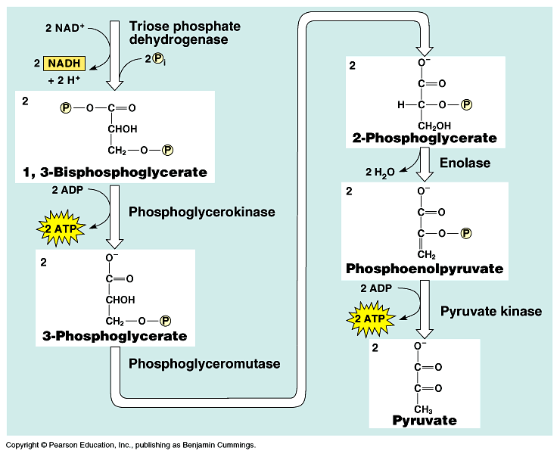
Energy payoff phase

Slide 31
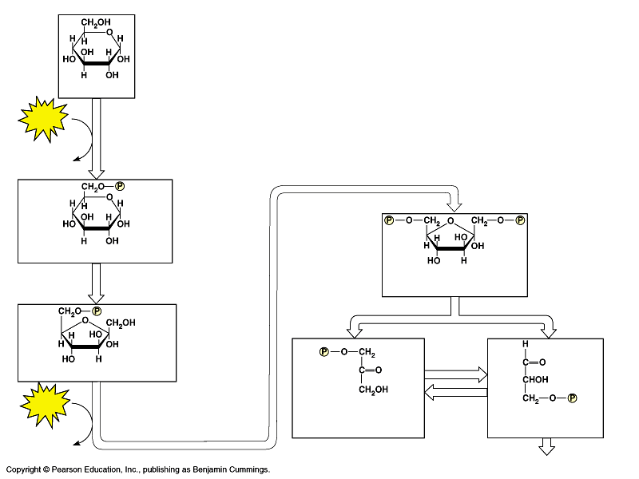
Energy payoff phase

Slide 32
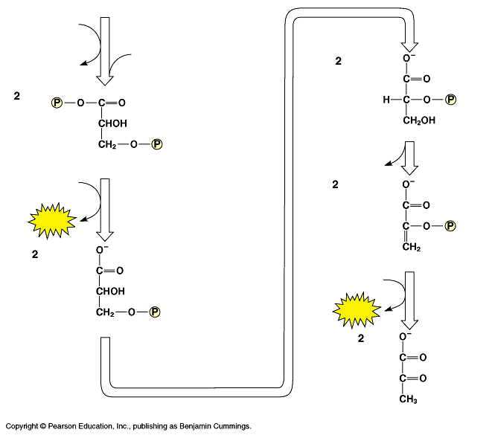
Energy payoff phase

Slide 35
Summary – net gain
2 ATP’s -- energy carrier
2 pyruvates -- energy carrier
2 NADH -- energy carrier
2 H₂O -- waste

Slide 37
2 possibilities for pyruvate
* Path depends on presence of oxygen.
* No oxygen – fermentation in cytosol
* Sufficient oxygen – aerobic respiration : pyruvate enters mitochondria

Slide 38
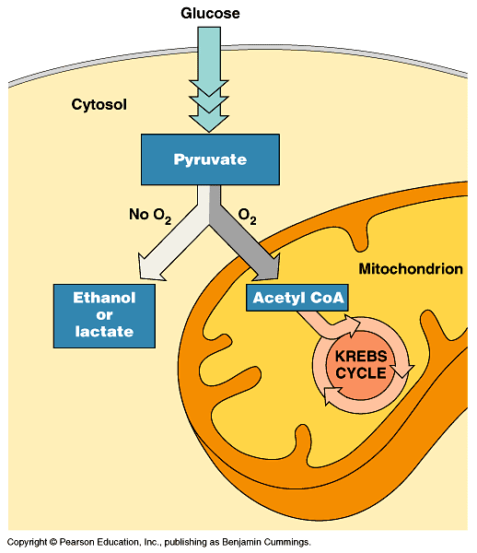

Slide 39
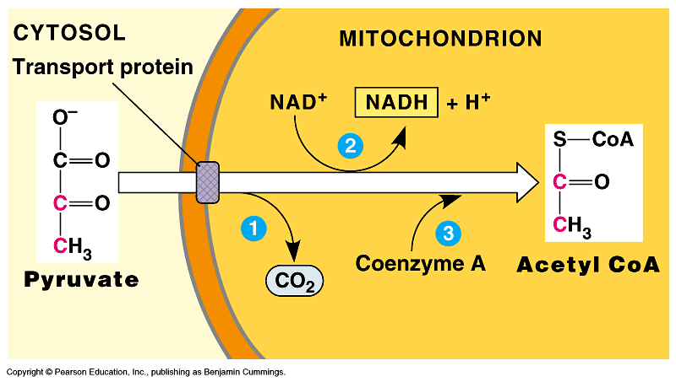

Slide 40
Aerobic respiration
Oxidation of pyruvate to acetyl CoA
- See pg. 170 fig. 9.10
- Small but important transition step – allows pyruvate to enter mitochondria

Slide 41
Aerobic respiration
Pyruvate oxidized to release NADH and CO₂ (total 2 per glucose)
Takes place in matrix solution of mitochondria – enzymes & coenzymes are present

Slide 42
Total gain from oxidation of pyruvate step
2 CO₂ -- waste
2 NADH – energy carriers
2 Acetyl CoA (to continue with respiration)

Slide 43
Citric Acid Cycle aka Krebs Cycle
Takes place in matrix solution
One acetyl CoA enters Krebs by bonding with OAA to form citric acid
The CoA drops off the acetyl compound & goes back to get another acetyl group
Citric acid can also inhibit PFK
See pg. 171

Slide 44
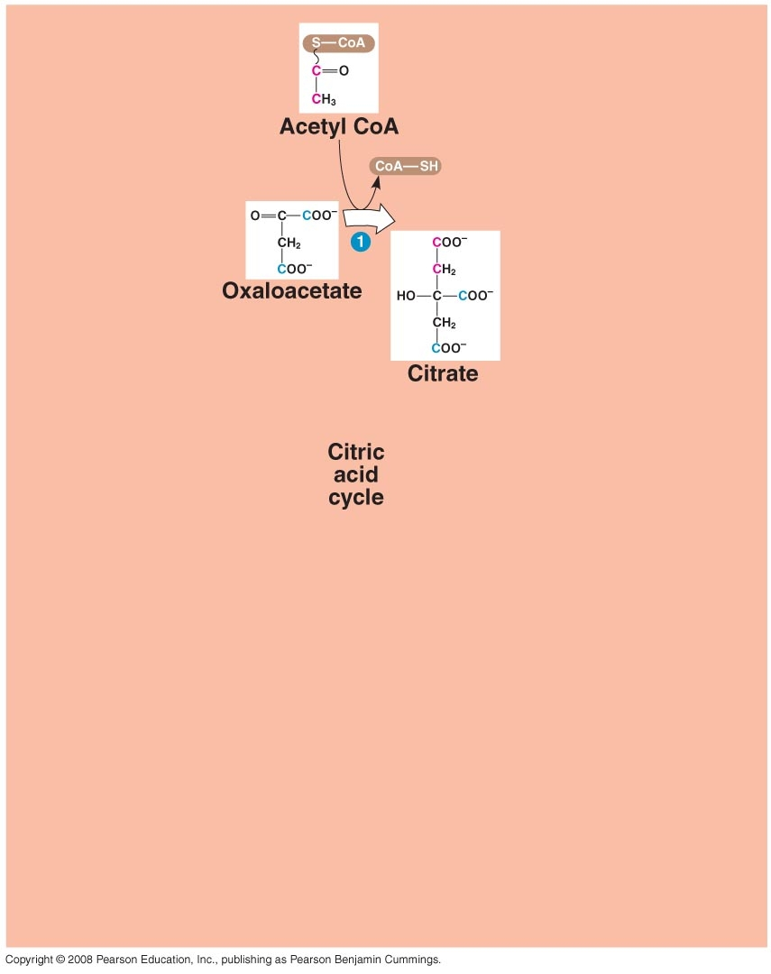

Slide 45
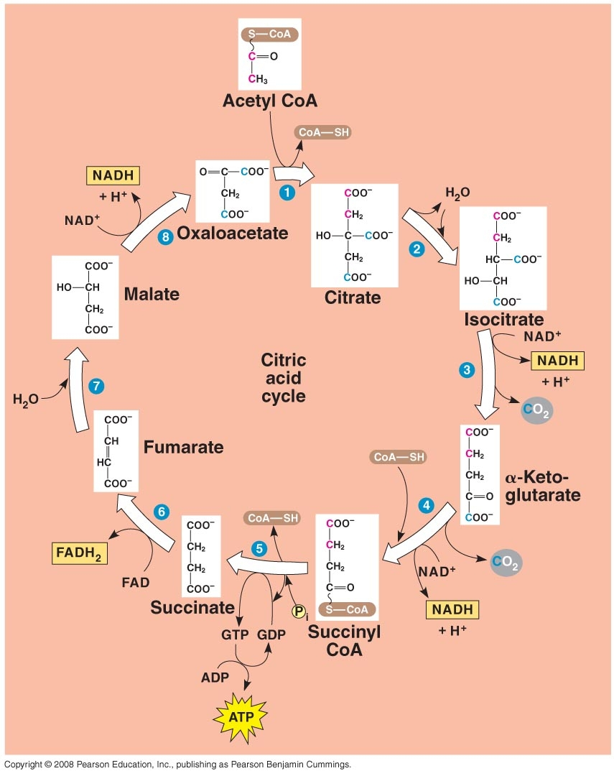

Slide 46
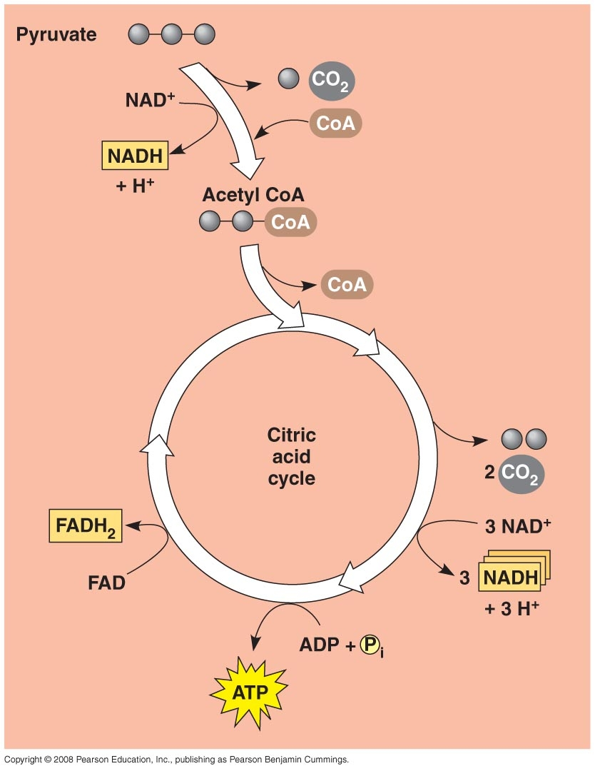

Slide 47
Citric Acid cycle summary
Into Citric Acid cycle
- Acetyl CoA
- NAD ⁺
- FAD ⁺
- ADP
Out of Citric Acid cycle
- 4CO2
- NADH
- FADH
- ATP

Slide 48
Citric Acid Cycle
- OAA is regenerated to repeat the cycle
- Glucose has been completely oxidized. All C’s from original glucose mol. have been removed.
How many net ATP’s so far?

Slide 49
Citric Acid Cycle
4 total ATP’s gained thus far
2 ATP from glycolysis
2 ATP from Citric acid
What type of phosphorylation occurred in glycolysis and Citric Acid cycle?
- Substrate level phosphorylation

Slide 50
Oxidative Phosphorylation
Production of ATP using energy from electron transport chain (ETC)

Slide 51
Electron Transport Chain
A chain of molecules that pass an electron from one molecule to another
Located across the inner membrane – members weave in and out of the matrix and intermembrane space

Slide 52
Electron Transport Chain
Electrons that enter come from NADH and FADH
Per glucose molecule what enters ETC?
10 NADH’s
- 2 from glycolysis
- 2 from oxidation of pyruvate
- 6 from Krebs
2 FADH’s from Citric Acid cycle

Slide 53
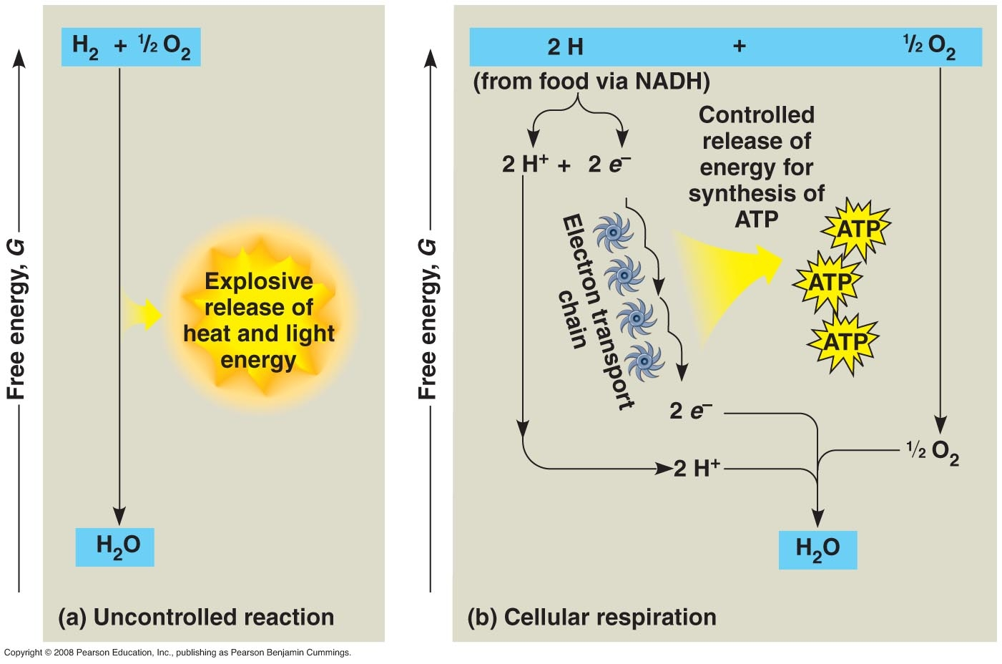

Slide 54
Structure of ETC
Most components of ETC are proteins called cytochromes (thus aka cytochrome chain)
Q (ubiquinone) is the only one that is not a protein
Electrons “fall” down an energy gradient from NADH to oxygen
Electronegative oxygen “pulls” electrons down the chain.
At the “bottom” O₂ captures these electrons along with hydrogen nuclei (H⁺) forming H₂O.

Slide 55
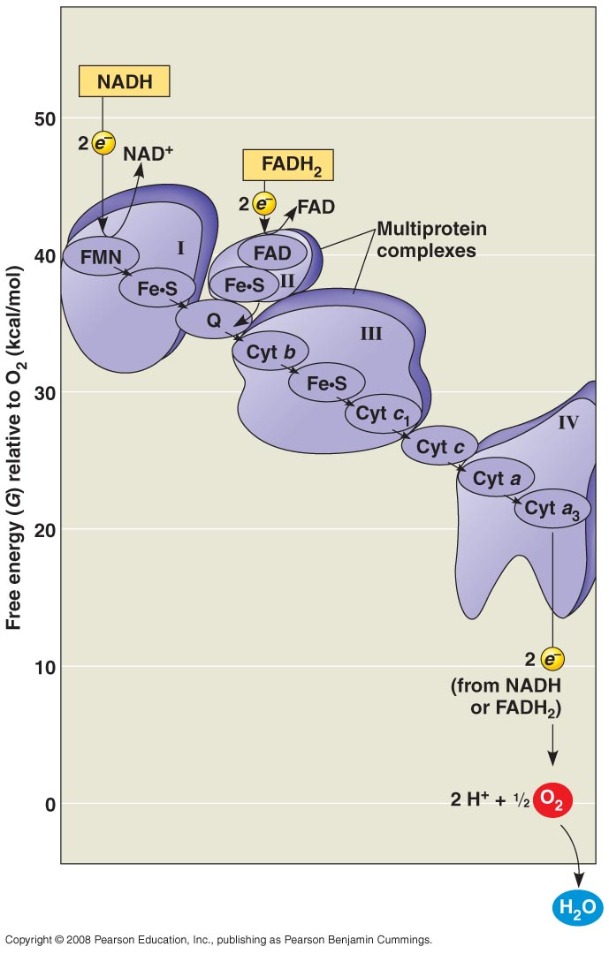

Slide 56
Working ETC
Multiprotein complexes accept and then donate electrons.
As they do this, they pump H⁺ from matrix to intermembrane space

Slide 57
How does ETC make ATP?
Chemiosmosis

Slide 58
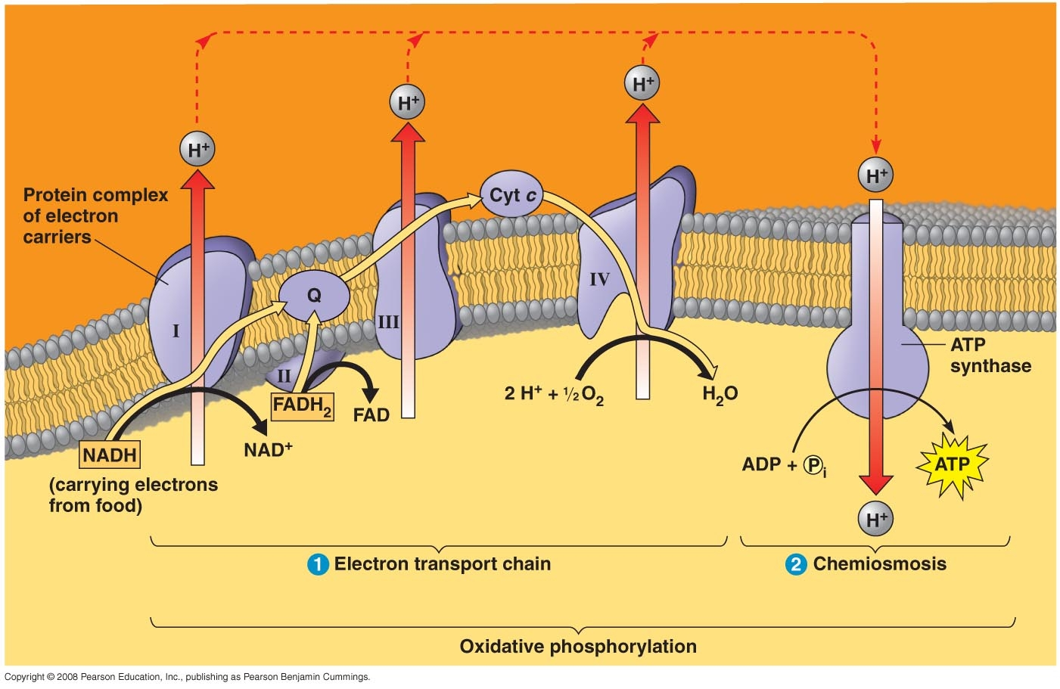
Intermembrane space
Cristae -
Inner membrane
Matrix

Slide 59
Chemiosmosis
Coupling the redox reactions of ETC to ATP synthesis
As e-’s are sent through ETC, H⁺ are pumped across membrane from matrix to intermembrane space

Slide 60
Chemiosmosis
H⁺ flow through the multiprotein complexes from matrix to intermembrane space
Protons then diffuse back into matrix through ATP synthase complexes - this powers ATP generation
H⁺ move one by one into binding sites of the proteins causing a rotation

Slide 61
Chemiosmosis
Some H ⁺ leak back through ATP synthase
This causes a proton gradient called the proton motive force.

Slide 62
Chemiosmosis
Structure of ATP synthase causes conformational changes that activate sites where ADP & P join to form ATP.
Much is hypothesized here. See fig. 9.14

Slide 63
Intermembrane space
Cristae -
Inner membrane
Matrix

Slide 64
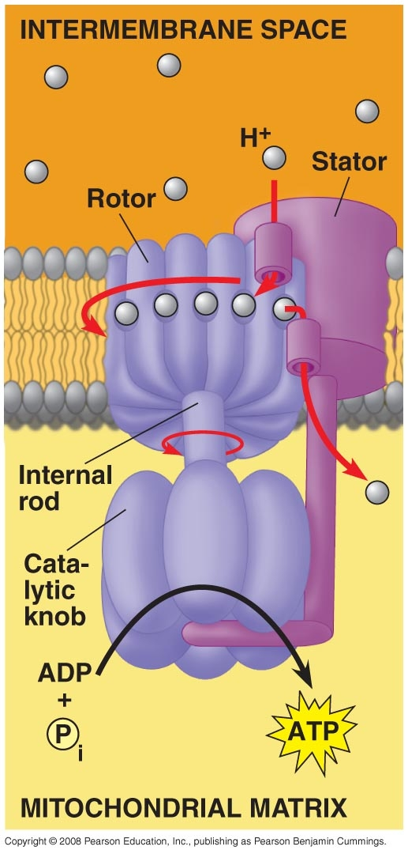

Slide 65
Working ETC
NADH deposits its electrons at the start thus the electrons from NADH pass 3 multiprotein complexes
This pumps enough H⁺ to create energy for production of 3 ATP molecules
FADH deposits its electrons farther down the chain and misses the 1st complex therefore fewer protons are being pumped into the space, therefore only 2 ATP’s made

Slide 66
* The 2 NADH’s from glycolysis made in cytosol are brought into mitochondria by shuttle
The shuttle may cause the NADH to enter at the same location as the FADH.

Slide 67
38 maximum
Or 36 depending on shuttle for NADH
How many ATP’s made through substrate level phosphorylation?
4
How many ATP’s made through Oxidative Phosphorylation?
34

Slide 68
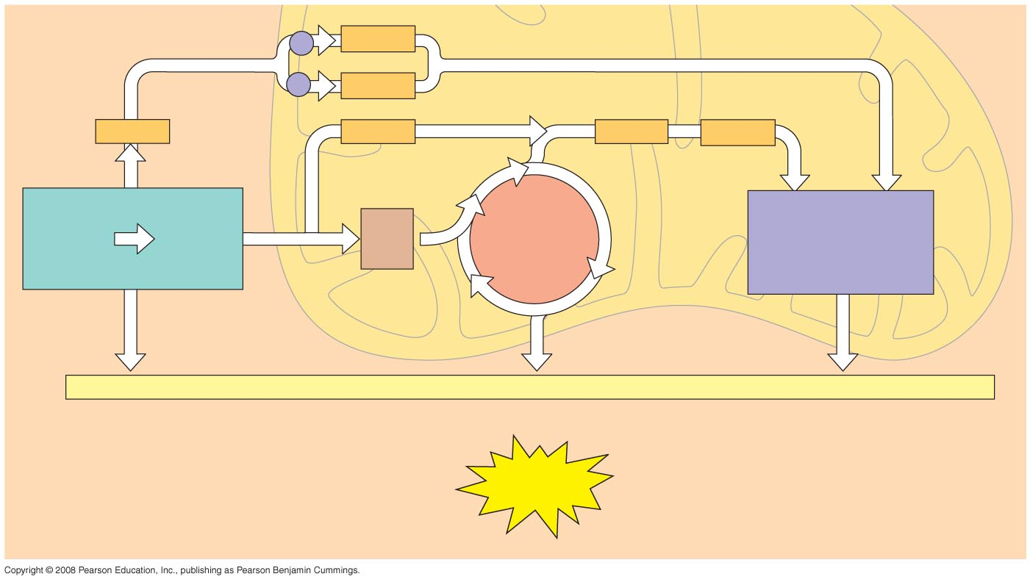

Slide 69
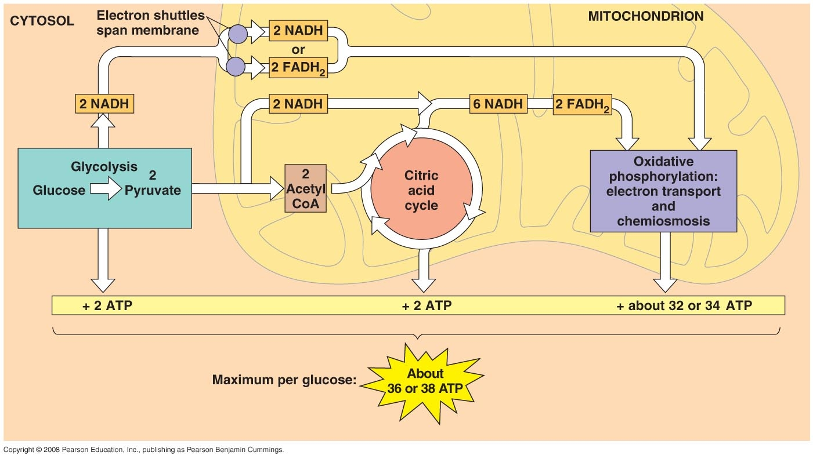

Slide 72
Intermembrane space
Cristae
Matrix

Slide 73
Anaerobic Respiration
Same process as aerobic resp. but uses sulfate or nitrate as final H acceptor not oxygen.

Slide 74
Regulation
3 substances that regulate cellular respiration:
- ATP inhibits PFK
- Citric acid inhibits PFK
- AMP stimulates PFK

Slide 75
Does respiration have to start with glucose?

Slide 76
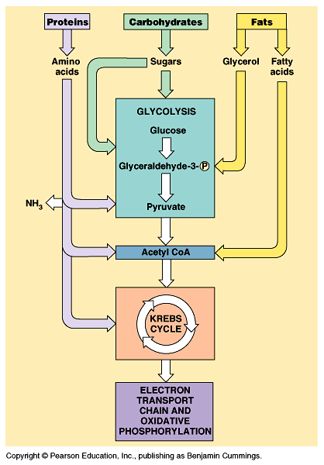
Oxidation of other organic molecules
Biosynthesis – this process working in revers to produce proteins, fats or carbohydrates such as glycogen

Slide 78
What if no oxygen is present?

Slide 80
Fermentation
Two types of fermentation
1. Alcohol ferm. -- yeast cells & bacteria
2. Lactic acid ferm. -- fungi & human muscle cells

Slide 81
Alcohol Fermentation
- Details fig. 9.18
- Glycolysis occurs first

Slide 82
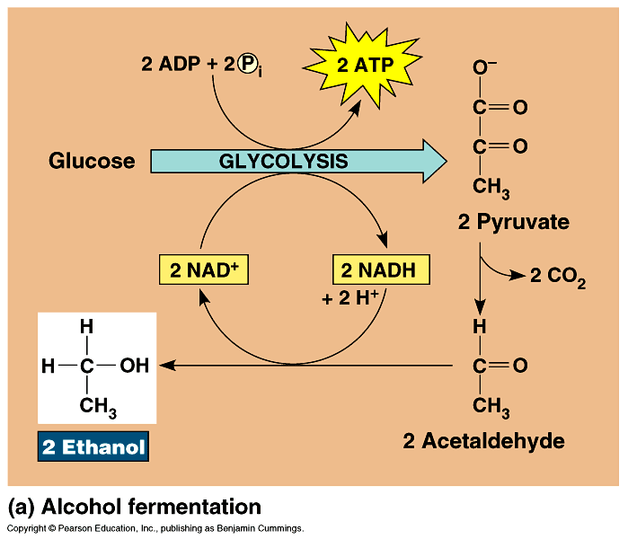

Slide 83
Alcohol Fermentation
2 steps:
- 1. Pyruvic acid from glycolysis releases CO₂ & forms acetaldehyde
- 2. Acetaldehyde is reduced by NADH to ethyl alcohol and gives off H ⁺

Slide 84
Alcohol fermentation summary
NAD ⁺ is regenerated for glycolysis
Net gain
- 2ATP from glycolysis
- 2 H₂O “ “
- 2 CO₂
- 2 ethanol (ethyl alcohol)

Slide 85
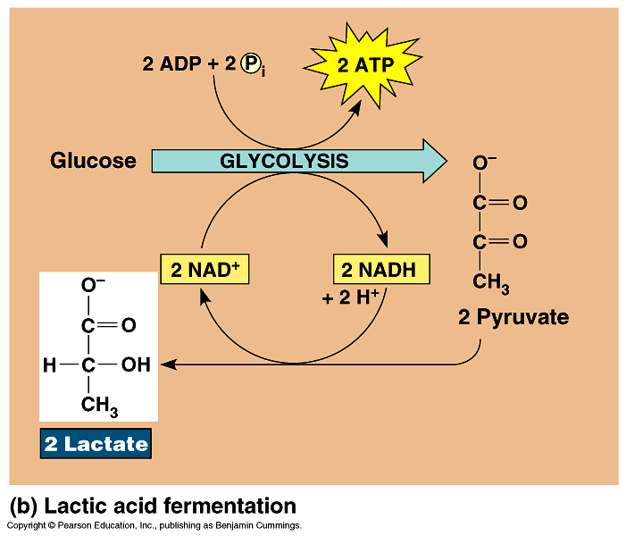

Slide 86
Lactic acid fermentation
One step:
Pyruvate is reduced directly by NADH to form lactate (lactic acid)
Net gain:
2 ATP from glycolysis
2 H₂O
2 lactates

Slide 87
Muscles do this when O₂ in high demand or in short supply
Glycogen → glucose → pyruvate → lactate

Slide 88
Results of lactic acid fermentation
a. Muscle fatigue
b. Lactic acid build up
c. Drop in pH of cells slows reactions
d. Lactic acid to liver to be
resynthesized into pyruvic acid
Pyruvate → glucose → glycogen

Slide 89
PHOTOSYNTHESIS

Slide 90
Background
Equation
- 6CO₂ + 6H₂O+ light E ⇒ C₆H₁₂O₆ + 6O₂
- CO₂ oxidized or reduced
- H₂O oxidized or reduced
- Light energy in – endergonic or exergonic
Transformation made from light E to chemical E

Slide 91
Light energy
Photons – particles of light
Visible light spectrum – ROYGBIV
Color differs due to length of the wave see diagram pg. 190
- wavelength – distance b/w peaks
- measured in nanometers

Slide 92
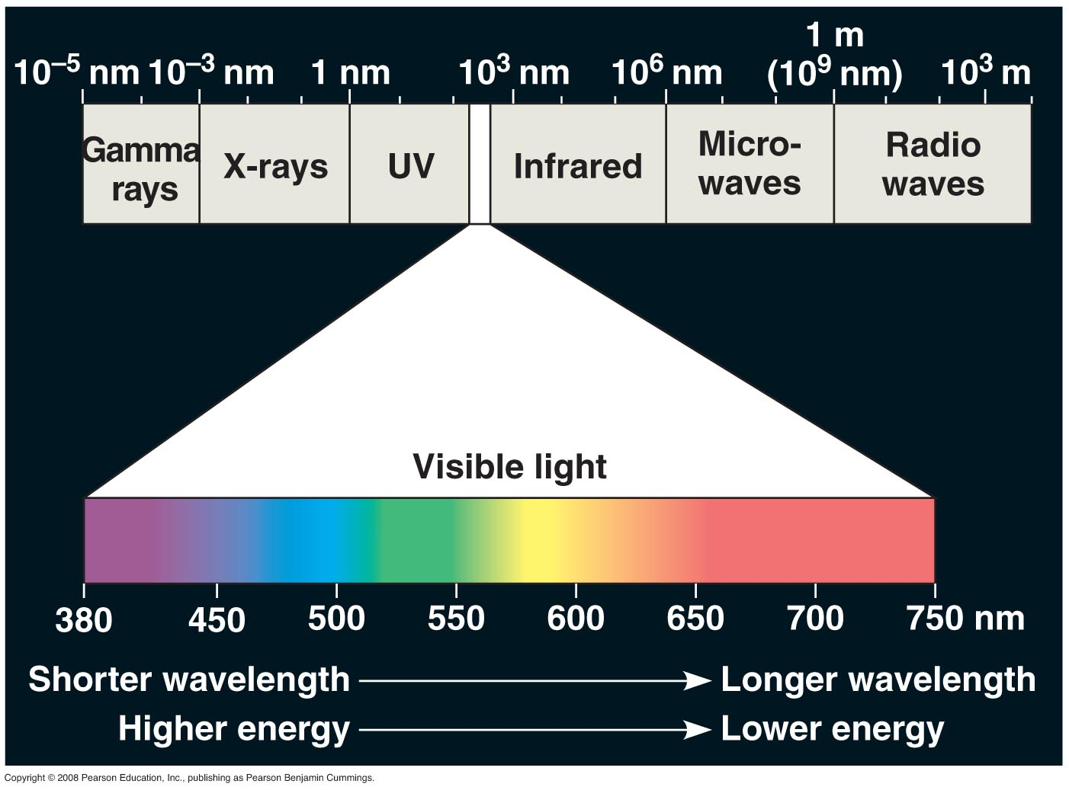

Slide 93
Light energy
Red – longest λ
Violet – shortest λ
Shorter λ – more E in each photon

Slide 94
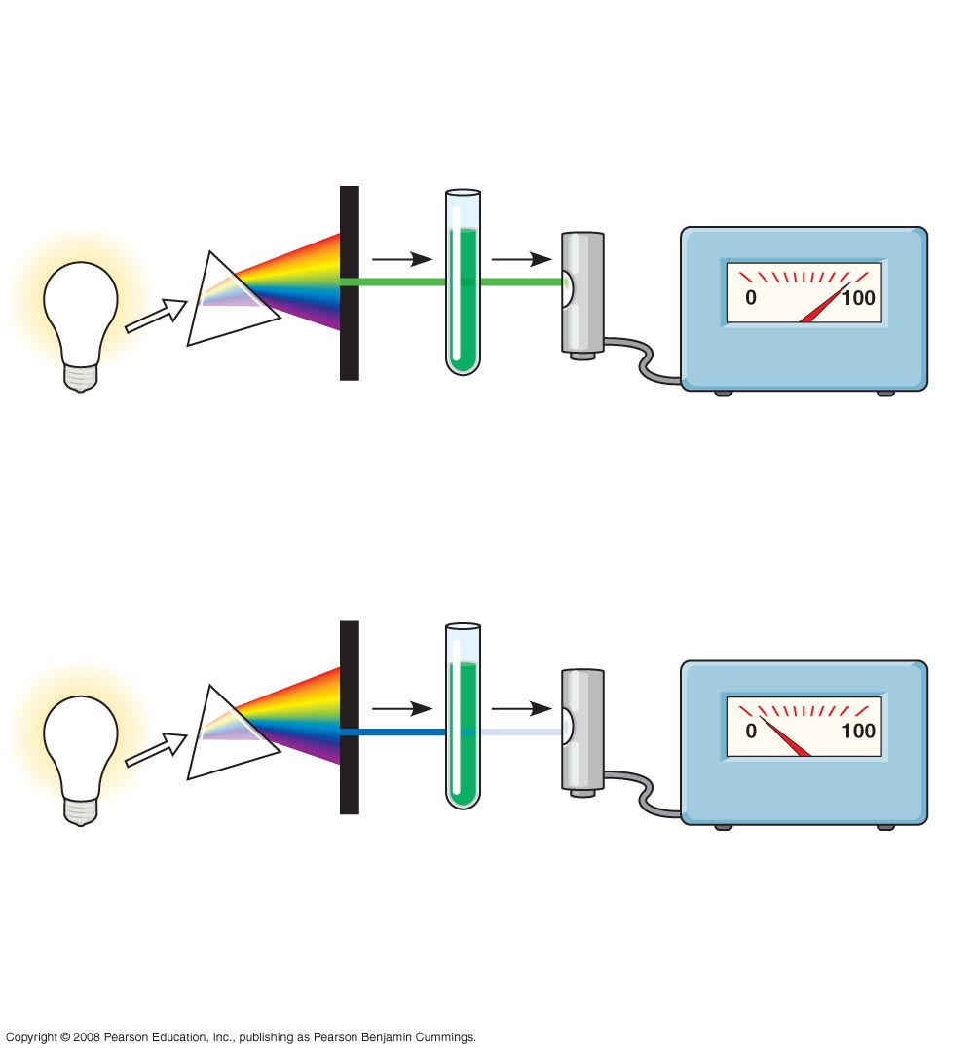
Fig. 10-8
TECHNIQUE
White
light
Refracting
prism
Chlorophyll
solution
Photoelectric
tube
Galvanometer
2
3
1
4
The high transmittance
(low absorption)
reading indicates that
chlorophyll absorbs
very little green light.
Slit moves to
pass light
of selected
wavelength
Green
light
The low transmittance
(high absorption)
reading indicates that
chlorophyll absorbs
most blue light.
Blue
light

Slide 95
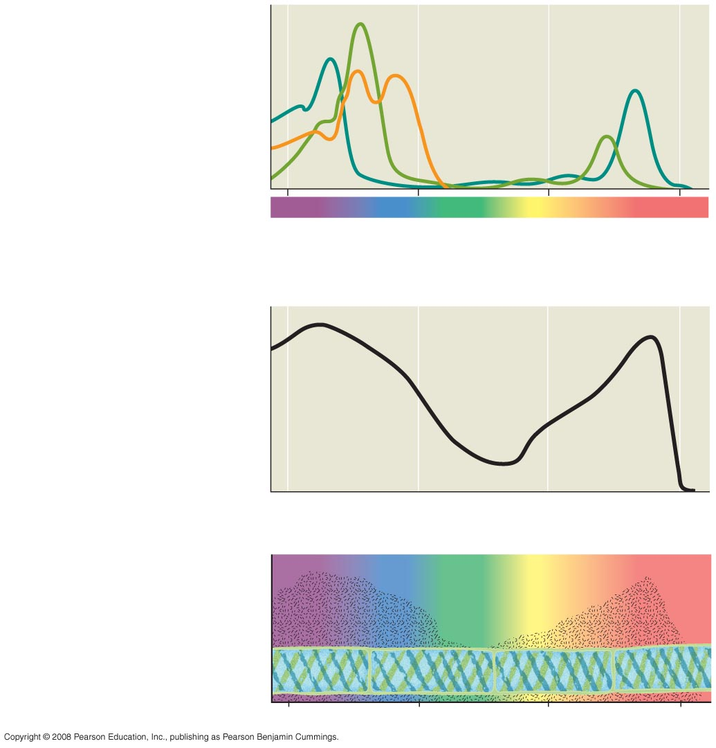
Fig. 10-9
RESULTS
Chloro-
phyll a
Chlorophyll b
Absorption of light by
chloroplast pigments
Carotenoids
(a) Absorption spectra
400
500
600
700
Wavelength of light (nm)
Rate of photosynthesis
(measured by O₂ release)
(b) Action spectrum
Aerobic bacteria
Filament
of alga
(c) Engelmann’s
experiment
400
500
600
700

Slide 96
Light energy
All parts of spectrum travel at same speed (300,000 Km/sec.)
Light E can affect electrons
- Light strikes e- & sends it flying into a higher energy level (orbital)
- Light E & e- → e- w/ ↑PE (potential energy)

Slide 97
Light energy’s affect on e-
- Chloroplast – contains chlorophyll
- Two types of chlorophyll
-- chlorophyll a
-- chlorophyll b

Slide 98
- Chlorophyll a
-- blue green
-- the only one that directly participates in light reactions
- Chlorophyll b
-- yellow green
-- energy must be sent to chlorophyll a

Slide 99
Carotenoids
-- accessory pigments
-- send energy to chl. a

Slide 100
Fig. 10-8
TECHNIQUE
White
light
Refracting
prism
Chlorophyll
solution
Photoelectric
tube
Galvanometer
2
3
1
4
The high transmittance
(low absorption)
reading indicates that
chlorophyll absorbs
very little green light.
Slit moves to
pass light
of selected
wavelength
Green
light
The low transmittance
(high absorption)
reading indicates that
chlorophyll absorbs
most blue light.
Blue
light

Slide 101
Fig. 10-9
RESULTS
Chloro-
phyll a
Chlorophyll b
Absorption of light by
chloroplast pigments
Carotenoids
(a) Absorption spectra
400
500
600
700
Wavelength of light (nm)
Rate of photosynthesis
(measured by O₂ release)
(b) Action spectrum
Aerobic bacteria
Filament
of alga
(c) Engelmann’s
experiment
400
500
600
700

Slide 102
Were Ancient Bacteria Purple?

Slide 103
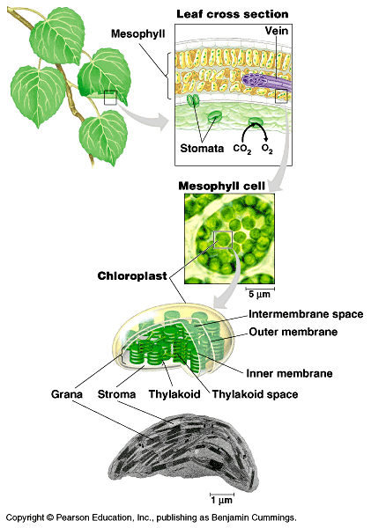

Slide 104
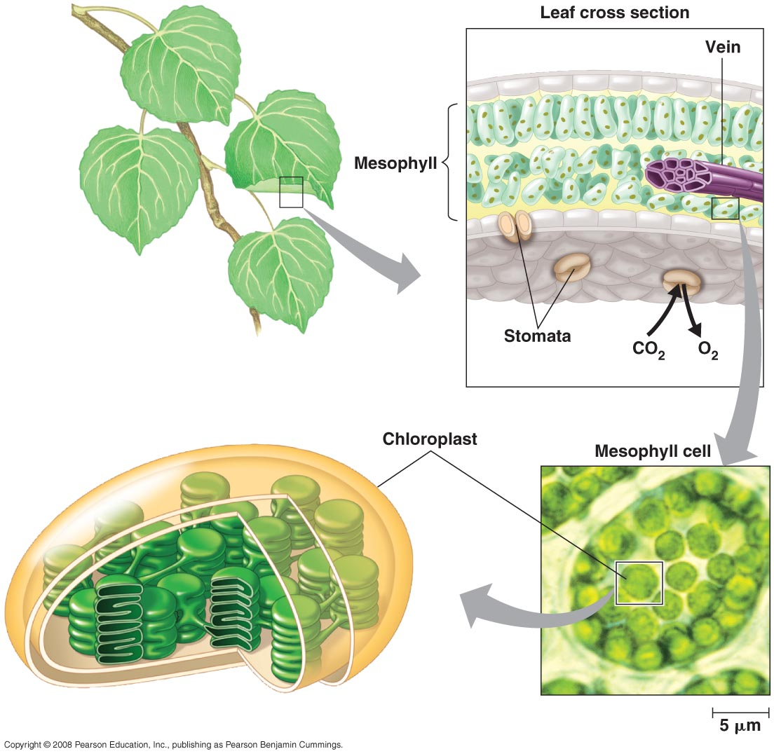

Slide 105
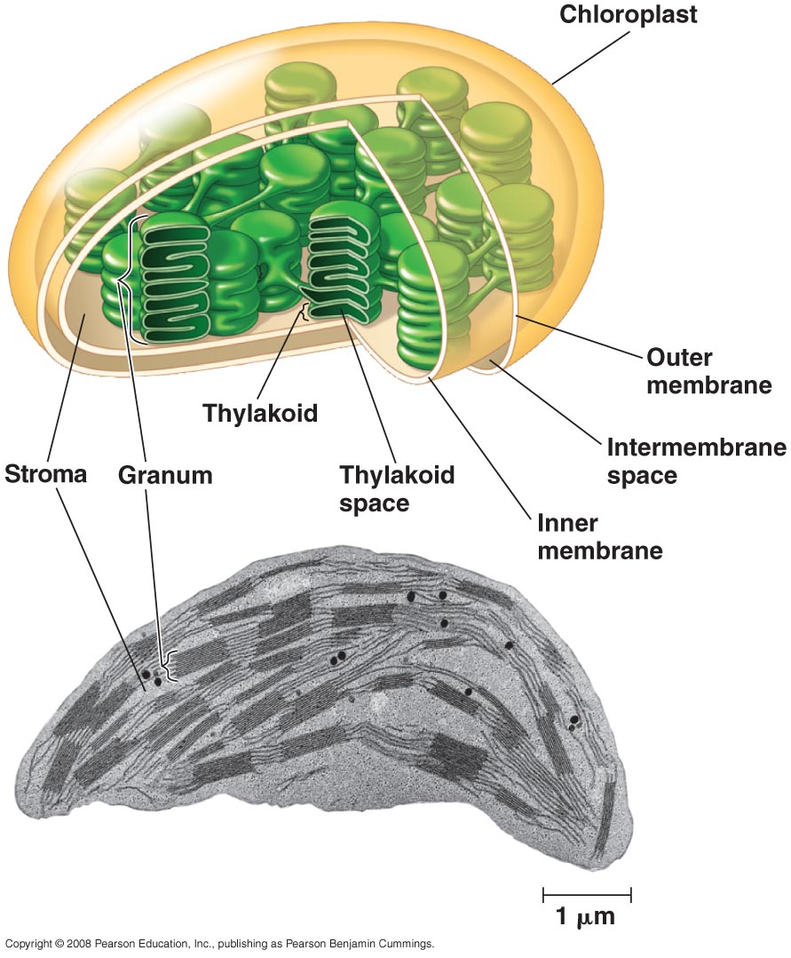

Slide 106
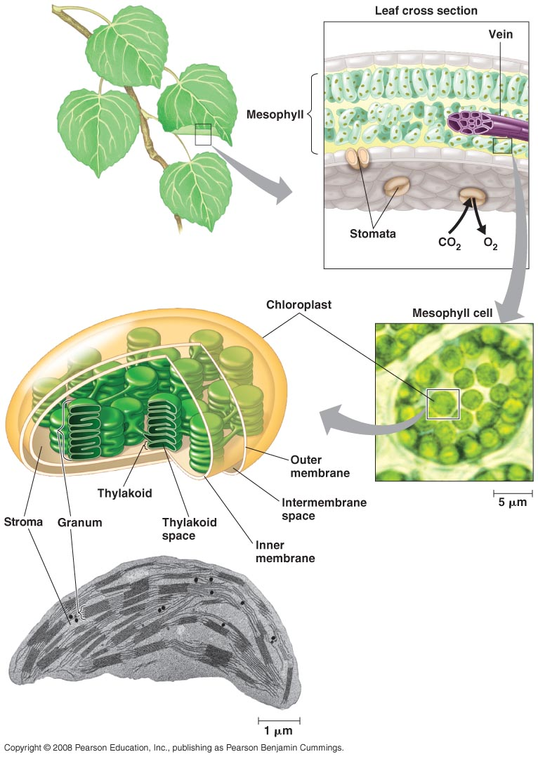

Slide 107
Chloroplast Structure
See pg. 187
Granna – stacks of thylakoids
Thylakoids – membrane & space
Stroma – space b/w granna
Chlorophyll mol. Is inside thylakoid memb.

Slide 108
Chloroplast Location
-Leaf cells
-Mesophyll
-See diagram pg. 187
-Sunlight has to penetrate cuticle & epidermal cells

Slide 109
Structure
Cuticle -- transparent waxy layer
-- CO₂ can’t get through
Stomata
– pores to allow Co₂ in & H₂O out
-- pores can open when cool & close at hottest part of day

Slide 110
Two stages of photosynthesis
Light reactions
-- energy capturing
-- light dependent
Calvin cycle –
-- carbon reduction
-- dark reactions
-- light independent

Slide 111
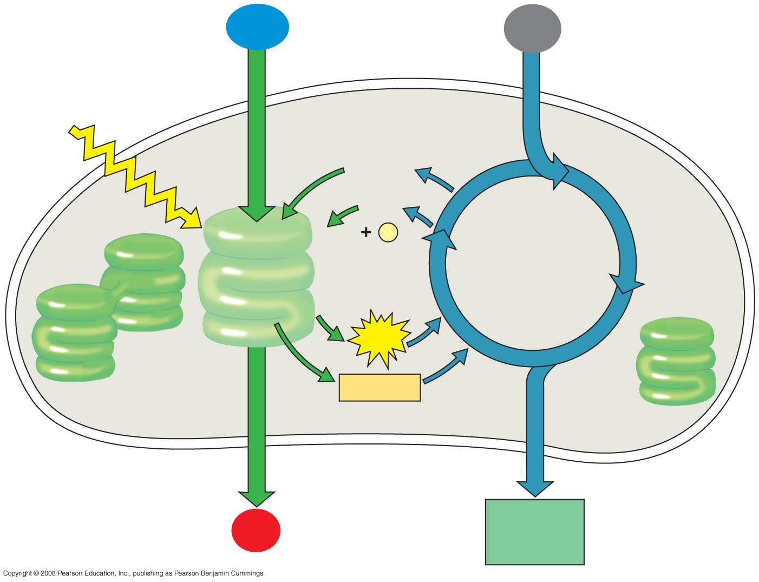
Fig. 10-5-4
H₂O
CO₂
Light
NADP⁺
ADP
+
P
_{i}
Calvin
Cycle
Light
Reactions
ATP
NADPH
Chloroplast
O₂
[CH₂O]
(sugar)

Slide 112
Light reactions
- Energy capturing
- Location: chlorophyll molecule in thylakoids in chloroplasts in mesophyll cells see diagram pg. 187

Slide 113
Light reactions
Two photosystems operating
- A photosystem is a light harvesting unit made of a protein complex called the reaction center surrounded by light harvesting complexes.
- light harvesting complexes consist of various pigments.

Slide 114
Light reactions
--Photosystem Ι (PSΙ) P700
-- absorbs λ700
-- Photosystem ΙΙ (PSΙΙ) P680
-- absorbs λ 680

Slide 115
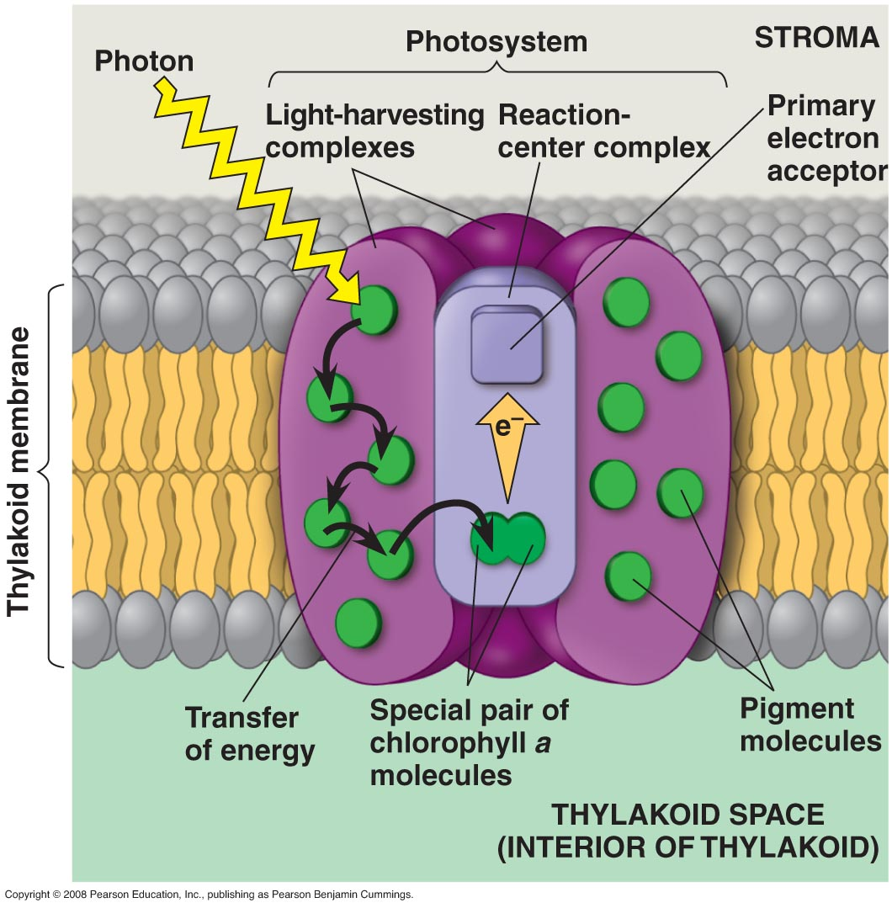

Slide 116
Light reactions
2 possible routes for electron flow
1. linear electron flow aka non cyclic
2. cyclic electron flow

Slide 117
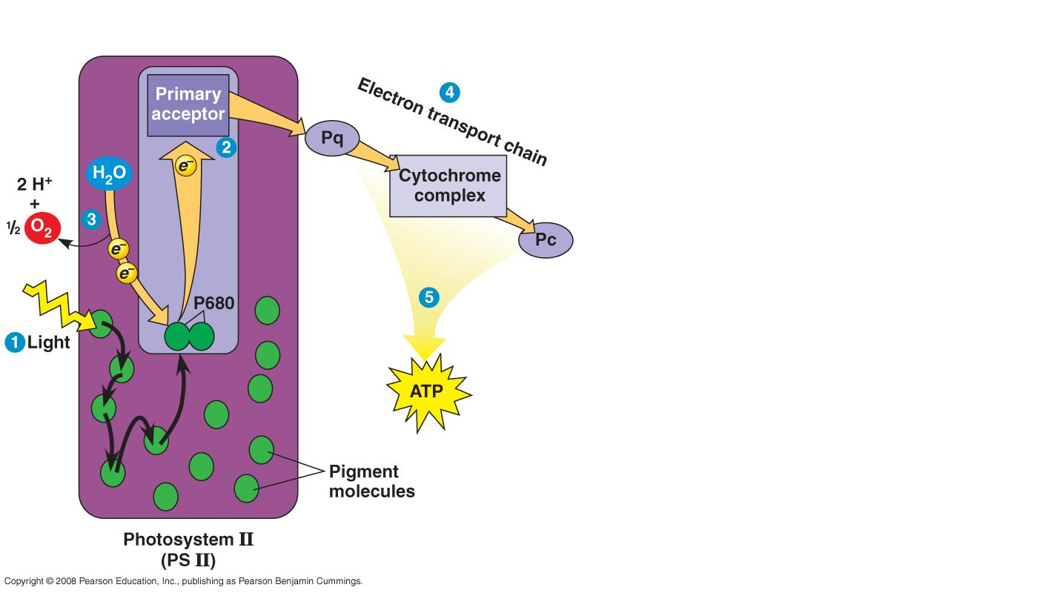
Linear electron flow

Slide 118
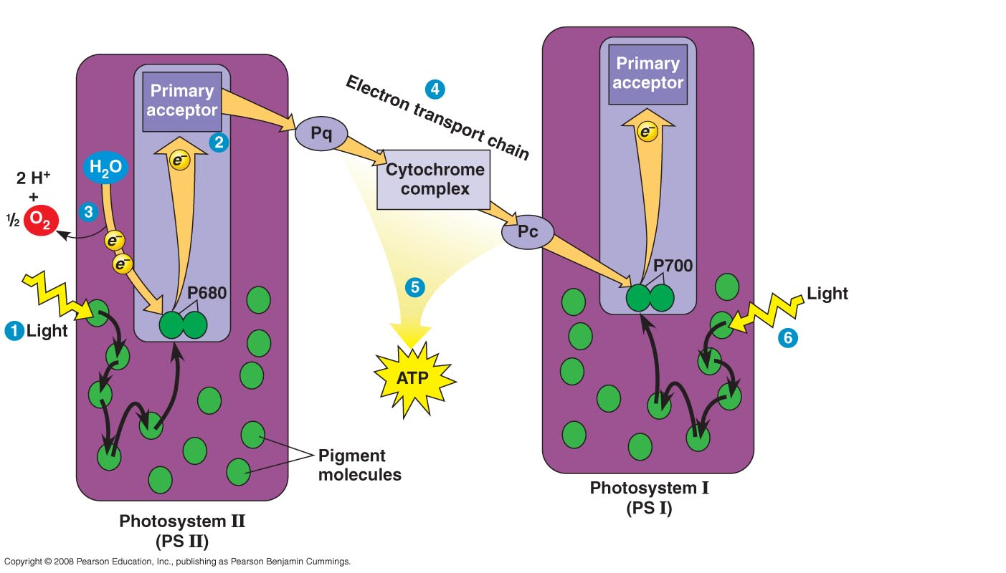

Slide 119
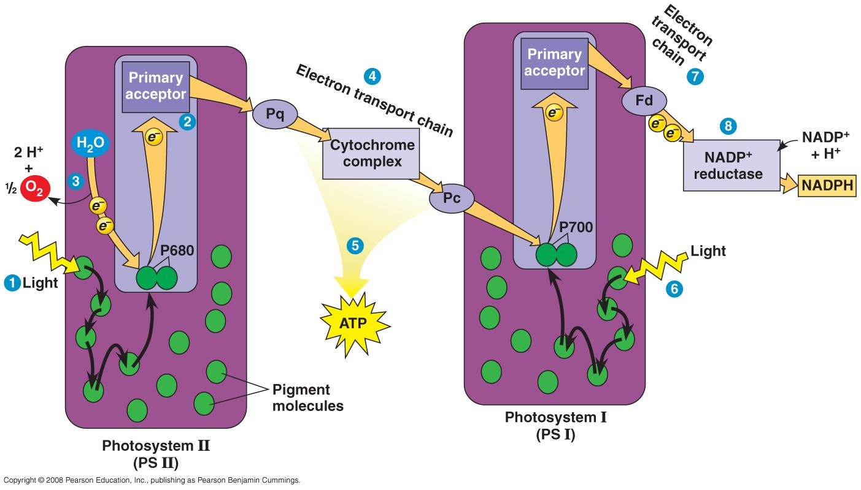

Slide 120
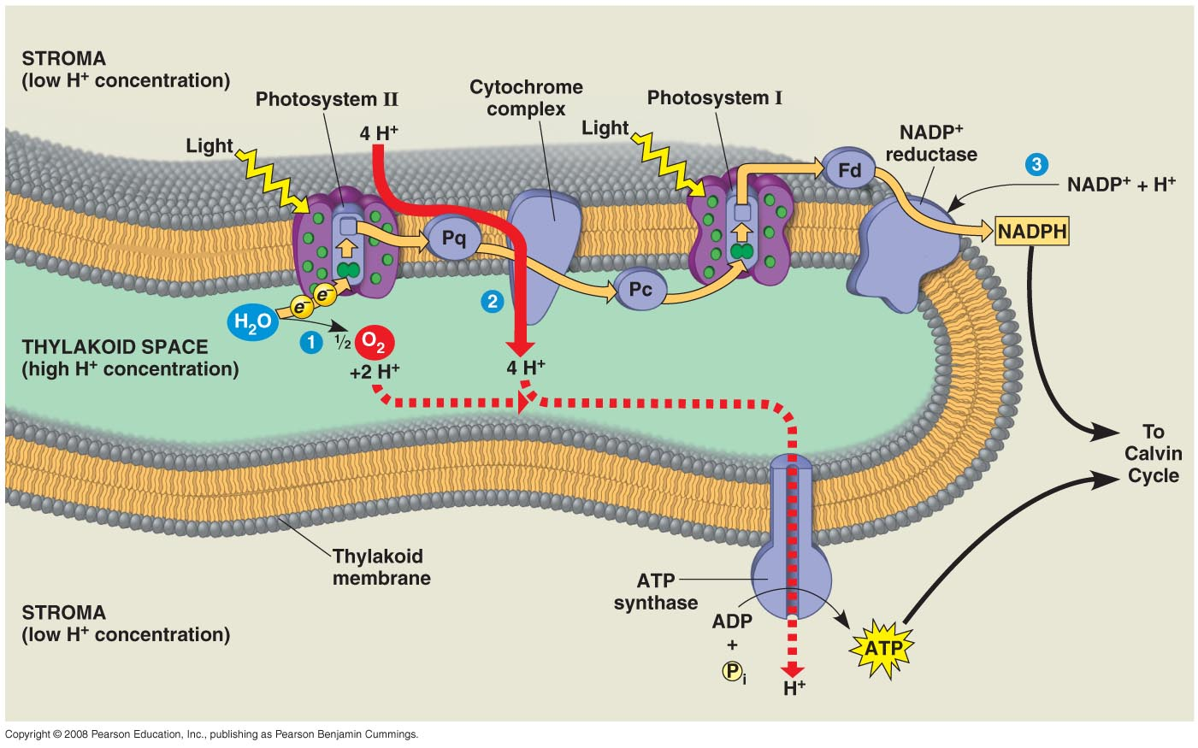

Slide 121
Linear electron flow
Photon hits PSΙΙ
e⁻ from chlorophyll a (usually from Mg⁺⁺) sent to a higher energy level of another molecule ( primary e-acceptor)
-chlorophyll oxidized

Slide 122
Linear electron flow
e⁻ passes down etc – proton gradient established across thylakoid membrane and ATP produced by photophosphorylation
e⁻ accepted by PSI chlorophyll mol.

Slide 123
Linear electron flow
e⁻ sent to primary acceptor
e⁻ sent down etc. – but this etc too short to make ATP
e⁻ put in carrier NADP⁺
NADP ⁺ → NADPH

Slide 124
Questions
What happens to the PSΙΙ chlorophyll molecule?
How is the electron replaced?
Notes:
Lost and electron that needs to be replaced and it was oxidized
H2O is oxidized and O2 is given off

Slide 125
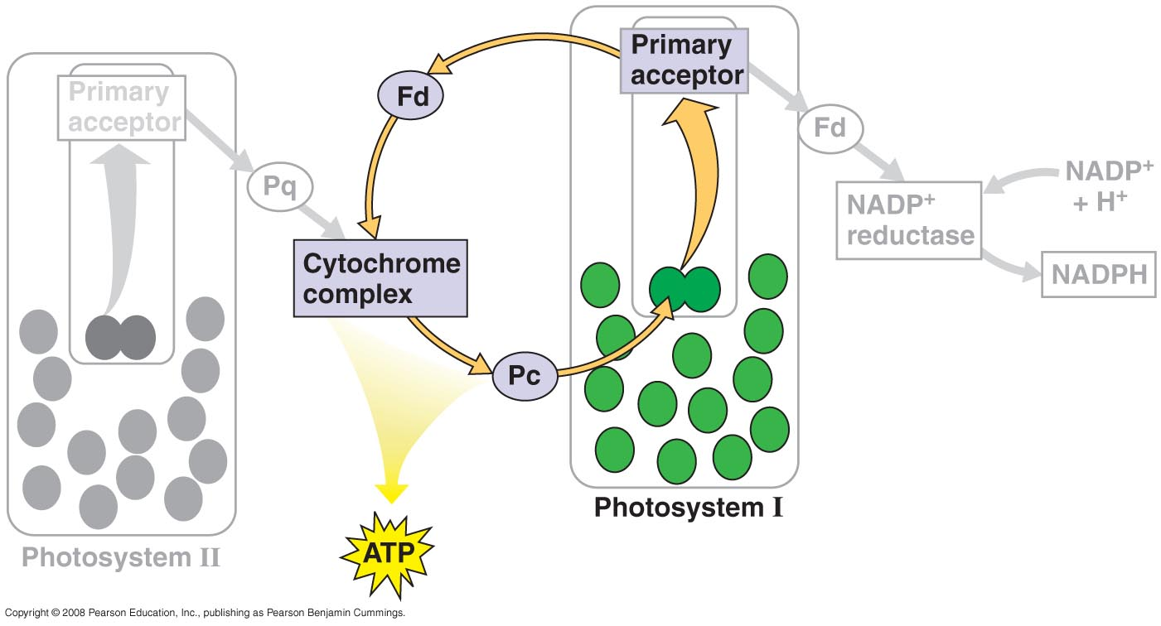
Cyclic electron flow

Slide 126
Homework
  Compare chemiosmosis in mitochondria and chloroplasts.

Slide 127
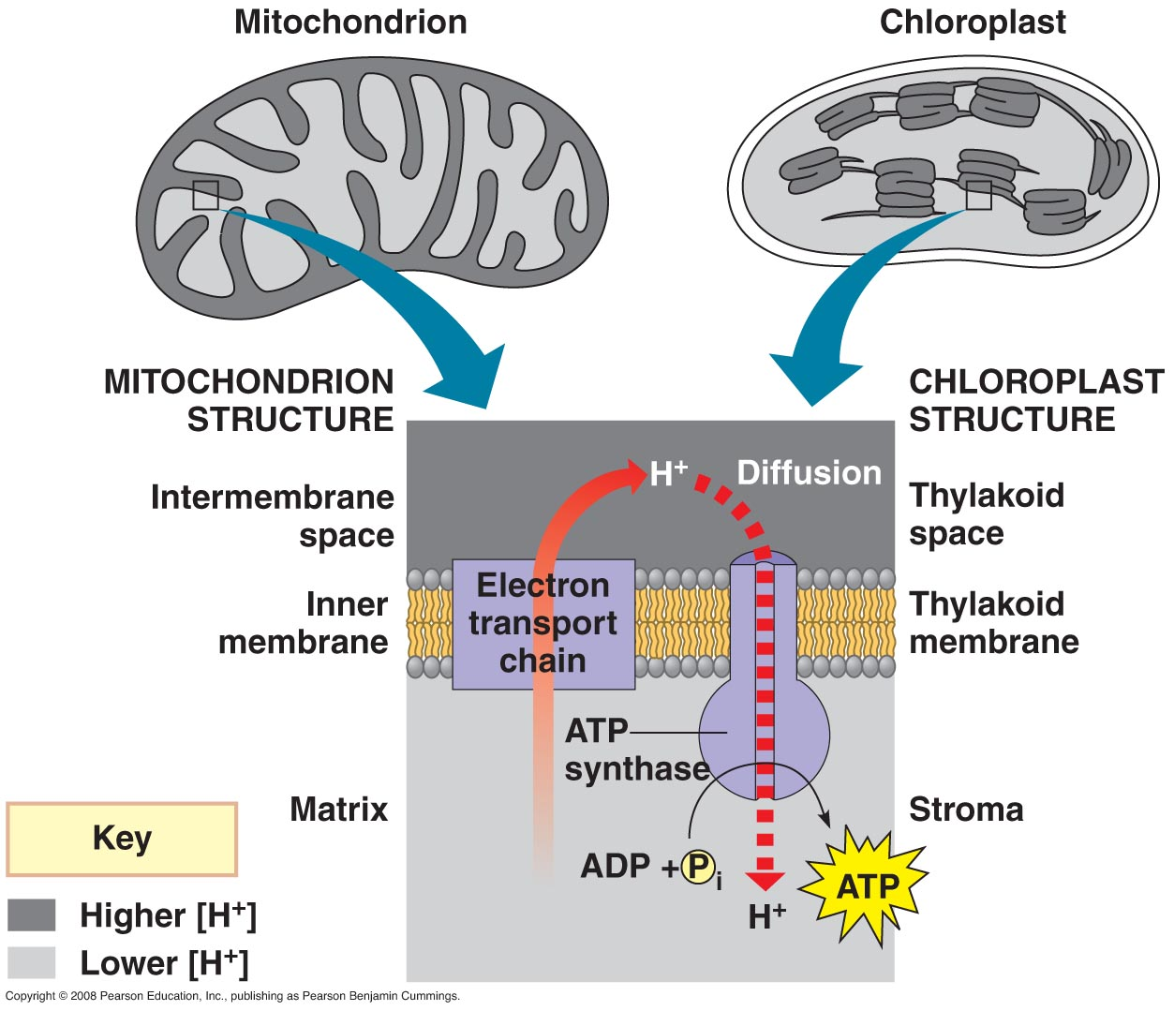

Slide 128
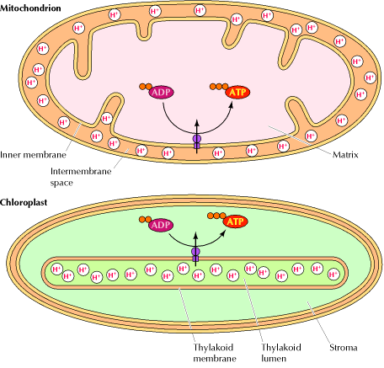

Slide 129
Cyclic electron flow
e- excited from PSΙ to primary acceptor (no PSΙΙ involved in cyclic)
e- sent down etc & produces ATP
e- returns to PSΙ
Does not produce NADPH - only ATP

Slide 130
Products of light reactions
ATP
NADPH
Both used to run Calvin cycle

Slide 131
Fig. 10-5-4
H₂O
CO₂
Light
NADP⁺
ADP
+
P
_{i}
Calvin
Cycle
Light
Reactions
ATP
NADPH
Chloroplast
O₂
[CH₂O]
(sugar)

Slide 132
Calvin Cycle
Occurs in the stroma
Pg. 199
Purpose is to produce sugar
Uses materials made in light reaction

Slide 133
Phases of Calvin Cycle
Carbon fixation
Reduction
Regeneration

Slide 134
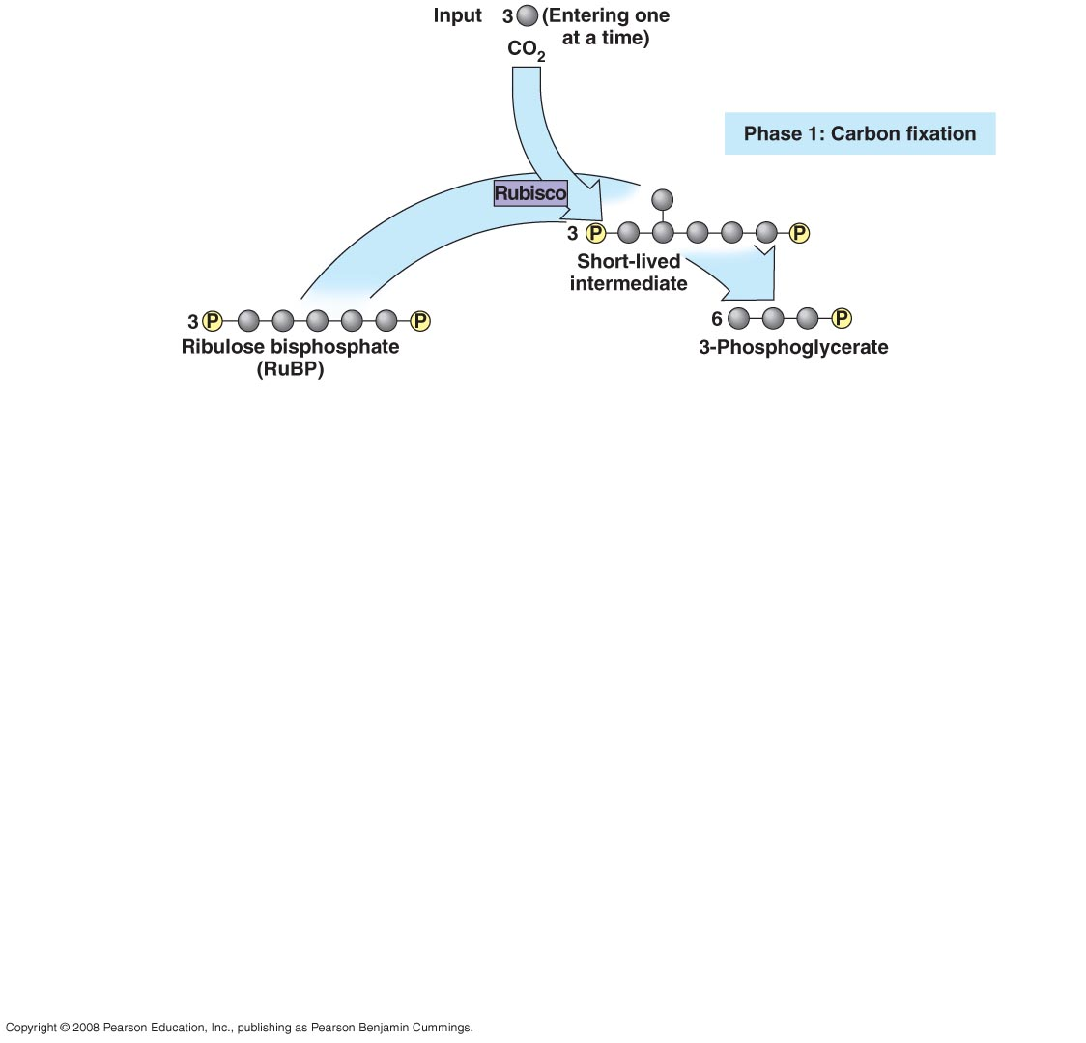

Slide 135
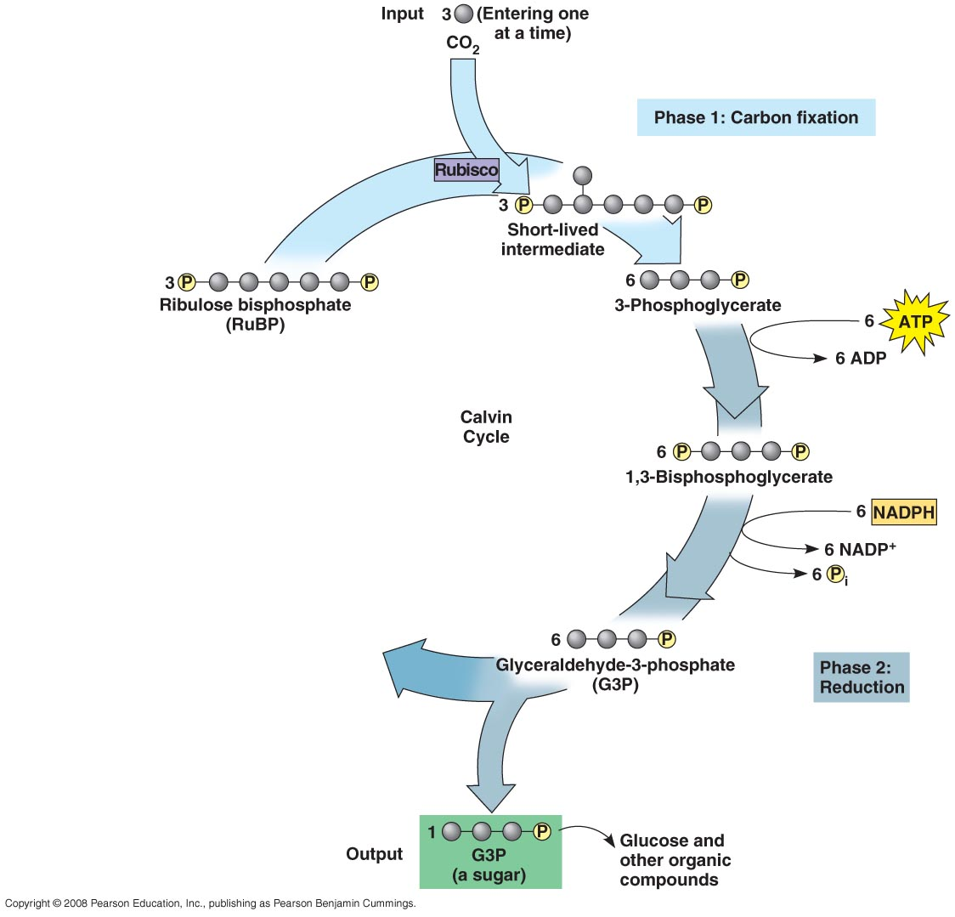

Slide 136
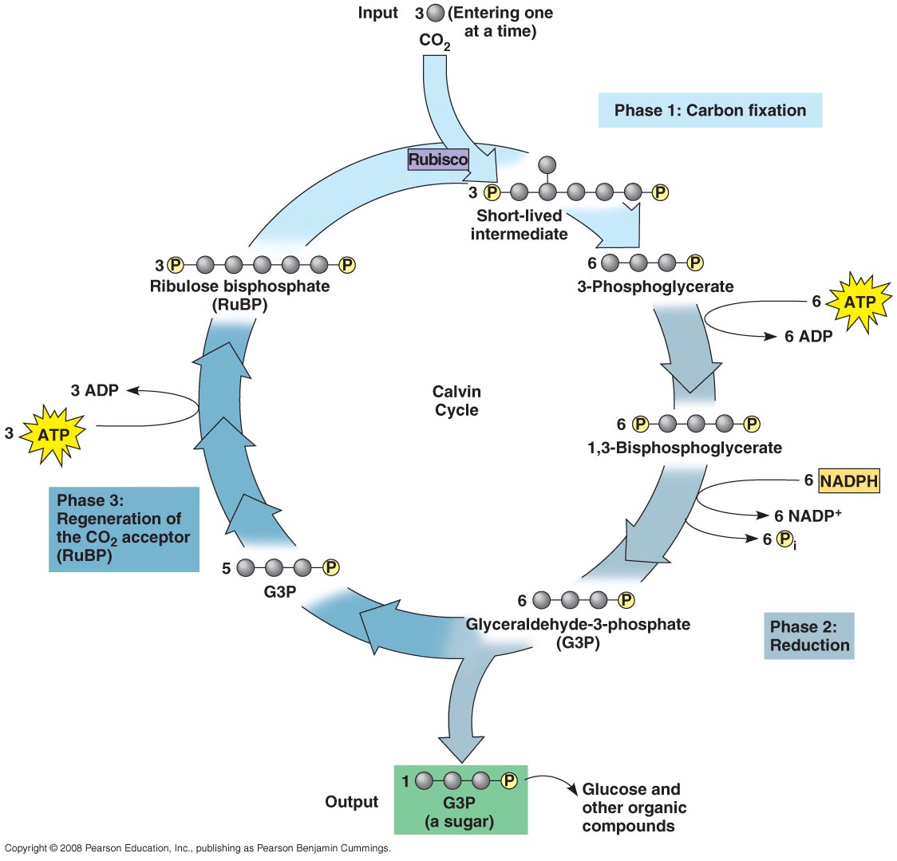

Slide 137
Carbon Fixation
Turns CO₂ into an organic compound
First step uses enzyme rubisco (aka RuBP carboxylase) to add 3 CO₂’s to RuBP to produce PGA
Most abundant protein in plants and possible the world

Slide 138
Carbon Reduction
Reduced PGA
One 3 carbon sugar (G3P)will be produced from 3 CO₂’s

Slide 139
Regeneration
RuBP is regenerated to begin the cycle again

Slide 140
Conclusion
Calvin uses:
- 3 CO₂
- 6 NADPH
- 9 ATP
Net gain from Calvin:
- 1 G3P (a sugar)
To produce one glucose molecule, how many times will the Calvin need to run?
Notes:
2

Slide 142
Fig. 10-5-4
H₂O
CO₂
Light
NADP⁺
ADP
+
P
_{i}
Calvin
Cycle
Light
Reactions
ATP
NADPH
Chloroplast
O₂
[CH₂O]
(sugar)

Slide 143
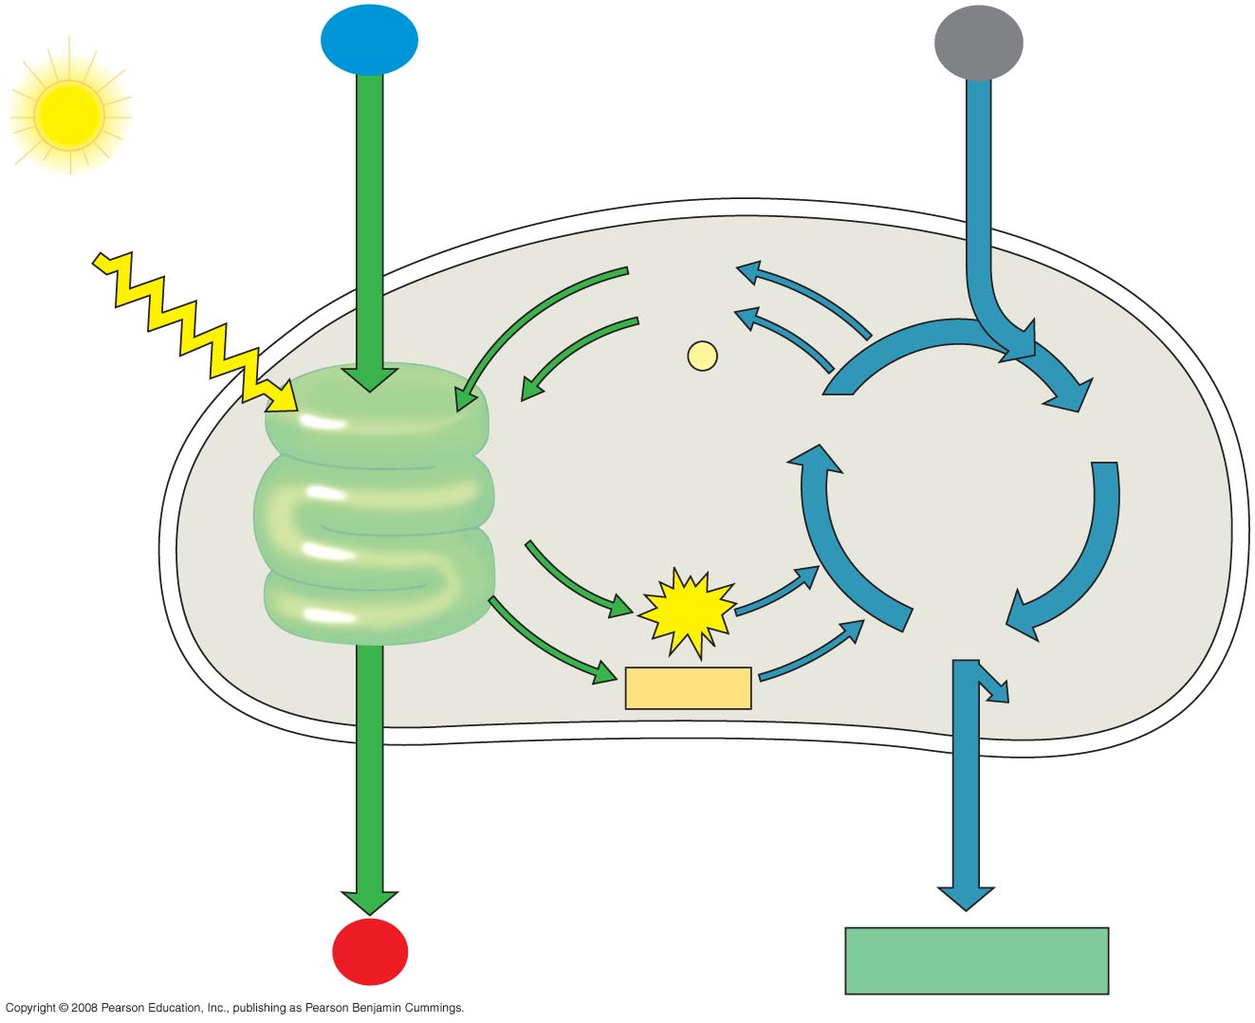
Fig. 10-21
H₂O
CO₂
Light
NADP⁺
ADP
+
P
i
Light
Reactions:
Photosystem II
Electron transport chain
Photosystem I
Electron transport chain
RuBP
3-Phosphoglycerate
Calvin
Cycle
ATP
G3P
NADPH
Starch
(storage)
Chloroplast
O₂
Sucrose (export)

Slide 144
Problems
Water loss through stomata
solution – regulation of stomata opening & closing – close when intense heat - open when cooler

Slide 145
Problem with Rubisco
- Rubisco can bind with either O₂ or CO₂
RuBP + CO₂ → Calvin cycle
RuBP + O₂ → photorespiration

Slide 146
Rubisco problem
Photoresp. is the same as Calvin but instead no sugar is made – only a 2C compound is formed

Slide 147
Rubisco problem
The 2C compound follows this path:
peroxisome
⇓
mitochondria
⇓
releases CO₂

Slide 148
Rubisco problem
- What is the problem with photorespiration ?
- no gain of ATP or sugar but it uses the material needed to make sugar
- therefore it decreases the output of photosynthesis

Slide 149
Solution
C₄ plants (i.e.. corn)
- structure pg. 192 fig. 10.18
- uses PEP carboxylase to fix CO₂ in mesophyll then sends this new org. mol. to bundle sheath cells

Slide 151
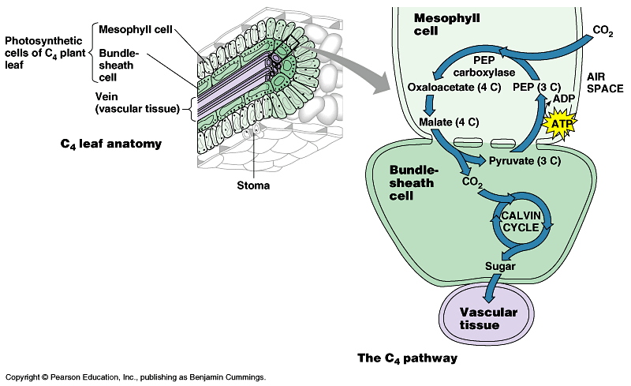

Slide 153
Solution
- the new org. mol. will be turned back into CO₂ in bundle sheath cells
- Calvin cycle will then occur in bundle sheath cells
Why is this a solution?

Slide 154
Solution because:
Raises CO₂ level in bundle sheath where Calvin occurs
Changes the ratio of O₂ to CO₂
More CO₂ less O₂

Slide 155
Desert conditions
Problem -- water
Solution – CAM plants (cacti)
-- CAM plants only open stomata at night so they don’t lose too much water during hot part of day

Slide 156
Desert conditions
-- make org. acid from CO₂ at night (carbon fixation)
-- day – the org. acid is changed & releases CO₂ in plant while stomata are closed

