Slide 1
Unit 4
Cell Communication and Division

Slide 2
Cell Communication
Belief is that signaling 1st evolved in prokaryotes and then unicellular eukaryotes
Examples
- mating in yeast
- quorum sensing in prokaryotes
http://www.youtube.com/watch?v=FsGwgiIv_NU

Slide 3
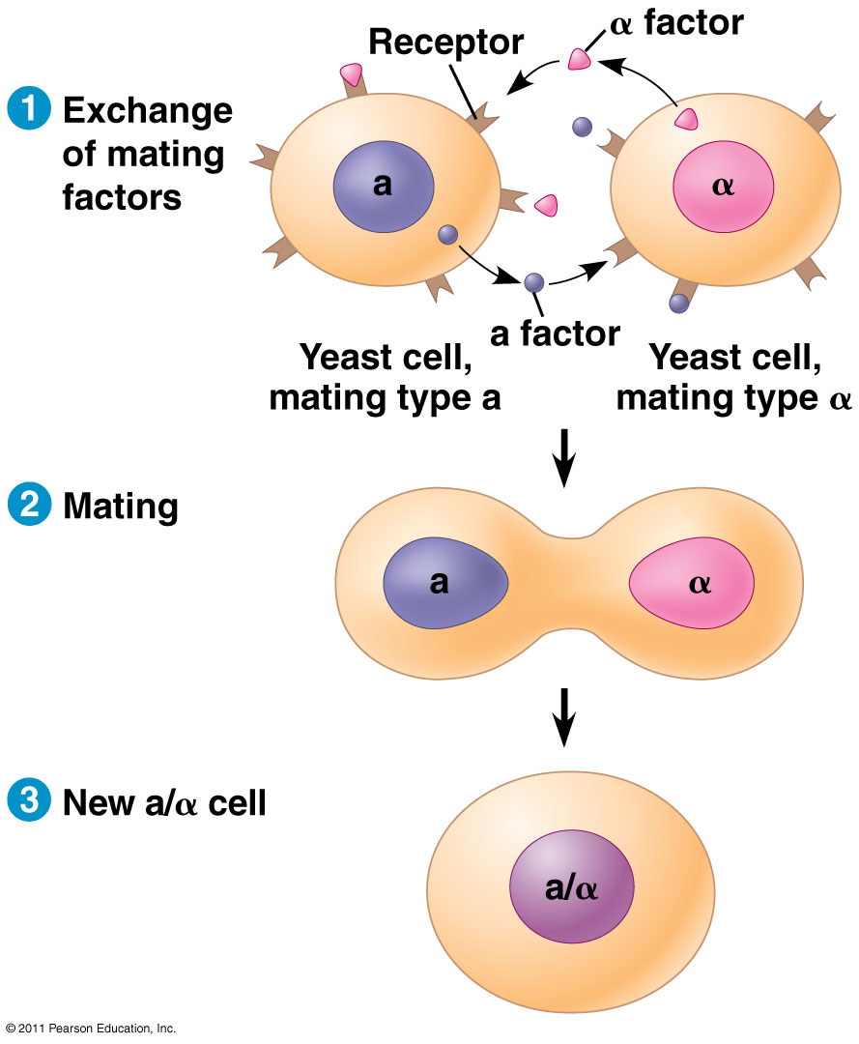

Slide 4
Types of Communication in multicellular organisms
Direct contact between cells
Local signaling
Hormonal signaling

Slide 5
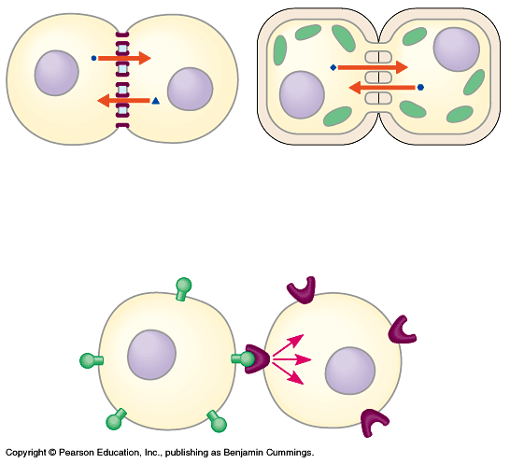

Slide 6
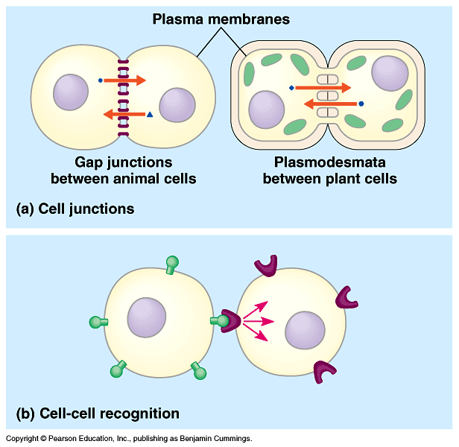

Slide 7
Direct Contact Between Cells
Animal Cells
gap junctions
cell surface mol’s
Plant Cells
plasmodesmata
Fig. 11.4

Slide 8
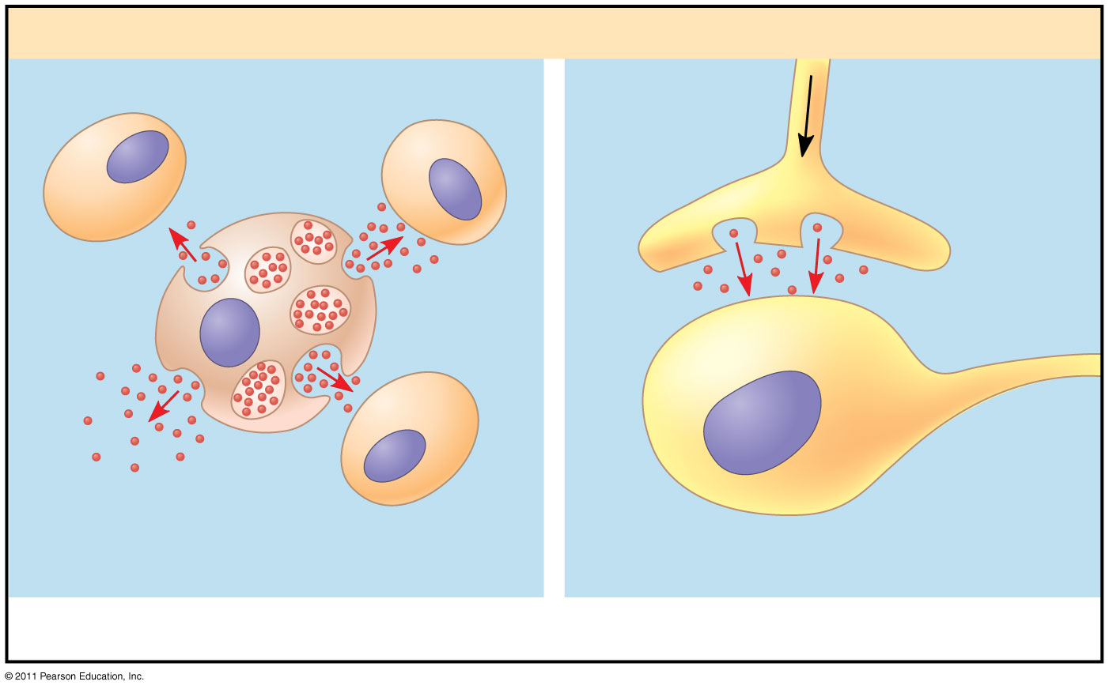

Slide 9
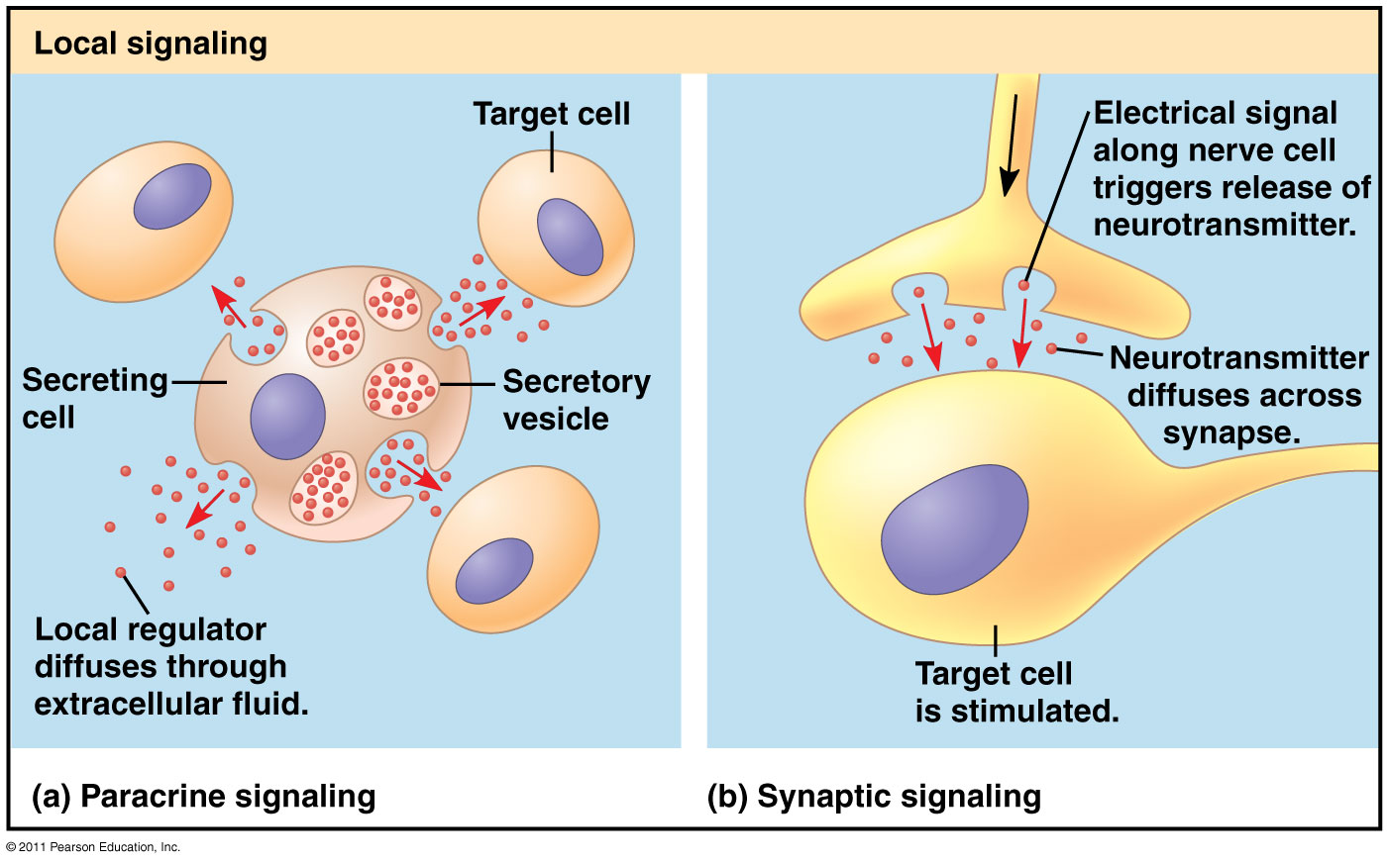

Slide 10
Types of Local
Signaling
Paracrine signaling – transmitting cell secretes molecules to influence neighbors
- ie. Growth factors
Synaptic signaling – one cell produces a neurotransmitter (chemical signal) that crosses the synapses (space b/w nerve cells)
Fig 11.3

Slide 11
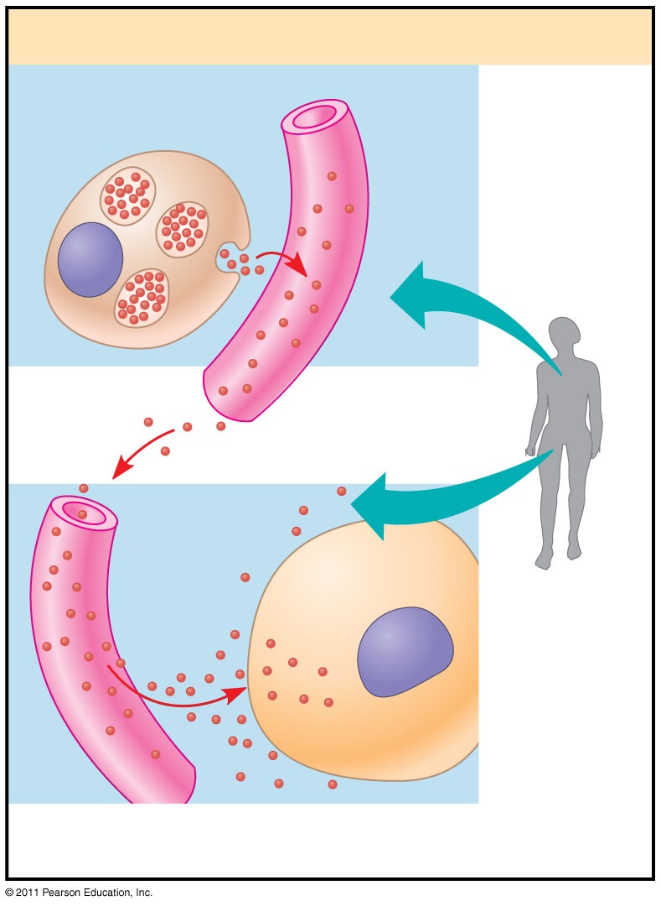

Slide 12
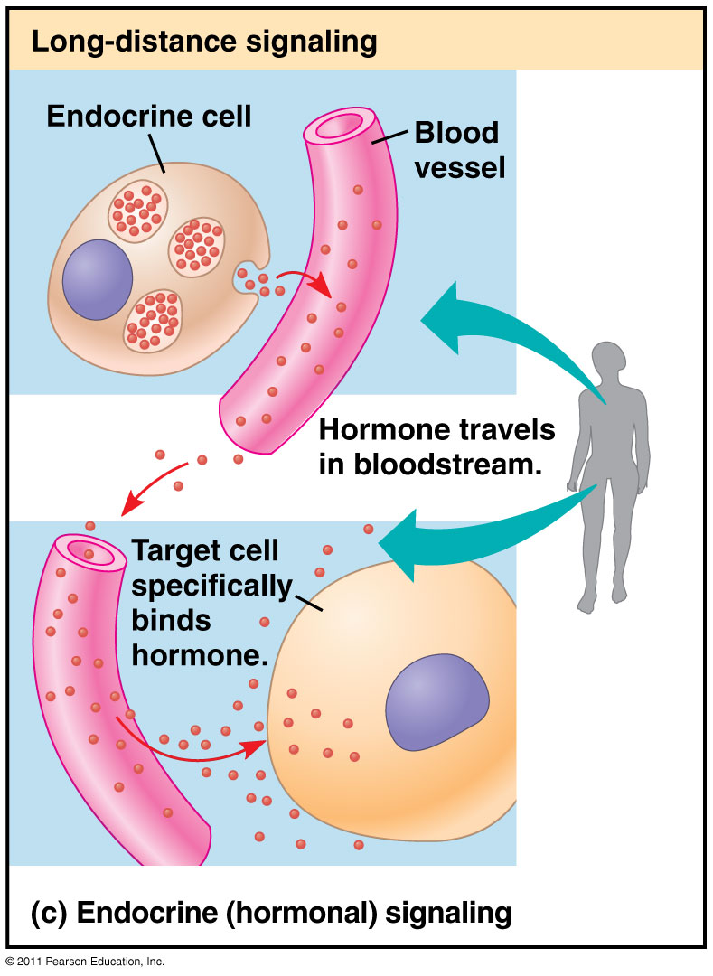

Slide 13
Hormonal Signaling
(long distance)
Cells release chemical into blood
Chemical travels to target cell
Target cell not in neighborhood

Slide 14
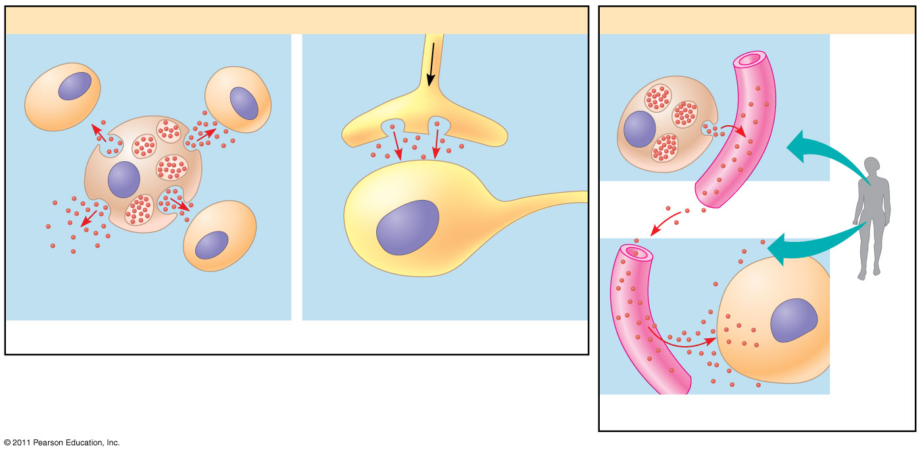

Slide 15
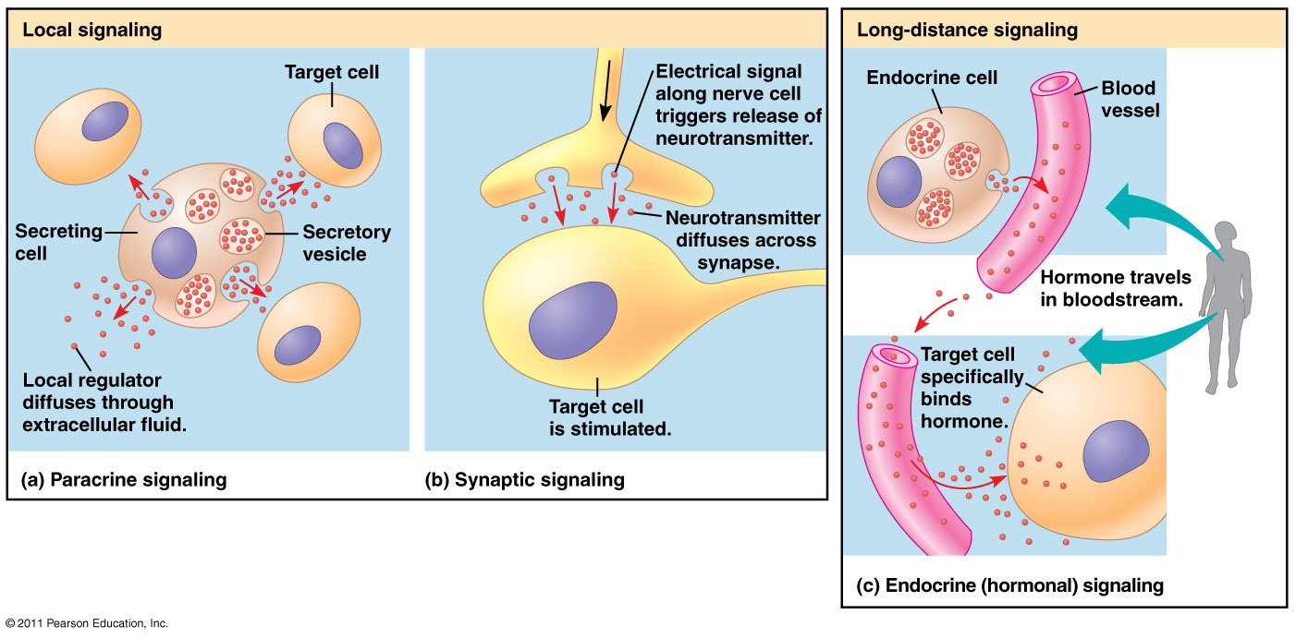

Slide 16
Signal Transduction Pathway
Process by which a signal on a cell’s surface is converted to a specific cellular response in a series of steps.

Slide 17
Stages of Signaling
Reception -- detects first message
Transduction – relays message
signal transduction pathway
Response

Slide 18
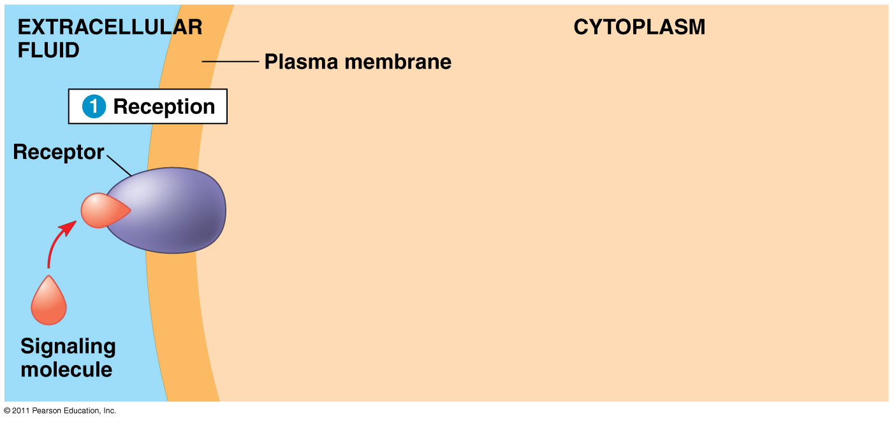

Slide 19
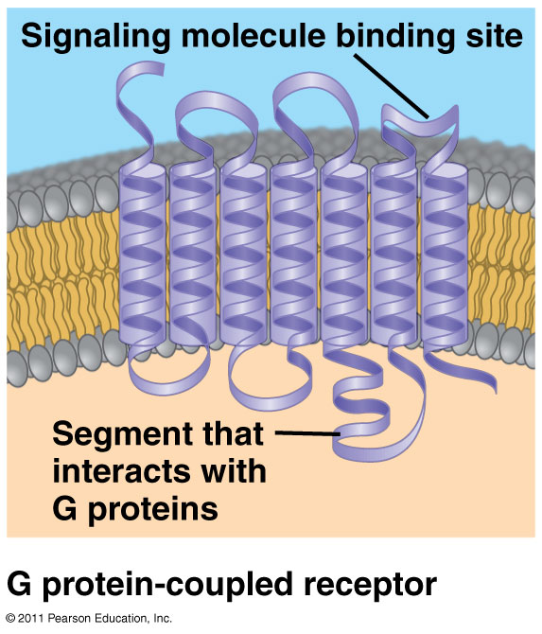

Slide 20
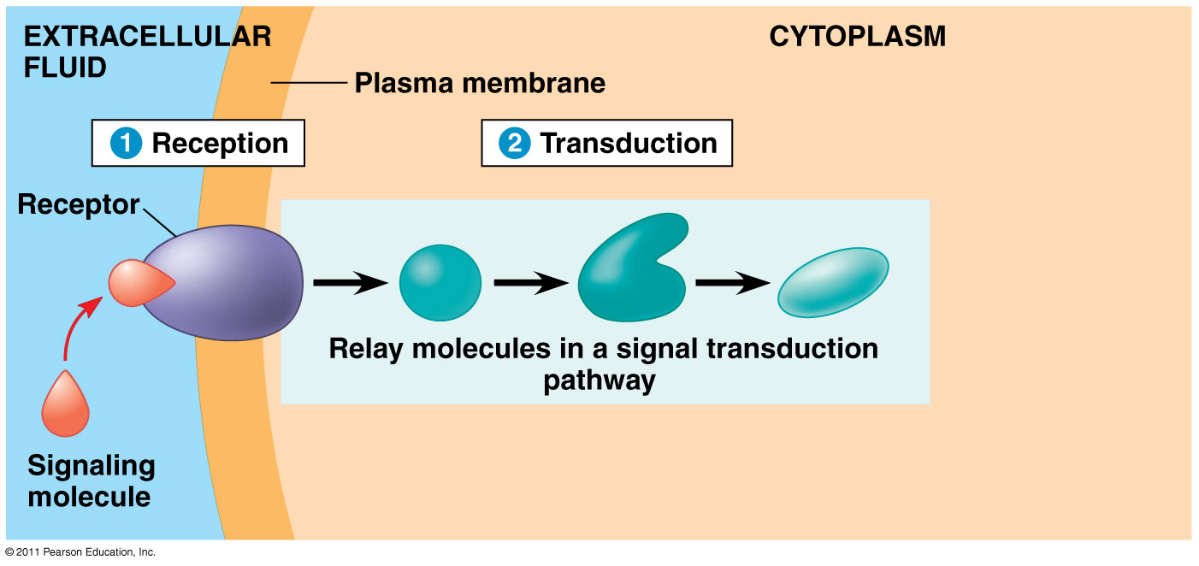

Slide 21
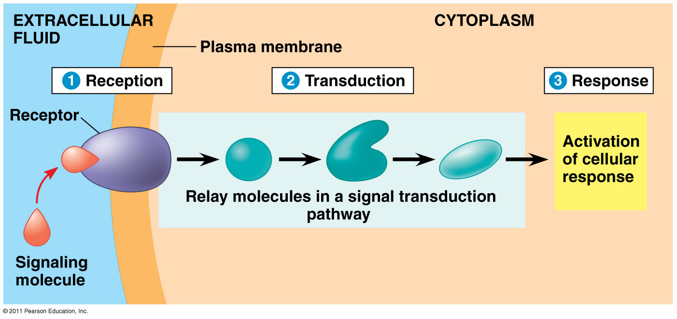

Slide 22
Reception
Signal molecules bind to receptor proteins that recognize the specific signal.
Ligand – term for a small molecule that specifically binds to a larger one.
Ligand binding causes a receptor protein to undergo a shape change.

Slide 23
3 types of reception
G-Protein linked
Tyrosine-kinase
Ion channels

Slide 24
Reception
1. G protein linked -- fig. 11.7
– receptor on membrane - switch
- signal molecules turn it on or off
– on causes change in shape which triggers G protein change which causes enzyme to be activated

Slide 25
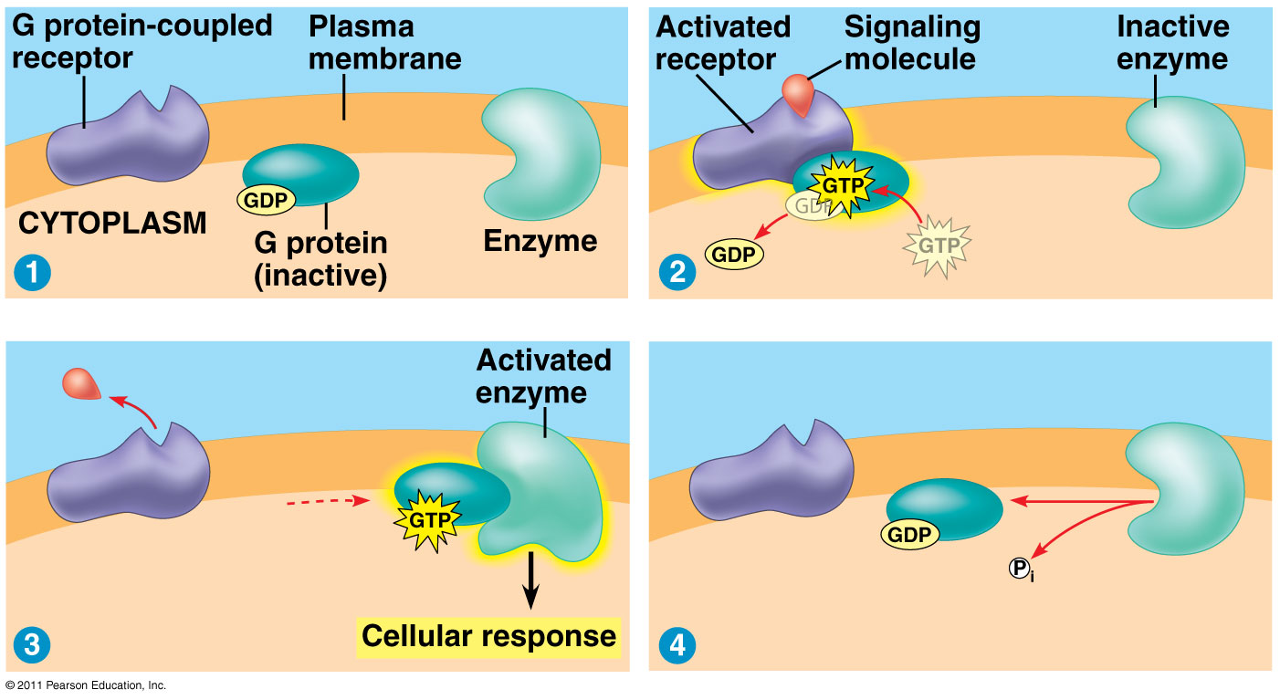

Slide 26
G-Protein animation http://telstar.ote.cmu.edu/biology/animation/Signaling/signaling.html
More animations http://telstar.ote.cmu.edu/biology/animation/index.html

Slide 27
Reception
2. Tyrosine – Kinase receptors fig. 11.8
- located on membrane
- catalyse the transfer of P from ATP to
tyrosine
- this causes polypeptide to aggregate and phosphorylation of receptor which causes activation of relay proteins

Slide 28
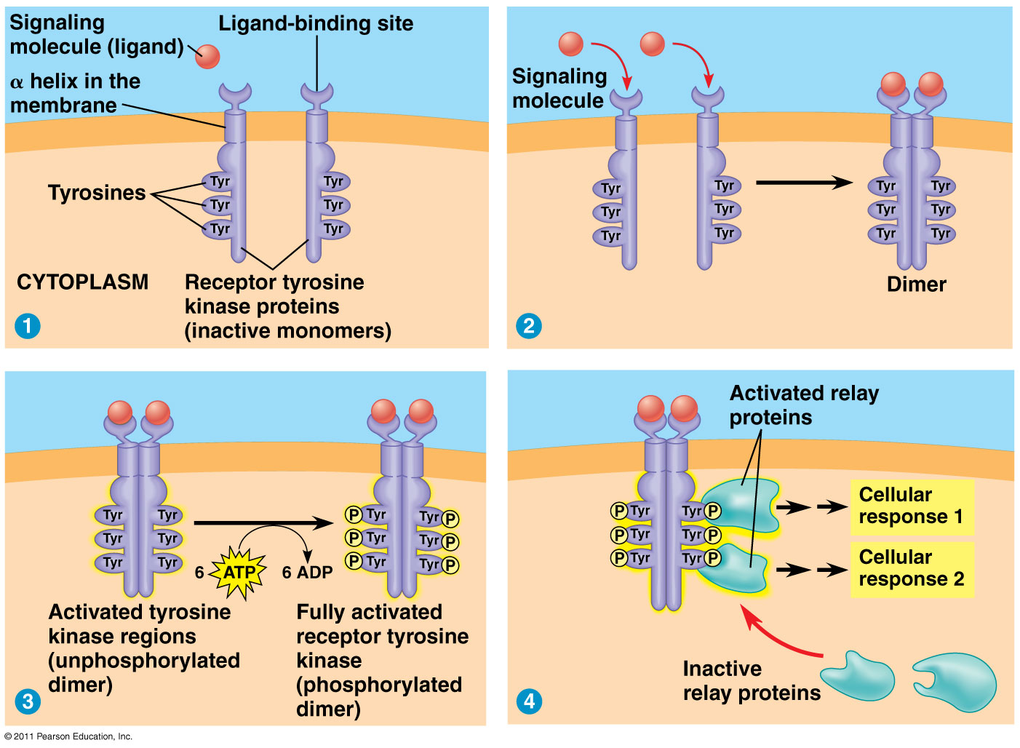

Slide 29
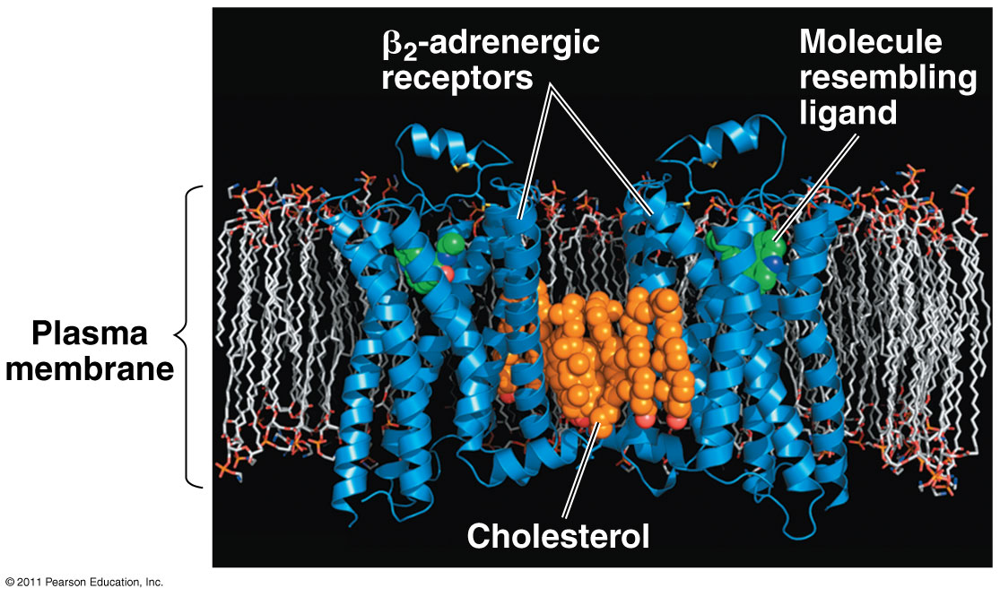

Slide 30
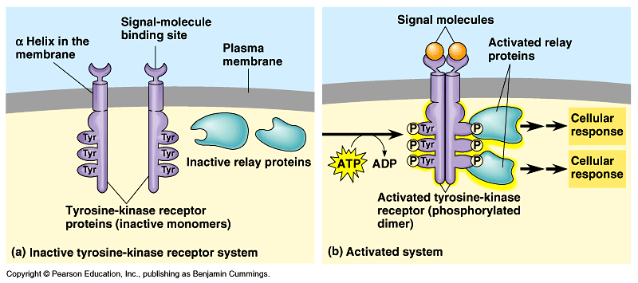

Slide 31
Tyrosine - Kinase
Tyrosine – Kinase advantage: a single ligand-binding event can trigger many pathways
Abnormal tyrosine - kinase receptors that aggregate without ligand causes some cancers

Slide 32
Vocabulary
Protein kinase
- Enzyme that transfers phosphate groups from ATP to a protein
Protein phosphatase
- Enzyme that can rapidly remove phosphate groups from proteins (dephosphorylation)

Slide 33
Reception
3. Ion – Channel receptors
gated channels that are protein pores in membrane
Ligand-gated ion channel
Act as gates

Slide 34
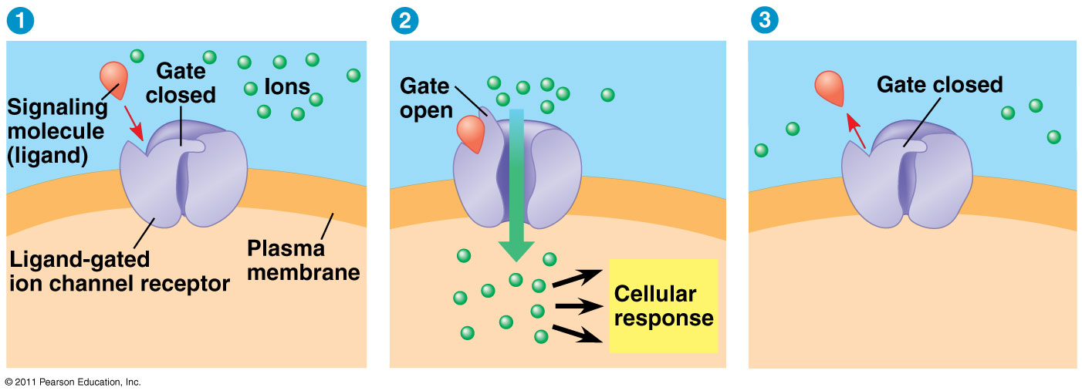

Slide 35
Transduction
Relays message
Usually proteins
Protein phosphorylation and second messengers

Slide 36
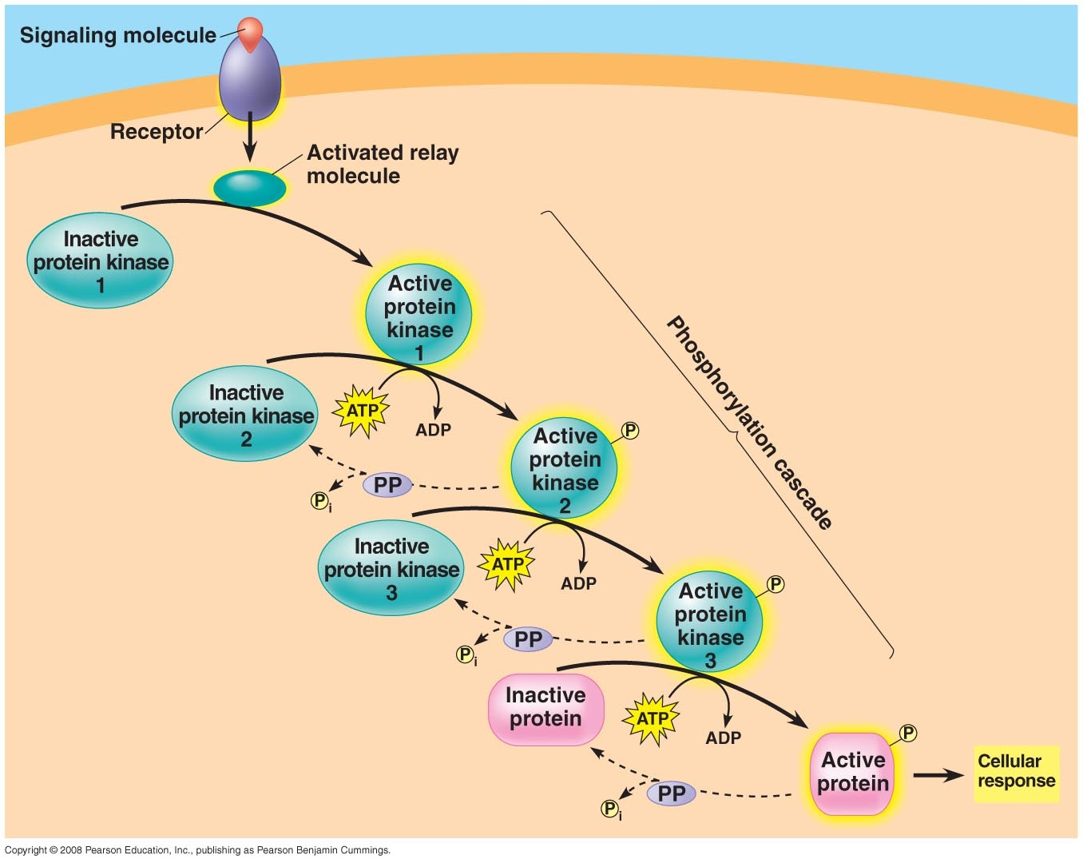

Slide 37
Second Messenger and Cyclic AMP
Cyclic AMP – cAMP (cyclic adenosine monophosphate)
Adenylyl cyclase converts ATP to cAMP in response to a signal like epinephrine
In this example if epinephrine is present cAMP ___________ (increases or decreases)
cAMP then acts as a second messenger and activates another protein which leads to a cellular response

Slide 38
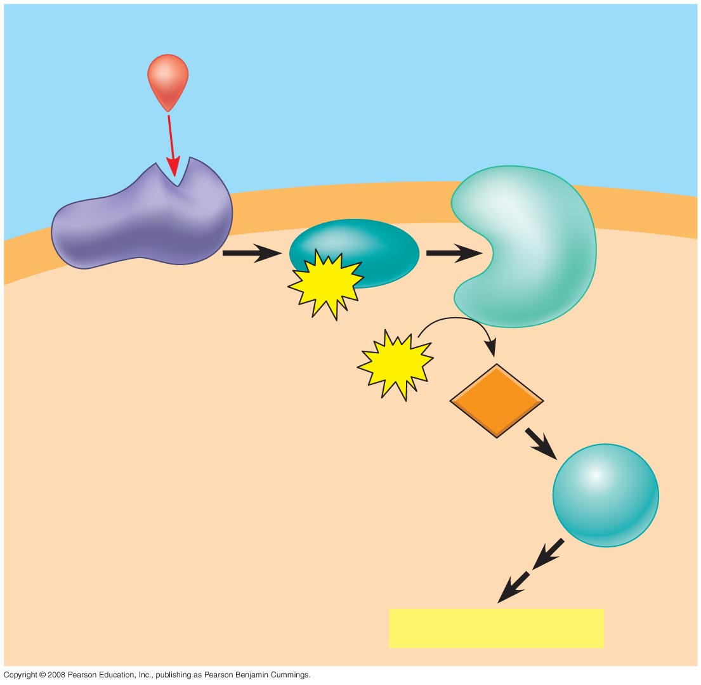
Fig. 11-11
First messenger
Adenylyl
cyclase
G protein
G protein-coupled
receptor
GTP
ATP
Second
messenger
cAMP
Protein
kinase A
Cellular responses

Slide 39
G-Protein animation http://telstar.ote.cmu.edu/biology/animation/Signaling/signaling.html
More animations http://telstar.ote.cmu.edu/biology/animation/index.html

Slide 40
Example
Glucagon and epinephrine
http://watcut.uwaterloo.ca/webnotes/Metabolism/page-13.2.html

Slide 41
G-protein systems and health
Cholera – these bacteria produce a toxin that chemically alters a G protein involving regulating salt and water secretion

Slide 42
G-protein systems and health
Viagra – cGMP is a signal to cause relaxation of smooth muscle cells like artery walls. Viagra inhibits conversion of cGMP to GMP thus dilating vessels and increasing blood flow to the penis.

Slide 43
Response
Activation of a certain gene
Stimulation of glycogen breakdown by epinephrine
Regulation

Slide 44
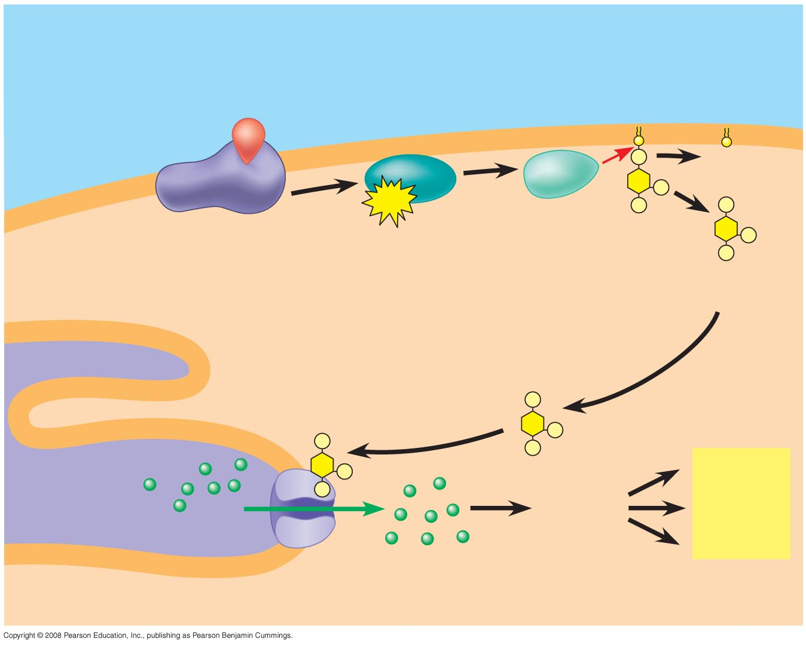
Fig. 11-13-3
EXTRA-
CELLULAR
FLUID
Signaling molecule
(first messenger)
Acts as a 2nd messenger in other paths
G protein
DAG
GTP
G protein-coupled
receptor
Phospholipase C
PIP₂
IP₃
(second messenger)
IP₃-gated
calcium channel
Endoplasmic
reticulum (ER)
Various
proteins
activated
Cellular
responses
Ca²⁺
Ca²⁺
(second
messenger)
CYTOSOL

Slide 45
Apoptosis
Program of controlled cell suicide
C. elegans (a nematode) is the organism of research because adult only has 1,000 cells
2 genes control cell death (Ced-3 and ced-4)
They produce proteins Ced-3 and Ced-4 which are continually present but inactive.
The death signal molecule triggers proteases (capsases) that cut up proteins and DNA

Slide 46
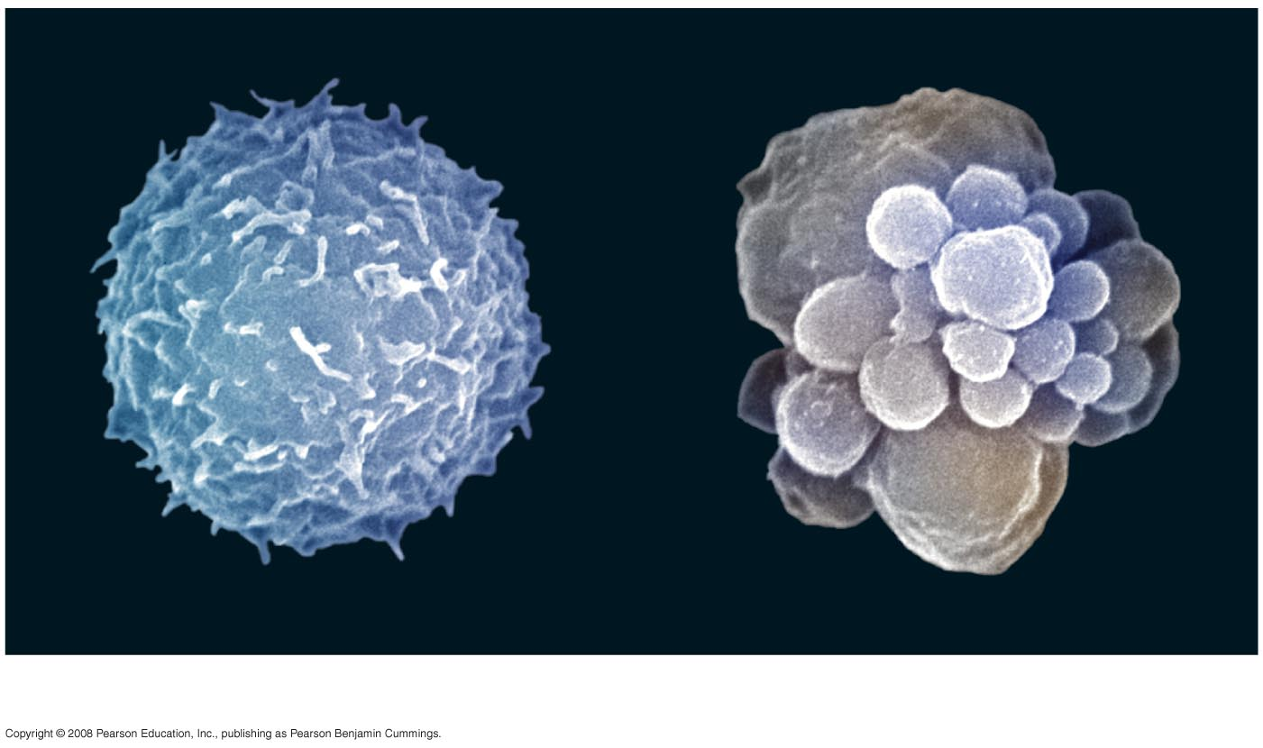
Fig. 11-19
Normal WBC
WBC undergoing apoptosis
2 µm

Slide 47
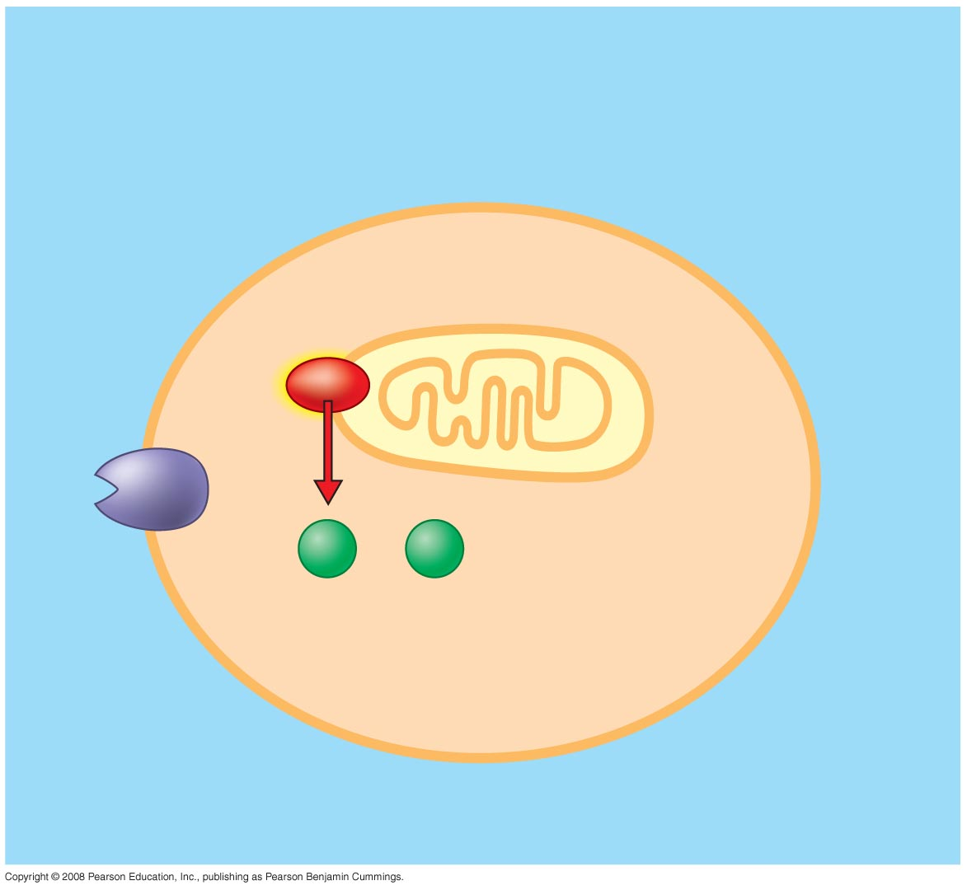
Fig. 11-20a
Ced-9
protein (active)
inhibits Ced-4
activity
Mitochondrion
Ced-4
Ced-3
Receptor
for death-
signaling
molecule
Inactive proteins
(a) No death signal

Slide 48
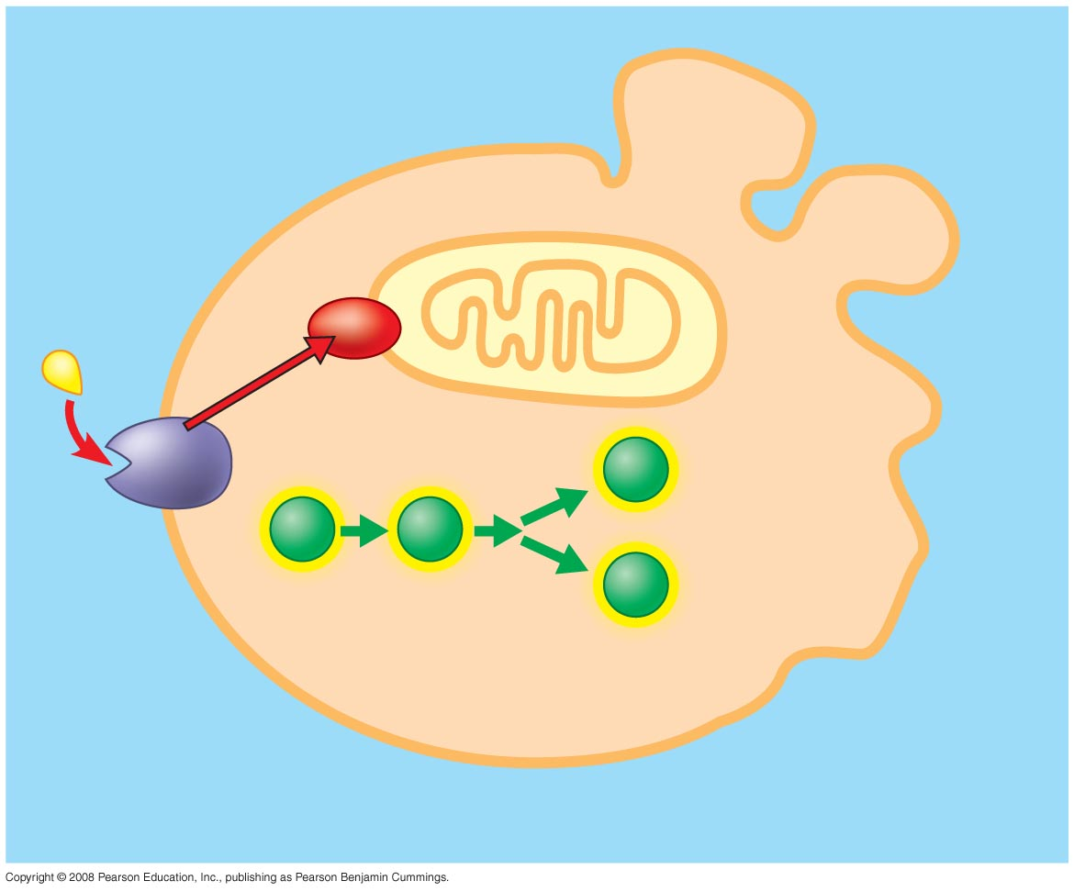
Fig. 11-20b
Ced-9
(inactive)
Cell
forms
blebs
Death-
signaling
molecule
Active
Ced-4
Active
Ced-3
Other
proteases
Nucleases
Activation
cascade
(b) Death signal

Slide 49
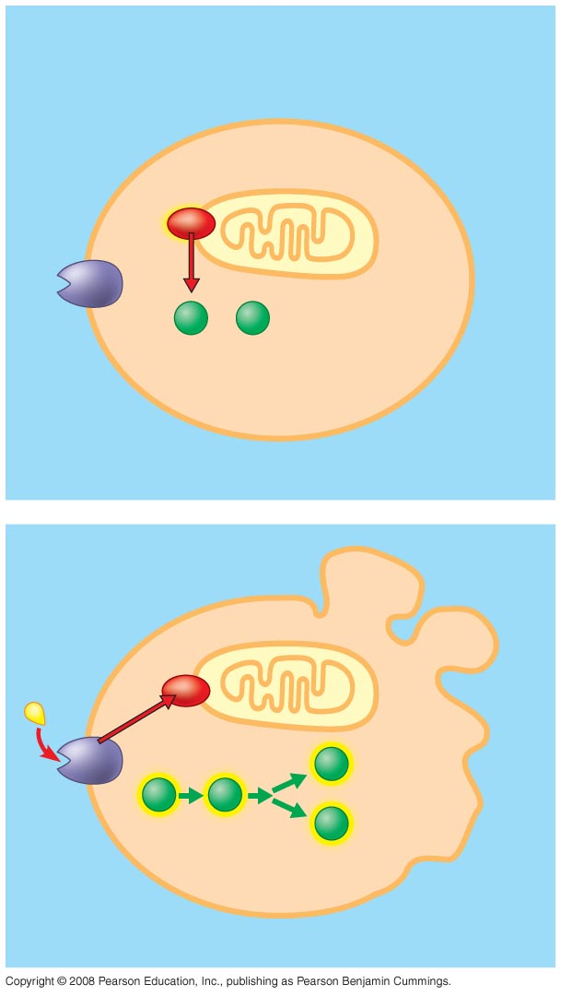
Fig. 11-20
Ced-9
protein (active)
inhibits Ced-4
activity
Mitochondrion
Receptor
for death-
signaling
molecule
Ced-4
Ced-3
Inactive proteins
(a) No death signal
Ced-9
(inactive)
Cell
forms
blebs
Death-
signaling
molecule
Active
Ced-4
Active
Ced-3
Other
proteases
Activation
cascade
Nucleases
(b) Death signal

Slide 50
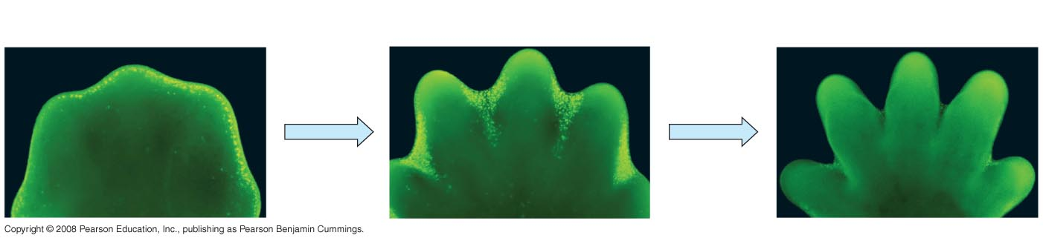
Fig. 11-21
Cells undergoing apoptosis appear bright colored
Interdigital tissue
1 mm

Slide 51
Cell
Division

Slide 52
Why Cell Division
Reproduction
Growth & development
Tissue renewal

Slide 53
3 Types of Cell Division
1. Binary fission
2. Mitosis
3. Meiosis

Slide 54
1. Binary Fission
Prokaryotes do this - have one circular chromosome
- Hypothesis on significance of membrane
- Divides into 2 new cells
- Simplest form of cell division

Slide 55
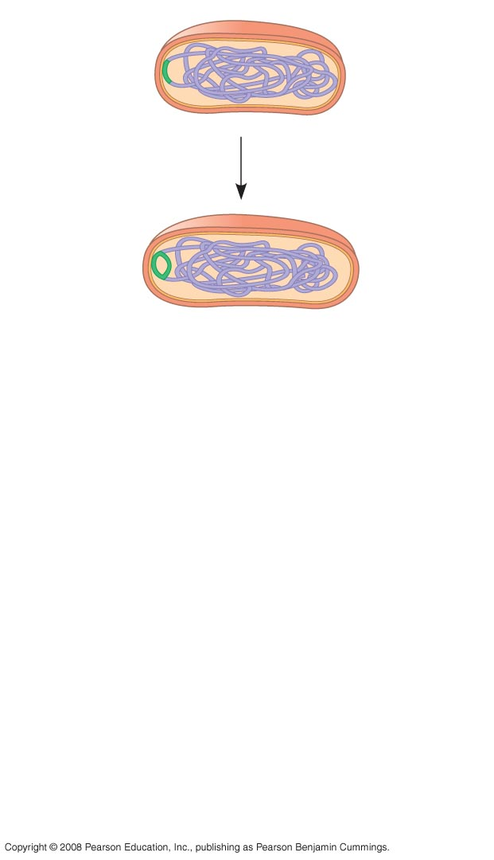
Fig. 12-11-1
Cell wall
Origin of
replication
Plasma
membrane
E. coli cell
Bacterial
chromosome
Two copies
of origin

Slide 56
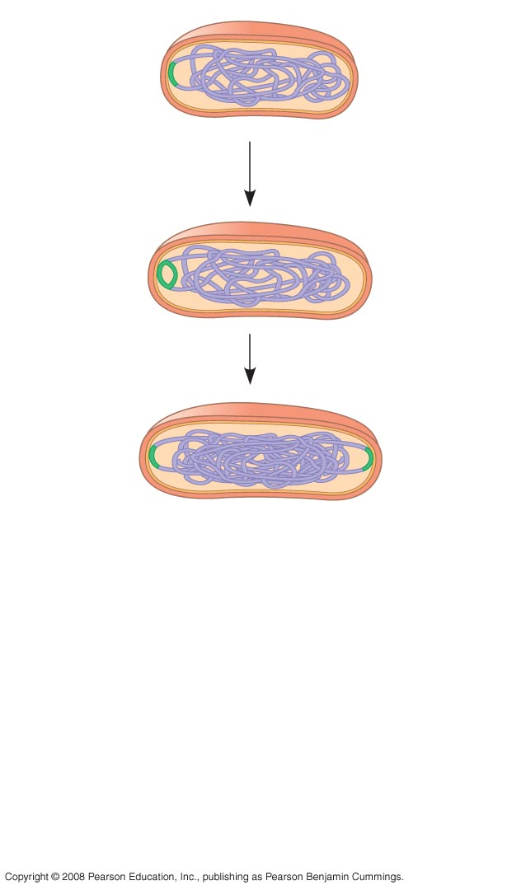
Fig. 12-11-2
Cell wall
Origin of
replication
Plasma
membrane
E. coli cell
Bacterial
chromosome
Two copies
of origin
Origin
Origin

Slide 57
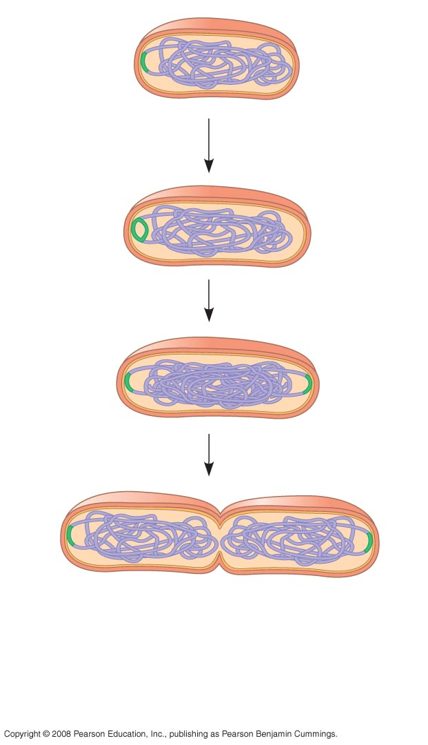
Fig. 12-11-3
Cell wall
Origin of
replication
Plasma
membrane
E. coli cell
Bacterial
chromosome
Two copies
of origin
Origin
Origin

Slide 58
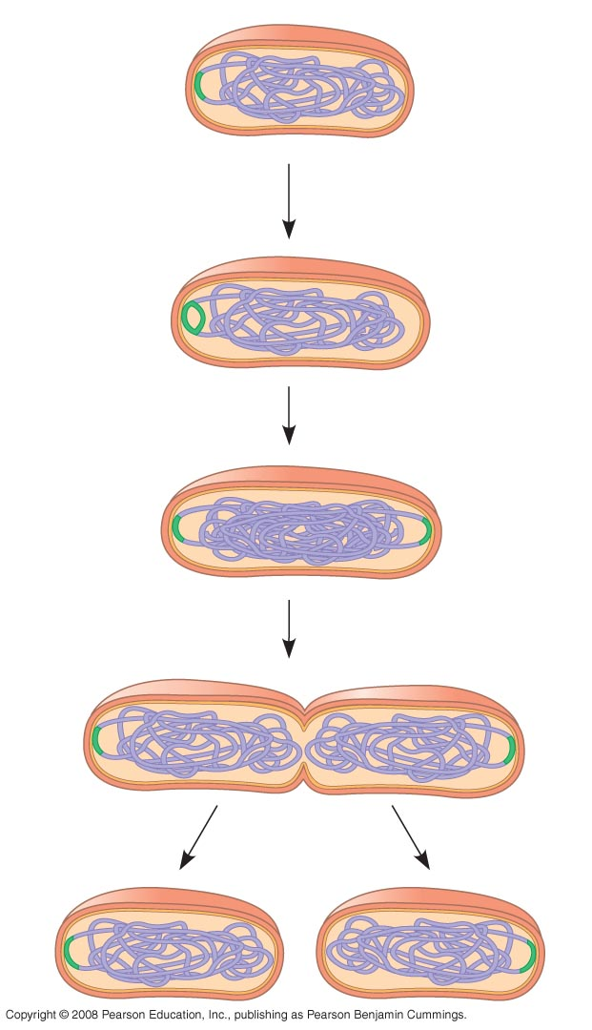
Fig. 12-11-4
Cell wall
Origin of
replication
Plasma
membrane
E. coli cell
Bacterial
chromosome
Two copies
of origin
Origin
Origin

Slide 59
2. Mitosis
Eukaryotes do this - have many linear chromosomes
Cell divides after duplication and organization of DNA
See fig. 12.12 for intermediary types of cell division

Slide 60
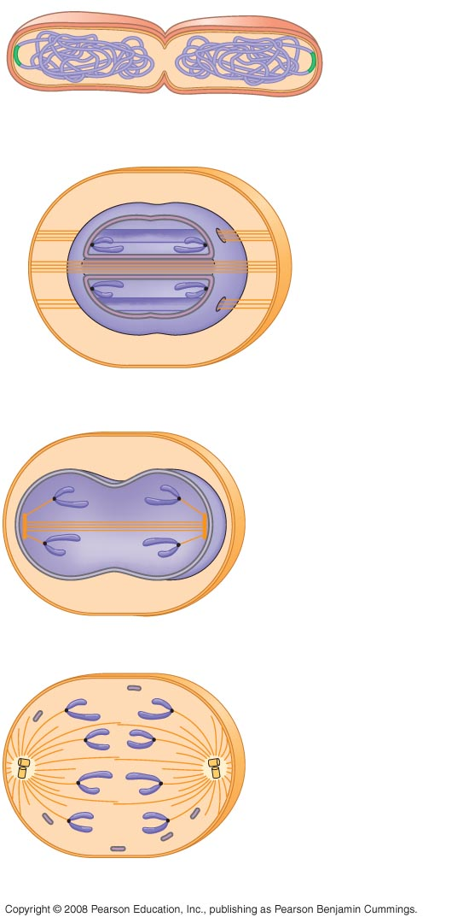
Fig. 12-12
Bacterial
chromosome
(a) Bacteria
Chromosomes
Microtubules
Intact nuclear
envelope
(b) Dinoflagellates
Kinetochore
microtubule
Intact nuclear
envelope
(c) Diatoms and yeasts
Kinetochore
microtubule
Fragments of
nuclear envelope
d. Most eukaryotes

Slide 61
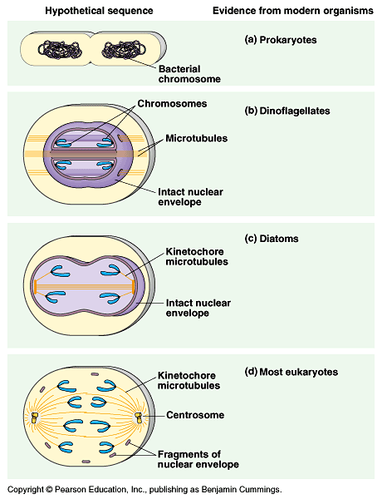

Slide 62
3. Meiosis
Division of cells to form gametes (egg & sperm cells)
Results in cells having ½ the original # of chromosomes

Slide 63
Eukaryotic Cells
Life Cycle of Eukaryotic Cell pg. 217
- Interphase
- Mitosis
- Cytokinesis

Slide 64
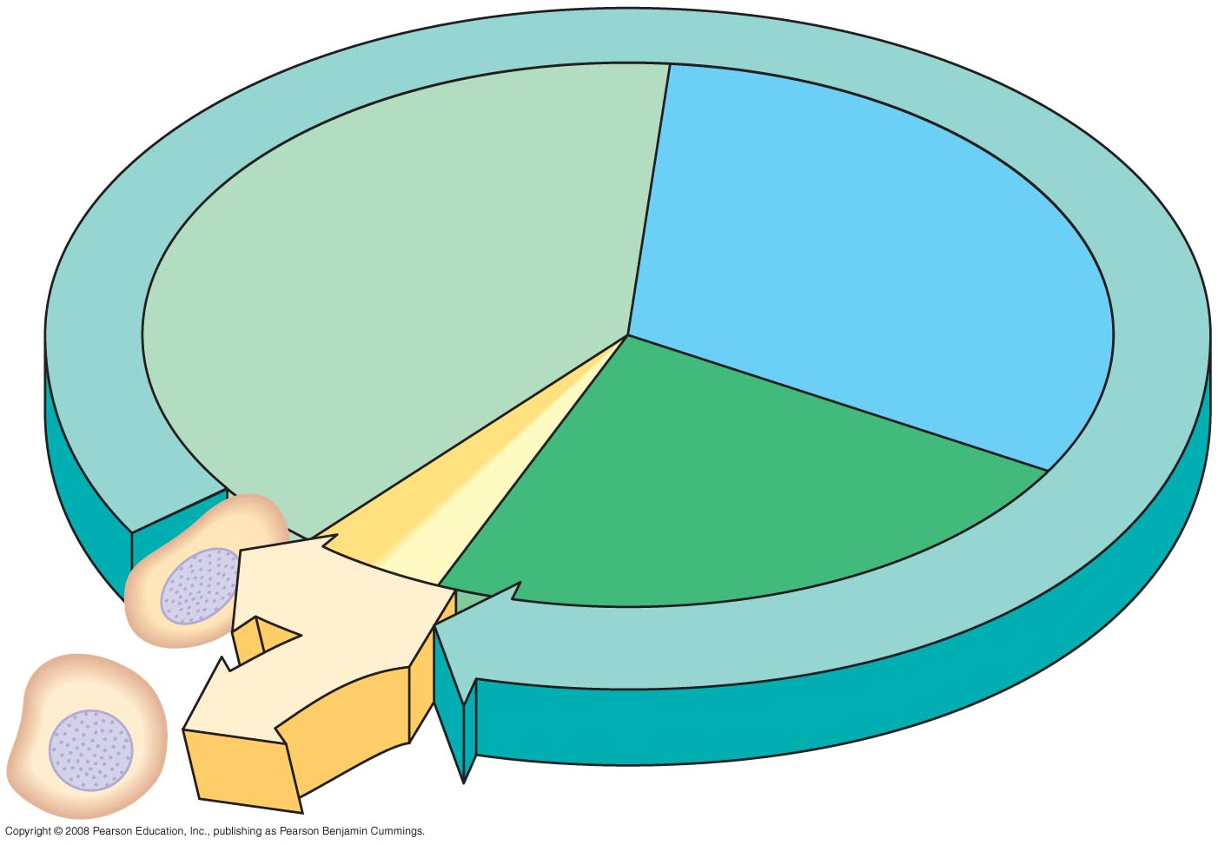
Fig. 12-5
INTERPHASE
G1
S
(DNA synthesis)
Cytokinesis
G2
Mitosis
MITOTIC
(M) PHASE

Slide 65
Interphase
G₁
- cell growth & development
- organelles begin to double
S - synthesis DNA replicates
G₂
- growth continues
- organelles complete duplication

Slide 66
Phases of Mitosis
Prophase
Prometaphase
Metaphase
Anaphase
Telophase & cytokinesis
Pg. 232-233
See fig. 12.6

Slide 67
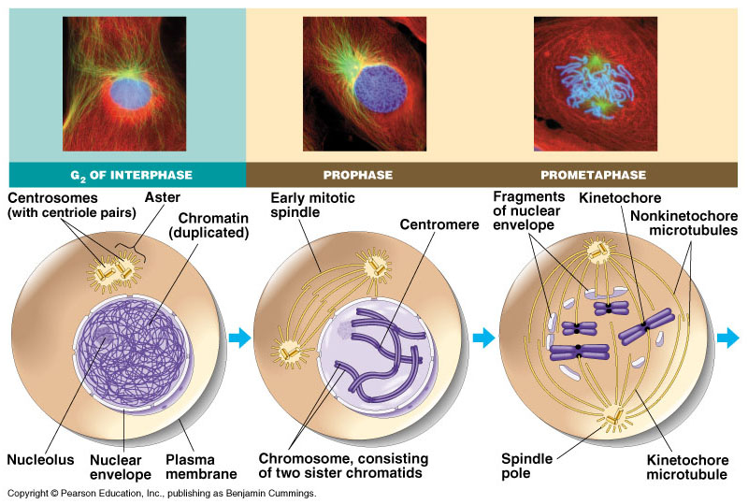

Slide 68
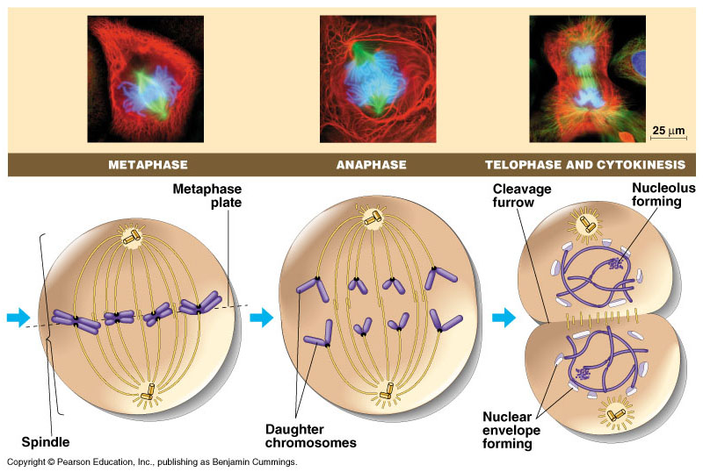

Slide 69
http://www.youtube.com/watch?v=VlN7K1-9QB0
http://www.hybridmedicalanimation.com/work/animation/the-stages-of-mitosis/

Slide 70
Plant Vs. Animal Mitosis
Plant
Forms cell plate
No centrioles
Spindle fibers from cytoskeleton
Animal
Cleavage of cell membrane
Centrioles w/ aster rays form spindle

Slide 71
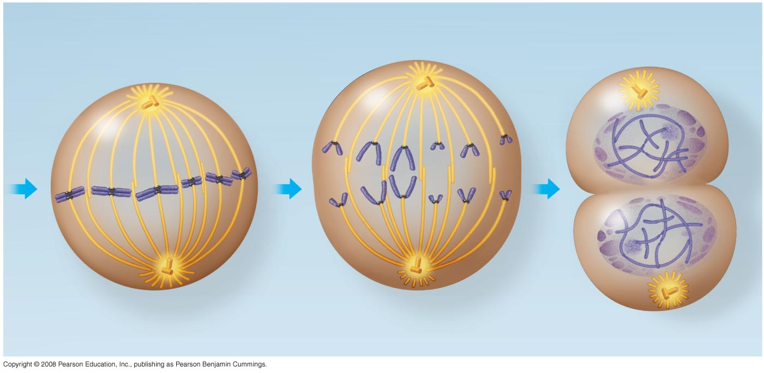
Fig. 12-6d
Metaphase
Anaphase
Telophase and Cytokinesis
A
Metaphase
plate
B
C
Nucleolus
forming
Daughter
chromosomes
Nuclear
envelope
forming
Spindle
Centrosome at
one spindle pole

Slide 72
Regulation of the Cell Cycle
Molecular control system
Internal & external signals

Slide 73
Molecular Control
Checkpoints at G₁, G₂, & M
G₁ checkpoint most important
- Decision
Go or don’t go
↓ ↓
Continues Enters G₀ phase
cell cycle

Slide 74
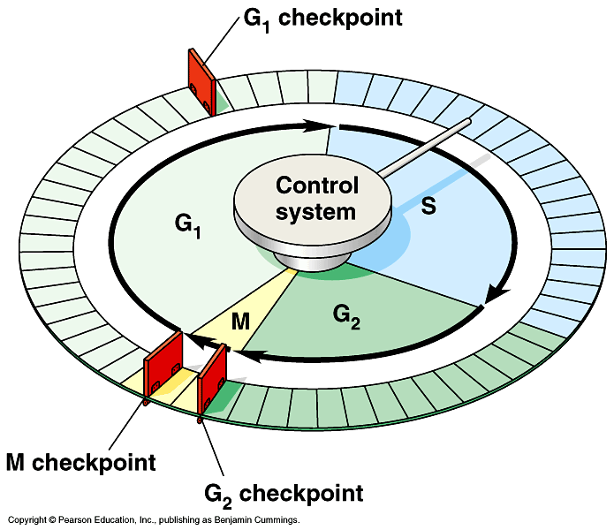

Slide 75
Molecular control continued
The cell cycle clock
- See fig. 12.17
- Levels of cyclin, cdks & MPF control the onset of mitosis

Slide 76
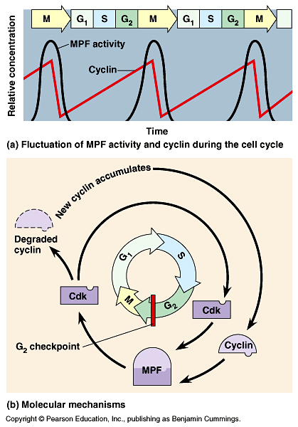

Slide 77
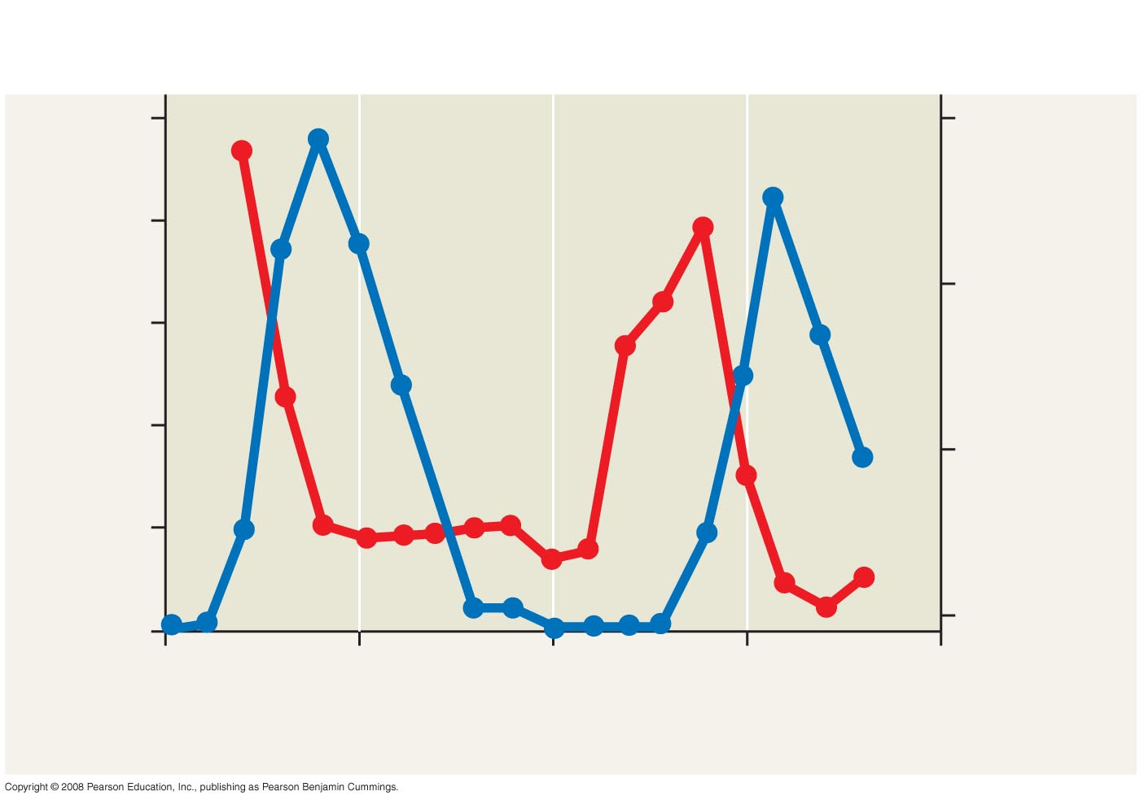
Fig. 12-16
RESULTS
5
30
4
20
3
% of dividing cells (– )
Protein kinase activity (– )
2
10
1
0
0
100
200
300
400
500
Time (min)

Slide 78
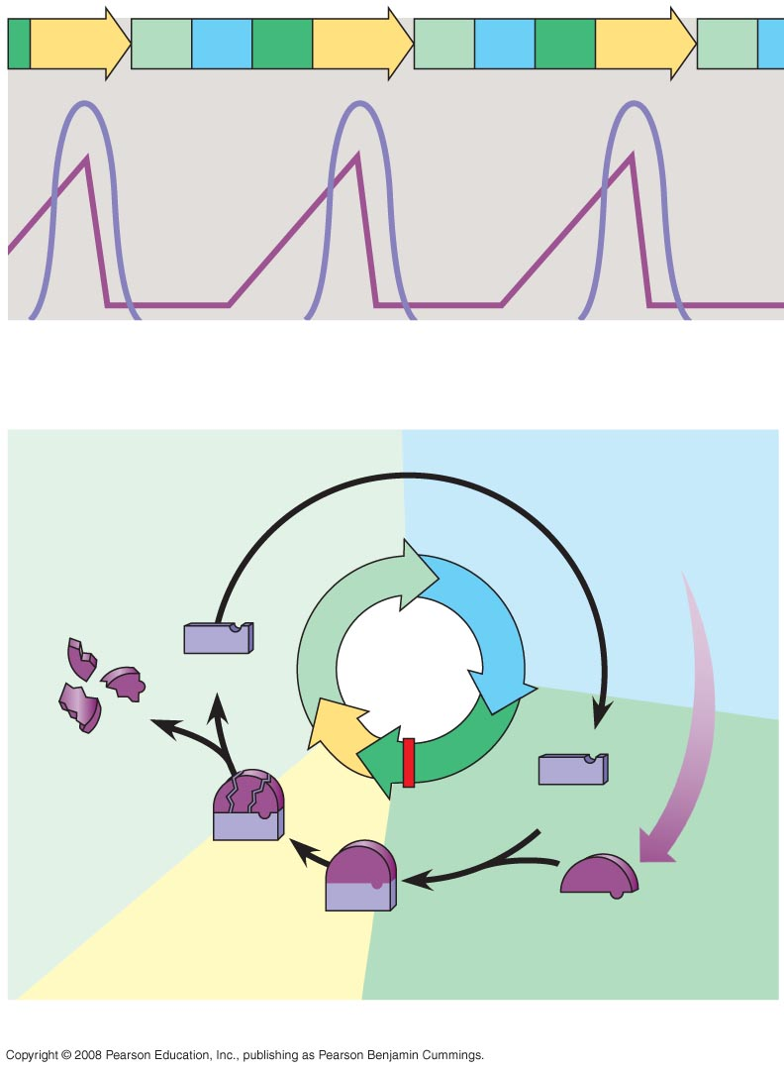
Fig. 12-17
M
G₁
S
G₂
M
G₁
S
G₂
M
G₁
MPF activity
Cyclin
concentration
Time
(a) Fluctuation of MPF activity and cyclin concentration during
the cell cycle
G₁
S
Cdk
M
Cyclin accumulation
Degraded
cyclin
G₂
G₂
Cdk
Cyclin is
degraded
checkpoint
MPF
Cyclin
(b) Molecular mechanisms that help regulate the cell cycle

Slide 79
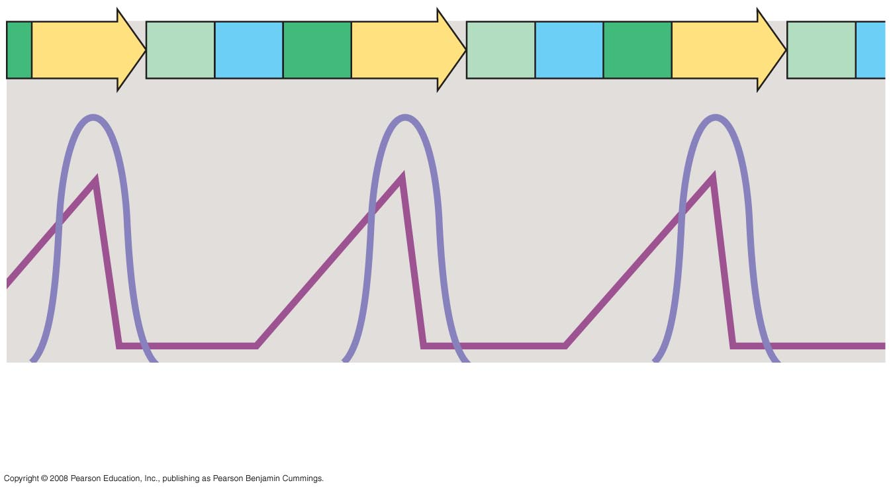
Fig. 12-17a
M
G₁
S
G₂
M
G₁
S
G₂
M
G₁
MPF activity
Cyclin
concentration
Time
(a) Fluctuation of MPF activity and cyclin concentration during
the cell cycle

Slide 80
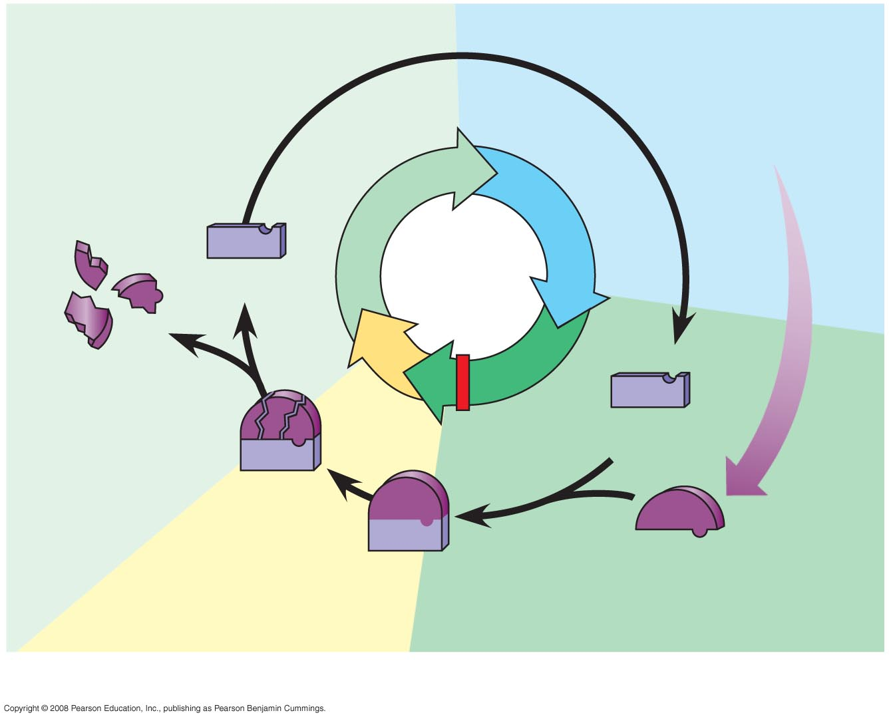
Fig. 12-17b
G₁
S
Cdk
M
Cyclin accumulation
Degraded
cyclin
G₂
G₂
checkpoint
Cdk
Cyclin is
degraded
Cyclin
MPF
(b) Molecular mechanisms that help regulate the cell cycle

Slide 81
External Signals
Density dependent inhibition
Crowding inhibits division
Insufficient growth regulators
fig. 12.18
Requirement for adhesion
Cells stop dividing if they lose their anchorage

Slide 82
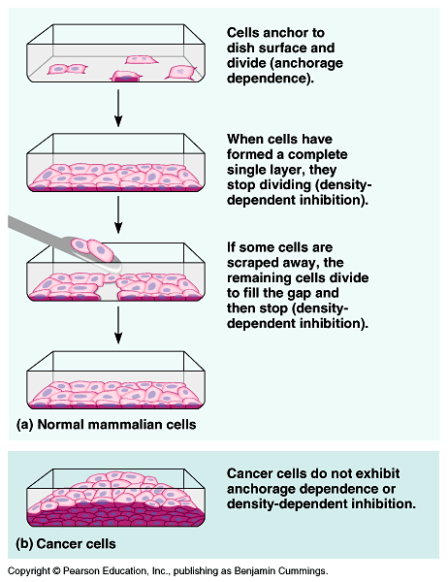

Slide 83
Internal Signals
Separation of sister chromatids does not occur until all chromosomes are properly attached to the spindle fibers.
APC -- anaphase promoting complex will be activated

Slide 84
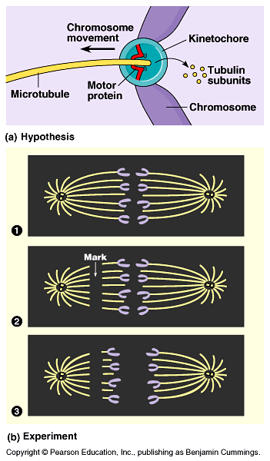

Slide 85
Cancer
Abnormal cell division

Slide 86
Characteristics of a cancer cell
Do not respond to controls thus form a tumor.
- Tumor can be:
benign – not invading other tissue
malignant – spreading into surrounding tissue
fig. 12.17
2. Division can stop at any stage or divide indefinitely

Slide 87
Characteristics continued
May have unusual # of chromosomes
Deranged metabolism
Surface can’t attach to “normal neighbors”
Cells are loose & free so can spread quickly (metastasize)

Slide 88
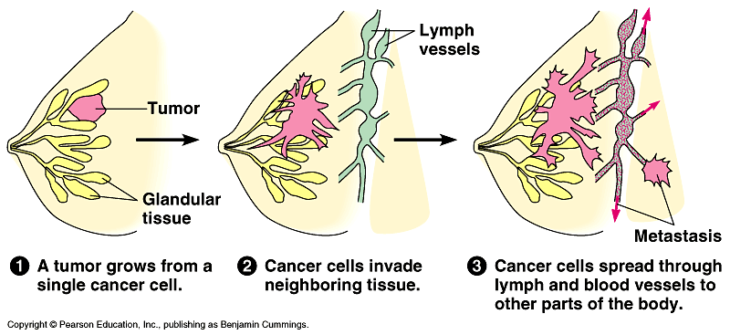

Slide 89
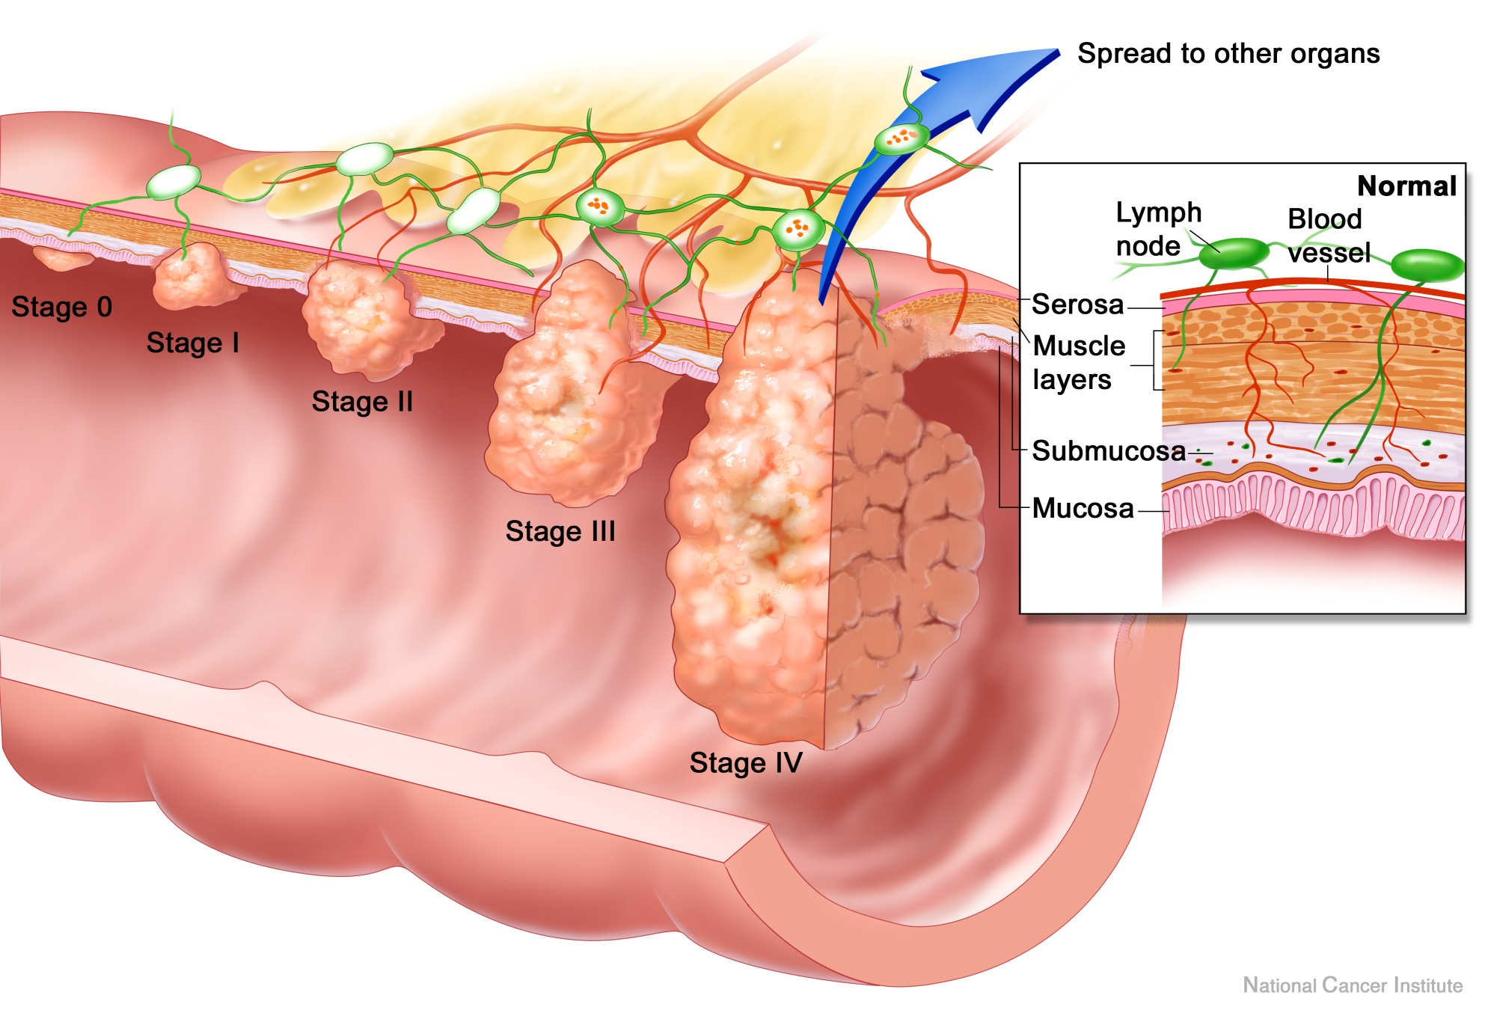

Slide 90
What triggers a cell to become cancerous?
Genetic alterations due to carcinogens
  i.e. Asbestos, nicotine
Oncogenes -- genes that stimulate cancer cell
-- switch is in “off” position but can switch “on”

Slide 91
Meiosis
Division of cells to form haploid gametes

Slide 92
Terms
Gamete – egg or sperm
Somatic cell – all cells of the body except gametes
Zygote – fertilized egg
Diploid – 2 sets of chromosomes (2N)
Haploid – one set of chromosomes (N)
Homologous chromosomes – chromosomes that make a pair. One from each parent. See diagram

Slide 93
Terms continued
Tetrad – complex of 4 chromatids. Present during prophase I of meiosis
Crossing over – exchange of piece of chromosomes. Occurs while tetrad is present.

Slide 94
Meiosis
Pgs. 240 – 241
Spermatogenesis – produces four haploid sperm
Oogenesis – produces 1 egg an 3 polar bodies
MEIOSIS

Slide 95
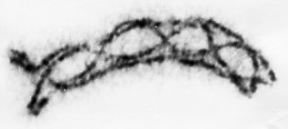
a tetrad of the grasshopper Chorthippus parallelus shows 5 chiasmata courtesy of Prof. Bernard John

Slide 96
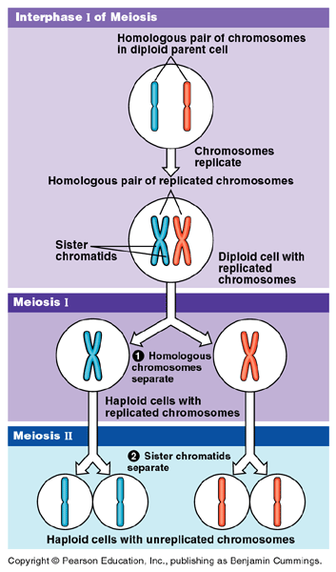

Slide 97
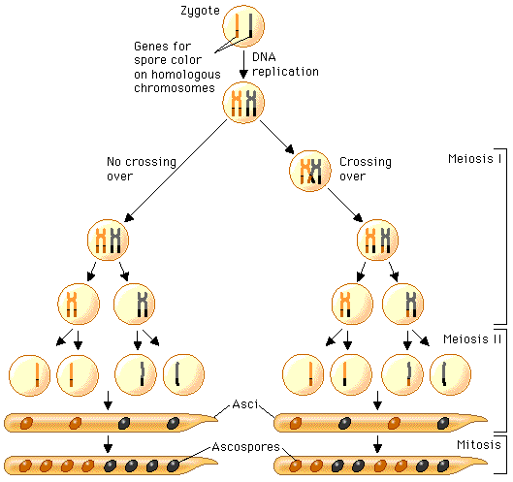

Slide 98
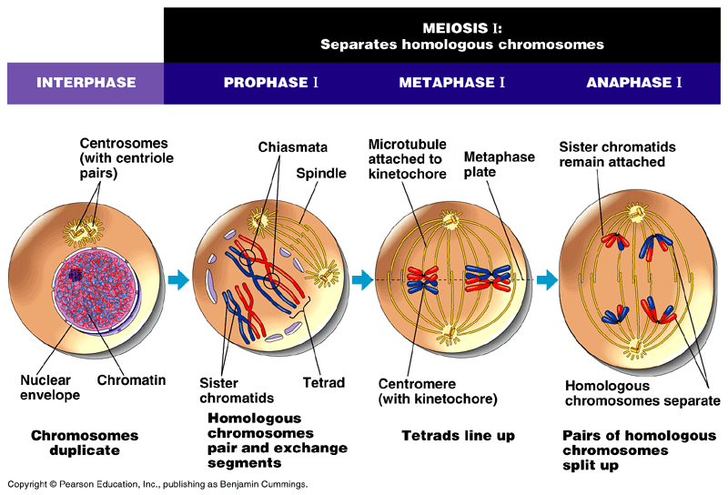

Slide 99


Slide 100
Differences & Similarities
Name 3 differences b/w mitosis & meiosis
Name 3 similarities b/w mitosis & meiosis

Slide 101

The life cycle of Sordaria fimicola is shown in Figure 1.

Slide 102
http://dragonnet.hkis.edu.hk/hs/science/Biology/apbio/images/Sordaria%20Tetrad%20Pics/3sordaria.jpg

Slide 103
Nondisjunction
Chromosomes fail to separate
Aneuploidy – gamete with abnormal # of chromosomes
If this gamete is fertilized it results in Monosomy or Trisomy
Monosomy – missing a chromosome
- Turners
Trisomy – extra chromosome
- Down Syndrome
- Klienfelters
Karyotype will show this

Slide 104


Slide 105
2. Fix cells
Allow cells to grow
Add distilled H₂O – cells swell
Add chemical to stop cell functions w/o exploding cell
Add dye to stain chrom.

Slide 106
3. Karyotype chromosomes
Cut out and arrange chromosomes by size

Slide 107


Slide 108


Slide 109


Slide 110


Slide 111


Slide 112


Slide 113


Slide 114


Slide 115


Slide 116
The life cycle of Sordaria fimicola is shown in Figure 1.

