Slide 1
DNA and Technology

Slide 2
Topics
Structure of DNA and RNA
DNA replication
Gene Expression
Regulation of Gene Expression
Genetic Engineering

Slide 3
DNA and RNA Structure
Deoxyribonucleic acid - DNA
Ribonucleic acid - RNA
Both made of nucleotides
Nucleotide building blocks:
sugar + phosphate + base

Slide 4
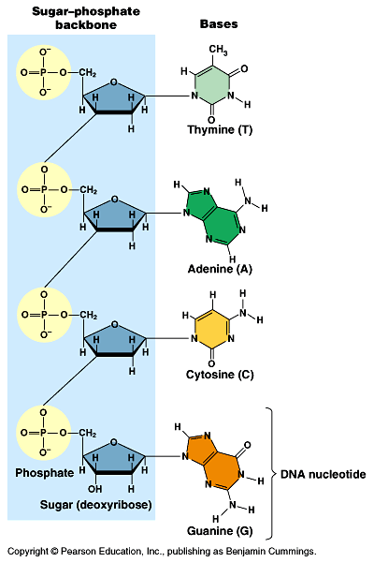

Slide 5
Sugars
5 carbon sugar
DNA’s sugar is deoxyribose
RNA’s sugar is ribose

Slide 7
Two Classes of Bases
Purines: 2 rings
adenine
guanine
Pyrimidines: 1 ring
cytosine
thymine
Base always attaches to the #1 carbon on the sugar

Slide 8
Phosphate
Always attaches to the #5 carbon on the sugar

Slide 9
Watson & Crick Model for DNA
Two strands of nucleotides that form a double helix fig. 16.7
2 strands join in an antiparallel arrangement
Sugar & phosphate make the backbone while bases are held together by H-bonds
Base pairs are always formed between
A - T
C - G

Slide 10
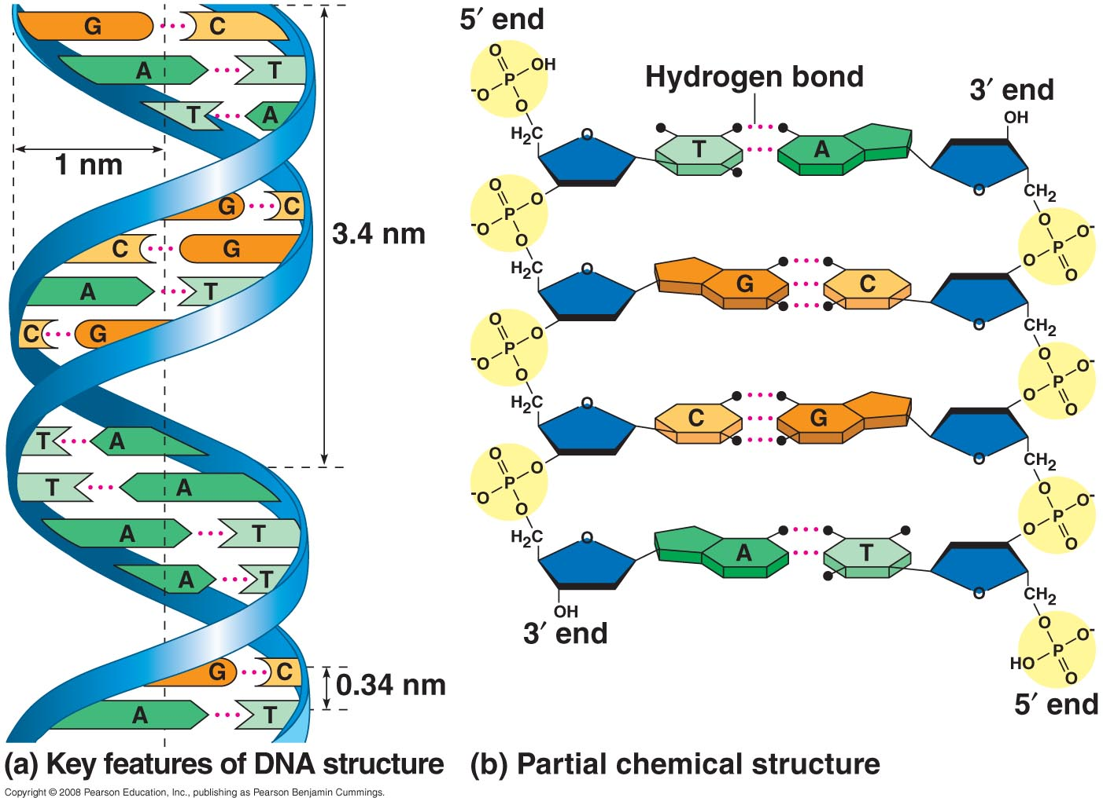

Slide 11
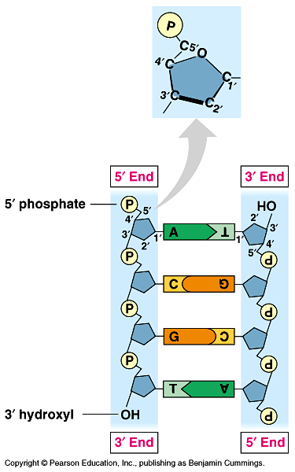

Slide 12
DNA Replication

Slide 13
DNA Replication
Each strand acts as a template for a new strand
Complimentary base pairing forms new strand
Called semi-conservative replication -- Why?

Slide 14
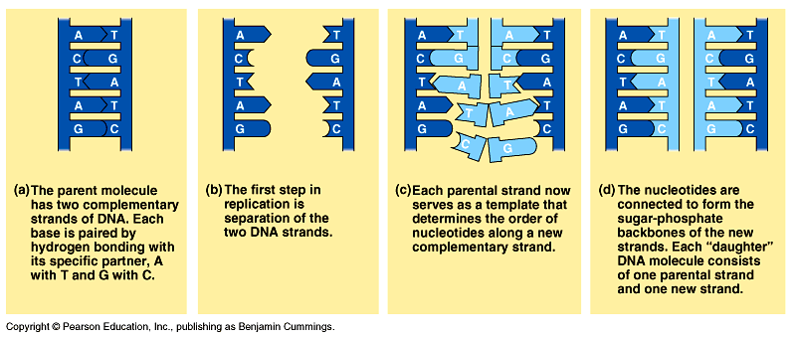

Slide 15
Experiments
Meselson-Stahl Experiment
Griffith
Hershey and Chase

Slide 16
Meselson-Stahl Experiment

Slide 17
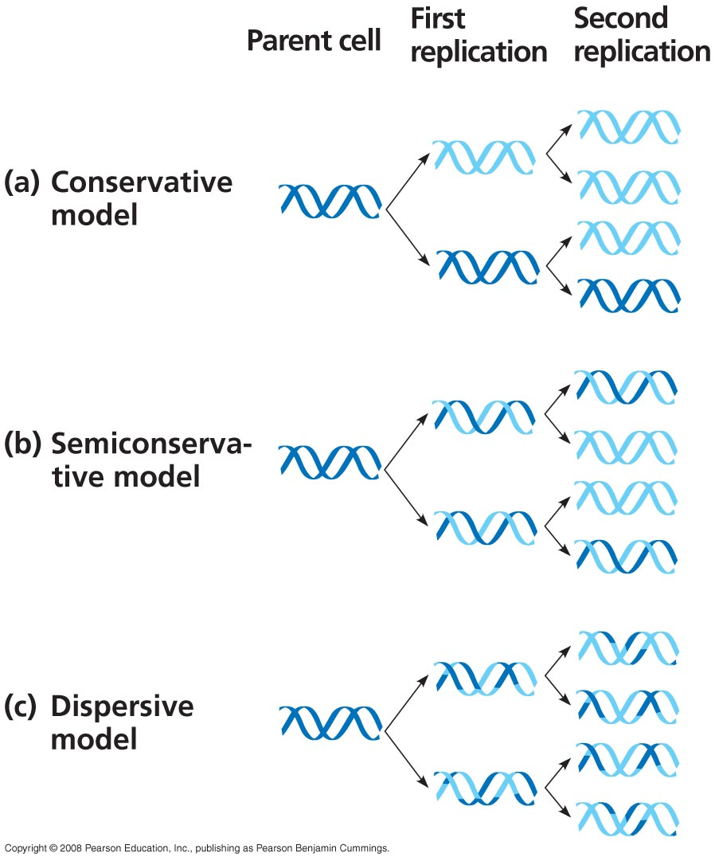

Slide 18
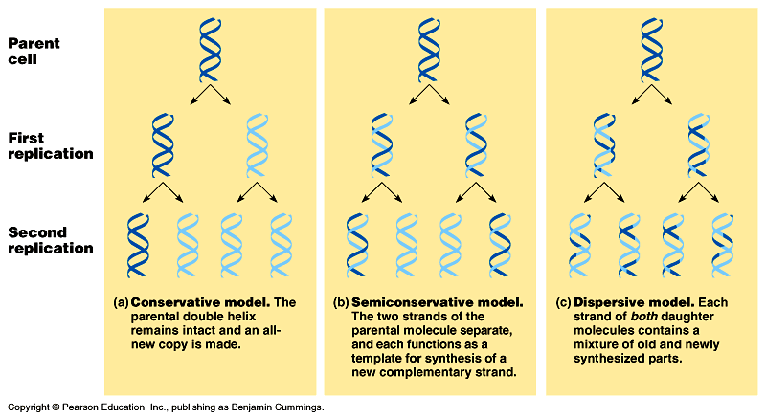

Slide 19
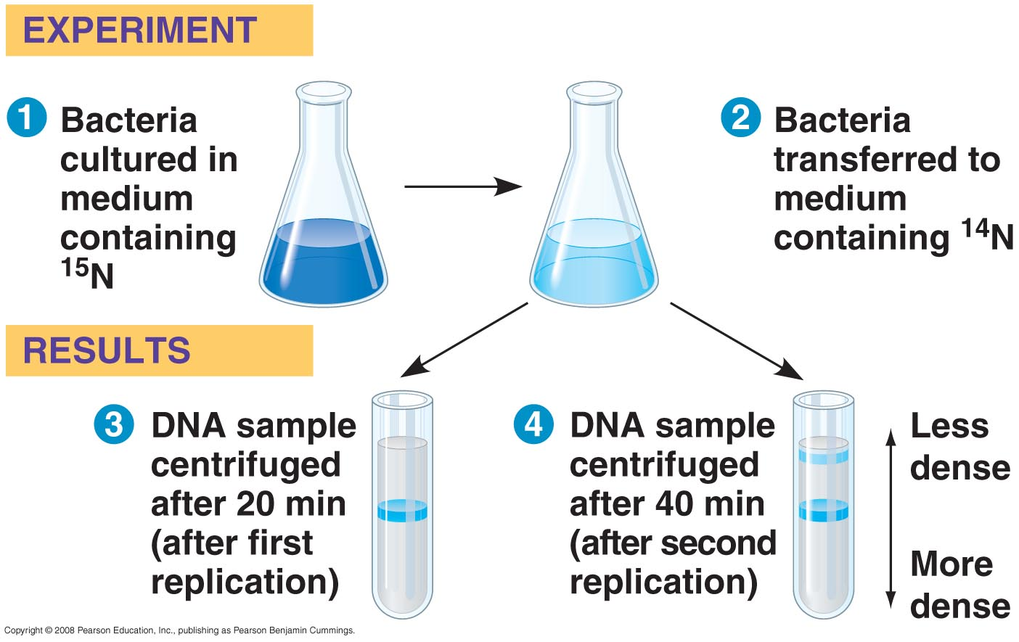

Slide 20
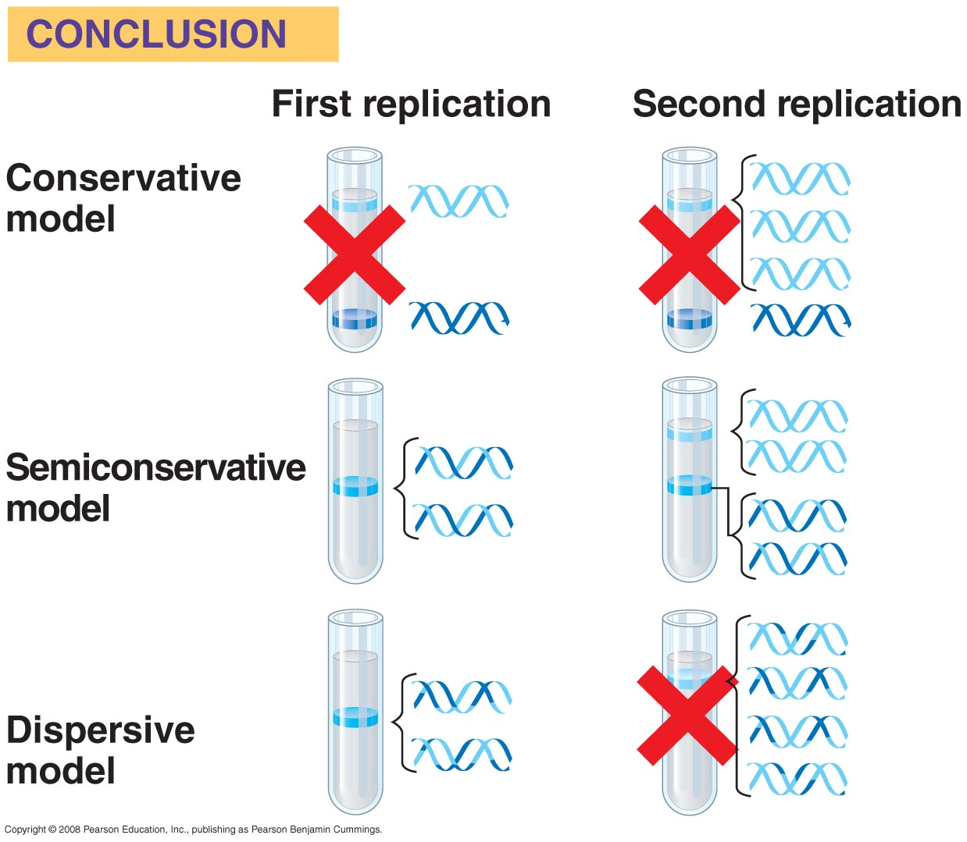

Slide 21
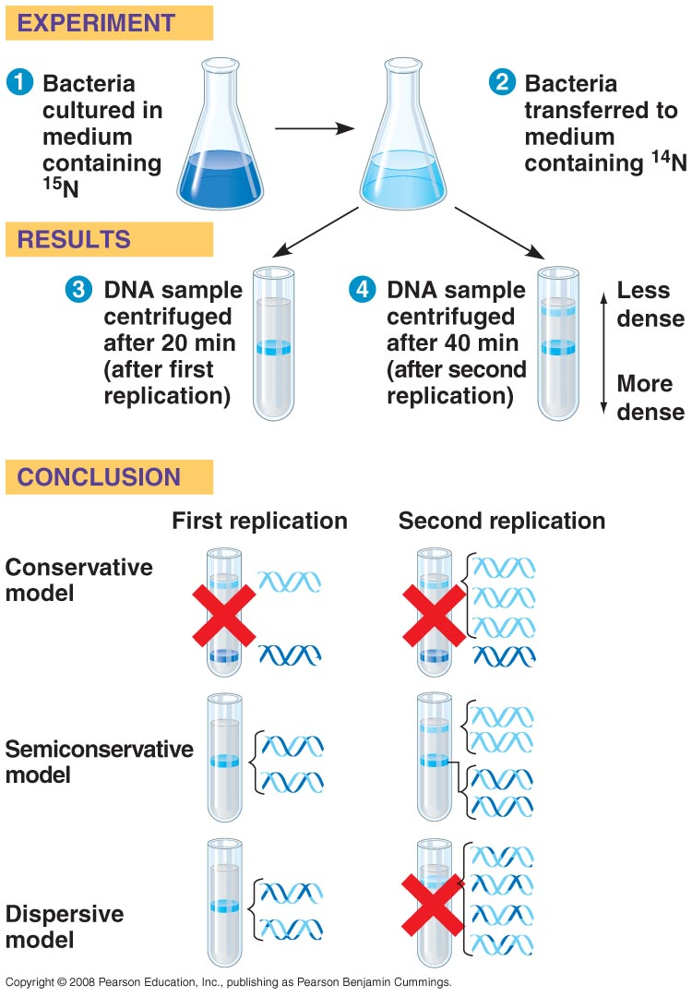

Slide 22
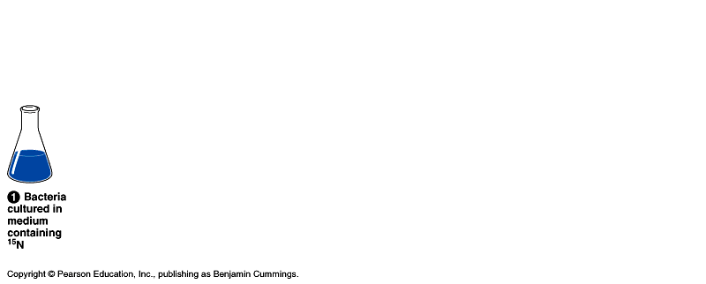

Slide 23
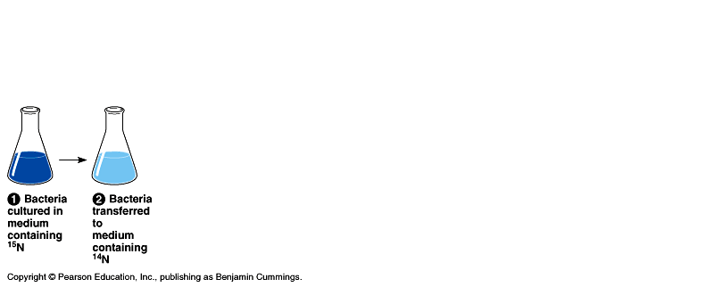

Slide 24
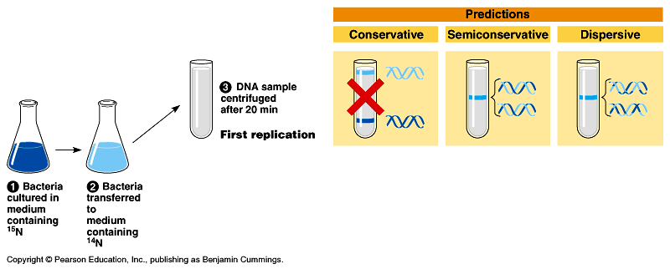

Slide 25
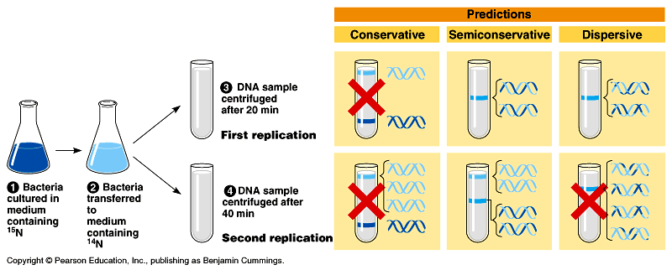

Slide 26
DNA Replication

Slide 27
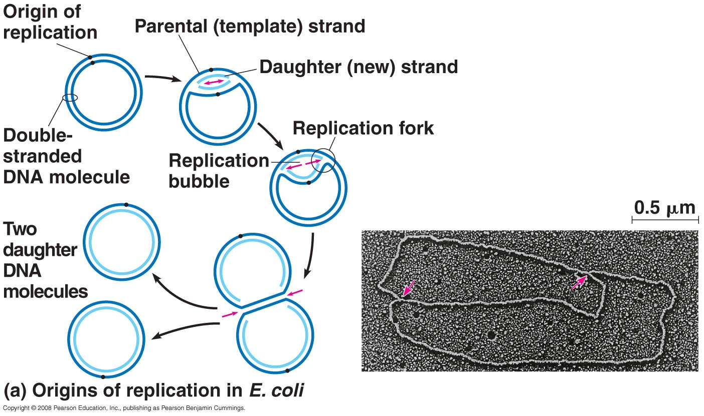
Replication in E.coli

Slide 28
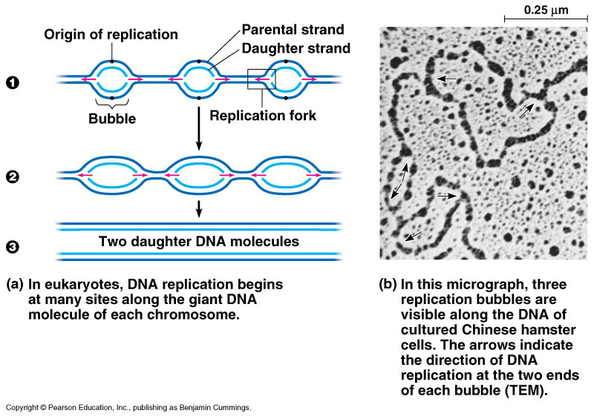
Replication in Eukaryotes

Slide 29
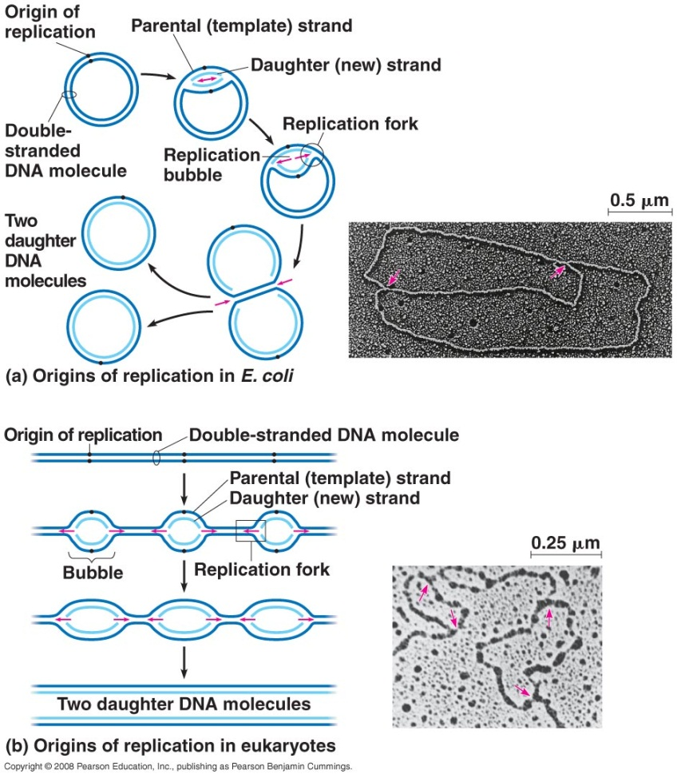
Comparison

Slide 30
Enzymes involved
Single strand binding protein - holds site open
Helicase – breaks helix
Topoisomerase – prevents supercoiling
Primase – initiates the RNA primer
DNA polymerase cannot initiate synthesis.
An RNA primer is needed.
RNA primer is later replaced by DNA.

Slide 31
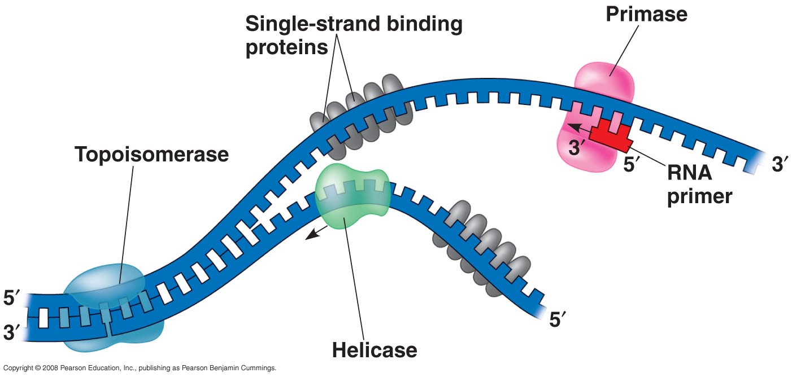

Slide 32
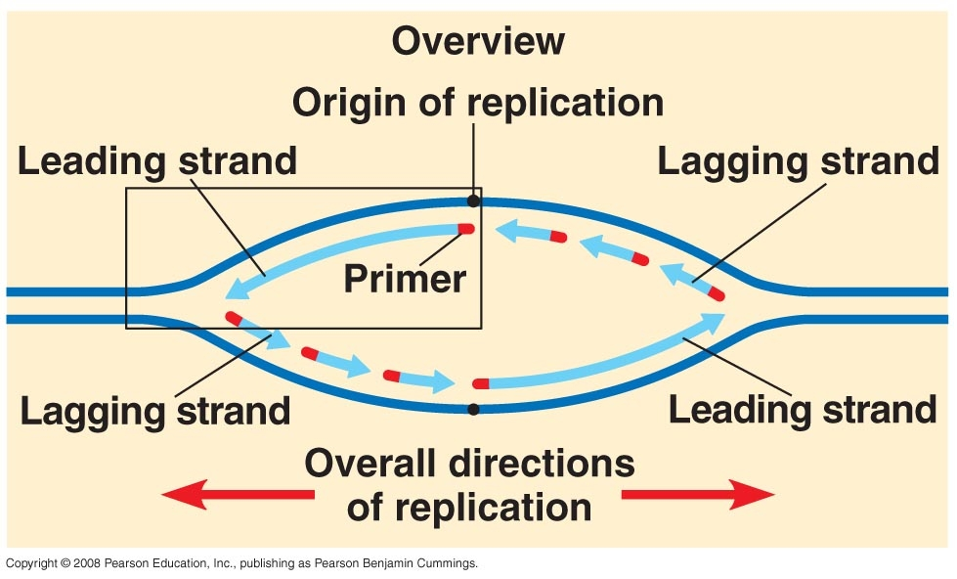

Slide 33
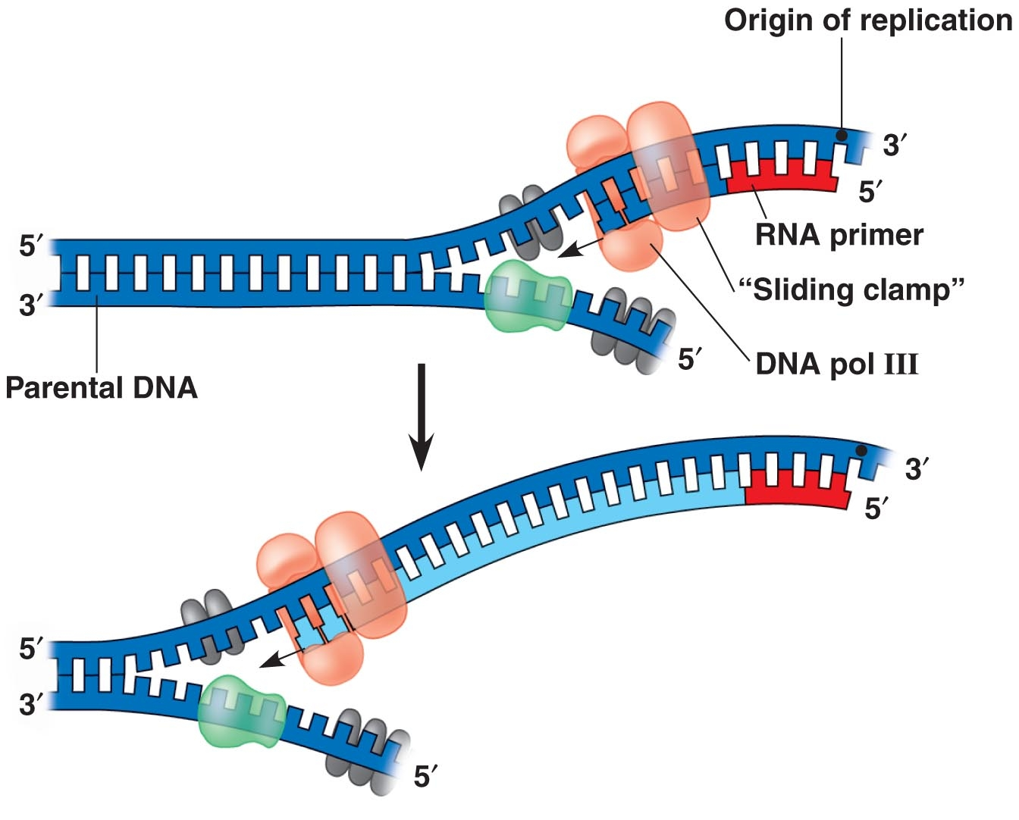

Slide 34
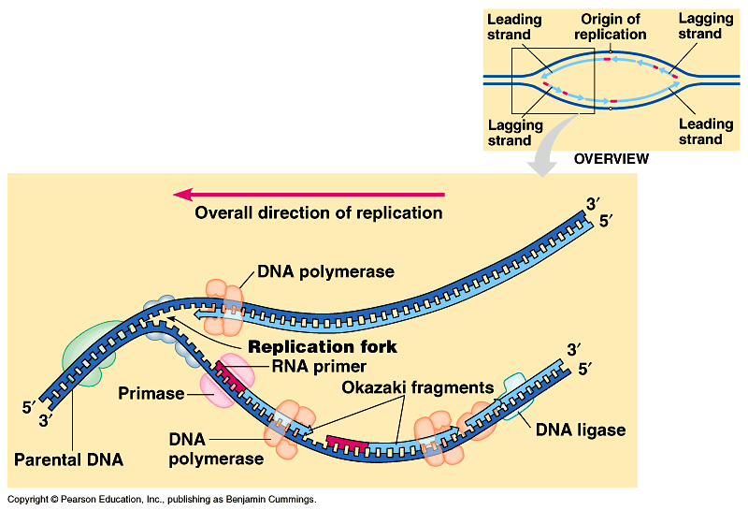

Slide 35
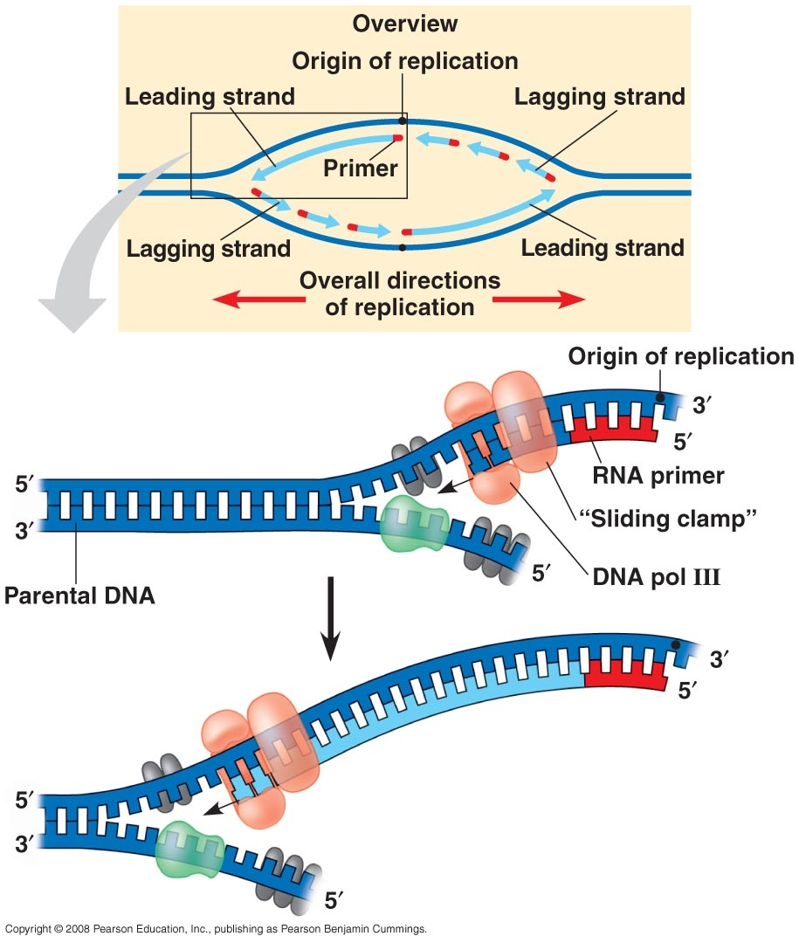

Slide 36
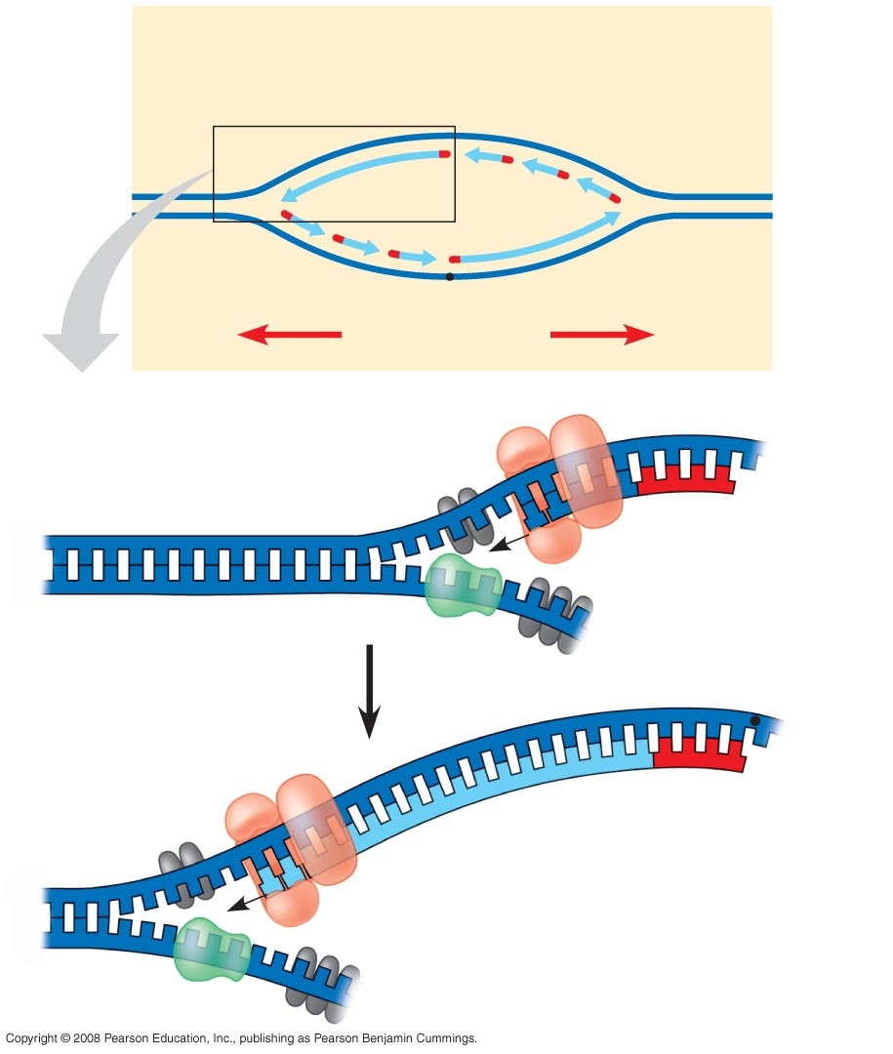

Slide 37
Replication in eukaryotes
1. H-bonds break at origin of replication
2. Replication bubble forms as H-bonds break
3. DNA polymerase directs synthesis of new strands
4. Replication is bi-directional (proceeds in both directions) fig. 16.17

Slide 38
Replication cont’d
5. DNA polymerase can only build the new strand in the in 5'→ 3' direction therefore new nucleotides are only added to the existing 3' side
One strand is synthesized continuously - leading strand
One strand synthesized in pieces -- lagging strand pieces called Okazaki fragments

Slide 39
Replication cont’d
6. Okazaki fragments joined by DNA ligase
7. DNA polymerase proofreads

Slide 41
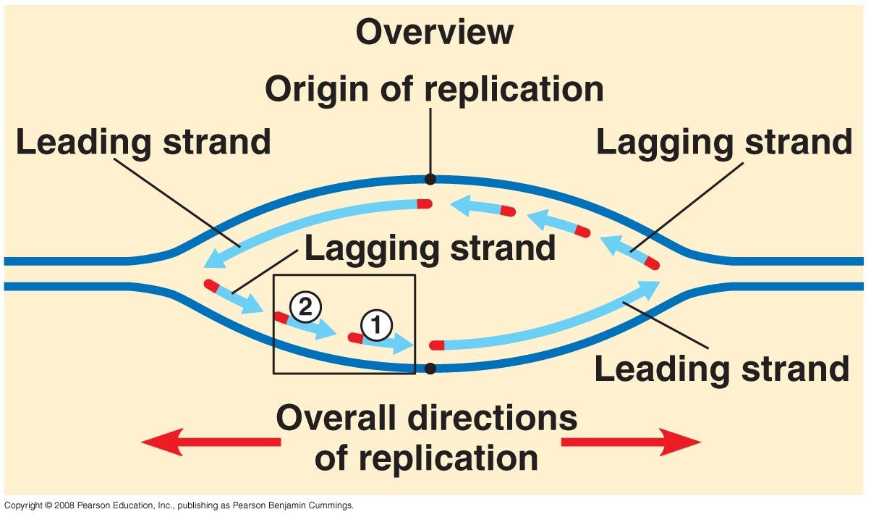

Slide 42
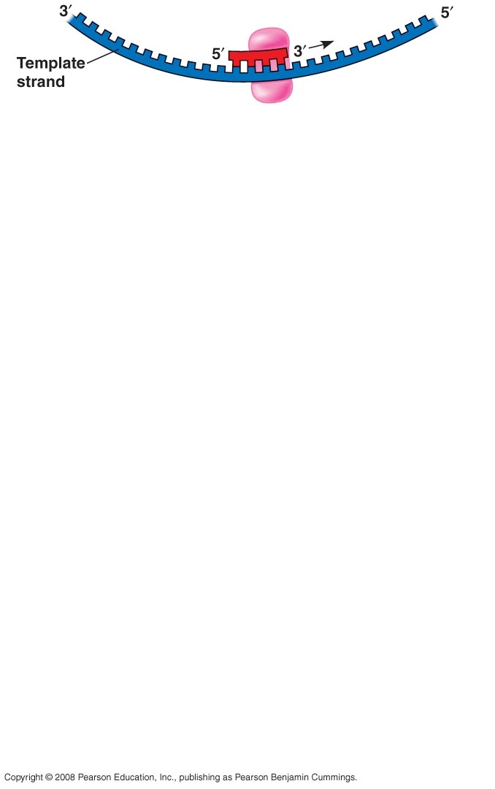

Slide 43
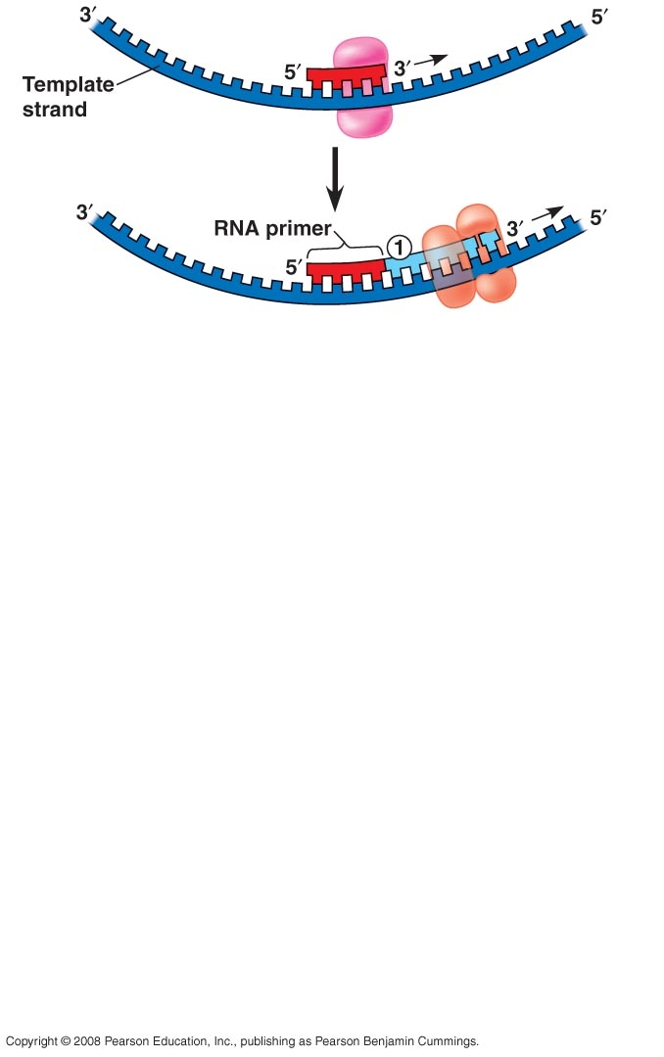

Slide 44
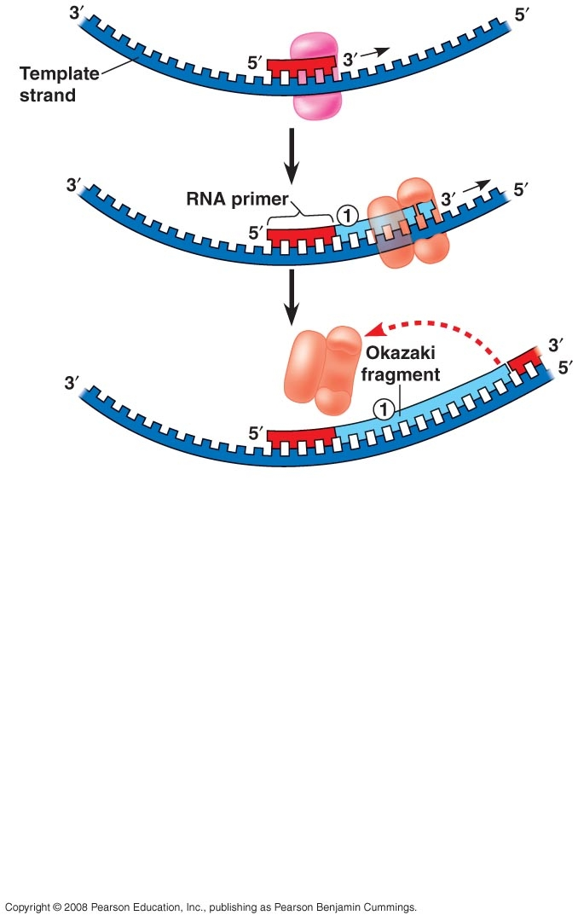

Slide 45
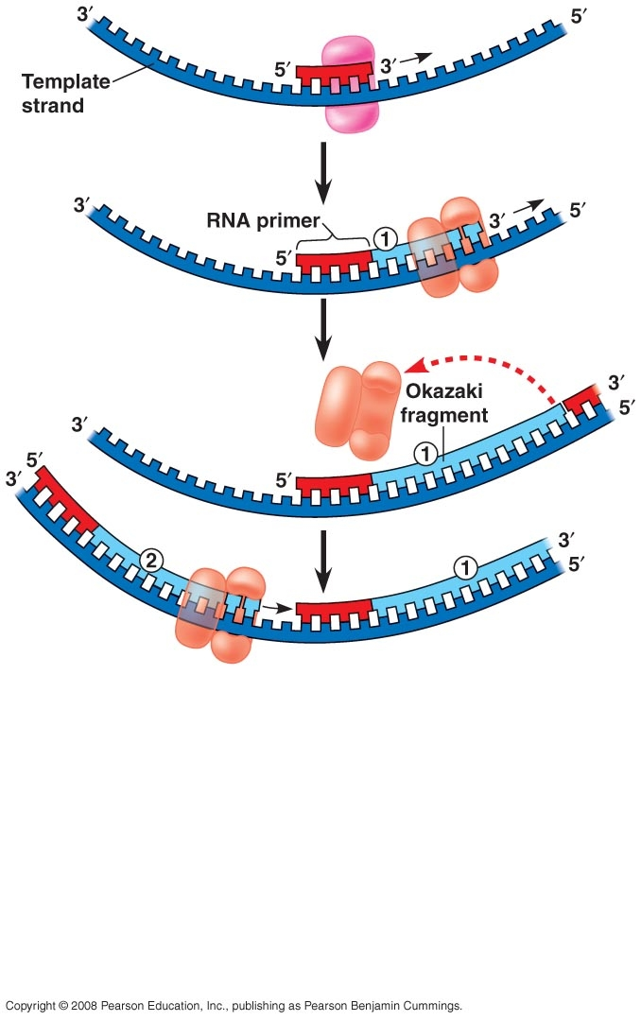

Slide 46
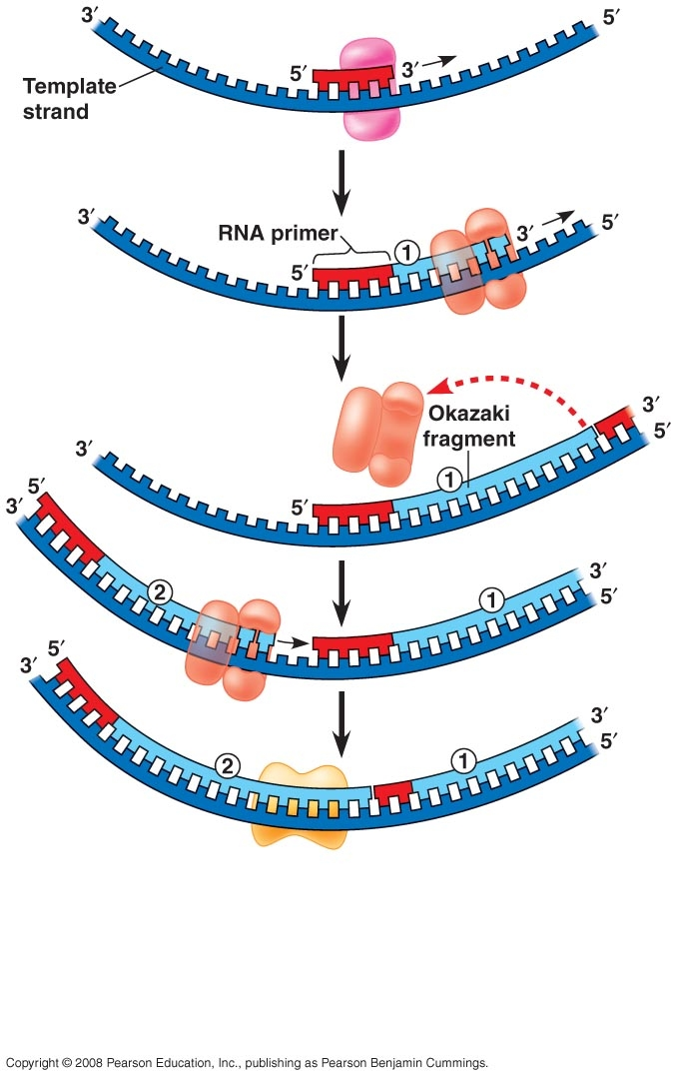

Slide 47
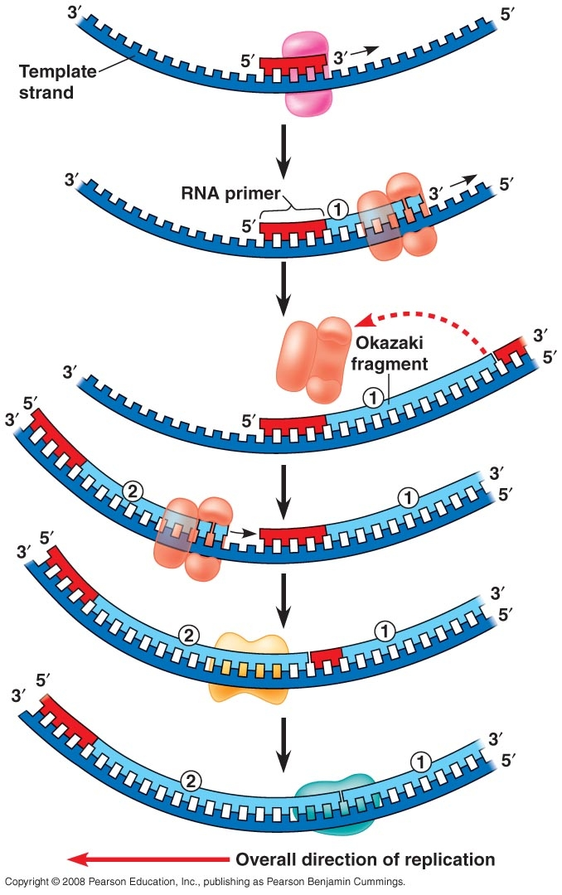

Slide 48
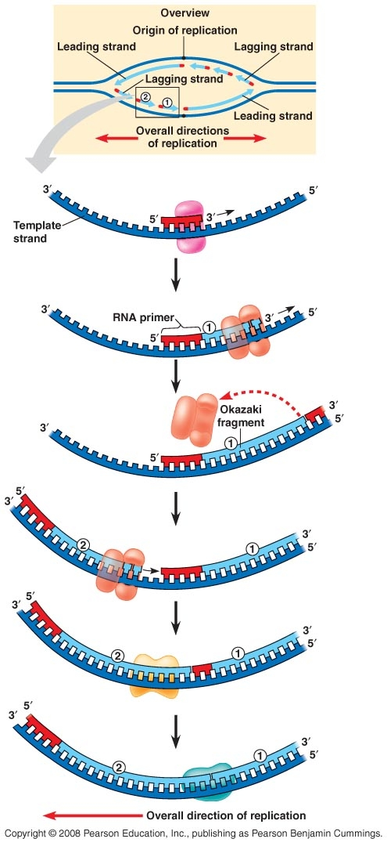

Slide 49
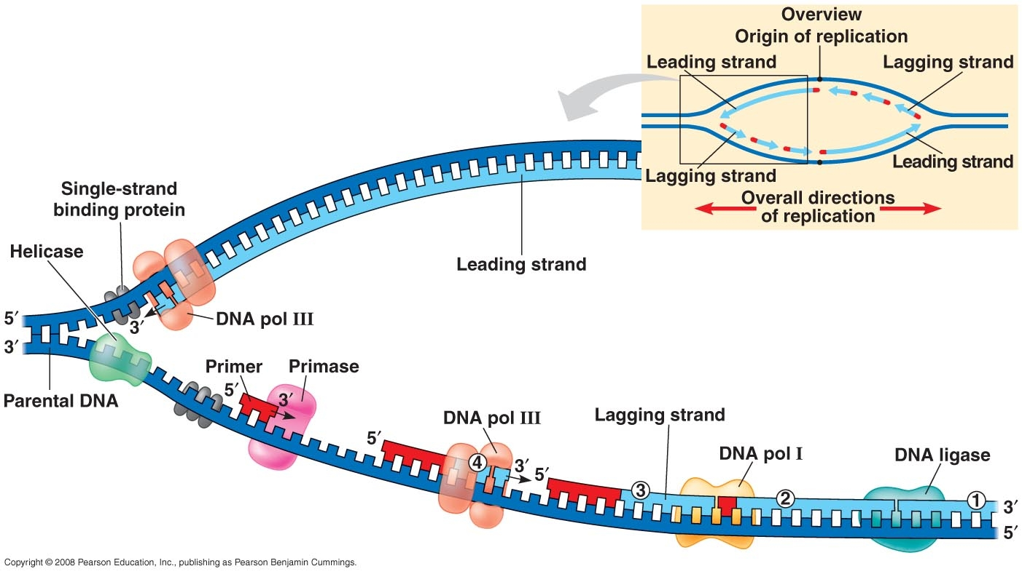

Slide 51
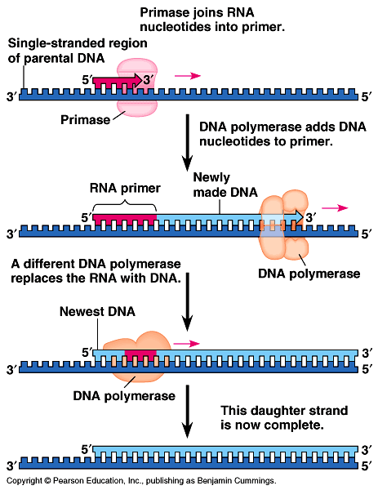

Slide 52
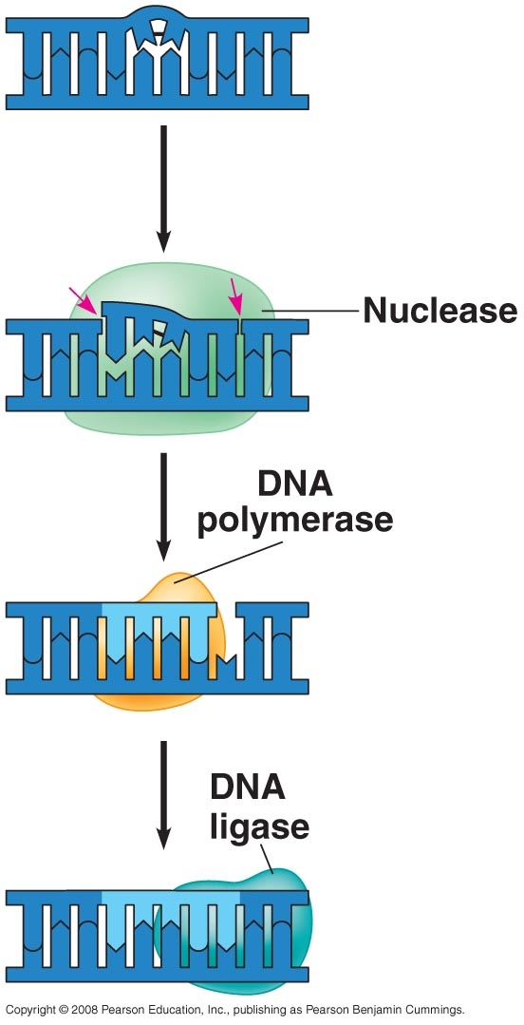

Slide 53
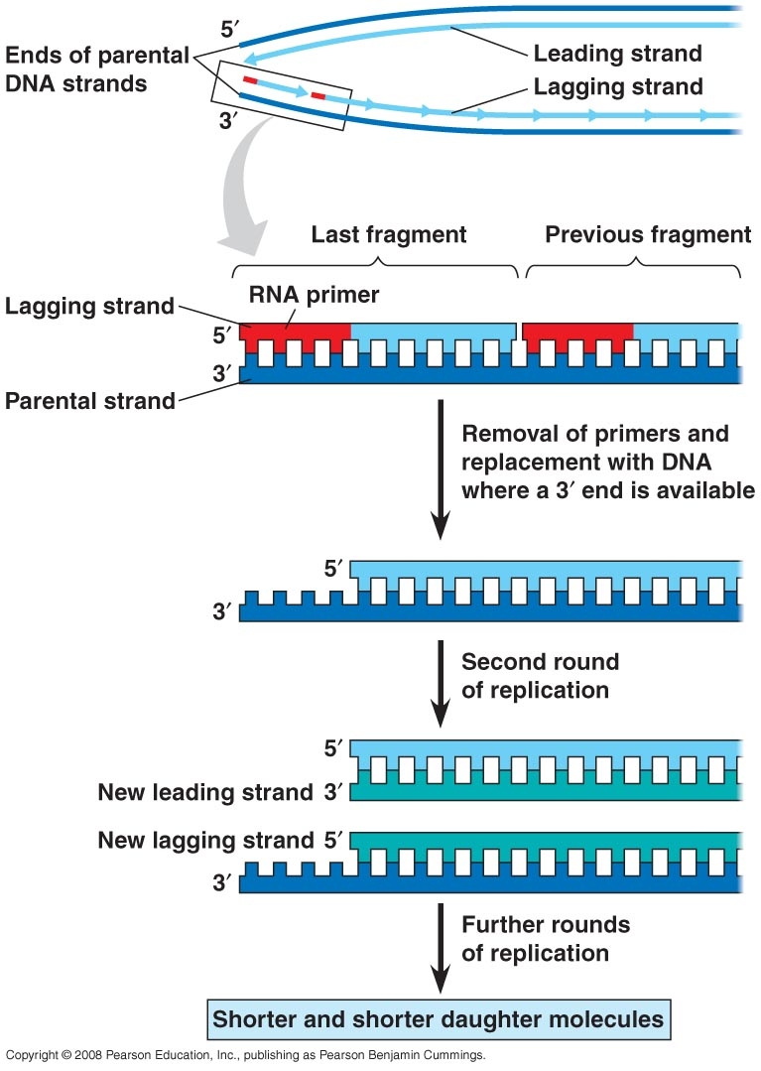

Slide 55
Replication Animations
http://www.wiley.com/college/pratt/0471393878/student/animations/dna_replication/index.html
http://www.fed.cuhk.edu.hk/~johnson/teaching/genetics/animations/dna_replication.htm
http://highered.mcgraw-hill.com/sites/0072437316/student_view0/chapter14/animations.html

Slide 56
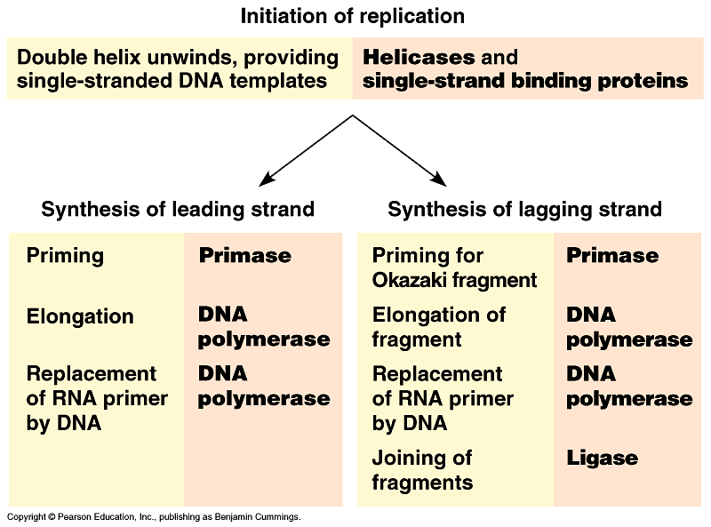

Slide 57
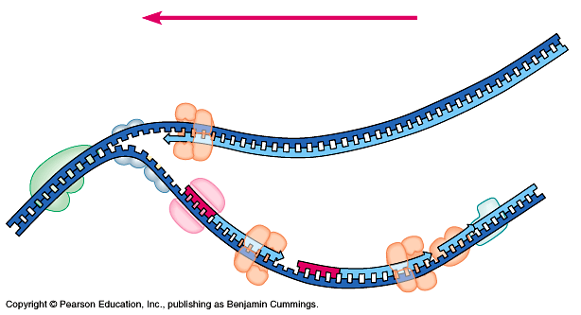

Slide 59
Replication cont’d
8. Energy required to build new strand
provided by ATP-like molecules:
3 PO₄’s, 1 deoxyribose, 1 base
DATP
DGTP
DTTP
DCTP

Slide 60
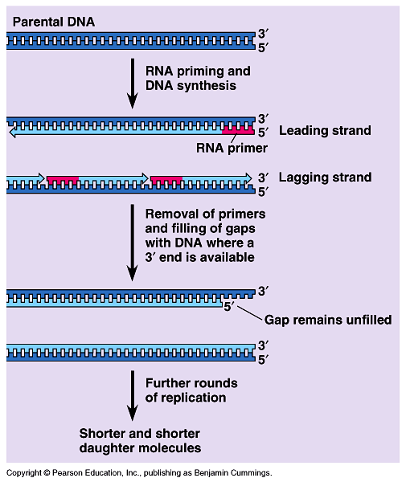

Slide 61
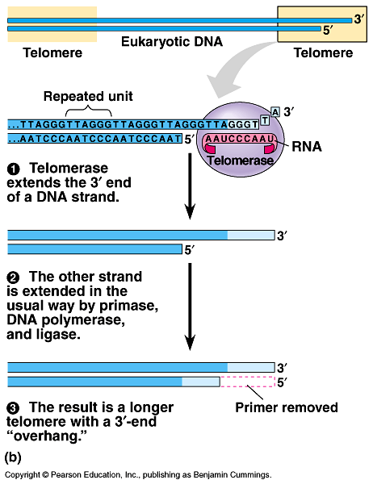

Slide 62
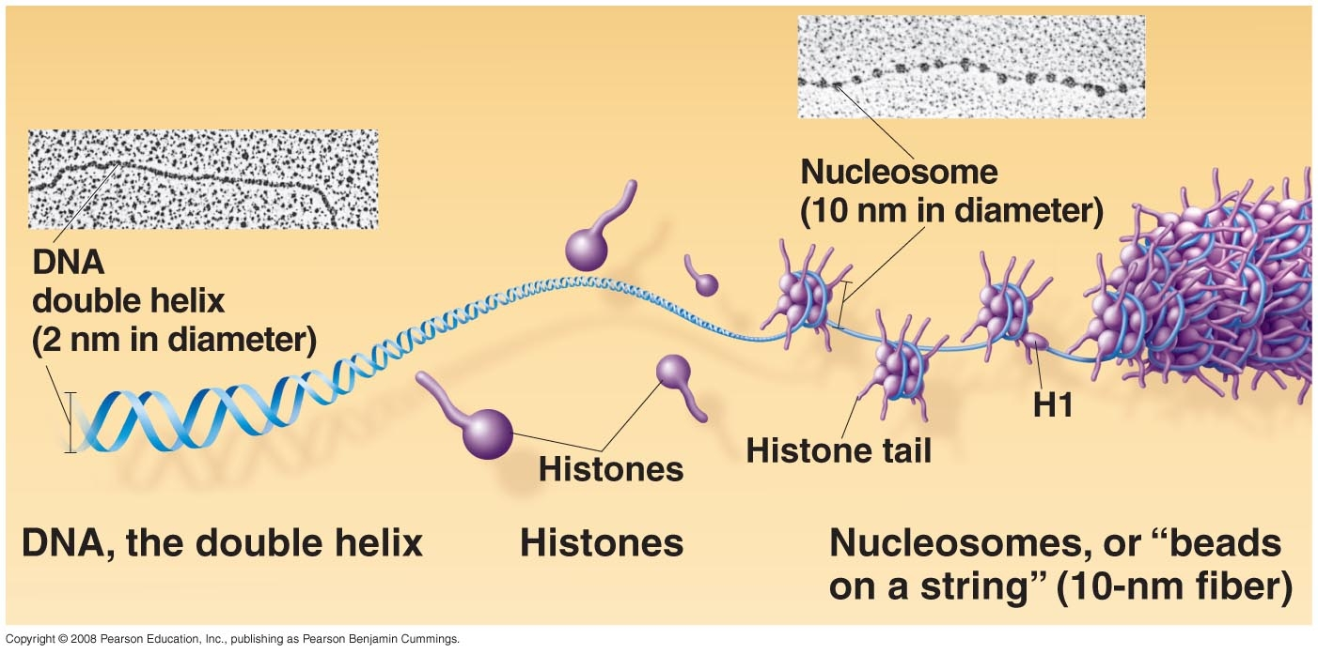

Slide 63
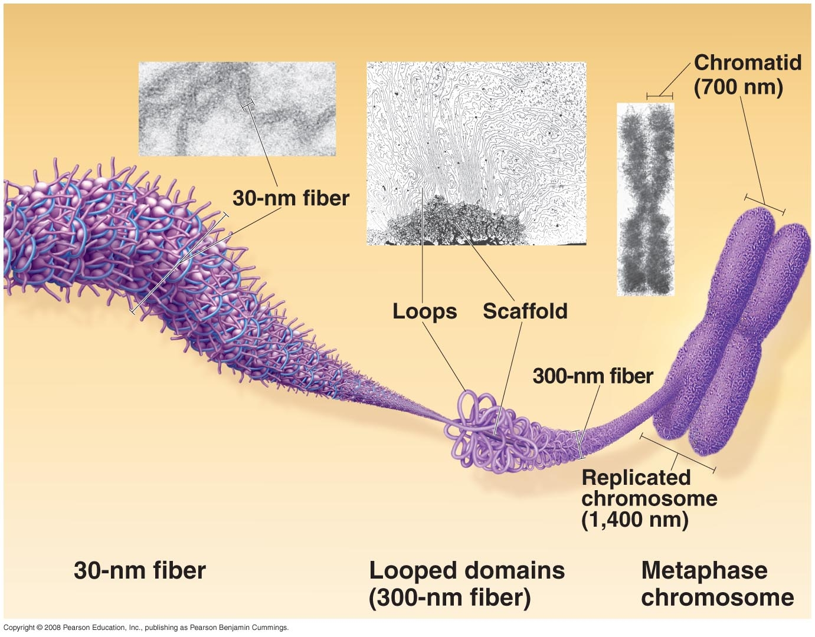

Slide 64
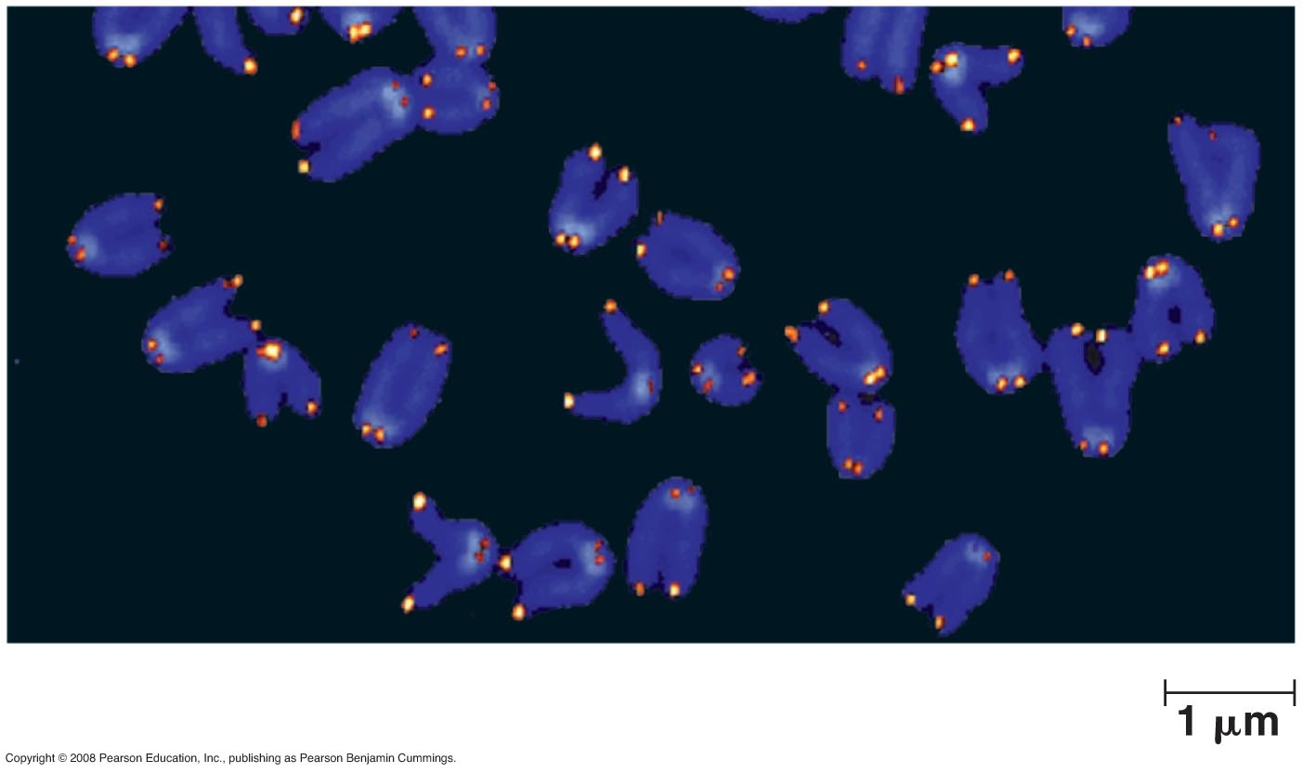

Slide 65
Chromosome 11

Slide 66
Gene Expression
Making Proteins

Slide 67
Gene Expression
AKA protein synthesis
Central Dogma
Background:
- genes on chromosomes contain DNA
- each gene codes for one protein

Slide 68
Two Stages of Protein Synthesis
1. Transcription
2. Translation

Slide 69
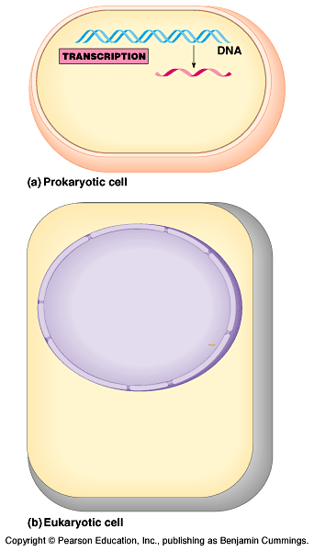

Slide 70
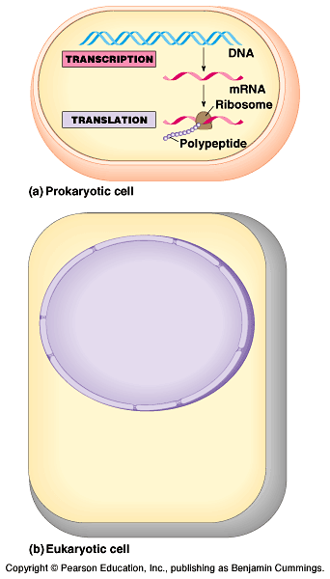

Slide 71
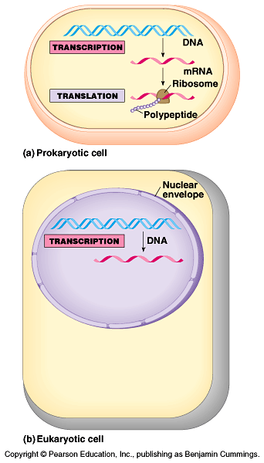

Slide 72
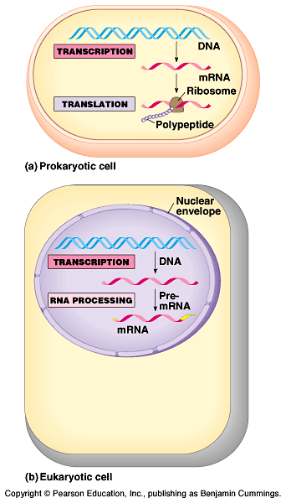

Slide 73
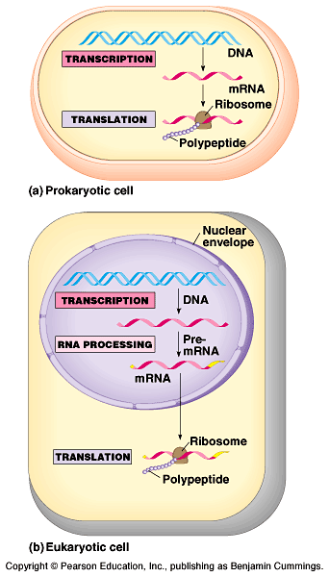

Slide 74
Transcription
Production of mRNA (messenger RNA) from DNA
RNA similar to DNA except:
- single stranded
- uracil instead of thymine
- ribose instead of deoxyribose

Slide 75
Steps of Transcription
Initiation
Elongation
Termination

Slide 76
Initiation
Transcription initiation complex assembles on the promoter.

Slide 77
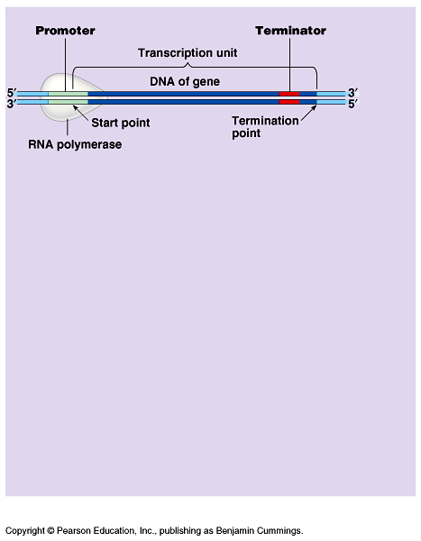

Slide 78
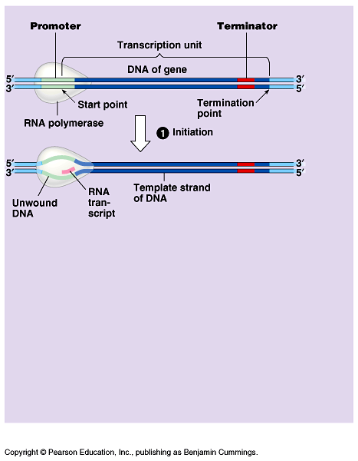

Slide 79
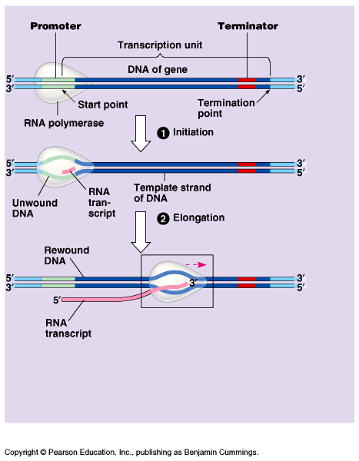

Slide 80
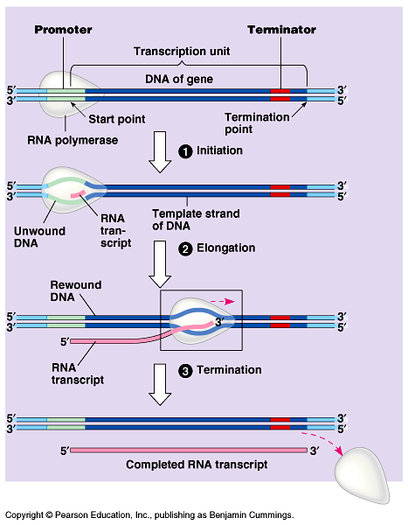

Slide 81
Steps of Transcription cont’d
1. Helicase breaks H-bonds
2. One strand of DNA serves as template for mRNA
3. Uses RNA polymerase
4. Synthesis in 5' → 3' direction
5. RNA Processing
6. mRNA leaves nucleus

Slide 82


Slide 83
RNA Processing
Occurs in the nucleus
Addition of 5’ cap and poly-A-tail
Splicing

Slide 84
Cap and tail
Aids in export from nucleus
Protects RNA from degradation
Once in cytoplasm these along with cytoplasmic proteins help ribosome attachment.

Slide 85
RNA Splicing
Why ?
Some sequences of DNA don’t code for anything & are b/w ones that do.
Noncoding segment called introns
Coding segment called exons

Slide 86


Slide 87


Slide 88
What Happens?
mRNA made in nucleus is pre mRNA
RNA splicing takes out introns & puts exons as a continuous strand
snRNP’s (snurps) proteins & RNA at end of proteins
snRNP’s & other proteins form a spliceosome -- where splicing occurs
Pg. 312 fig. 17.10

Slide 89
Translation
Interpreting amino acid sequence from nucleotide language
Proteins made according to codons
Codons - 3 nucleotide sequence on mRNA
Each codon specifies one amino acid

Slide 90
Codons read in 5' → 3' direction
AUG is start codon
Use chart pg. 308 to determine the amino acid coded for by each codon -- (mRNA)

Slide 91


Slide 92
2 other RNA’s needed
tRNA
rRNA

Slide 93
tRNA
Carries amino acid to ribosome – see structure fig. 17.13
A.a. attached to 3' end
Anticodon read 3' → 5'

Slide 94


Slide 95
rRNA
Component of ribosome – maintains structure of ribosome as well as regulation of mRNA & tRNA

Slide 96
Ribosome Structure
Two subunits -- small & large
Lg. Unit has three sites
- A site (aminoacyl)
- P site (peptidyl)
- E site (exit)

Slide 97


Slide 98
3 Phases of Translation
Initiation
Elongation
Termination

Slide 99
Initiation

Slide 100


Slide 101
Initiation
5' end of mRNA attaches to small subunit of ribosome
Start codon, AUG, binds w/ initiator tRNA (met)
P – site of lg. subunit binds to AUG mRNA codon

Slide 102
Elongation

Slide 103


Slide 104
Elongation
2nd tRNA enters A- site & binds to 2nd codon
Peptide bond forms b/w a.a. of each tRNA
1st tRNA moves from P-site to E-site
As mRNA moves through ribosome 2nd tRNA now in A-site w/ 2 a.a.’s
Cycle repeats until a STOP codon enters A-site

Slide 105


Slide 106
Termination
http://telstar.ote.cmu.edu/biology/animation/index.html#dnarna

Slide 107


Slide 109
Termination
STOP codon in A-site
Protein release factor binds to codon -- no tRNA -- no a.a.
Polypeptide is freed
Two subunits separate

Slide 110
Trivial but Important
Some tRNA’s have anticodons that can recognize 2 or more different codons
Third base of codon & anticodon can vary
I.e. U can bind w/ either A or G
This is called wobble

Slide 111


Slide 112
Folding and Modification
Some amino acids can be modified by attaching sugars, lipids phosphate groups etc.
Enzymes may remove some amino acids from leading end
All translation starts with a free ribosome and then depending on the developing polypeptide chain it may attach to rough ER

Slide 113
Folding and Modification
Polypeptides of proteins destined for endomembrane system (secretion) are marked by a signal peptide (directs it to rough ER)
Signal peptide is recognized by a protein-RNA complex called a signal recognition particle (SRP)

Slide 114
Mutations

Slide 115
Mutations
Any change in sequence of DNA
Most mutations are harmless b/c only 10-20% of all human DNA actually codes for proteins -- some junk DNA present

Slide 116
2 Types of Mutations
Large -- delete or rearrange pieces or whole chromosomes
Small -- single nucleotide change called point mutation
- SNPs single-nucleotide polymorphism

Slide 117
SNPs
http://www.ncbi.nlm.nih.gov/About/primer/snps.html

Slide 118
2 Types of Point Mutations
Substitution
  -- Sometimes has no effect on amino acid
-- if any - only one amino acid is affected
-- I.e. Sickle celled anemia
-- Missense change one amino acid to another

Slide 119

Fig. 17-22
Wild-type hemoglobin DNA
Mutant hemoglobin DNA
3′
C
T
T
5′
3′
C
A
T
5′
5′
G
A
A
3′
5′
G
T
A
3′
mRNA
mRNA
5′
G
A
A
3′
5′
G
U
A
3′
Normal hemoglobin
Sickle-cell hemoglobin
Glu
Val

Slide 120


Slide 121

Fig. 17-23
Wild-type
DNA template strand
3′
5′
5′
3′
mRNA
5′
3′
Protein
Stop
Amino end
Carboxyl end
A instead of G
Extra A
3′
5′
3′
5′
5′
3′
5′
3′
U instead of C
Extra U
5′
3′
5′
3′
Stop
Stop
Silent (no effect on amino acid sequence)
Frameshift causing immediate nonsense (1 base-pair insertion)
T instead of C
missing
3′
5′
3′
5′
5′
3′
5′
3′
A instead of G
missing
5′
3′
5′
3′
Stop
Missense
Frameshift causing extensive missense (1 base-pair deletion)
A instead of T
missing
3′
5′
3′
5′
5′
3′
5′
3′
U instead of A
missing
5′
3′
5′
3′
Stop
Stop
Nonsense
No frameshift, but one amino acid missing (3 base-pair deletion)
(a) Base-pair substitution
(b) Base-pair insertion or deletion

Slide 122

Fig. 17-23a
Wild type
DNA template
strand
3′
5′
5′
3′
mRNA
5′
3′
Protein
Stop
Amino end
Carboxyl end
A instead of G
3′
5′
5′
3′
U instead of C
5′
3′
Stop
Silent (no effect on amino acid sequence)

Slide 123

Fig. 17-23b
Wild type
DNA template
strand
3′
5′
5′
3′
mRNA
5′
3′
Protein
Stop
Amino end
Carboxyl end
T instead of C
3′
5′
5′
3′
A instead of G
5′
3′
Stop
Missense

Slide 124

Fig. 17-23c
Wild type
DNA template
strand
3′
5′
5′
3′
mRNA
5′
3′
Protein
Stop
Amino end
Carboxyl end
A instead of T
3′
5′
5′
3′
U instead of A
5′
3′
Stop
Nonsense

Slide 125

Fig. 17-23d
Wild type
DNA template
strand
3′
5′
5′
3′
mRNA
5′
3′
Protein
Stop
Amino end
Carboxyl end
Extra A
3′
5′
5′
3′
Extra U
5′
3′
Stop
Frameshift causing immediate nonsense (1 base-pair insertion)

Slide 126

Fig. 17-23e
Wild type
DNA template
strand
3′
5′
5′
3′
mRNA
5′
3′
Protein
Stop
Amino end
Carboxyl end
missing
3′
5′
5′
3′
missing
5′
3′
Frameshift causing extensive missense (1 base-pair deletion)

Slide 127

Fig. 17-23f
Wild type
DNA template
strand
3′
5′
5′
3′
mRNA
5′
3′
Protein
Stop
Amino end
Carboxyl end
missing
3′
5′
5′
3′
missing
5′
3′
Stop
No frameshift, but one amino acid missing (3 base-pair deletion)

Slide 128
Addition or deletion
-- Also called frame shift mutation. Why?
-- Changes all codons after mutation

Slide 129
Example
Normal sequence
THE FAT CAT ATE ONE ANT AND ONE NUT
Substitution
THE FAT CAN ATE ONE ANT AND ONE NUT

Slide 130
More Examples
Deletion
THE FAT CA_A TEO NEA NTA NDO NEN UT…
Addition
THE FAT CAT ART EON EAN TAN DON ENU T…
Addition and Deletion
THE FAT CA_A RTE ONE ANT AND ONE NUT

Slide 131
Lab on Electrophoresis
Electrophoresis – tool for use with DNA
-- operates with a gel and electricity
Since DNA is negative we can attract it to a positive end
Separates fragments of DNA by size
Can be used to identify individuals

Slide 132
How do you cut DNA?
Restriction Enzymes – cut at known sequences of DNA
AKA restriction endonuclease
Examples of restriction enzymes
  Hind III
  EcoRI
  Hae III

Slide 133
Lab
We can use electrophoresis to find if the suspect of a crime is the actual criminal
This lab has us use electrophoresis to find the number of base pairs in each fragment of DNA
-- this is done by sending known DNA fragments alongside of unknown DNA fragments
-- then measure the distance each fragment traveled
-- use interpolation technique on a graph to find the actual number of base pairs in each fragment

Slide 134


Slide 135


Slide 136
PCR
Polymerase Chain Reaction
Method used to make many copies of a single strand of DNA
Uses a DNA polymerase that can withstand the heat used to separate DNA
Very useful when DNA is in short supply

Slide 137


Slide 138
Genetic Engineering

Slide 139
Genetic Engineering
Terms
Plasmid
– extra circular DNA in some bacteria
Restriction Enzymes
– Enzymes found in bacteria that cut up foreign DNA Why?
protection
http://wehi.tv/

Slide 140
How?
Recognizes a specific sequence of 4-8 nucleotides
Cuts DNA at that sequence
Bacteria protects itself from restriction by adding CH3 groups to adenine or cytosine
  This keeps restriction enz. from recognizing itself

Slide 141


Slide 142


Slide 143


Slide 144
Restriction Enzymes Are Useful
Sticky ends are produced when DNA is cut.
These ends can now join to new DNA of choice
DNA ligase makes it permanent
DNA can then be sent by a vector to enter new cell
New cell is then cloned
See fig. 20.1 and 20.3
Notes:
PCR Chain Reaction pg. 371

Slide 145
Gene therapy and SCID
http://www.youtube.com/watch?v=0-cC1VDneV4

Slide 146
plasmids
http://www.dnalc.org/resources/plasmids.html
electrophoresis
http://learn.genetics.utah.edu/content/labs/gel/
You tube electrophoresis
http://www.youtube.com/watch?v=qMxQ-65qYDk

Slide 147


Slide 148
Lab on Transformation
Bacterial transformation with ampicillin resistance
Inserting a plasmid w/gene for ampicillin resistance into E. coli
-- pAMP is the plasmid w/ampicillin resistance
-- Luria broth is food for the bacteria

Slide 149
We will try to put the plasmid into the E. coli
How will we know if it worked?
Grow E. coli on ampicillin agar plates & measure growth
We then calculate the efficiency rate.

Slide 150
Regulation of Gene Expression

Slide 151


Slide 152
Regulation in Prokaryotes
Operon Theory

Slide 153
Review transcription

Slide 154
Operon Structure
Promoter – where transcription begins
TATA box
Operator – on/off switch
Structural genes – code for polypeptide
Terminator – stop sequence
Notes:
Could be IV.

Slide 155
Two types of operons
Synthesis of repressible enzymes
Synthesis of inducible enzymes

Slide 157


Slide 158


Slide 159
Repressible
Tryp operon fig. 18.20
Alone the operator is on & tryptophan is produced
As tryptophan accumulates it binds to the repressor
Repressor now fits into operator and blocks attachment of RNA polymerase – operator is now off

Slide 160


Slide 161


Slide 162
Inducible
Lac operon fig. 18.21
When no lactose present active repressor fits into operator thus keeping it off
Lactose present & changes to allolactose, an isomer

Slide 163
Allolactose binds to repressor and inactivates it
Enzymes for lactose breakdown are produced

Slide 164
Regulation of Gene Expression in Eukaryotes

Slide 166

Fig. 18-6
Signal
NUCLEUS
Chromatin
Chromatin modification
DNA
Gene available
for transcription
Gene
Transcription
RNA
Exon
Primary transcript
Intron
RNA processing
Tail
Cap
mRNA in nucleus
Transport to cytoplasm
CYTOPLASM
mRNA in cytoplasm
Degradation
of mRNA
Translation
Polypeptide
Protein processing
Degradation
of protein
Active protein
Transport to cellular
destination
Cellular function

Slide 167
Regulation in eukaryotes
Regulation of Chromatin structure
Regulation of transcription initiation

Slide 168
Regulating Chromatin Structure
Histone Acetylation
DNA Methylation
Epigenetic inheritance

Slide 171
Histone Acetylation
Histones are small proteins with a high proportion of positive charged amino acids that bind to negative DNA causing DNA to wrap around it
When wrapped tightly the gene is not expressed, if loosely it can be expressed

Slide 172
Histone Acetylation continued
Adding an acetyl group (-COCH₃) causes tails to not bind to neighbor nucleosomes which causes it to be less compact so chromatin is looser.
Thus acetylation promotes initiation of transcription.

Slide 173
DNA Methylation
Adds methyl groups to DNA bases (usually cytosine)
Causes inactivation of genes – example inactive X
This appears to be passed on (epigenetics)

Slide 174
Epigenetic Inheritance
No change in DNA nucleotides but the chromatic modifications are inherited.

Slide 175
Regulating Transcription Initiation
Control elements - some noncoding DNA help regulate transcription by binding certain proteins.
Transcription factors helps RNA polymerase

Slide 176
Control Elements
Proximal – located near promoter
Enhancers - Distal (located at a distance from promoter)
Enhancers cause folding of DNA which influence promoter

Slide 177

Fig. 18-9-1
Activators
Promoter
Gene
DNA
Enhancer
Distal control
element
TATA
box

Slide 178

Fig. 18-9-2
Activators
Promoter
Gene
DNA
Enhancer
Distal control
element
TATA
box
General
transcription
factors
DNA-bending
protein
Group of
mediator proteins

Slide 179

Fig. 18-9-3
Activators
Promoter
Gene
DNA
Enhancer
Distal control
element
TATA
box
General
transcription
factors
DNA-bending
protein
Group of
mediator proteins
RNA
polymerase II
RNA
polymerase II
Transcription
initiation complex
RNA synthesis

Slide 180

Fig. 18-10
Enhancer
Promoter
Control
elements
Albumin gene
Crystallin gene
LIVER CELL
NUCLEUS
LENS CELL
NUCLEUS
Available
activators
Available
activators
Albumin gene
not expressed
Albumin gene
expressed
Crystallin gene
not expressed
Crystallin gene
expressed
(a) Liver cell
(b) Lens cell

Slide 181
miRNA and siRNA
miRNA – associates with a protein that can degrade or prevent translation of an mRNA
siRNA –
RNAi – interference antiviral defense and turns off expression

Slide 182
Gene Regulation
http://prezi.com/jgpqmkmh7xk5/ap-bio-molecular-genetics-3-regulation-of-gene-expression/

