Slide 1
Principles of Genetics

Slide 2
Background
Gene – section of DNA
There are 2 genes for every trait ( sometimes more)
Allele – form of a gene
- Most have 2 forms; a dominant and a recessive
Dominant – if present the trait shows
Recessive – only shows if both are present

Slide 3
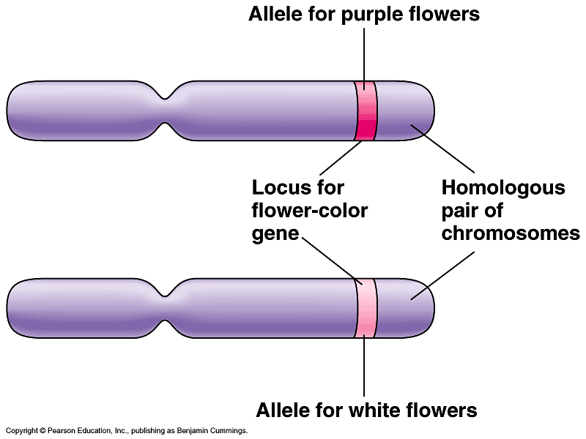

Slide 4
Heterozygous – one recessive gene & one dominant gene
  Also called hybrid
Homozygous – both genes are the same
- Homozygous dominant
- Homozygous recessive

Slide 5
Mendel’s Law of Segregation
Each individual has 2 genes for 1 trait
This pair of genes separates into diff. cells during meiosis
- a person is heterozygous for the tongue rolling trait (Tt) then two types of gametes are produced – see board

Slide 6
Mendel’s Law of Independent Assortment
2 genes for 2 different traits separate independently of each other during meiosis
- ie. Earlobes and tongue rolling
- If parent is heterozygous for both traits what are the possibilities of gametes produced after meiosis?

Slide 7
Vocabulary
Genotype – written expression of genes that express a trait i.e.. Tt
Phenotype – appearance that results because of the genotype i.e.. tongue rolling

Slide 8
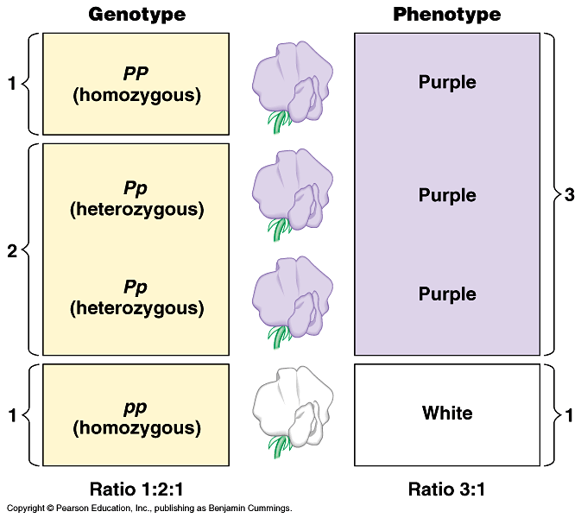

Slide 9
Solving Genetic Problems
Establish parental genotypes
List all unique gametes for each parent
Put gametes on Punnett square and find potential offspring
Evaluate

Slide 10
Complete Dominance
Heterozygous and homozygous dominant are indistinguishable
Typical genetics problem you’ve done before

Slide 11
Monohybrid Cross
Crossing one trait at a time
Example on board
- Cross a heterozygous tongue roller with a non tongue roller
- Tongue rolling is dominant
- What are the chances of having a heterozygote?

Slide 12
Problems cont’d
Testcross – cross a homozygous recessive with organism of unknown genotype
Why is this a testcross?
If get any recessive offspring then the genotype was heterozygous – if all dominant then it must be homozygous dominant.

Slide 13
Dihybrid Cross
Crossing 2 traits at a time
Ie. Earlobes & tongue rolling
Cross a diheterozygote( heterozygous for both traits) with a heterozygous tongue roller who has attached ears
Attached earlobes is recessive to free earlobes
Give the ratio of each possible phenotype

Slide 14
Incomplete Dominance
Dominant gene doesn’t completely hide the recessive gene
Snapdragons
- Red – RR
- White – rr
- Pink – Rr
- Cross 2 heterozygotes

Slide 15
Multiple Alleles
More than 2 alleles for a certain trait
Ie. blood type
Three alleles A, B, O
A & B are codominant (both dominant)
O is recessive
Use letter I to indicated blood type
Use superscripts to indicate which allele

Slide 16
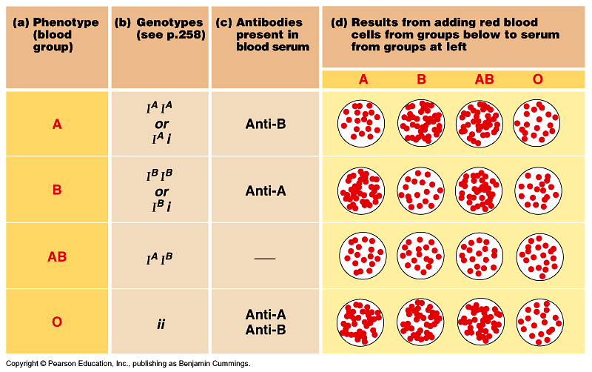

Slide 17
Cross a type AB person with a type O
Give the ratio of each phenotype

Slide 18
Pedigree
Family history following a trait
See board
  Circle female
  Square male
  Shade in the ones showing the trait

Slide 19
Sex Determination Problems
23 pairs of chromosomes
Pairs 1-22 autosomes
23rd pair sex chromosomes
  Male XY
  Female XX
X is longer than Y

Slide 20
X Inactivation
In female mammals only one X is activated
The inactive X is called a Barr body and most of these genes are not expressed
Attachment of methyl group is seen on inactive X’s

Slide 21
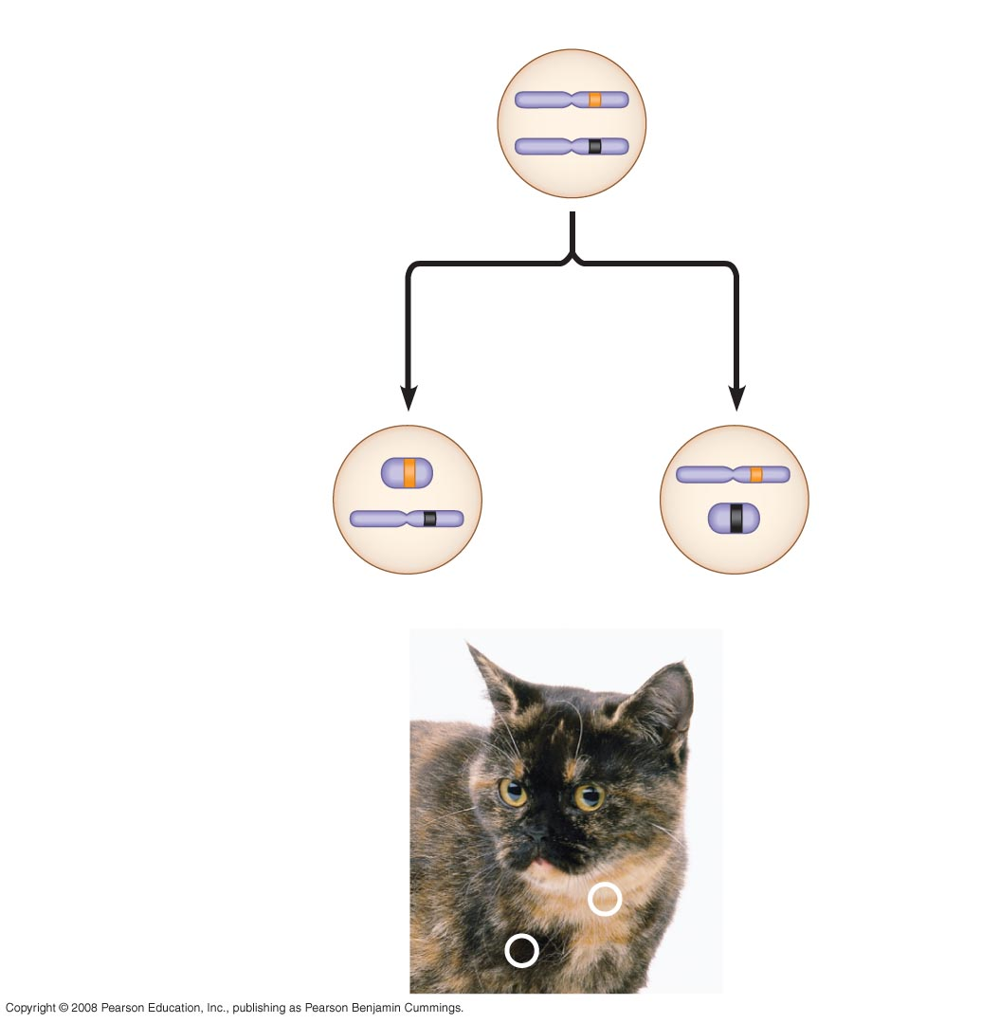
Fig. 15-8
X chromosomes
Allele for
orange fur
Early embryo:
Allele for
black fur
Cell division and
X chromosome
inactivation
Two cell
populations
in adult cat:
Active X
Inactive X
Active X
Black fur
Orange fur

Slide 22
Genetics & Sex Determination Problems
Cross two parents that are heterozygous for earlobes
What are the chances of having males w/attached ears?

Slide 23
3 males w/free ears or 3/8 or 37.5%
3 females w/free ears
1 male w/attached ears or 1/8 or 12.5%
1 female w/attached ears

Slide 24
Probability
What is the chance of having 3 boys in a row?
Rule of multiplication
½ X ½ x ½ = 1/8 or 12.5%
What are the chances of having 2 girls & 1 boy in any order?
3/8 or 37%

Slide 25
What are the chances of drawing 3 aces in a row? (Keep card each time)
4/52 x 3/51 x 2/50 = 24/132,600 =
.018%

Slide 26
Sex-Linked Traits
Found only on the X chromosome
colorblindness
hemophilia
Duchene's muscular dystrophy
Cross a carrier female with a normal male.
See board

Slide 27
Polygenic
A trait that is determined by more than one type of gene (i.e. Height & skin color)
2. Skin color – 3 genes on 3 chromosomes
ABC & abc = 6 alleles
aabbcc - very light
AABBCC - very dark
Determined by the number of dominant genes.

Slide 28
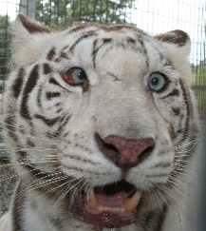
Pleiotropy
When a single gene affects many different phenotypes.
Tigers – one allele causes abnormal pigmentation AND cross-eyes

Slide 29
Epistasis
When 1 gene alters the phenotypic expression of another.
-Mice – black coat (B)is dominant to brown(b) A second gene D affects how the protein for color will stick to the hair
If the second gene is dd protein will not stick & the mouse will have white hair
Cross 2 black mice heterozygous for B & D

Slide 30
9 black (B_ D_)
3 brown (bbD_)
4 white (3B_dd and 1 bbdd)

Slide 31
Morgan Genetics
Known for sex-linked studies with Drosophila melanogaster
(fruit flies)

Slide 32
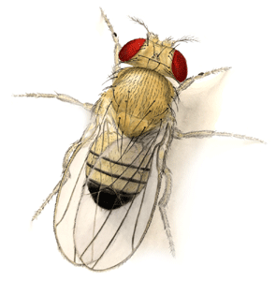

Slide 33
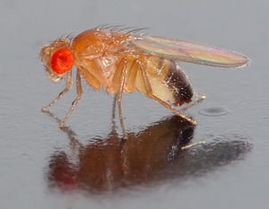

Slide 34
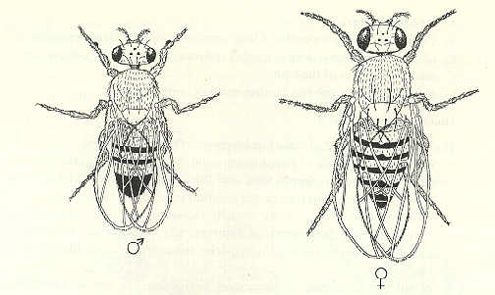

Slide 35
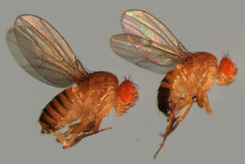

Slide 36
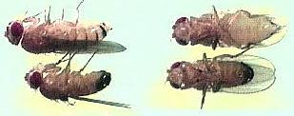

Slide 37
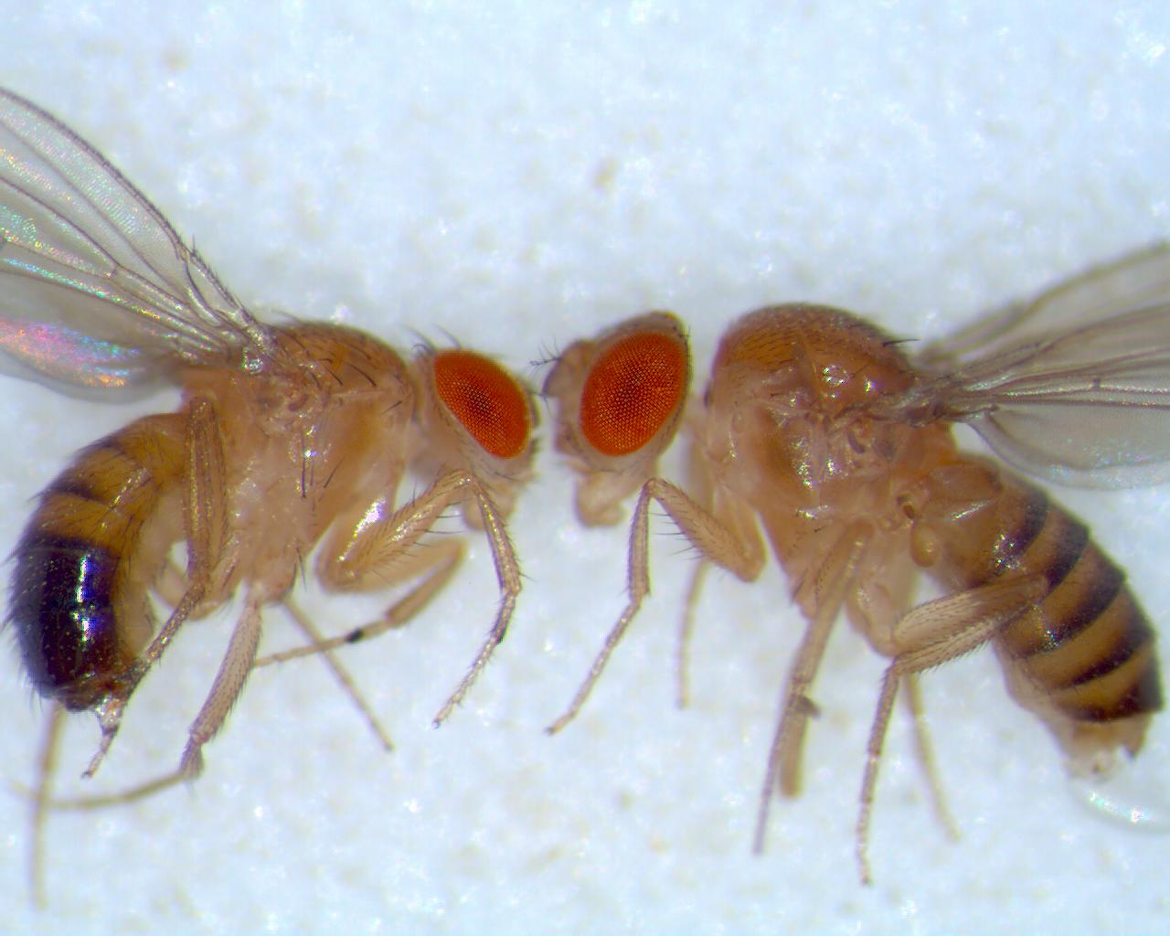

Slide 38
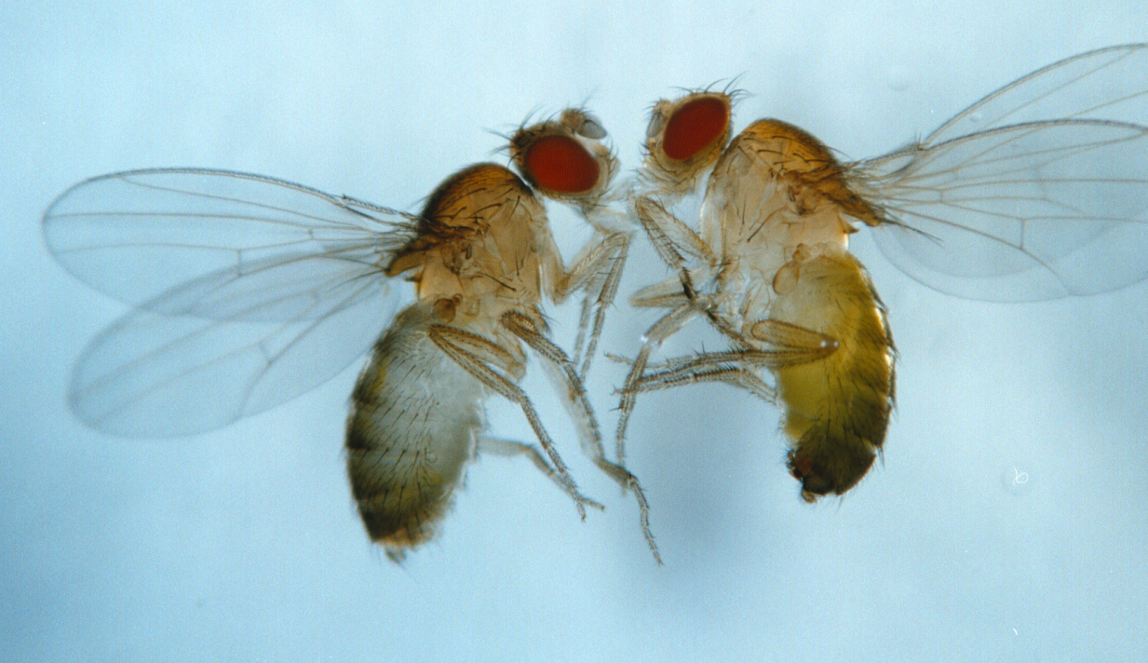

Slide 39
Symbols replace Mendel’s
+ called wild type - refers to the normal trait
Without the + then it refers to the mutant
Use first letter of the first mutation discovered
Use the uppercase if it is a dominant mutation

Slide 40
Drosophila characteristics
Wild Type +
- gray body
- normal wings
- red eyes
Mutants
- black body
- vestigial wings (vg)
- white eyes
- sepia eyes (brown)

Slide 41
Assume the above mutations are recessive – use Morgan's symbols to describe the genotype of a fruit fly that is diheterozygous for body color and wings

Slide 42
b⁺b vg⁺vg
Cross the above fly with one that is homozygous recessive for both traits
Should get a 1:1:1:1 ratio
  1 gray normal
  1 gray vestigial
  1 black normal
  1 black vestigial
This assumes no gene linkage

Slide 43
Gene Linkage
Genes are on the same chromosome
A— a— B— b— Not linked
A—B a—b Linked
If linked then Ab or aB cannot be produced unless crossing over occurs
Notes:
A— a— B— B— Not linked
A—a B—b Linked

Slide 44
Mendel's rules are based on no linkage
According to Mendelian genetics the above problem (b⁺b vg⁺vg x bb vg vg)
should give 1:1:1:1 ratio

Slide 45
If genes are linked and no crossing over occurred you will get a 1:1 ratio where both phenotypes are the same as the parents

Slide 46
If the genes are linked the results would have been:
  965 gray normal (parent type)
  944 black vestigial (parent type)

Slide 47
Morgan’s Actual Experiment Results
Total offspring 2300
  965 gray normal (parent type)
  206 gray vestigial
  185 black normal
  944 black vestigial (parent type)

Slide 48
Since two most occurring phenotypes are parent type and ratio is not 1:1:1:1 suspect gene linkage with crossing over
The 2 phenotypes that are not the same as the parents are a result of cross over

Slide 49
Frequency of Crossover
More often cross over does not occur
Frequency of crossing over is directly related to distance between the 2 genes
- ↑distance – ↑chance of cross over
- by determining the distance b/w genes you determine the frequency of cross over

Slide 50
Cross over Problem
Drosophila – body color gene is linked to wing gene
How far are genes apart
What is the frequency of cross over?

Slide 51
Data from cross of previous problem
b⁺b vg⁺vg X b b vg vg
Total offspring 2300
  965 gray normal (parent type)
  206 gray vestigial
  185 black normal
  944 black vestigial (parent type)

Slide 52
Steps
Add up total offspring that resulted from crossing over
206 + 185 = 391
Divide that # by total # of offspring
391/2300 = .17
.17 x 100 = 17 map units
Frequency of cross over is 17%
Turn this # into map units
17 map units

Slide 53
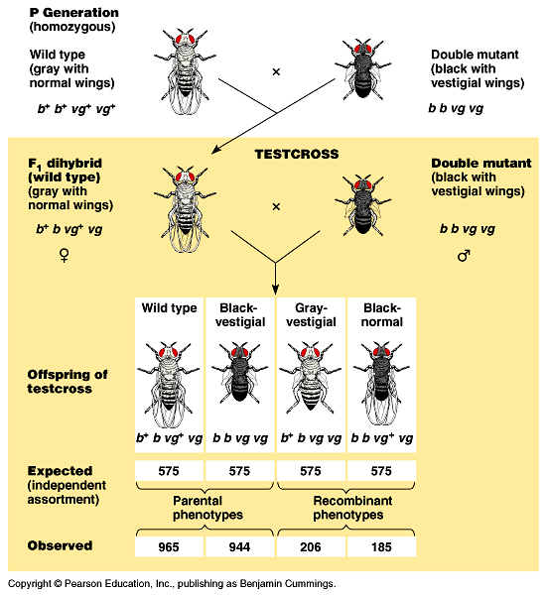

Slide 54
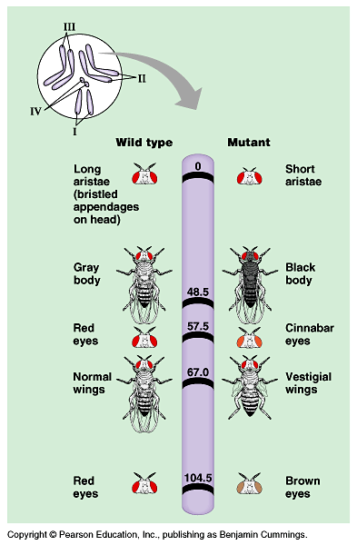

Slide 55
