Slide 1
Evolution
Chapters 22,23,24

Slide 2
Theories of Evolution
Early ideas pg. 453 fig. 22.1
Darwin & Wallace – Theory of Natural Selection
- organisms with certain inherited characteristics are more likely to survive and reproduce than organisms with other characteristics
- the organisms survive better because of the environment in which they live

Slide 3
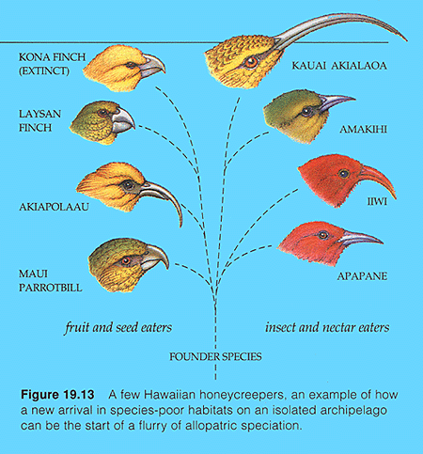

Slide 4
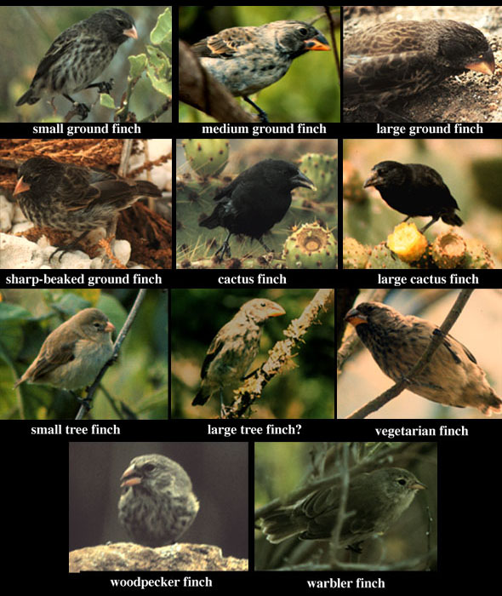

Slide 5
Natural Selection
Theory based on 3 premises
1. Organisms produce more individuals than environment can support – leads to struggle for existence
2. Survival depends on genetic make-up which allows adaptations to flourish
3. Unequal ability to survive causes change in population

Slide 6
Examples of Natural Selection
Insecticide use – DDT no longer used b/c 230 known species are unaffected by it Why?
gene pool changed

Slide 7
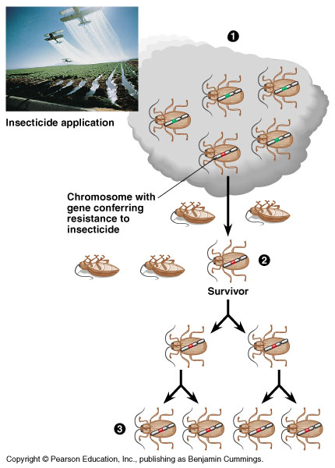

Slide 8
Examples of Natural Selection
2. Penicillin – “miracle drug”
- used widely for strep throat
- bacteria w/ resistance survived
- now many other antibiotics are used

Slide 9
Examples of Natural Selection
3. Peppered Moth
- two varieties on moths (dark & light)
- fed at night, rest in day
- before 1850 light were camouflaged on trees w/lichen(light) and dark were conspicuous

Slide 10
Examples of Natural Selection
- frequency of light allele rose as they were favored & reproduced
- late 1800’s gene pool changed Why?
Industrial Revolution
soot caused lichens to die - light were conspicuous & dark were camouflaged

Slide 11
Examples of Natural Selection
Early 1800’s
95% AA, Aa (light)
5% aa (dark)
Late 1800’s
10% AA, Aa
90% aa
Recently light is coming back
- less pollution

Slide 12
Types of Evolution
Divergent Evolution
Convergent Evolution

Slide 13
Divergent Evolution
aka adaptive radiation
- organisms had a common descent ( same ancestors)
- organisms have homologous structures
- variations on a common theme
- arms, wings, flippers

Slide 14
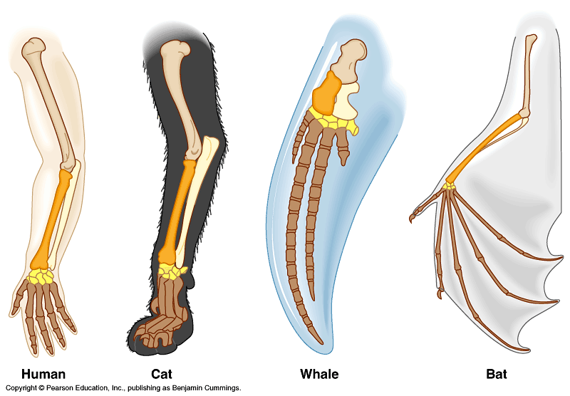

Slide 15
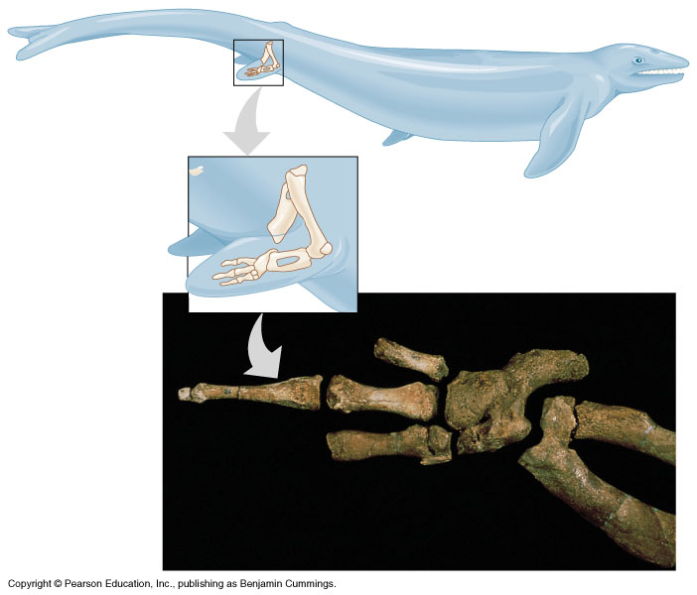

Slide 16
Convergent Evolution
- organisms becoming more alike
- have analogous structures
- same function – different ancestry

Slide 17
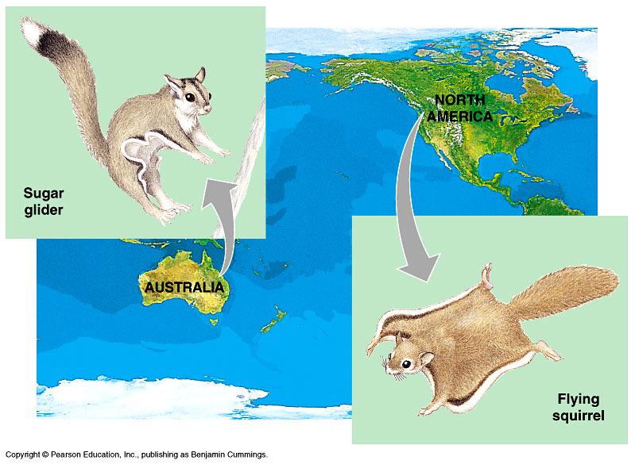

Slide 18
Comparative Anatomy & Embryology
Vestigial organs – rudimentary organ
- little or no function
- historical remnants
- i.e. snake skeletons have vestigial pelvis & legs from walking ancestors

Slide 19
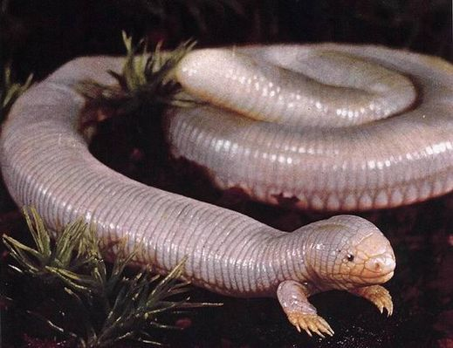

Slide 20
B. Comparative embryology
1. Closely related organisms have similar embryonic development
2. Late 19th century theory
Ontogeny recapitulates phylogeny
(embryonic development replays evolutionary history)

Slide 21
3. More accurate – ontogeny provides clues to phylogeny
I.e. Gill slits become gills in fish or eustachian tubes in our ears.

Slide 22
Hardy Weinberg Theorem
Theorem – an equation that provides a standard by which change can be measured
Compares a changing population to a theoretical unchanging one.

Slide 23
Hardy Weinberg conditions
Conditions that are needed for a population to not change

Slide 24
Hardy Weinberg conditions
No natural selection – all alleles are equally successful
No mutation
No gene flow in or out
Must have random mating – no selection of mate
No Genetic drift– genetic drift means drifting away from the laws of probability (if you don’t want change the laws of probability must be in affect)

Slide 25
The above 5 results in a population with NO CHANGE
Equation
p = dominant allele (A)
q = recessive allele (a)

Slide 26
Hardy Weinberg Theorem (cont’d)
Aa x Aa same as pq x pq
Set up Punnett Square
p q
p
q
p²
pq
pq
q²

Slide 27
Hardy Weinberg Theorem
p² + 2pq + q² = 1
p + q = 1
Can use this to calculate frequency of alleles or frequency of a particular phenotype.

Slide 28
Hardy Weinberg Theorem
Example fig. 23.7
In 1993 1/10,000 people had PKU, a genetic recessive disorder
aa - also q²
Therefore q² = 1/10,000
q² = .0001
What is the frequency of the p allele?

Slide 29
Hardy Weinberg Theorem
q = .01
p + q = 1
p = .99
Find the % heterozygotes in the population

Slide 30
Hardy Weinberg Theorem
2pq = heterozygotes
2(.99)(.01) = .0198
Round to .02
.02 x 100 = 2%

Slide 31
Hardy Weinberg Problems
http://www.mac3.amatyc.org/anthropology/human_origins/Human_origins_edcc_HW.htm
http://www.k-state.edu/parasitology/biology198/hardwein.html
http://www.biosci.msu.edu/courses/bs110Lab/hardy/population_genetics.htm

Slide 32
Factors to change a gene pool
Opposite of Hardy Weinberg conditions
1. Natural selection occurs which leads to ↑differences b/w populations
2. Mutations occur – raw material for variation
3. Gene flow occurs which introduces new alleles and differences b/w populations

Slide 33
Factors to change a gene pool
4. Non random mating – organisms select a mate
Snow geese
- blue is dominant- white is recessive
- blue mates w/blue
- white mates w/ white
- heterozygotes died out

Slide 34
Factors to change a gene pool
5. Genetic drift occurs – change in gene pool due to pure chance
- the smaller the sample the greater the chance for deviation from the expected

Slide 35
Genetic Drift
Genetic drift usually requires a small population that drifts away from the laws of probability

Slide 36
Examples of genetic drift
1. Founder effect
- small sample of pop. breaks away & starts new colony
- Old world Amish people founded in 1770 w/ few members
- one member had extra fingers & dwarfism
- later generations had many cases reported

Slide 37
Examples of genetic drift
2. Bottleneck effect
- when a disaster occurs that reduces the population drastically the remaining pop. is not a true representation of the original pop.
- i.e. Elephant seal hunt only left 20 seals
Are they a true representation of the original pop?

Slide 38
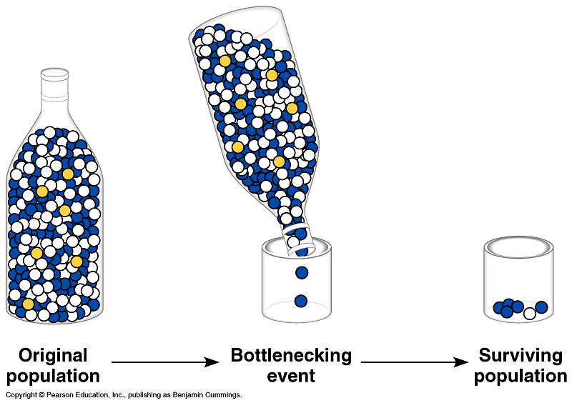

Slide 39
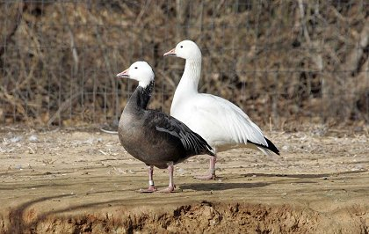

Slide 40
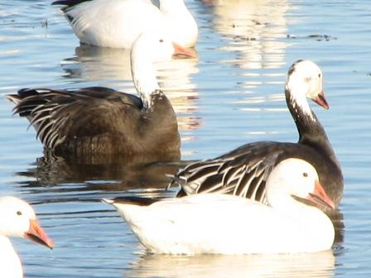

Slide 41
Types of Natural Selection
Stabilizing selection - favors the intermediate phenotype
- i.e. birth weight in humans
under 3 lbs. < 30% chance
over 10 lbs. < 50% chance

Slide 42
Types of Natural Selection
B. Directional selection – favors one particular phenotype due to environmental change
- I.e.
- moth
- DDT

Slide 43
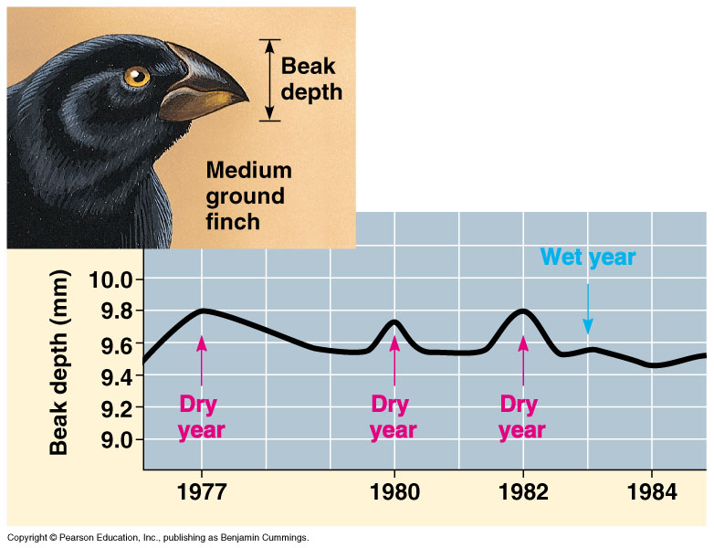

Slide 44
Types of Natural Selection
Disruptive selection aka diversifying
– favors both extremes phenotypes
- I.e. Noxious butterflies
- Leads to balanced polymorphism

Slide 45
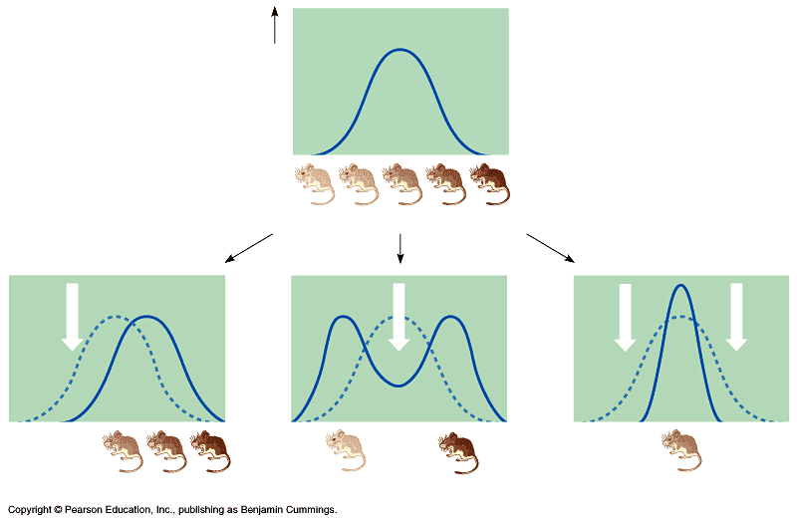

Slide 46
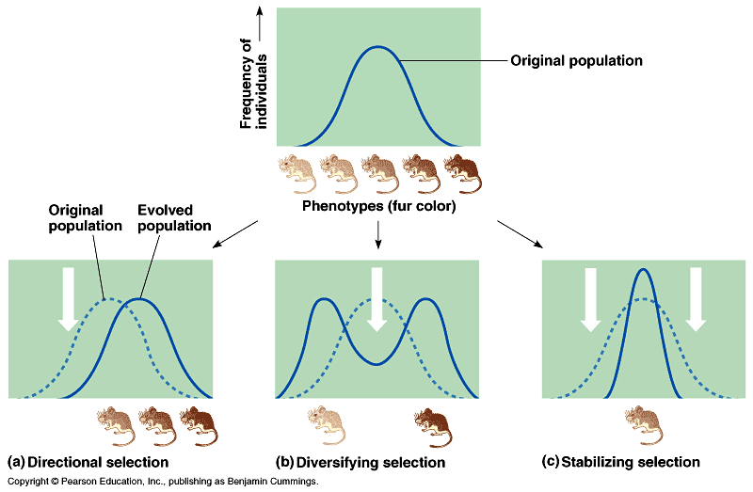

Slide 47
What Is Balanced Polymorphism?
Maintenance of diversity in a pop.
Causes of bal. poly. morph.
- heterozygote advantage as in sickle cell anemia
- frequency dependent selection
- repro. success of a phenotype ↓if it becomes too common

Slide 48
Types of Natural Selection
D. Sexual Selection
- male competes for mate
- leads to sexual dimorphism ( distinction based on secondary sex charac.)
examples:
manes on male lion
antlers on deer
colorful males

Slide 49
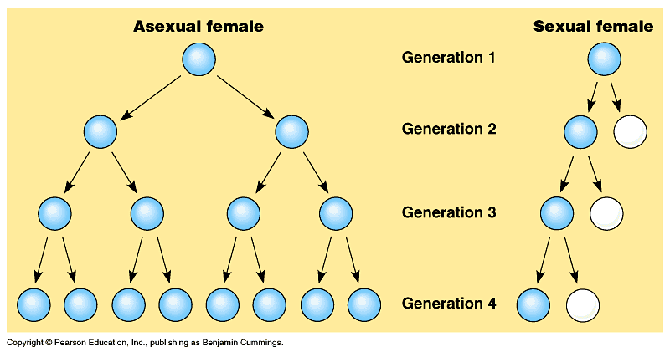

Slide 50
Origin of new species
Speciation – process of forming a new species
B. Causes
1. Allopatric - Geographic isolation
2. Sympatric - Reproductive isolation

Slide 51
Allopatric Speciation
Also called Geographic Isolation
Results from geographic barriers like islands – Galapagos

Slide 52
Sympatric speciation
Results from reproductive barriers
Less common than allopatric speciation
Two main types
1. Prezygotic
2. Postzygotic

Slide 53
Prezygotic
Before fertilization
Temporal isolation – mating occurs at different seasons
Behavioral isolation – no sexual attraction b/w male & female
Mechanical isolation – genitals too different
Gamete isolation – egg & sperm incompatible

Slide 54
Postzygotic
After fertilization
Hybrid inviability – embryo forms but is never born
Hybrid sterility – embryo survives but is sterile
Hybrid breakdown – embryo survives & can reproduce but offspring is sterile

Slide 55
