Slide 1
Phylogeny and Animal Diversity
Chapters 26 and 32

Slide 2
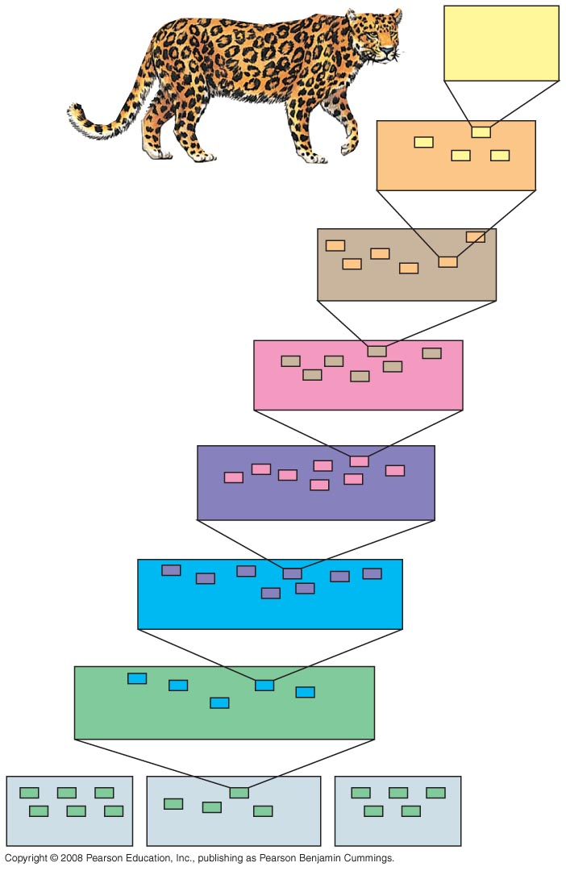
Fig. 26-3
Species:
Panthera
pardus
Hierarchical Classification
Genus: Panthera
Family: Felidae
Order: Carnivora
Class: Mammalia
Phylum: Chordata
Kingdom: Animalia
Bacteria
Domain: Eukarya
Archaea

Slide 3
Classification and phylogeny
Classification (genus and species names) is based on morphological characteristics
Phylogeny is based on evolutionary history of a species or group.
Knowing that there are17 different families of lizards doesn’t really tell us about their evolutionary relationships to each other.

Slide 4
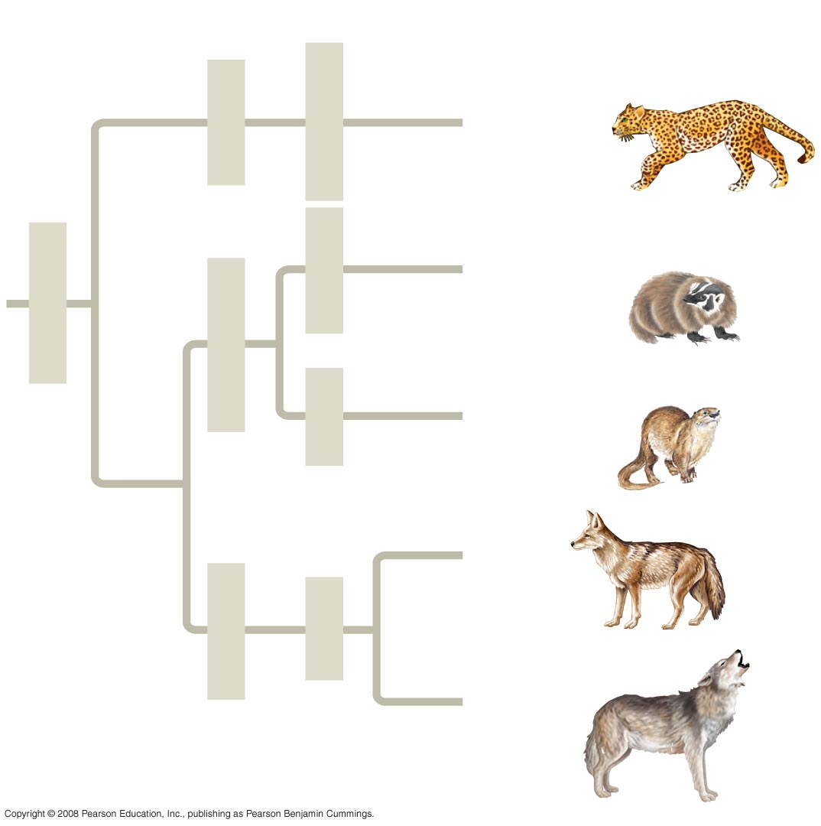
Fig. 26-4
Species
Order
Family
Genus
Felidae
Panthera
Pantherapardus
Taxidea
Taxidea
taxus
Carnivora
Mustelidae
Lutra
Lutra lutra
Canis
latrans
Canidae
Canis
Canis
lupus
Connection between classification & phylogeny

Slide 5
Classification and phylogeny
Many propose that classification be based entirely on evolutionary relationships.
Example – PhyloCode which is a new approach that only names groups that include a common ancestor and descendants.

Slide 6
Phylogenetic Trees
Constructing phylogenetic trees uses data from fossils or molecules to infer evolutionary relationships.
Branch nodes represents the divergence of two evolutionary lineages from a common ancestor.

Slide 7
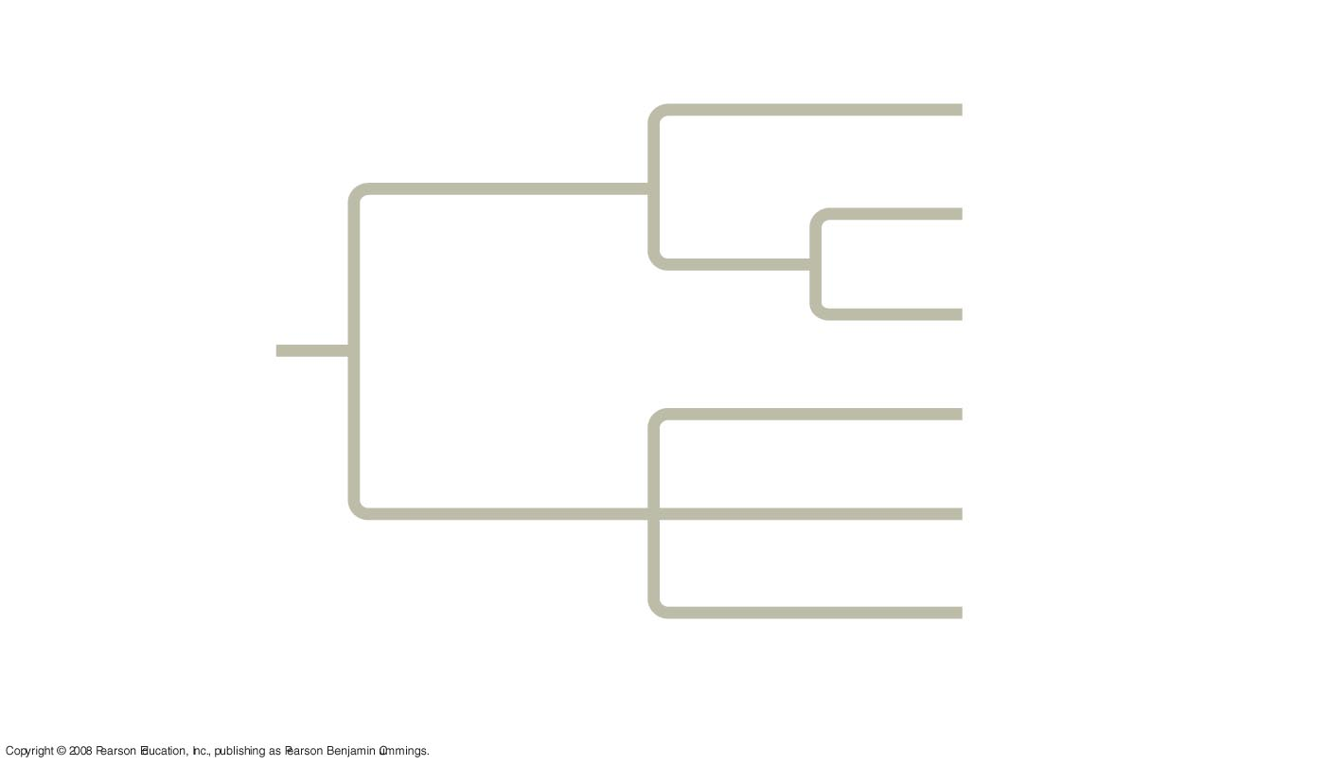
Fig. 26-5
Branch point
(node)
Taxon A
1.
Taxon B
Sister
taxa
Taxon C
ANCESTRAL
LINEAGE
Taxon D
Taxon E
Taxon F
Common ancestor of
taxa A–F
Polytomy

Slide 8
Branch point 1 shows a common ancestor of taxa A, taxa B, and taxa C
Why are B and C called sisters?
In some trees the length of the branch is proportional to amount of evolutionary change.

Slide 9
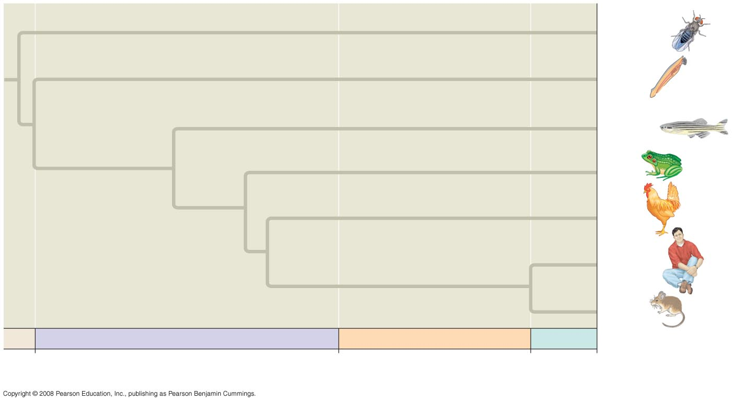
Fig. 26-13
Drosophila
Lancelet
Zebrafish
Frog
Chicken
Human
Mouse
PALEOZOIC
MESOZOIC
CENOZOIC
542
251
65.5
Present
Millions of years ago

Slide 10
Constructing a Tree
See page 546

Slide 11
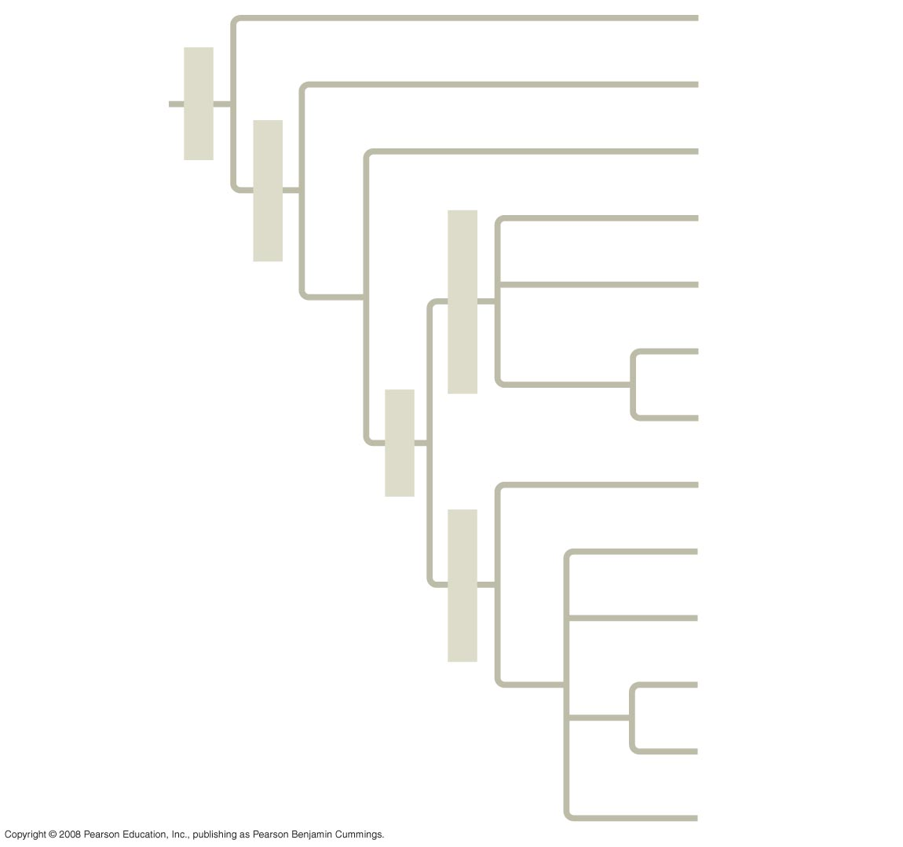
Fig. 32-10
“Porifera”
Cnidaria
ANCESTRAL
COLONIAL
FLAGELLATE
Metazoa
Ctenophora
Eumetazoa
Ectoprocta
Brachiopoda
Deuterostomia
Echinodermata
Chordata
Bilateria
Platyhelminthes
Rotifera
Protostomia
Mollusca
Annelida
Arthropoda
Nematoda

Slide 12
Animals Background
Who were the ancestors of animals?
Notes:
choanoflagellates

Slide 13
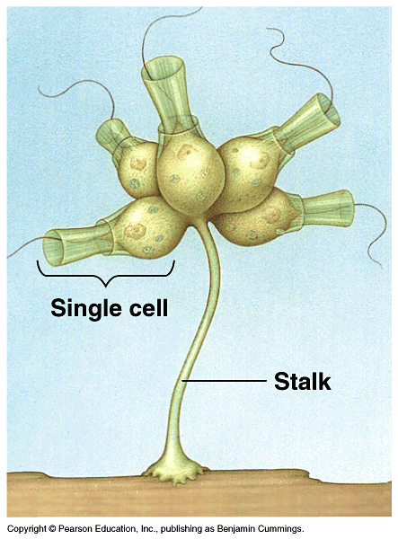

Slide 14
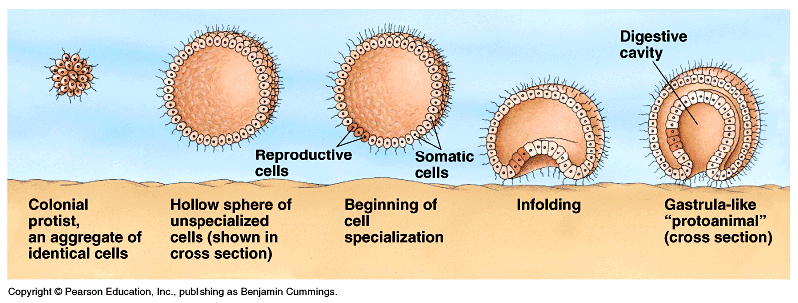

Slide 15
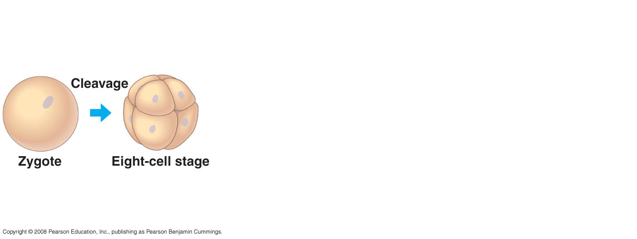

Slide 16
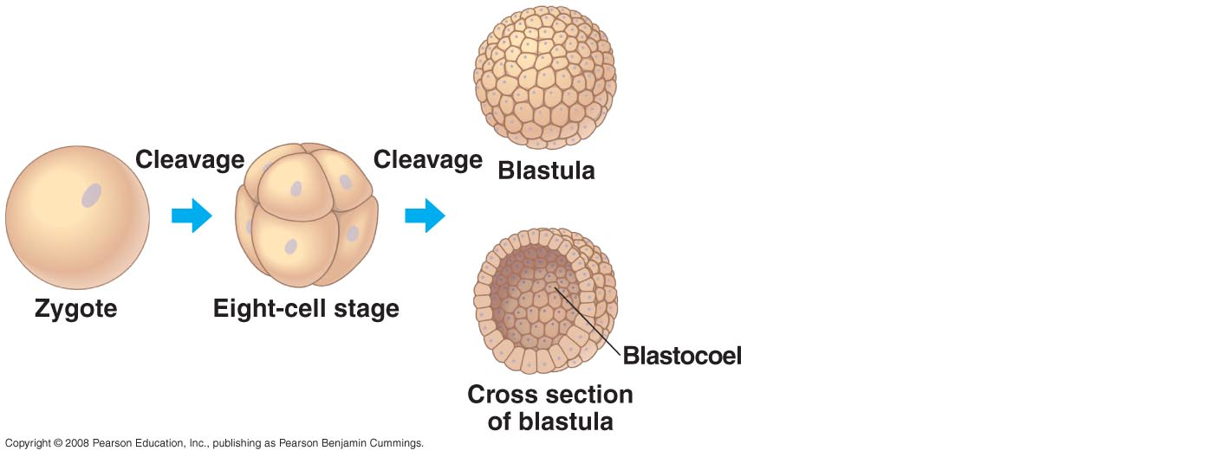

Slide 17
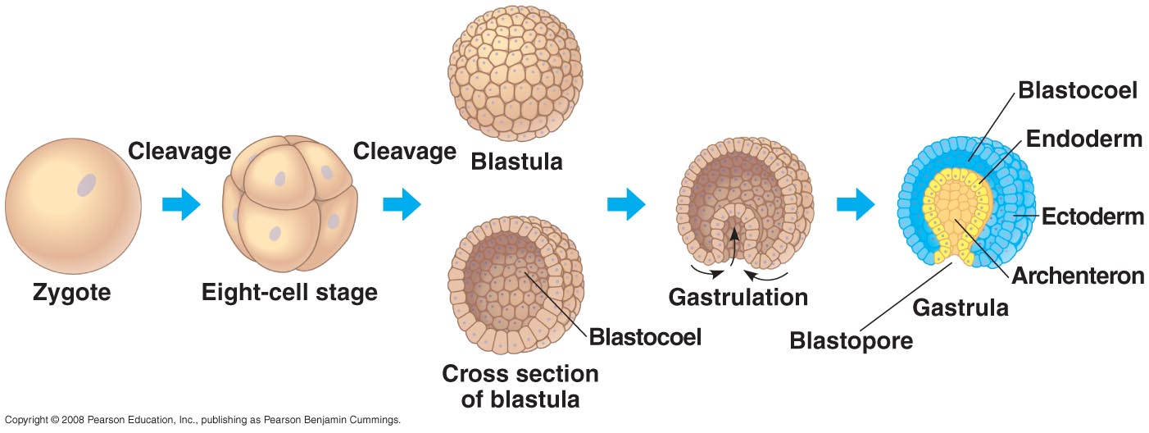

Slide 18
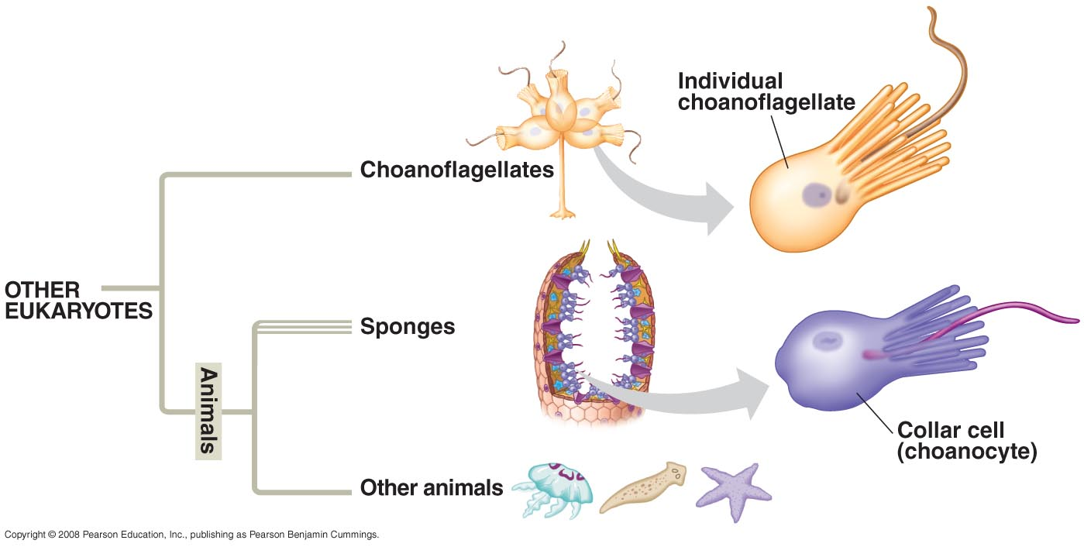

Slide 19
Animal Characteristics
Multicellular
Heterotrophic
Eukaryotic
Ingestion & digestion

Slide 20
Characteristics
- stores energy as glycogen
- no cell wall
two types of specialized tissue for movement and impulse conduction
muscles & nerves

Slide 21
Characteristics
Most reproduce sexually w/diploid stage dominating the life cycle
egg + sperm = zygote
2n zygote → blastula → gastrula →

Slide 22
→ gastrula →larva → adult
OR
→ gastrula → embryo → fetus → adult

Slide 23
Phylogeny based mainly on morphology and development page 662

Slide 24
Fig. 32-10
“Porifera”
Cnidaria
ANCESTRAL
COLONIAL
FLAGELLATE
Metazoa
Ctenophora
Eumetazoa
Ectoprocta
Brachiopoda
Deuterostomia
Echinodermata
Chordata
Bilateria
Platyhelminthes
Rotifera
Protostomia
Mollusca
Annelida
Arthropoda
Nematoda

Slide 25
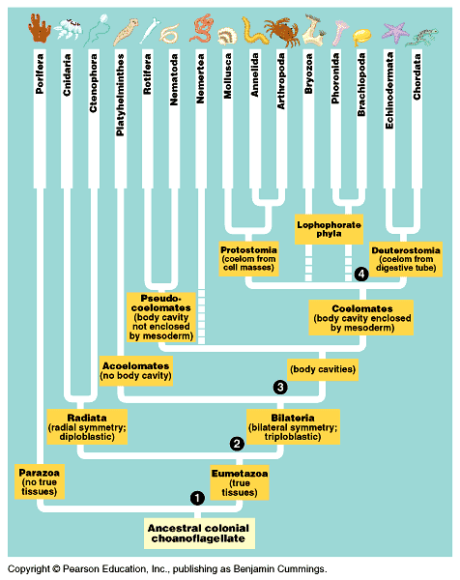

Slide 26
Phylogeny based mainly on molecular data

Slide 27
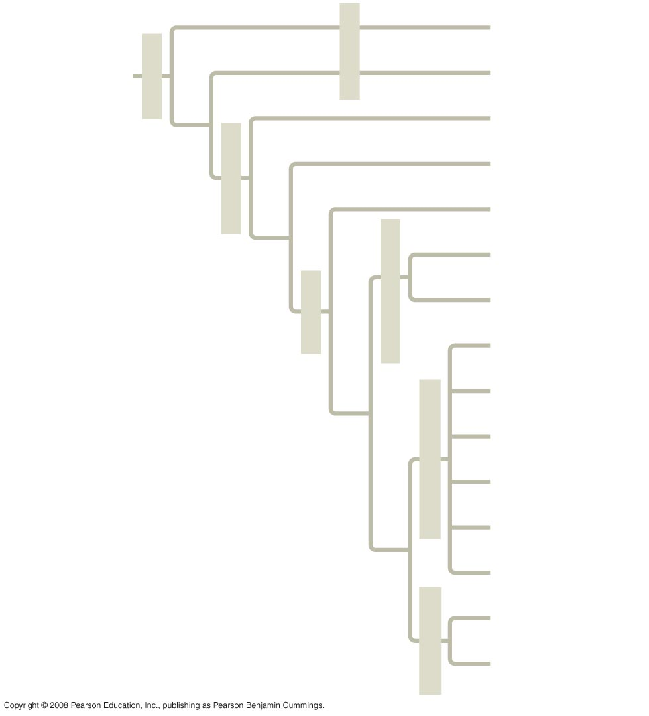
Fig. 32-11
Silicea
“Porifera”
ANCESTRAL
COLONIAL
FLAGELLATE
Metazoa
Calcarea
Ctenophora
Cnidaria
Eumetazoa
Acoela
Echinodermata
Deuterostomia
Chordata
Bilateria
Platyhelminthes
Rotifera
Ectoprocta
Lophotrochozoa
Brachiopoda
Mollusca
Annelida
Nematoda
Ecdysozoa
Arthropoda

Slide 28
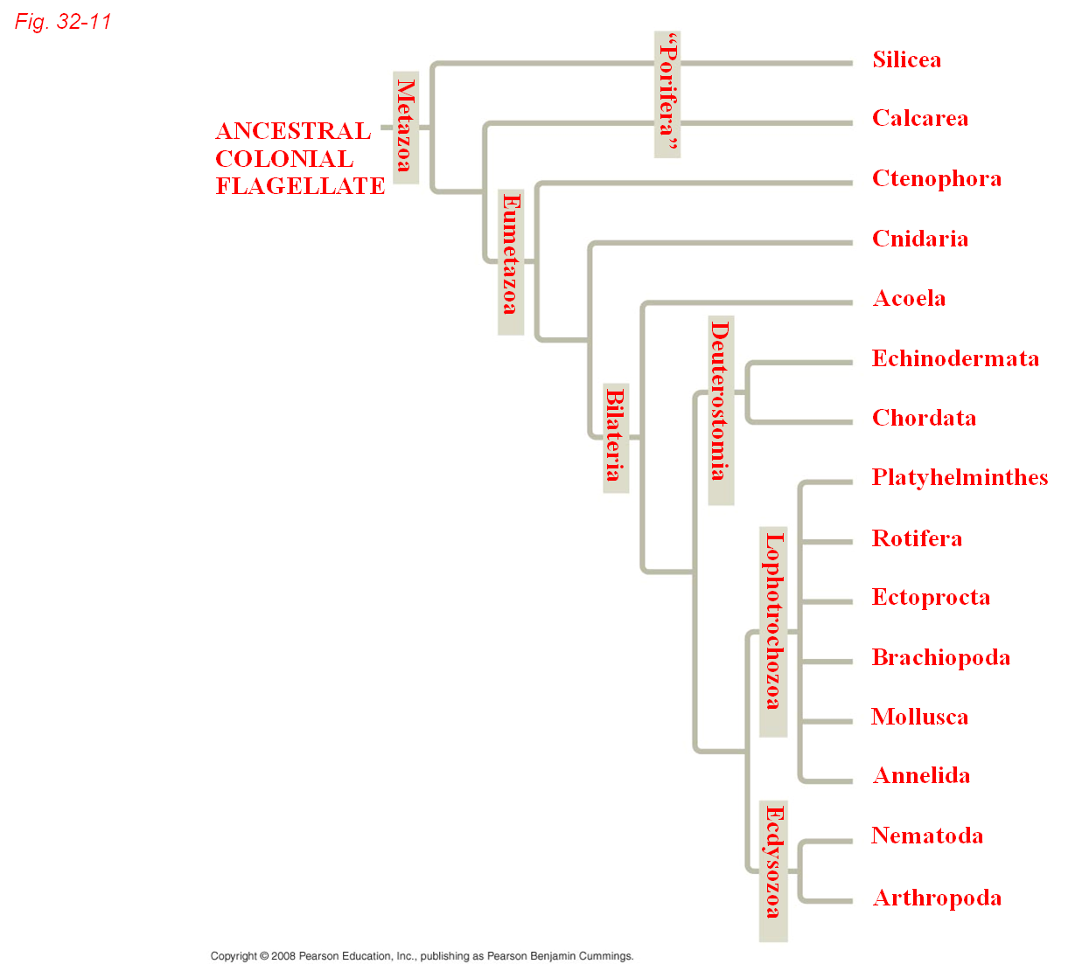
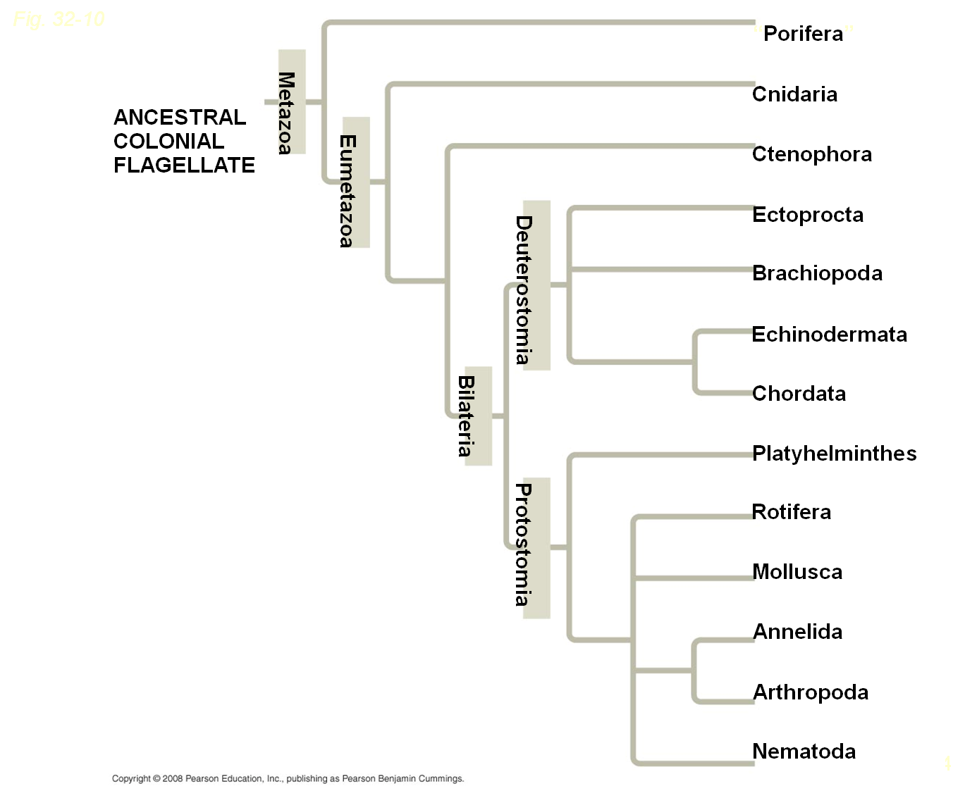
Based on morphology and development
Based on molecular data

Slide 29
1. Parazoa – lack true tissues
Phylum Porifera
2. Eumetazoa – true tissues
Divided by type of symmetry
a. Radial
b. Bilateral

Slide 30
Radial
- top & bottom (also called oral & aboral)
- no front & back or left & right

Slide 31
Bilateral
- top (dorsal)
- bottom (ventral)
- head (anterior)
- tail – (posterior)
- shows cephalization – concentration of sensory equipment at anterior end
like brain

Slide 32
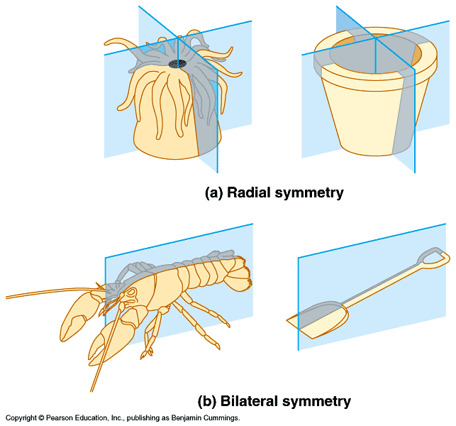

Slide 33
Eumetazoa Body Plan
During gastrulation germ (tissue) layers form which become tissues & organs
3 germ layers
1. Ectoderm – covers surface & forms outer covering (skin) & nerves

Slide 34
Eumetazoa Body Plan cont’d
2. Endoderm – innermost forms archenteron (gut) & digestive tract with its outpockets like liver (also lungs)
3. Mesoderm – middle layer forms muscles & most other organs

Slide 35
Eumetazoa Body Plan cont’d
Diploblastic organisms
- form only ecto & endo
- no meso
- radial symmetry
Triploblastic organisms
- form all 3 layers
- most eumetazoa
- bilateral symmetry

Slide 37
Types of triploblastic organisms
Acoelomates - no coelom
- solid body, no cavity b/w gut & outer body
- flatworms – Platyhelminthes
Psuedocoelomates – false coelom
- fluid filled cavity separates dig. Tract from outer body
- cavity not lined with tissue

Slide 38
Types of triploblastic organisms cont’d
3. Coelomates
- tissue lined fluid filled cavity “true coelom”
- tissue layers connect to form mesenteries which suspend internal organs
- coelom function - allows for growth & movement of internal organs
Pg.660

Slide 40
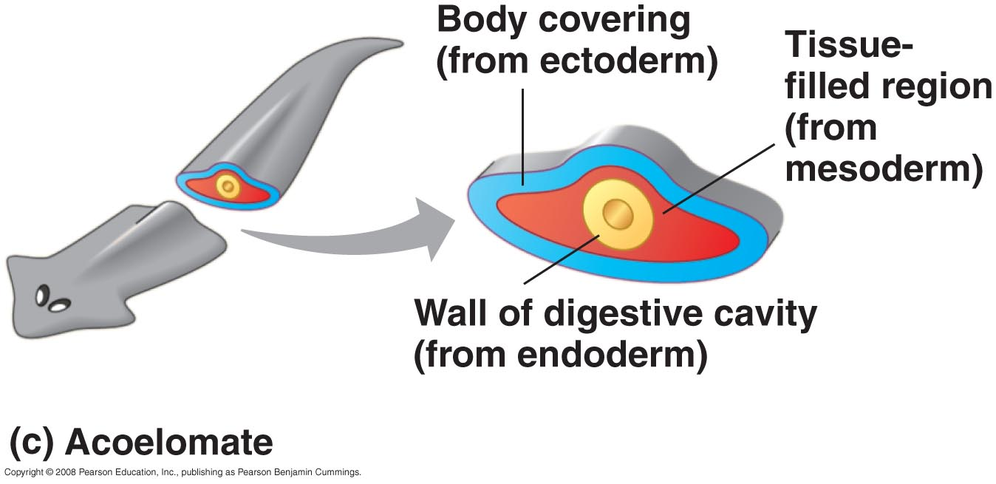

Slide 41
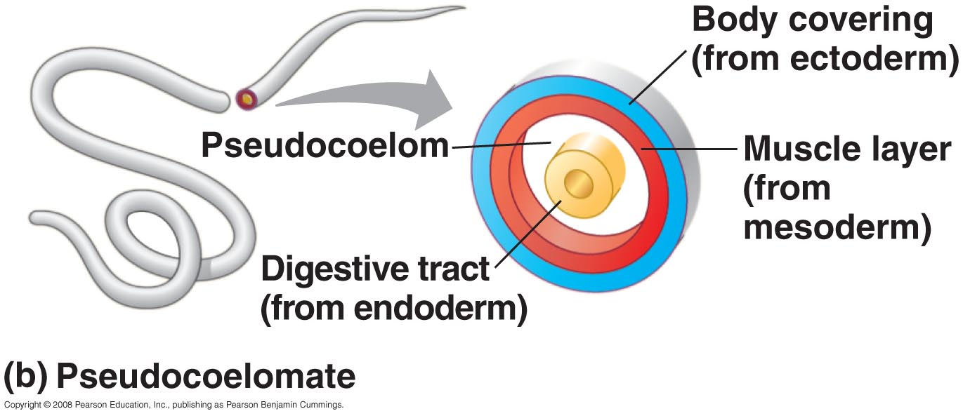

Slide 42
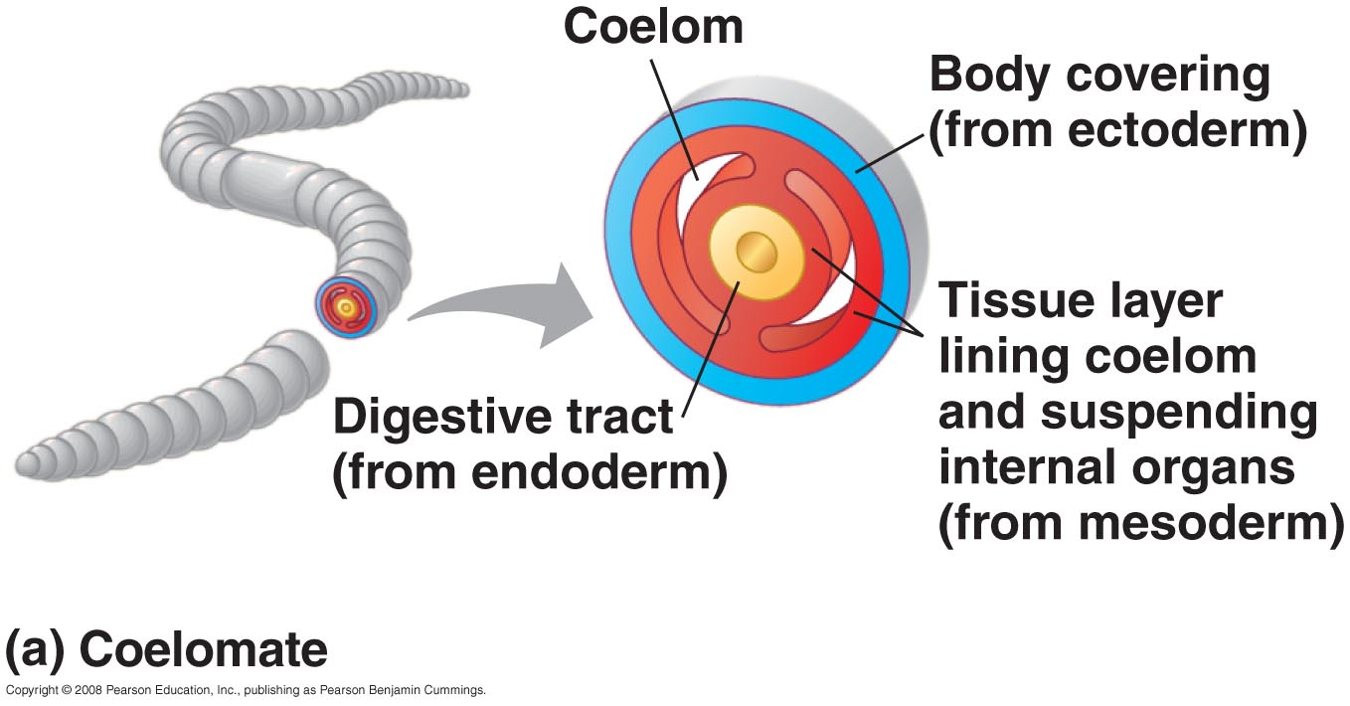

Slide 43
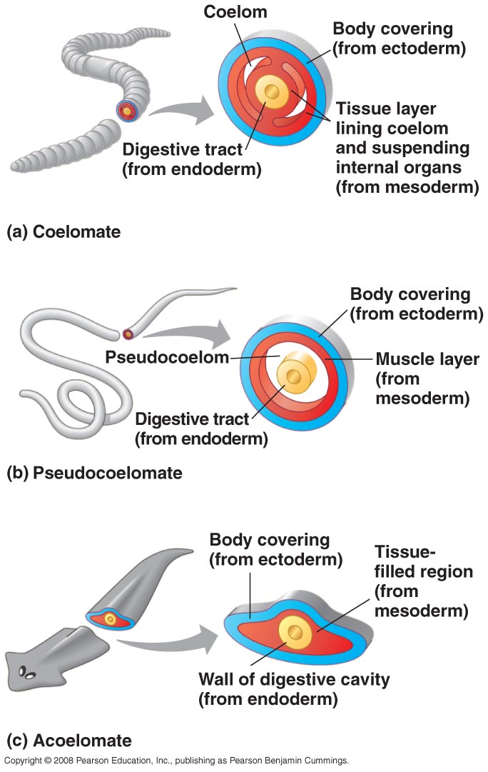

Slide 44
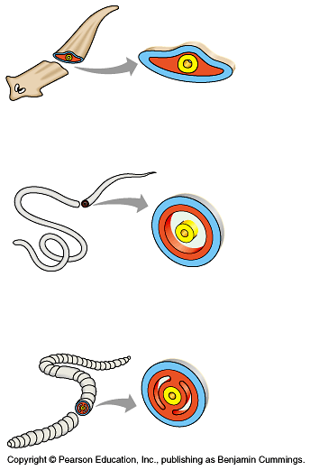

Slide 45
Two types of Coelomates
Protostomes
- blastopore becomes the mouth
- spiral & determinate cleavage fig 32.9
Deuterostomes
- blastopore becomes the anus
- radial & indeterminate cleavage

Slide 46
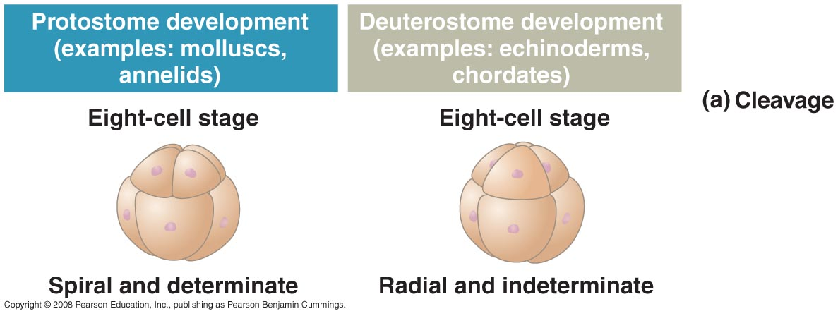

Slide 47
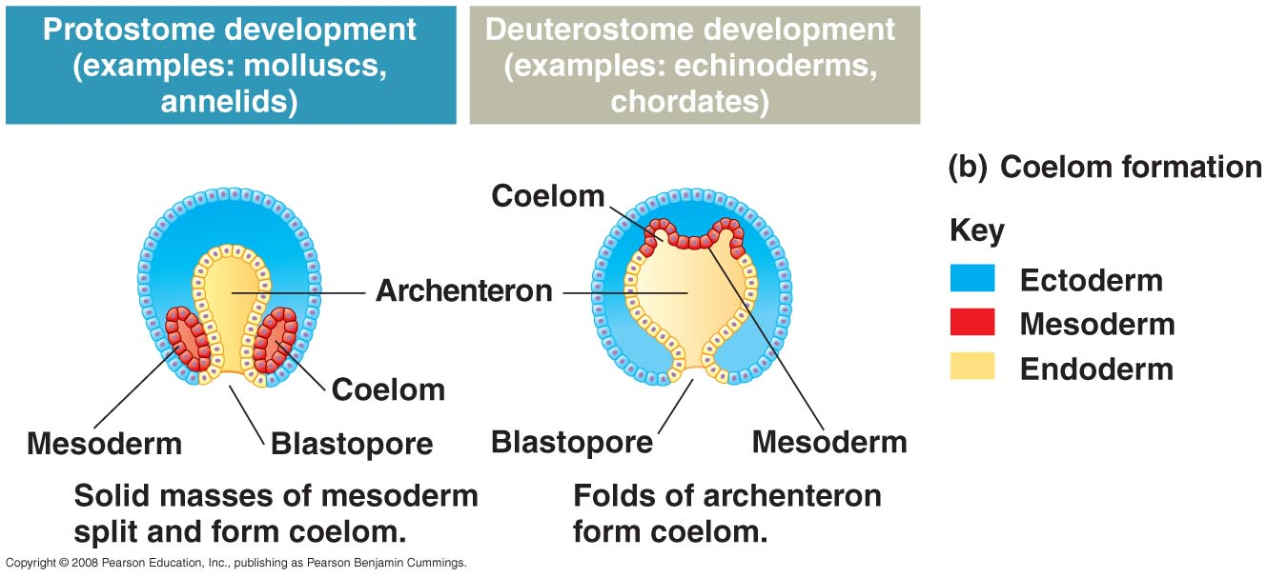

Slide 48
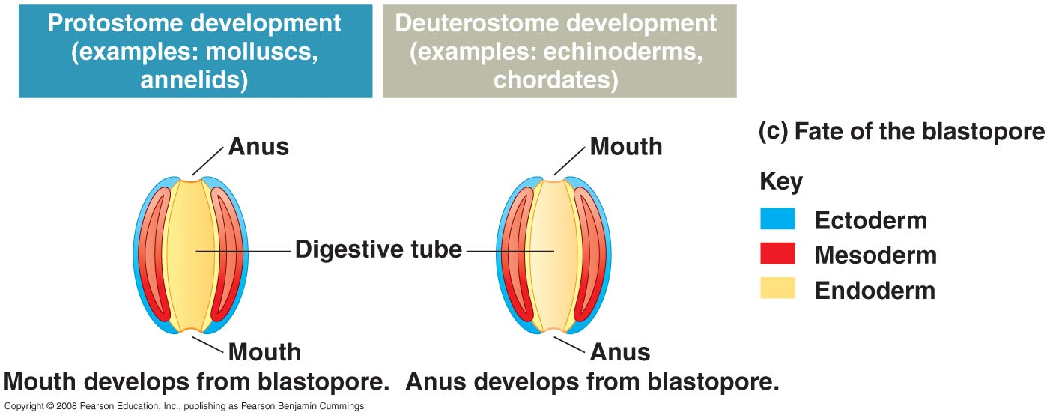

Slide 49
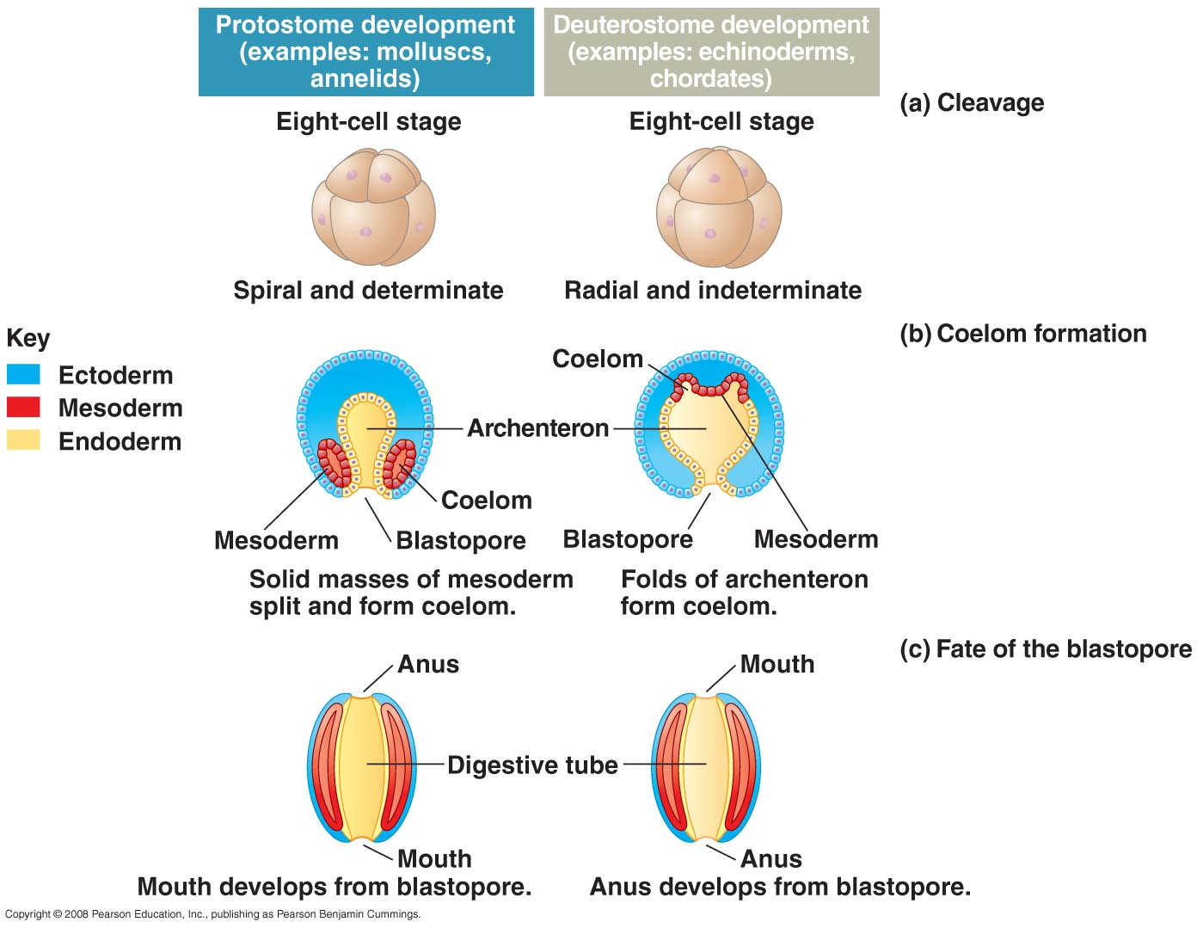

Slide 50
Cleavage
Determinate – one cell taken from 4 cell stage becomes an inviable embryo
Indeterminate – one cell taken from 4 cell stage can become a viable embryo

Slide 51
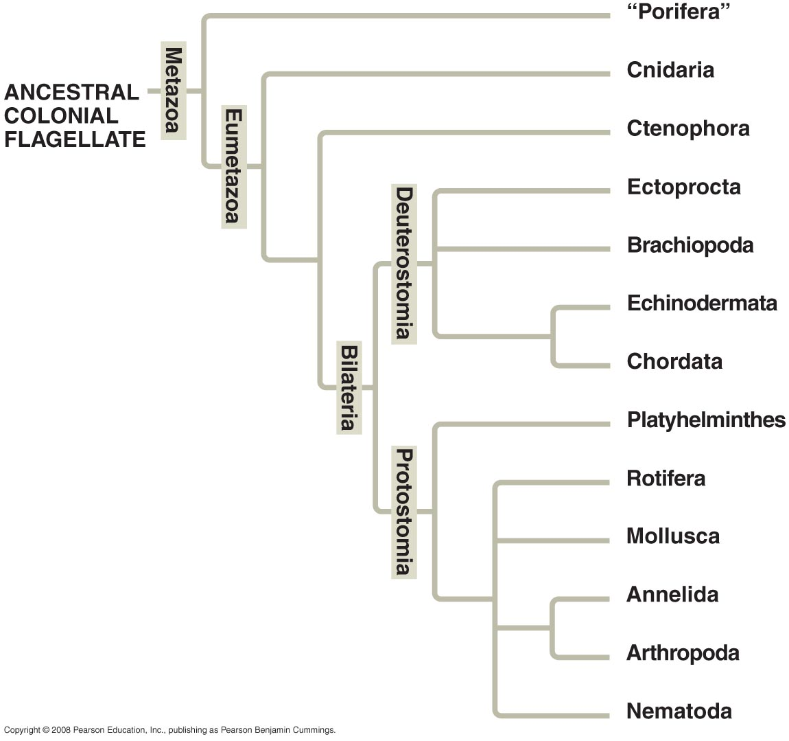

Slide 52
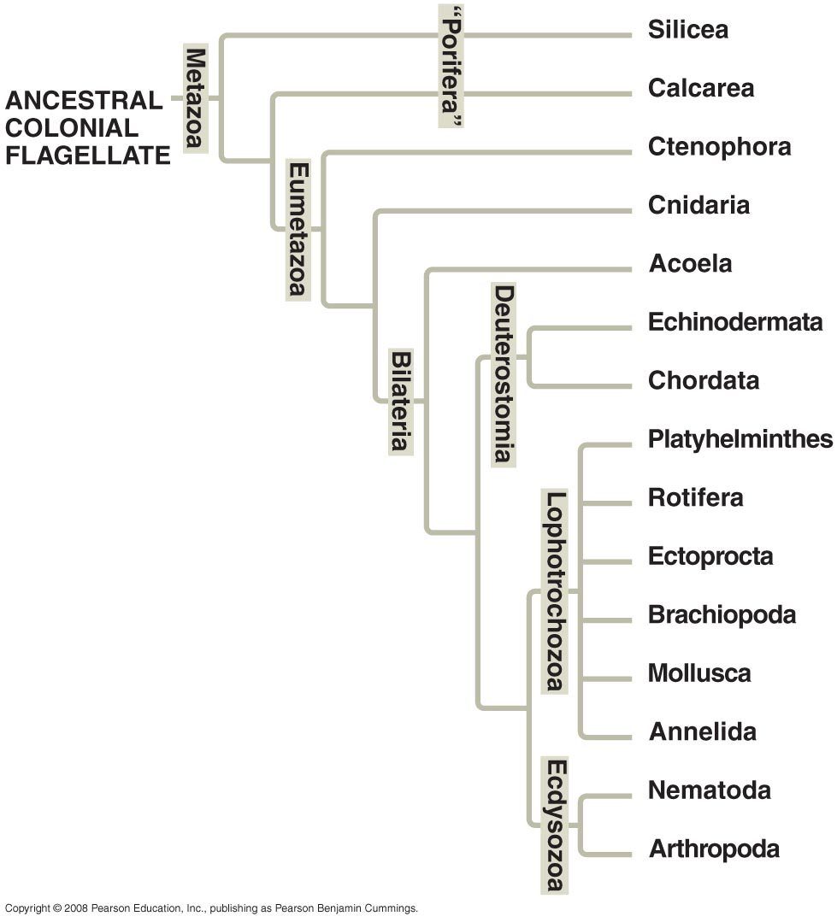

Slide 53
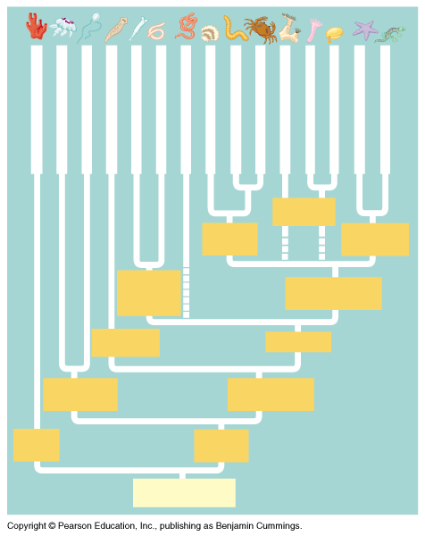

Slide 55
Nine Phyla
Porifera –
Cnidaria –
Platyhelminthes –
Nematoda –
Mollusk –
Annelida –
Arthropod –
Echinoderm –
Chordata –

Slide 56
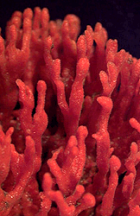
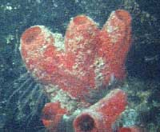

Slide 57
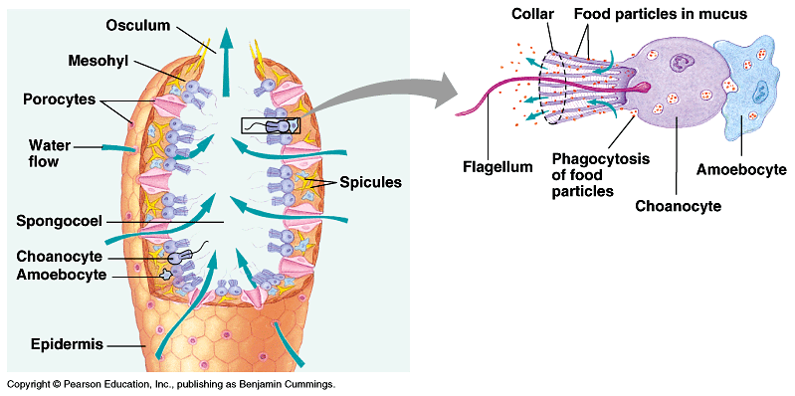

Slide 58
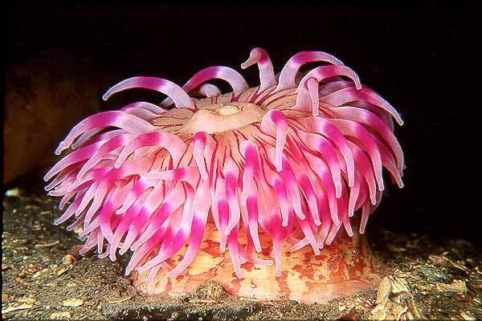

Slide 59
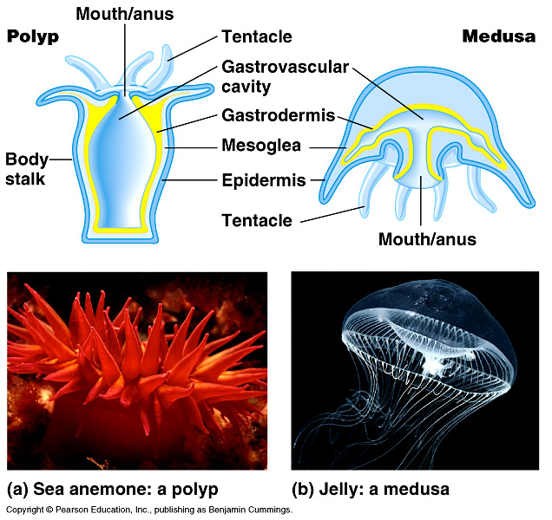

Slide 60
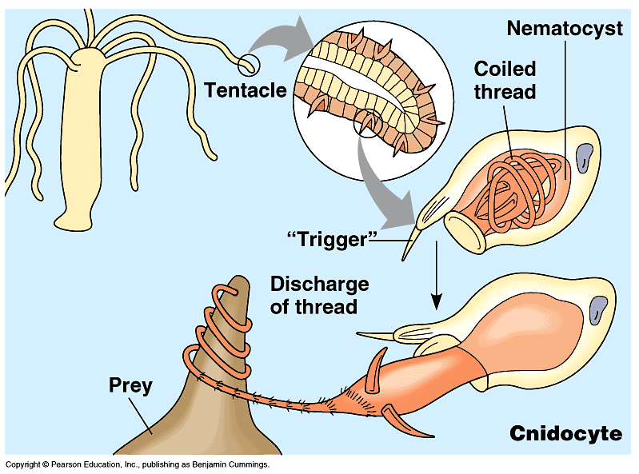

Slide 61
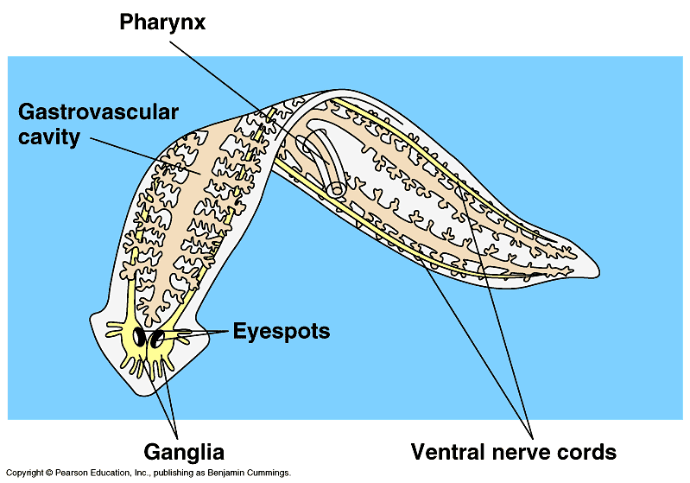

Slide 62
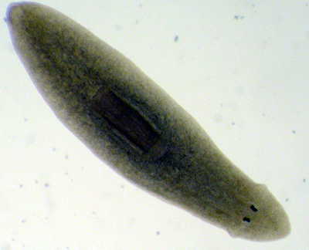

Slide 63
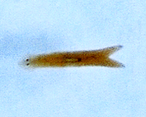

Slide 64
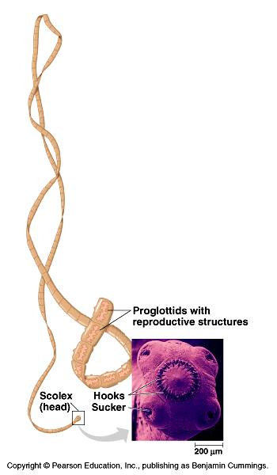

Slide 65
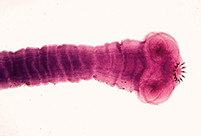

Slide 66
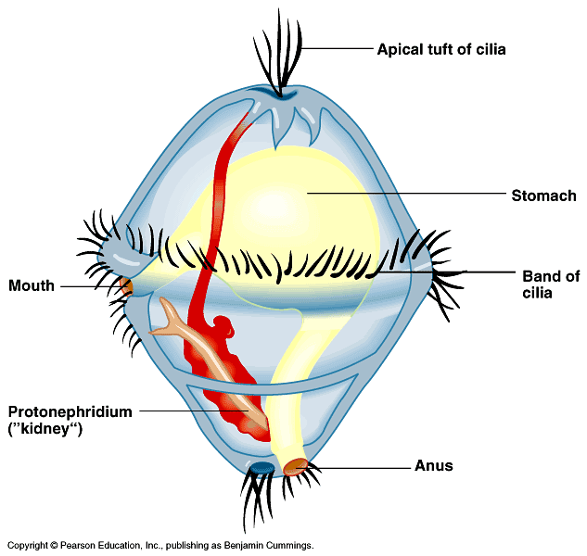
Trocophore larva

Slide 67
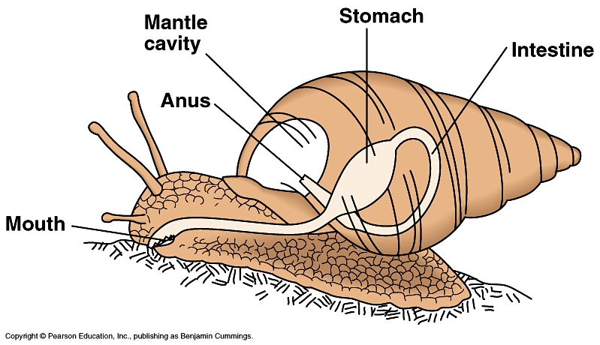
Torsion

Slide 68
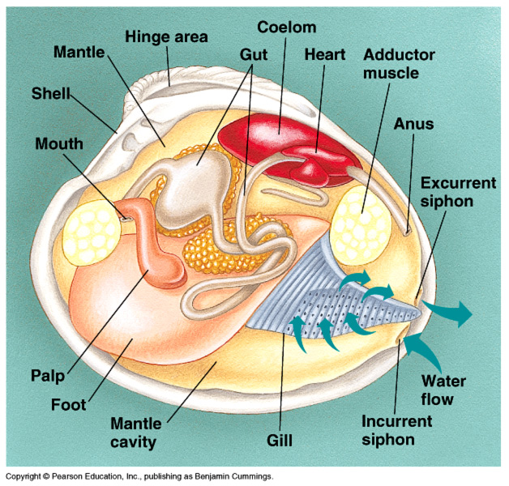
Filter - feeders

Slide 69
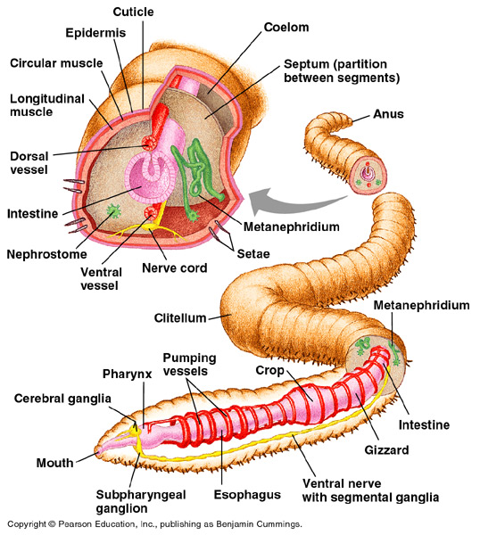

Slide 70
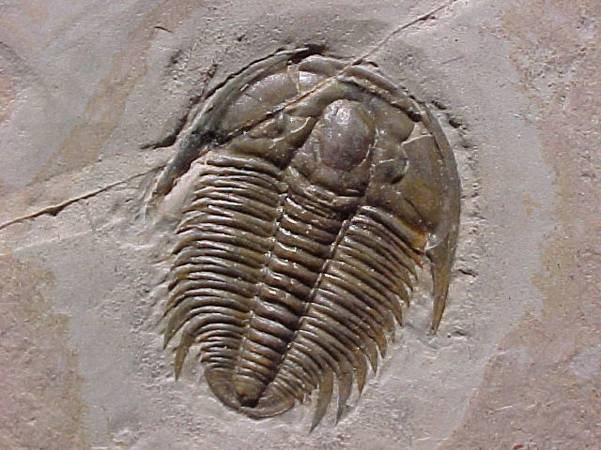

Slide 71
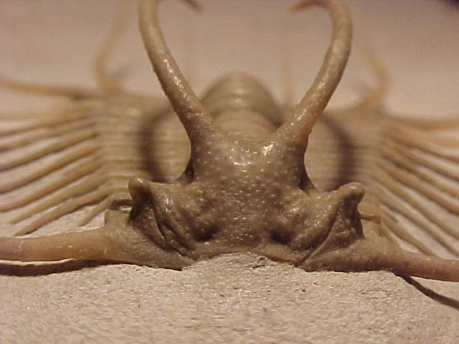

Slide 72
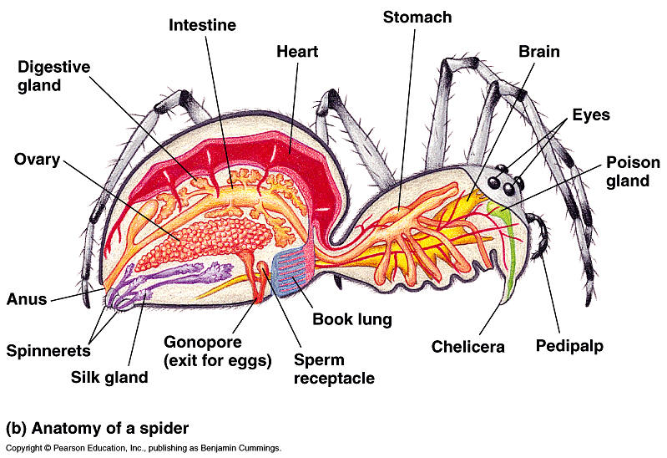

Slide 73
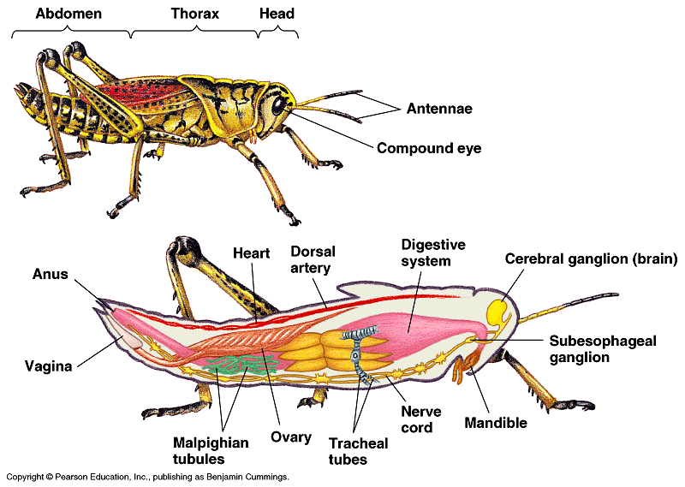
Open circulation

Slide 74
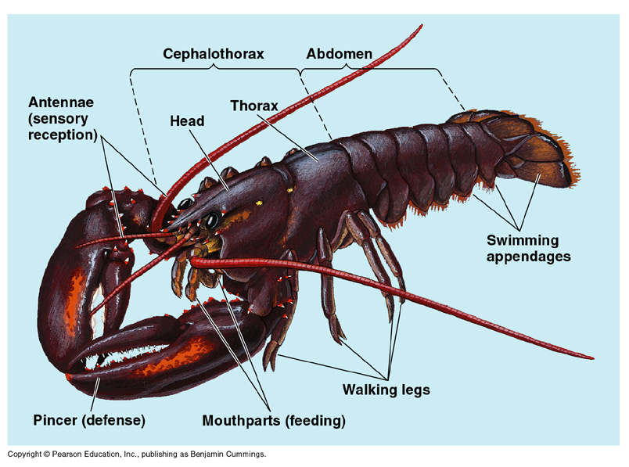

Slide 75
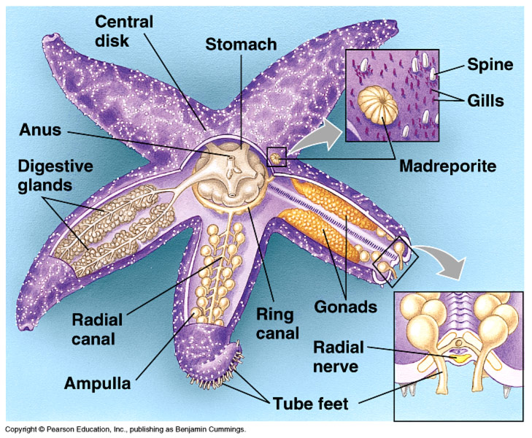

Slide 76
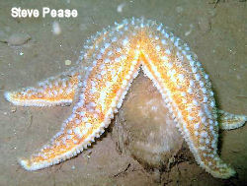

Slide 77


Slide 78


Slide 79

Origin of segmentation

Slide 80


Slide 81


Slide 82


Slide 83


Slide 84


Slide 85


Slide 86


Slide 87


Slide 88


Slide 89


Slide 90


Slide 91


Slide 92


Slide 93


Slide 94
There are many different species of sharks whose life spans range widely. Very little is known about the life spans of most sharks. More is being discovered all the time.
SHARK | LIFE SPAN
Great White Shark | No one knows the life span of the great white shark. Some people estimate it to be about 100 years, but this has not been proven.
Tiger shark | Perhaps 30 - 40 years.
Nurse shark | Nurse sharks reach maturity at about 15 to 20 years old. Life span is about 25 years (in captivity)
Whitetip reef shark | Unknown
Short-finned Mako shark | Unknown
Great Hammerhead shark | Unknown
Lemon shark | Unknown
Bull shark | Unknown
Galapagos shark | Unknown
Megamouth shark | Unknown
Spiny Dogfish shark | Estimates of the dogfish's life span range from 25-100 years.
Tiger shark | Unknown
Basking shark | Unknown
Whale shark | It has been estimated that whale sharks may live up to 100 - 150 years.
Spined pygmy shark | Unknown

Slide 95


Slide 96


Slide 97


Slide 98


Slide 99


Slide 100


Slide 101


Slide 102


Slide 103


Slide 104


Slide 105


Slide 106


Slide 107


Slide 108


Slide 109


Slide 110


Slide 111


Slide 112


Slide 113


Slide 114
Ethology aka Animal Behavior
Proximate causation – how
Ultimate causation – why in terms of natural selection

Slide 115
Fixed Action Patterns
Fixed action patterns - the sequence of acts that once initiated usually are completed.
Sign stimulus – the cue that causes the fixed action
  i.e. male stickleback fish react to red
  http://www.youtube.com/watch?v=vUNZv-ByPkU

Slide 116
Types of Animal Behaviors
Orientation behaviors: put the animal in it’s most favorable environment.
- kinesis: random movement
- Taxis: moves toward or away from stimulus

Slide 117
Agonistic behavior: animals responding to each other by aggressive or submissive responses.
Mating Behaviors; finding, courting and mating – Lab #11

