Slide 1
Sports and Entertainment Marketing
Lesson 4.2

Slide 2
Discover What People Want
TWO LESSON GOALS
Explain the importance of understanding buyer behavior when making marketing decisions.
List and describe means of collecting marketing information for use in decision making.

Slide 3
Discover What People Want
LESSON TERMS
Economic market
Benefits derived
Comparative advantage
Emotional purchases
Rational purchases
Patronage purchases

Slide 4
Understand Buyer Behavior
Economic market-all consumers who will purchase a product or service
Two major marketing goals
  1.What do consumers want
  2.How much are they willing to pay
    Spending habits, buying motives
By knowing their customers, businesses are able to respond to their needs more quickly

Slide 5
Consumer Spending Habits
It is important to research the spending habits of consumers in order to maximize profits on items they purchase at sporting and entertainment events

Slide 6
Consumer Spending Habits
The price fans are willing to pay for a ticket depends upon
  Their degree of interest
  Their perception of the benefits derived- the value people believe they receive from a product or service
The global market has Intense competition
Organizations must determine where they have a Comparative advantage -capability to produce products or services more efficiently and economically than the competition

Slide 7
Consumer Spending Habits
When a company can produce a product more efficiently and economically than others, it should be able to pass along production cost savings to its customers in the form of lower prices

Slide 8
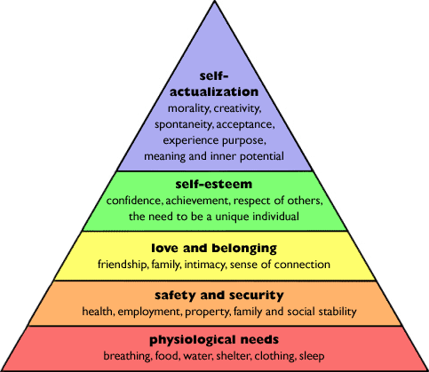
Consumer Wants and Needs
Maslow’s Hierarchy of Needs
American psychologist
Theory of the hierarch y of needs
Different people are at different levels on the hierarchy at any given time, making it challenging to design the most effective marketing strategies

Slide 9
Buying Motives
Emotional purchases- spending with little thought during emotional highs and lows
Rational purchases- make purchases based upon careful thought and sound reasoning
Patronage purchases- loyalty to a particular brand or product

Slide 10
Gather Information
Most consumers use the decision-making process to decide how to spend their money
  1. recognize a need or want
  2. conduct research for more information
  3. information should be collected on all alternatives
  4. evaluate your choices
  5. make a decision to purchase
  6. evaluate the decision

Slide 11
Gather Information
Marketers can help a customer recognize a need, provide information, assist with the purchase, follow up with the customer

Slide 12
Information Needed
Marketing decisions are based upon consumers and the business environment
Important factors to consider about consumers include demographics and shopping behaviors
Marketing research looks at how consumers spend money, including product and brand preferences and the frequency with which products are purchased

Slide 13
Information Needed
The business environment has an impact on consumer purchases
Once marketers have fully assessed their potential customers and the business environment, they are better prepared to select the right marketing mix that will influence customers to buy

Slide 14
Sources of Information
It is essential to collect information about customer needs and buying behaviors
Internal sources – a business’s own customer records, sales records, production records, and operation records
External sources – government reports, trade and professional organizations, business publications, commercial data, and information services

Slide 15
Sources of Information
Research data on customers:
Primary data – obtained for the first time and specifically for the particular problem or issue
Secondary data – has already been collected for some other purpose but is now found useful in the current study

Slide 16
Target Markets
4.3

Slide 17
Determine the Target Market
Target market – a specific group of consumers you want to reach
  Who is the customer for the product?
Market segment – a group of consumers within a larger market who share one or more characteristics
  Millions of people love college basketball, a smaller group specifically enjoys Duke basketball

Slide 18
Market segments
Snowbirds
Die-hard Rolling Stone fans
Rodeo fans
NASCAR fans
NASCAR fan demographics

Slide 19
Meet Target Market Needs
Analyze market segments in order to devise the most effective marketing strategies
Market segmentation data can improve business decision making
Sodas
  By the cup
  By the bottle
  People more interested in safety then cups

Slide 20
Market Segmentation
Businesses recognize that individuals have different wants and needs and view product and service choices quite differently
  College football
    Loyalty to school
    Social outing
    Family bonding activity
Markets may be segmented in many ways

Slide 21
Geographic Segmentation
Divided into physical locations
  Eastern
  Northern
  Southern
  Western
  OR urban/rural areas
  i.e. clothing chains offering different clothing in different weather regions, or based on team loyalty

Slide 22
Demographic Segmentation
Information that can be measured like
  Age, income, profession, gender, education, marital status, size of household
  http://www.zipskinny.com/
  i.e. advertising upscale hotels to those who can afford them, sports camps advertised to households with children

Slide 23
Psychographics Segmentation
Focus on characteristics that can’t be physically measured like values, interests, and lifestyle choices
  i.e. sports fans buy more clothing with team logo right after they win a big victory (emotion)

Slide 24
Behavioral-based Segmentation
Focuses on a customer’s attitude toward products and services
  Product usage-reflects what products you use and how often
    i.e. maybe one promotion encourages frequent visitors to purchase a season pass, while another promotion may encourage infrequent visitors to visit the park more often
  Benefits derived-satisfaction of spending time with the family

Slide 25
Capture a Market Share
The % of total sales of a product or service that a company expects to capture in relation to its competitors

