Slide 1
Sports and Entertainment Marketing
More than advertising!!
McDonald's Ad
Mcdonald’s ad remade
Gatorade

Slide 2
Chapter 1
Section 1.1

Slide 3
Goal #1-Basic Concepts of Marketing
The creation and maintenance of satisfying exchange relationships
  Creation involves product development
  Maintenance means marketing must continue as long as a business operates
  Satisfaction implies that the needs of both businesses and customers are met
  Exchange relationships occur when the business and customer both give and receive something of value

Slide 4
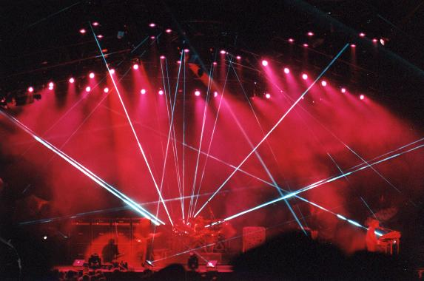
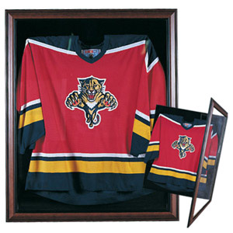
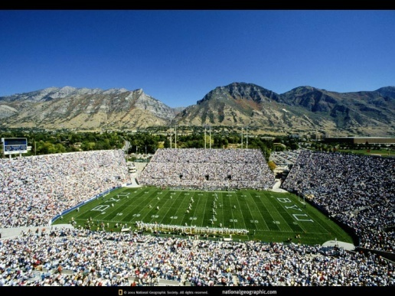
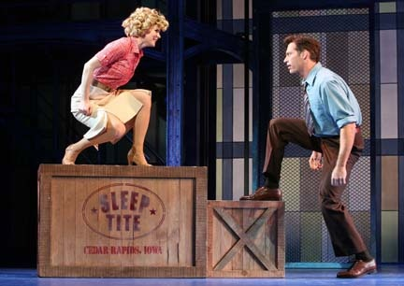
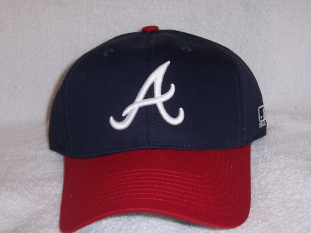
Satisfying Customer Needs
Primary focus of marketing
  1. identity your customer and the needs of that customer
  2. develop products that customers consider better than other choices
  3. operate your business profitably

Slide 5
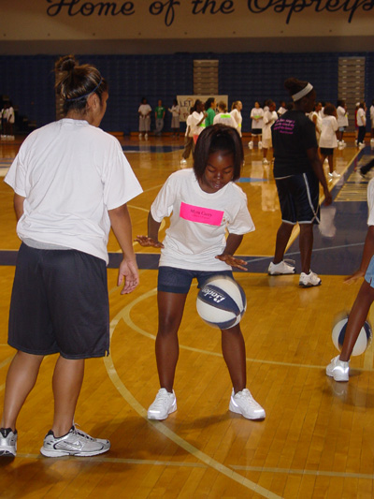
Sports and Entertainment Marketing
Busy individuals and families must carefully choose which sports and entertainment activities and events they will enjoy with their limited time and resources
Marketers must assess
  consumer demand
  the competition
  the financial valuation of the goods and services they offer
Consider the marketing mix and the core standards of marketing

Slide 6
Goal #2: The Marketing Mix
Marketing mix-the blend of:
  Product-goods, services
    Athletic shoes, video rentals
  Distribution-locations and methods used to make products available to customers
    Internet, storefront, catalog
  Price-amount that customers pay for products
  Promotion-ways to make customers aware of products and encourage them to buy
    Ads, trailers, sponsoring teams

Slide 7
Marking Mix Considerations-Product
Product offerings for sports and entertainment must be constantly evaluated and updated
  Discretionary income is the amount of money individuals have available to spend after paying for the necessities of life and other fixed expenses (housing, car payments)
Marketers must consider the quantities of the product to produce
Too much of a product could result in lost sales
Too few of a product could result in lost sales

Slide 8
Marketing Mix Considerations-Price
Price influences the purchasing decisions made by consumers
Must offer products and services customers need and want at prices they are able and willing to pay
Must also cover the costs of the business AND making a profit
Must be sensitive to consumer demand and the state of the economy

Slide 9

Marketing Mix Considerations-Distribution
Distribution involves transporting or delivering goods to final customers
  UPS
    delivers athletic uniforms
  Semitruck
    Delivers turf for football field
Distribution ALSO involves planning the location where the event will take place

Slide 10
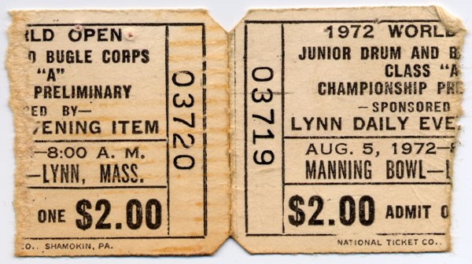
Marketing Mix Considerations-Promotion
Promotion is essential to inform prospective customers
  TV commercials
  Newspaper ads
  In-stadium ads through special offers on the back of ticket stubs and on giant video screens
Promotion requires creativity
Promotion costs large sums of money

Slide 11
Assignment
Create a newspaper advertisement using Publisher
What are you advertising? Upcoming Concert
Incorporate all of the marketing mix elements, including product, distribution, price, and promotion
4” wide X 5” tall
Must include a minimum of one graphic

Slide 12
Goal #3-Define the Core Standards of Marketing
Distribution
Marketing-Information Management
Pricing
Product/Service Management
Promotion
Selling
Financing-Not one of the six core standards

Slide 13
Distribution
Determining the best way to get a company’s products or services to customers
i.e. Television makers like Sony sell their products through electronics retailers like Circuit City..
Circuit City

Slide 14
Marketing-Information Management
Gathering and using information about customers to improve business decision making to predict consumer demand and to estimate the right quantities of merchandise to produce
i.e. When Domino’s first considered expanding operations into Japan, it used its marketing research findings to adapts its traditional pizza to Japanese tastes.
Japan Dominoes in English
Japan Dominoes in Japanese

Slide 15
Pricing
Process of establishing and communicating to customers the value or cost of goods and services
i.e. Super Bowl ticket prices go through the ceiling since there are a limited number of tickets and there is an enormous demand for them.
Super Bowl 2012
Herberger’s

Slide 16
Product/Service Management
Designing, developing, maintaining, improving, and acquiring products or services for the purpose of meeting customer needs and wants
i.e. Fisher Price tests new toy ideas with children and parents to make sure kids will enjoy playing with the toys.
Barbie and Ken

Slide 17
Promotion
Using advertising and other forms of communication to distribute information about products, services, images, and ideas to achieve a desired outcome
i.e. Sports fans often find coupons on the back of ticket stubs after they attend a ball game.
Storm Hockey

Slide 18
Selling
Any direct and personal communication with customers to assess and satisfy their needs and wants
i.e. Selling in today’s world includes purchases made through the Internet with no face-to-face communication whatsoever.
Buckle

Slide 19
Financing
A company must budget to its own marketing activities
  Promotions
i.e. Sponsors spend large sums of money to be visible during sports and entertainment events.
i.e. Customers may receive financing in the form of different payment options, such as cash, credit, and installment payments. People like more than one payment option.

Slide 20
Section 1-2
Sports Marketing

Slide 21
Goal #1 Define Sports Marketing
Demographics -Common characteristics of a group, such as age range, marital status, gender, ethnic background, income level, and education level
Sports marketing -using sports to market products
The goal of sports marketing is to use the right marketing mix to meet customer needs while generating a profit
To do this successfully, marketers must consider three factors: new opportunities, gross impression, and timing

Slide 22
New Opportunities
Sports marketers must continually search for new ways to appeal to customers
New sports markets offer new opportunities for endorsement and marketing-tickets, team clothing or equipment, etc.
  Omaha Nighthawks
  Arena Football-founded in 1987
  Bossaball
  Kronum League

Slide 23

Gross Impression
Gross Impression -the number of times per advertisement, game, or show that a product or service is associated with an athlete, team, or entertainer
  Back of a pair of shoes
  In a scene in a movie
  On the license-plate holder on a car
  Uniforms
Marketers hope the spectators will see them, will want to be associated with the elite team or athlete, and will buy the sponsor’s products

Slide 24
Gross Impression Assignment
Must watch a sporting event by next Thursday, January 19 (1/2 bball, ½ football, etc.)
Must turn assignment in Friday, January 20
Must write down each product and then record hash marks each time you see it
Example
  Coca Cola-|||| ||||
  Ford-|||| ||
  Etc.

Slide 25
Timing
Marketers are aware that the popularity of teams and sports figures is based on sustaining a winning record
Timing is extremely important when marketing sporting goods
Winning trends need to be monitored
Must be aware that success leads to increased competition
World Series TV Ratings

Slide 26
Goal #2-The Value of Sports Marketing
Sporting events impact budgets
  Soccer tournament for the kids
  Orange Bowl for a national football championship
Restaurants, hotels, service stations count on business generated by events
Creates Jobs-Ranging from parking lot attendant to marketing executive
  Venues-Building managers, horticulturalists, security personnel, maintenance crews
  Athletes-trainers, handlers, personal attendants
  Agents-maintain publicity, book engagements, negotiate contracts

Slide 27
The Value of Sports Marketing
Emotional Value
  Ties to their favorite teams
  Emotions compels fans to buy tickets and sports-related merchandise
So Many Channels
  Cable and satellite systems-right mix of programming to reach audiences, attract sponsors, and maximize profits
  High-profile events attract high-paying promoters
    March madness
    Super Bowl

Slide 28
Chapter 1
Lesson 1.3
Evolution of entertainment and entertainment marketing

Slide 29
Goal #1-Define Entertainment
Entertainment Marketing - Influencing how people choose to spend their time and money on entertainment
1. Entertainment is a product to be marketed
  i.e. concert, game, trade show, circus, ballet, opera, etc.
2. Entertainment can be used as a marketing tool to attract attention to other products
  i.e. an author appearing on a talk show to discuss a new book

Slide 30
What is Entertainment?
Entertainment - Whatever people are willing to spend their money and spare time viewing rather than participating in
Entertainment can include sports or the arts
Can be viewed in person or in broadcast or recorded form
Sometimes what qualifies as sports and what qualifies as entertainment is a matter of opinion

Slide 31
What is Entertainment?
Sponsors of the event want to gather as much marketing information as possible about the audience
Then they design product promotions specifically for that audience
They must understand the needs and wants
They must maintain accurate information about their customers

Slide 32
Mall of America
Mall of America
Successfully combined shopping, sports, and entertainment for the satisfaction of a diverse group of visitors
There are distinct roles for each category, but all three activities are interrelated and can be successfully combined for the ultimate experience

Slide 33
Goal #2
Describe the impacts of advances in entertainment technology on entertainment marketing.

Slide 34
Evolution-Then
Performing arts used to include live theater, ballet, opera, and concerts
Marketing was limited to posters, newspapers, magazines, and word of mouth
People had to travel to where the entertainment was showcased
Shows were live, and entertainers received instant feedback from the audience

Slide 35
Evolution-Now
Moving pictures initiated the merger of technology and entertainment and added new dimension and depth to entertainment marketing
Technology distanced entertainers from their audience
  First with movies
  Then with television
The Internet has renewed instant response to marketing information
Technology has furthered the possibilities of distribution of entertainment to the masses

Slide 36
Movies
How many of you have been to a movie recently?
List all-time classic movies
  IMDb-Top 250 Movies
  Top 100 Greatest Movies

Slide 37
First Moving Pictures-Movies
1927-First movie with sound
1888-First Moving Pictures
1938 Snow White-1st full-length animated film
1895-First projected movie to a paying audience
1928Mickey Mouse arrived
1955-Disneyland opened
Masterful marketing move-Disneyland-the Theme Park was born
The live arts and recorded arts were joined by an ever-evolving, technology-driven series of new media

Slide 38
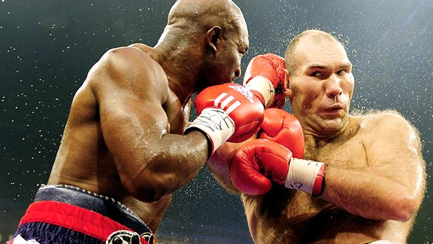
Television
Sports and entertainment marketers found a wide-open highway into the billfolds of consumers
1945-25,000 people-Gimbel’s
60% viewed the Beatles
1949-9 TV stations grew to 98
1946-1st sports spectacular
1956-82% of TV sets tuned in to the Ed Sullivan Show
Advertising fees charged for the show reflected the high audience ratings
150,000 watching on 5,000 TV sets

Slide 39
Change
Improvements in technology has made distribution to the masses easier
  Moving pictures, radio, tv, video recorders, CDs, DVDs, and the Internet, HD
Internet continues to evolve
  Social media
    Twitter, Facebook, MySpace
Instant feedback from customers
  Instant messages, e-mail, phone calls, Tweets, blogs (i.e. reality TV voting)

