Slide 1
Industry Segments
Lesson 3.1
https://fanclub.harryconnickjr.com/

Slide 2
Lesson 3.1-Goals
Define Industry and give examples of subdivisions of an industry
Explain why marketing decisions are based on industry standards, norms, and trends

Slide 3
Sports & Entertainment Industry
Industry-group of organizations involved in producing or handling the same product or type of services

Slide 4
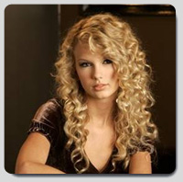
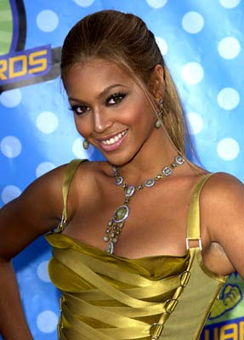
Subdivisions of the Music Industry
Country
Rock
Top-40
Hip-hop

Slide 5

Hotel Industry
Full service
Limited service
Economy
Extended stay

Slide 6
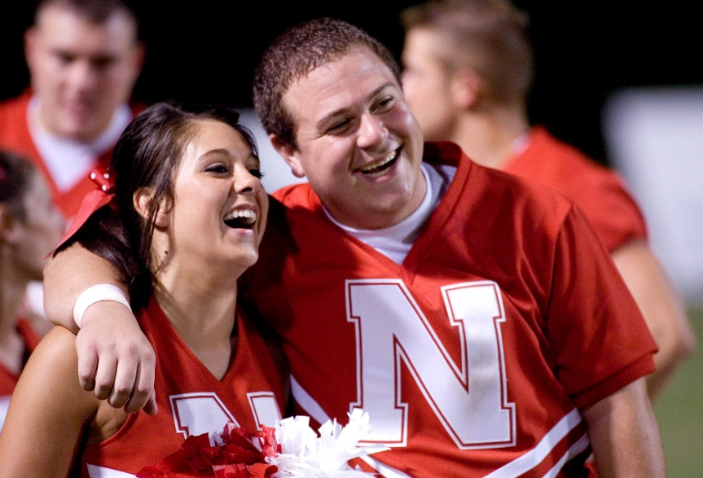
Sports Camp Industry
Sports
Baseball
Basketball
Football
Track
Wrestling, etc.
Dance teams
Cheerleading groups

Slide 7
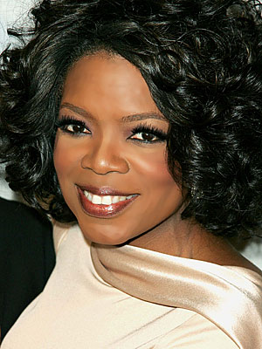

Television Industry
Talk show
Reality television
Sitcoms
Sports
Soap operas

Slide 8
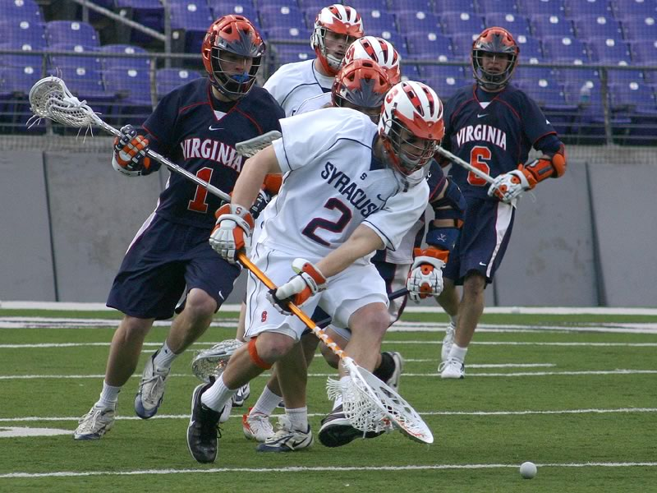
College Sports Industry
Football
Basketball
Baseball
Soccer
Softball
Lacrosse
Gymnastics

Slide 9

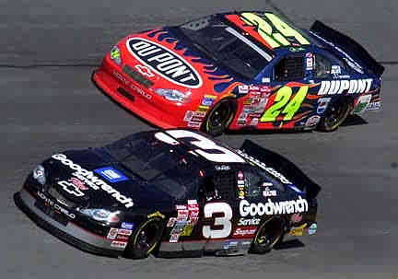
Other Industries
Concert
County and state fairs
Car racing

Slide 10
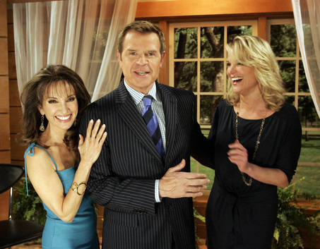



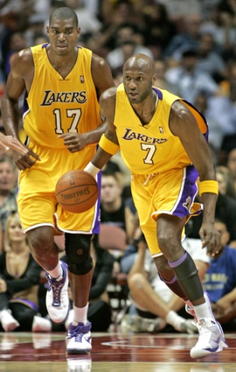
Competition!!!!!!!!
Businesses in the same industry MUST understand consumer behaviors and spending habits
Create strategies to overcome the competition

Slide 11
Industry Standards and Trends
Industry standards -guidelines and goals set for different entertainment industries
Industry norm -average expectation within an industry
Example-3 star hotel should be clean, nicely furnished room w/amenities such as pool, fitness center, room service, Internet
Marketing plans are often based on these

Slide 12
Marketing Decisions for an Industry
Example-Basketball camp
Industry standards
What should be taught
Amount of liability insurance to cover injuries
Industry norms
# of days
Price charged per student
Maximum enrollment for one camp
Average revenue from related sponsors

Slide 13
U.S. Sports Camps Trends
Being able to access information and register online
Links to help campers arrange transportation
Close ties with large sponsors

Slide 14
College Sports Trends
Continual increase in salaries into the millions of dollars to get and keep top coaches
Expanding stadiums
Major sponsors

Slide 15
Television Industry Trends
Reality tv has replaced more expensive sitcoms and traditional programs
Reach viewers through Internet, video iPods, on-demand services from cable providers
Video screens in supermarkets providing mini-programming for shoppers on topics like health or nutrition

Slide 16
Concert Industry Trends
Fewer stars with universal appeal (Beatles, Rolling Stones)
Concert music experience less important to today’s youth than to previous generations
Increasingly fragmented music industry
More artists and smaller fan bases

Slide 17
State and County Fairs
Turning to a younger management group for fresh marketing ideas on how to attract larger audiences of young people
Use of technology stepped up
Expanded schedules
Special events
Major corporate sponsorships
http://www.statefair.org/fair/

Slide 18
Assignment
PowerPoint
Find 5-10 trends in an industry
5-10 slides that tell of each trend
Pictures to go with the trends
Tell what and why trends are changing?
Select an industry from Mrs. Blum’s list.

