Slide 1
Lesson 3.3

Slide 2
Goal #1
Explain the role of travel and tourism in sports and entertainment

Slide 3
Lesson 3.3-Travel and Tourism
Tourism-traveling for pleasure, whether the travel is independent or tour-based
Travel and hotel industries are closely related to the sports and entertainment industries
i.e. If you go to the Super Bowl, you will have to travel to another destination
You will need airline tickets, hotel rooms, rental cars, food, etc.

Slide 4
Attracting Tourists
Trade Trade Mission
To increase the volume of visitors and their spending
Direct economic impact-total of new spending resulting from the event or attraction

Slide 5
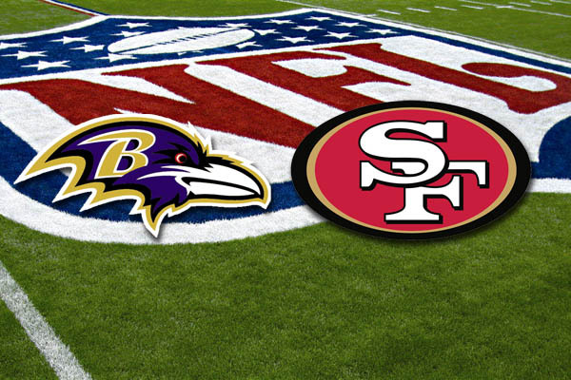
Attracting Tourists
Indirect economic impact- determined by the multiplier effect, meaning the portion of the money spent by visitors on local goods and services
Super Bowl 2012
Complete the worksheet for Super Bowl 2012

Slide 6
Tailor-Made Vacations
Niche travel – recreational travel or tours planned around a special interest
Music enthusiasts traveling through Europe listening to classical concerts
Ecotourism – responsible travel to natural areas that conserves the environment and sustains the well being of the local people
Enjoying while at the same time preserving natural environments so that they may also be enjoyed in the future is sustainable tourism

Slide 7
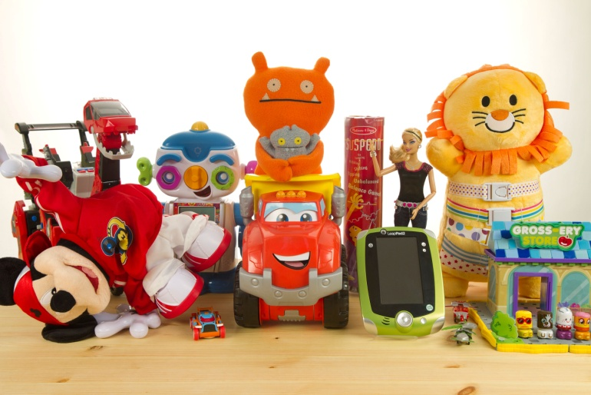
Halls of Fame
Can serve as a basis for promoting tourism
Rock and Roll Hall of Fame
National Baseball Hall of Fame
National Toy Hall of Fame
National Mustard Museum
Attracting visitors is critical to keeping a hall of fame alive.
Motivating a traveler to exit the interstate require the perfect marketing mix

Slide 8

A Complete Destination
The World Golf Hall of Fame is part of a complete destination-World Golf Village
A whole family can be entertained
Custom packages are available that include golf, the Hall of Fame, a showing at the IMAX theater, and a selection of hotels

Slide 9
Resorts and Theme Parks
Theme parks are thought of as family-oriented destinations, while resorts are usually aimed at adults rather than children
Theme parks-rides or activities centered around movies, cartoon characters, TV shows
Resorts-golf or relaxing activities
Many travel destinations have incorporated both

Slide 10
Resorts and Theme Parks
Domestic visitors – U.S. Tourists
Walt Disney World
Theme Park
Resort

