Slide 1
Lesson 4.4
Customer Service

Slide 2
Outstanding service equals success
Business success depends upon excellent customer service
All customers expect to be treated with fairness and dignity
Customer expectations also include a safe, comfortable environment and value for the money spent
Customer relationships should continue after the sale of goods and services

Slide 3

Outstanding service equals success
The best strategy for a business to rise above the competition is to provide uncompromising, outstanding customer service
Paying attention to customers and their needs is the first step in making customers happy
Successful sales personnel take time to get acquainted with customers
Many businesses establish customer databases that include the addresses, telephone, buying preferences, and birthdays of customers

Slide 4

Outstanding service equals success
Sales associates who take time to send thank-you notes and birthday cards with special coupons can strengthen their relationships with customers
It is also important to keep an eye on the competition and solicit customer feedback

Slide 5
A Track record for great customer service
Customer service gap – the difference between customer expectations and the service that is actually received
Examples:
  Chatting on the phone while customers are waiting to be served
  Dismissing a customer by whining “It’s not my department”
  Placing a calling customer on hold for long periods
  Yelling at a customer who fails to understand policy
  Failing to follow up with customers in a timely manner to ensure satisfaction

Slide 6
A Track record for great customer service
America’s service economy fails when its members do not remember that customer service is everyone’s department
Customers are more likely to try out the competition when they receive less than adequate service from a business
Customers are likely to tell at least ten people about their poor customer service

Slide 7
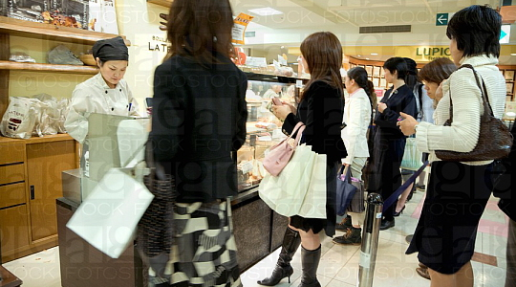
Customer service
Customer service is everyone’s department

Slide 8
Training programs that make an impact
Businesses should train their employees on proper customer service before a problem occurs
First, the right employees must be hired
Once the right employees are in place, they must be properly trained
The focus should be on how to serve customers well
However, in many programs the focus is on what happens when an employee makes a mistake

Slide 9
Training programs that make an impact
Nordstrom’s shoe department employees are trained to bring out three pairs of shoes when a customer requests to try on a pair
1. They bring out the pair you requested
2. They bring out a pair in the same style but a different color
3. They bring out a pair of that week’s hottest-selling shoes

Slide 10

Training programs
Make an impact

Slide 11
Creating a service culture
Gallery Furniture is the biggest single retail store in America
Jim McIngvale (Mattress Mack) has become an icon in Houston
His success can be attributed to:
  A strong work ethic
  Outstanding customer service
  Principles that guide the business

Slide 12
Creating a service culture
Many of his principles can be applied to the sports and entertainment industries.
1. Demonstrate a values-based culture that is rooted in high performance and excellent customer service-TODAY
2. Follow the “FAST” strategy-A Focus on concepts, Turn the focus into Action, Search for ways to increase customer satisfaction, have the Tenacity so you can survive in the highly competitive business world

Slide 13
Creating a service culture
3. Passion results in energy-Energy is acquired by having a passion for what you do
4. Demonstrate pride in every sale-this will keep customers coming back
5. Remember the value of long-term positive relationships-customers appreciate service representatives who answer their questions, give them guidance, and remember their first name
The number one goal of customer service is customer satisfaction

Slide 14
How may I help you?
“It’s not my department” should be replaced with “How may I help you?”
Mystery shopping programs
This program can produce valuable marketing information
Positive feedback should be shared with employees to motivate them to continue their good performance
Employees who provide outstanding customer service should be recognized

