Slide 1
Movie Maker
Lights!
Camera!
Action!

Slide 2
Getting Started
Every one has this program on the district computers
Items you need
  Pictures or videos
  Music or audio files
  CD, DVD, flash drive or jump drive.
  Creative mind

Slide 3
Step 1
Importing the Media

Slide 4
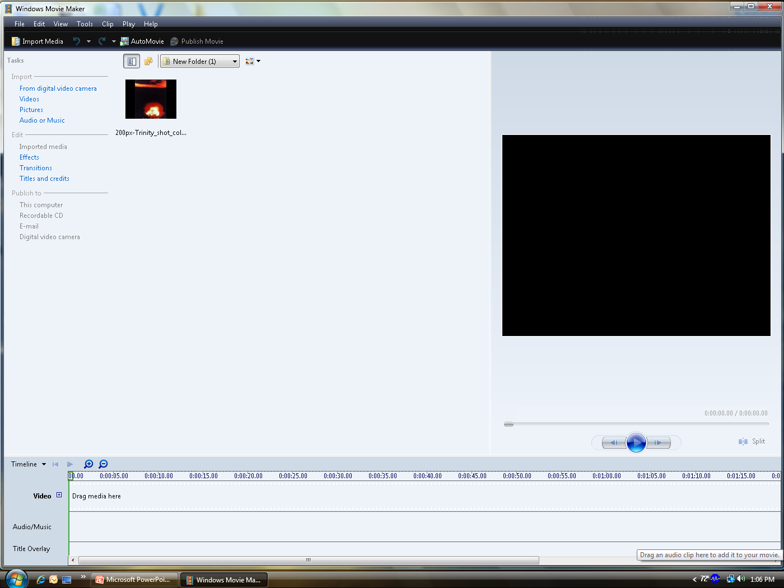
Importing Pictures
Pictures
  Under the Task Heading click on Pictures

Slide 5
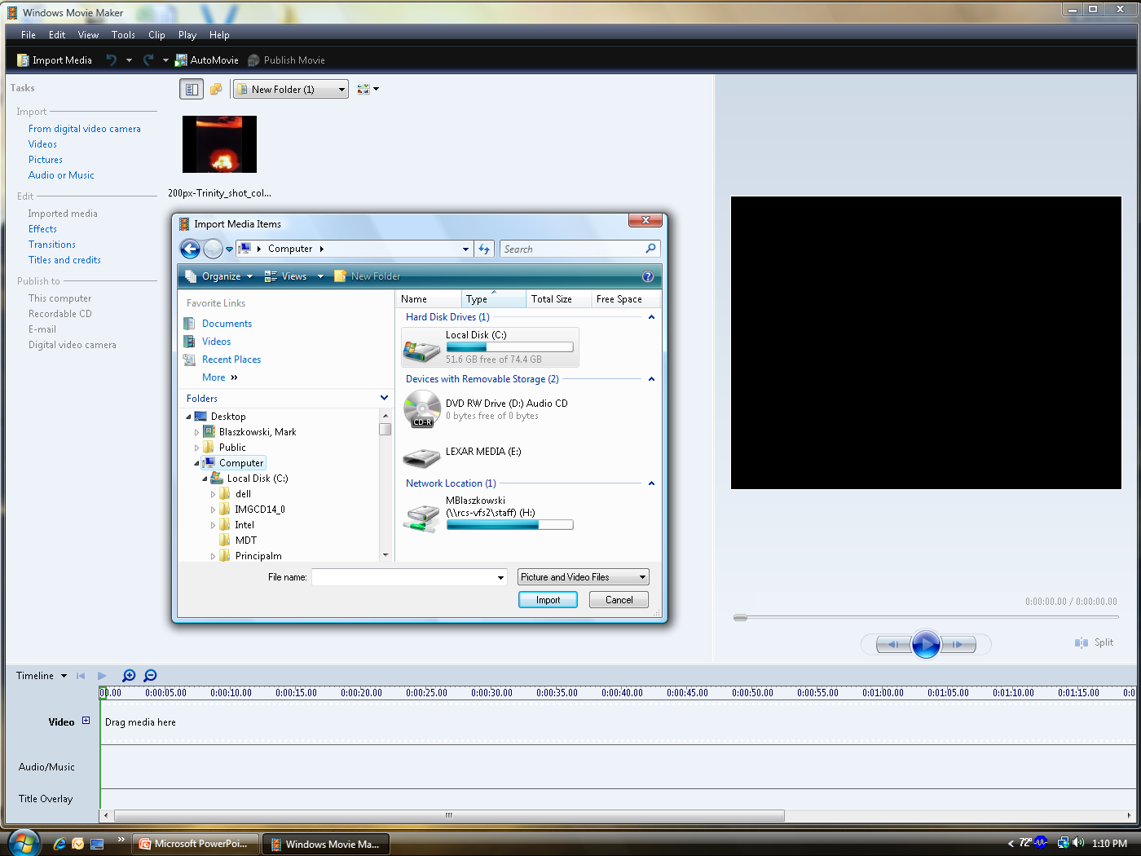
Importing Pictures
Choose your file of pictures

Slide 6
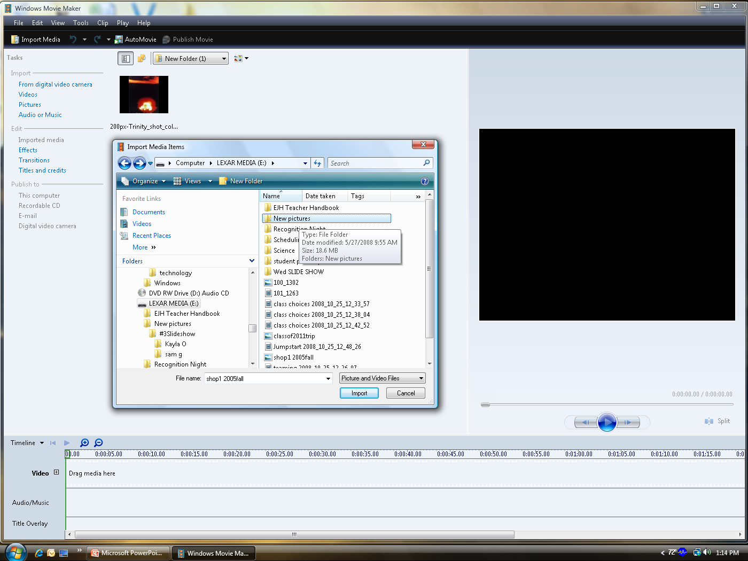
Importing the Pictures
Highlight all pictures you may want to use.

Slide 7
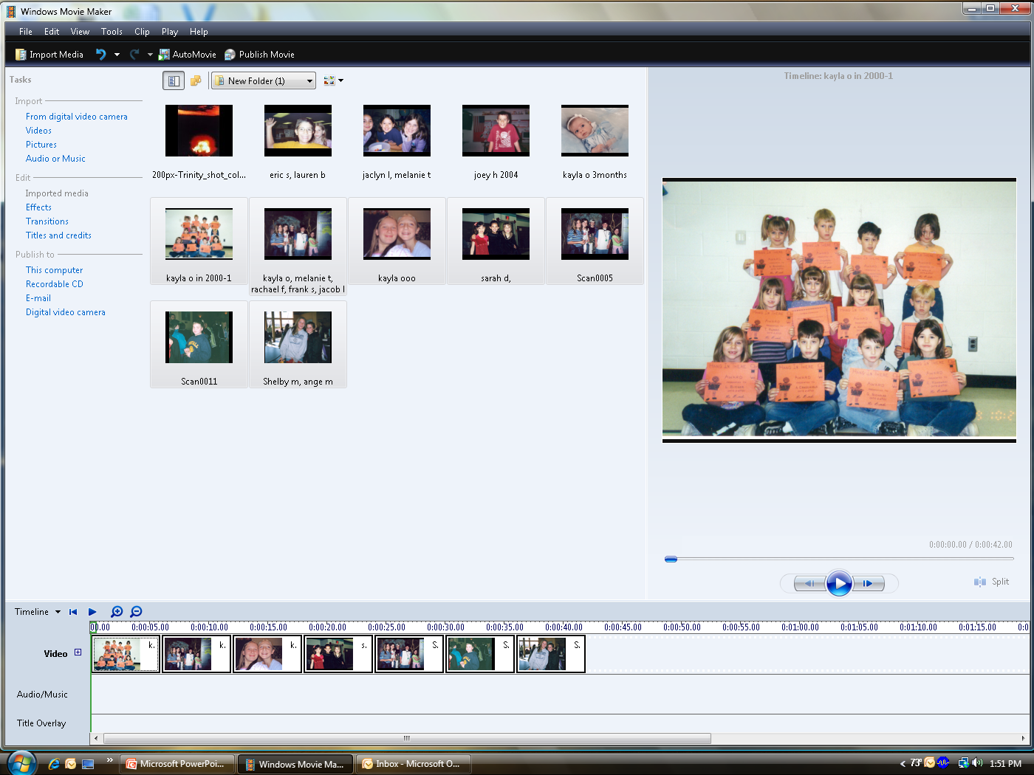
Importing Pictures
Highlight a picture and drag to the bottom of the screen.

Slide 8
Importing Music
Save music to a file on your computer.
I-pod music does not work unless you burn a CD and save into windows media player file.
Same as a picture you can now click and drag to your timeline.
Free downloads for educational use. http://www.ilovewavs.com/Holidays/July4/july4.htm

Slide 9
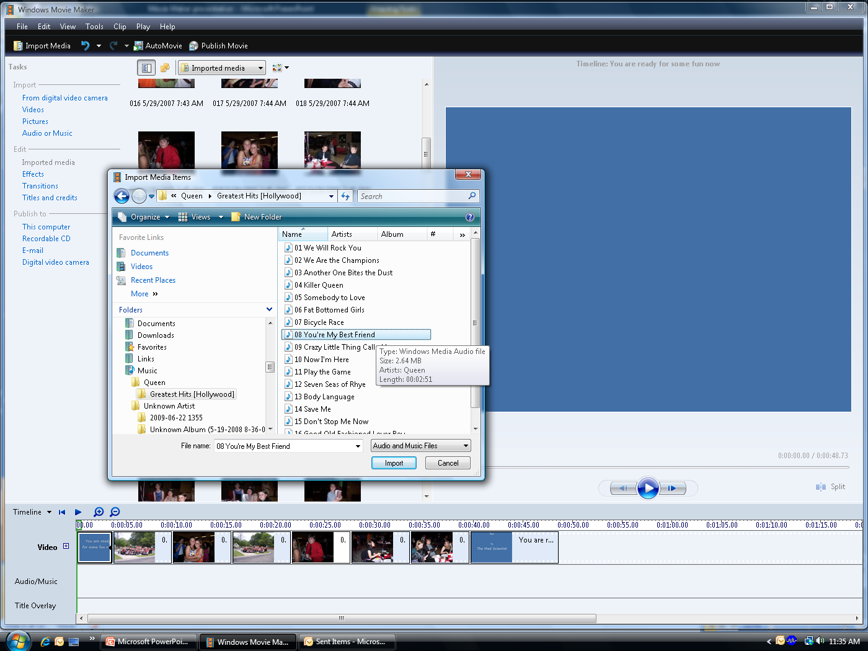
Importing Music

Slide 10
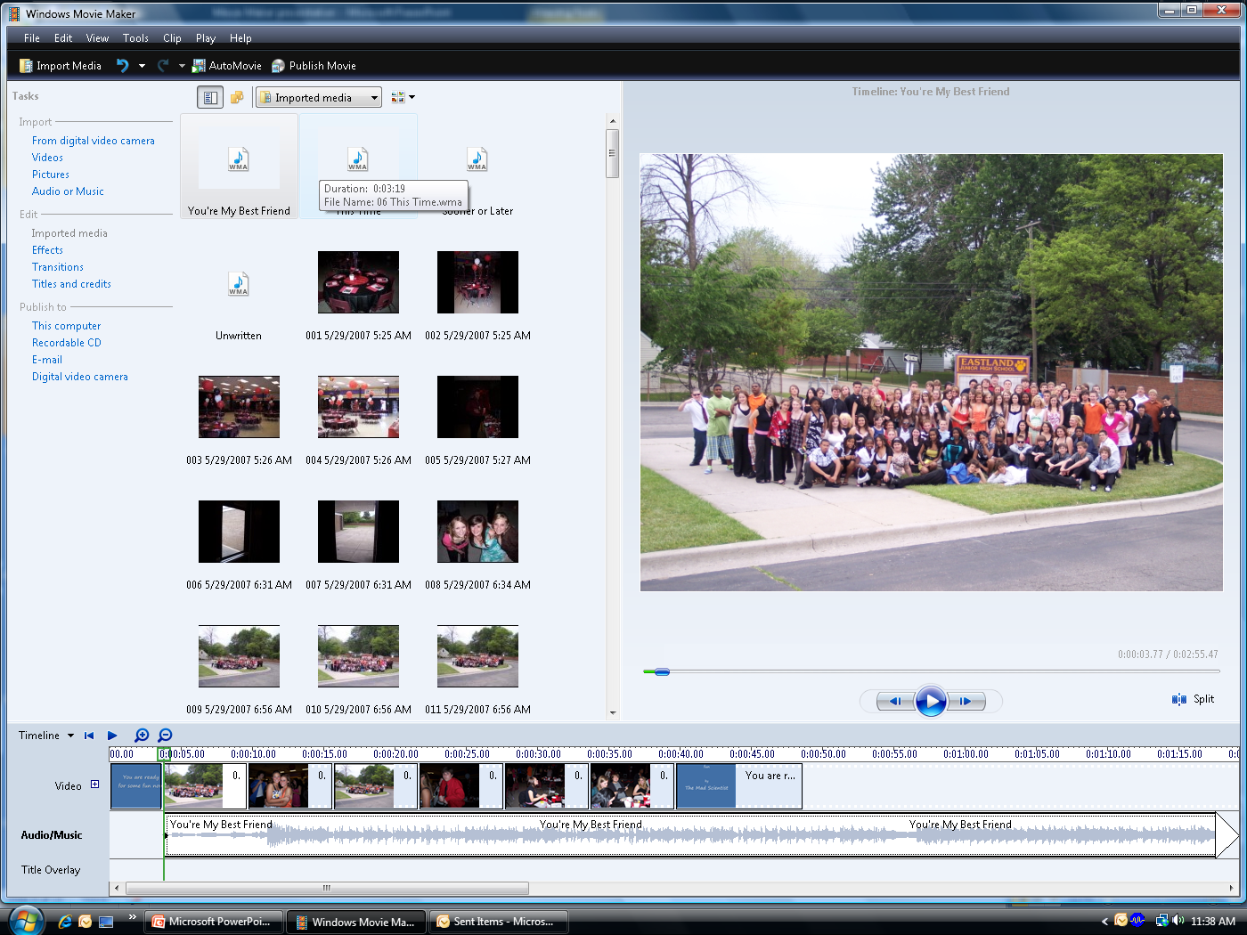
Importing Music

Slide 11
Step 2
Editing

Slide 12
Editing
Effects
  Allows you to float pictures as the slide is showing
Transitions
  How the slide changes from one slide to another
  Ex checkerboard, bow tie, circle
Title and Credits
  Allows you to add writing on slides including ones with pictures on them.

Slide 13
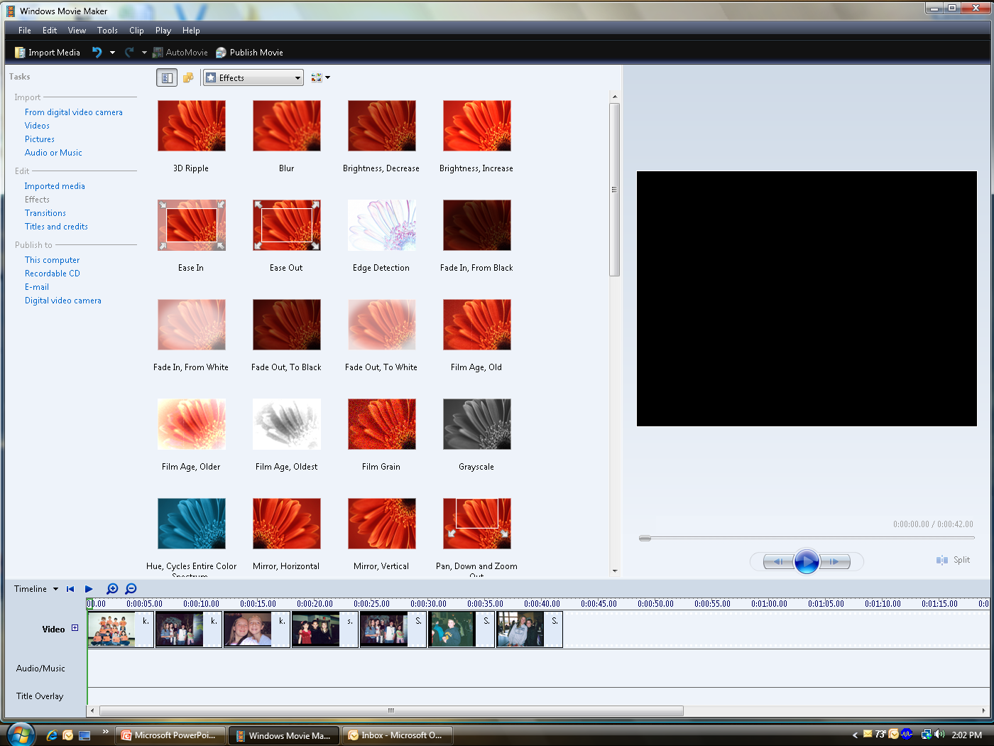
Editing
Click on effects heading on the left.

Slide 14
Effects
Choose an effect and it will show you a sample on the right side.
Drag effect to the picture you want to effect.
Try the Sepia for an old time picture look.

Slide 15
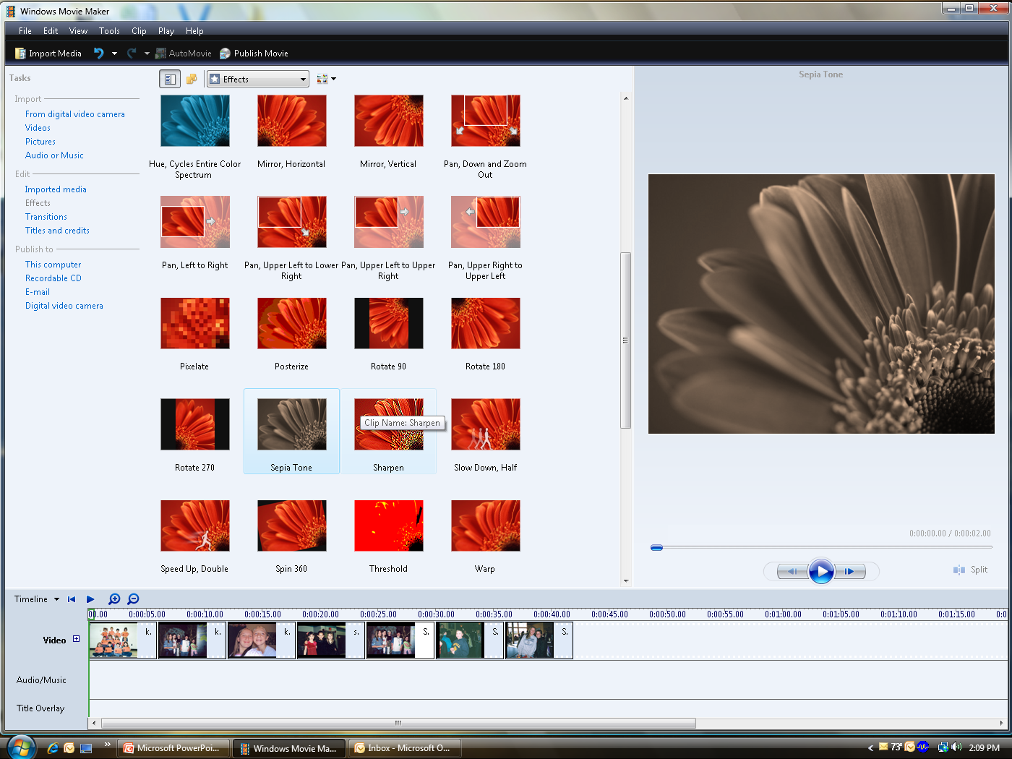
Effects
Sepia Tone

Slide 16
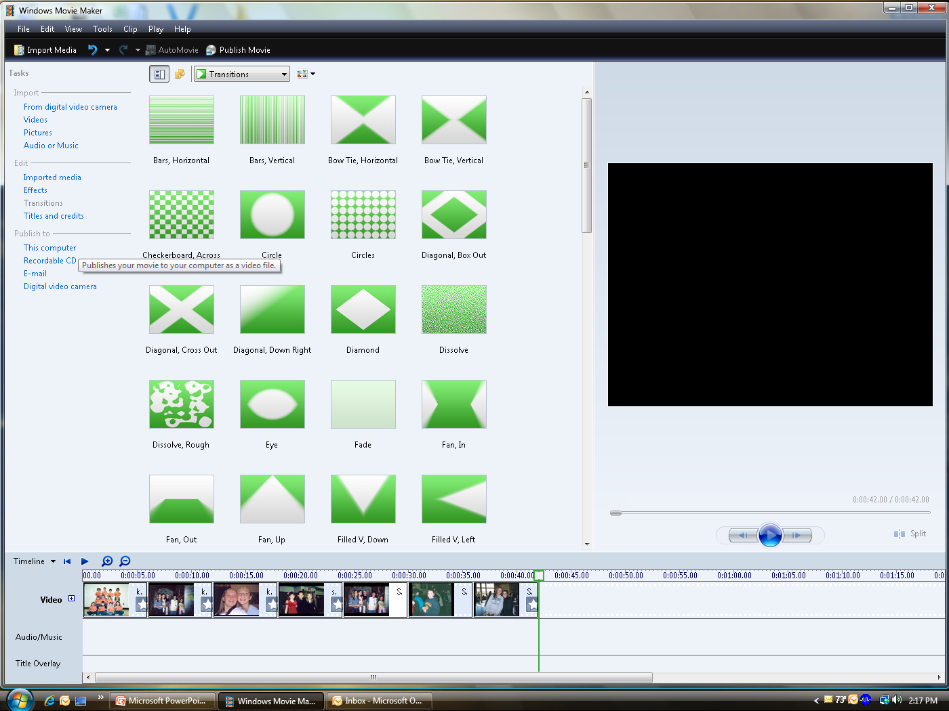
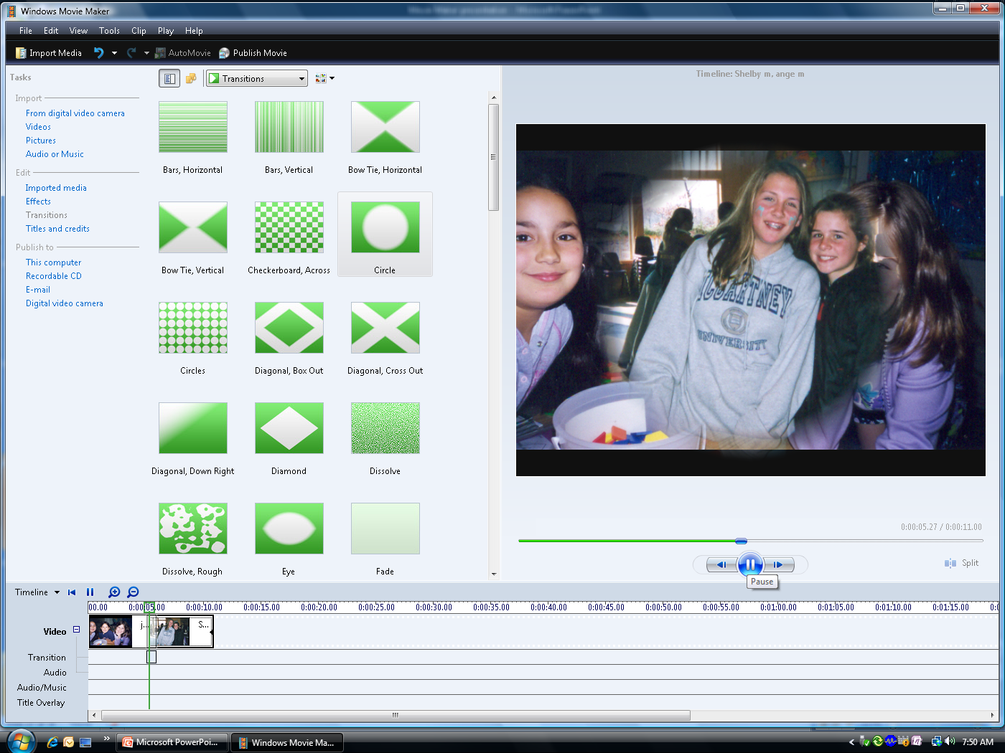
Transitions
Click on transitions on left

Slide 17
Transitions
Click and drag your choice onto the picture.
Try the dissolve or circles

Slide 18
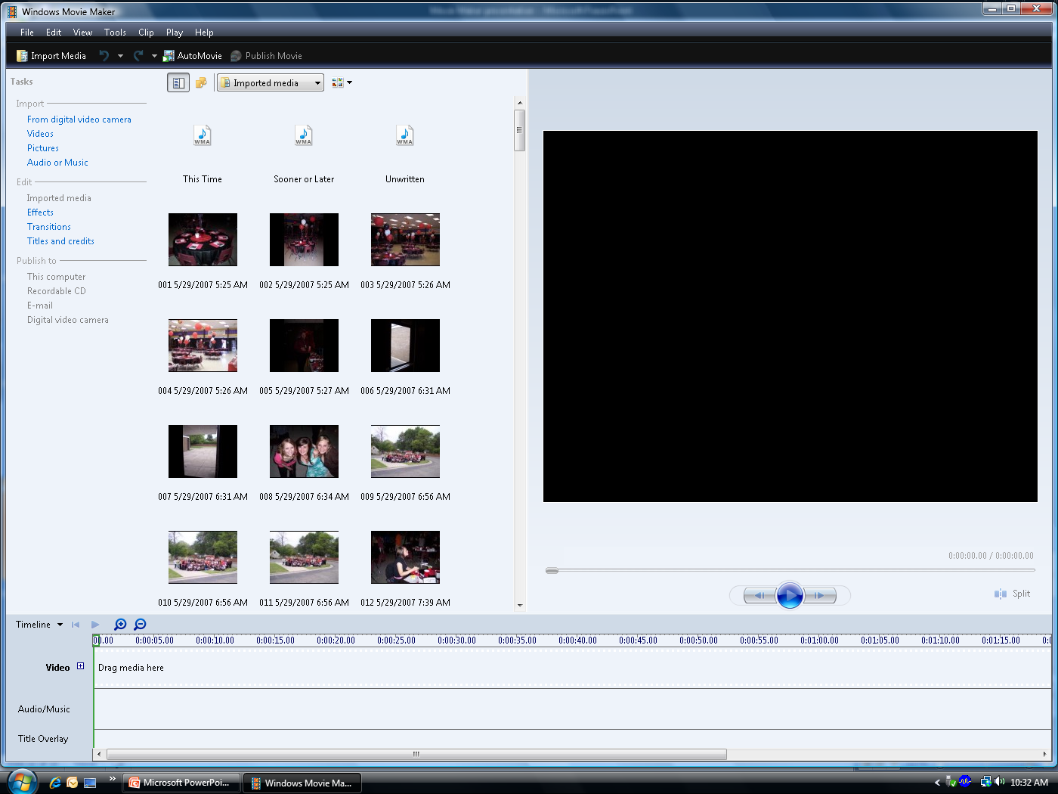
Title and Credits

Slide 19
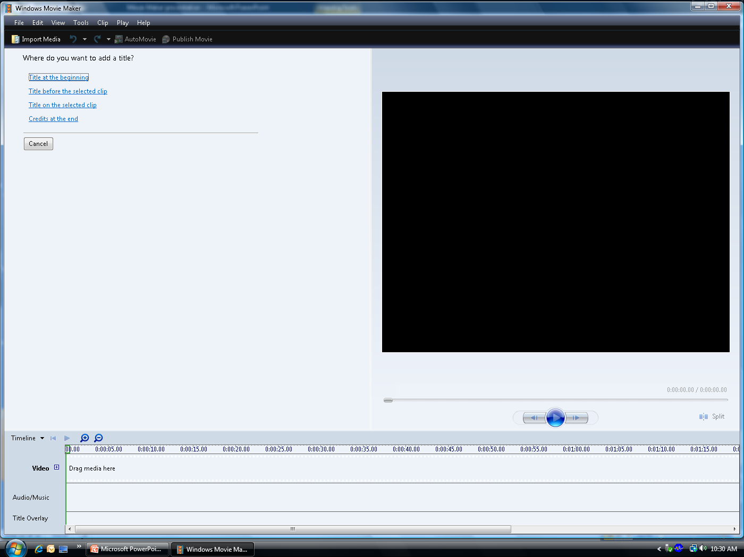
Title at the Beginning

Slide 20
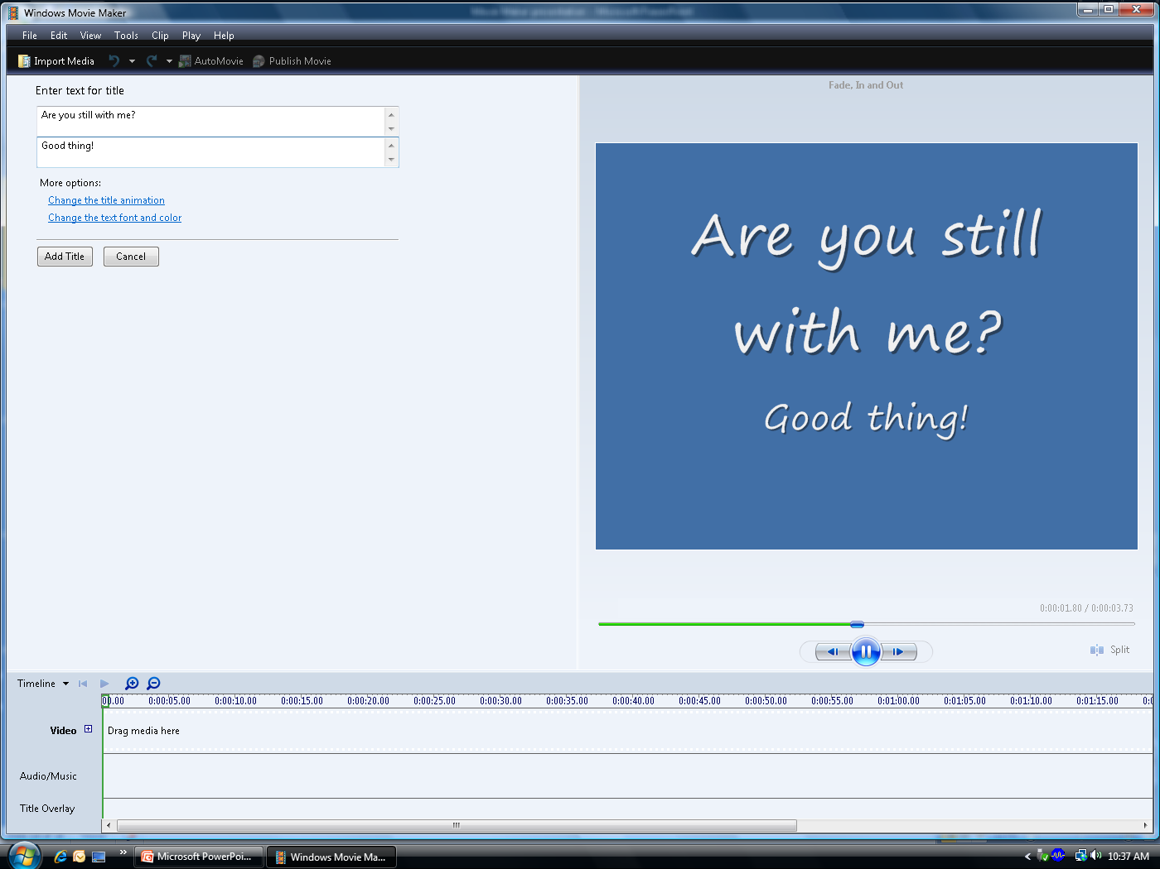
Title at the Beginning
This allows you to give your project a title and a sub title.
It will create a new slide at the beginning of the show.

Slide 21
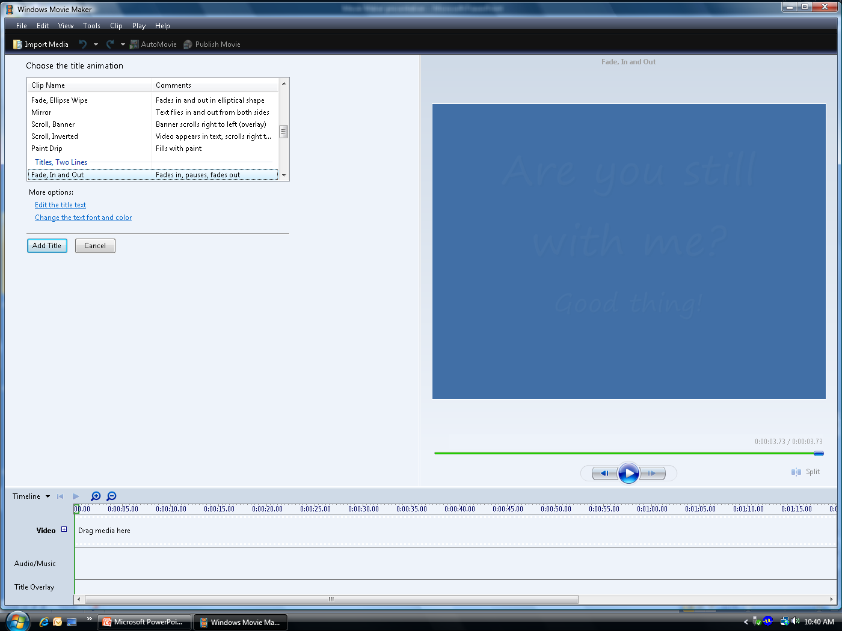
Title at the Beginning
You can also change your animation of the slide

Slide 22
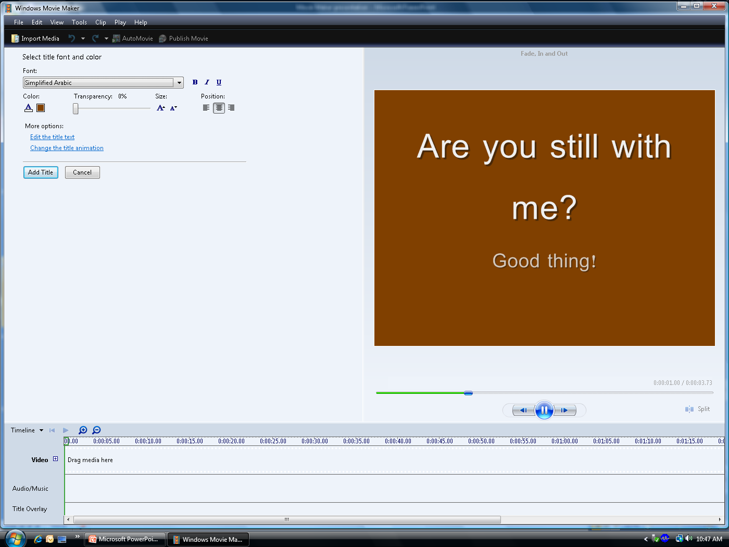
Title at the Beginning
You can change your font and color

Slide 23
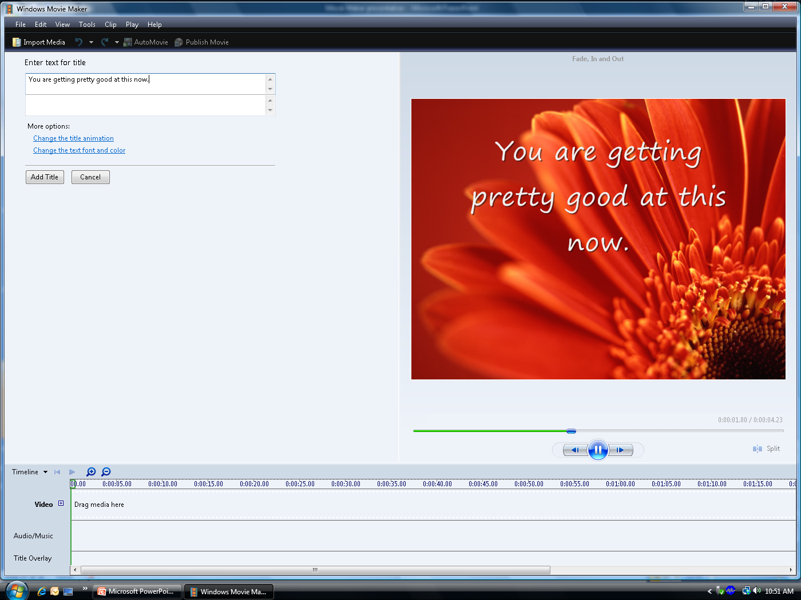
Title before clip or on selected clip
You can put slides in the middle of your show.
You can put a message on the top of your clip.

Slide 24
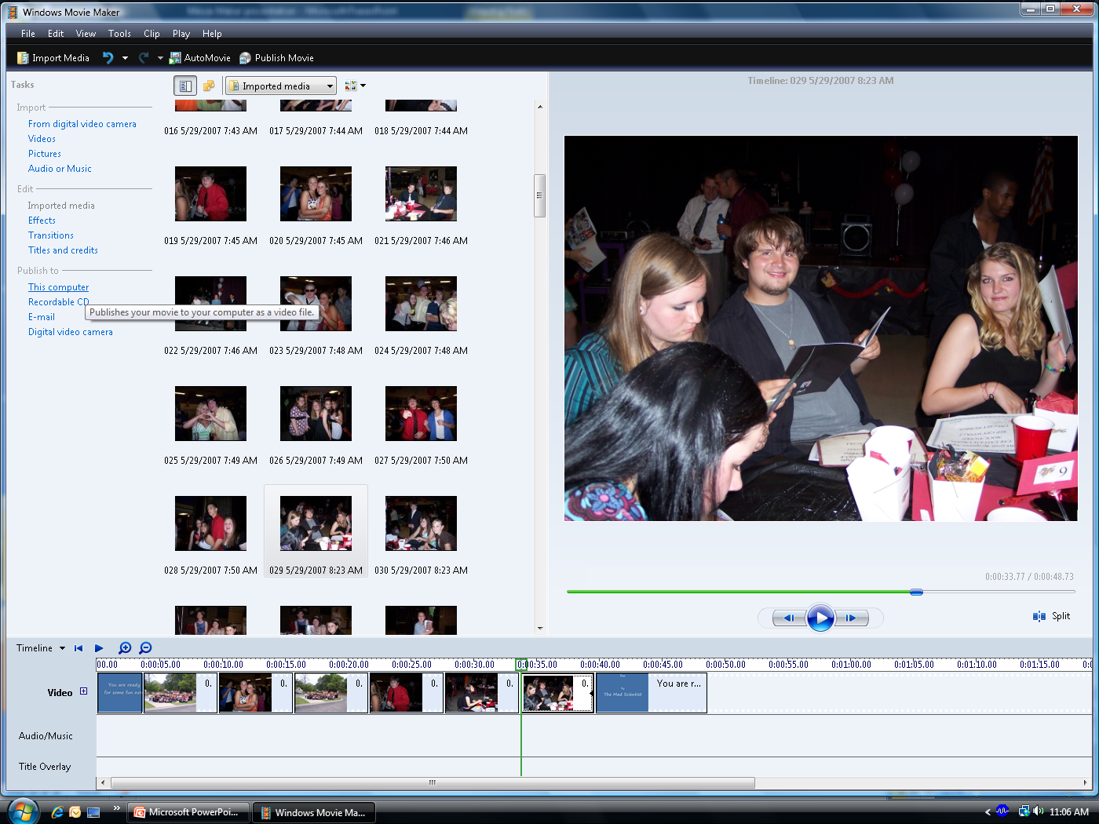
Publishing Your Production

Slide 25
Step 3
Publishing your movie

Slide 26
Publish Movie
Publish to your computer, jump drive, flash drive.
E-mail it to a friend
Burn to a CD
  At home you may be able to burn to a DVD which has a better picture quality.

Slide 27
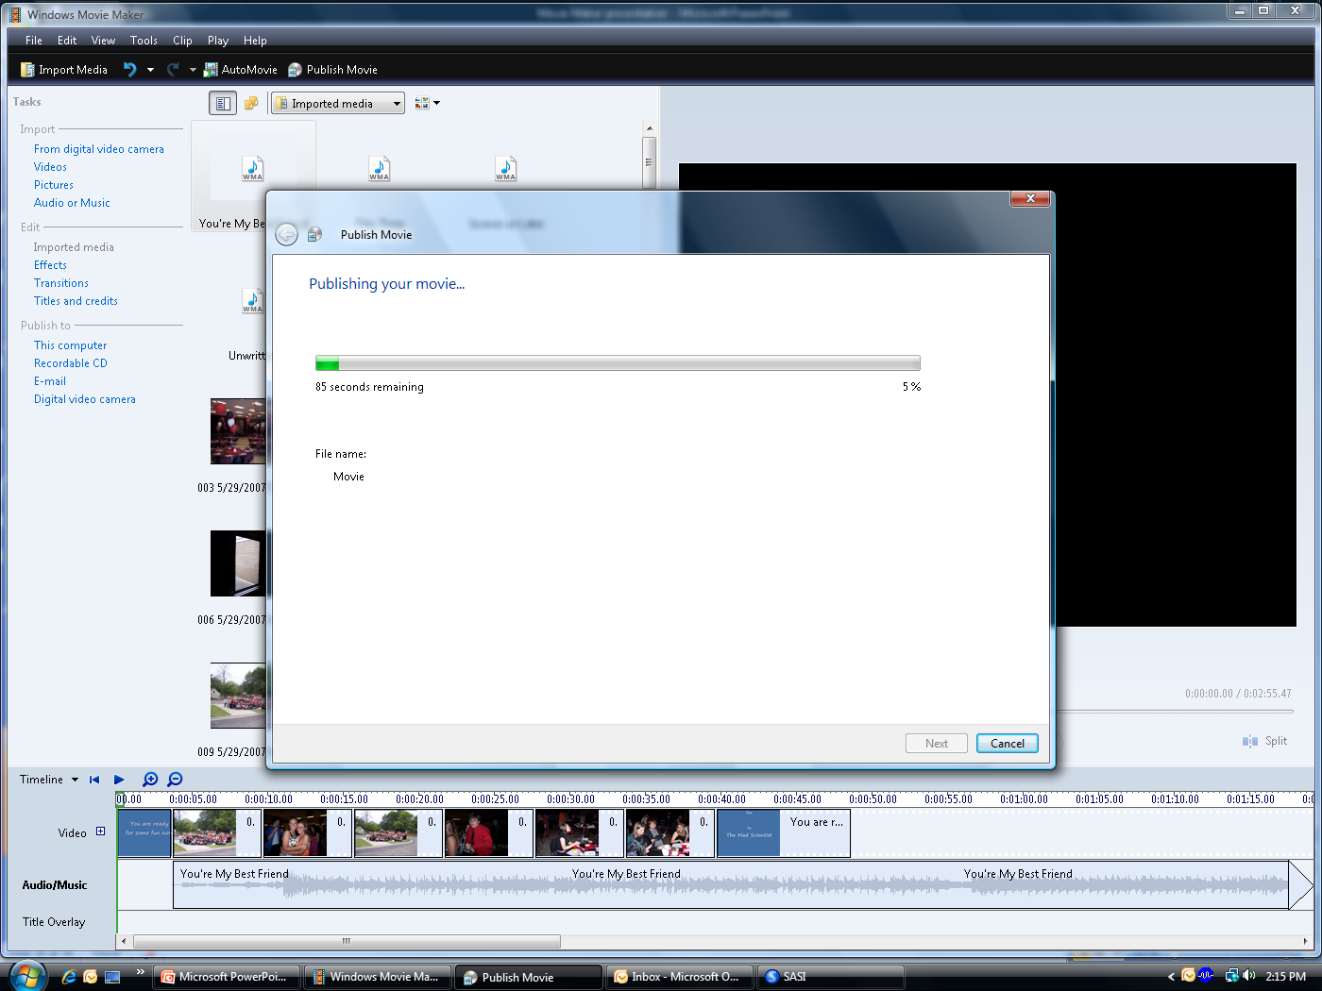
Publishing your movie

Slide 28
Warning
Copyright issues
  Music
    Only use 30 seconds of each song if you are broadcasting the movie.
    Careful about posting on the internet.
    Look for free music online.
    Do not distribute movie for profit if you use any copyrighted music.
  Pictures
    Be sure not to have student pictures broadcasted on cable if they have sent in a request not to.

