Slide 1
4.2.5
HBS

Slide 2
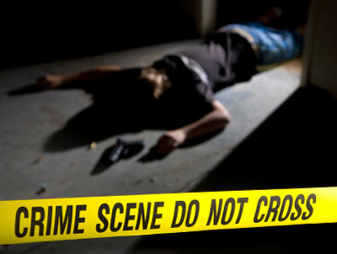
Think back to the last time you watched a crime scene investigation show on TV or a thriller at the movies.

Slide 3
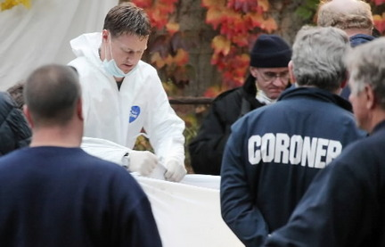
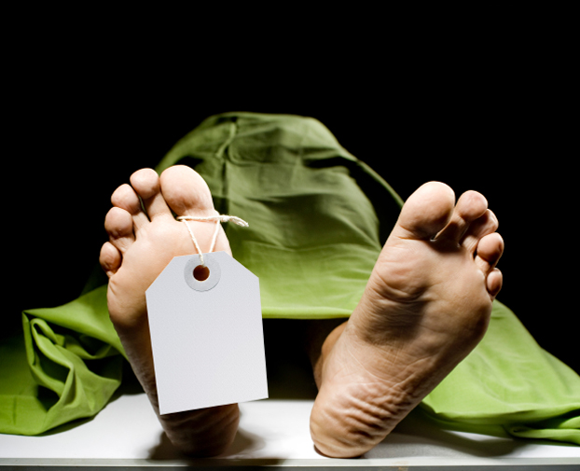
The coroner or medical examiner comes to examine the scene and states that a dead body is in “full rigor” or that “rigor mortis” has set in.

Slide 4
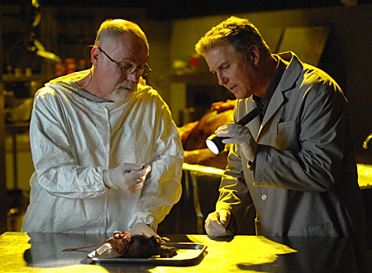
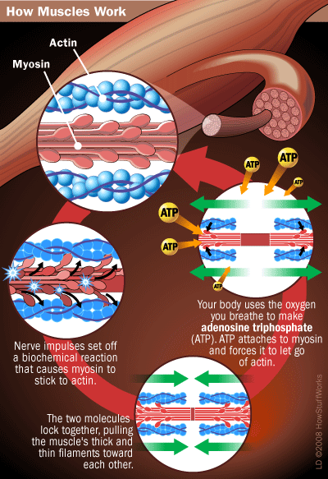
You probably figured out that this means that the body is now stiff and the limbs are hard to move, but have you figured out what causes this change?
The answer, of course, lies in the science.
This stiffening is directly related to the chemical state of your muscles upon death.

Slide 5
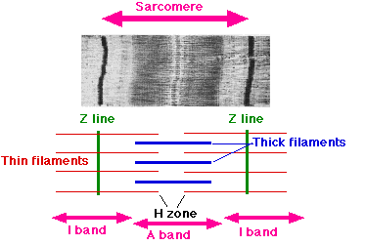
Muscle contraction
You understand that ATP is important for muscle contraction.
Now you will zoom in on the sarcomere, the smallest unit of a muscle, and see exactly how ATP is used to make a muscle contract and relax.

Slide 6
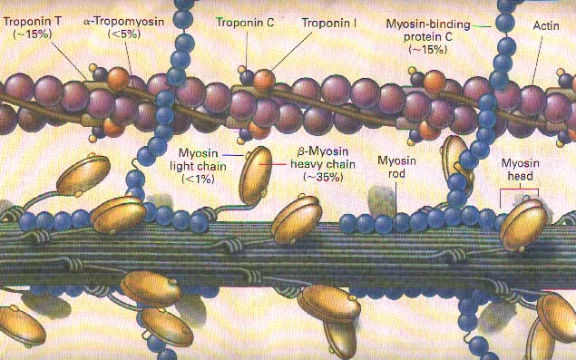
The sarcomere is made up of two important proteins, actin and myosin.

Slide 7
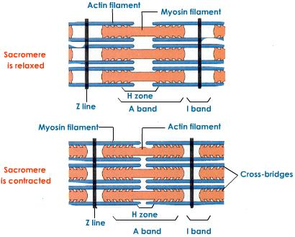
You will investigate the movement of these two fibers in contraction as well as the role other ions, electric stimuli and body systems play in this process.

Slide 8
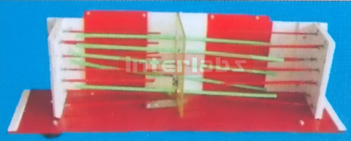
Using your findings, you will design and build a 3D working model of muscle contraction.

Slide 9

You will present your model on a segment of the fictitious show CSI - The Science Revealed targeted to middle and high school students.

Slide 10
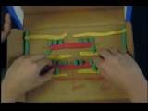
This model will be manipulated to show the sequence of events that occur during normal shortening of the sarcomere, as well as educate your audience on why the muscles can lock up after death.

Slide 11
Today
1. Use the Internet to research the mechanics of muscle contraction. Focus on what happens at the level of the sarcomere. This theory of muscle contraction is often called the “sliding filament theory.”
2. Find three legitimate sources of information that include diagrams, pictures or animations. Write the name of each site as well as the associated web address in your laboratory notebook.
3. Under the heading for each source, take notes on the process and make sketches of the stages of contraction. Pay attention to actin and myosin as well as other important proteins.
4. With your winter partner, write a step-by-step description of the “sliding filament theory.” Think about the requirements for contraction. What stimuli, sources of energy and other ions are needed to shorten a muscle?

