Slide 1
HBS
4.2.5

Slide 2
Objectives
Today, you will understand where ACTIN and MYOSIN are located on muscle tissue and the role they play in muscle contraction.
You will be able to –
  Research Sliding Filament from 3 reliable sites.
  Explain the location of actin and myosin on the filaments.

Slide 3
Review Warm Up
_________________ connects bone to bone.
_________________ connects muscle to bone.
Muscles work in ________________ _______________.
Muscles always contract and __________________.

Slide 4
So if muscles contract and shorten
http://www.youtube.com/watch?v=T-ozRNVhGVg
Do the muscle fibers shorten?

Slide 5
Muscle contraction
http://www.youtube.com/watch?v=EdHzKYDxrKc

Slide 6
Today….
Research from at least 3 websites:
  Muscle contraction
  Sliding Filament
  How the two items above are related to Rigor Mortis.
At the end of the period, you will show me your notes from 3 different sites… list source, then put notes under it.
Look for key words:
  Myosin
  Actin
  Sarcomere
  Sliding Filament
  Rigor Mortis
Be prepared to answer a question about myosin, actin, thin filament and thick filament.
Tomorrow, you will begin by putting your notes into a concept map, then writing a summary of the sliding filament theory.

Slide 7
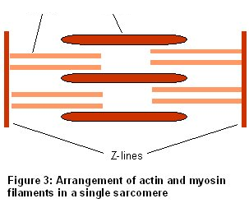
Success Check
PP: In the figure above, label the actin and myosin on the filaments.
P: Write a sentence using the terms actin, myosin, thick filament and thin filament.
Adv: Write a brief explanation using the terms: actin, myosin, thick filament, thin filament, sliding, shorten, calcium ions, ATP, return to relaxed state.

