Slide 1
4.2.5
HBS
http://www.youtube.com/watch?v=huhVKoIDZ3w&feature=related

Slide 2
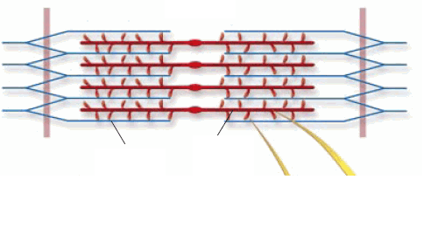
Warm up-Review
If the tricep muscle is relaxed and long, then the bicep is ____________ and _____________.
The diagram below is of a ____________. The thick filament (red) is made up of _____________ and the thin filament (blue) contains _______________.

Slide 3
Muscle Cell Contraction
http://www.youtube.com/watch?v=W7c1dAOVbvw
Think about – How does this occur on a cellular level?
Why does it matter?
  What do our bodies need for muscle contraction to occur?
  What happens if the muscles don’t receive these key factors?

Slide 4
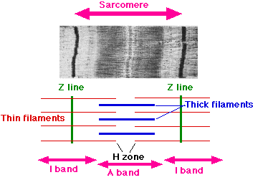
Muscle contraction
You understand that ATP is important for muscle contraction.
Now you will zoom in on the sarcomere, the smallest unit of a muscle, and see exactly how ATP is used to make a muscle contract and relax.

Slide 5
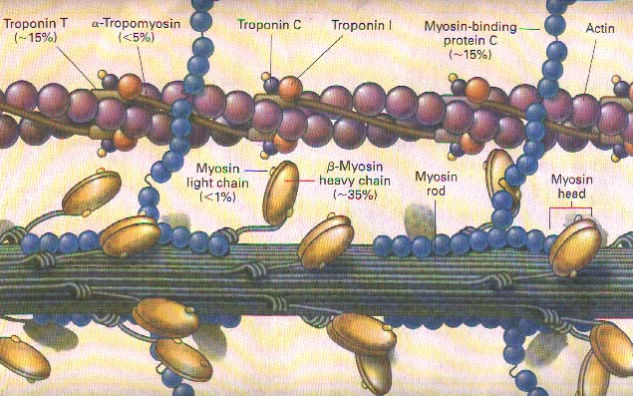
The sarcomere is made up of two important proteins, actin and myosin.

Slide 6
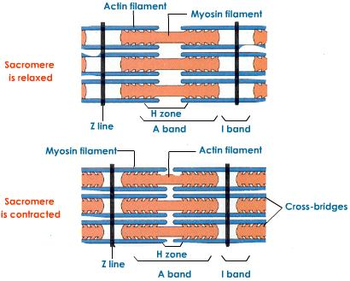
You will investigate the movement of these two fibers in contraction as well as the role other ions, electric stimuli and body systems play in this process.

Slide 7
Concept Map
Take out your notes from your research yesterday.
Using either Inspiration software or paper and pencil, create a concept map to organize your understanding of the SLIDING FILAMENT THEORY and how it relates to rigor mortis.

Slide 8
Partner Share
With your SOUTH partner, share your concept maps.
Compare them to the proficient example.
Use the RUBRIC to evaluate each others.
  Language I should hear:
    I like that your concept map includes…
    One way to improve your concept map is…
    A concept that I learned from your diagram is…
    Your thinking map caused me to realize that….
Some questions to ponder:
“Did the map show how the process repeats?”
“What other way could the concept map have been arranged to show the role of ATP?”
“If there were no calcium ions what would happen?”
“If there were no ATP what would happen?”

Slide 9
Summarize your Thinking
Create a paragraph that explains the Sliding Filament Theory.
Use cause and effect language.
  _____ takes place when ___________
  ___________ stimulates the release of _________ causing ______.
  _______________ results in ___________________.
If you finish, please read 4.2.5.

Slide 10
Discuss at your table
What is lacking in the system for Rigor Mortis to set in?

Slide 11
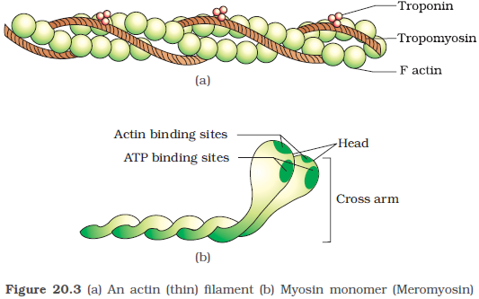
What if there were no ATP?
http://www.youtube.com/watch?v=CbfK1Gi-aCk

Slide 12
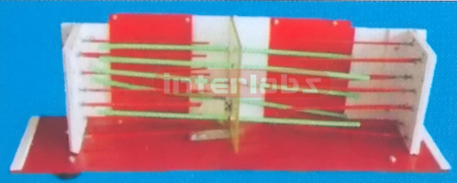
Project
Using your findings, you will design and build a 3D working model of muscle contraction.

Slide 13

Project
You will present your model on a segment of the fictitious show CSI - The Science Revealed targeted to middle and high school students.

Slide 14
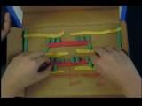
Project
This model will be manipulated to show the sequence of events that occur during normal shortening of the sarcomere, as well as educate your audience on why the muscles can lock up after death.

Slide 15
Examples
http://www.youtube.com/watch?v=boPT3H1tAaI&feature=related
http://www.youtube.com/watch?v=Csz2Vt7HLrU&feature=fvsr

Slide 16
Use remaining time to…
Meet with your partner, discuss ideas.
Decide if you need to bring any supplies.
Begin filling in your ideas for the rubric, we will finalize it tomorrow.
You will have class time tomorrow to work on your model and your script.
On Monday, you will turn in your script and your model.
If you would like to make a video, see me to schedule use of camera.

