Slide 1
HBS
http://www.youtube.com/watch?v=EQRwrOfAyls
4.2.6

Slide 2
Learning objectives
Understand the basics of nerve structure and function and …
Be able to describe how nerves stimulate muscles.

Slide 3
When someone says “YOU’VE GOT NERVE” what comes to your mind?
http://www.youtube.com/watch?v=Djdr8utkagg

Slide 4
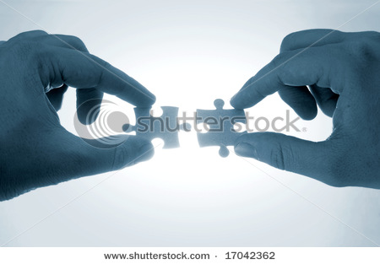
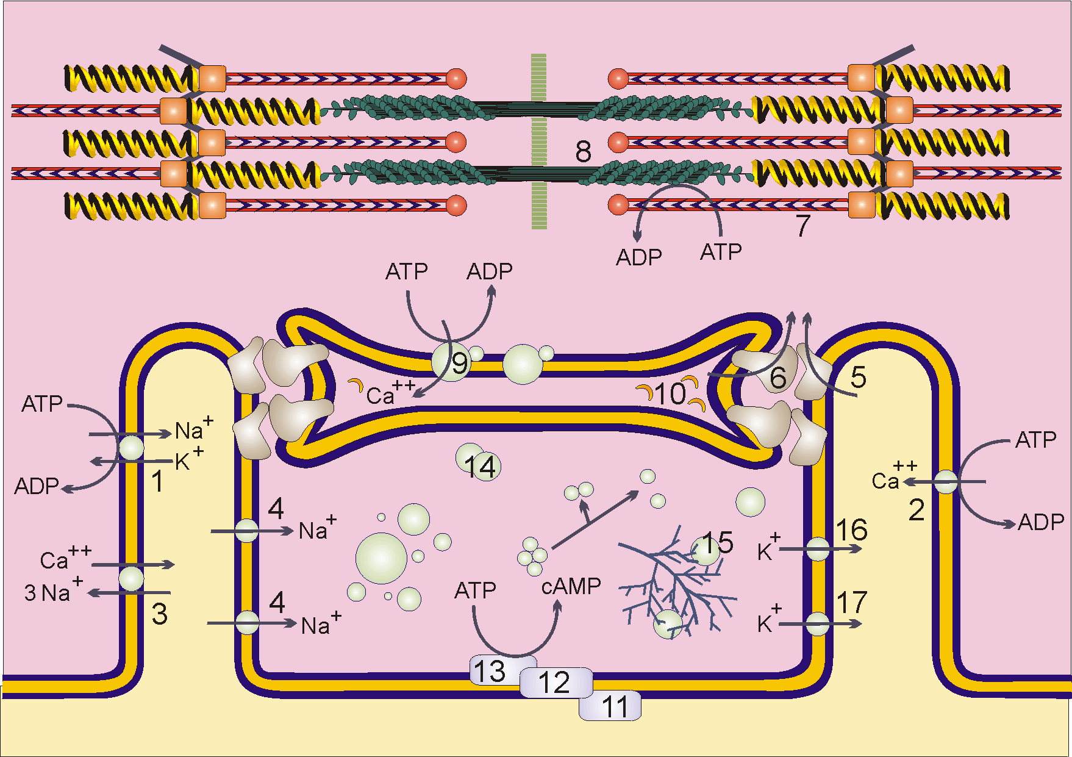
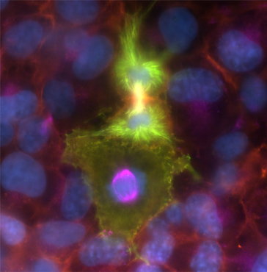
Let’s put it all together.
You have looked at the requirements for muscle contraction and you have seen how communication from the nervous system is crucial to getting a muscle to fire.
Neurons are packed together in wiring called nerves, and these nerves serve as a highway for electrical messages.

Slide 5
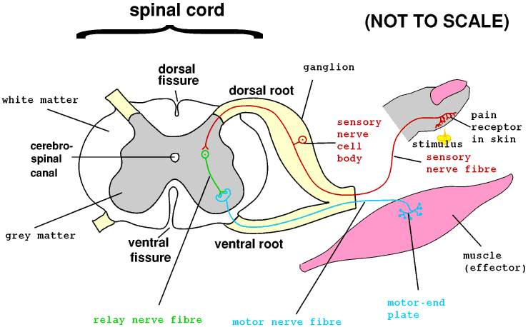
Efferent nerves
take messages from the brain to our tissues

Slide 6
Afferent nerves
are on the other side of the road, bringing messages from the body to the control center

Slide 7
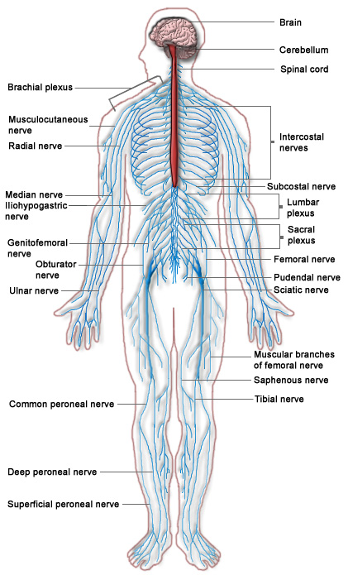
This highway of neurons is buried deep in the body

Slide 8
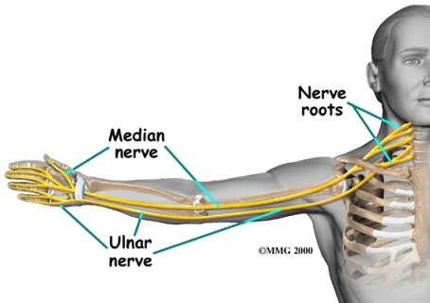
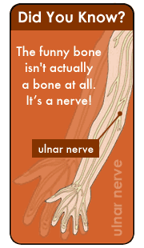
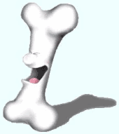
Ulnar Nerve
The ulnar nerve, at the elbow, is one of the few that grazes the surface. If this nerve is knocked against the humerus, the “funny bone,” you feel that familiar tingly sensation down your arm that is anything but funny.

Slide 9
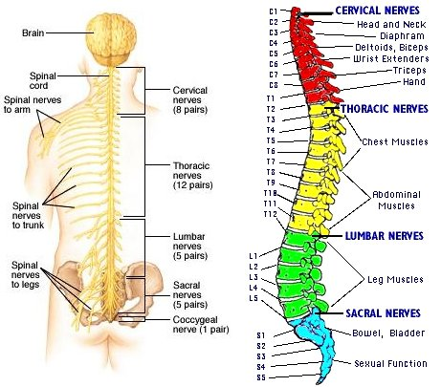
Spinal nerves are a vital part of the peripheral nervous system
They connect the central nervous system to sensory receptors, muscles and glands in all parts of the body.

Slide 10
Spinal nerves are a vital part of the peripheral nervous system
Depending on their points of connection with the central nervous system, nerves fall into two categories.

Slide 11
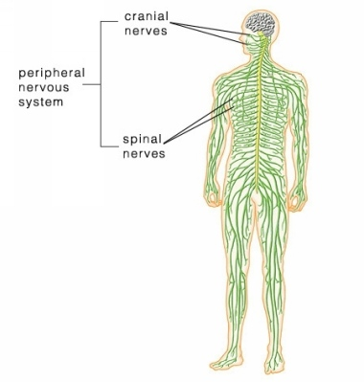
Spinal nerves are a vital part of the peripheral nervous system
Twelve pairs of cranial nerves connect directly with the brain and bring signals to and from the head and neck

Slide 12
Spinal nerves are a vital part of the peripheral nervous system
Thirty-one pairs of spinal nerves supply the rest of the body and connect directly with the spinal cord.

Slide 13
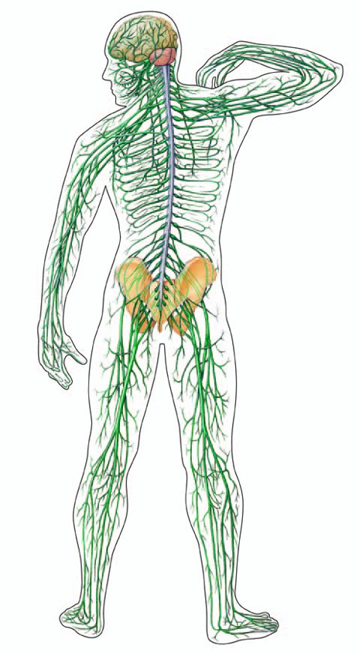
Nerves divide and divide
with ends reaching even the body’s most remote tissues.

Slide 14
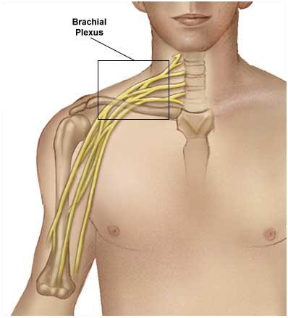
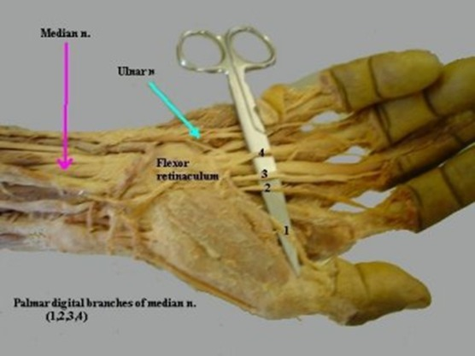
Plexuses
Some nerves, such as those that service the arm and hand, first converge in clusters called plexuses and then disperse to control fine motor movement.

Slide 15
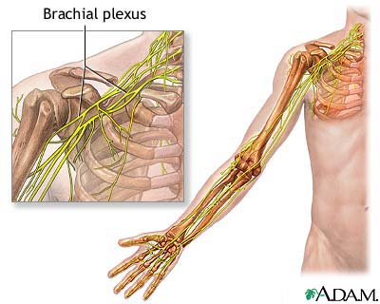
Brachial plexus
The brachial plexus is a group of nerves that begin in your neck and provide feeling and movement to the arms and hands.

Slide 16
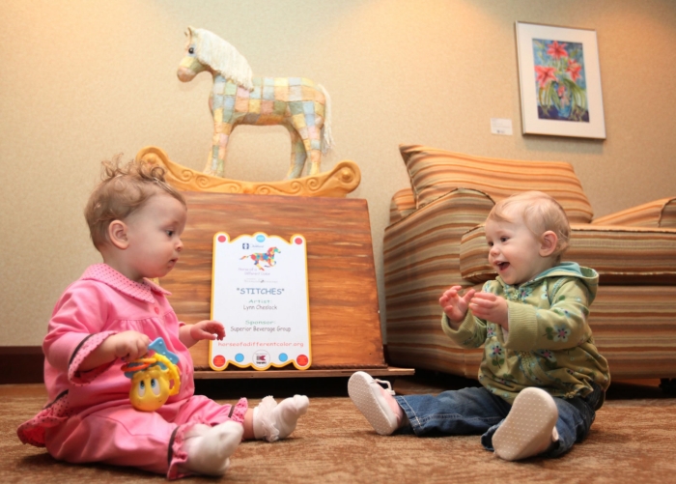
Brachial plexus
Think about how these nerves interact with the muscles of the arm to cause even the tiniest movement.

Slide 17
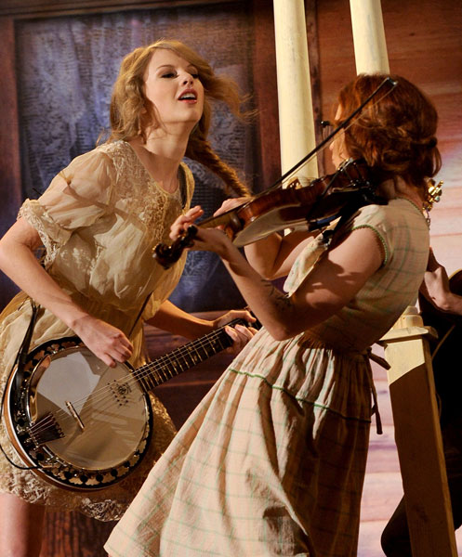
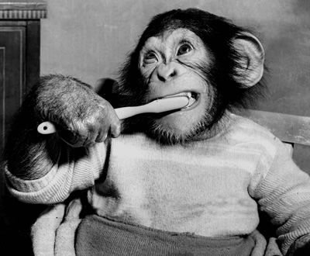

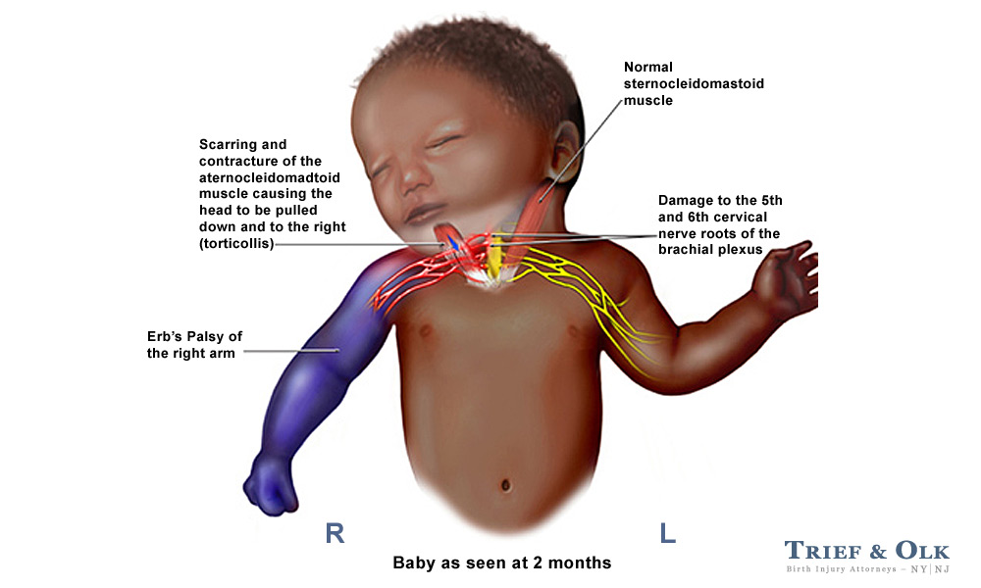
This coordination allows you to type, to play an instrument or even brush your teeth.

Slide 18
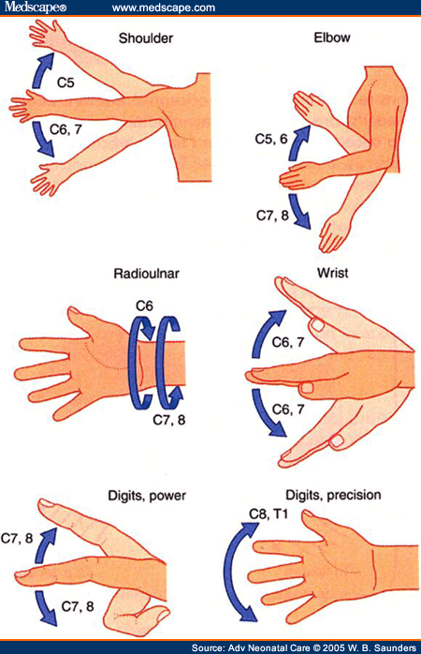
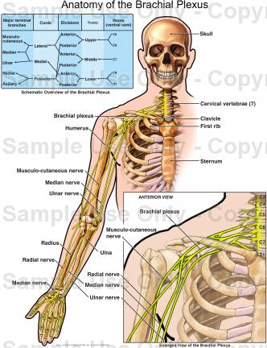
Your life would be very difficult if you could not move your digits or flex your wrists.

Slide 19
This Lesson
In this lesson, you will build the brachial plexus on your Maniken® and begin to attach the nerves of the arm. Visualize how this network of wires brings needed electrical stimulation to your muscles and see if you can figure out which types of muscles are controlled by each nerve you build.

Slide 20
View the muscles you have built on the arm of your Maniken®.
Remember that nerves usually do not travel on top of muscle, but rather between muscles or below muscle for maximum protection.
As you build, do not worry that the anatomy is perfect, but do take time to show the correct path of each nerve

Slide 21
View the diagram
Note the orientation of the brachial plexus. The main root looks like a sideways “V” followed by a line and then another sideways “V”. The connections hook up the nerves of the arm.

Slide 22
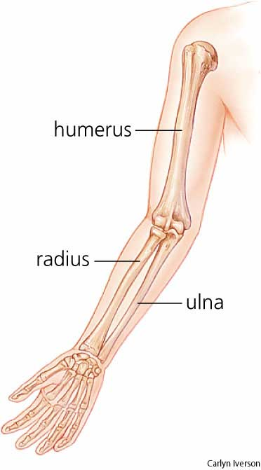
Ulnar nerve
Note that the first nerve you are going to build is the ulnar nerve. As the name implies, this nerve runs close to the ulna of the arm. Locate the ulna on your Maniken®.

Slide 23
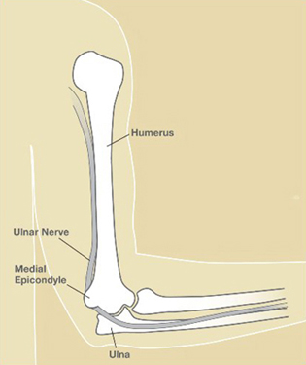
View the pathway of this nerve.

Slide 24
Preparing Clay
Use a clay extruder to create white or bone-colored clay spaghetti strands. Create two or three, two-foot strands and put them off to the side.
Create a small spaghetti strand about 6 inches long out of yellow clay. In this activity, you will create the nerve roots in yellow

Slide 25
Nerve root
Using the strand of yellow spaghetti, pinch off a piece approximately 1 ½ long.
Fold the piece into a “V” shape. One leg of the “V” should be slightly longer than the other. This “V” will represent the nerve root (the on and off ramp of the nerve) that forms the lower part of the plexus

Slide 26
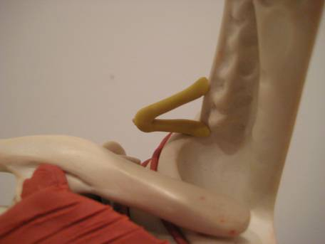
Locate the vertebrate on the neck and thorax of your model. Intervertebral foramen, or neural foramen, are openings between the vertebrate that allow the spinal nerves to extend to other parts of the body. Remember that we have seven cervical vertebrae followed by twelve thoracic vertebrae. These bones are referred to as C1 – C7, counting down from the top, followed by T1 - T12.
Connect the short leg of the “V” to C7 and the long leg to T1.
Point the “V” laterally away from the spinal cord.

Slide 27
Slip one end of a white spaghetti string up the armpit, under the clavicle and connect this string to the “V”. NOTE: Depending on which muscles you have built on your model, you may have to be creative when placing nerves.
If you have created too many muscles in the chest and shoulder area and cannot reach under the clavicle, simply connect a small piece to the “V” and then start another on the other side of the muscle. (Fake it! It will look like the nerve runs through your muscle!)

Slide 28
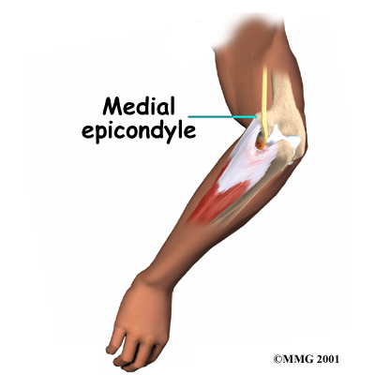
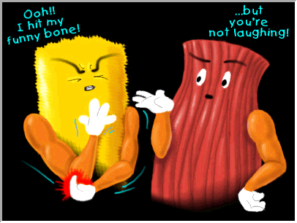
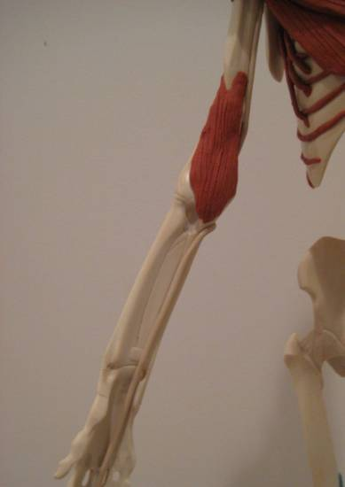
Drop the free end of the nerve down the arm. Press the nerve on the medial side of the humerus and take the strand down to the medial epicondyle (the bump near the elbow). Make sure the nerve notches around the bump. This is the nerve responsible for the sensation you feel when you hit your “funny bone”. Think about where you need to hit yourself to feel this sensation. Press the nerve gently onto the Maniken®.

Slide 29
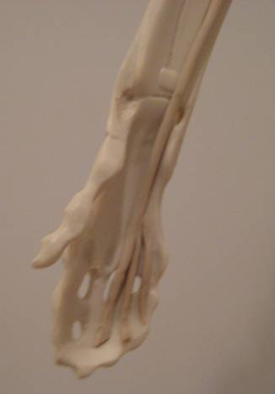
Note that the string from the dorsal elbow spirals to the ventral forearm along the ulna. Stop the nerve before it runs downs the middle finger.
Roll pieces of spaghetti out even thinner and use these small pieces to create digital branches of the ulnar nerve to the ring and little finger. Note the fingers that are fed by this nerve.

Slide 30
Clean up and then discuss these questions at your table:
Given the placement of the ulnar nerve, what type of forearm muscles do you think this nerve stimulates? Explain. HINT: What type of muscles is found on the ventral side of the body?
Explain how the placement of the ulnar nerve is linked to the pain and discomfort you feel when you bang your “funny bone.”
Answer them on your dry erase board.

Slide 31
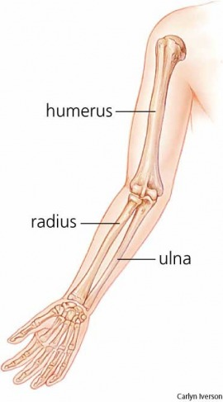
Day 2
Now work to build the radial nerve. As the name implies, this nerve runs close to the radius of the arm. Locate the radius on your Maniken®. Use your skeletal system organizer if needed.

Slide 32
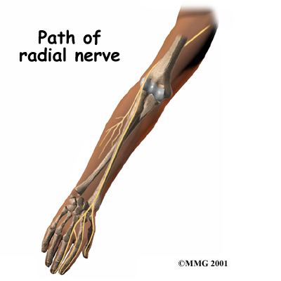

Slide 33
Note that the nerve root for the radial nerve is a bit more complicated than the root for the ulnar nerve.
This nerve has a very complicated system of on-ramps and off-ramps because it goes so many places.
Pinch off a two inch piece from a new white spaghetti strand.

Slide 34
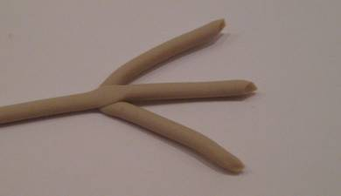
Form a “V” as you did for the ulnar nerve.
Place the end of the longer strand (the one you took the piece from) in the middle of the “V” you just made. Press down to connect the two pieces.
Make sure this piece now looks like the letter “W” or a bird’s foot with a long middle leg. This piece of clay represents the complex nerve root of the radial nerve. Lay this structure down on your desk.

Slide 35
Take a piece of yellow spaghetti that is only about 1 inch in length.
Connect this piece to the foramen of C6.
The end will extend laterally from the spinal cord.
Use a small piece of yellow spaghetti to form a small “V”- about the size of the “V” you created for the ulnar nerve.

Slide 36
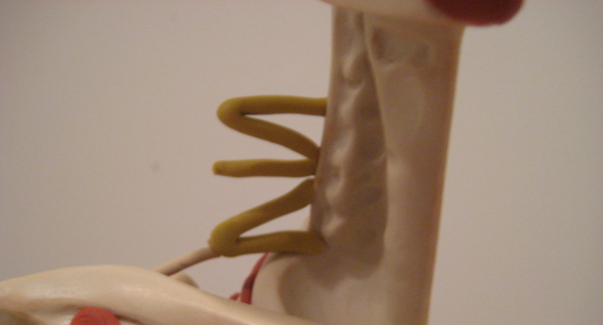
Place one end of the “V” in the foramen of C4 and the other in the foramen of C5. From top to bottom, you should now see a “V”, a single strand, and the ulnar root with the nerve attached to it coming from the side of the cervical region.

Slide 37
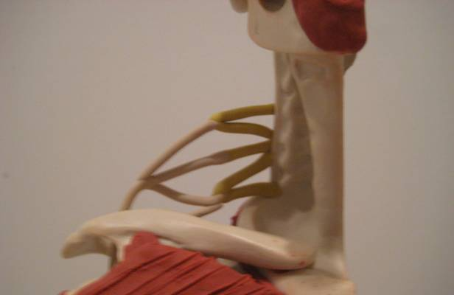
Pick up the strand with the “W” attached at its end.
Drop the free end under the clavicle and down through the armpit so the nerve is hanging down.
  Hook up the “W” to the nerve root at three different areas.
  The top end of “W” is attached to the V coming out of C4 and C5.
  The middle of the “W” is attached to the single strand leaving C6.
The last end is attached to the end of the V where the ulnar root is attaching (they share this nerve root!).

Slide 38
Grasp the nerve that is hanging down from the “W” you just attached
Refer to the diagram for the path of the nerve

Slide 39
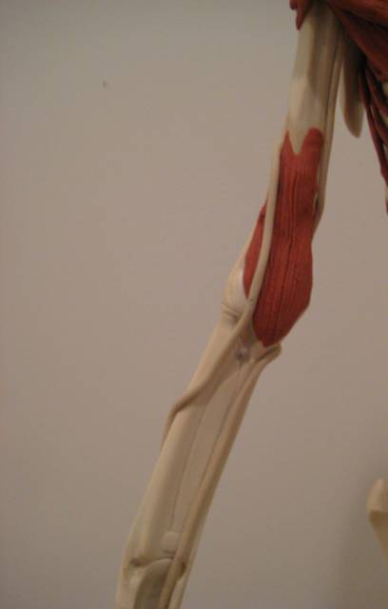
Move the nerve dorsally and wrap it around the humerus from the back to the front. Angle the nerve downwards towards the antecubital region (where they draw your blood).
Place the nerve through the antecubital region and stay on the medial side of the radius for about ¼ of the way down the radius.
When you are ¼ of the way down the radius, take the nerve over the radius and have it travel along the radius on the dorsal side.

Slide 40
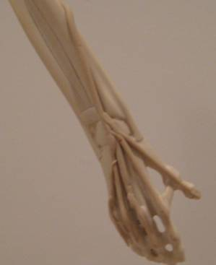
Upon reaching the wrist, branch the nerve to the tips of each digit on the dorsal side (opposite your palm). Use additional small spaghetti strings to form these nerves.

Slide 41
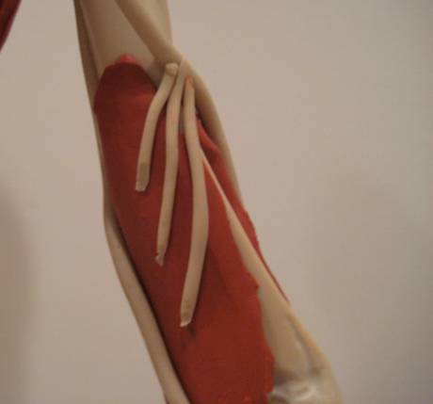
Use small white spaghetti strings to “wire up” the triceps medial head muscle on the model’s arm.
Branch these tiny strands from the radial nerve into the muscle.
As you add these nerves to the muscle, think about the direct connection between the nervous system and the muscular system.

Slide 42
Success check
Label and Draw an arm and trace in the placement of the ulnar and radial nerves.
You may need multiple views of the arm to provide a complete picture.

