Slide 1
MI
3.3.2

Slide 2
On dry erase boards
Make two columns titled VOLUNTARY, INVOLUNTARY
Under each, list as many processes in the body that you can think of that qualify as voluntary or involuntary.

Slide 3
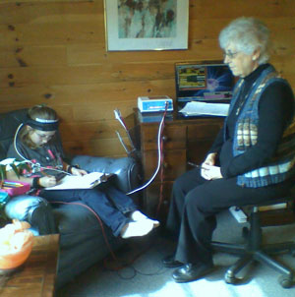
Read Introduction to 3.3.2

Slide 4
Read articles
Fill out 3-2-1
Get into group with others who read your article
Come up with three IMPORTANT IDEAS that you would like to share from your article

Slide 5
Be Mara’s oncologist
Explain to Mara how biofeedback therapy may be able to help her through her cancer treatments.
Mention the goal of therapy and describe how a typical session might work.
Write a script for what you would say to your patient.
Turn it in.

Slide 6
LOGGER PRO experiment
3.3.2 Logger Pro with Hand Grip Monitor
Follow all the steps 5-46
Copy all graphs to a word document
Due Thursday - All graphs, answer to conclusion question number 5 and…
Design an experiment to test the effectiveness of this approach in biofeedback therapy.
  How can this technique be utilized during and after the stress event?
  What should the patient focus on and what is the desired response?
  How could this method help a person when he or she feels their body begin to become stressed?
Due Friday -Write a detailed description of your experimental design.
  Discuss how you would gather and analyze data.
  You would not need to use data from all three probes, but you must justify your choice of indicators.

