Slide 1
MI
4.3.3

Slide 2

You will understand the difficulty in open and laparoscopic surgical techniques.
You will watch a video of surgical techniques, take notes and correctly answer conclusion questions 1-4.
Today –
Essential Question: How are organ transplant surgeries performed?

Slide 3
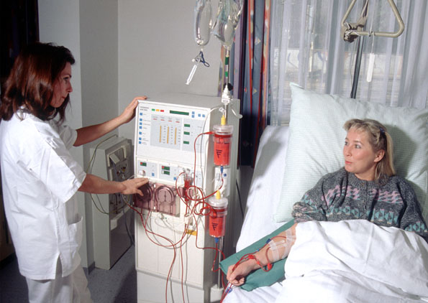
Intro
Diana Jones has been receiving dialysis treatments for the past six months.

Slide 4
Although these treatments have saved her life, she has been experiencing some complications common to dialysis patients..

Slide 5

Diana has been unable to work for the last three months due to extreme fatigue and joint problems.

Slide 6
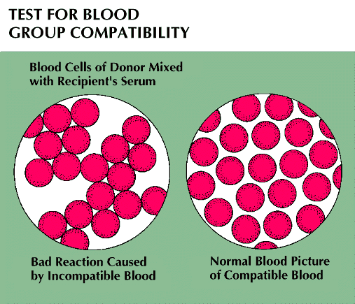
In the previous activity, you tested Diana’s family members and identified Louis, Diana’s brother, as a compatible donor.

Slide 7
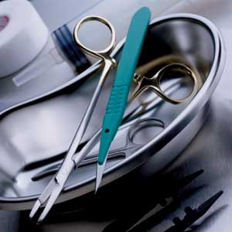
The surgery was initially scheduled for two months from now, but due to Diana’s complications, the hospital pushed up the surgery to happen as soon as possible.

Slide 8
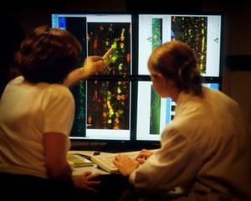
All pre-operative tests are complete, and it is now the day of the kidney transplant surgery.

Slide 9
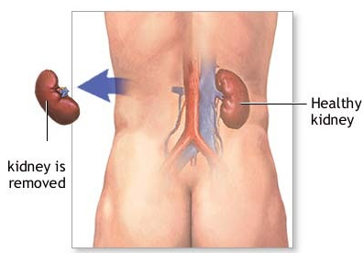
Live donor kidney transplants actually involve two separate surgeries: the first being a nephrectomy where the donor’s kidney is removed, and the second being the actual transplant where the kidney is implanted into the patient.

Slide 10
The transplant surgery begins today with Louis’s nephrectomy. Traditionally, nephrectomies have been extremely invasive surgeries that required a long incision, and sometimes a rib removal, to allow the surgeon to access the kidney, the corresponding blood vessels, and the ureter

Slide 11
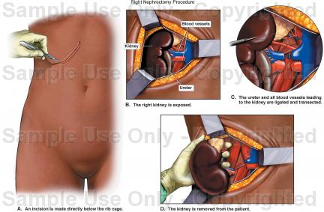

Slide 12
Advances in minimally invasive surgical techniques now allow the kidney from a living donor to be removed in a procedure called laparoscopic nephrectomy

Slide 13
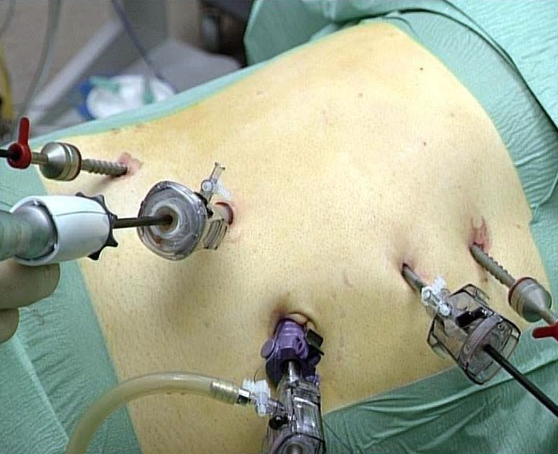
Laparoscopy is a minimally invasive surgical technique that uses small cylindrical tubes, called trocars, to enter the abdominal cavity.

Slide 14
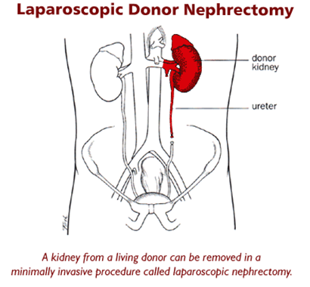

Slide 15
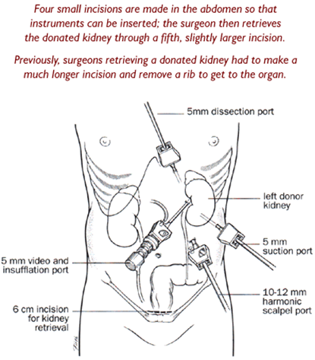

Slide 16
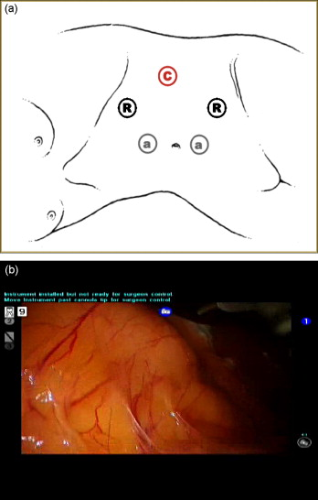
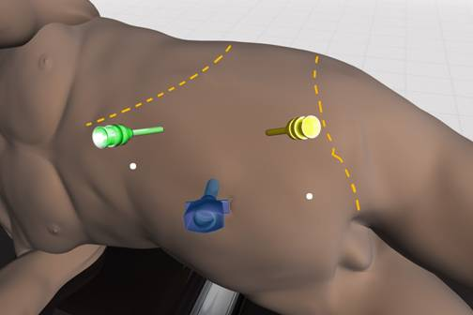
The trocars allow entry of a fiber-optic video camera, called a laparoscope, to view the inside of the abdominal cavity.

Slide 17
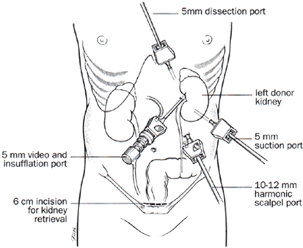
Smaller trocars are used to allow entry of the instruments necessary to perform the surgery

Slide 18
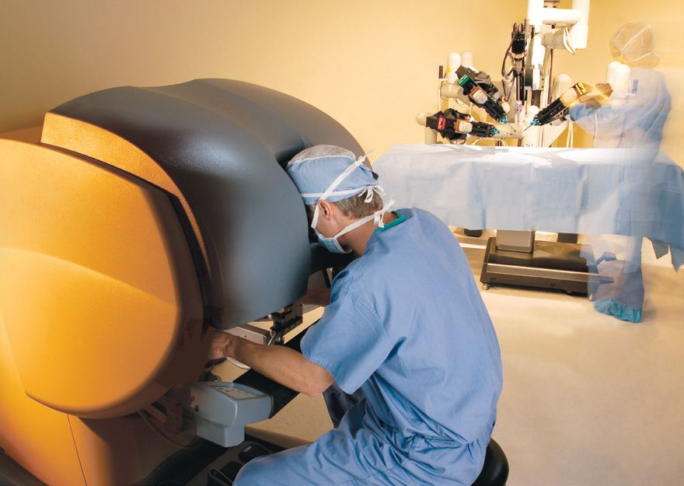
Laparoscopic nephrectomies, compared to traditional open nephrectomies, require less pain medication, shorter hospital stays, and a shorter time before the patient can go back to work.

Slide 19
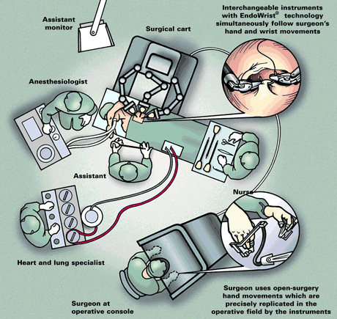
Louis has chosen to have a laparoscopic nephrectomy for his kidney removal surgery. In this activity, you are going to play the role of the laparoscopic surgeon.

Slide 20
You will begin by investigating the actual procedure and then explore the techniques necessary to perform a laparoscopic procedure.

Slide 21
Watch the video that you can link to in part 1. Stop the video as directed to take notes.
Answer conclusion questions 1-4, due Monday.

Slide 22

Template Provided By
www.animationfactory.com
500,000 Downloadable PowerPoint Templates, Animated Clip Art, Backgrounds and Videos

