Slide 1
Chapter 10 - Meiosis

Slide 2


I. Cell Reproduction
A. Two Types: Sexual and Asexual

Slide 3
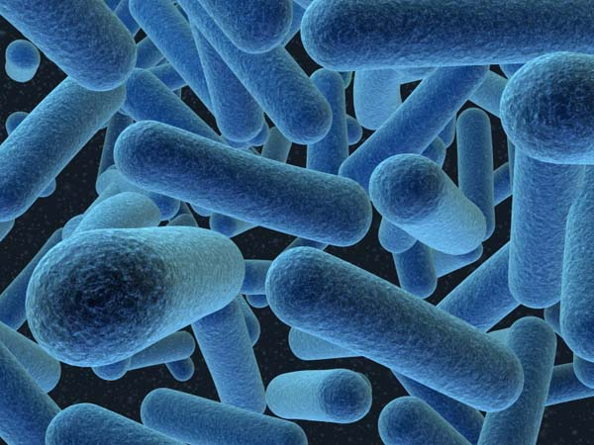
B. Asexual Reproduction
1. producing off-spring from 1 parent
2. produces an exact copy of the parent (why?)
3. occurs in simple plants and animals

Slide 4

C. Sexual Reproduction
1. involves 2 parent cells
a. if 1 organism has both male and female organs, it is called monoecious
b. if separate sexes, called dioecious

Slide 5
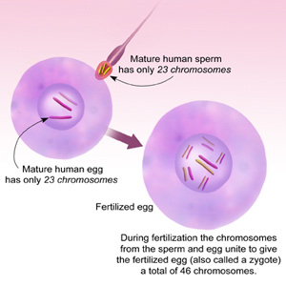
2. sexual reproduction involves the union of 2 cells
3. these cells are called gametes (sex cells)
a. male gametes are called sperm
b. female gametes are eggs
c. egg + sperm = zygote

Slide 6
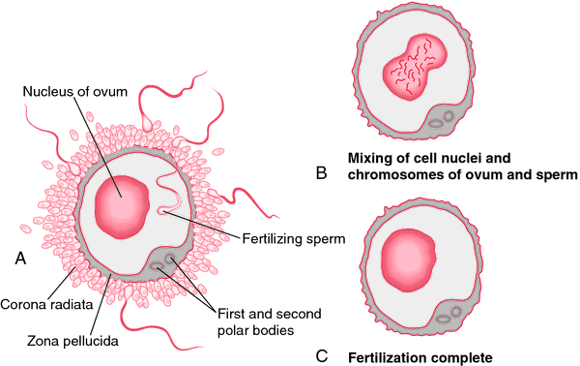
4. process of 2 gametes combining is called fertilization
5. fertilized egg is called a zygote

Slide 7
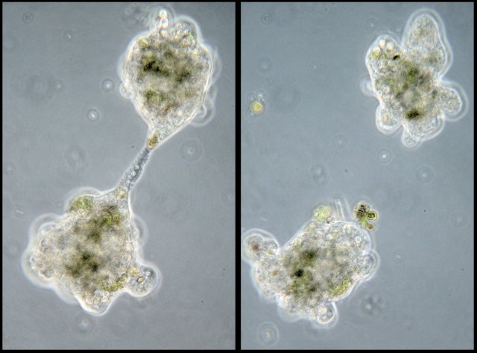
Types of Asexual Reproduction
A. fission – parent cell splits into 2 daughter cells
Amoeba fission

Slide 8
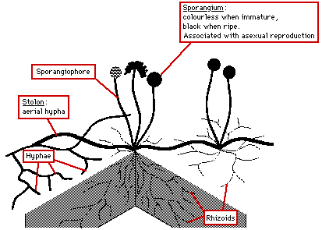
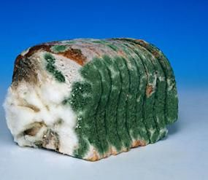
B. Spores – small asexual reproductive cells with a thick protective coat (ie. Bread mold)

Slide 9
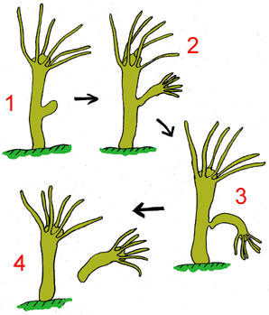
C. budding – cell forms a bud or knob which falls off
1. this often occurs in multicellular organisms
2. example is the hydra

Slide 10
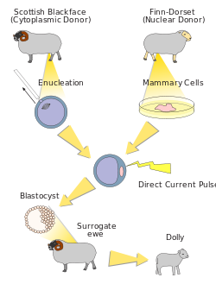

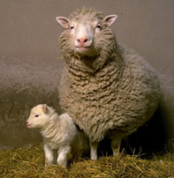
D. Cloning – when 1 cell multiplies and becomes an organism

Slide 11
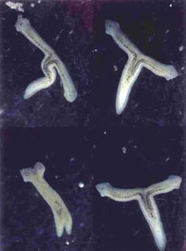
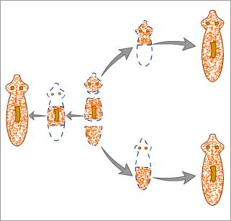
E. Regeneration – ability to replace lost parts
1. starfish
2. planaria

Slide 12
Complete Self-Check on the bottom of page 10-1 and in the middle of 10-2
10-1: What is the main difference between sexual and asexual reproduction at the cellular level?
10-2: What would be the benefit for an organism that used asexual reproduction?

Slide 13
III. Meiosis
A. Chromosome number
1. Each body cell (somatic cell) contains 2 sets of chromosomes, 1 set from each parent
23
46
23

Slide 14
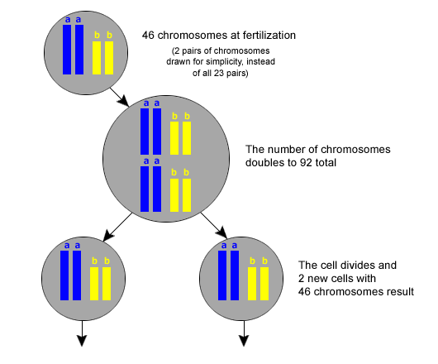
2. because they contain double sets the cells are called diploid in number
a. n = # of chromosomes
b. diploid (# found in somatic cells) = 2n

Slide 15
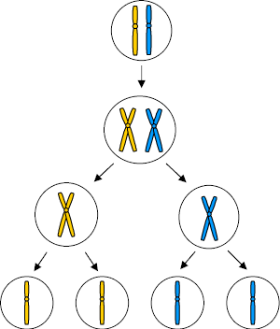
3. A single set of chromosomes (1 of a pair) is called the haploid # = 1n or n
Haploid (n) cells

Slide 16
4. in humans:
a. body cells contain diploid # of chromosomes
b. gametes contain haploid # of chromosomes
i. diploid # = 46 (23 pairs)
ii. haploid # = 23

Slide 17
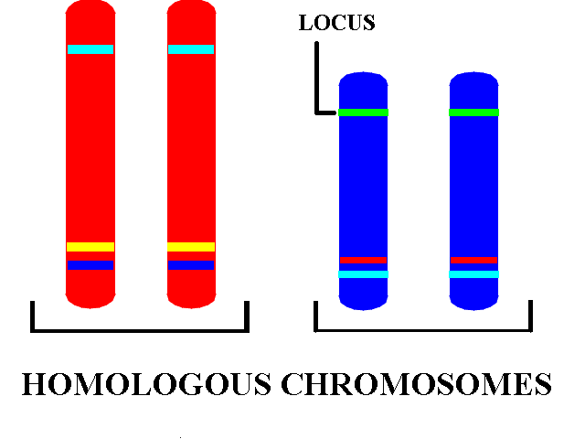
5. the matching chromosome pairs in a diploid cell are called homologous chromosomes

Slide 18

B. Sexual Reproduction/Chromosome #
1. ovary (2n) egg (n)
2. testes (2n) sperm (n)
3. egg + sperm Zygote
(n) + (n) (2n) (haploid + haploid) diploid

Slide 19
4. Process by which diploid cell (2n) becomes a haploid cell (n) is called meiosis
5. Meiosis occurs in all sexually producing organisms
6. Meiosis occurs in ovaries and testes in production of eggs and sperm

Slide 20
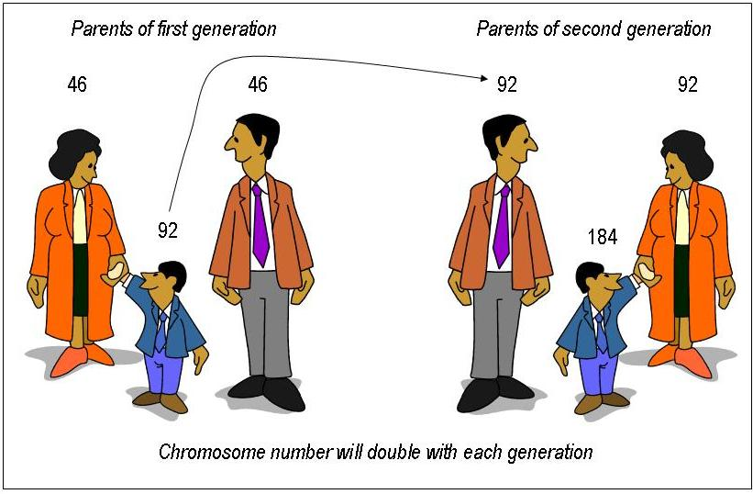
So, why meiosis?

Slide 21
IV. Meiosis/Spermatogenesis and Oogenesis
A. Spermatogenesis = the making of sperm
B. Oogenesis = the making of eggs

Slide 22
Meiosis takes a diploid cell (2n) and replicates the chromosomes to give a tetraploid cell (4n)
1. these 4n cells divide 2 times to give 4 cells with n chromosomes
2. the 2 stages of cell division are distinguished by Roman numerals I and II

Slide 23
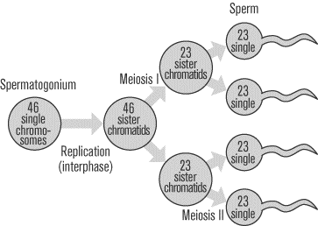
V. Differences between Spermatogenesis and Oogenesis
A. Spermatogenesis results in 4 functional gametes (sperm)

Slide 24
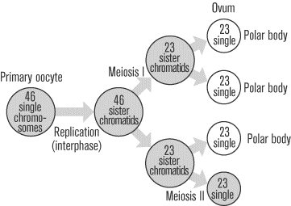
Oogenesis results in 1 functional gamete (egg) and three non-functional haploid cells called polar bodies.
1. the egg is larger because it contains food
2. the polar bodies die

Slide 25
Step by step Meiosis

Slide 26
VI. Stages of Meiosis (IPMAT I and IPMAT II)
A. First half
1. Interphase I – chromatin replicates (4n)
2. Prophase I – homologous chromosomes pair

Slide 27
3. Metaphase I – chromosomes line up in the middle
4. Anaphase I – homologous chromosomes separate
5. Telophase I – cell divides into 2 cells, each cell has 1 pair of homologous chromosomes

Slide 28
B. Second half
1. Interphase II – NO REPLICATION
2. Prophase II – chromosomes appear
3. Metaphase II – chromosomes line up in the middle (single file like in mitosis)
4. Anaphase II – chromatids separate
5. Telophase II – cell divides and the result is 4 cells(n)

Slide 29
VII. Differences between meiosis and mitosis

Slide 30
A. Mitosis –
B. Meiosis –
C. Mitosis
D. Meiosis
E. Mitosis occurs in
F. Meiosis occurs in

Slide 31
VIII. After Meiosis

Slide 32
A. Review of Meiosis
1. in oogenesis, one egg is formed
2. in spermatogenesis, four sperm are produced

Slide 33
B. Fertilization
- the egg and sperm unite to produce a zygote (2n)

Slide 34
C. The zygote
1. starts as
2. cell numbers

Slide 35
IX. Differentiation – making the cells different from each other

