Slide 1
Mendel
The Father of Genetics

Slide 2
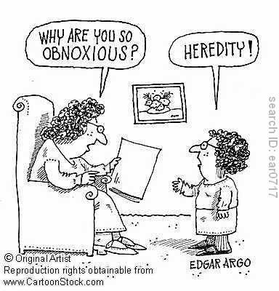
Genetics – Science of heredity
Heredity – how traits are passed on from parent to offspring from generation to generation

Slide 3
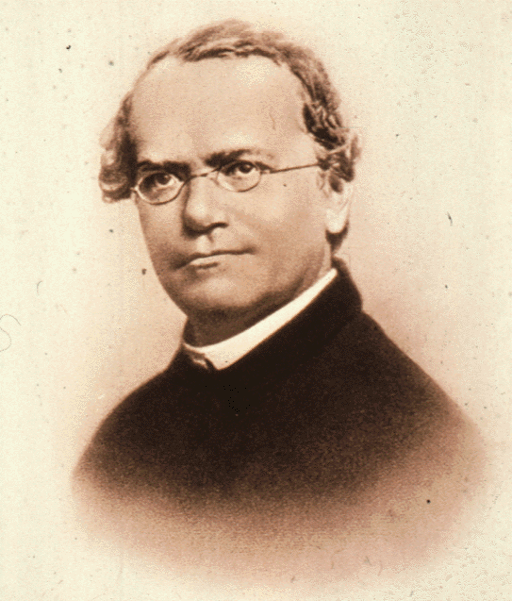
Gregor Mendel (1822 – 1884)
1. Father of “genetics”
2. Austrian monk in the 1800’s – worked w/pea plants

Slide 4
3. Why garden peas?
reproduced by self-pollination
has 7 different traits (ie. Tall vs Short)
His experiments led to 4 Laws
Mendel’s discovery clip

Slide 5
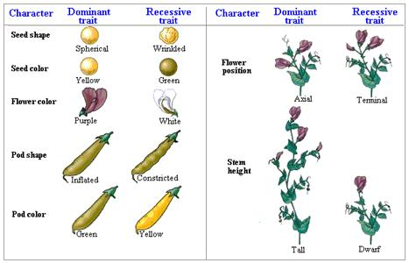

Slide 6
Fundamental Laws of Heredity:
Law of Unit Characters:
a. traits are controlled by “factors”
called genes
b. for every trait you have 2 genes
(1 from each parent)

Slide 7
Fundamental Laws of Heredity:
Law of Dominance:
a. one of the gene pair can mask the other
b. the allele that masks is called the dominant gene
c. the gene being masked is called recessive

Slide 8
Fundamental Laws of Heredity:
Law of Segregation:
During the formation of gametes (meiosis) each gamete receives only one gene of a pair. (they split chromatid from chromatid)

Slide 9
Fundamental Laws of Heredity:
Law of Independent Assortment:
Chance is involved and determines which allele a gamete will receive

Slide 10
Chant Review – “Here’s the news, they come in twos. They segregate. It’s up to fate. If an egg and a sperm has a trait that will dominate.”
Laws
Unit Characters
They come in twos.
Dominance
If an egg and a sperm has a trait that will dominate.
Segregation
They segregate.
Independent Assortment
It’s up to fate.

Slide 11
V. Incomplete Dominance vs. Complete Dominance
A. Complete dominance
1. one gene completely hides the other
2. ex. T covers up t making the plant tall

Slide 12
B. Incomplete dominance
1. dominant and recessive blend
2. there is NOT one allele that
overpowers the other
(Allele – form of a gene)

Slide 13
3. Ex. 4 o’clock flowers
RR = Red WW = White RW= Pink
Red Flower X White Flower

