Slide 1
Human Genetics
Chapter 11

Slide 2
I. Pedigree
A. What is it? A chart that shows heredity
B. Symbols
1. Female –
2. Male –

Slide 3
3. If the symbol is:
a. completely shaded – homozygous, usually
recessive (ie. bb)
b. ½ shaded – heterozygous,
ie. Bb
c. not shaded – homozygous, usually dominant, ie. BB

Slide 4
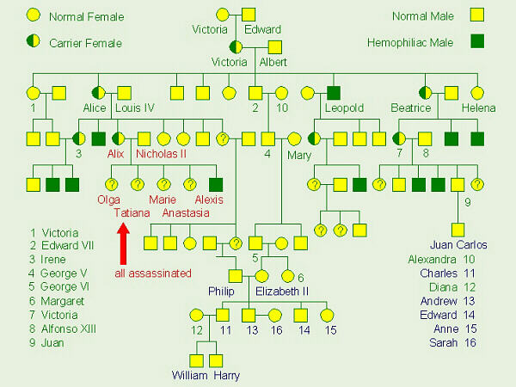

Slide 5
4. line connecting and is called the marriage line

Slide 6
5. line extending down from this is called the children’s line – twins are indicated by 2 offshoots of one line

Slide 7
6. line through the individual indicates a deceased individual

Slide 8
C. Directions for pedigree making
1. Place a descriptive heading above each
2. Make a circle – square for family
a. father on the left, mother on the right
b. siblings oldest (left) to youngest (right)

Slide 9
3. Number the generations – roman numerals, on the right side
4. Number the individuals – start over for each generation, place below the symbol (# children first then spouses)

Slide 10
5. Shade in the symbols which show recessive traits
6. Determine the rest of the genotypes the best you can – write below the symbol, next to the individual #

Slide 12
II. Multiple Alleles
A. Rather than having just two types of alleles like tall (T) and
short (t), there are several different forms of a gene

Slide 13
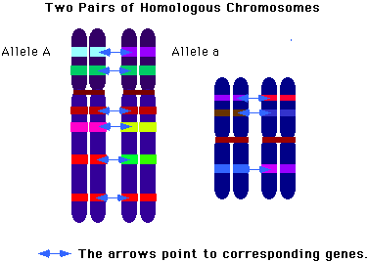
B. Recall that alleles are different forms of a gene

Slide 14
C. A classic example: Human blood types
1. three alleles for blood are possible – A, B, O

Slide 15
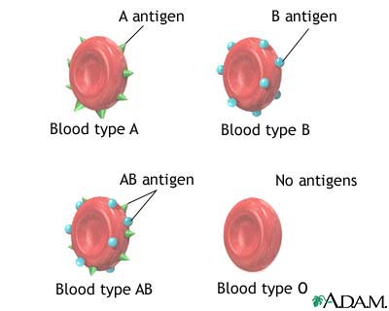

Slide 16
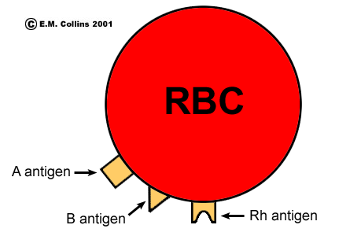

Slide 17
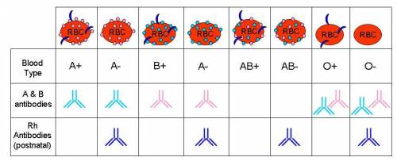
B-

Slide 18
2. Both A and B are dominant over O
six genotypes possible –
AA, BB, OO, AO, BO, AB
four phenotypes possible –
A, B, O, AB

Slide 19
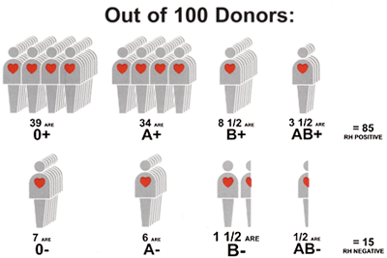
O = universal donor,
AB = universal recipient

Slide 20
6. here’s how:

Slide 21
Explain which type of blood might be considered a “universal
donor” and why. None of the blood types changed color when O was added.
Explain which type of blood might be considered a “universal recipient” and why. AB did not change color when any other blood type was added.
3. What makes blood different types – in other words, what about the cells is different? The antigens or proteins on the outside of the red blood cells are different (and O has none). Also, antibodies are different.
What would happen to the cells if the wrong types of blood were mixed? The blood cells would stick together because of the antibodies
5. Summarize which types of transfusions would be safe for the following:
type A receiver – A and O
type B receiver – B and O
type AB receiver – A, B, AB and O
type O receiver – O

Slide 23
III. Multiple Genes – Polygenic
A. This is when more than one gene pair determines a phenotype
B. Polygenic inheritance is the term that is used to describe traits determined by multiple genes

Slide 24
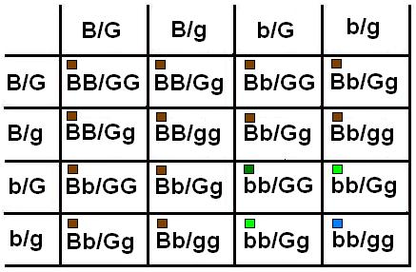
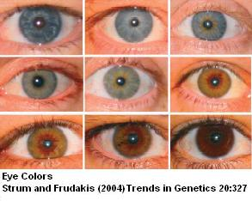
C. Example: eye color, hair color and skin color

Slide 25
One cute, easy-to-see example of a polygenic trait is the inheritance of fruit color in bell peppers, and it is a bit analogous to the human traits just named. There are at least three genes involved here, which we'll abbreviate as:
* Y - timing of chlorophyll elimination (Y - early; y - normal)
* R - color of carotenoids (R - red; r - yellow)
* C - regulation of carotenoid deposition
(C - normal; c1, c2 - lowered concentration)
(The capital letters indicate the dominant alleles; the lower case indicate various versions of recessive alleles.)
This leads to a few possible genotypes producing interesting phenotypes:
o Y- rr c1c2 - pale yellow
o Y- rr Cc2 - darker yellow
o yy rr CC - green
o Y- R- CC - red
o yy Rr CC - purple
o Y- Rr Cc2 - pale yellow http://en.allexperts.com/q/Biology-664/2009/9/Hair-eye-color-inheritance.htm

Slide 26
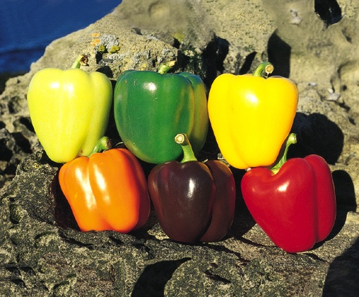

Slide 27
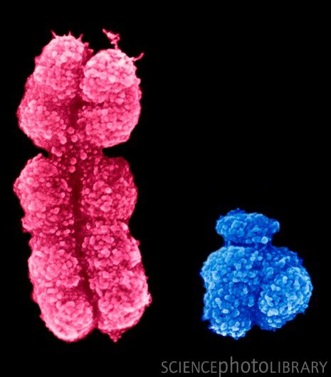
The Sex Chromosomes
X chromosome – rod shaped
Y chromosome – hook shaped

Slide 28
Each egg has one X chromosome
Each sperm has either an X or a Y
XX
XY
Meiosis
Meiosis
X
X
X
X
X
Y
X
Y

Slide 29
The chromosomes that determine the sex of an individual are called
the sex chromosomes
The other chromosomes are called the autosomes

Slide 30
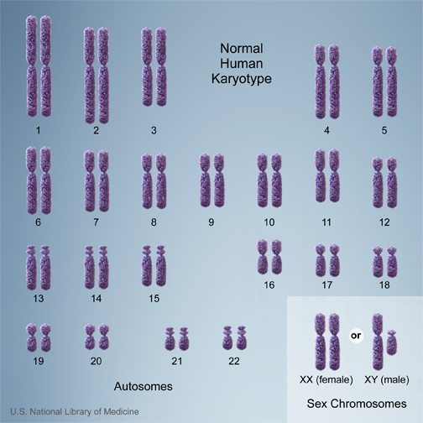

Slide 31
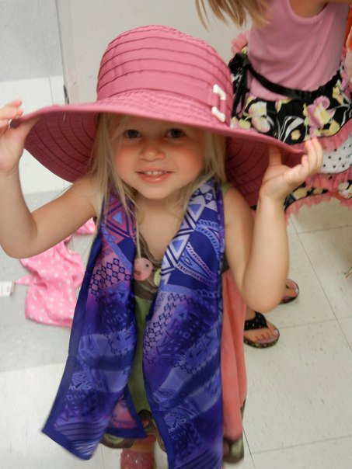
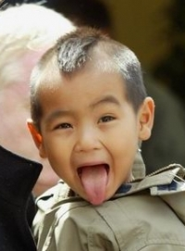
Fertilization drawing (sex chromosomes)
X
XX
X
X
XY
Y

Slide 32
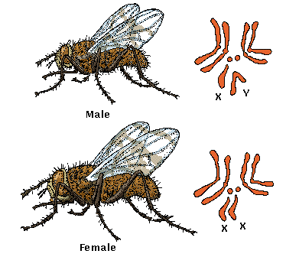

Slide 33
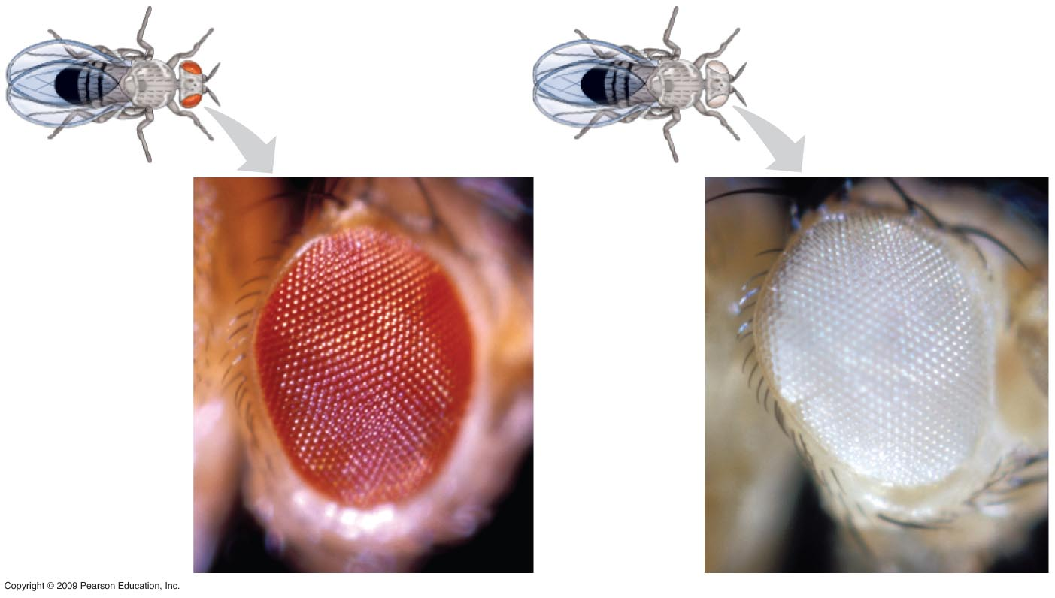
Red eyed fruit flies X white eyed fruit flies
Known: Red eye color (R) is dominant over white eye color (r)
Morgan crossed a white eyed male with a red eyed female

Slide 34
Morgan crossed a white eyed male with a red eyed female
So…here’s how those genotypes are written:
Female: X^{R}X^{R} and Male: X^{r}Y

Slide 35
F₁ Generation:

Slide 36
F₁ Generation – All red eyed
Punnet Square:
X^{r}
Y
X^{R}X^{r} | X^{R}Y
X^{R}X^{r} | X^{R}Y
X^{R}
X^{R}

Slide 37
Next allow F₁ generation to mate (to make F₂ generation):
Predicted Punnet Square:
X^{R} Y
X^{R}X^{R} X^{R}Y
X^{R}X^{r} X^{r}Y
X^{R}
X^{r}
Resulting F2 generation gave a
3 red eyes:1 white eye ratio

Slide 38
Surprisingly all of the F2 flies with white eyes were male
Why were there no females with white eyes?

Slide 39
Conclusion: The alleles for eye color are carried only on the X chromosome.
This type of trait is called sex-linked.

Slide 40
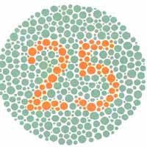
Examples of human Sex-linked traits:
1. Red-Green Colorblindness

Slide 41
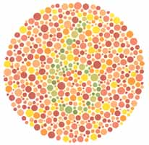

Slide 42
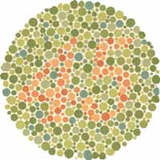

Slide 43
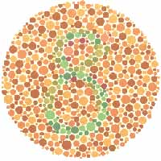

Slide 44
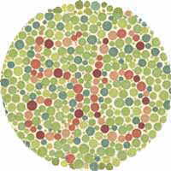

Slide 45
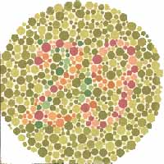

Slide 46
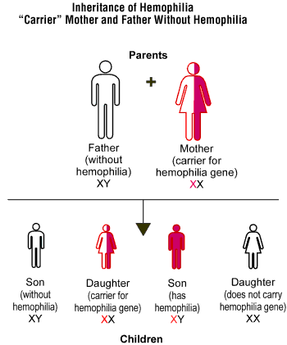
2. Hemophilia

Slide 47
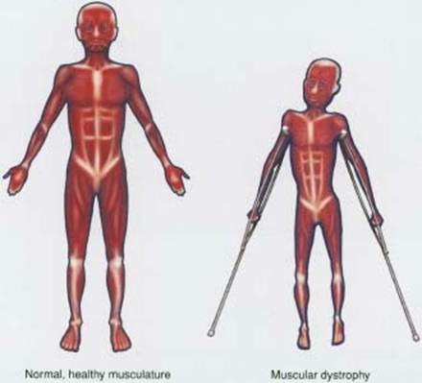
3. Duchenne’s Muscular Dystrophy

Slide 48
For most sex-linked traits, there are no alleles found on the Y chromosome

Slide 49
Draw sex linked trait punnet squares:
normal vision = X^{C} colorblindness = X^{c}
Cross a normal vision male with a colorblind female

Slide 50
Normal = X^{N} Duchenne’s = X^{n}
Cross a carrier female and a normal male

Slide 51
Since males have only one X chromosome – any allele present will be expressed. How can the recessive alleles be expressed in females?

Slide 52
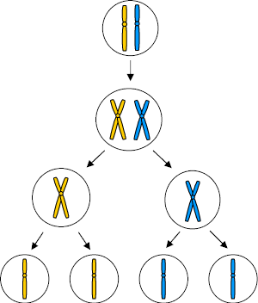
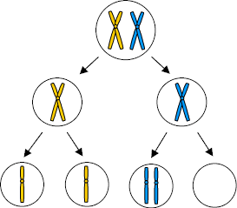
Nondisjunction – chromatids stick together in meiosis (results in trisomy or monosomy)

Slide 53
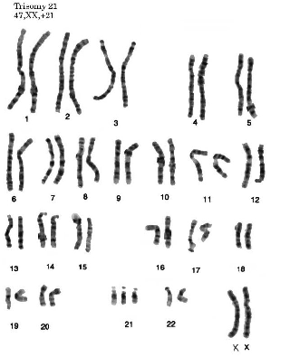

Slide 54
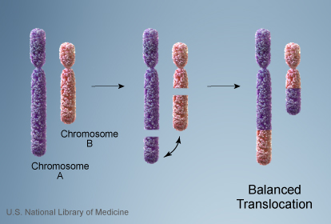
Translocation – a piece of one chromosome breaks off and joins another

Slide 55
