Slide 1
March 23, 2012
What does it mean to transcribe something?
What does it mean to translate something?
To record a copy of some piece of information.
To take information and change it into a new form.

Slide 2

Learning Target:
Understand how the genetic information stored in DNA is used to create the thousands of proteins that each cell requires to function.

Slide 3
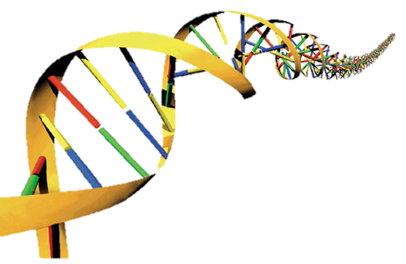
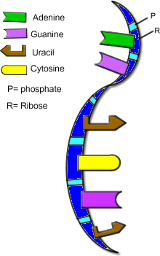
I. Review: Types of Nucleic Acids
A. DNA
B. RNA

Slide 4
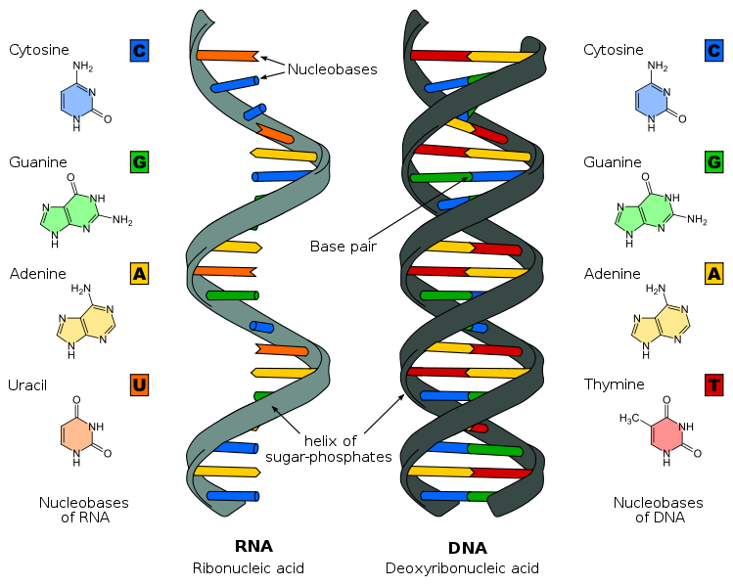
B. RNA
1. location – inside the nucleolus OR in the cytoplasm
2. structure of RNA –
a. single stranded

Slide 5
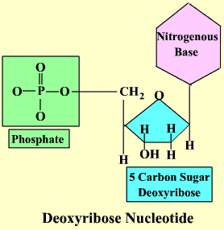
b. nucleotides – composed of 3 parts:
i. phosphate
ii. sugar – ribose
iii. nitrogen bases – Adenine – A
Guanine – G
Cytosine – C
Uracil – U
instead of Thymine (T)

Slide 6
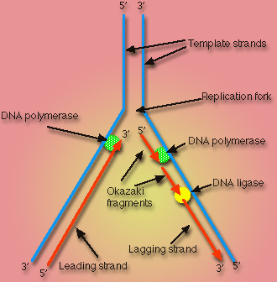
II. Replication of DNA (review)
A. DNA makes an exact copy of itself
B. DNA uncoils, unzips, and makes a copy of itself

Slide 7

Medical Transcriptionist

Slide 8
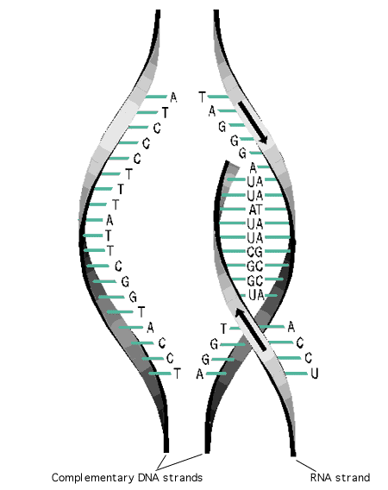
III. Transcription of DNA – rewriting
A. Process in which DNA gives the “recipe” to RNA
-process in which DNA make a ***similar***copy to itself

Slide 9
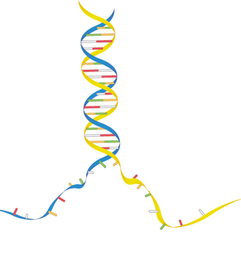
B. Steps in transcription:
1. H bonds break
2. ladder unzips → 2 halves

Slide 10
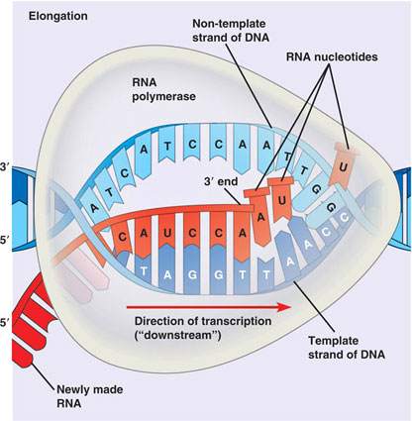
3. bases (nucleotides floating around in the nucleus form 1 stranded mRNA)
a. mRNA – messenger RNA
b. mRNA carries the information from the nucleus and DNA to the site of protein synthesis (called ribosomes)
c. called mRNA because it carries a message (recipe)

Slide 11
Transcription and Translation
Video Clip

Slide 12
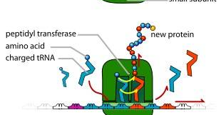
IV. Translation
A. Translation takes place after transcription
B. Translation is the process of connecting a.a. together to make
proteins

Slide 13
C. Steps of Translation:
1. after the DNA has been transcribed into mRNA, the mRNA pairs up with rRNA
a. rRNA is different from mRNA
b. rRNA = ribosomal RNA
c. rRNA has three sites, an A site, a P site, and an E site

Slide 14
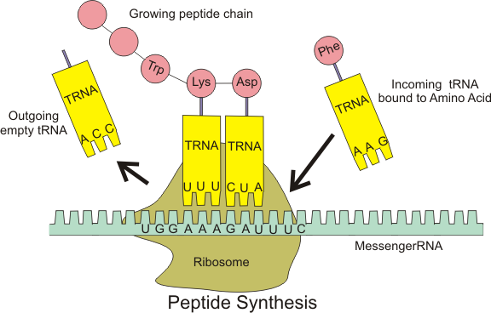
2. as soon as mRNA and r RNA are paired, the message or “recipe” is read
a. the message is always read in groups of three at a time
ex. AAG UAC CUU
b. these groups of three are called CODONS

Slide 15
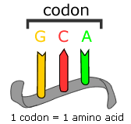
3. Codons
a. Code is carried in groups of 3 bases called triplet codons
b. there are 64 possible 3 letter codes using A,G,U,C
c. These 64 codes, like AAG, are coding for amino acids
d. 20 amino acids w/64 codes, therefore many amino acids have more than 1 code

Slide 16
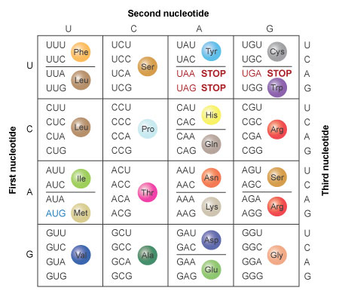
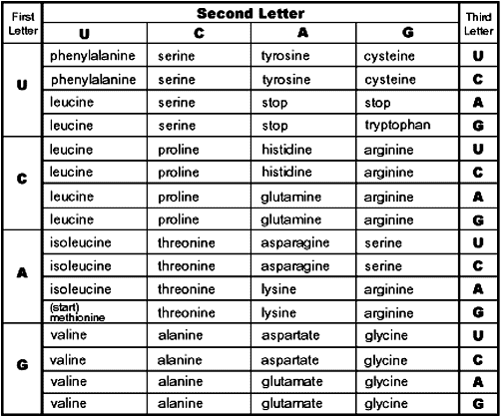

Slide 17
e. There are also start (methionine) and stop codons that signal the beginning and end of each polypeptide chain
f. A chart is used to determine a.a. (see Chart – page 204 or notes)

Slide 18
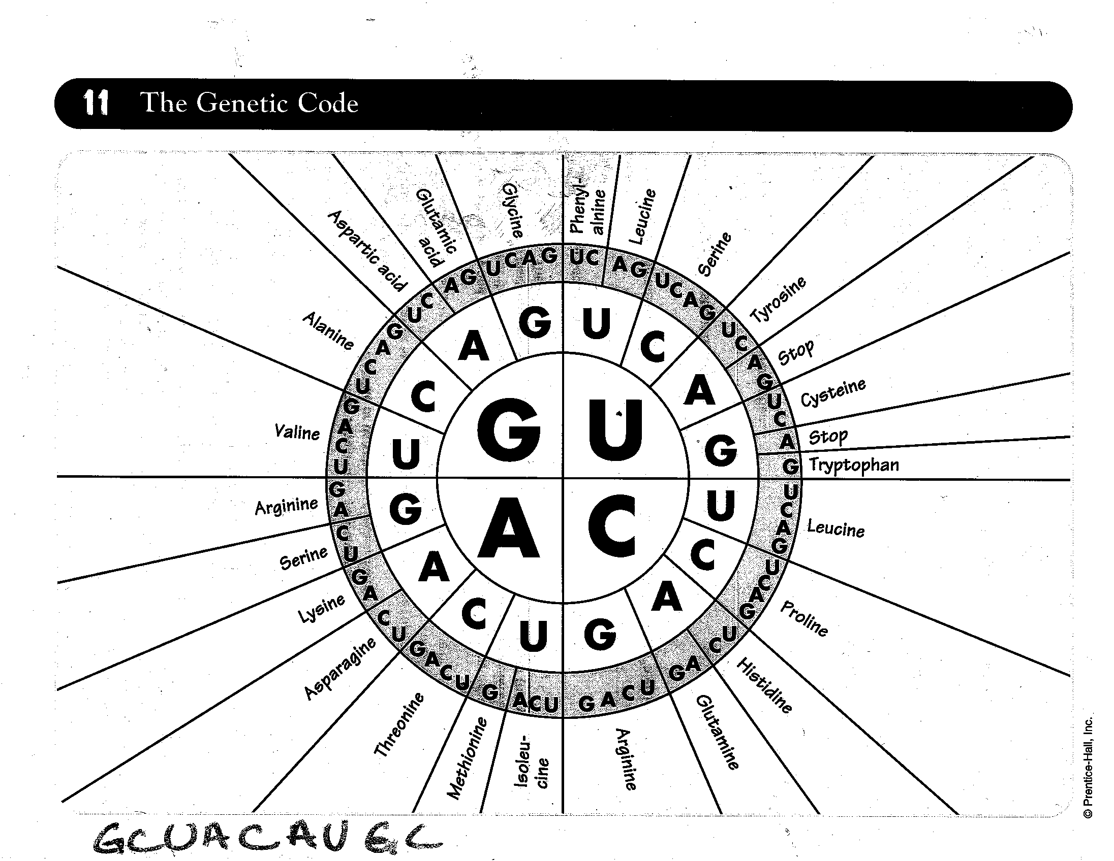

Slide 19
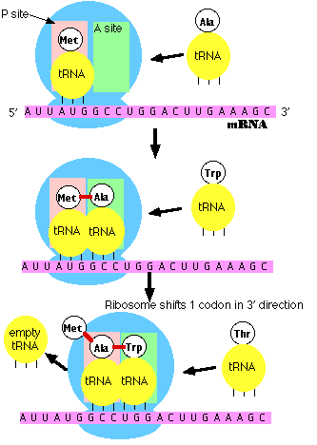
4. as the codons are being read from the mRNA, it “advertises” for its base pair codon
a. these base pairs are called ANTICODONS
b. anticodons are carried by yet another type of RNA called tRNA
c. tRNA = transfer RNA

Slide 20
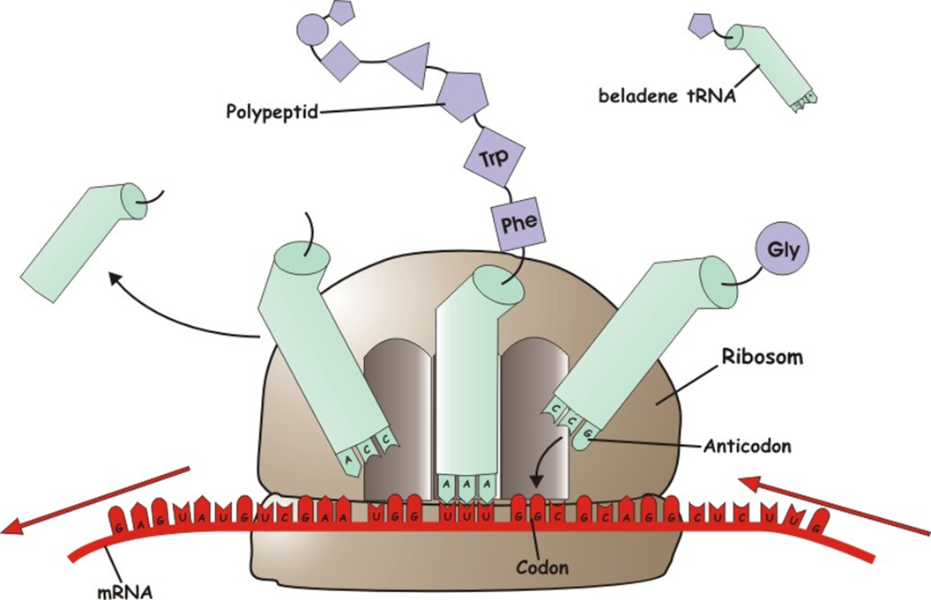
5. tRNA carries with it a particular amino acid

Slide 21
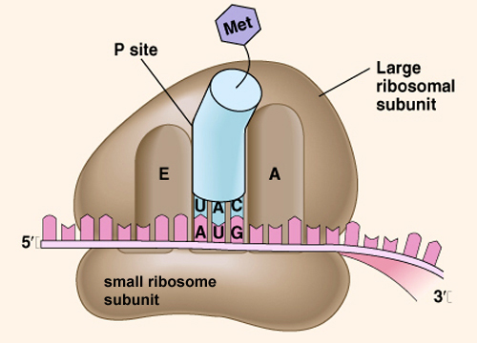
6. as the tRNA moves from the A site to the P site, the a.a. are connected by peptide bonds

Slide 22
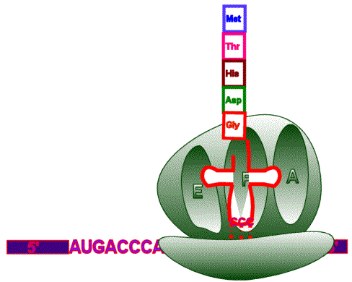
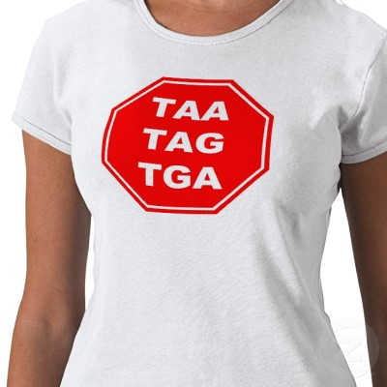
7. when the stop codon is reached that signals the end of the protein

Slide 23
Transcription and Translation
Video Clip

