Slide 1
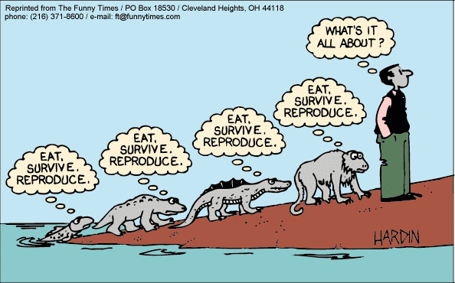
Chapter 15 - Evolution
Reading Guide Discussion/Notes
Pages 423-427

Slide 2
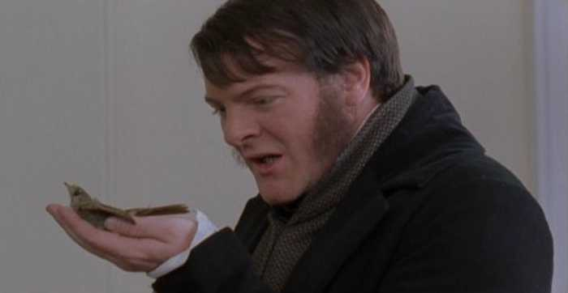
Darwin’s Dangerous Idea

Slide 3
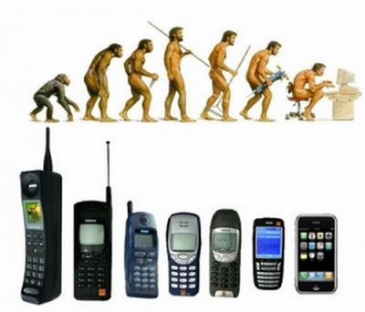
1. What is the definition of evolution?
Change over time

Slide 4
2. The Earth is now thought to be at least 3.8 billion years old. In Darwin’s day, how old did they believe the Earth to be and why do you suppose this belief would make it hard for them to accept Darwin’s ideas about evolution?
They believed the earth was 6,000 years old.
That made the people of Darwin’s day wonder how things could change in such a small amount of time.
How could fossil evidence be explained?

Slide 5
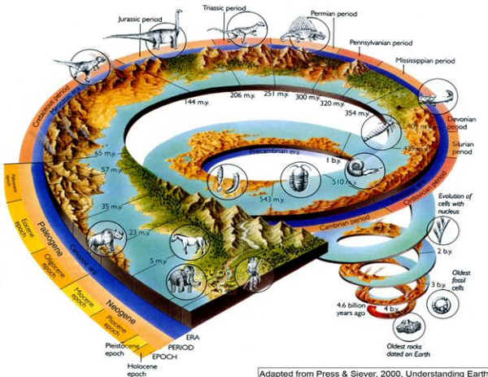

Slide 6
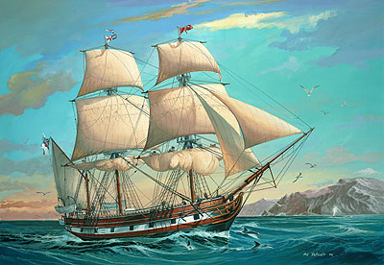
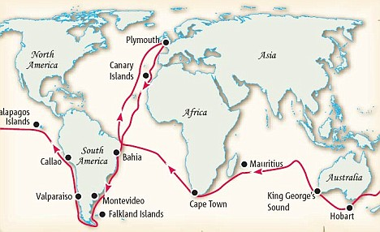
3. The name of the ship that Darwin sailed on was called:
H. M. S. Beagle

Slide 7
4. What was Darwin’s role on the ship he sailed on?
Darwin was a naturalist and a companion to the captain
He collected different specimen from where ever they went…birds, fossils, plants, etc.

Slide 8
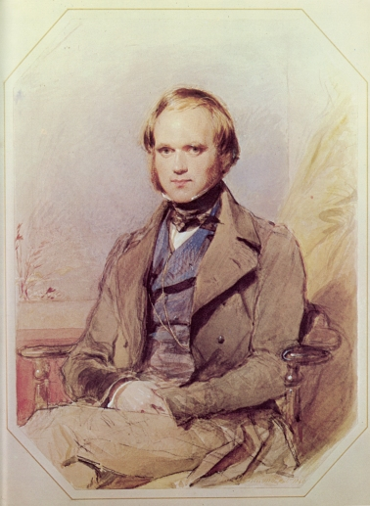
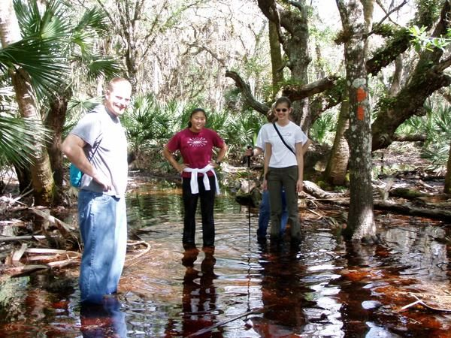

Slide 9
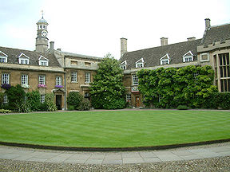
5. Was Darwin qualified to do the role mentioned in #3? Why or why not?
Yes/no
Yes, he had studied medicine and had a science background
No, he had a degree in theology (religion)

Slide 10
6. How might reading Charles Lyell’s book, Principles of Geology, impact Darwin’s thinking?
It suggested that the earth was older than 6,000 years old.
Volcanoes, U-shaped valleys

Slide 11
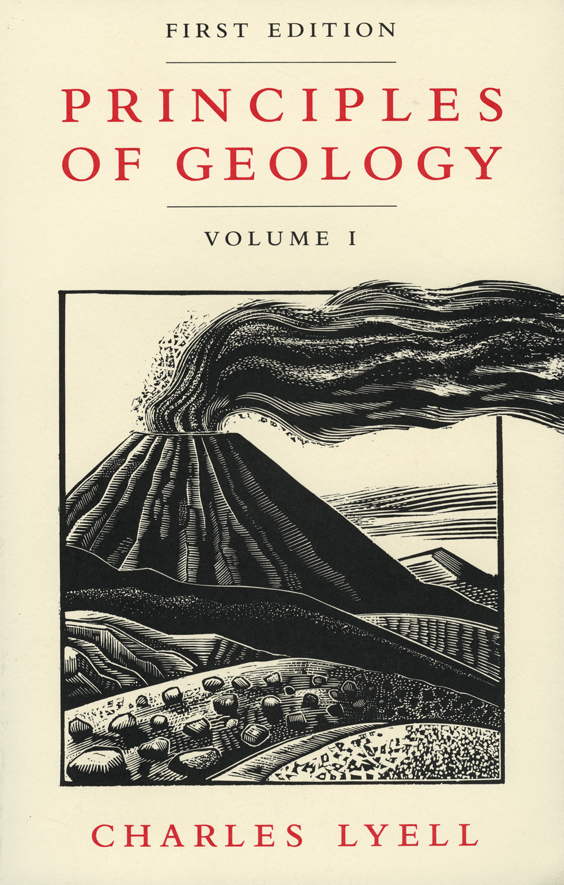
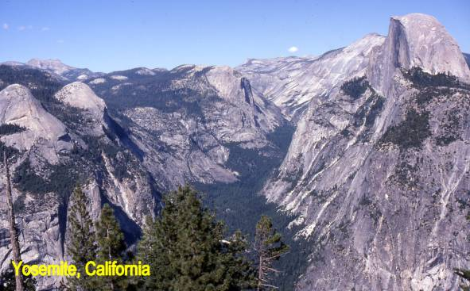

Slide 12
7. When Darwin looked into John Gould’s findings with the finches that he had collected from the Galapagos, what clues did he find that was leading him to understand evolution?
The finches were all different species
These finches were only found in the Galapagos

Slide 13
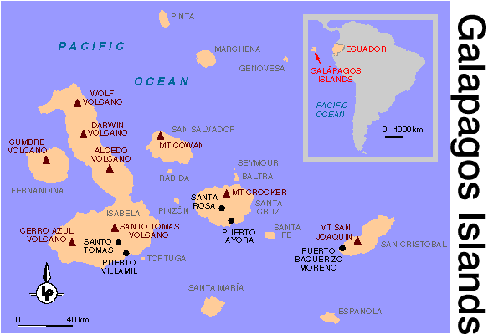

Slide 14
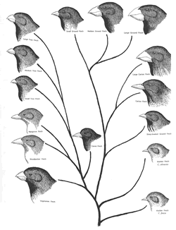

Slide 15
8. What was Darwin’s hypothesis of how a new species could appear?
Maybe the finches came from the main land and then adapted to their new environment
Perhaps they adapted so much that they became their own species

Slide 16
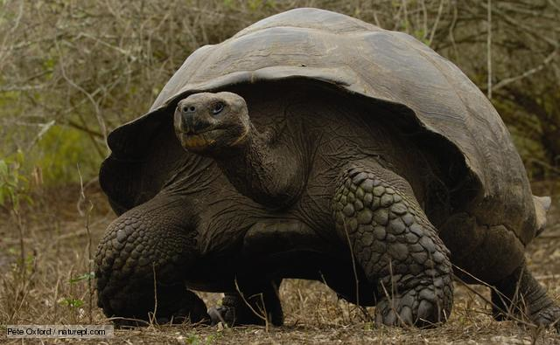
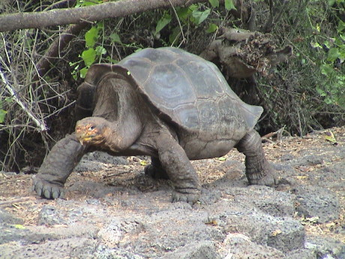
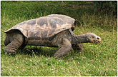

Slide 17
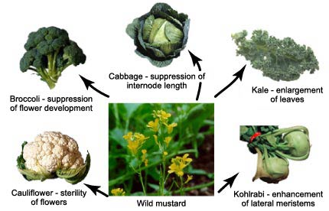
9. In order to gather evidence to support his hypothesis of how a new species could appear, he talked to pigeon breeders. He found that breeders can pick out which types of traits they want passed on to the offspring. What kind of selection is this?
Artificial Selection – humans choose which genetics are passed on

Slide 18
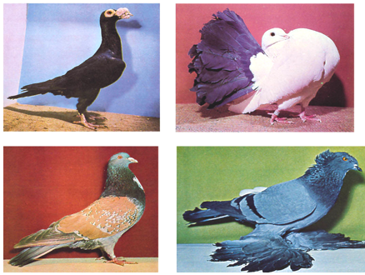

Slide 19
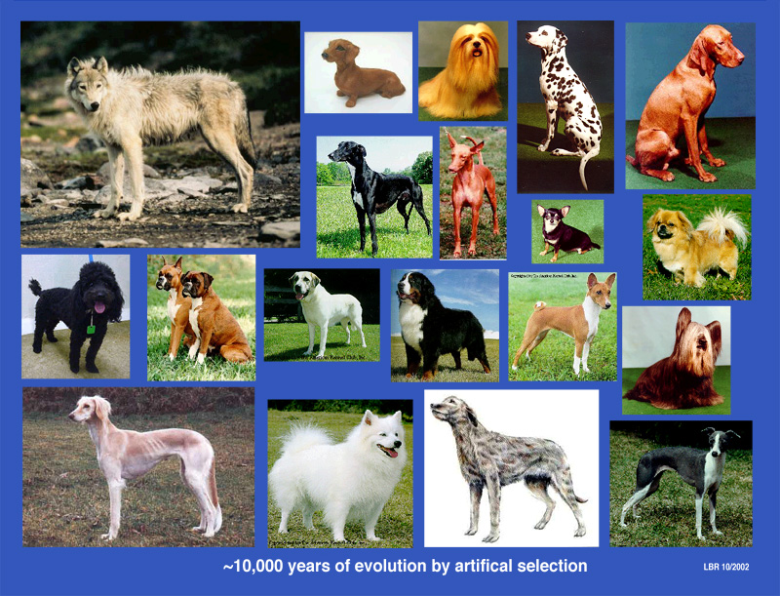

Slide 20
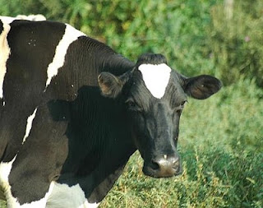
10. Who else, besides pigeon breeders, use this type of selection?
Dog breeders
Farmers (crops and herds)

Slide 21
11. How does natural selection work?
Where competition occurs, some individuals will be better equipped for survival and some would struggle.
The ones who struggle will die and the ones that are better equipped will pass on their genes
Lizard Evolution in Action – NOVA video short

Slide 22
12. How did Darwin use Thomas Malthus’s essay to better understand how evolution worked?
Malthus basically said that the human population would outgrow its resources if left unchecked.
Darwin thought that this same competition would happen in nature.
In competition there is a winner and a loser. The winner gets to pass on its genes.

Slide 23

13. Read through Darwin’s four principles that explain how traits of a population change over time. Rewrite and summarize each principle using your own words.
a. Variation – individuals in a population have different genetics – different phenotypes

Slide 24
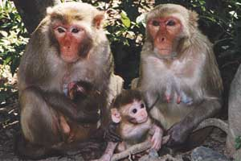
b. Heritability
Variation is due to gene differences.
These genes can be passed on from generation to generation

Slide 25
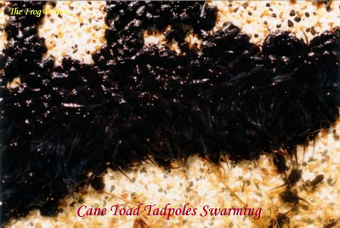
c. Over reproduction
Organisms have more offspring than necessary.
Many individuals will not survive, but those that do can pass on their genes.

Slide 26
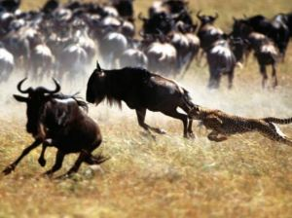
d. Reproductive Advantage
Genes that help an organism survive have a better chance of being passed on because it helps the parents survive until they can reproduce.

Slide 27
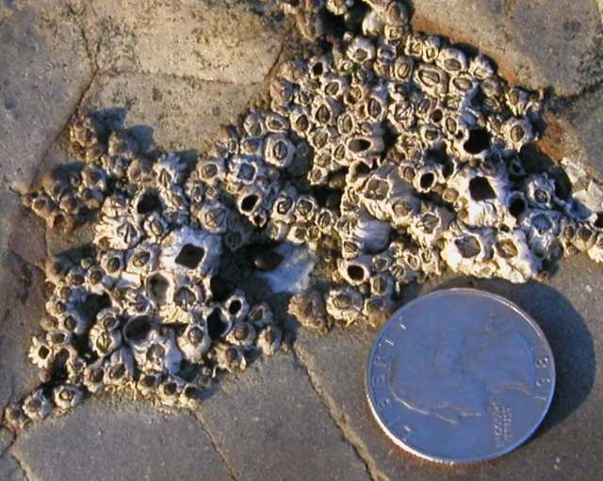
14. Darwin’s book, The Origin of Species, took a long time to publish. State two reasons that explain why it might have taken him so long to make his ideas public.
A. He continued to study relationships between species in order to gain evidence for evolution

Slide 28
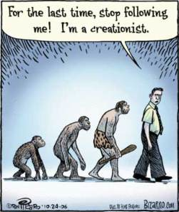
b. Most people of Darwin’s time believed in creationism

Slide 29

c. People believed the world was only 6,000 years old.

Slide 30
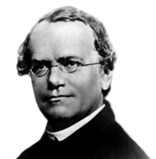
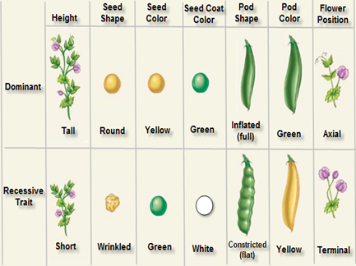
d. Mendel’s findings about genes were just starting to be appreciated.

Slide 31
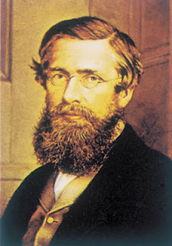
15. What was one reason that Darwin published his book when he did? (Hint: Remember, in science, coming in second doesn’t mean much.)
In 1858, Alfred Russel Wallace was going to publish the same ideas in his book.
    If Wallace had done this before Darwin, he would have gotten all of the credit.

Slide 32
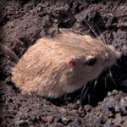
16. Evolution and natural selection do not mean the same thing. How are these two words different in their meaning?
Natural selection (nature determining who survives and who doesn’t) can cause changes in a species over time.
Pocket mouse video clip - HHMI

