Slide 1
Notes 15.2

Slide 2
Fossil Record
What is it?
By looking at the bones and the structures of former organisms, comparisons can be made to present organisms

Slide 3
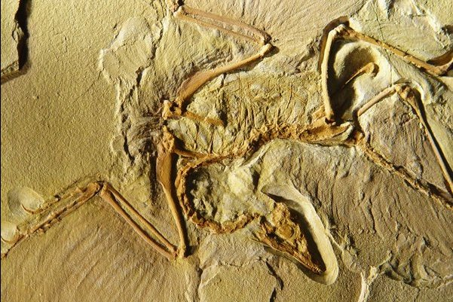
Fossil Records

Slide 4
Fossil Records
How does it support evolution?
Derived traits – show newly evolved features (like feathers)
Ancestral traits – features that do appear in common ancestors (teeth, tails, etc.)
Carbon dating

Slide 5
Comparative Anatomy
What is it?
Comparing structures between different species and different organisms of different times

Slide 6
Homologous Structures
Definition – Body parts that have the same structure (ie. same bones), but the structures are used differently

Slide 7
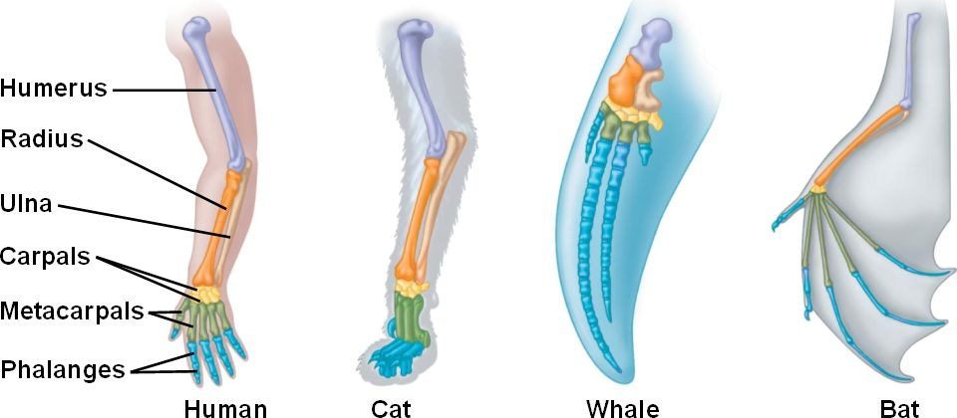
Homologous Structures
Examples – Human hand and bat wing

Slide 8
Homologous Structures
Justification of Example – Each of the forelimbs shown in the picture had the same bones in them but they work in different ways. Hand to grasp and hold/bat wing to fly

Slide 9
Vestigial Structures
Definition – Structures that are smaller or not even working in one organism, but in a related species it works just fine.

Slide 10
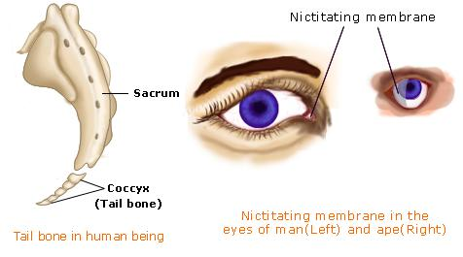
Vestigial Structures
Examples – snake pelvis, kiwi wings, human appendix

Slide 11
Vestigial Structures
Justification for Examples –
snake pelvis and leg bones are not used for walking
Kiwi wings are not used for flying
Appendix has no known vital function

Slide 12
Analogous structures
Definition – Two structures that are used for the same purpose but are not constructed the same way.

Slide 13
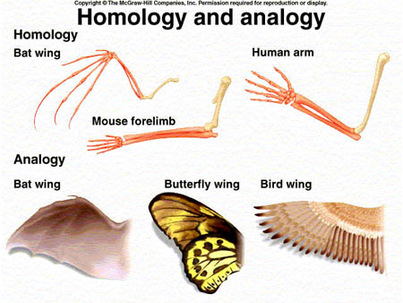
Analogous structures
Examples – Wings of a bat and wings of a butterfly

Slide 14
Analogous Structures
Justification for Examples – Both types of wings are used to fly, but they are constructed entirely differently

Slide 15
Comparative Anatomy
How does it support evolution?
Shows how species have changed through time
Shows how adaptations have occurred to make new species over time
Shows ancestry

Slide 16
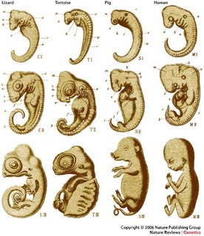
What is Comparative embryology?

Slide 17
How does comparative Embryology support Evolution?
Even though structures develop differently and may be totally different in the adults, it suggests that the organisms came from the same ancestor.

Slide 18
Comparative Biochemistry
What is it?
Comparing the biochemistry of related organisms. Organisms that are related share some proteins/enzymes that change little throughout time. Proteins are coded for by DNA (putting amino acids together to make proteins), so the DNA code for some chemicals are similar and unchanging

Slide 19
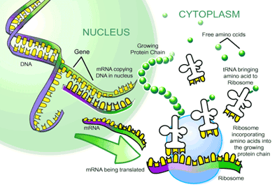

Slide 20
Comparative Biochemistry
How does it support evolution?
By studying the genomes or genotypes of extinct organisms, we can understand more about their phenotypes
If two species’ genotypes are similar that could suggest a common ancestry

Slide 21
