Slide 1
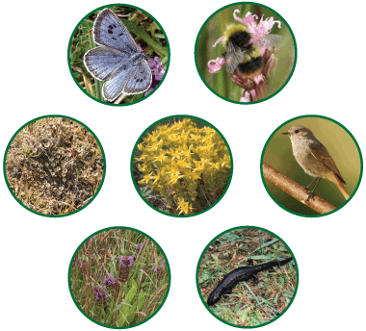
Organizing Life’s Diversity
Chapter 17

Slide 2
What is classification?
The grouping of objects or information based on similarities
This helps biologists understand how organisms are related to each other.
This is useful in agriculture, forestry, biochemistry, and medicine (to name a few fields).

Slide 3
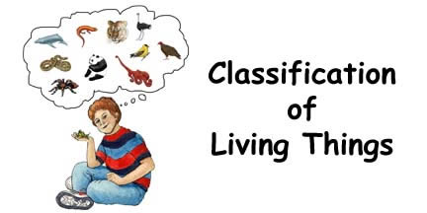
Taxonomists study taxonomy.
Taxonomy and taxidermy – study two different things
Taxonomy is the branch of biology that groups and names organisms based on studies of their different characteristics.

Slide 4
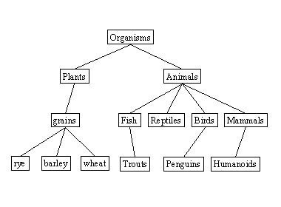
Aristotle was the first to classify
Life
Aristotle based groups on appearance and abilities
Plant
Animal
Herb Shrub Tree

Slide 5
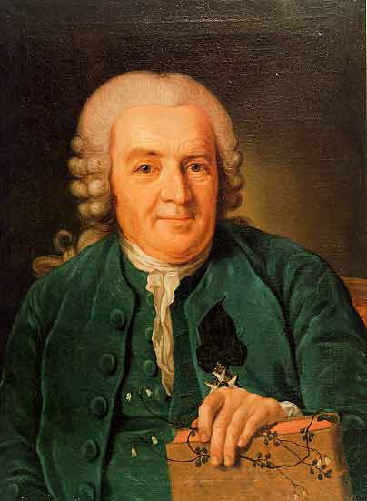
Carolus Linnaeus: 1707 - 1778
Swedish botanist
Created modern classification system based on physical and structural similarities
Modern taxonomists have altered the Linnaean system to reflect evolutionary relationships.

Slide 6
Binomial nomenclature
Binomial = 2 name
Nomenclature = naming system
Used to identify organisms
Genus: group of related species
  Always capitalized
Species: organisms that share very particular characteristics
  Always lower case

Slide 7
Example of binomial nomenclature
Homo sapiens
Genus
Species
When writing the scientific name which is Latin, one must italicize when typing or underline when handwriting

Slide 8
Why classify?
It is more specific
Common names change
Common names are different from one area to another
Using Latin is descriptive and a dead language

Slide 9
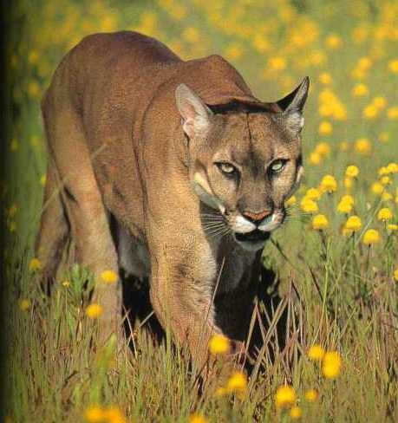
Example of why classification is important
Common name – cougar, puma, panther, catamount
Scientific name – Panthera concolor

Slide 10
Dichotomous key: system to identify organisms and their scientific names
A key is made up of sets of numbered statements
Each set deals with a single characteristic of an organism, such as leaf shape or arrangement.

Slide 11
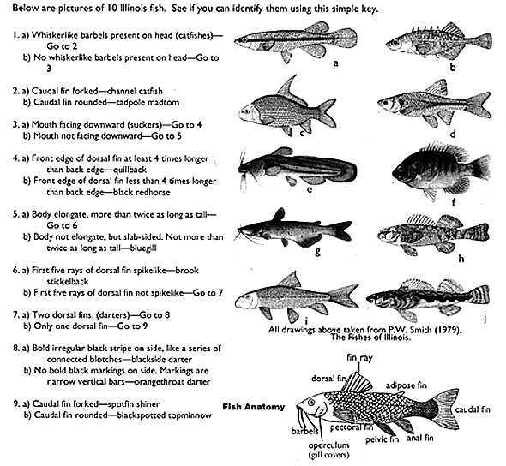

Slide 12
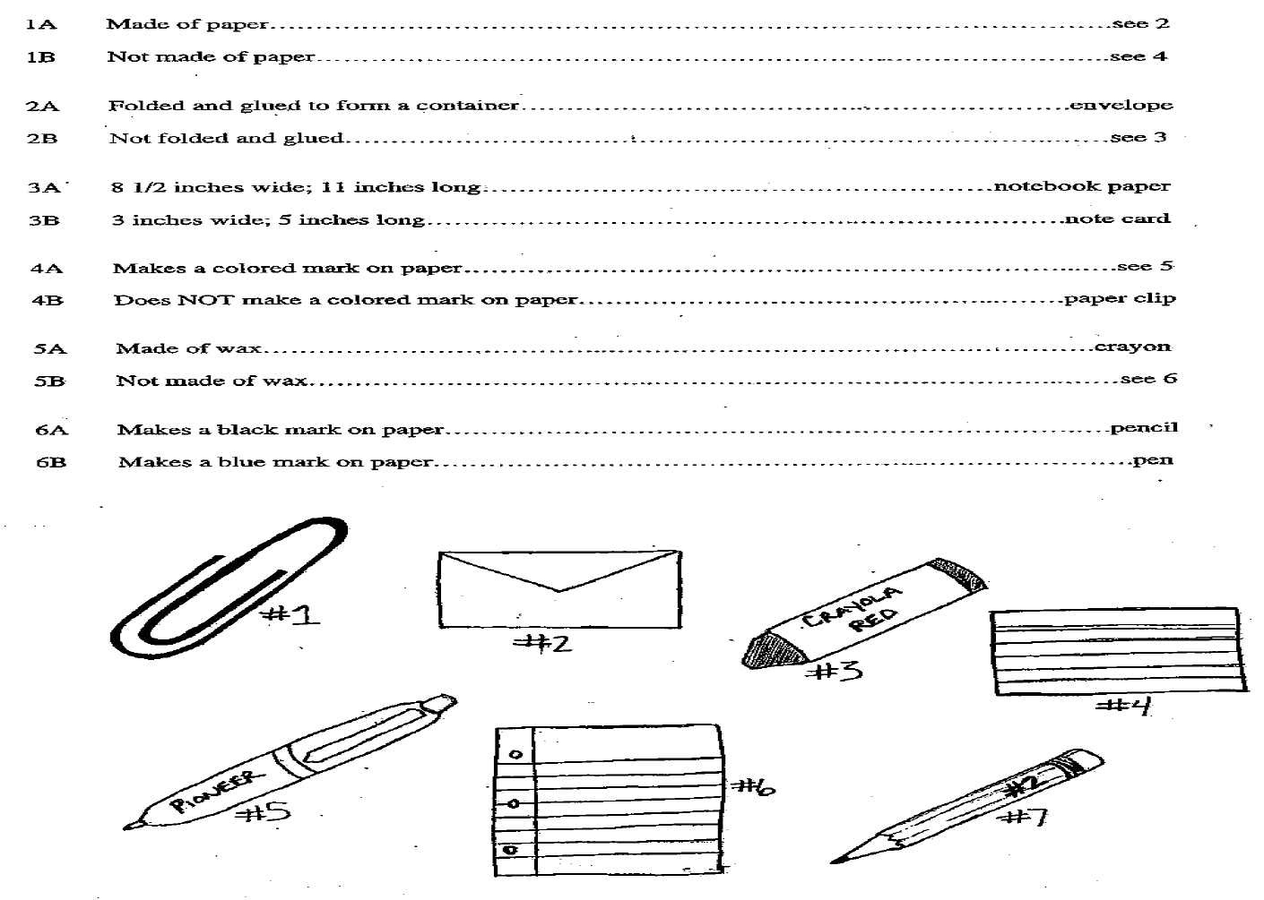

Slide 13
How living things are classified
Taxon: a group of organisms
These groups (taxa) can be very broad or very specific
The taxonomic levels from most broad to most specific: kingdom, phylum, class, order, family, genus, species
King Philip Came Over For Great Spaghetti

Slide 14
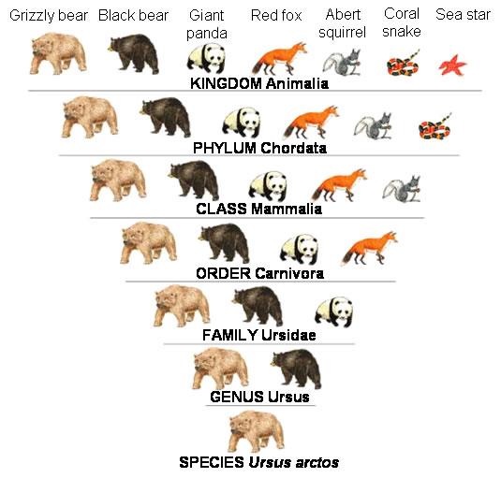

Slide 15
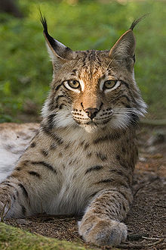
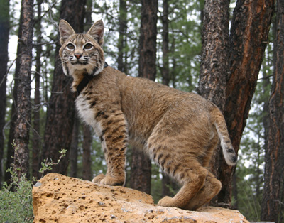
Comparing related animals
lynx
Mountain lion
bobcat
Lynx rufus – lynx
Panthera concolor – mountain lion
Lynx canadensis,- bobcat
Which two are more related? How do you know?

Slide 16
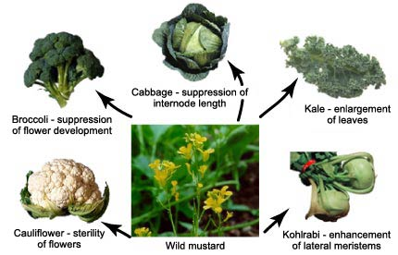
What determines evolutionary relationship?
Anatomy and physiology
  Common structures imply a common ancestor
Breeding and behavior patterns
Geographic distribution
DNA and biochemistry
Very little difference in DNA between these plants

Slide 17
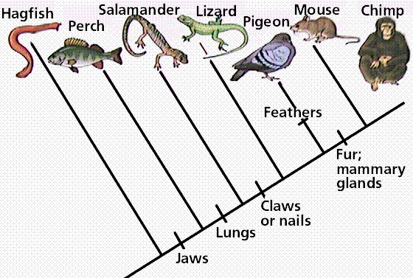
Phylogeny: Studying the evolutionary histories and relationships of organisms
Cladistics: a phylogenic study that assumes probable groups of organisms diverged and evolved

Slide 18
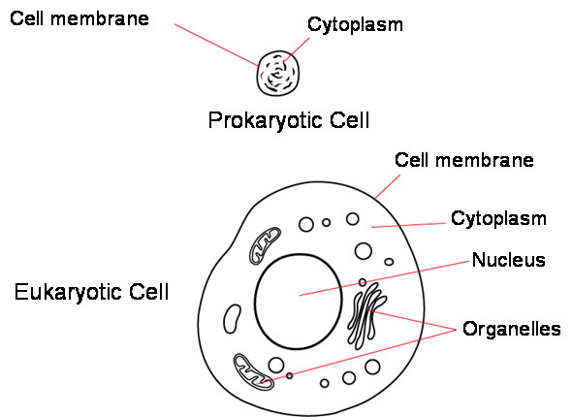
Modern six-kingdom classification
Archaebacteria: prokaryotic
Eubacteria: prokaryotic
Protists: eukaryotic
Fungi: eukaryotic
Plants: eukaryotic
Animals: eukaryotic

Slide 19
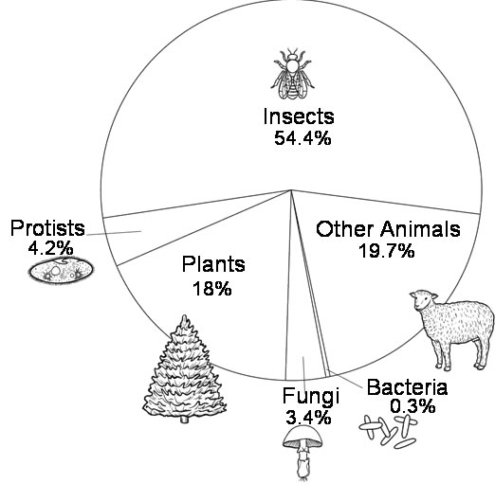

Slide 20
