Slide 1
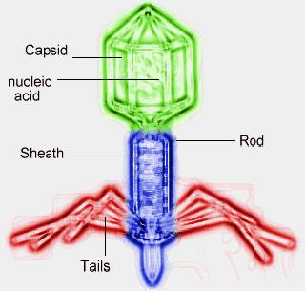
Viruses
Chapter 18 Continued

Slide 2
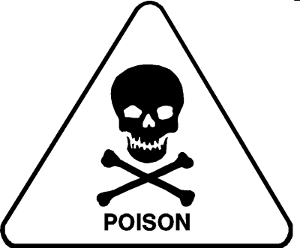
I. Properties of viruses
A. Discovered (identified in 1898)
1. Couldn’t see but concluded that there was something : disease
2. This substance named virus (Latin for poison)

Slide 3
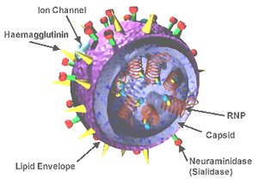
Viruses are not cellular
1. Lack cytoplasm, cell membrane, nucleus, and ribosomes
2. Referred to as sub-cellular: below cell

Slide 4
They don’t do things that true cells do
a. Never grow or carry on metabolism on their own
b. Do not develop from preexisting cells
c. Don’t have enzymes
4. Can be crystallized and reactivated later

Slide 5
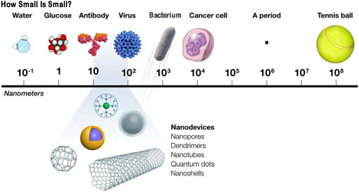
Size of viruses
1. Too small to be seen with the light microscope
2. Measured in units called nanometers (1 millionth of a mm)
(remember there are 1000 micron in a mm)

Slide 6
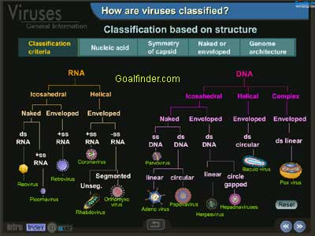
D. Classification of viruses
1. None
2. Not placed into any of the 6 kingdoms because they are sub cellular and non-living
3. Viruses grouped according to host
  a. Plant
  b. Animal
c. Bacteria

Slide 7
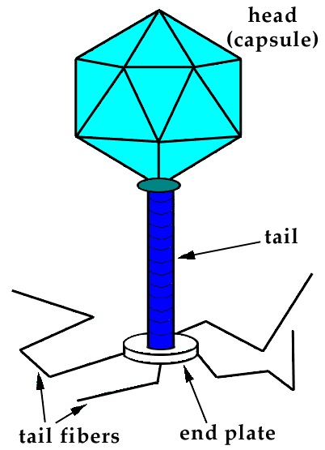
Anatomy of a virus
  Consists of protein coat covering called a capsid
    1. Tapered at one end to form a tail
    2. Tail functions to attach and pierce the host’s cell membrane

Slide 8
B. Inside the capsid is nucleic acid (either DNA or RNA)

Slide 9


III. Reproduction in viruses
  A. 5 steps in cycle
    The virus first attaches to a host cell with its tail
      The virus releases its nucleic acid in the host
      tail is used as a needle to inject nucleic acid
    Injected DNA/RNA takes over
      Viral DNA/RNA and protein made
      b. Host cell becomes factory

Slide 10
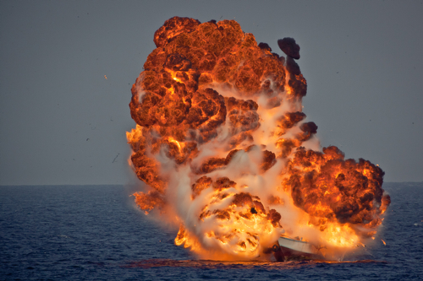
    Assembly of parts
-DNA and protein put together
    Release of new viruses
-Cell wall bursts (called lysis) releasing new viruses

Slide 11
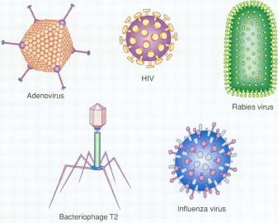
Viral infections
  Entry of viruses into cell called infection
  1. Viruses not capable of own motion
2. Remain inactive until reach right cell

Slide 12
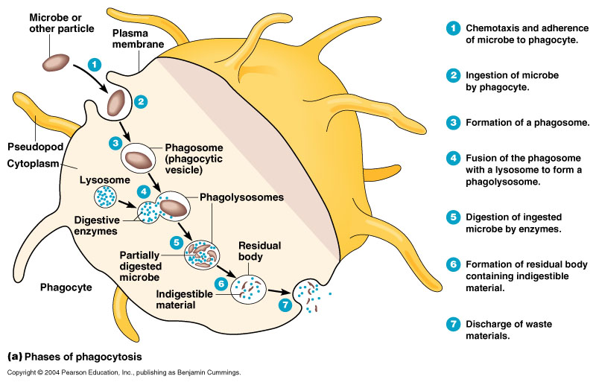
  Defense against infections
    1. Phagocytosis – wbc’s surround and destroy

Slide 13
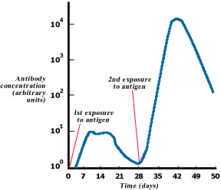
    2. Antibodies – substance produced by body which neutralizes
      a. These are produced by the immune system
      b. Can be activated by having the disease or by receiving a vaccine, which may be inactive or active parts of the virus
c. Takes about 7-10 days

Slide 14
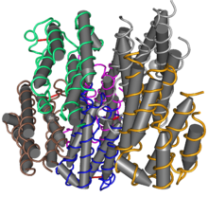
3. Interferon – natural substance produced in small quantities in the blood which interferes with reproduction

Slide 15
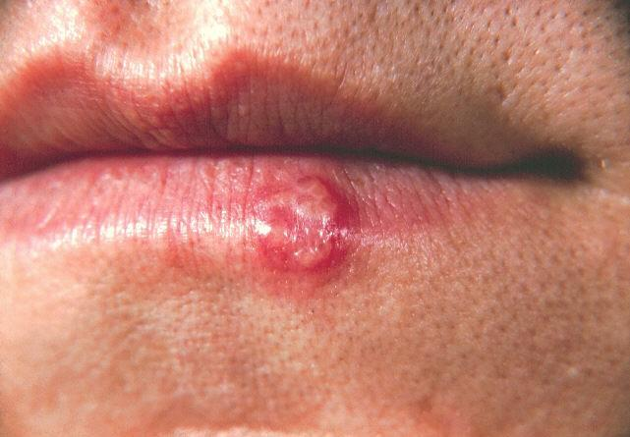
  C. Effects of viral infections
    1. Latent infections
a. Virus enters the cell but does nothing – is latent until triggered by something like fever, cold sore, stress

Slide 16
      Herpes groups like this
      i. All Herpes diseases have common characteristics – lesion or sore
        ii. Herpes -> cold sore, chicken pox, mononucleosis, STI
        iii. Once disease has run its course, it becomes dormant and hides in the body (brain or spinal cord)
          a. May be latent for years, months, or days then reactivated
b. Can cause meningitis and encephalitis

Slide 17
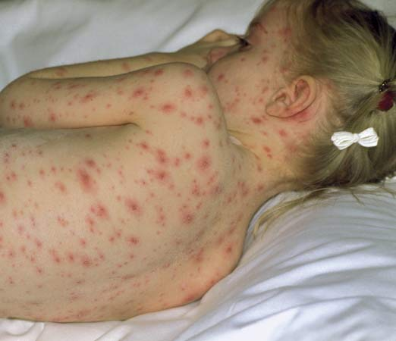

Slide 18
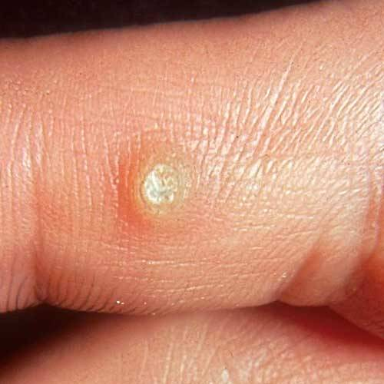
    2. Second effect of viruses may be production of tumors virus causes cells to divide
      i. Harmless – benign like warts
ii. Malignant – harmful

Slide 19
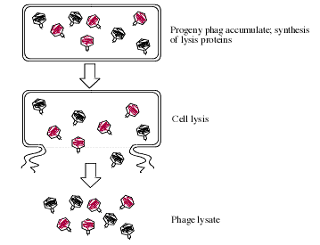
    3. Third effect of viruses – cell death
      a. Occurs when infected cell ruptures – lysis
b. Such viruses are called virulent Example: polio, mumps, rabies, influenza, hepatitis, colds, AIDS

