Slide 1
Lafayette High School
AVID Program
2008-2009

Slide 2

It’s all about -
CHANGE!!!!!

Slide 3
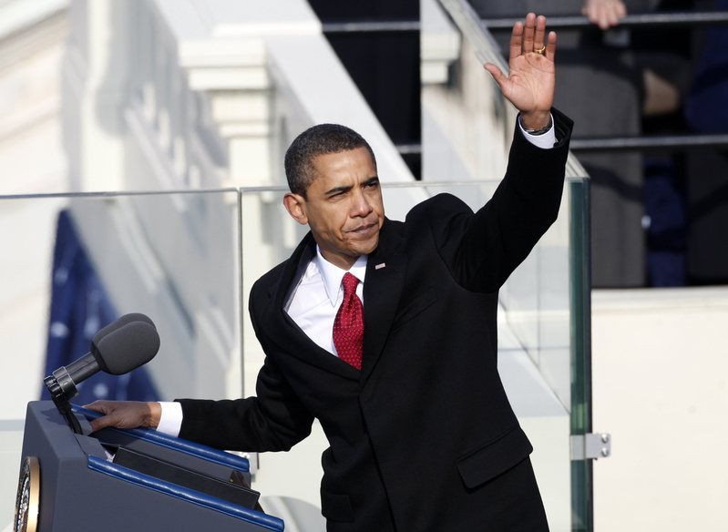
The need for change must be addressed!

Slide 4

LHS has successfully addressed many challenges from last year!!!

Slide 5
The Lafayette High School AVID
Program has put forward many positive changes!!!!
These changes have truly helped to develop a more successful AVID Program that not only helps all AVID students, but also brings up the climate of the entire school!

Slide 6
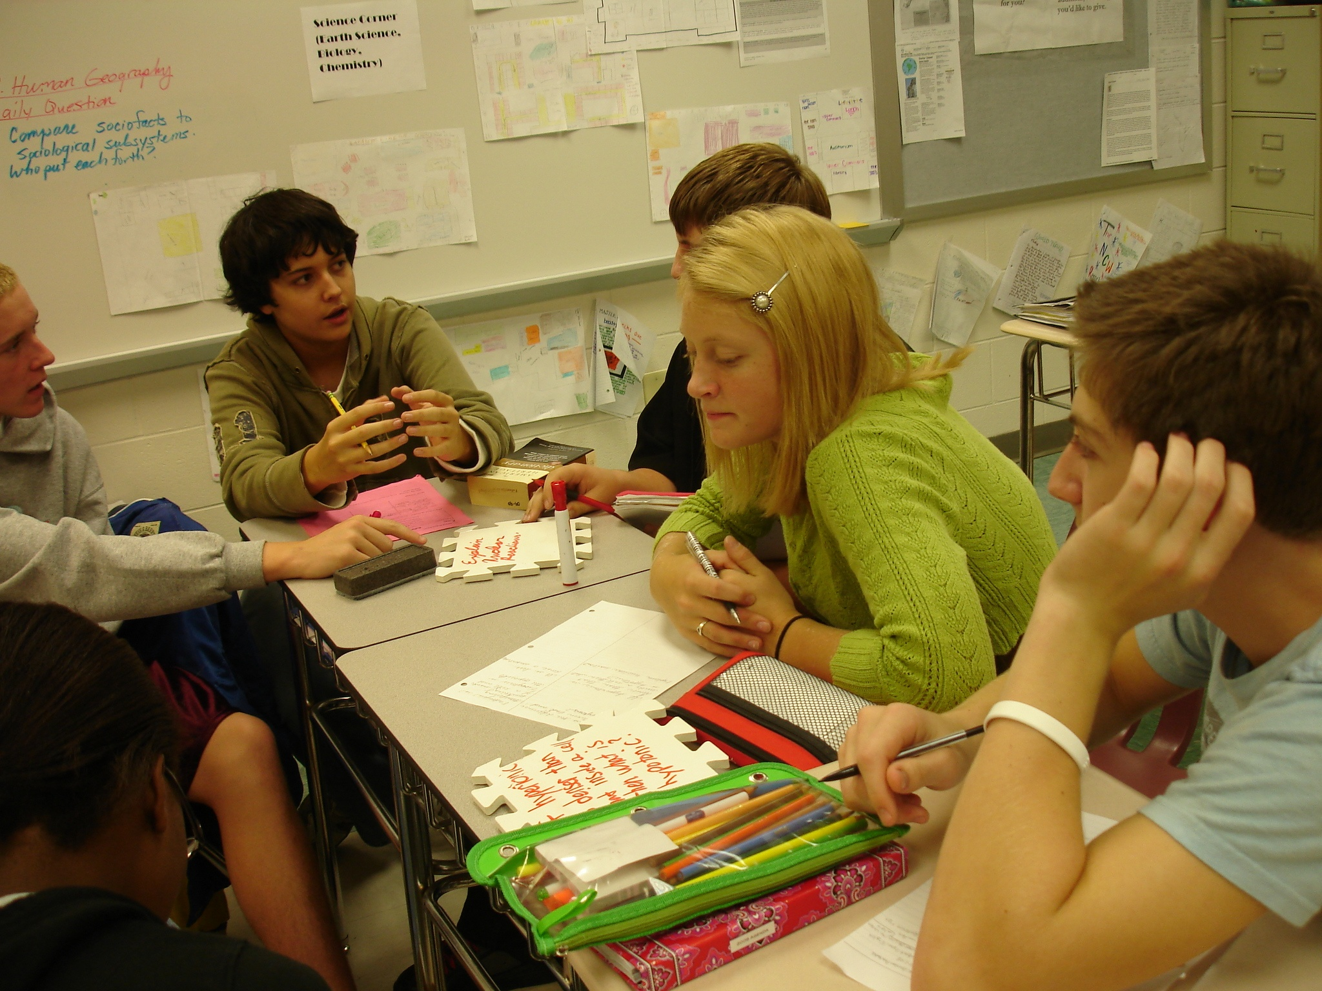

Slide 7
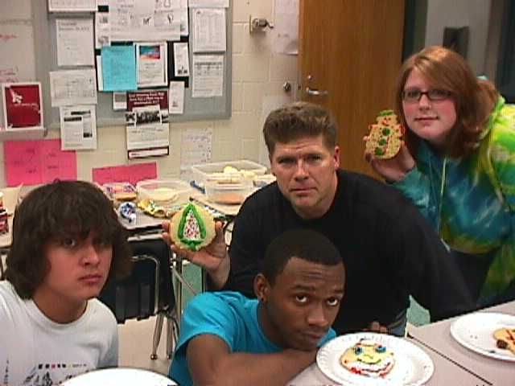
AVID Christmas Cookie Party

Slide 8


Slide 9
The Lafayette High School AVID Program began the school year having faced
And successfully addressed some of the challenges from last year.
These included:
1. The creation of a schedule that clusters 9th grade AVID students both in the Fall and in the Spring.
2. The creation of a schedule that clusters 10th grade AVID students both in the Fall and in the Spring.

Slide 10


Slide 11
3.
. LHS HAD ALREADY INVENTORIED THE AVID LIBRARY FOR ALL AVID MATERIAL USED WITHIN THE SCHOOL AND CREATED A LIBRARY FOR SITE Team members to borrow the needed materials
4. LHS had created a recruitment program and timeline as well as initiative to offer the program to as many students as possible within the school!

Slide 12


Slide 13
5. The Senior AVID students had accounts on the AVID Center and were set to
Input their personal data on their own AVID accounts.
6. The LHS AVID Site Team had grown to include many different disciplines and was set to continue to grow!
7. The “AVIDizing” of Lafayette High School continued to develop through continual staff development of LHS faculty by members of the LHS AVID Site Team.

Slide 14


Slide 15
However, there were still many challenges by the opening of school!
These challenges included:
1. The need to investigate a way to create a schedule that would cluster all 11th and 12th grade AVID students during both semesters.
2. The continual need to communicate more efficiently with all stakeholders within the LHS AVID Program!
3. The continual need to coordinate and collaborate within and between all three high schools – Lafayette, Jamestown, and Warhill.

Slide 16


Slide 17


Slide 18
One of the most important challenges that continue:
How to create a usable and efficient AVID Schedule for all Academic Coaches in order to be able to reach all AVID students, including those students who were not clustered during the spring semester.

Slide 19
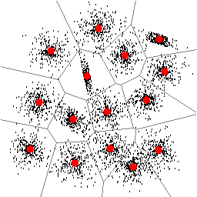
Clustering is SOOOO important!

Slide 20
Lafayette High School
AVID Essentials

Slide 21

The Tools of change – to get the job of preparing all AVID students for College!!!

Slide 22
AVID Essential No. 1: AVID student selection must focus on students in the middle, with academic potential, who
Would benefit from AVID support to improve their academic record and begin college preparation.
The Lafayette AVID Site Team has continued to work hard to expand the school’s AVID program. The newly revised Student Selection Rubric and Recruitment Plan were utilized during the recruitment process. This year, a staff survey requesting more specific information about the recommended students resulted in an increase in the number of AVID students for next year.

Slide 23

During recruitment we target students who would most benefit from AVID!

Slide 24
Not only were parents invited to become active members of the LHS AVID Site Team, but Academic Coaches (Tutors) were invited as well. Our wonderful
11th/12th grade AVID Elective class, taught by Ashley Ferguson, truly helped the AVID juniors and seniors to prepare for, search, and apply for acceptance by four year colleges. The LHS AVID Program is truly beginning to be viewed by the LHS faculty, staff, students, and community as a true college preparatory program!

Slide 25

Our Goal – to prepare students for success in college!!

Slide 26

There is a need to continue to emphasize recruitment within the school. The LHS AVID recruitment
Process expanded this year through the use of the Quia Staff Survey instrument.
There continues to be a need to enroll parental participation in the AVID Progam!

Slide 27


Slide 28
AVID Essential No. 2
AVID Program participants, both students and staff, must choose
To participate in the AVID Program.
Lafayette High School participants in the AVID Program, on all levels, administration, teachers, tutors, and students, have continued to voluntarily choose to either become or continue to be a part of the program. The LHS AVID Site Team has continued to develop and grow to incorporate even more types of disciplines.

Slide 29


Slide 30
To further develop a more positive image of the LHS AVID Program which would allow faculty
Members to feel more comfortable getting involved on the LHS AVID Site Team, Lafayette High School continued to maintain the LHS AVID Website, put forward an AVID Public Relations “Blitz”, and developed an after-school AVID Club open to all students.

Slide 31

http://www.quia.com/pages/avidlhs.html

Slide 32
At this time, parents and tutors have been invited and have participated in the LHS AVID Site
Team. There is still a need to enroll further parental participation by developing a Parent Advisory Board to further facilitate decisions and developments relating to the LHS AVID Program.

Slide 33


Slide 34
AVID Essential NO. 3
The school must be committed to full implementation of the AVID Program, with students enrolled in the AVID year-long elective class(es) available within the regular academic school day.
The LHS AVID Program has continued to allow clustering/grouping of all AVID students at all levels. The 9th grade AVID students are clustered in 9th grade World History in the Fall, and in English 9 or Intensified English 9 in the Spring.

Slide 35
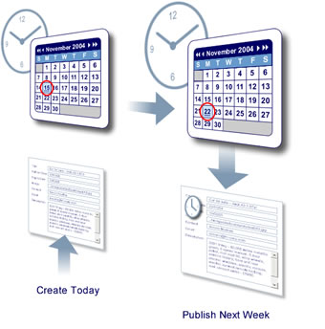
The importance of focus on scheduling!

Slide 36
The 10th grade AVID students are clustered in World Geography or A.P. Human Geography in the Fall
And either English 10 or Intensified English 10 in the Spring.
The 11th/12th grade AVID students are clustered in the 11th/12th AVID Elective during the Spring. Every single student has access to vital AVID tutorials during the school day and week.

Slide 37


Slide 38
There is still a need to facilitate
The clustering of 11th/12th grade AVID students for both Fall AND Spring semesters. The AVID 11th/12th AVID Elective is still given only in the Fall. While staff development related to AVID strategies and methodologies occur on a regular basis, there is still a need to further involve and continue to train all 9th grade faculty in order to further “AVIDize” Lafayette High School

Slide 39


Slide 40
AVID Essential No. 4
AVID students must be enrolled in a rigorous course of study that will enable them to meet requirements for university enrollment.
All of the Lafayette High School students are enrolled in the most rigorous courses that are appropriate to them. All 9th and 10th grade AVID students have taken the PSAT standardized tests. District funds were utilized to purchase SAT preparation books for LHS AVID students.

Slide 41


Slide 42
This year, for the first time, all 11th and 12th grade AVID students took
The SAT tests. All 12th grade AVID students were also encouraged to complete the ACT tests.
Meaningful college trips were planned and facilitated.
A Scavenger Hunt at William and Mary was coordinated by the LHS AVID Site Team, and participated in by Jamestown High School also.

Slide 43
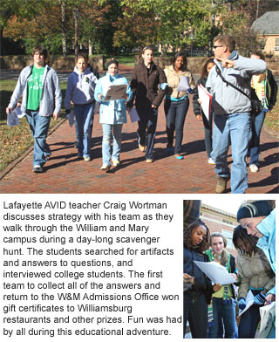

Slide 44
The LHS AVID Site Team has and will continue to encourage all LHS
AVID students to enroll in the most rigorous courses that are appropriate and available to them.
Because of the need for more awareness about AVID on the part of the LHS faculty and staff, a publicity “Blitz” and Webpage initiative were both maintained. This need for awareness of the value of the LHS AVID Program and the importance of rigorous coursework necessary to prepare for college require continual development, awareness workshops, and maintenance.

Slide 45


Slide 46
AVID Essential No. 5
A strong, relevant writing and reading curriculum provide a basis for instruction in the AVID classroom.
LHS AVID students, at all levels, participate in rigorous and meaningful reading and writing to learn activities. These activities continue to be part of all core and elective AVID courses, using the Write Path curriculum. Students continue to complete Learning Logs, write reflections based on metacognition, and add to their skills.

Slide 47
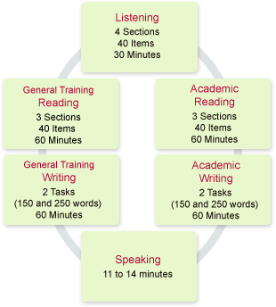

Slide 48
The AVID Site Team, which now includes almost all disciplines, emphasizes WIC-R curriculum
And consistent usage of Cornell note-taking. Members of the LHS AVID Site Team continue to give staff development on AVID methodology on a regular basis.
The LHS AVID Site Team has continued to expand to include many other teachers from many disciplines, including A.P. teachers and those who do not teach the AVID elective as a core teacher. These other teachers have graciously allowed tutors to come into their classes in order to facilitate Collaborative Inquiry Sessions (Tutorials) for all of their students.
These teachers have been trained in and have received further instruction on WIC-R methodology.

Slide 49

It’s all about the students!!!!

Slide 50
An observation tool to observe all AVID teachers (both core and support) has been chosen
And refined in order to demonstrate how well all are utilizing AVID strategies.
Further actual observations by the coordinator, would be beneficial to gather additional evidence of the usage of AVID methodology throughout the school.

Slide 51


Slide 52
AVID Essential No. 6
Inquiry is used as a basis for instruction in the AVID classroom to promote critical thinking.
The LHS AVID Site Team this year has worked diligently to develop mastery in the usage of philosophical chairs and Socratic Seminars in both AVID and non-AVID courses.
All AVID core courses have practiced higher level critical thinking skills needed for success. Many additional teachers, through AVID Site Team members running staff development, have been trained in AVID methodologies and strategies.
A faculty incentive program was put forth to encourage all faculty to collect and turn in student work that demonstrates AVID strategies and methodologies.

Slide 53


Slide 54
There is a need to facilitate further the growth of students’ independent higher level thinking
During Collaborative Inquiry Sessions. There is a need to further push students to always strive for higher level thinking on a much more consistent basis.
Further periodic observations of both core and non-core AVID teachers, using the new AVID observation tool, is needed to further ensure that inquiry methodology is consistently used during the day.

Slide 55
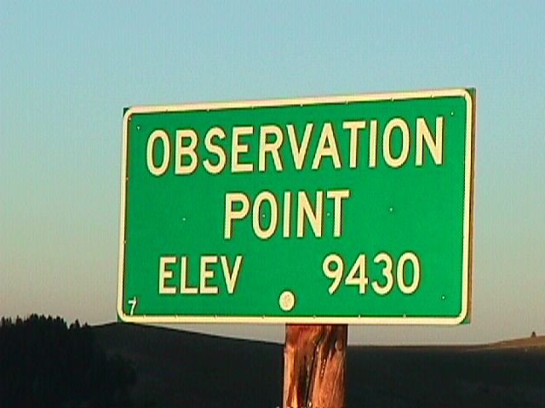

Slide 56
AVID Essential No. 7
Collaboration is used as a basis for instruction in the AVID classroom.
The students, faculty, and parents, as well as tutors of the LHS AVID program have continued to collaborate effectively on a regular basis.
LHS AVID students continue to be encouraged to reach for higher levels of critical thought in all AVID and non-AVID classes.
AVID tutors continue to collaborate with AVID teachers and students to facilitate binder checks, Collaborative Inquiry Sessions, and some tutors have graciously given speeches about their personal experiences.

Slide 57
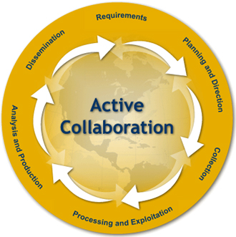

Slide 58
There was effective collaboration between all 3 high schools, and
Vertical collaboration between the middle schools and the high schools.
The LHS AVID Site Team has continued to grow to include even more subjects and disciplines. The AVID students continue to be given the opportunity to collaborate, not only with and about AVID core classes, but also in reference to many different disciplines.
All AVID students continue to be encouraged to complete community service collaborative activities. The 11th/12th grade Elective students collaborated on a Gingerbread House Community Service project for AVALON.

Slide 59

11th/12th grade AVID Elective Students’ Gingerbread Houses AVALON Comm. Service Project.

Slide 60
AVID Essential No. 8
A sufficient number of tutors must be available in AVID elective class(es) to facilitate student access
To rigorous curriculum. Tutors should be students from colleges and universities and they must be trained to implement the methodologies used in AVID.
The majority of LHS academic coaches who work with Lafayette AVID students are college students who have a good grasp of higher level critical thought. The WJCC school division’s AVID Program, headed by Marie Nice, selects and trains all tutors very effectively in preparation for successful Collaborative Inquiry Session.

Slide 61


Slide 62
The LHS Site Team now includes tutors as participating members, indicating that the Site Team
Has taken on ownership of the implementation of an effective tutor recruitment and retention plan.
All AVID students are required and encouraged to be prepared with tutorial request forms that are correctly completed with higher level questions and prepared before tutorial sessions.
Observations and observation tools have been selected, refined, and utilized in order to observe the LHS tutorial collaborative process.

Slide 63
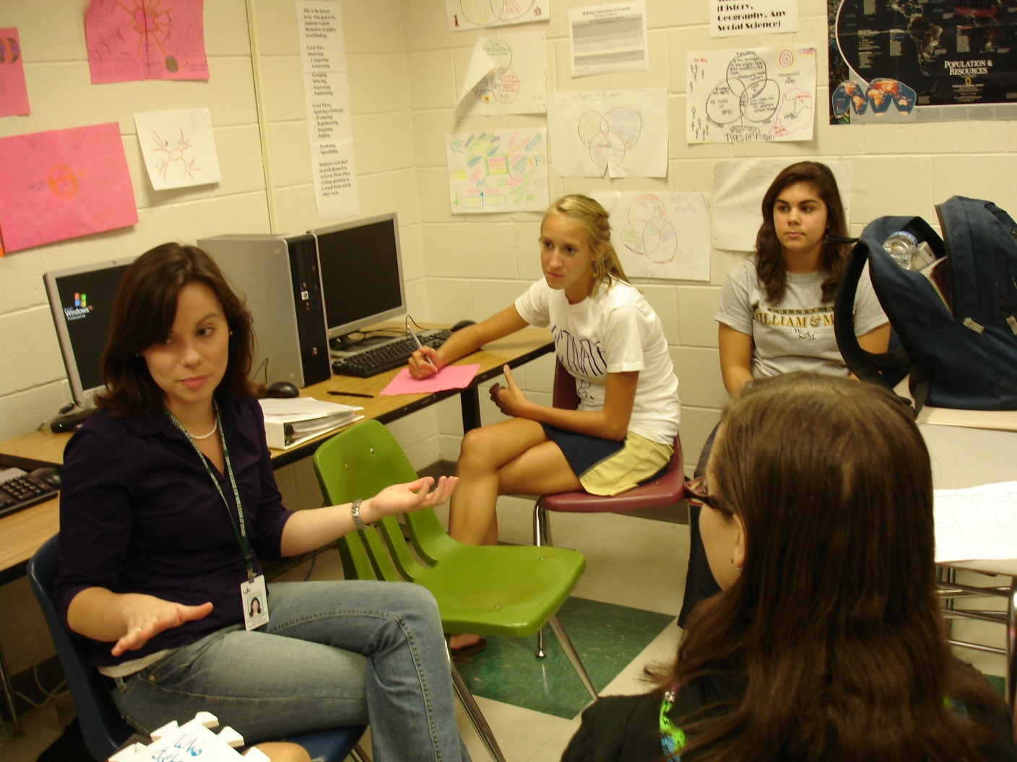
One of our LHS Superb Tutors – Colleen Kennedy!!

Slide 64
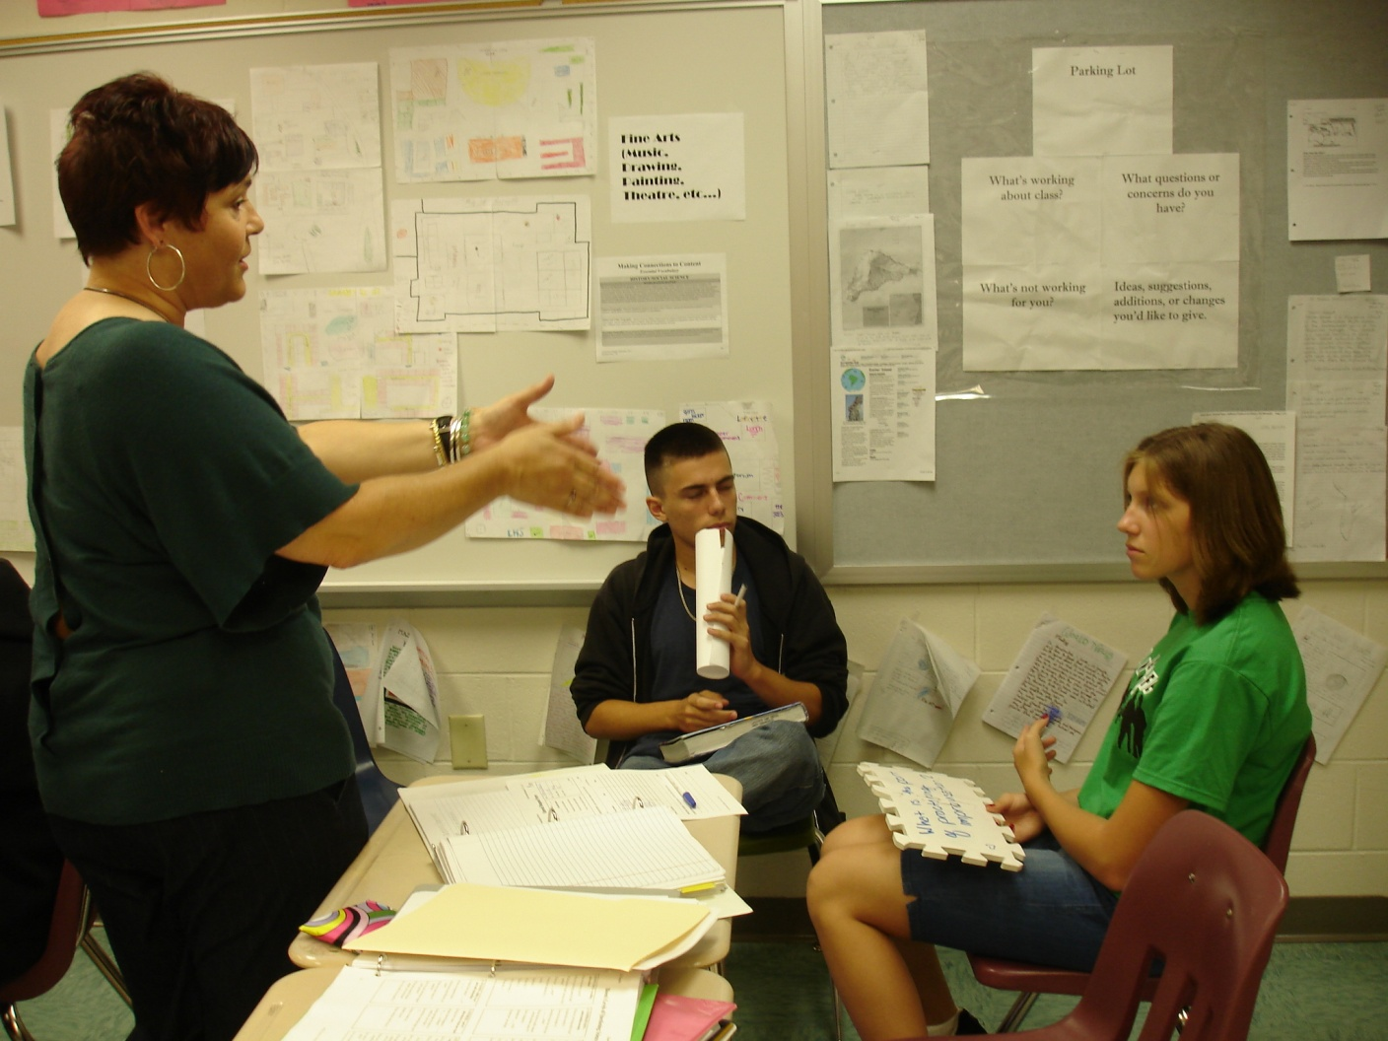
Another one of our Superb Tutors – Kat Lindsay!!

Slide 65
AVID Essential No. 9
AVID program implementation and student progress must be
Monitored through AVID Center Data System, and results must be analyzed to ensure success.
The LHS school-wide and AVID data was submitted as part of the Initial Self-Study. The LHS AVID seniors completed Senior Data Collection forms and submitted them to the AVID Center using their own accounts created by the LHS Coordinator.
All 9th and 10th grade LHS AVID students took the PSAT test.
All 11th and 12th grade LHS AVID students took the SAT test.
The entire LHS AVID Site Team is well trained in AVID methodology and continues to further their learning during AVID Site Team meetings.

Slide 66

This is the SAT Prep. Book that all AVID students utilized.

Slide 67
Monthly Site Team meetings continue to demonstrate a high level of commitment to the AVID
Program by the entire team.
Monthly AVID Coordinator meetings continue to be held at the district level.
Many Site Team members continue to give regular staff development workshops in an effort to further “AVIDize” the school

Slide 68


Slide 69
This year, for the first time, both juniors and seniors from the
11th/12th AVID Elective, took the SAT tests.
An incentive program to motivate the entire faculty to turn in documents that illustrate the usage of AVID methodology occurred. The incentives included restaurant gift certificates.
There is still a need to work on further analysis, further disaggregation of and collection of standardized test results.

Slide 70
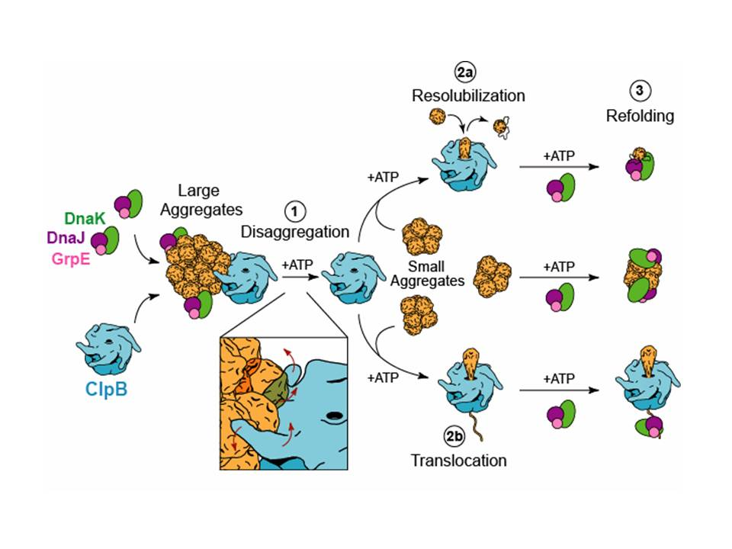

Slide 71
AVID Essential No. 10
The school or district has identified resources for program costs, has
Agreed to implement all AVID Implementation Essentials and to participate in AVID Certification. It has committed to ongoing participation in AVID staff development.
The entire LHS AVID Site Team is well trained in AVID methodology. Monthly Site Team agendas and minutes demonstrate a high commitment to the AVID program.
The WJCC and LHS Program of Studies confirms the importance of the LHS AVID program during the school day.

Slide 72


Slide 73
LHS Site Team members participate in and give continual staff development workshops in an
Effort to further “AVIDize” the entire school.
The LHS AVID Site Team has greatly expanded to include teachers of many disciplines, administration, and tutors.
The LHS AVID Site Team continues to maintain the LHS AVID Website.
The LHS AVID Site Team continues to make faculty/staff aware of the importance of AVID through successfully putting forth an AVID Public Relations “Blitz.”

Slide 74


Slide 75
Fund-raising through the creating and submission of a grant was pursued.
Continuous and on-going training is essential for all AVID teachers, both core and non-AVID Site Team members. Even though all of these teachers have been trained, further training would further develop strength in WIC-R strategies, Socratic Seminars, and the tutorial process.
Our 11th/12th grade AVID Elective students participated in a team-building Ropes Course!

Slide 76
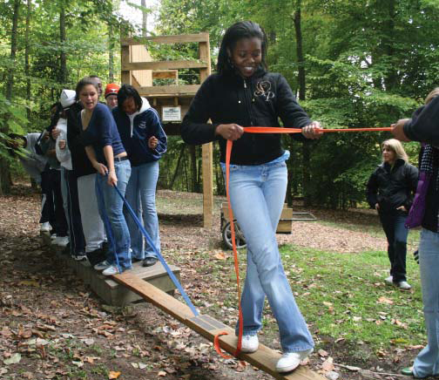

Slide 77
AVID Essential No. 11
An active interdisciplinary AVID Site Team collaborates on issues of
Student access to and success in rigorous college preparatory courses.
The LHS AVID Site Team has been effective and has worked very hard to welcome more members into membership.
This year, both parents and tutors have been invited to become LHS AVID Site Team members. The “AVIDizing” of Lafayette has continued, largely through the efforts of the LHS AVID Site Team.

Slide 78
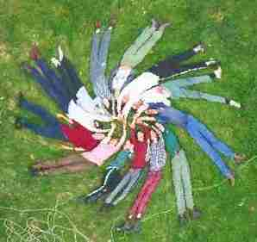


Slide 79
The LHS AVID Site Team includes people from many different disciplines
many of whom regularly give staff development workshops on AVID methodology. Current Site Team members serve on professional development committees within the school.
These committees include the Shared Leadership Council, The Parent Shared Leadership Council, the Professional Development Committee, and many others.
The AVID website, and the AVID Bulletin Board in the lobby, continue to be maintained by LHS AVID Site Team members.
AVID student work is displayed throughout the building.

Slide 80


Slide 81

There remains a need for Site Team members to become involved in key site/district committees.
Example – Site Team Coordinator participation in Curriculum Leader meetings.

Slide 82
Challenges for next year:
1. We now have all 9th and 10th grade AVID students clustered for each semester. However, we would benefit from clustering all 11th and 12th grade AVID students for each semester, instead of just in the Fall.
2. For some reason, knowledge about the rigor and intent of the AVID Program by the faculty, staff, and community. The Publicity “Blitz” ideally will be continued into next year. The displays of student work and AVID posters will be continued into next year, as well.

Slide 83


Slide 84
3. Parental involvement is key
To a successful AVID Program. The challenge is to bring more parents voluntarily into participation in the program. We will have more Parent Workshops and invitations to more parent involvement next year.
4. Knowledge of the school performance of each of the AVID students is absolutely vital. We will work very hard to know exactly what is happening in terms of class performance for each AVID student in more detail than has been possible this year.

Slide 85


Slide 86
5. Another important challenge
Is to create more opportunities for students to experience college life through more field trips and cultural experiences each semester.
6. Better communication between parents, teachers, administration, guidance and students is always an ongoing challenge.

Slide 87


Slide 88
Change is part of life, and it
Continues to be a part of the Lafayette High School AVID Program! We look forward to addressing these challenges for next year, and expect that next year will be extremely successful!
The LHS AVID Program will continue to work to successfully address the needs of the students in the “middle”, and to focus upon WIC-R curricula, collaboration, and to grow the AVID Program in order to “AVIDize” Lafayette High School.

Slide 89

The ultimate result -

Slide 90

Success!!!!

