Slide 1
The Constitution
U.S. History Kehoe-France Northshore
Robert B. Tate Jr
(2012)

Slide 2

Preamble
You must know the preamble by memory by 19 December 2012
Oral Quiz to follow!!

Slide 3
Homework 11 Jan 2012
Read 36 - 41
Complete the questions 1-9.
on page 43 “Review the facts”

Slide 4
Homework 13 Jan 2012
Read 45-56. Complete Reviewing the Facts 1-8 p.57

Slide 5
Class work- Homework
20 Jan 2012
American Indians are mentioned twice in the main body of the Constitution. Article I, Section 2, originally excluded Indians from the population counts to apportion congressional representation. Article I, section 8, gives Congress the exclusive right to regulate commerce with Indian tribes. The Constitution also includes an indirect reference to American Indians. Article I, section 10, prohibits the states from entering into compacts, or treaties, with foreign powers, which also includes Indian tribes.
Q: What does the original Constitution reveal about the attitudes toward the American Indians in the late 1700’s?

Slide 6
Homework 23 Jan 2012
Read Pages 58 - 63.

Slide 7
Homework 24 Jan 2012 (25 PTS)
Read 64-69
Complete “Thinking Things Through” 1-4
Complete “Reviewing the Facts” 1-8

Slide 8
Homework 25 Jan 2012
Prepare for Constitution Article 1 Test
Study all information in power point and your constitution Handbook
Know the Vocab words on page 57,63 and 69.

Slide 9
Homework 26 Jan 2012
Read Pages 70- 74. Complete Words to Know on page 75, and “Thinking Things Through” Q1-5.

Slide 10
Homework 27 Jan 2012
Complete “Reviewing the facts” on page 75.

Slide 11
Homework 30 Jan 2012
Read 76-81
Complete Reviewing the facts on page 81.
Words to Know P81

Slide 12
Homework 01 Feb 2012
READ 83-86Complete “Words to Know” on page 87.
Complete “Reviewing the Facts Q:1-10 P.87

Slide 13
Homework 06 Feb 2012
Read 88-95. Complete Reviewing the Facts P94-Q1-10
***Important – Study reviewing the facts. We will not go over these facts, but I promise you will see these facts again!!

Slide 14
Homework 07 Feb 2012
Complete Reviewing the Facts P95
***Important – Study reviewing the facts P95 We will not go over these facts, but I promise you will see these facts again!!

Slide 15
Homework 10 Feb 2012
Read 99-105

Slide 16

Test Article I
01/26/2012

Slide 17
Test Vocab Articles 1 and 2
31 Jan 2012

Slide 18
Test (article I, II, and III)
02/06/12

Slide 19
Test (article IV Through VII)
13 Feb 2012

Slide 20
Constitution Final Test
16 Feb 2012

Slide 21
Revolution
For the many reason we studied the colonists succeeded from the British Crown, among these reasons the most important was the Crowns desire to rule the its colonists from abroad. The colonists without hope of self rule or colonial representation declared its independence from King George and his Parliament. The Colonists made know their desire of independence with the Declaration of Independence and the articles of confederation.
The war began on April 19, 1775 in the battles of Concord and Lexington and ended in Yorktown on October 19, 1781.
Treaty of Paris 1783 Use this link to skip review

Slide 22
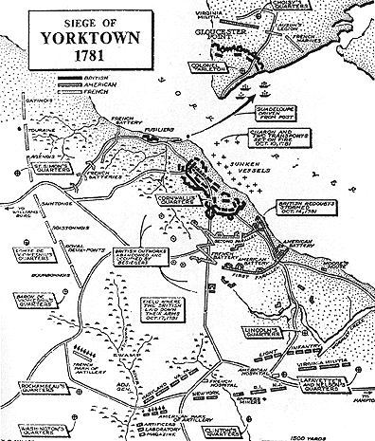

Slide 23
Yorktown and Selected Principles of War
Objective
  Trap and defeat Cornwallis’ army on the York Peninsula
Offensive
  Two parallel siege lines followed by an assault
Mass
  Allies had an overwhelming advantage in numbers (16,000 to fewer than 8,000)

Slide 24
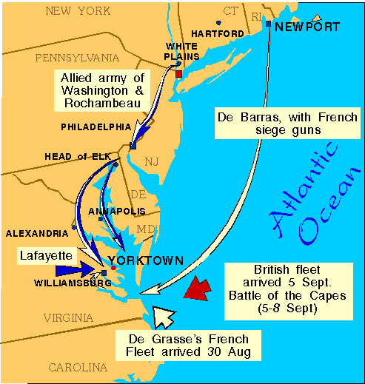
Yorktown: Maneuver

Slide 25
Yorktown: Unity of Command
More appropriately, unity of effort
  Joint (Army and Navy)
  Combined (Americans and French)
Rochambeau (French) and Lafayette (French) cooperated on land with Washington
De Grasse (French) sealed off the Chesapeake with the Navy

Slide 26
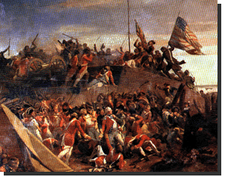
Yorktown
Washington leads combined Colonial and French in feint against NY, then to Yorktown, VA.
  Feint ties down British forces that would have reinforced VA.
French defeat Brit ships at Battle of Capes (sink 19 ships). ADM De Grasse effectively cut off supplies to Cornwallis.

Slide 27
Yorktown
British faced with American army to their front and French Navy to their rear.
Colonial Army lays siege to Yorktown, then bombards it.
Americans force Brits to surrender on 17 Oct 1781

Slide 28
Causes of British Defeat
Tactical vs. Strategic: Won battles, but lost the war.
Geography limited their greatest advantage (Navy).
Poor leadership
  Decision-making from England
  Lack of flexibility
  Indecisive and slow to act

Slide 29
Causes of British Defeat
Focused on terrain (cities) instead of the enemy
  Could not impose their will on the Colonies.
  Objective?
Identification and pursuit of a Colonial center of gravity or critical vulnerability?

Slide 30
French Contributions
Majority of weapons and military related supplies came from French.
French threatened British in other areas.
  West Indies, Europe
French Navy threatened seaward approaches.
  US Navy incapable of performing the same function.
French Army made American threat at Yorktown credible.

Slide 31
WEAPONS
BRITISH
  Brown Bess musket
    volley fire
    no targets picked
UNITED STATES
  Rifle (minority)
    More accurate
    No bayonet
    Longer to reload
    More effective for guerilla use
  Musket (majority)
  Accurate fire
    Hunters
    individual targets

Slide 32
Impact
Militia must be “well regulated” to achieve national goals.
“Democratization” of war.
  Reversing trend of recent European conflicts.
TOTAL WAR is needed for a nation to achieve lofty goals. Did US ever achieve total war? Britain?
New rules for/type of warfare? Guerilla?

Slide 33
Articles of Confederation
In 1776the Second Continental Congress created a congressional committee led by John Dickinson to draft a plan in formulating a central government. On July 12, 1776 this committee presented its plan titled the Articles of Confederation to the delegates of the congress. This plan was finally adopted on 15 November 15, 1777. The Articles created a confederation or association, of states while guaranteeing each state its “sovereignty, freedom, and independence.”
The articles authorized Congress to borrow and coin money, conduct foreign affairs, set policy toward American Indians, and settle disputes between states.

Slide 34
Articles of Confederation
After much compromise and land ordinance legislation the Articles of Confederation and Perpetual Union were finally ratified into law on March 1, 1781 in York, Pennsylvania.
04 Jan 07
6th Grade Homework assignment: Write a 3 paragraph summary that explains the weaknesses in the Articles of Confederation and how Shay’s rebellion affected the continued implementation of these articles.
7th Grade Homework: Read from your text book chapter 5 section 2 pages 143 -148. Completed on line quiz 5.2

Slide 35

Articles to Central Government
Switch programs to 13 colonies to Art-Constitution.

Slide 36
The Constitution
Begin Our Study
U.S. History Kehoe-France Northshore
Robert B. Tate Jr
(2012)

Slide 37
The Constitution
“To be ignorant of the Constitution is to be ignorant of all things your country is . . . . and of the truths its people have believed to be above all others in the relationships between human beings and government.”
Floyd G. Cullop

Slide 38
Treaty of Paris 1783
Talks begin in Paris in 1782.
Congress sent Ben Franklin and John Adams along with John Jay of New York and Henry Laurens of South Carolina, to work a treaty that would end the conflict.

Slide 39
Treaty of Paris 1783
Under the Treaty of Paris, the British recognized the United States as an independent nation. The borders of this new nation extended from the Atlantic ocean to the Mississippi river. The southern border stopped at Florida (although this border will be disputed later).
  U.S. secures fishing rights in North Atlantic
The New Nation agreed to ask state legislatures to pay loyalists for property lost during the war,

Slide 40
A New Nation
On April 15, 1783, Congress ratified the Treaty of Paris. It was almost eight years to the day since the battles of Lexington and Concord.

Slide 41
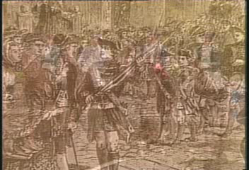
Constitutional Convention

Slide 42
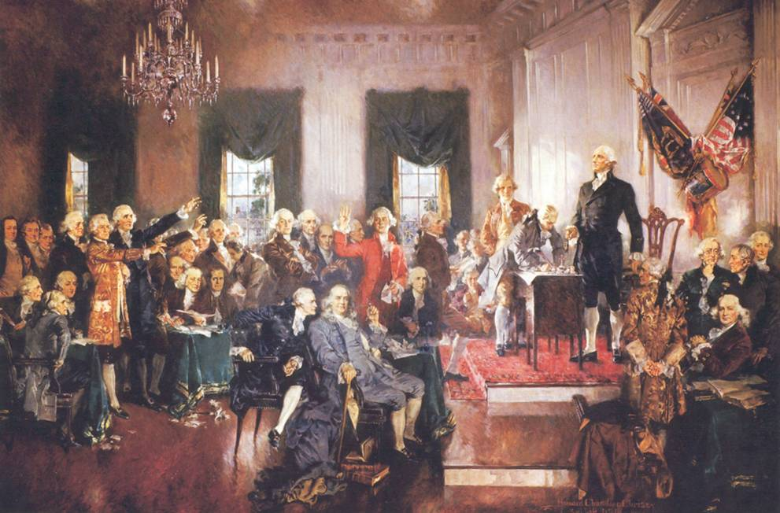

Constitutional Convention
Historical Time Line
1784/01/14 WR - Revolutionary War Ends (Treaty of Paris)
1787/05/25 NA - Constitutional Convention opens
1787/09/17 NA - Final draft of the Constitution sent to Congress 1787/12/07 SH - Delaware
1787/12/12 SH - Pennsylvania
1787/12/18 SH - New Jersey
1788/01/02 SH - Georgia
1788/01/09 SH - Connecticut
1788/02/06 SH - Massachusetts
1788/04/28 SH - Maryland
1788/05/23 SH - South Carolina
1788/06/21 SH - New Hampshire
1788/06/21 NA - Constitution Ratified
1788/06/25 SH - Virginia
1788/07/26 SH - New York
1789/03/04 NA - The Constitution goes into effect

Slide 43
Delegates
May 25, 1787 delegates had assembled at Independence hall.
55 delegates took part representing 12 of the 13 states (Rhode Island did not send representatives)

Slide 44
Delegates
Many well known political leaders of their states.
George Washington- elected presiding officer of the convention by unanimous consent
Benjamin Franklin – elder statesman encouraged delegates to listen to each others opinion.

Slide 45
Delegates
All 55 delegates had extensive experience in government.
46 had served in their colonial or state legislatures and seven had been governor of their states.
At least 21 had fought in the Revolutionary war
Eight had signed the declaration of Independence.

Slide 46
Constitutional Convention (1787)
Major conflicts:
  Large states / small states (representation)
  Slavery

Slide 47
Great Compromise:
Issue of Representation
Virginia Plan–Edmund Randolph
  Framework for a new constitution
  Representation was to be based on the population of each state or the proportion of each state's revenue contribution

Slide 48
New Jersey Plan–William Patterson
Each state should be equally represented regardless of population

Slide 49
Connecticut Compromise
(Great Compromise)
Roger Sherman of Connecticut
Created a bicameral legislature
The first chamber of Congress would be apportioned according to number of inhabitants in each state (House).
In the second chamber, each state would have equal representation (Senate).

Slide 50
Three-fifths Compromise
Fundamental difference lies between slave and non-slave states
Over 90 percent of the slaves lived in five states (Georgia, Maryland, North Carolina, South Carolina, and Virginia)
Compromise result: five slaves would be counted as three persons.
  Supported by slave states to increase representation
  Supported by non-
  slave states that advocated principle of property representation
Left slavery question unresolved until Civil War

Slide 51
Examine the painting on this slide, now put yourself in this painting as a representative of one of the 12 states that sent representatives to Philadelphia. Write a paragraph describing the event that is taking place. How does Christy show the importance of the Constitution. This painting can also be seen on page 158 of your text book.

Slide 52
10 minutes

Slide 53
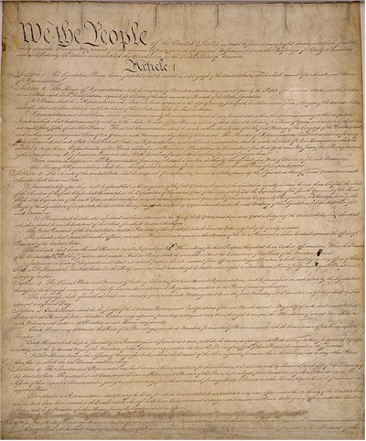
The Principles of the
United States Constitution
10 Jan 2006
17 Jan 07

Slide 54
The Basic Principles of the
U.S. Constitution
Federalism - power is divided among the states and the national government.
Separation of Powers – power was divided vertically through federalism and horizontally through separation of powers among the three branches of government.

Slide 55
The Basic Principles of the
U.S. Constitution
Checks and Balances - The power of each branch of government is checked or limited and balanced by powers held by other branches.

Slide 56
Basic Principles cont.
Popular Sovereignty - all political power rests with the people.
Limited Government - gov’t may only do what the people give it the authority to do.
Judicial Review- power of the Court to determine constitutionality of a gov’t action.

Slide 57
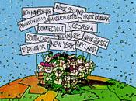
I. Popular Sovereignty
The people hold the ultimate authority
A representative democracy lets the people elect leaders to make decisions for them.

Slide 58
II. Limited Government
Framers wanted to guard against tyranny
Government is limited to the power given them in the Constitution.

Slide 59

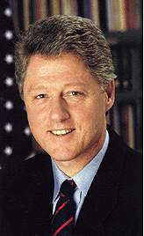
II. Limited Government
The Constitution tells how leaders who overstep their power can be removed

Slide 60
III. Federalism
The division of power between State and National Governments
Some powers are shared
The National Government has the “supreme power”

Slide 61
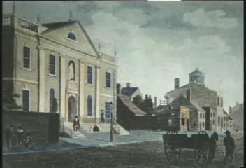
Checks and Balances; Separation of Powers

Slide 62


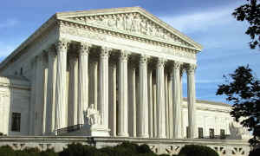
IV. Separation of Powers
No one holds “too much” power
Legislative branch makes the laws
Executive branch carries out the laws
Legislative branch interprets the laws

Slide 63

V. Checks and Balances
Prevents the abuse of power in government
Each branch can check each other branch

Slide 64
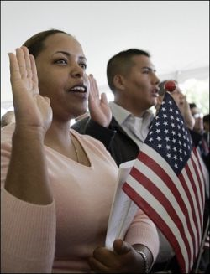
Citizenship Test

Slide 65
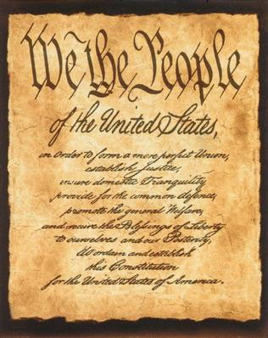
Constitution

Slide 66
The Constitution
Preamble ~
Explains why the Constitution was written
Amendments (27)
~
Describes the rights of the citizens of the United States
Articles
(7)
~
Describe how the government works and how the Constitution works and can be changed

Slide 67
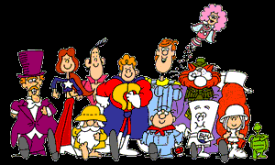
Schoolhouse Rock VHS clip

Slide 68
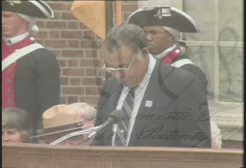
Preamble

Slide 69
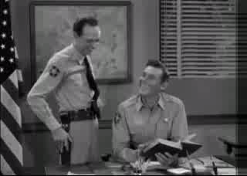
Preamble

Slide 70
Constitution, Preamble
“We the People of the United States in Order to form a more perfect Union, establish Justice, insure domestic Tranquility, provide for the common defense, promote the general Welfare, and secure the Blessings of Liberty to ourselves and our Posterity, do ordain and establish the CONSTITUTION for the United States of America.”

Slide 71
What does the Preamble mean?
We the People of the United States, want to make a better country. We want a court system that treats people fairly and equally. We want peace in our country. We want an army to protect us. We want our people to have the things they need. We want freedom now and in the future. We are writing and signing this Constitution to guarantee we will have these things.

Slide 72
Preamble
You must know the preamble by memory by 19 Jan 2012
Oral Quiz to follow!!

Slide 73
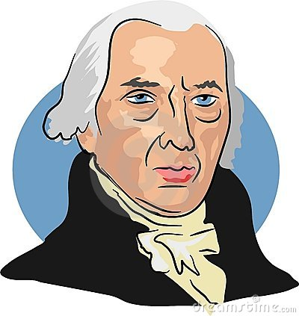
Preamble Oral quiz (12 Jan 2012)
One point deducted for every incorrect or omitted word.

Slide 74
Class work- Homework
20 Jan 2012
American Indians are mentioned twice in the main body of the Constitution. Article I, Section 2, originally excluded Indians from the population counts to apportion congressional representation. Article I, section 8, gives Congress the exclusive right to regulate commerce with Indian tribes. The Constitution also includes an indirect reference to American Indians. Article I, section 10, prohibits the states from entering into compacts, or treaties, with foreign powers, which also includes Indian tribes.
Q: What does the original Constitution reveal about the attitudes toward the American Indians in the late 1700’s?

Slide 75
Homework 1/22/09
Robert Whitehall , an antifederalist who spoke at the Pennsylvania ratifying convention, explained the need for a Bill of Rights. “We know that it is the nature f power to seek its own augmentation (increase), and thus the loss of liberty is necessary consequence of a loose or extravagant delegation of authority…It is our duty to employ the present opportunity in stipulating (demanding) such restrictions as are the best calculated to protect us from oppression and slavery.”
According to the above excerpt how did Whitehall view Government entities? Could this excerpt apply to the processes of Government today? How? 2 Paragraphs.

Slide 76
The Articles of the Constitution
Article I - establishes the legislative branch.
Article II - establishes the executive branch headed by the president.
Article III - establishes the judicial branch.

Slide 77
The Articles of the Constitution
Article III - establishes the judicial branch.
Articles IV – establishes the "full faith and credit clause" that mandates that states honor the laws and proceedings of another state.

Slide 78
The Articles of the Constitution
Articles IV through VII - also include rules on the admission of new states to the union, how amendments can be added to the Constitution, prohibits religious tests for holding office, and set out procedures for the ratification of the document.

Slide 79
Homework 23 Jan 2012
Read Pages 58 - 63.

Slide 80
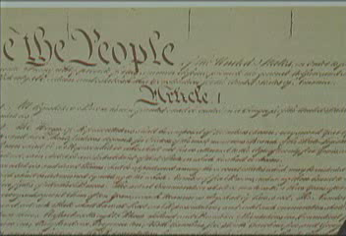
Article One (23 Jan 2012)

Slide 81
Legislative Branch Overview
Senate and House of Representatives
Make our laws
Appropriate Money
Regulate Immigration
Establish Post Offices and Roads
Regulate Interstate Commerce and Transportation
Declare War

Slide 82
Article I
The Legislative Branch
Article I explains the two parts
of Congress and how Congress
works. It also explains the
powers of Congress.

Slide 83
The Legislative Branch
~makes the laws~
House of
Representatives
Senate
Each state has representatives that go to Washington D.C. and work to make laws for our country. The number of representatives from each state depends on the population of the state. Representatives are elected by the people of the state and have 2 year terms.
Each state has two senators that go to Washington D.C. to work and make laws for our country. Senators are elected by the people of the state and have 6 year terms.

Slide 84
Constitution, Article I
Legislative Branch
Section 1
All legislative powers vested in a Congress, which shall include a House and Senate

Slide 85
Constitution, Article I
Legislative Branch
Section 2
Membership of House
Election Cycle: Every 2 years by the people
Age: 25 years
Citizenship: 7 years,
Allocation: based by population

Slide 86
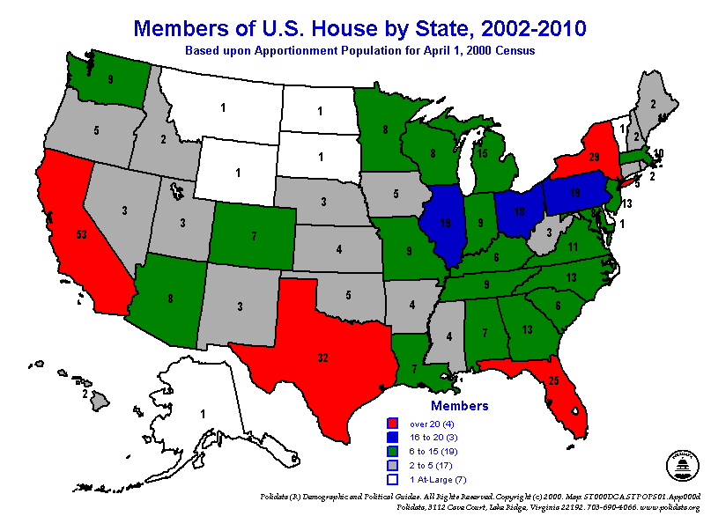
This has changed as of 2011 .

Slide 87
2011 Census Redistricting
According to Polidata projections (the best in the business), eight states are positioned to gain one or more seats in the remapping and 10 states are slated to lose a seat or more.
The gainers are, not surprisingly, primarily in the South and Southwest, the regions that have been growing fastest for much of the past two decades. Among the eight states -- Arizona, Florida, Georgia, Nevada, South Carolina, Texas, Utah and Washington

Slide 88
States to lose a seat
The losers -- again, not surprisingly -- come from the Northeast and the industrial Midwest (a.k.a. the Rust Belt). 10 states -- Ohio, Louisiana, Michigan, Minnesota Pennsylvania, Illinois, Massachusetts, New York, Iowa and New Jersey.

Slide 89
Constitution, Article I
Section 3: Senate
Membership: 2 from each state
Election cycle: 6 years, 1/3 up for election every 2 years.
Age: 30 years

Slide 90
Constitution, Article I
Section 3: Senate
Citizenship: 9 years
Provide for senate leadership
Try all impeachments 2/3 majority for convictions
The Vice-President will be the President of the Senate

Slide 91

Article I
Section 4
Each state will decide when and where it will have elections for the House of Representatives and the Senate.
Congress will meet once a year.

Slide 92
Article I
Section 5
In order for Congress to meet, a majority (more than half) of the members must be at the meeting.

Slide 93

Article I
Section 6
Members of Congress are paid with money from the Treasury of the United States (“bank” of the federal government)

Slide 94
Article I
Section 6
Members of Congress cannot be arrested while Congress is meeting except if they have committed a serious crime (such as murder).

Slide 95
Constitution, Article I
Section 7
Bills of Revenue originate in the House
Process for Bills to become law

Slide 96
How A Bill Becomes a Law!
IBILL
Congress votes again, if 2/3 of the members agree
Congress
If the President vetoes the bill
If the President approves and signs the bill
President
If the President keeps the bill for ten days and does not sign it

Slide 97
School House Rock
Bill!!
http://www.fanpop.com/spots/school-house-rock/links/14616

Slide 98
Constitution, Article I
Section 8: Specific Powers of Congress
Lay and collect taxes
Provide for common Defense, General Welfare
Borrow money

Slide 99
Constitution, Article I Section 8 Con’t
Regulate commerce with Foreign Nations
Coin money
Confirm Presidential appointments (Senate)
Establish Post Offices
Declare War

Slide 100
Constitution, Article I Section 8 Con’t
Raise and Support Armies
Maintain Navy
All laws necessary and proper

Slide 101
Constitution, Article I
Section 9
Congress cannot make laws to stop the buying and selling of slaves until 1808. (Slavery was made illegal by Amendment 13 in 1865)
A person who is arrested must be told the reason for the arrest.

Slide 102
Constitution, Article I
Congress cannot make a law to punish a person for a serious crime. A person must have a trial.
Congress cannot charge a tax on things sent out of state.

Slide 103
Homework 24 Jan 2012 (25 PTS)
Read 64-69
Complete “Thinking Things Through” 1-4
Complete “Reviewing the Facts” 1-8

Slide 104
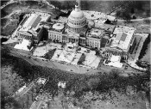
(Review Homework From 24 Jan 2012)
HW- 25 points
Notes:
Complete “Thinking Things Through” 1-4
Complete “Reviewing the Facts” 1-8

Slide 105
Constitution, Article I
Section 9 Con’t
Ships from one state entering the port of another state cannot be taxed.
Money cannot be spent from the U.S. Treasury without the permission of Congress.
The government cannot give people the title of king or queen.

Slide 106
Constitution, Article I
Section 10
States cannot make treaties with other countries or become part of another country.
States cannot make laws to punish a person for a serious crime. A person must have a trial.

Slide 107
Constitution, Article I
Section 10
States cannot have their own armies.
States cannot fight in wars with other states or countries unless Congress says it is okay.

Slide 108
Homework 18 Jan 2011
18 Jan 11-Write a summary of article I. This summary must include a brief description of each section listed in article I.
Please write this summary in your own words

Slide 109
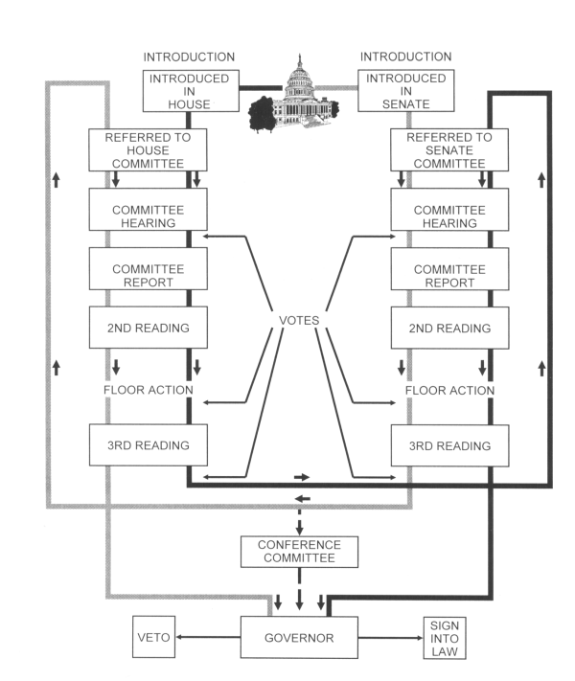
The process of creating a law

Slide 110
Checks and Balances
Prevents the abuse of power in government
Each branch can check each other branch

Slide 111
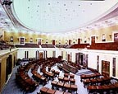
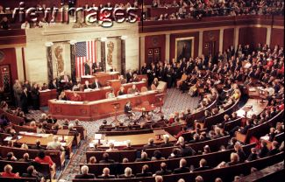
Legislative Checks
Override president’s veto
Ratify treaties
Confirm executive appointments

Slide 112
Legislative Checks
Impeach federal officers and judges
Create and dissolve lower federal courts

Slide 113
Homework 25 Jan 2012
Prepare for Constitution Article 1 Test
Study all information in power point and your constitution Handbook
Know the Vocab words on page 57,63 and 69.

Slide 114
Test U.S. Constitution Article #1
01/26/2012

Slide 115
Article II—Executive Branch
(Begin by 27 Jan 2012)

Slide 116
Homework 26 Jan 2012
Read Pages 70- 74. Complete Words to Know on page 75, and “Thinking Things Through” Q1-5.

Slide 117
Homework 27 Jan 2012
Complete “Reviewing the facts” on page 75.

Slide 118
Executive Branch
The President of the United States is also the:
Chief Executive
Chief of State
Chief Legislator
Commander in Chief

Slide 119
Article II—Section One
There will be a President and a Vice President.
To become President or Vice President a person must:
~ be born in the United States
~ be at least 35 years old
~ must have lived in the United States for 14 years

Slide 120
Article II—Section One
If the President dies, quits or gets very sick, the Vice President will become President.
The President will be paid. The President cannot have any other jobs while he or she is president.

Slide 121
Article II—Section One
Clause one—How long is the President in office?
  Four year terms
  1951—22 Amendment changed it to a maximum of 2 terms or ten years

Slide 122
Article II—Section One
  FDR served the most years in office (12)
  Grover Cleveland served 2 nonconsecutive terms (22nd & 24th President of the United States)

Slide 123
Article II—Section One
Clause Two - How is the U.S. President elected?
  Electors—Presidential voters
  Electoral college—system used to elect the President, founders didn’t want a pure form of democracy, wanted a representative democracy

Slide 124
Article II—Section One
  538=total number of Presidential electors, must have 270 to become president
  Purpose of the electoral college---give each state somewhat equal representation

Slide 125
Article II—Section One
Clause Three—former method of electoral college (changed by 12th Amendment)
  Thomas Jefferson and Aaron Burr each had the same number of electoral votes (73)

Slide 126
Article II—Section One
  Tie would go to the House of Representatives and each state gets one vote, still have to get a majority

Slide 127
Article II—Section One
Close Elections in History
Popular Votes Electoral Votes
Hayes (1876) 4,033,950 185
Tilden (1876) 4, 284,855 184
Bush (2000) 50,456, 169 271
Gore (2000) 50, 996, 116 266

Slide 128
Article II—Section One
Clause 4 - When does the Electoral College vote?
  Official ballot for President is cast by the Electoral College
  Electoral College—cast votes on the first Monday after the second Wednesday in December

Slide 129
Article II—Section One
Clause Five—What are the qualifications for U.S. President?
  35 years old, 14 year resident, natural born citizen
  1st seven presidents were not natural born

Slide 130
Article II—Section One
  1st natural born was Martin Van Buren
  Youngest—Teddy Roosevelt=42
  Youngest elected—John Kennedy=43
  Oldest—Ronald Reagan=69

Slide 131
Article II—Section One
Clause Six - Changed by the 25th Amendment
  The amendment provides for involuntary removal of the President from his power

Slide 132
Article II—Section One
Clause Seven - Can the Congress decrease the President’s salary midway through the term? (No)
  Can not increase or decrease during the term
  Can not receive any other salary from the federal government during the term

Slide 133
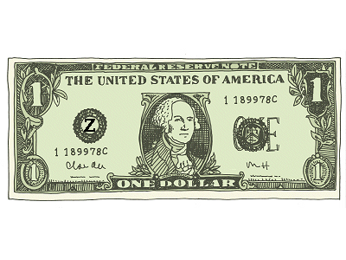
Article II—Section One
  2001 - Salary doubled to $400,000/ year
  Pays taxes on the income

Slide 134
Article II—Section One
Clause Eight - The Presidential Oath
  Any judge can swear a president into office, most common is the Chief Justice of the Supreme Court
  Calvin Coolidge—Sworn in by his father - a Justice of the Peace

Slide 135
Article II—Section One
  LBJ—sworn in on Air Force One by a Dallas judge
  “So help me God.”---Washington added this to Oath

Slide 136
Homework 30 Jan 2012
Read 76-81
Complete Reviewing the facts on page 81.
Words to Know P81

Slide 137
Article II Section Two
Powers of the President
(Should begin by 30 Jan 2012)

Slide 138
Article II Section Two
Clause One—What are the Military Powers?
  President is the head of the military - Commander in Chief
  President can grant pardons to criminals who have committed federal crimes

Slide 139
Article II Section Two
Clause Two—Treaties and Appointments
  President needs approval by the U.S. Senate to create certain and specific treaties and appointments

Slide 140
Article II Section Two
Clause Three - What if an ambassador dies when the Senate is in recess?
  The President can fill position by temporarily

Slide 141
The Cabinet
The Cabinet is a group of people who are in charge of different things in the government. The Cabinet members are chosen by the President. The Cabinet is now made up 0f these members:
Secretary of State
Secretary of the Treasury
Secretary of Defense
Attorney General
Secretary of the Interior
Secretary of Agriculture
Secretary of Commerce
Secretary of Labor
Secretary of Health and Human Services
Secretary of Housing and Urban Development
Secretary of Transportation
Secretary of Education
Secretary of Energy
Secretary of Veterans’ Affairs

Slide 142
Article II - Section Three
Duties of the President?

Slide 143
Article II - Section Three
What are the duties of the President?
State of the Union Address - The President explains the condition of the country - usually in January

Slide 144
Article II - Section Three
What are the duties of the President?
President can convene and adjourn Congress in the event of a special circumstance
Main job is to see that the laws are faithfully executed

Slide 145
Article II – Section Four Impeachment

Slide 146
Section Four--Impeachment
President, Vice President, and all civil officers can be impeached
Can only be impeached for three things: treason, bribery, or other high crimes and misdemeanors.
Judges are civil officers that are the most often convicted of impeachment

Slide 147
V. Checks and Balances
Prevents the abuse of power in government
Each branch can check each other branch

Slide 148

Executive Checks
Propose laws to Congress
Veto laws made by Congress
Negotiate foreign treaties
Appoint federal judges
Grant pardons to federal offenders

Slide 149
Homework Review
Review all homework Responses.
Notes:
If time permits also go over Vocab words if time permits. Check out word blank on test page.

Slide 150
Homework 01 Feb 2012
READ 83-86Complete “Words to Know” on page 87.
Complete “Reviewing the Facts Q:1-10 P.87

Slide 151
Test (Vocabulary) Article 1 and 2
01 February 2012

Slide 152
Article III—Judicial Branch
Section One—Federal Courts
Should begin 02 Feb 2012

Slide 153
Homework Review
Review homework Responses.

Slide 154
Judicial Branch
Supreme Court and other Federal Courts
Preserve and protect the rights guaranteed by the Constitution

Slide 155
Judicial Branch
Considers cases involving national laws
Declares laws and acts “unconstitutional”

Slide 156
Article III Section 1
  Clause One - Who interprets the law?
  Judicial branch interprets the law (Courts)
  Legislative makes the law (Congress)

Slide 157
Article III Section 1
  Clause One - Who interprets the law?
  Executive enforces the law (President)
  Judicial powers—the power to hear cases
  Federal Judges are appointed by the President and approved by the Senate

Slide 158
Article III - Section Two
Jurisdiction of the Federal Courts
03 Jan 2011

Slide 159
Article III - Section Two
Clause One—Jurisdiction
  Jurisdiction—power and right to apply law
  Plaintiff—one who brings charges
  Defendant—one being charged

Slide 160
Article III - Section Two
  Clause One—Jurisdiction
  Criminal case—when government is plaintiff (California vs. O.J. Simpson)
  Civil case—between two or more people (O. J. Simpson vs. Goldman family)

Slide 161
Article III - Section Two
Clause Two - How does a case reach the Supreme Court?
  SC has two kinds of jurisdiction:
  a. Original—a case is first heard by the SC

Slide 162
Article III - Section Two
b. Appellate—cases that are appealed by a lower court (Most cases come to the SC through appellate jurisdiction)

Slide 163
Article III - Section Two
Clause Three—Conduct of Trials
  Guarantees a trial by jury in federal courts
  Extradition—returning a fugitive to the state in which the crime was committed

Slide 164
Section Three--Treason

Slide 165
Section Three--Treason
Clause One - What is treason?
  Only crime defined in the Constitution (helping a nation’s enemies or carrying out war against your country)

Slide 166
Section Three--Treason
Clause One - What is treason?
  2 ways of being convicted:
  1. Confession in court room
  2. Having two witnesses testify against you

Slide 167
Section Three--Treason
Clause Two - What is the penalty for treason?
  Treason can only happen during time of war
  Maximum penalty is death

Slide 168
Clause Two - What is the penalty for treason?
  Espionage, Sabotage, conspiracy to overthrow the government are all similar to treason but happen during times of peace

Slide 169
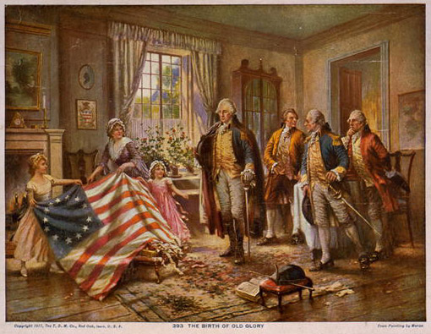

Slide 170
V. Checks and Balances
Prevents the abuse of power in government
Each branch can check each other branch

Slide 171

Judicial Checks
Declare executive acts unconstitutional
Declare laws unconstitutional

Slide 172
Judicial Checks
Declare acts of Congress unconstitutional
The Supreme Court holds the final check

Slide 173
Test (article I, II, and III)
02/06/12
Notes:
The test has four essay questions that are worth ten points each. Give the students these questions ahead of time.
They are:
1. Write the preamble of the Constitution. Then, describe in your own words the six goals stated in the Preamble.
2. Suppose the President could not veto a bill. How would the system of checks and balances be changed?
3. What was the Great Compromise? Who authored this plan? What state was the author from? Why was it important?
4. Describe the Virginia and New Jersey plan, include the authors name.
Also: Create a diagram that shows how a bill becomes a law; include all Presidential options available in this process.

Slide 174
Homework 06 Feb 2012
Read 88-95. Complete Reviewing the Facts P94-Q1-10
***Important – Study reviewing the facts. We will not go over these facts, but I promise you will see these facts again!!

Slide 175
Homework 07 Feb 2012
Complete Reviewing the Facts P95
***Important – Study reviewing the facts P95 We will not go over these facts, but I promise you will see these facts again!!
Notes:
Must Stress the importance of this work. Our constitution final test mirrors this section of reviewing the facts. Make sure your review this homework!!!!

Slide 176
Article IV—Relations Among the States
(Should begin NLT 08 Feb 2012)

Slide 177
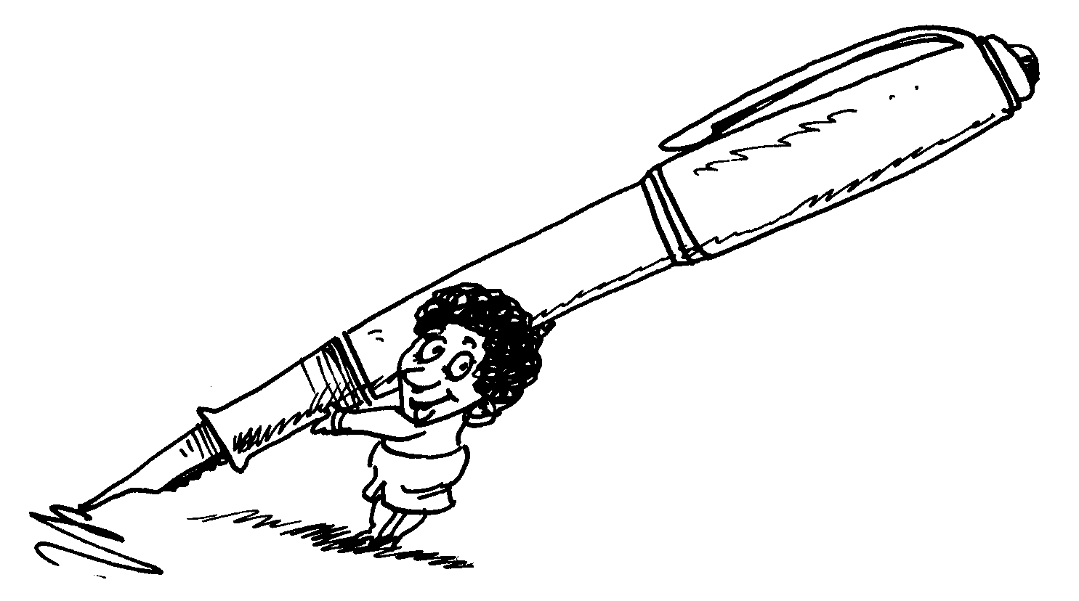
Note Taking
Please, Please take great notes during this section and rewrite your notes daily if possible. Your test on 13 Feb 2012 will allow use of your notes.

Slide 178
Article IV- Section One—Official Acts
Clause One - I live in Minnesota do I have to follow the rules of North Dakota? (Yes - full faith and credit)
  Each state shall respect legal action of another state (marriage licenses, speed limits, fines, drivers license)

Slide 179
Article IV - Section Two—Privileges of Citizens
Clause One - Can I buy a lake home in Minnesota if I live in Illinois?
(Yes)
State cannot discriminate against you because you are a citizen of another state.

Slide 180
Article IV - Section Two—Privileges of Citizens
Clause Two—Extradition
  Bringing back a fugitive (interstate rendition)
  “shall”—tradition, custom, and the courts have interpreted this to mean “may”
  Governors can refuse to return a fugitive

Slide 181
Article IV - Section Two—Privileges of Citizens
Clause Three—Fugitive slaves (nonexistent) - Changed by amendment after the Civil War.
  “persons” refer to slaves
  If a slave escapes from a slave state to a free state, the slave is not free

Slide 182
Article IV- Section – Three -New States
Clause One - How does a state become admitted to the Union?
  Only Congress can admit states

Slide 183
Article IV - Section Four - Guarantees of the State
The federal government guarantees each state a republic
Republic—Representative democracy where we elect officials to represent our concerns
The government will protect us from invasions

Slide 184
Article V
Methods of Amendments

Slide 185
Article V - Methods of Amendments
1st Method - need 2/3 of Congress to PROPOSE an Amendment
2nd Method - need 2/3 of the state legislatures to ask Congress for a national convention to propose an Amendment (this method has never been used)

Slide 186
Article V - Methods of Amendments
Need 3/4 of all states to actually ratify or APPROVE an Amendment. This is done by state legislatures or a special ratifying convention.
Over 4000 proposed Amendments since the early 1800s

Slide 187
Article V - Methods of Amendments
Only 27 have been ratified
1st Ten Amendments were a package deal, 18 and 21 cancel each other out, leaves 15 separate Amendments that went through the process

Slide 188
Article VI—General Provisions

Slide 189
Article VI – Section one
Section One - Could the new government evade debts owed as a result of the Revolutionary War?
New government can’t evade old debts

Slide 190
Article VI- Section Two
Section Two - Is the federal law the supreme law of the land?
  Yes - State law cannot override a federal law

Slide 191
Article VI – Section Three
Section Three—all officers, state and federal, must take an oath to support the U.S. Constitution
  Can’t have a religious requirement has part of the Oath

Slide 192
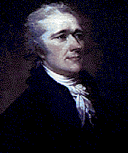
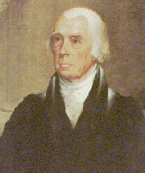
Article Seven--Ratification

Slide 193
Ratification of Constitution
Section One—
  Convention—calling of delegates from each state to ratify the Constitution
  Must have nine states to approve the Constitution

Slide 194
Finished product
On September 17, 1787, after 16 weeks of deliberation, the finished Constitution was signed by 39 of the 42 delegates present. Franklin, pointing to the half-sun painted in brilliant gold on the back of Washington's chair, said:
I have often in the course of the session...looked at that [chair] behind the president, without being able to tell whether it was rising or setting; but now, at length, I have the happiness to know that it is a rising, and not a setting, sun.

Slide 195
CLOSURE
Constitution was finished September 17, 1787
55 total delegates during the convention
42 were present on the final day but only
39 people signed the Constitution
The following two years provided debate for ratification
The United States Constitution took effect April 30 , 1789 when George Washington was sworn in as President

Slide 196
Summary
Constitution was finished September 17, 1787
55 total delegates during the convention
42 were present on the final day but only

Slide 197
Summary
39 people signed the Constitution
The following two years provided debate for ratification

Slide 198
Finish ??
The Convention had decided that the Constitution would take effect upon ratification by conventions in nine of the 13 states. By June 1788 the required nine states ratified the Constitution, but the large states of Virginia and New York had not. Most people felt that without the support of these two states, the Constitution would never be honored. To many, the document seemed full of dangers: would not the strong central government that it established tyrannize them, oppress them with heavy taxes and drag them into wars?

Slide 199
Finish??
When the first Congress convened in New York City in September 1789, the calls for amendments protecting individual rights were virtually unanimous. Congress quickly adopted 12 such amendments; by December 1791, enough states had ratified 10 amendments to make them part of the Constitution. Collectively, they are known as the Bill of Rights. Among their provisions: freedom of speech, press, religion, and the right to assemble peacefully, protest and demand changes (First Amendment); protection against unreasonable searches, seizures of property and arrest (Fourth Amendment); due process of law in all criminal cases (Fifth Amendment); right to a fair and speedy trial (Sixth Amendment); protection against cruel and unusual punishment (Eighth Amendment); and provision that the people retain additional rights not listed in the Constitution (Ninth Amendment).

Slide 200
Summary
The United States Constitution took effect April 30 , 1789 when George Washington was sworn in as President

Slide 201
Finished!!
Since the adoption of the Bill of Rights, only 16 more amendments have been added to the Constitution. Although a number of the subsequent amendments revised the federal government's structure and operations, most followed the precedent established by the Bill of Rights and expanded individual rights and freedoms.
Now allow me to introduce you to the first ten amendments!!

Slide 202
Homework 10 Feb 2012
Read 99-105

Slide 203
Test (article IV Through VII)
13 Feb 2012

Slide 204

Constitution Lesson

Slide 205
Amendments to the Constitution
ARTICLES IN ADDITION TO, AND AMENDMENTS OF, THE CONSTITUTION OF THE UNITED STATES OF AMERICA, PROPOSED BY CONGRESS, AND RATIFIED BY THE LEGISLATURES OF THE SEVERAL STATES, PURSUANT TO THE FIFTH ARTICLE OF THE ORIGINAL CONSTITUTION.

Slide 206

The First Ten Amendments
Should begin 0n 14 Feb 2012

Slide 207
Amendments to the Constitution
[I.]
Congress shall make no law respecting an establishment of religion, or prohibiting the free exercise thereof; or abridging the freedom of speech, or of the press; or the right of the people peaceably to assemble, and to petition the Government for a redress of grievances.

Slide 208
Freedom of Religion
“Congress shall make no law respecting an establishment of religion or prohibiting the free exercise there of”
Two clauses:
  Establishment clause
  Free Exercise clause

Slide 209
Establishment and free exercise clause often conflict with each other
In schools, the religion issue is most prevalent
If a student raises his hand and says “teacher, can we say an opening prayer before this test”
If the teacher says:
“Yes”, It looks like establishment of religion
“No”, It is deigning a student free exercise.

Slide 210
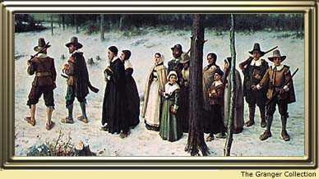
Establishment Clause—Government cannot promote religion

Slide 211
Establishment clause-Government
Cans Cannot
Teach about religions in school
Allow voluntary prayer in many examples
Transport students to a religious school
Read Bible for culture or literacy content
Set a state religion
Government cannot order a prayer
Teach religious doctrine in the school
Pay seminary teachers
Teach creationism

Slide 212
Free Exercise—The person
Can Cannot
Choose whatever religion
Lead a prayer in most examples
Ask questions about religions
Worship who ever you want
Break the law and claim it is religious belief
Raise children without education
Deprave children of basic needs

Slide 213
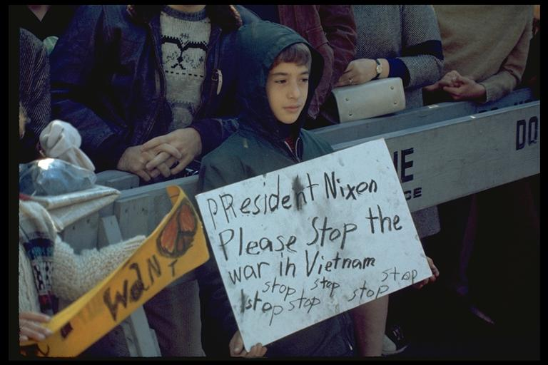
Freedom of speech
“Congress shall make no laws . . . abridging the freedom of speech”

Slide 214
Free speech– The individual can:
Say any political belief
Protest (without getting out of control)
Say things about someone that are true
Burn the flag
Say racist and hate slogans
Free speech means someone might say something you disagree with

Slide 215
Free speech—limits on the person
Threaten to blow up airplanes, schools or the president
Sexual harassment
Create too much social chaos
Extremely crude language in a public form
Disrespectful, vulgar language in schools
Hate crimes

Slide 216
Freedom of the press
Congress shall make no law . . . abridging . . . the freedom of the press.”

Slide 217
Freedom of the press-the press
Can Cannot
Print any political position
Make fun of people, especially politicians
Expose wrongs by the government
Say things you might not agree with
Libel– intentionally injuring a person’s reputation by false facts
Disclose defense-security secrets
Detail how to make a certain weapons

Slide 218
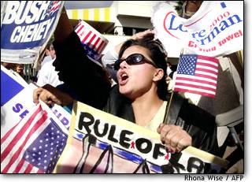
Freedom of Assembly
Congress shall make no law . . . Abridging . . . The people to peaceably assemble”

Slide 219
Freedom of Assembly--Individual
Can Cannot
Protest
Parade (with a permit)
Parade chanting hate slogans
Gang members can congregate in public
Protest by throwing rocks and breaking windows
Hang out on private land against owners will—loitering
Teen curfew

Slide 220
Petition the Government
“Congress shall make no law . . . Abridging . . . the people. . . to petition the government for a redress of grievances”

Slide 221
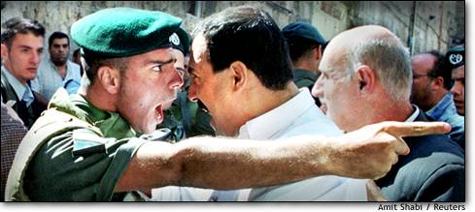
Petition the government
You may sue the government for wrongs
You cannot be punished for exposing wrongs by the government
The courts decide the wrongs

Slide 222
Amendments to the Constitution
[II.]
A well regulated Militia, being necessary to the security of a free State, the right of the people to keep and bear Arms, shall not be infringed.

Slide 223
2nd Amendment—Right to bear arms
“A well-regulated militia, being necessary to the security of a free state, the right of the people to bear arms shall not be infringed.”

Slide 224
What is the debate with the right to bear arms?
How much can the government keep guns from criminals and youth?
In order to keep guns away from criminals, does that limit the right of law abiding citizens?

Slide 225
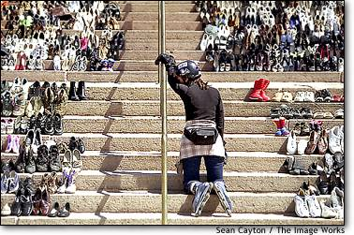
Gun debate continued
Thousands of people die every year because of guns
Thousands of crimes are prevented because of guns
Shoes representing gun deaths.

Slide 226
Amendments to the Constitution
[III.]
No Soldier shall, in time of peace be quartered in any house, without the consent of the Owner, nor in time of war, but in a manner to be prescribed by law

Slide 227
Third Amendment
The Government cannot force you to shelter soldiers in your home without your consent in time of war or peace.

Slide 228
Amendments to the Constitution
[IV.]
The right of the people to be secure in their persons, houses, papers, and effects, against unreasonable searches and seizures, shall not be violated, and no Warrants shall issue, but upon probable cause, supported by Oath or affirmation, and particularly describing the place to be searched, and the persons or things to be seized.

Slide 229
Fourth Amendment
What does a policeman need in order to search your home?
  A warrant given to him by a judge
  Probable cause is also needed

Slide 230
[V.]
No person shall be held to answer for a capital, or otherwise infamous crime, unless on a presentment or indictment of a Grand Jury, except in cases arising in the land or naval forces, or in the Militia, when in actual service in time of War or public danger; nor shall any person be subject for the same offence to be twice put in jeopardy of life or limb; nor shall be compelled in any criminal case to be a witness against himself, nor be deprived of life, liberty, or property, without due process of law; nor shall private property be taken for public use, without just compensation

Slide 231
Fifth Amendment
You cannot be tried for the same crime twice—called “Double Jeopardy”
You do not have to testify against your self. “I plead the fifth”
You must have due process of law before you are convicted
The government cannot take your land unless it pays.

Slide 232
Amendments to the Constitution
[VI.]
In all criminal prosecutions, the accused shall enjoy the right to a speedy and public trial, by an impartial jury of the State and district wherein the crime shall have been committed, which district shall have been previously ascertained by law, and to be informed of the nature and cause of the accusation; to be confronted with the witnesses against him; to have compulsory process for obtaining witnesses in his favor, and to have the Assistance of Counsel for his defence

Slide 233
Sixth Amendment
Right to speedy trial by impartial jury—meaning not favoring either side

Slide 234
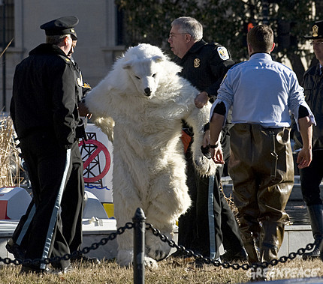
Sixth Amendment continued
You must be told of charges
You must be provided a lawyer if you cannot afford one

Slide 235
Amendments to the Constitution
[VII.]
In Suits at common law, where the value in controversy shall exceed twenty dollars, the right of trial by jury shall be preserved, and no fact tried by a jury, shall be otherwise re-examined in any Court of the United States, than according to the rules of the common law

Slide 236
Amendments to the Constitution
[VIII.]
Excessive bail shall not be required, nor excessive fines imposed, nor cruel and unusual punishments inflicted.

Slide 237
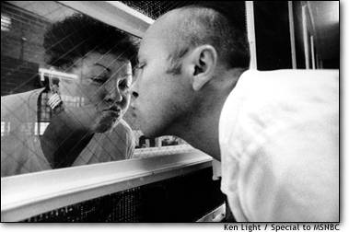
Eighth Amendment
No excessive bail
No cruel and unusual punishment
Prisoner kissing his Mom in prison

Slide 238
Amendments to the Constitution
[IX.]
The enumeration in the Constitution, of certain rights, shall not be construed to deny or disparage others retained by the people.

Slide 239
Amendments to the Constitution
[X.]
The powers not delegated to the United States by the Constitution, nor prohibited by it to the States, are reserved to the States respectively, or to the people.

Slide 240

10th Amendment
The 10th Amendment states that any power not granted to the federal government belongs to the states.

Slide 241
The End
This is the end of our study of the constitution. I hope you now have a better understanding of how our country’s laws are created and how our government works.
Your test is tomorrow, the test will include everything provided in this presentation and in the constitution booklet.
Study hard and you will do well!!!!
Begin your study Now!!!!!

Slide 242
Constitution Final Test
16 Feb 2012

Slide 243
References
Our Constitution: The Document that Gave Birth to a Nation. Rainbow Educational Media (1988). Retrieved December 30, 2005, from unitedstreaming: http://www.unitedstreaming.com/
Picture: Constitutional Convention. Howard Christy. (1940). Retrieved December 30, 2005, from www.constitution.org/ img/christy_wash.jpg

