Slide 1


KFN
The Civil War

Slide 2
Homework
Read Chapter 12
Prepare for a daily quiz starting on 08 May 2012.

Slide 3
Objectives:
What attempts were made to compromise with the secessionists?
How did the fall of Fort Sumter affect the relationship between the Union and the Confederacy?
What advantages did each side possess at the beginning of the war?
What were the consequences of the First Battle of Bull Run?

Slide 4
Attempts to compromise
The Union Dissolves
The Crittendon Compromise proposed that the Union be preserved but that the Missouri Compromise line extend through the rest of the western territories.
Notes:
Series of compromises in 1860 – 61 intended to forestall the American Civil War. Sen. John J. Crittenden proposed constitutional amendments that would reenact provisions of the Missouri Compromise and extend them to the western territories, indemnify owners of fugitive slaves whose return was prevented by antislavery elements in the North, allow a form of popular sovereignty in the territories, and protect slavery in the District of Columbia. The plan was rejected by president-elect Abraham Lincoln and narrowly defeated in the Senate.

Slide 5
The War Begins
The Big Idea
Civil war broke out between the North
and the South in 1861.
Main Ideas
Following the outbreak of war at Fort Sumter, Americans chose sides.
The Union and the Confederacy prepared for war.
When Abraham Lincoln was elected as president in 1860. Southerners thought the government was becoming too strong. They did not think the government had the right to tell them how they should live. Southerners felt if they stayed in the United States, the North would control them.

Slide 6
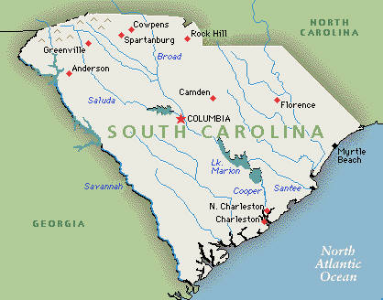
February 1861
The South Carolina legislature called a state convention and delegates voted to remove the state of South Carolina from the united States of America.

Slide 7
Main Idea 1:
Following the outbreak of war at Fort Sumter, Americans chose sides.
Seven southern states seceded as Lincoln took office.
South Carolina was the first to leave the Union and form a new nation called the Confederate States of America. Four months later, six other states seceded. They were Georgia, Florida, Alabama, Mississippi, Texas and Louisiana. Later Virginia, Arkansas, North Carolina, and Tennessee joined them.
Lincoln refused to recognize secession and tried desperately to save the nation.
Confederate officials began seizing federal-mint branches, arsenals, and military posts.
Notes:
At a convention in in Montgomery, Alabama, the seven seceding states created the Confederate Constitution and Jefferson Davis was named the Provisional president of the Confederacy. Four more states soon proclaimed secession – Virginia, Arkansas, Tennessee, and North Carolina, making eleven states the Confederate states of America.

Slide 8
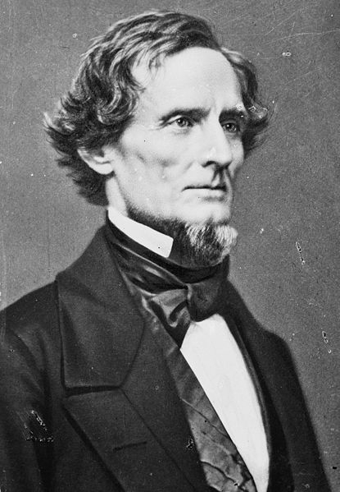
Jefferson Davis
________ is the President of the Confederate States of America

Slide 9
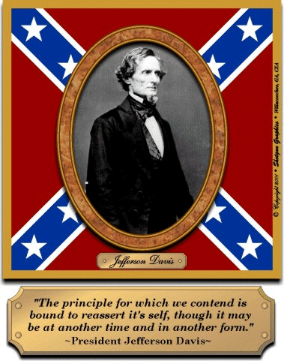
Jefferson Davis
Elected to a six year term as President of the Confederacy, inaugurated in Richmond, Va. (Capital of the Confederacy) on 22 Feb 1861.
Notes:
Jefferson Davis was born June 3, 1808, in that portion of Christian county, Kentucky, which was afterwards set off as Todd county – youngest of ten children. Accepted an Appointment to West Point in 1824- married Sarah Taylor – Daughter of Zachary Taylor, Fought and injured in the Mexican War, severed as Senator for Mississippi and Secretary of War for Franklin Pierce. Resigned his Senate Seat on 21 Jan 1861 when Mississippi seceded. Captured and imprisoned in Fort Monroe on 10 May 1865. Died in New Orleans, La. – 06 December 1889

Slide 10
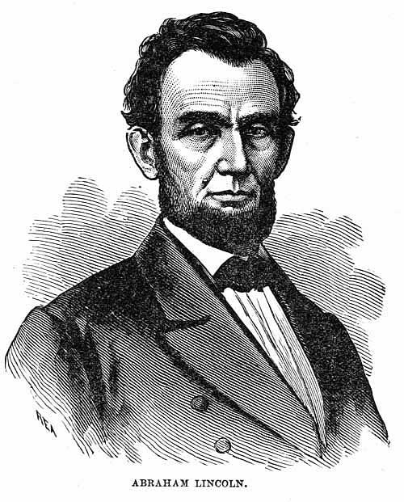
Abraham Lincoln
At his Inauguration on March 4, ________ announced that he would not accept secession.

Slide 11
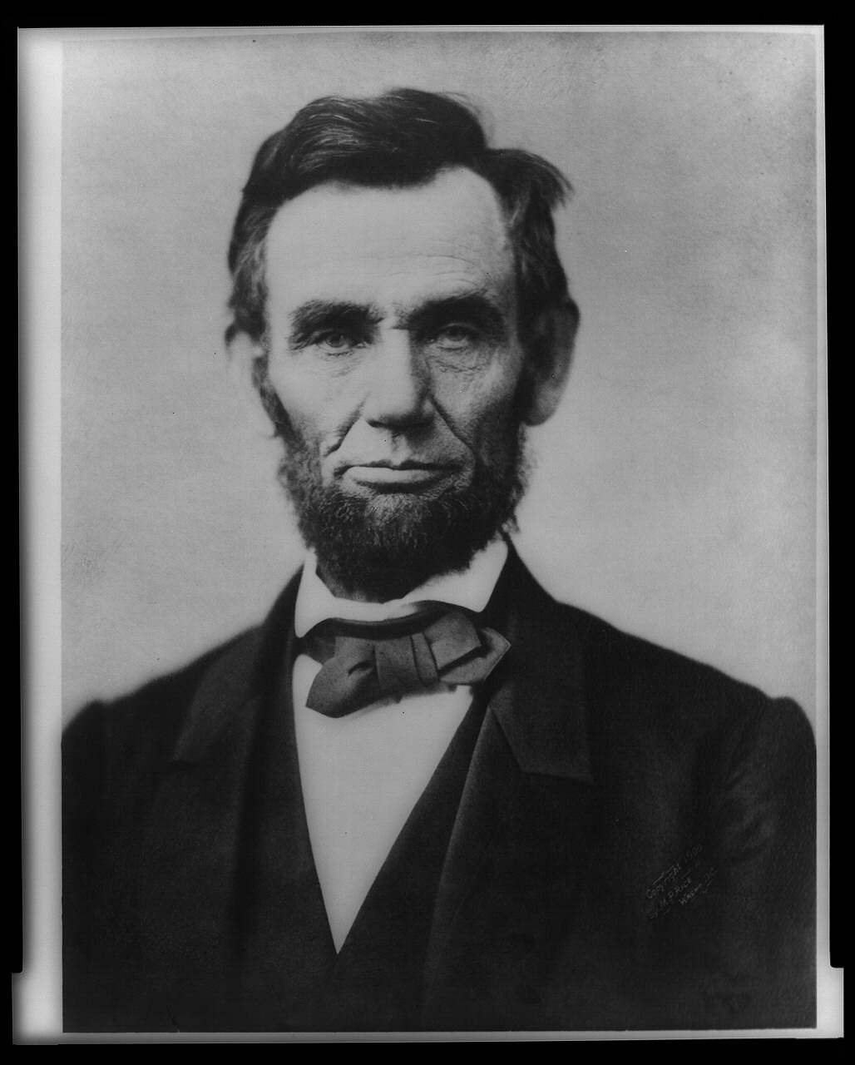
…was the president-elect who had to deal with 7 states seceding before his inauguration in 1861.

Slide 12
ANSWER: Abraham Lincoln

Slide 13
Northern advantages
Comparing North and South
larger population
greater industrial resources
more railroad lines
possession of the U.S. Navy
Southern advantages
would be fighting a defensive war
excellent military leaders

Slide 14
Northern and Southern Resources
The North
Population of 22 million
Some 22,000 miles of railroad track
More developed economy, banking system, and currency
Strategy—General Winfield Scott planned to blockade southern ports and to capture Mississippi River to divide the South.
The South
Strong military tradition that put many smart officers into battle.
Advantages of fighting on home soil – only had to defend itself until the North grew tired of fighting.
Strategy—tried to win foreign allies through cotton diplomacy: idea that Britain would support Confederacy because it needed the South’s cotton.

Slide 15
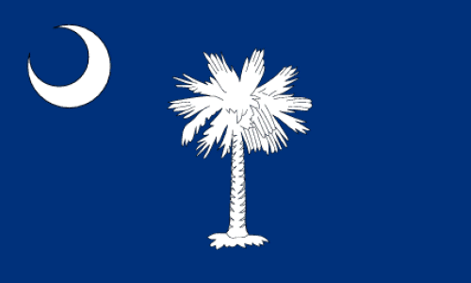
Essential Question
How did the North feel about South Carolina’s act of secession?

Slide 16
ANSWER
Federal officials deemed the act as unconstitutional, or illegal, while southerners believed that if a state entered the Union voluntarily, it also had the right to leave it.

Slide 17
Answer Continued
Lincoln believed that the Union was older than the Constitution. He said that secession was illegal and that any violence supporting it would be viewed as revolutionary, and an act of war. Lincoln believed that the Union would hold all federal property in the South and not give it up.

Slide 18
Essential Question
What attitudes did citizens in different areas have about succession? How did they make their feelings known?

Slide 19
ANSWER
North – Northern people opposed the idea of secession. They said states could not leave the Union. The Border States of Kentucky, Missouri and Maryland voted against secession. In the Border State of Delaware, only a few slaveholders supported secession.

Slide 20
ANSWER:
South – Southern states felt that states existed before the Federal government therefore, they had the right to withdraw from the Union. They argued that they voluntarily joined the Union. The upper southern states joined the Confederacy on the idea of secession.

Slide 21
KENTUCKY
DELAWARE
MISSOURI
MARYLAND
…were slave states strategically located between the North and the South that stayed in the Union.

Slide 22
June 1861
West Virginia joined the Union as a new state over the issue of secession. (The Federal Government approved the succession of Va. And created a new state. ??) President Lincoln stated his intention to preserve the Union. He argued that no state could lawfully get out of the Union. Senator Stephen Douglas (Democrat) said, “Every man must be for the U.S. or against it. There can be no neutrals in this war, only patriots – or traitors.”
Notes:
Lincoln and his constitutions stated unconstitutional to secede, yet they (Congress w/Lincoln’s approval) allow citizens from Va. To secede and create a new state West Virginia – was this action constitutional??? This sounds like a good essay question.

Slide 23
Emotions ran high on both sides. Disagreements over secession deeply divided many friends and families. With no solutions in sight, the country headed towards war.

Slide 24
The Union and the Confederacy prepared for war.
Volunteer armies would fight the battles. Thousands of men joined the armies.
Civilians helped those in uniform.
  Raised money, ran hospitals, served as nurses
  Sent supplies to troops
Both armies faced shortages of clothing, food, and weapons.
Volunteers had to learn the military basics of marching, shooting, and using bayonets.

Slide 25
Essential Question
How did both northerners and southerners criticize the war effort in terms of politics, economics, and personal beliefs? How did Abraham Lincoln limit the personal, political, and economic rights of people during the war?

Slide 26
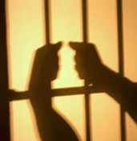

Slide 27
Answer
After the president declared martial law, Lincoln took away habeas corpus, which allowed him to place Confederate sympathizers in jail without seeing a judge or having a trial. The sympathizers were known as the copper heads.
Notes:
Martial Law: Temporary rule by military authorities, imposed on a civilian population especially in time of war or when civil authority has broken down.
The law imposed on an occupied territory by occupying military forces.

Slide 28
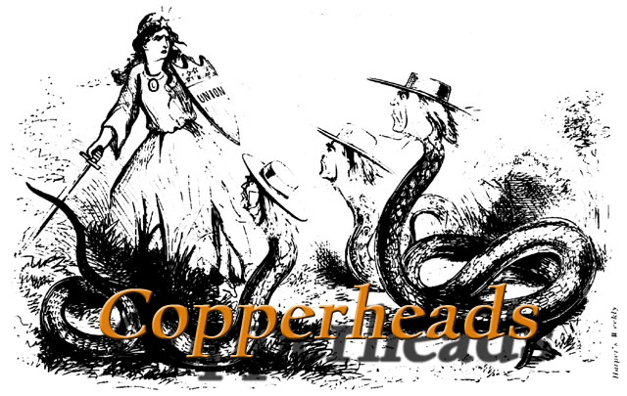

Slide 29
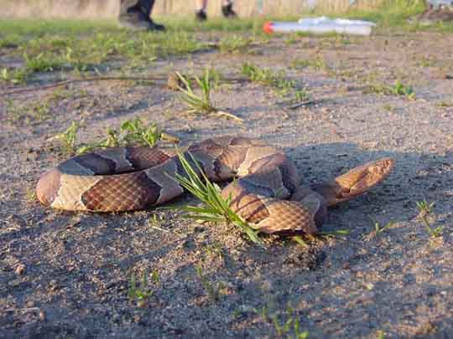
…were Northern Democrats who sympathized with the South and opposed the abolition of slavery.
Notes:
Although the Democratic party had broken apart in 1860, during the secession crisis Democrats in the North were generally more conciliatory toward the South than were Republicans. They called themselves Peace Democrats; their opponents called them Copperheads because some wore copper pennies as identifying badges.
A majority of Peace Democrats supported war to save the Union, but a strong and active minority asserted that the Republicans had provoked the South into secession; that the Republicans were waging the war in order to establish their own domination, suppress civil and states rights, and impose "racial equality"; and that military means had failed and would never restore the Union.
The Lincoln administration's arbitrary treatment of dissenters caused great bitterness there. Above all, anti-abolitionist Midwesterners feared that emancipation would result in a great migration of blacks into their states.
The most prominent Copperhead leader was Clement L. Valladigham of Ohio, who headed the secret antiwar organization known as the Sons of Liberty. At the Democratic convention of 1864, where the influence of Peace Democrats reached its high point, Vallandigham persuaded the party to adopt a platform branding the war a failure, and some extreme Copperheads plotted armed uprisings.
With the conclusion of the war in 1865 the Peace Democrats were thoroughly discredited. Most Northerners believed, not without reason, that Peace Democrats had prolonged war by encouraging the South to continue fighting in the hope that the North would abandon the struggle.

Slide 30
habeas corpus
"you have the body" Prisoners often seek release by filing a petition for a writ of habeas corpus. A writ of habeas corpus is a judicial mandate to a prison official ordering that an inmate be brought to the court so it can be determined whether or not that person is imprisoned lawfully and whether or not he should be released from custody. A habeas corpus petition is a petition filed with a court by a person who objects to his own or another's detention or imprisonment. The petition must show that the court ordering the detention or imprisonment made a legal or factual error. Habeas corpus petitions are usually filed by persons serving prison sentences. In family law, a parent who has been denied custody of his child by a trial court may file a habeas corpus petition. Also, a party may file a habeas corpus petition if a judge declares her in contempt of court and jails or threatens to jail her.

Slide 31
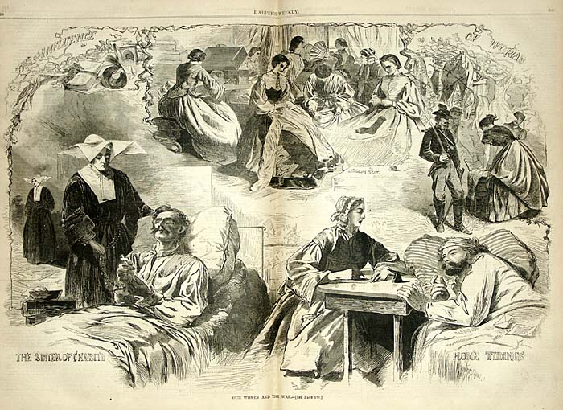

How did women and other civilians contribute to the war effort?

Slide 32
ANSWER:
Since workers in factories and on plantations were scarce, women became most of the workforce. They kept the homes and businesses going, and also set-up hospitals to care for the wounded and sick. They learned herbal medicines when supplies ran short. They held fundraisers to raise money for hospital supplies. They also hand-made most of the clothing worn by soldiers as well as bandages. Women also rationed, or saved supplies and materials, to be diverted to the war effort.

Slide 33
ANSWER:
Dr. Elizabeth Blackwell became the first woman to earn a medical license. With her political connections, she pressured President Lincoln to form the U.S. Sanitary Commission to improve conditions in military camps and hospitals.
Dorothea Dix led more than 3,000 women who served as nurses in the Civil War.

Slide 34
Clara Burton was a volunteer who coordinated medicine and other supplies to be delivered on the battlefield. Her work formed the basis for what is today known as the American Red Cross.
Sally Louisa Tompkins provide care to sick and wounded confederate soldiers at a small hospital she established in Richmond, Virginia.
Both women comforted the wounded in the hospitals.

Slide 35
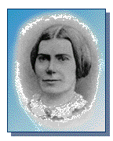
…was the first woman to receive a license to practice medicine and pressured Lincoln to form the U.S. Sanitary Commission.

Slide 36
ANSWER: Elizabeth Blackwell

Slide 37
additionally:
Slaves were a labor force for the confederate army by digging ditches, cooking meals, and performing other tasks such as substituting as soldiers for their owner on the battlefield.
Some contributed inventions such as the first submarine called the Hunley. Others ran blockade runners to get supplies in the South.

Slide 38
Essential Question
What was the effect of volunteer soldiers for the north/south? What was the effect of conscription?

Slide 39
ANSWER
Volunteer soldiers rushed to join on both sides because they thought it would be over in 3 to 6 months. Hundreds of troops that were “green” died in the first battle. Union troops dropped their weapons and ran back to Washington. Confederate troops were too disorganized to pursue.

Slide 40
Conscription means to draft into military service. It was unpopular in both the North and South. The North had draft riots. The South allowed exceptions for owners of 15 slaves or more. These owners could hire substitutes to fight in their place during the war. Wealthy individuals in the North could also hire substitutes. Slaves could not be drafted into combat (only work crews), but it seemed that the war was fought by the poor to support the wealthy.

Slide 41
ANSWER:
The Union army had only 16,000 troops at the start of the war. The army soon swelled with thousands of volunteers. This was true for the north and south. They were excited and eager but had the misunderstanding that the war would be short and adventurous.
Notes:
When sufficient numbers of volunteers began to diminish Congress with Lincoln’ support passed the Enrollment Act on 03 March 1863. Across the north especially in areas controlled by democrats such as –New York City, Boston Mass, - Portsmouth NH, -Rutland, Vermont – Troy, New York- and Wooster, Ohio. – riots broke out in protests. In New York city these riots involved mainly Irish immigrants who beat and lynched African Americans whom they blamed for the continuation of the war. These Irish Americans also had to compete with Blacks for low paying jobs.
These riots symbolize that racism was not limited to the south and that everyone in the North did not support the efforts to preserve the union.

Slide 42
African Americans were allowed to volunteer in the Union army. Their work was invaluable to the northern cause. They had a sense of urgency and duty to their service. The 54th Massachusetts Infantry served with valor during the attack on Fort Wagner outside of Charleston, South Carolina.

Slide 43
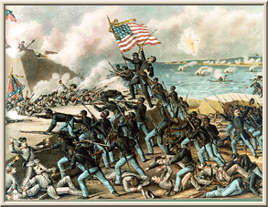

Slide 44
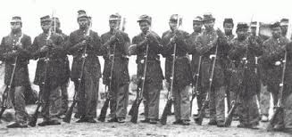
Louisiana Civil War History –Side Bar
This is a picture of the freemen division who fought at Port Hudson La.
Notes:
“Black regiments from Louisiana, composed of freeman as well as former slaves, repeatedly assaulted Confederate positions at Port Hudson on 27 may 1863.” (Civil War 100 p143) General Banks (who we will discuss later in our study) declared “ Whatever doubts may have existed heretofore as to the efficiency of Negro regiments, the history of this day (27 May 1863) proves conclusively to those who were in condition to observe the conduct of these regiments that severe test to which they were subjected and determined manner in which they encountered the enemy, leaves upon my mind no doubt of their ultimate success.”

Slide 45
Homework
Answer this Essential Question
How did the north view Abraham Lincoln? The south?

Slide 46
Essential Question
What were the major political and military events of the Civil War?
These are the events that will dominate or study of this destructive war.

Slide 47
ANSWER
The major political events of the Civil War were the Ordinances of Secession, which created the Confederate States o f America, the Emancipation Proclamation, which freed all slaves in the rebelling states, the Gettysburg Address, and the formal surrender of General Robert E. Lee to General Ulysses S. Grant at Appomattox Courthouse.

Slide 48
The major military events of the civil War included the siege of Fort Sumter, the 1st Battle of the Bull Run, the Battle of Antietam (or Manassas), the Battle of Pea Ridge, the Siege of Vicksburg, the Union blockade, the clash between the ironclads at Hampton Roads, the Battle of Chancellorsville, the Battle of Gettysburg, Sherman’s march to the sea, and the surrender at Appomattox Courthouse.

Slide 49
Essential Question
How did geography affect wartime strategies and battles?

Slide 50
The Appalachian Mountains affected the Civil War by dividing the war into different theaters, or areas of fighting. The Union blockade concentrated around ports to cut off supplies from Europe and the Caribbean being carried by blockade runners. Since southerners fought a defensive plan for most of the war, they used their home knowledge of the territory to out maneuver northern armies, who did not know the land as well. This helped the South to stay in the war longer.

Slide 51
Essential Question
How did the issue of cotton diplomacy help or hurt the Confederate States of America?

Slide 52
ANSWER
Cotton diplomacy did not win any foreign support for the Confederacy. Confederate leaders hoped that the British would help them, since southern cotton was important to the British textile industry.
However, the British already had reserves of cotton and made future purchases from countries like Egypt until the Civil War was over.

Slide 53
Homework:
Answer this Essential Question
What were the advantages and disadvantages of the labor systems of the North and South during the Civil War?
Notes:
This could easily be an essay question on your final exam!!!

Slide 54
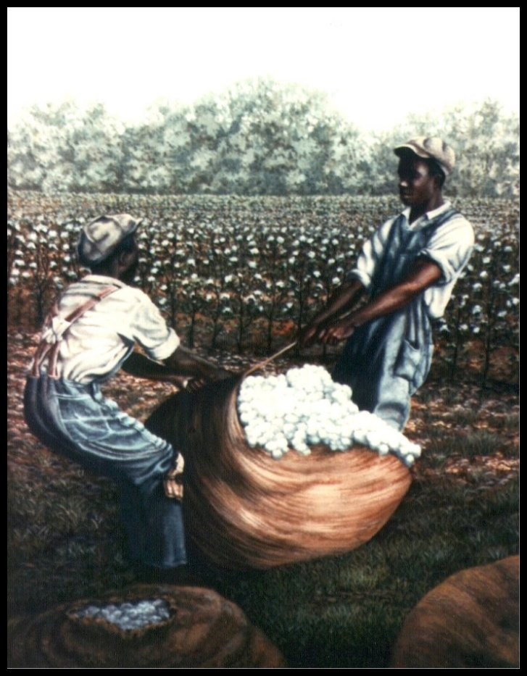
ANSWER: Cotton diplomacy

Slide 55
…meant that Confederate leaders hoped to gain British support by emphasizing the importance of southern cotton to the British textile industry.

Slide 56
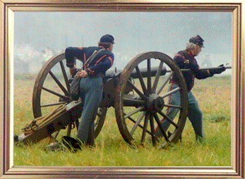
The War Begins!!!

Slide 57
Fall of Fort Sumter
For Sumter was a Federal outpost in Charleston, South Carolina.
The Fort’s Commander Major Robert Anderson sent word to Washington that he was nearly out of supplies.
Confederate forces asked for its surrender.
Lincoln refused surrender and sent ships with supplies.
Confederate cannons began firing at 0430 on April 12, 1861. (P.G. T. Beauregard)
Fort Sumter fell 34 hours later.
The Civil War began.

Slide 58
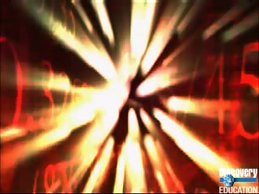
The Fall of Fort Sumter

Slide 59
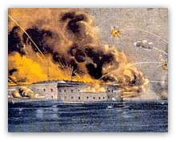
…was the most important federal outpost in the South and controlled the entrance to Charleston harbor.

Slide 60
ANSWER: Fort Sumter

Slide 61
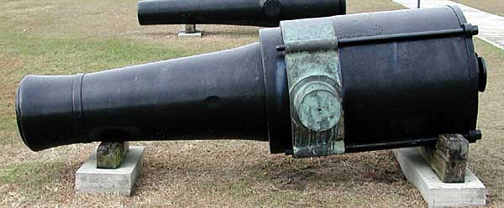
Confederate type of cannon in Charleston called a Columbia 10-inch smoothbore.

Slide 62
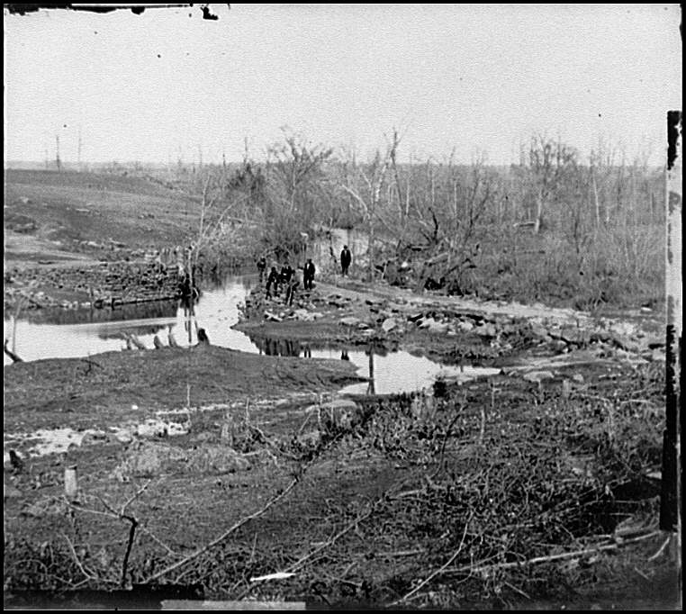
…was were the Union army met the Confederate army near Richmond and drove the Union army back.
(July 1861)

Slide 63
ANSWER: First Battle of Bull Run
Notes:
At the behest of Lincoln and against General-in Chief Winfield Scott judgment Scott organized a 35,000 man army commanded by General Irvin McDowell (WHO HAD NO PRIOR FIELD EXPERIENCE) advanced on the South before adequately training his untried troops. Confederate reinforcements fought in what became a southern victory and a chaotic retreat toward Washington federal troops.
The war didn’t begin in earnest until the Battle of Bull Run, fought in Virginia just miles from Washington DC, on July 21, 1861. Popular fervor led President Lincoln to push a cautious Brigadier General Irvin McDowell, commander of the Union army in Northern Virginia, to attack the Confederate forces commanded by Brigadier General P.G.T. Beauregard, which held a relatively strong position along Bull Run, just northeast of Manassas Junction. The goal was to make quick work of the bulk of the Confederate army, open the way to Richmond, the Confederate capital, and end the war.
Fearing his men were tired from the march Mc Dowell decided to postpone the attach on the railhead at Manassas for three days. This delay allowed General Joe Johnson (Joseph E. Johnson) to transfer 10,000 men via rail from his army in nearby Winchester to Manassas in time P.G.T. Beauregard ( of Fort Sumter fame) to join the battle.

Slide 64
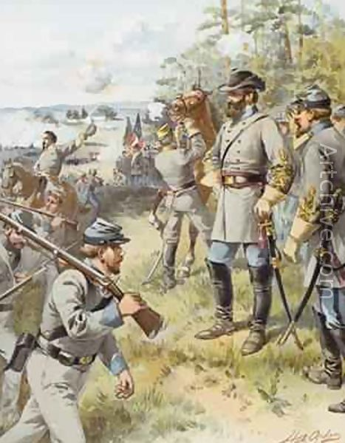
First Great Battle of the Civil War Advantage Confederates !!
July 18 – 21, 1861
Notes:
This southern victory allowed the people and armies of the south a great confidence boost. This is the battle that initially the north was controlling the day, there was great confusion as both the union and confederates troops were all very inexperienced. The union troops were in reach of a victory before a Virginia brigade led by Thomas Jackson held the line at Henry’s House Hill. Confederate Bernard Bee encouraged his own troops to hold their position, shouting “Look at Jackson’s brigade, it stands like a stone wall! Rally behind the Virginians!” Then Bee fell to a fatal shot. However, his men did rally behind Jackson and repelled the union advance. From that time on Jackson would be known as “Stonewall”
This battle was very important!!! Important because Northerners now realized that the war would not be easy nor quick in duration. And the South took this victory with great pride as proof of their superiority and thought that Lincoln would not continue the war.
Union General in Charge – Irwin McDowell
Confederate General in Charge - Joseph E. Johnson
Union Causalities- 2,700 including 418 dead.
Confederate losses: 2,000including 387 killed.

Slide 65
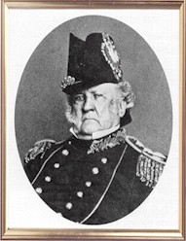
…developed the plan to defeat the South with a blockade to strangle the South’s economy, and gaining control of the Mississippi River to split the Confederacy into two.
Notes:
Wow – This is a very experienced General!! His Anaconda plan was ridiculed by the majority of politicians, young military officers and all of the press. Many though he was to old, fat to be in charge of the army. Scott anticipated a long and grueling war and bloody war, whereas most northern leaders expected a quick and decisive union victory. General Winfield Scott Anaconda plan which proposed a massive mobilization, a sea blockade of the south, and a general offensive to split the Confederacy along the Mississippi River.

Slide 66
ANSWER:
Winfield Scott
Notes:
General Scott was born 5 years after the Constitution was ratified, 13 June 1786. By the time the Civil War began General Scott had served over a half –century in the Federal Army. He turned down an offer to be General-in-Charge of the Northern Va. Army. General Winfield Scott participated and was wounded in the War of 1812, as Commander of the entire Army he lead the invasion force on the Mexican eastern coast at Vera Cruz. During the Mexican war Scott led and trained U.S. Grant and Robert E. Lee.
Scott was the General of the Army when the Civil War began. Blamed for the defeats at the first Bull Run and Ball’s Bluff, Virginia President Lincoln accepted Scott’s resignation and the General retired on 01 November 1861. General Scott lived long enough to see the defeat of the rebellion, mostly as a result of his Anconda Plan!He died at West Point NY 29 May 1866.

Slide 67

POP Quiz #1
I will now pass out a sheet of note book paper. I want you to put your heading on this sheet, don’t forget to include today’s date.

Slide 68
Pop Quiz #1
Who was Abraham Lincoln?
Who was Winfield Scott?
What was the importance of Fort Sumter?
What was cotton diplomacy?

Slide 69
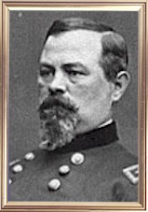
…was ordered by Lincoln to capture the Confederate capital of Richmond, but complained that his soldiers were poorly trained.

Slide 70
ANSWER: Irvin McDowell
Notes:
Irvin McDowell was selected to lead the Army because of political connects ( Scott and SecNav Chase), Irvin was a staff officer who never lead any troops. This lack of field leadership was apparent in the first battle of Bull Run. This major Union loss gave the South the positive perception of final victory. When McDowell returned to Washington he was relieved of his command and George McClellan (we will talk often about McClellan in our study) became the commander of the new Army of the Potomac.
Mc Dowell saw little combat after the first Bull Run, however he did lead some troops in the Second battle of Bull Run and as a result of this loss was once again relieved of duty and sent to California.

Slide 71
POP Quiz #2
I will now pass out a sheet of note book paper. I want you to put your heading on this sheet, don’t forget to include today’s date. Also title this as POP Quiz #2

Slide 72
Pop Quiz #2
What were the border states?
Who was Elizabeth Blackwell?
Who was Abraham Lincoln?
What was cotton diplomacy?

Slide 73
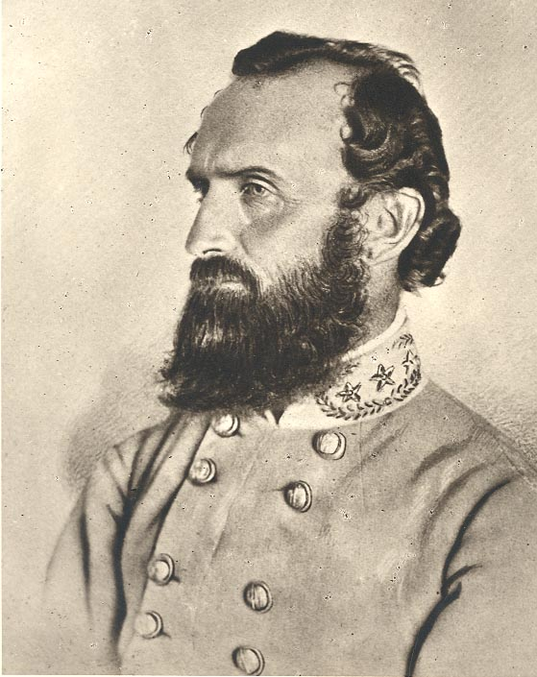
…held the left side of the Confederate line firm at the First Battle of the Bull Run.

Slide 74
ANSWER: Thomas “Stonewall” Jackson
Notes:
Born in what is now the state of West Virginia, in the town of Clarksburg, Thomas Jonathan Jackson possessed a strong military background at the outbreak of the Civil War. His training in the U.S. Military Academy at West Point, recognition as a hero in the Mexican War, and his experience as an instructor at the Virginia Military Institute justified Jackson's rank of brigadier general at the first major battle of the Civil War near Manassas, Virginia. Upon that field, General Bernard E. Bee proclaimed, "There is Jackson standing like a stone wall," and a legend as well as a nickname was born.

Slide 75
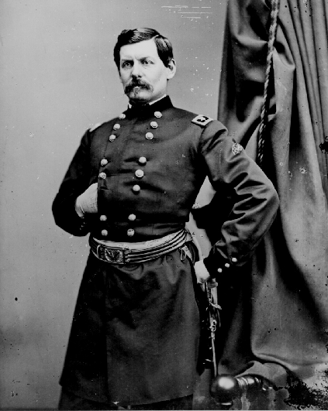
…was the new Union general whose hesitation allowed the Confederates to reinforce their Richmond defenses. He was pushed by Lee out of Virginia.
Notes:
McCellan was called to take charge at Washington after the disaster at Ist Bull Run, but his behavior toward Scott and the civil authorities was unpardonable. Now called "The Young Napoleon," he actively worked for Scott's retirement and was named in his place. His engineering and organizational skills shined bright in the creation of the Army of the Potomac, a mighty machine. But he did not advance and refused to divulge his plans to the civilians over him. He even refused to see the president on one occasion.

Slide 76
ANSWER: George B. McClellan
Notes:
Suddenly aware of the threat of a protracted war and the army's need for organization and training, Lincoln replaced McDowell with General George B. McClellan.
brevet referred to a warrant authorizing a commissioned officer to hold a higher rank temporarily, but usually without receiving the pay of that higher rank except when actually serving in that role

Slide 77
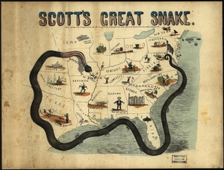
July 1861
Notes:
To blockade the coast of the Confederacy effectively, the federal navy had to be improved. By July, the effort at improvement had made a difference and an effective blockade had begun. The South responded by building small, fast ships that could outmaneuver Union vessels. Remember the all laughed at Scott’s plan yet the southern blockade was the first phase of his plan.

Slide 78
George B. McClellan
Notes:
January 1862 -- Abraham Lincoln Takes Action.
On January 27, President Lincoln issued a war order authorizing the Union to launch a unified aggressive action against the Confederacy. General McClellan ignored the order.
March 1862 -- McClellan Loses Command.
On March 8, President Lincoln -- impatient with General McClellan's inactivity -- issued an order reorganizing the Army of Virginia and relieving McClellan of supreme command. McClellan was given command of the Army of the Potomac, and ordered to attack Richmond. This marked the beginning of the Peninsular Campaign.

Slide 79
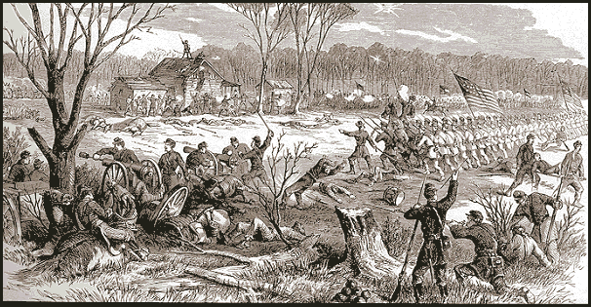
The Confederates launched a surprise attack in the ___, when Grant continued moving his troops toward Mississippi.

Slide 80
ANSWER: Battle of Shiloh
Notes:
April 1862 -- The Battle of Shiloh.
On April 6, Confederate forces attacked Union forces under General Ulysses S. Grant at Shiloh, Tennessee. By the end of the day, the federal troops were almost defeated. Yet, during the night, reinforcements arrived, and by the next morning the Union commanded the field. When Confederate forces retreated, the exhausted federal forces did not follow. Casualties were heavy -- 13,000 out of 63,000 Union soldiers died, and 11,000 of 40,000 Confederate troops were killed.

Slide 81
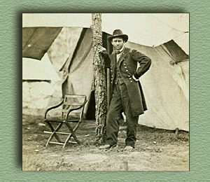
…led Union forces in the West and was a determined and aggressive fighter.

Slide 82
ANSWER: Ulysses S. Grant
Notes:
The man we know as Ulysses S. Grant was actually named Hiram Ulysses Grant. As a boy he was known as "Lyss". Thomas Hamer, the Congressman who appointed Grant to West Point, forgot all about Hiram. Remembering that Grant's mother's maiden name was Simpson and thinking that was Lyss Grant's middle name, he filled out the application in the name of "Ulysses S. Grant".
When Grant arrived at West Point and discovered that the Academy had him registered under the wrong name, he tried to get the error corrected. He was told that it didn't matter what he or his parents thought his name was, the official government application said his name was "Ulysses S." and that application could not be changed.
At the outbreak of the Civil War, Grant was working in his father's leather store in Galena, Illinois. He was appointed by the Governor to command an unruly volunteer regiment. Grant whipped it into shape and by September 1861 he had risen to the rank of brigadier general of volunteers.
He sought to win control of the Mississippi Valley. In February 1862 he took Fort Henry and attacked Fort Donelson. When the Confederate commander asked for terms, Grant replied, "No terms except an unconditional and immediate surrender can be accepted." The Confederates surrendered, and President Lincoln promoted Grant to major general of volunteers.
At Shiloh in April, Grant fought one of the bloodiest battles in the West and came out less well. President Lincoln fended off demands for his removal by saying, "I can't spare this man--he fights." More about Grant later

Slide 83
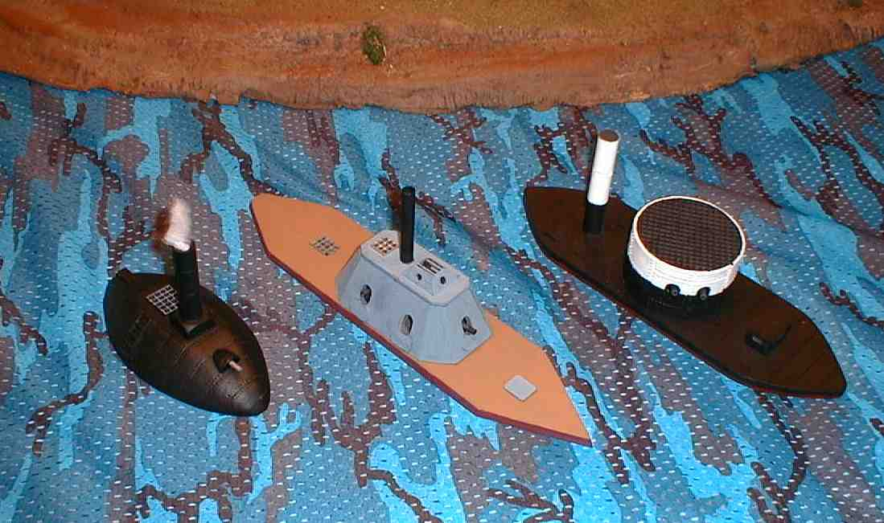
…were heavily armored warships that were hard to damage.
Notes:
In an attempt to reduce the North's great naval advantage, Confederate engineers converted a scuttled Union frigate, the U.S.S. Merrimac, into an iron-sided vessel rechristened the C.S.S. Virginia. On March 9, in the first naval engagement between ironclad ships, the Monitor fought the Virginia to a draw, but not before the Virginia had sunk two wooden Union warships off Norfolk, Virginia.

Slide 84
ANSWER: Ironclads

Slide 85
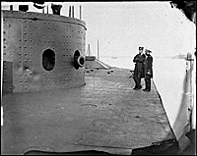
…was the Union ironclad battleship.

Slide 86
ANSWER: U.S.S. Monitor

Slide 87
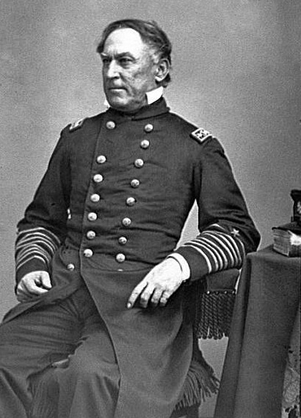
…was a daring Union naval leader who boldly sailed past the two forts guarding the approach to New Orleans to take the city.

Slide 88
ANSWER: David G. Farragut
Notes:
Flag Officer David Farragut led an assault up the Mississippi River. By April 25, he was in command of New Orleans.

Slide 89
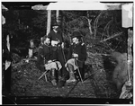
The Peninsular Campaign.
Notes:
The Peninsula, Va. Lts. George A. Custer, Nicolas Bowen, and William G. Jones].
Gibson, James F., b. 1828, photographer
April 1862 -- The Peninsular Campaign.
In April, General McClellan's troops left northern Virginia to begin the Peninsular Campaign. By May 4, they occupied Yorktown, Virginia. At Williamsburg, Confederate forces prevented McClellan from meeting the main part of the Confederate army, and McClellan halted his troops, awaiting reinforcements.
McClellan wanted to take advantage of Union sea power to bypass these defences. On 3 February 1862 he wrote to Lincoln describing his plan. His intention was to ship the army from the Potomac River to Urbana on the Rappahannock River. From there, the Union army would be able to march to Richmond virtually unopposed. Johnston at Manassas would be too far away to intervene effectively before the fall of the Confederate capital.
This was potentially a good plan, but for it to work, McClellan would have to demonstrate speed and daring. Otherwise, as Lincoln pointed out, all he would find would be the same opponents, in similar fortifications. Nevertheless, by the end of February, Lincoln had approved McClellan’s plan, and the war department had started to buy up naval transports.
The campaign was dogged by poor relationships between McClellan, Lincoln and Secretary of War Stanton. McClellan had been under a great deal of pressure to use the impressive army he had created. He had responded with silence over the winter – one of his flaws was an inability (or unwillingness) to understand the political pressures that affected Lincoln. McClellan was known to favour a generous peace, leaving Southern institutions intact. There was even some concern that his Peninsula plan was designed to leave Washington vulnerable to a Confederate attack, allowing for a negotiated peace.
In some ways the fate of the Peninsula Campaign was decided on 8 March, nearly a month before the first fighting. On that day, Lincoln asked McClellan to call a meeting of his twelve divisional commanders to find out if they favoured the plan. Eight of the twelve did, and so Lincoln approved the plan. However, he issued three orders led to McClellan feeling a great deal of resentment.
Reference: Civil War photographs, 1861-1865 / compiled by Hirst D. Milhollen and Donald H. Mugridge, Washington, D.C. : Library of Congress, 1977. No. 0029

Slide 90
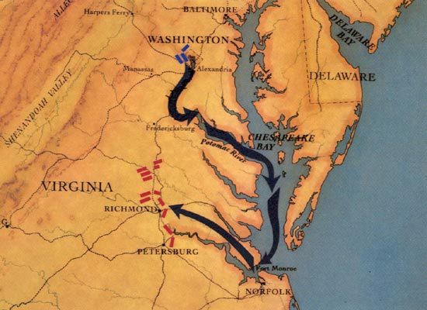
The Peninsular Campaign.
Notes:
The failure of the Peninsula Campaign was one of the most controversial episodes of the civil war. McClellan moved slowly, was held up by relatively small Confederate forces, and despite reaching within a few miles of Richmond never made a serious assault on the Confederate capitol. McClellan himself blamed sinister forces in Washington for failing to provide him with enough men or support, despite actually outnumbering his opponents for the entire campaign.
On the Confederate side, the Peninsula Campaign saw the emergence of Stonewall Jackson and Robert E. Lee as commanders of great stature and ability. Richmond had looked about to fall, before Jackson and Lee combined to push them away.

Slide 91
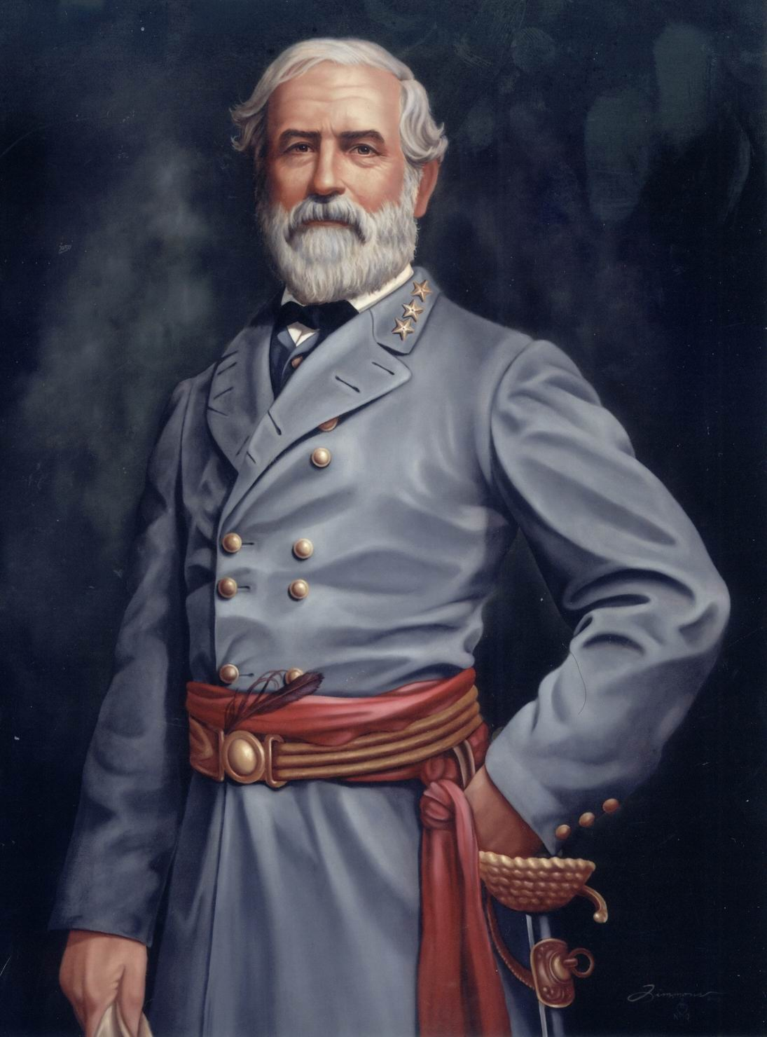
Robert E. Lee
"With all my devotion to the Union and the feeling of loyalty and duty of an American citizen, I have not been able to make up my mind to raise my hand against my relatives, my children, my home. I have therefore resigned my commission in the Army, and save in defense of my native State, with the sincere hope that my poor services may never be needed, I hope I may never be called on to draw my sword....."
Lee in a letter to his sister, April 20, 1861
Notes:
Politically, Robert E. Lee was a Whig. Ironically, he was attached strongly to the Union and to the Constitution. He entertained no special sympathy for slavery.
When Virginia withdrew from the Union, Lee resigned his commission rather than assist in suppressing the insurrection. His resignation was two days following the offer of Chief of Command of U.S. forces under Scott. He then proceeded to Richmond to become Commander-in-Chief of the military and naval forces of Virginia. However, it was not until the wounding of General Joe E. Johnston in May of 1862 that Lee assumed the role of commander of the army he would rename as the Army of Virigina. When these forces joined Confederate services, he was appointed Brig. Gen. in the Regular Confederate States.

Slide 92
Robert E. Lee
Born into wealthy Virginia family in 1807
Graduate of the U.S. Military Academy at West Point
Fought in Mexican-American War
Lincoln asked Lee to lead Union army at start of Civil War.
Lee declined and resigned from the Union Army to become a Confederate general.

Slide 93
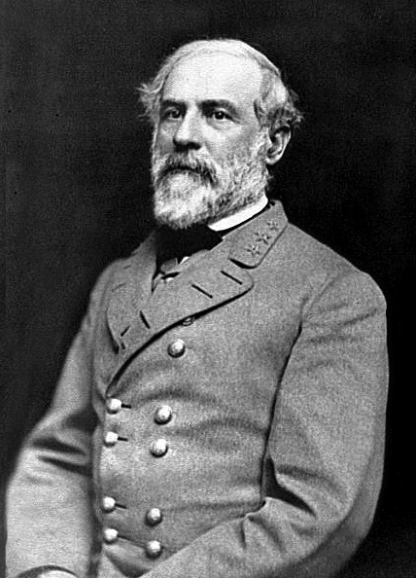
…commanded the Confederate army in Virginia and was one of the war’s most talented officers.

Slide 94
ANSWER:
Robert E. Lee

Slide 95
May 1862 “Stonewall” Jackson defeats Union forces
Notes:
Confederate General Thomas J. "Stonewall" Jackson, commanding forces in the Shenandoah Valley, attacked Union forces in late March, forcing them to retreat across the Potomac. As a result, Union troops were rushed to protect Washington, D.C.

Slide 96
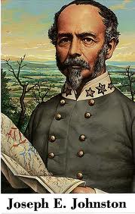
Battle of Seven Pines (Fair Oaks)
Notes:
June 1862 -- The Battle of Seven Pines (Fair Oaks).
On May 31, the Confederate army attacked federal forces at Seven Pines, almost defeating them; last-minute reinforcements saved the Union from a serious defeat. Confederate commander Joseph E. Johnston was severely wounded, and command of the Army of Northern Virginia fell to Robert E. Lee.

Slide 97
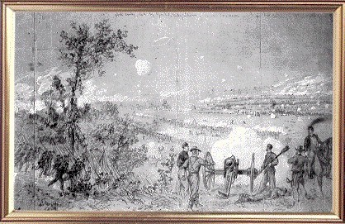
…were five separate fights that forced the Union army out to the Richmond area.

Slide 98
ANSWER: Seven Days Battles
Notes:
July 1862 -- The Seven Days' Battles.
Between June 26 and July 2, Union and Confederate forces fought a series of battles: Mechanicsville (June 26-27), Gaines's Mill (June 27), Savage's Station (June 29), Frayser's Farm (June 30), and Malvern Hill (July 1). On July 2, the Confederates withdrew to Richmond, ending the Peninsular Campaign.

Slide 99
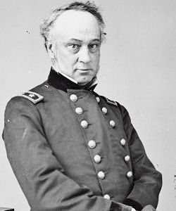
Major General Henry Halleck
Notes:
11 July 1862, Halleck was named general-in-chief of the Union armies. He commanded the Federal forces at the Battles of Iuka and Corinth. Although he won these battles, his cautious advance allowed the Confederates to escape. In his capacity as general-in-chief, he proposed little in the way of strategy and instead was little more than a military clerk for Lincoln and Secretary of War Stanton. Secretary of the Navy Gideon Welles said that Halleck "originates nothing, anticipates nothing. . . . takes no responsibility, plans nothing, suggests nothing, is good for nothing." When General Grant was promoted to general in chief in 1864, he made Halleck his chief of staff, a position Halleck held until the end of the war.

Slide 100
…was a confederate victory after the Union attack on Richmond failed.

Slide 101
ANSWER: Second Battle of Bull Run
Notes:
Union General John Pope suffered defeated at the Second Battle of Bull Run on August 29-30. General Fitz-John Porter was held responsible for the defeat because he had failed to commit his troops to battle quickly enough; he was forced out of the army by 1863.

Slide 102
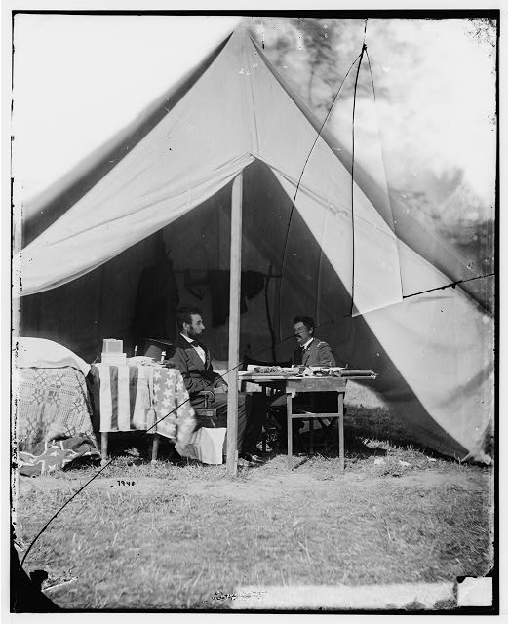
Notes:
With Pope defeated at 2nd Bull Run and his men streaming back to the Washington fortifications, McClellan was restored to active command of his reconstituted army and was welcomed by his men who affectionately called him "Little Mac." In the Maryland Campaign he advanced to confront Lee in the western part of the state and moved uncharacteristically fast when some of his command found a copy of Lee's orders for the movement of his troops. Lee fought several delaying actions along South Mountain in order to reconcentrate his army. His caution returning, McClellan slowed down, and Lee was able to get most of his men in line at Antietam. McClellan attacked piecemeal and his attacks failed to crush Lee who was heavily outnumbered with his back to the Potomac River. Lincoln was extremely upset by the escape of Lee and his army but nonetheless used the "victory" to issue the Emancipation Proclamation.
[Antietam, Md. President Lincoln and Gen. George B. McClellan in the general's tent].
Gardner, Alexander, 1821-1882, photographer.
CREATED/PUBLISHED
1862 October 3.
SUMMARY
Photograph from the main eastern theater of the war, Battle of Antietam, September-October 1862.
NOTES
Reference: Civil War photographs, 1861-1865 / compiled by Hirst D. Milhollen and Donald H. Mugridge, Washington, D.C. : Library of Congress, 1977. No. 0144
Title from Milhollen and Mugridge.
Forms part of Civil War glass negative collection (Library of Congress).

Slide 103
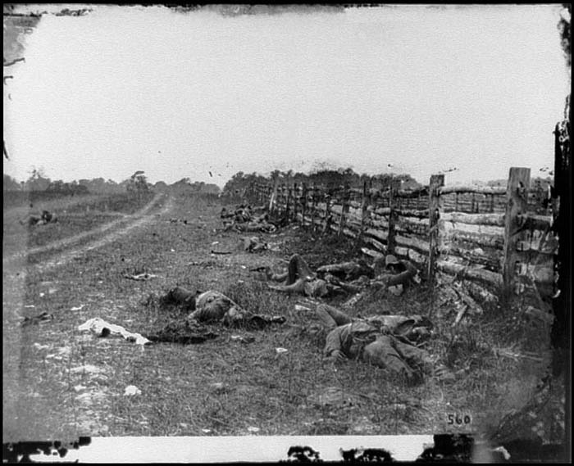
…cost Lee nearly a third of his troops in Maryland, and his northern advance was stopped.

Slide 104
ANSWER: Battle of Antietam
Notes:
On September 17, 1862 Confederate forces under General Lee were caught by General McClellan near Sharpsburg, Maryland. This battle proved to be the bloodiest day of the war; 2,108 Union soldiers were killed and 9,549 wounded -- 2,700 Confederates were killed and 9,029 wounded. The battle had no clear winner, but because General Lee withdrew to Virginia, McClellan was considered the victor. The battle convinced the British and French -- who were contemplating official recognition of the Confederacy -- to reserve action, and gave Lincoln the opportunity to announce his Preliminary Emancipation Proclamation (September 22), which would free all slaves in areas rebelling against the United States, effective January 1, 1863.

Slide 105
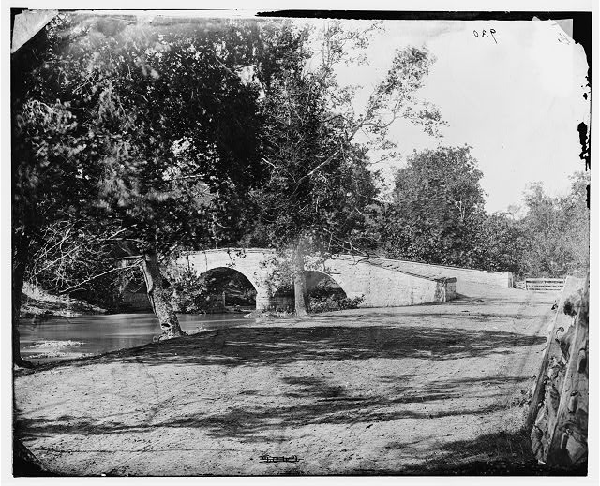
Burnside Bridge Sharpsburg, MD.
Notes:
Antietam, Md. Burnside's bridge].
Gardner, Alexander, 1821-1882, photographer.
CREATED/PUBLISHED
1862 September.
SUMMARY
Photograph from the main eastern theater of the war, Battle of Antietam, September-October 1862.
NOTES
Reference: Civil War photographs, 1861-1865 / compiled by Hirst D. Milhollen and Donald H. Mugridge, Washington, D.C. : Library of Congress, 1977. No. 0130
Title from Milhollen and Mugridge.

Slide 106

Fredericksburg, Md.
Notes:
December 1862 -- The Battle of Fredericksburg.
General McClellan's slow movements, combined with General Lee's escape, and continued raiding by Confederate cavalry, dismayed many in the North. On November 7, Lincoln replaced McClellan with Major-General Ambrose E. Burnside. Burnside's forces were defeated in a series of attacks against entrenched Confederate forces at Fredericksburg, Virginia, and Burnside was replaced with General Joseph Hooker.

Slide 107
POP Quiz #3
I will now pass out a sheet of note book paper. I want you to put your heading on this sheet, don’t forget to include today’s date. Also title this as POP Quiz #3

Slide 108
Pop Quiz #3 (1 of 2) more questions on the next slide
Who was Stonewall Jackson?
What was the importance of the Battle of Antietam?
Who was George B. McClellan?
What was the importance of the Seven Days Battle?
Who was Robert E. Lee?

Slide 109
Pop Quiz #3 continued
What was the importance of the Second Battle of Bull Run?
What was the importance of the First Battle of Bull Run?
Who was Irvin McDowell?
What were ironclads?

Slide 110
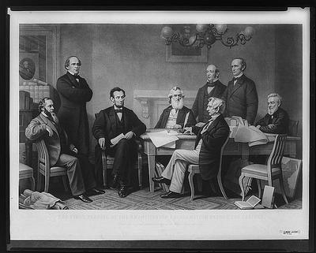
…was an order that freed slaves in Confederate areas.

Slide 111
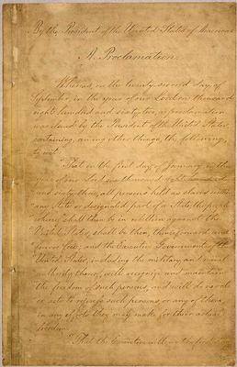
ANSWER: Emancipation Proclamation
Notes:
January 1863 -- Emancipation Proclamation.
In an effort to placate the slave-holding border states, Lincoln resisted the demands of radical Republicans for complete abolition. Yet some Union generals, such as General B. F. Butler, declared slaves escaping to their lines "contraband of war," not to be returned to their masters. Other generals decreed that the slaves of men rebelling against the Union were to be considered free. Congress, too, had been moving toward abolition. In 1861, Congress had passed an act stating that all slaves employed against the Union were to be considered free. In 1862, another act stated that all slaves of men who supported the Confederacy were to be considered free. Lincoln, aware of the public's growing support of abolition, issued the Emancipation Proclamation on January 1, 1863, declaring that all slaves in areas still in rebellion were, in the eyes of the federal government, free.

Slide 112
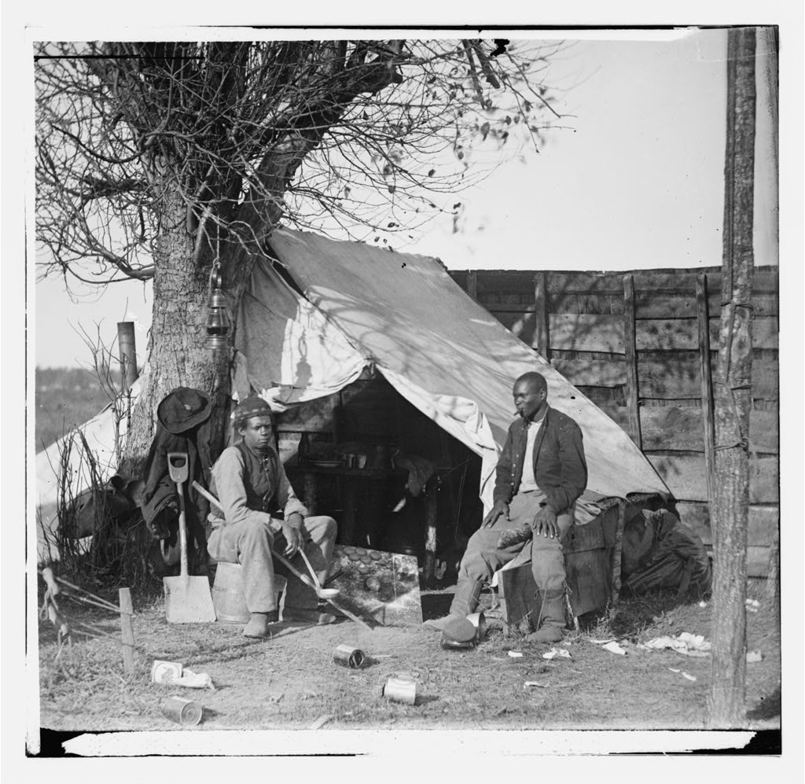
…were slaves who had escaped past Union lines, in South Carolina and could enlist in the Union army.

Slide 113
ANSWER: Contrabands

Slide 114
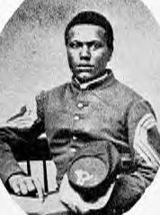
…was made up mainly of free African Americans and played an important role in capturing Fort Wagner in South Carolina.

Slide 115
ANSWER: 54th Massachusetts Infantry

Slide 116
The First Conscription Act
March 1863 -Because of recruiting difficulties, an act was passed making all men between the ages of 20 and 45 liable to be called for military service. Service could be avoided by paying a fee or finding a substitute. The act was seen as unfair to the poor, and riots in working-class sections of New York City broke out in protest. A similar conscription act in the South provoked a similar reaction.

Slide 117
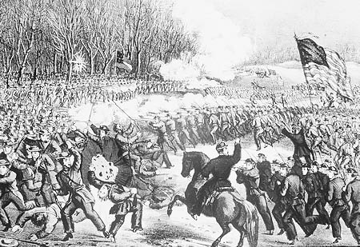
Battle of Chancellorsville
Notes:
The Battle of Chancellorsville is known to many as General R. E. Lee's greatest battle. After the Battle of Freidricksburg in December of 1862, President Lincoln appointed a new general to the Army of the Potomac due to the resignation of general Burnside, who had led the Union army to a humiliating defeat. It was General Joseph Hooker, also known as "Fighting Joe," who replaced Burnside's command of the Army of the Potomac the following year. Hooker did not have the best reputation, and he was often said to be quarrelsome, boastful, and a heavy drinker, but as a general, he was genuine and admired greatly by his men. He believed in having his soldiers live comfortably and did his best to make sure that they were housed, fed, and taken care of. Hooker restored confidence to his wary troops and prepared them well for the battle that was to come.
Over the next few days, the Union and Confederate Army would have countless fights. Rather than attacking the Southern forces as was Hooker's plan, the Northern Army ended up taking a defensive position through most of the battle, which eventually led to their retreat back across the Rappahannock River. The battle ended on May 4, with a victory to the Confederates. Chancellorsville is remembered as Lee's greatest battle because of the South's amazing victory. They had won the battle against heavy odds, with an army only half the size of the Union. However, the southern victory was not all glorious. The battle had resulted in the loss of about 22% of the Lee's army, as well ask the death of Gen. "Stonewall" Jackson. Ironically, Jackson had been shot by his own men, who had mistaken him to be part of a Union calvary on May 2. He died eight days later.

Slide 118
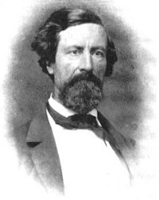
…was the Confederate general who covered the high river bluffs around Vicksburg with heavy guns.

Slide 119
ANSWER: John C. Pemberton

Slide 120
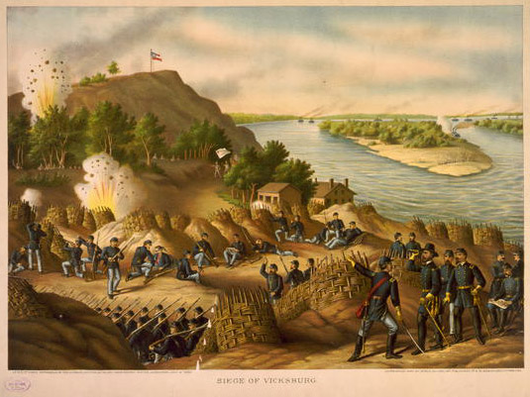
…lasted for six weeks until the city’s food supplies ran out, and the Confederates surrendered.

Slide 121
ANSWER: Siege of Vicksburg
Notes:
Union General Grant won several victories around Vicksburg, Mississippi, the fortified city considered essential to the Union's plans to regain control of the Mississippi River. On May 22, Grant began a siege of the city. After six weeks, Confederate General John Pemberton surrendered, giving up the city and 30,000 men. The capture of Port Hudson, Louisiana, shortly thereafter placed the entire Mississippi River in Union hands. The Confederacy was split in two.

Slide 122
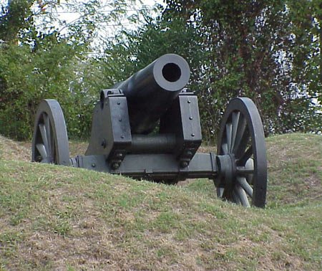
Union Cannon at the Battle of Vicksburg.

Slide 123
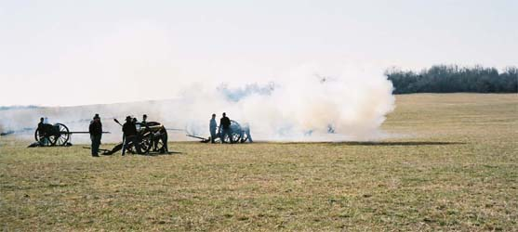
In March 1862, Union forces defeated the prosouthern Missourians in ____.

Slide 124
ANSWER: Battle of Pea Ridge

Slide 125
POP Quiz #4
I will now pass out a sheet of note book paper. I want you to put your heading on this sheet, don’t forget to include today’s date. Also title this as POP Quiz #4

Slide 126
Pop Quiz #4
Who was John C. Pemberton?
Who was Ulysses S. Grant?
What was the Siege of Vicksburg?
What was the Battle of Pea Ridge?
Who was David G. Farragut?
What was the Battle of Shiloh?

Slide 127
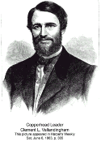
…was the leader of the copperheads , who were mid-westerners that sympathized with the South and opposed abolition.
Notes:
Vallandigham opposed the Federal government's prosecution of the Civil War, publishing a letter in the 20 Apr. 1861 Cincinnati Daily Enquirer stating his belief that the South could not be coerced into reentering the Union., he blamed the war on Pres. Abraham Lincoln and the Republican Party, voted against national Conscription, refused to cooperate with congressional war measures, and alienated the powers within his own political party. A Copperhead, falsely believed to belong to the Knights Of The Golden Circle, he was abandoned by the state's War Democrats in a fight to keep his original congressional district intact. It was gerrymandered to contain a minority of his supporters, and he was not reelected in 1 862. Determined to run for the governorship in 1863, he began an unofficial campaign in spring 1862, following Democratic victories in Dayton, and tried to rally support for his candidacy over that of Democratic elder-statesman Hugh J. Jewett. The preliminary Ohio Democratic convention met 28 Apr. and rejected Vallandigham's bid for the gubernatorial nomination.

Slide 128
ANSWER: Clement L. Vallandigham
Notes:
On 13 Apr. 1863, Maj. Gen. Ambrose E. Burnside, Commmander of the Department Of The Ohio, had issued General Order No. 38, forbidding expression of sympathy for the enemy. On 30 Apr. Vallandigham addressed a large audience in Columbus, made derogatory references to the president and the war effort, then hoped that he would be arrested under Burnside's order, thus gaining popular sympathy. Arrested at his home at 2 a.m., 5 May, by a company of troops, he was taken to Burnside's Cincinnati headquarters, tried by a military court 6-7 May, denied a writ of habeas corpus, and sentenced to 2 years' confinement in a military prison. Following a 19 May cabinet meeting, President Lincoln commuted Vallandigham's sentence to banishment to the Confederacy. On 26 May the Ohioan was taken to Confederates south of Murfreesboro, Tenn., and there entered Southern lines. Outraged at his treatment, by a vote of 411 -11 state Democrats nominated Vallandigham for governor at their 11 June convention.
Vallandigham was escorted to Wilmington, N.C., and shipped out to, Bermuda, arriving there 1 7 June. He traveled to Canada, arrived at Niagara Falls, Ontario, 5 July, and from there and Windsor, Ontario, conducted his campaign for the governorship. Candidate for lieutenant governor George Pugh represented Vallandigham's views at rallies and in the press. Lincoln interested himself in the election, endorsed Republican candidate John Brough, downplayed the illegalities of a civilian's arrest and trial by military authorities, and claimed that a vote for the Democratic contender was "a discredit to the country." In the election of 13 Oct. 1863, Brough defeated Vallandigham 288,000 - 187,000.
With the election crisis passed, Lincoln and the military ignored Vallandigham's return to the U.S, in disguise 14 June 1864. Here established residence in 0hio, attended the August national Democratic convention in Chicago, and helped construct the disastrous "peace" plank in presidential candidate George B. McClellan's platform.

Slide 129

…is a right the protects Americans against unlawful imprisonment.

Slide 130
ANSWER: habeas corpus

Slide 131

…organized efforts to to gather medicine and supplies and deliver them to Union troops on the battlefield. Her work formed the basis for the American Red Cross.

Slide 132
ANSWER: Clara Barton

Slide 133

…established a small army hospital in Richmond for Confederate soldiers that grew into a major hospital by the end of the war.

Slide 134
ANSWER: Sally Louisa Tompkins

Slide 135
POP Quiz #5
I will now pass out a sheet of note book paper. I want you to put your heading on this sheet, don’t forget to include today’s date. Also title this as POP Quiz #5

Slide 136
Pop Quiz #5 (1 of 2) more question on the next slide
Who was Clara Burton?
Who was Clement L. Vallandigham?
Who were the Copperheads?
What was the Emancipation Proclamation?
What is habeas corpus?

Slide 137
Pop Quiz #5 continued
What was the Emancipation Proclamation?
What are contrabands?
What was the 54th Massachusetts Infantry?
Who was Sally Louisa Tompkins?

Slide 138

…began in early July and last for several days when Lee decided to attack Union territory again in southern Pennsylvania.

Slide 139
ANSWER: Battle of Gettysburg
Notes:
Confederate General Lee decided to take the war to the enemy. On June 13, he defeated Union forces at Winchester, Virginia, and continued north to Pennsylvania. General Hooker, who had been planning to attack Richmond, was instead forced to follow Lee. Hooker, never comfortable with his commander, General Halleck, resigned on June 28, and General George Meade replaced him as commander of the Army of the Potomac.
On July 1, a chance encounter between Union and Confederate forces began the Battle of Gettysburg. In the fighting that followed, Meade had greater numbers and better defensive positions. He won the battle, but failed to follow Lee as he retreated back to Virginia. Militarily, the Battle of Gettysburg was the high-water mark of the Confederacy; it is also significant because it ended Confederate hopes of formal recognition by foreign governments. On November 19, President Lincoln dedicated a portion of the Gettysburg battlefield as a national cemetery, and delivered his memorable "Gettysburg Address."

Slide 140

…was the Union general who defeated Lee at the Battle of Gettysburg in Pennsylvania.

Slide 141
ANSWER: George G. Meade
Notes:
With the invasion of Pennsylvania, Meade was chosen to relieve Hooker in army command only three days before Gettysburg. Originally planning to fight farther to the rear along Pipe Creek, he dispatched General Winfield S. Hancock to Gettysburg-following the death of General John F. Reynolds-to determine if it would be an acceptable battlefield. Accepting that officer's opinion, he ordered a continued concentration there. During the next two days he masterfully shifted his troops from one threatened sector to another. He received the, thanks of Congress and an appointment as a brigadier in the regulars. However, he soon came in for criticism for allowing Lee to escape to Virginia without another battle.
His handling of the Bristoe and Mine Run campaigns was not shining. In the spring of 1864 newly appointed General-in-Chief U.S. Grant set up his headquarters with Meade's army. This cumbersome arrangement worked out surprisingly well. However, since Meade was known for his temper and had come into conflict with a number of correspondents, there was an agreement not to mention him in dispatches except in reference to setbacks. He fought through the Overland and Petersburg campaigns, earning Grant's respect and being considered for command in the Shenandoah.
At Grant's request he was advanced to major general in the regular army. He served in the Appomattox Campaign but felt slighted by the reports which seemed to give all the credit to Grant and Sheridan. Mustered out of the volunteer service, he continued in the regular army, performing Reconstruction duty in the South. In 1866, he became commissioner of Fairmount Park in Philadelphia, a post he held until his death. He died in Philadelphia November 6, 1872 as a result of old war wounds complicated by pneumonia.

Slide 142

…led 15,000 Confederate soldiers up Cemetery Ridge to attack the Union center at the Battle of Gettysburg.

Slide 143
ANSWER:
George Pickett

Slide 144

…took place at Cemetery Ridge when 15,000 Confederate soldiers attacked the Union center at the Battle of Gettysburg.

Slide 145
ANSWER: Pickett’s Charge
Notes:
Pickett's division arrived at the Battle of Gettysburg on the evening of the second day, July 2, 1863. It had been delayed by the assignment of guarding the Confederate lines of communication through Chambersburg, Pennsylvania. After two days of heavy fighting, Gen. Robert E. Lee's Army of Northern Virginia, which had initially driven the Union Army of the Potomac to the high ground south of Gettysburg, had been unable to dislodge the Union soldiers from their position. Lee's plan for July 3 called for a massive assault on the center of the Union lines on Cemetery Ridge, calculating that attacks on either flank the previous two days had drawn troops from the center. He directed General Longstreet to assemble a force of three divisions for the attack—two exhausted divisions from the corps of Lt. Gen. A.P. Hill (under Brig. Gen. J. Johnston Pettigrew and Maj. Gen. Isaac R. Trimble), and Pickett's fresh division from Longstreet's own corps. Although Longstreet was actually in command, Lee referred to Pickett as leading the charge, which is one of the reasons that it is generally not known to popular history by the name "Pickett-Pettigrew-Trimble Assault." In addition, much of the mythology of the Charge arose from newspaper reports; Pickett was the only Virginia commander of his rank, and the Virginia newspapers played up their native son's role and made the assault a more glamorous "charge".
Following a two-hour artillery barrage meant to soften up the Union defenses, the three divisions stepped off across open fields almost a mile from Cemetery Ridge. Pickett inspired his men by shouting, "Up, Men, and to your posts! Don't forget today that you are from Old Virginia."[18] Pickett's division, with the brigades of Brig. Gens. Lewis A. Armistead, Richard B. Garnett, and James L. Kemper, was on the right flank of the assault. It received punishing artillery fire, and then volleys of massed musket fire as it approached its objective. Armistead's brigade made the farthest progress through the Union lines. Armistead was mortally wounded, falling near "The Angle", at what is now termed the "High Water Mark of the Confederacy". Neither of the other two divisions made comparable progress across the fields; Armistead's success was not reinforced, and his men were quickly cut down or captured.
Pickett's Charge was a bloodbath. While the Union lost about 1,500 killed and wounded, the Confederate casualties were several times that. Over 50% of the men sent across the fields were killed or wounded. Pickett's three brigade commanders and all thirteen of his regimental commanders were casualties. Kemper was wounded, and Garnett and Armistead did not survive. Trimble and Pettigrew were the most senior casualties, the former losing a leg and the latter wounded in the hand and later mortally wounded during the retreat to Virginia.

Slide 146

…was a speech by President Lincoln that expressed the Union’s hopes for the future and spoke of the bravery of the Union soldiers.

Slide 147
ANSWER: Gettysburg Address

Slide 148

…led 100,000 troops from Tennessee toward Atlanta, Georgia on his march toward the sea.

Slide 149
ANSWER: William Tecumseh Sherman

Slide 150

Notes:
General Sherman continued his march through Georgia to the sea. In the course of the march, he cut himself off from his source of supplies, planning for his troops to live off the land. His men cut a path 300 miles in length and 60 miles wide as they passed through Georgia, destroying factories, bridges, railroads, and public buildings.
Sherman in Atlanta -- September-November, 1864
After three and a half months of incessant maneuvering and much hard fighting, Sherman forced Hood to abandon Atlanta, the munitions center of the Confederacy. Sherman remained there, resting his war-worn men and accumulating supplies, for nearly two-and-a-half months.

Slide 151

May 1864 -- Grant's Wilderness Campaign.
Notes:
General Grant, promoted to commander of the Union armies, planned to engage Lee's forces in Virginia until they were destroyed. North and South met and fought in an inconclusive three-day battle in the Wilderness. Lee inflicted more casualties on the Union forces than his own army incurred, but unlike Grant, he had no replacements.

Slide 152

June 1864 -- The Siege of Petersburg.
Notes:
Talk about why two pictures in the frame!!
Grant hoped to take Petersburg, below Richmond, and then approach the Confederate capital from the south. The attempt failed, resulting in a ten month siege and the loss of thousands of lives on both sides.
General Benjamin F. Butler's command was in the vacinity of Petersburg as early as May 11, missing its opportunity to capture this vital railroad center; but the photographs are all from the later days when Butler was holding a fortified line on both sides of the James and extending nothward as far as the Market or River Road running into Richmond. The photographs follow Butler's lines from south to north, and then, after the evacuation of Richmond, record the Confederate defenses on the James. The "Dictator," a closer view
Petersburg, Va.
1864 October
[Petersburg, Va. General view].
O'Sullivan, Timothy H., 1840-1882, photographer.
CREATED/PUBLISHED
[1865]
SUMMARY
Photograph of the main eastern theater of war, the siege of Petersburg, June 1864-April 1865.
NOTES

Slide 153

July 1864 -- Confederate Troops Approach Washington, D.C.
Notes:
Confederate General Jubal Early led his forces into Maryland to relieve the pressure on Lee's army. Early got within five miles of Washington, D.C., but on July 13, he was driven back to Virginia

Slide 154

…is a type of war in which armies destroy an area’s ability to produce food and other goods in order to make it difficult to fight back.

Slide 155
ANSWER: Total war

Slide 156
November 1864 – Lincoln is reelected
1864 Election Results
Candidate Party
Electoral Votes Popular Votes
Abraham Lincoln (I) 212 2,213,665
G. B. McClellan (D) 21 1,805,237
Notes:
In the United States Presidential election of 1864, Abraham Lincoln was re-elected as president. Lincoln ran under the National Union banner against his former top Civil War general, the Democratic candidate, George B. McClellan. McClellan was the "peace candidate" but did not personally believe in his party's platform.
The 1864 election occurred during the Civil War; none of the states loyal to the Confederate States of America participated.
Republicans loyal to Lincoln, in opposition to a group of Republican dissidents who nominated John C. Frémont, joined with a number of War Democrats to form the National Union Party. The new political party was formed to accommodate the War Democrats.
On November 8, Lincoln won by over 400,000 popular votes and easily clinched an electoral majority. Several states allowed their citizens serving as soldiers in the field to cast ballots, a first in United States history. Soldiers in the Army gave Lincoln more than 70% of their vote.
This was the first election since the re-election of Andrew Jackson in 1832 that an incumbent president won re-election. Lincoln's second term was ended just 6 weeks after inauguration by his assassination.

Slide 157

Fall of Richmond
Notes:
April 1865 -- Fallen Richmond.
On March 25, General Lee attacked General Grant's forces near Petersburg, but was defeated -- attacking and losing again on April 1. On April 2, Lee evacuated Richmond, the Confederate capital, and headed west to join with other forces.
Alexander Gardner and probably other photographers made a splendid record of the Confederate capital, desolate after the evacuation of April 2 and the fire which raged along the waterfront but fortunately had stopped short of Thomas Jefferson's capitol. The photographs are arranged in a kind of guided tour of the city, first along the James from Rocketts westward to the Tredegar Iron Works, inland to the capitol and its environs, and on to the residence of President Jefferson Davis. Present-day street numbers have been provided where possible.
The Lincoln administration was determined to make the capital safe from attack by ringing the city with a chain of forts manned by substantial garrisons of artillerists and other troops. The sequence of photographs starts with the forts on the Virginia shore (in alphabetical order, since hardly anyone today would be familiar with their locations, mostly long since submerged by city or suburbs), follows with defenses north of the Potomac (in the same order), and ends with a number of garrisons or local military units.

Slide 158

…was the town where Grant surrounded Lee’s army, and Lee formally surrendered.

Slide 159

ANSWER: Appomattox Courthouse
Notes:
On 09 April, after 4 years of war, Lee failed to escape with what little Army he had left, and federal troops surround him. Sheridan’s Calvary and infantry blocked Lee’s retreat on one side and Grant and Meade advanced from the rear. Grant sent a note advising Lee to surrender and Lee agreed. On April 9, the two commanders met at Appomattox Courthouse, and agreed on the terms of surrender. Lee's men were sent home on parole -- soldiers with their horses, and officers with their side arms. All other equipment was surrendered. Sherman and Confederate general Johnston signed a similar agreement on 18 April 1865

Slide 160
POP Quiz #6
I will now pass out a sheet of note book paper. I want you to put your heading on this sheet, don’t forget to include today’s date. Also title this as POP Quiz #6

Slide 161
Pop Quiz #6 (1 of 2)
Who was George Pickett?
Who was William Tecumseh Sherman?
Who was George G. Meade?
What was the Battle of Gettysburg?
What is total war?

Slide 162
Pop Quiz #5
What was Pickett’s Charge?
What was the Gettysburg Address?
What was the Battle of Gettysburg?
Who was William Tecumseh Sherman?

Slide 163

Lincoln’s funeral parade –Pennsylvania , Ave
Notes:
On April 14, as President Lincoln was watching a performance of "Our American Cousin" at Ford's Theater in Washington, D.C., he was shot by John Wilkes Booth, an actor from Maryland obsessed with avenging the Confederate defeat. Lincoln died the next morning. Booth escaped to Virginia. Eleven days later, cornered in a burning barn, Booth was fatally shot by a Union soldier. Nine other people were involved in the assassination; four were hanged, four imprisoned, and one acquitted.

Slide 164


Slide 165


Slide 166


Slide 167


Slide 168
Other Websites to Visit
For Present-day Civil War Photos of Battlefields Cut and Paste this address: http://images.google.com/imgres?imgurl=users.ev1.net/~rhuseth/CivilWar/PeaR001.jpg&imgrefurl=http://users.ev1.net/~rhuseth/CivilWar/PeaRidge01.htm&h=412&w=652&sz=60&tbnid=BxI_ddr7d1IJ:&tbnh=85&tbnw=134&prev=/images%3Fq%3DBattle%2Bof%2BPea%2BRidge%26start%3D20%26hl%3Den%26lr%3D%26ie%3DUTF-8%26oe%3DUTF-8%26sa%3DN

Slide 169
Reference Page for Pictures
www.civics-online.org/.../ images/lincoln1.html http://images.google.com/images?q=Abraham+Lincoln&ie=UTF-8&oe=UTF-8&hl=en 8 Mar. 2004
www.mises.org/ fullarticle.asp?control=952 http://images.google.com/images?hl=en&lr=&ie=UTF-8&oe=UTF-8&q=Fort+Sumter&btnG=Google+Search 8 Mar. 2004
www.civilwarartillery.com/.../ widowblakely2.jpg http://images.google.com/imgres?imgurl=www.civilwarartillery.com/Vicksburg/widowblakely2.jpg&imgrefurl=http://www.civilwarartillery.com/cannon/default.htm&h=378&w=450&sz=63&tbnid=4mOQXB-A9PcJ:&tbnh=103&tbnw=123&prev=/images%3Fq%3DSiege%2Bof%2BVicksburg%26hl%3Den%26lr%3D%26ie%3DUTF-8%26oe%3DUTF-8%26sa%3DG 13 Mar. 2004
www.upstate.edu/library/history/ cppblackwell.html
http://images.google.com/images?hl=en&lr=&ie=UTF-8&oe=UTF-8&q=Elizabeth+Blackwell&btnG=Google+Search 8 Mar. 2004
www.civilwarhome.com/ scottbio.htm http://images.google.com/images?hl=en&lr=&ie=UTF-8&oe=UTF-8&q=Winfield+Scott&btnG=Google+Search 8 Mar. 2004
janicehuse.com/ gullah.htm http://images.google.com/images?hl=en&lr=&ie=UTF-8&oe=UTF-8&q=Cotton+fields 8 Mar. 2004
www.civilwarhome.com/ mcdowellbio.htm http://images.google.com/images?hl=en&lr=&ie=UTF-8&oe=UTF-8&q=Irvin+McDowell&btnG=Google+Search 8 Mar. 2004
americancivilwar.com/south/ stonewall_jackson.html http://images.google.com/images?hl=en&lr=&ie=UTF-8&oe=UTF-8&q=Thomas+%E2%80%9CStonewall%E2%80%9D+Jackson&btnG=Google+Search 8 Mar. 2004
memory.loc.gov/.../4a39000/ 4a39400/4a39445r.jpg http://images.google.com/images?hl=en&lr=&ie=UTF-8&oe=UTF-8&q=First+Battle+of+Bull+Run&btnG=Google+Search 8 Mar. 2004

Slide 170
Reference Page 2 for Pictures
www.pha.jhu.edu/~dag/4thtex/ history/mcclellan.htm http://images.google.com/images?q=George+B.+McClellan&ie=UTF-8&oe=UTF-8&hl=en&btnG=Google+Search 10 Mar. 2004
www.americaslibrary.gov/jb/ civil/jb_civil_sur... http://images.google.com/images?hl=en&lr=&ie=UTF-8&oe=UTF-8&q=Robert+E.+Lee&btnG=Google+Search 10 Mar. 2004
www.civilwarhome.com/ sevendays.htm http://images.google.com/images?hl=en&lr=&ie=UTF-8&oe=UTF-8&q=Seven+Days+Battles&btnG=Google+Search 10 Mar. 2004
www.americaslibrary.gov/jb/ civil/jb_civil_bat... http://images.google.com/images?hl=en&lr=&ie=UTF-8&oe=UTF-8&q=Battle+of+Antietam&btnG=Google+Search 10 Mar. 2004
www.angelfire.com/.../ images/ironclads.jpg http://images.google.com/images?hl=en&lr=&ie=UTF-8&oe=UTF-8&q=Ironclads&btnG=Google+Search 10 Mar. 2004
www.npg.si.edu/exh/brady/ war/bradgran.htm http://images.google.com/images?q=Ulysses+S.+Grant&hl=en&lr=&ie=UTF-8&oe=UTF-8&start=20&sa=N 13 Mar. 2004
www.germantown.k12.il.us/ html/battles.html http://images.google.com/images?hl=en&lr=&ie=UTF-8&oe=UTF-8&q=Battle+of+Shiloh&btnG=Google+Search 13 Mar. 2004
www.germantown.k12.il.us/ html/battles.html http://images.google.com/images?hl=en&lr=&ie=UTF-8&oe=UTF-8&q=Battle+of+Shiloh&btnG=Google+Search 13 Mar. 2004
www.americaslibrary.gov/.../ jb/civil/ftmorgan_1 http://images.google.com/images?hl=en&lr=&ie=UTF-8&oe=UTF-8&q=David+G.+Farragut&btnG=Google+Search 13 Mar. 2004

Slide 171
Reference Page 3 for Pictures
www.civilwarhome.com/ pembertonbio.htm http://images.google.com/images?hl=en&lr=&ie=UTF-8&oe=UTF-8&q=John+C.+Pemberton&btnG=Google+Search 13 Mar. 2004
www.americaslibrary.gov/jb/ civil/jb_civil_vic... http://images.google.com/images?hl=en&lr=&ie=UTF-8&oe=UTF-8&q=Siege+of+Vicksburg&btnG=Google+Search 13 Mar. 2004
www.civilwarartillery.com/.../ widowblakely2.jpg http://images.google.com/images?hl=en&lr=&ie=UTF-8&oe=UTF-8&q=Siege+of+Vicksburg&btnG=Google+Search 13 Mar. 2004
www.nps.gov/peri/ vol_photo3.htm
http://images.google.com/images?q=Battle+of+Pea+Ridge&hl=en&lr=&ie=UTF-8&oe=UTF-8&start=40&sa=N 13 Mar. 2004
www.columbia.edu/itc/law/ witt/raw_images/lect... http://images.google.com/images?hl=en&lr=&ie=UTF-8&oe=UTF-8&q=Emancipation+Proclamation&btnG=Google+Search 13 Mar. 2004
www.columbia.edu/itc/law/ witt/raw_images/lect... http://images.google.com/images?hl=en&lr=&ie=UTF-8&oe=UTF-8&q=Emancipation+Proclamation&btnG=Google+Search 13 Mar. 2004
www.civil-war.net/cw_images/ files/images/669.jpg http://images.google.com/images?hl=en&lr=&ie=UTF-8&oe=UTF-8&q=Contrabands&btnG=Google+Search 13 Mar. 2004
www.yale.edu/glc/tangledroots/ tr12bb1.htm http://images.google.com/images?hl=en&lr=&ie=UTF-8&oe=UTF-8&q=54th+Massachusetts+Infantry&btnG=Google+Search 13 Mar. 2004
oha.ci.alexandria.va.us/.../ fw-freedom.html http://images.google.com/images?hl=en&lr=&ie=UTF-8&oe=UTF-8&q=54th+Massachusetts+Infantry&btnG=Google+Search 13 Mar. 2004
members.cox.net/nhs/herppics/ copperheads_20.jpg http://images.google.com/images?hl=en&lr=&ie=UTF-8&oe=UTF-8&q=Copperheads&btnG=Google+Search 13 Mar. 2004

Slide 172
Reference Page 4 for Pictures
www.secondwi.com/.../ copperheadspage.htm http://images.google.com/images?hl=en&lr=&ie=UTF-8&oe=UTF-8&q=Copperheads&btnG=Google+Search 13 Mar. 2004
www.zzzptm.com/ historypatriotism.html http://images.google.com/images?hl=en&lr=&ie=UTF-8&oe=UTF-8&q=habeas+corpus&btnG=Google+Search 13 Mar. 2004
www.civil-war.net/cw_images/ files/images/194.jpg http://images.google.com/images?hl=en&lr=&ie=UTF-8&oe=UTF-8&q=Clara+Barton&btnG=Google+Search 13 Mar. 2004
www.sandiego.edu/~kelliej/ tompkins.html http://images.google.com/images?hl=en&lr=&ie=UTF-8&oe=UTF-8&q=Sally+Louisa+Tompkins&btnG=Google+Search 13 Mar. 2004
www.newarksattic.com/ historical_people.htm http://images.google.com/images?hl=en&lr=&ie=UTF-8&oe=UTF-8&q=Clement+L.+Vallandigham&btnG=Google+Search 13 Mar. 2004
www.pusd.info/.../David/ david/the_pictures.htm http://images.google.com/images?hl=en&lr=&ie=UTF-8&oe=UTF-8&q=Battle+of+Gettysburg&btnG=Search 20 Mar. 2004
www.wildwestweb.net/.../ George%20G.%20Meade.jpg http://images.google.com/images?q=George+G.+Meade&ie=UTF-8&oe=UTF-8&hl=en&btnG=Google+Search 20 Mar. 2004
www.wildwestweb.net/cwleaders/ George%20Edward... http://images.google.com/images?q=George+Pickett&hl=en&lr=&ie=UTF-8&oe=UTF-8&start=20&sa=N 20 Mar. 2004
www.gettysburg.com/.../pastpics/ 1998/705981.htm http://images.google.com/images?hl=en&lr=&ie=UTF-8&oe=UTF-8&q=Pickett%27s+Charge 20 Mar. 2004

Slide 173
Reference Page 5 for Pictures
www.pbs.org/.../resources/ archives/four/64_09.htm
http://images.google.com/images?hl=en&lr=&ie=UTF-8&oe=UTF-8&q=William+Tecumseh+Sherman&btnG=Search 20 Mar. 2004
www.personal.psu.edu/faculty/ t/3/t3b/courses/... http://images.google.com/images?q=Gettysburg+Address&hl=en&lr=&ie=UTF-8&oe=UTF-8&start=60&sa=N 20 Mar. 2004
dlg.galileo.usg.edu/.../barnard/ jpgs/plate53.jpg http://images.google.com/images?hl=en&lr=&ie=UTF-8&oe=UTF-8&q=Columbia+South+Carolina+Civil+War+Sherman 20 Mar. 2004
www.nps.gov/apco/ court.htm http://images.google.com/images?hl=en&lr=&ie=UTF-8&oe=UTF-8&q=Appomattox+Courthouse&btnG=Search 20 Mar. 2004
www.15thnewyorkcavalry.org/ images/dscn2024.jpg http://images.google.com/images?hl=en&lr=&ie=UTF-8&oe=UTF-8&q=Appomattox+Courthouse&btnG=Search 20 Mar. 2004
oha.ci.alexandria.va.us/.../ freedom/
http://oha.ci.alexandria.va.us/fortward/special-sections/freedom/images/fw-freedom-ftwagner.gif 01 May 2005

Slide 174
References continued
habeas corpus definition http://www.lectlaw.com/def/h001.htm 01 May 2005.
http://www.blumenreichlaw.com/images/5crime-012%5B1%5D.jpg 01 May 2005
http://www.sonofthesouth.net/Homer_Letter/Civil_War_Women.jpg http://images.google.com/imgres?imgurl=http://www.sonofthesouth.net/Homer_Letter/Civil_War_Women.jpg&imgrefurl=http://www.sonofthesouth.net/Women_Civil_War.htm&h=510&w=700&sz=138&tbnid=86BPg7gg8CIJ:&tbnh=100&tbnw=137&hl=en&start=2&prev=/images%3Fq%3Dcivil%2Bwar%2Bwomen%26hl%3Den%26lr%3D%26sa%3DG
01 May 2005
Picture of Robert E. Lee www.rebelyell1.com/Biographies/BioLee.htm retrieved 24 April 2007

Slide 175

ANSWER
Buffalo Soldiers – Thomas Nast

