Slide 1
Chapter 16
Reconstruction and
the New South 1863-1896

Slide 2
Rebuilding the Nation
Chapter 16 – Section 1

Slide 3
Preparing for Reunion
Enormous Problems for the South
  Vast areas of the South lay in ruin
  What to do about the freed slaves?
  What to do about homeless refugees?
  Cities and plantations in physical ruin
  Hard feelings between North and South
  Many Prisoners of War
  Living casualties of war – vets returning wounded
  Confederate money was worthless.
    Banks closed.
    People lost their life savings

Slide 4
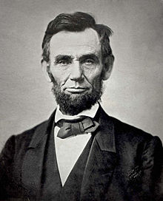
Lincoln’s Ten Percent Plan
Worked on reuniting the Union long before the end of the war
In December, after the Gettysburg Address
Wanted to make it easy for the Southern states to rejoin the Union
  Goals
    To bind the wounds
    Return the south into the Union

Slide 5
Ten Percent Plan
Introduced in December 1863
As soon as 10% of the state’s voters swore an oath of loyalty to the United States,
  the voters could organize a new state government
State governments must declare an end to slavery
State could send members to Congress
  Amnesty (group pardon) for former Confederates who took a loyalty oath
  Did not include amnesty for high government officials or top military officers
    Jefferson Davis, Robert E Lee

Slide 6
Wade-Davis Bill - 1864
Congress ignored Lincoln’s Ten Percent Plan
Passed stricter plan for Reconstruction
50 % had to sign a loyalty oath before a state could return
Anyone who had voluntarily fought for the Confederacy would be barred from voting for delegates to write new state constitutions
  Would not give them the right to vote
Lincoln vetoed the bill

Slide 7
Party Politics
Lincoln’s Republicans
  Hoped to see a strong Republican party in the new South
  Thought a lenient approach would win support from influential Southerners
Radical Republicans
  Supported a strict policy
  Felt that a strict plan
    keep secession leaders from regaining power
    keep control by the Radical Republicans

Slide 8
The Freedmen’s Bureau
Congress created in March 1865
First duty
  to provide emergency relief to people displaced by war
Set up schools
Helped freedmen find jobs
Resolved disputes between blacks and whites
Set up own courts

Slide 9
Freedman’s Bureau
African Americans wanted education
  Pooled pennies and dollars to start schools
Teachers
  Northern white women
  Edmonia Highgate – daughter of freed slaves in Louisiana
Public Schools
  More organized in the North
  South lacked systems of public education
  Began to educate both blacks and whites
  Grew into Fisk University (Tn) and Hampton University (Va)

Slide 10
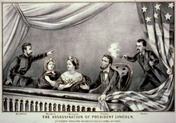
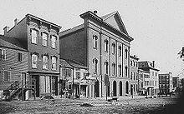
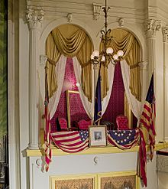
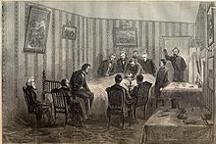
Lincoln is Assassinated
April 14, 1865 – 5 days after Lee’s surrender
Shot in Ford’s Theater while attending a play and died a few hours later in house across street

Slide 11
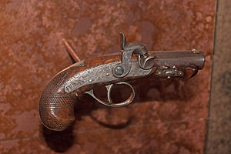
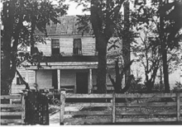
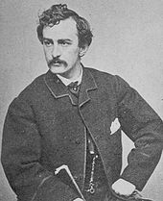
Lincoln’s Assassination
  John Wilkes Booth
    fired a single pistol shot
    Southern sympathizer/actor/conspirator
  Booth was shot – two weeks later
  Shot by pursuers
    trapped in a barn
  8 conspirators
  Convicted
  4 were hanged

Slide 12
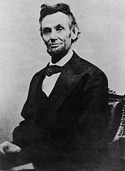
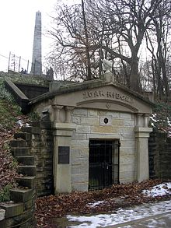
Lincoln’s Death
Shocked the nation
Funeral train carried Lincoln’s
body back to Illinois by the same route as his train took to come to Washington
Crowds paid their last respects as the train passed
Buried in Springfield, Illinois

Slide 13
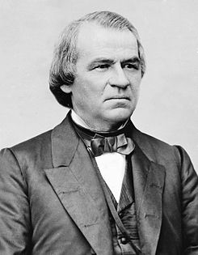
The Battle of Reconstruction
Andrew Johnson
17th President of the United States
Section 2

Slide 14
Lincoln’s Successor
Andrew Johnson
  Tennessee
  Southern Democrat
  Remained loyal to the Union
  Critical of the South
  Many expected him to take a strict approach to Reconstruction

Slide 15
A Growing Conflict
Andrew Johnson proposed a lenient Reconstruction plan
Followed Lincoln’s example to put the plan in effect without consulting Congress
Issued broad amnesty to most former Confederates
Allowed southern states to organize new governments
Elected Congressmen including former Confederate leaders
Each state – required to ratify the 13th Amendment and abolish slavery
  January 1865 – Congress approved the amendment to abolish slavery – banned both slavery and forced labor
  Gave Congress the power to make laws to enforce the terms

Slide 16
The Thirteenth Amendment 1865
Section 1. Outlawing Slavery and Involuntary Servitude
Neither slavery nor involuntary servitude except as punishment for crime whereof the party shall have been duly convicted, shall exist within the United States, or any place subject to their jurisdiction.
Section 2. Enforcement
Congress shall have power to enforce this article by appropriate legislation.

Slide 17
Congress
Met in December 1865
Rejected Johnson’s approach
Refused to seat the Southern senators and representatives
Appointed a committee to form a new plan for the South

Slide 18
Congressional Hearings
Held public hearings
  Testimony on black codes – new laws used by southern states to control African Americans
  Critics – claimed that the codes replaced slavery with near-slavery
  Mississippi – blacks could not vote, serve on juries
  If unable to pay a fine, blacks could be hired out to a white who would pay the fine

Slide 19
Radical Republicans
Took a hard line
Two goals
  Prevent former Confederates from regaining control over southern politics
  Protect the freedmen and guarantee them a right to vote

Slide 20
Conflict between Congress/President
Civil Rights Act of 1866
  Granted citizenship rights to African Americans
  Guaranteed the civil rights of all people except Native Americans
  Johnson vetoed the bill
  Johnson vetoed the law extending the Freedman’s Bureau
  Congress voted to overturn both vetoes
  Both bills became law

Slide 21
The Fourteenth Amendment
Congress wanted to make sure the Supreme Court would not strike down the Civil Rights Bill
  Dred Scott – no one descended from slaves could be citizens
Amendment failed at first to win approval of ¾ states
When Radical Republicans took control - approved in 1868

Slide 22
The Fourteenth
Amendment

Slide 23
Fourteenth Amendment
  All people born or naturalized in the US are citizens
  States may not pass laws that take away a citizen’s rights
  Takes away 3/5 clause for census
  Limits Confederate Officers’ and Leaders’ roles in government
  No state can deprive any person of life, liberty, or property without due process of law or deny any person equal protection of the law
  Any state that denies the vote to any male citizen over 21 could have its representatives to Congress reduced page 244

Slide 24
Radical Reconstruction
Andrew Johnson
Majority of white men must swear oath of loyalty
Must ratify 13th amendment
Former Confederate officials may vote and hold office
Thaddeus Stevens
Must disband state gov’ts
Must write new constitutions
Must ratify 13th & 14th amendments
Must allow African American men to vote

Slide 25
Reconstruction Act of 1867
  Removed governments of all Southern states who refused to ratify the 14th Amendment
  Imposed military rule on these states – dividing them into 5 military districts
  Had to write a new Constitution
  Had to ratify the 14th Amendment
  Had to let African Americans vote

Slide 26
South Under Military Rule
Soldiers helped register southern blacks to vote
African-Americans
  outnumbered white voters – 5 states
Election of 1868
  Republicans won all southern states
  Wrote new constitutions
  June 1868 – Congress seated representatives from 7 reconstructed states

Slide 27
Time of Hope and Advancement
African Americans played role in politics
Elected sheriffs, mayors, judges, legislators
16 served in the House of Representatives 1872-1901
2 African Americans served in the Senate
  1st -Hiram Revels,
  2nd - Blanche Bruce
Opened public schools
Spread taxes more evenly
Made fairer voting rules
Gave property rights to women
Rebuilt bridges, roads, and buildings

Slide 28
Radical Reconstruction
Leaderships changed to Republican Party
Three groups played key roles
  Scalawags
    Southern whites who opposed secession
  Carpetbaggers
    Northern whites who went south to start businesses or pursue political office
  Freedmen
    Freed slaves

Slide 29
Impeachment of Andrew Johnson
Article 2 of the Constitution
Impeachment – bringing of formal charges against a public official
Congress can impeach a president for ‘treason, bribery or other high crimes and misdemeanors’
House brings forth charges – hold hearings
Senate – holds the trial
Supreme Court Chief Justice presides

Slide 30
Impeachment of Andrew Johnson
Power struggle between Johnson and Radical Republicans
Johnson removed Secretary of War Stanton and replaced him with Ulysses S. Grant
House of Representatives accused him of Violating Tenure of Office
February 24, 1868 – 11 Articles of Impeachment
Trial went to the Senate
Chief Justice Salmon P Chase presided
Senate voted – 1 vote shy of 2/3 majority for impeachment
Final vote taken May 26th

Slide 31
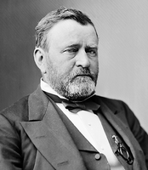
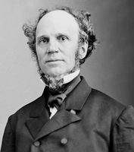
Election of 1868
Ulysses S. Grant defeated Horatio Seymour
Electoral votes – 26 out of 34 states
Republican Democrat
Virginia, Texas, Mississippi still not able to cast votes
500,000 African Americans voted
Moderate Grant had support from northern business
Radicals began to lose support in Republican party

Slide 32
Fifteenth Amendment
Congress passed in 1869
Barred all states from denying African American males the right to vote on account of race, color, or previous condition of servitude
Critics complained that it did not prevent states from requiring property ownership to vote or pay a poll tax
¾ states approved the amendment in 1870

Slide 33
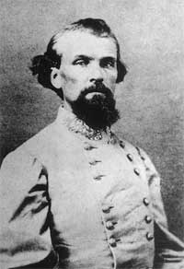
Ku Klux Klan
Began in Pulaski, Tennessee
Followed by Nashville
Angry at being shut out of politics
Organized a secret society of whites
Many were former Confederates/officers
First Grand Wizard – Nathan Bedford Forrest
Wore white robes and hoods – spread fear among African Americans – keep them from voting
Rode at night – threatened,, tortured, burned crosses and shot or hung many African Americans
Took hundreds of lives during the election of 1868

Slide 34
KKK
Radical Republicans urged President Grant to investigate the KKK
Ku Klux Klan Acts of 1870 and 1871
  Barred the use of force against voters
  Original Klan dissolved officially
  New groups took its place
  Some Klan groups stayed through the 1960s
  Threats to African Americans caused a decline in voting

Slide 35
The End of Reconstruction
Chapter 16 – Section 3

Slide 36
Reconstruction’s Conclusion
Radical Republicans lost support
  People worried about own lives
  Many didn’t care about government
  Time healed wounds

Slide 37
Grant’s Presidency
  Full of corruption
    Great General/Poor President
    Grant himself had no part in the corruption
    Appointed friends to public office
      often corrupt
    Won re-election in 1872
    Northerners lost faith in the Republican party

Slide 38
Self-rule for the South
Many wanted withdrawal of military in the South
Radical Republicans losing power
South slowly took away rights of African Americans
By 1874 Republicans controlled only 3 states
By 1877 Democrats controlled all
Groups like the KKK were a factor in the change

Slide 39
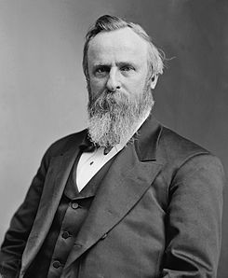
The Election of 1876
Candidates
  Rutherford B Hayes of Ohio – Republican
  Samuel J Tilden of New York - Democrat
Republicans vowed to continue Reconstruction
Democrats vowed to end Reconstruction
Tilden won the popular vote by 250,000
20 Electoral votes disputed
  Tilden needed 19 electoral votes to win
Congress appointed a special commission of 15 members
  All were Republicans and gave all 20 to Hayes
  Democrats agreed to accept the decision
  Hayes had privately said he would remove troops from South

Slide 40
African American Lose Rights
Techniques to stop blacks from voting
  Poll Tax – personal tax to be paid before voting
    Kept out a few poor whites and many poor blacks
  Literacy Test – test to see if a person can read and write
    Read a section of the Constitution
  Grandfather Clauses
    Provision that allowed a voter to avoid the literacy test if his father/grandfather had been eligible to vote on Jan. 1, 1867
    Because no African Americans could vote before 1867 – eliminated all blacks

Slide 41
Segregation
Enforced separation of races
Jim Crow Laws
  Barred the mixing of races in almost every aspect of life
  School, hospitals, cemeteries, playgrounds, restaurants, hotels
  When African Americans challenged Jim Crow laws in the courts, they were ruled legal

Slide 42
Plessy v. Ferguson
Homer Plessy had been arrested for sitting in a coach marked ‘for whites only’
The Court ruled in favor of the Louisiana law
The court said that as long as facilities were ‘equal’, the law could require ‘separate’ facilities
‘Separate but equal’ remained in effect until 1950s
Reality – African American’s facilities were inferior
Will be challenged in Brown v. Board of Education of Topeka

Slide 43
A Cycle of Poverty
At Emancipation
  Most blacks owned little more than the clothes they wore
Sharecropping
  Laborer who works the land for the farmer/owner in exchange for a share of the value of the crop
  Landlord supplied
    Living quarters, tools, seed and food on credit
  Sharecropper
    Labor
  Bad years
    Due to weather/crop prices – did not cover expenses
    Went into debt

Slide 44
Opportunities for African Americans
Skilled jobs under Reconstruction disappeared
Educated blacks
  teachers
  lawyers
  preachers in the black community
Most found only menial jobs

Slide 45
Industrial Growth in the South
New industries started to appear
‘New South’
  Agriculture rebounded first
    Cotton production revived
    Tobacco production grew
  Textile industries
    Developed own resources
      Iron
      Timber
      Oil
    New Lumber mills processed pine and hardwoods
    New factories were built

Slide 46
Reconstruction
Many successes -------Many Failures
African Americans were now citizens
Fourteenth Amendment will be the basis of Civil Rights Movement that begins in the 1950s

