Slide 1
How To Set Up Your Online Science Textbook
Please have your textbook ready and be able to read the back cover.
Follow the instructions on this slide show to create your user account.
Good luck!

Slide 2
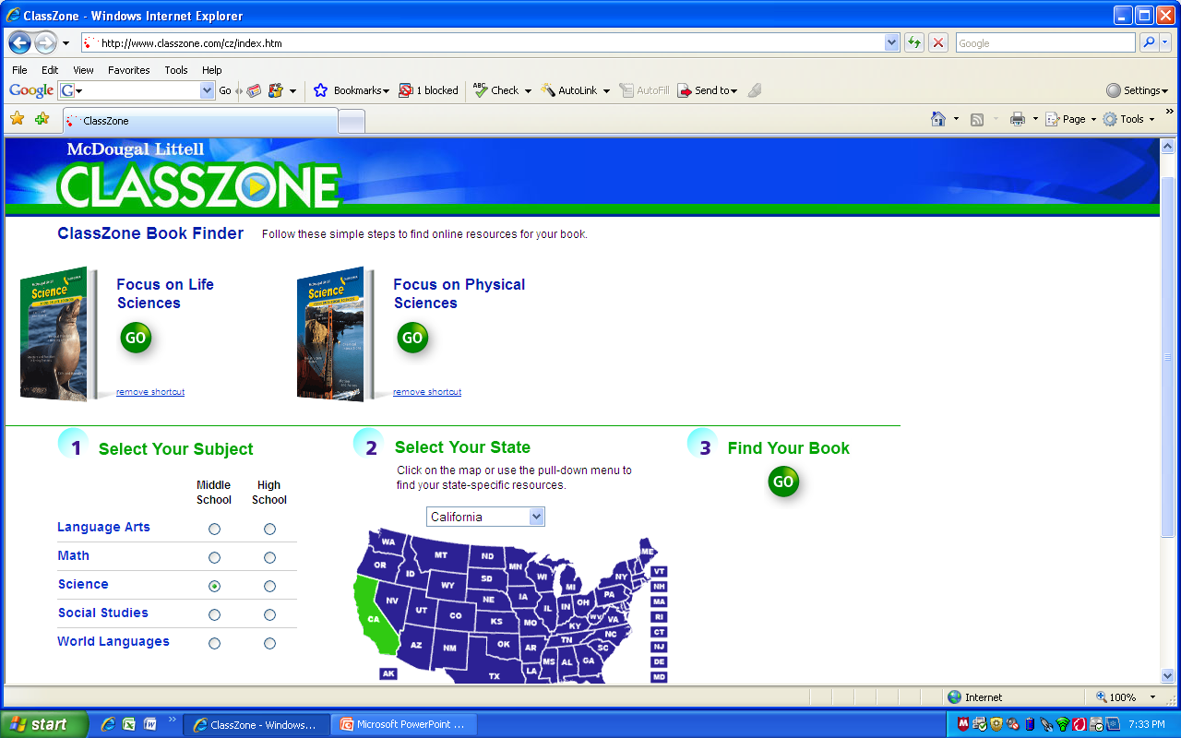
Firstly you must visit http://www.classzone.com
Then select 1. Science, 2. CA, 3. GO

Slide 3
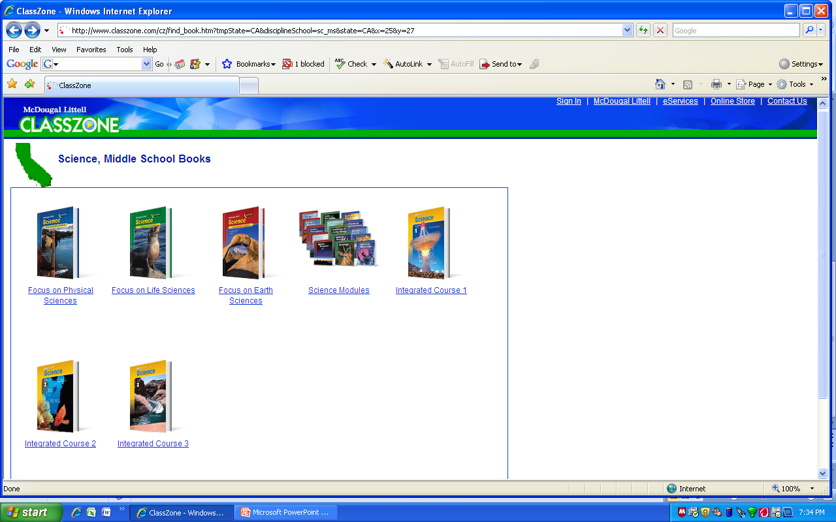
On this page select the textbook you have been given by me.

Slide 4
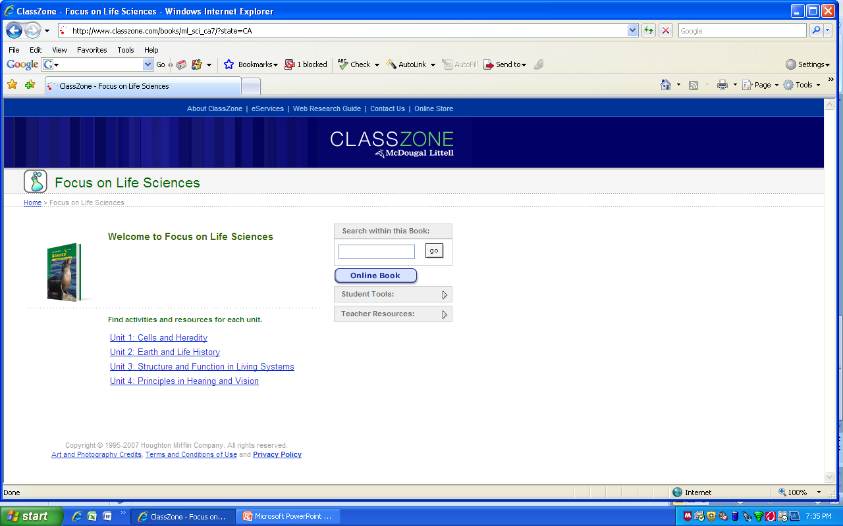
Here, click on ‘Online Book’

Slide 5
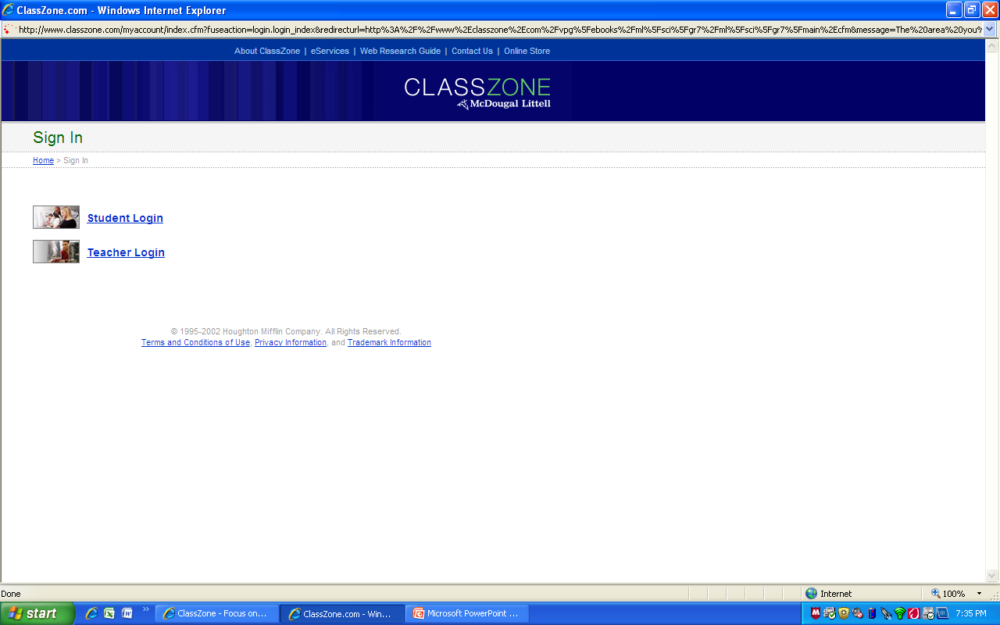
Select Student Login

Slide 6
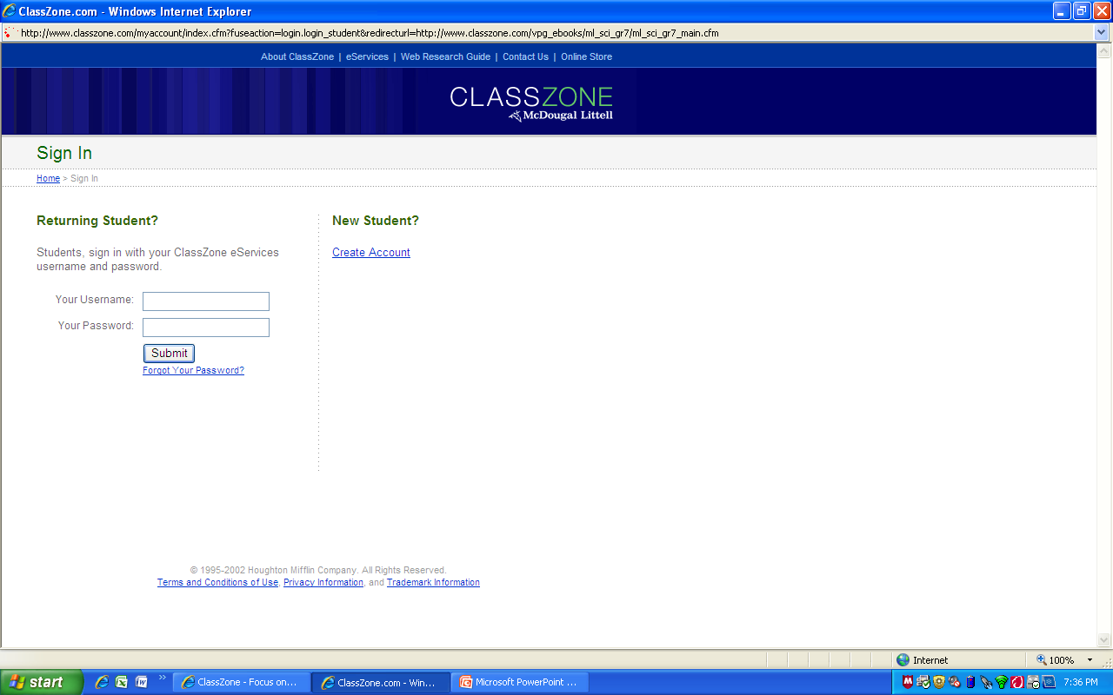
Select ‘Create Account’

Slide 7
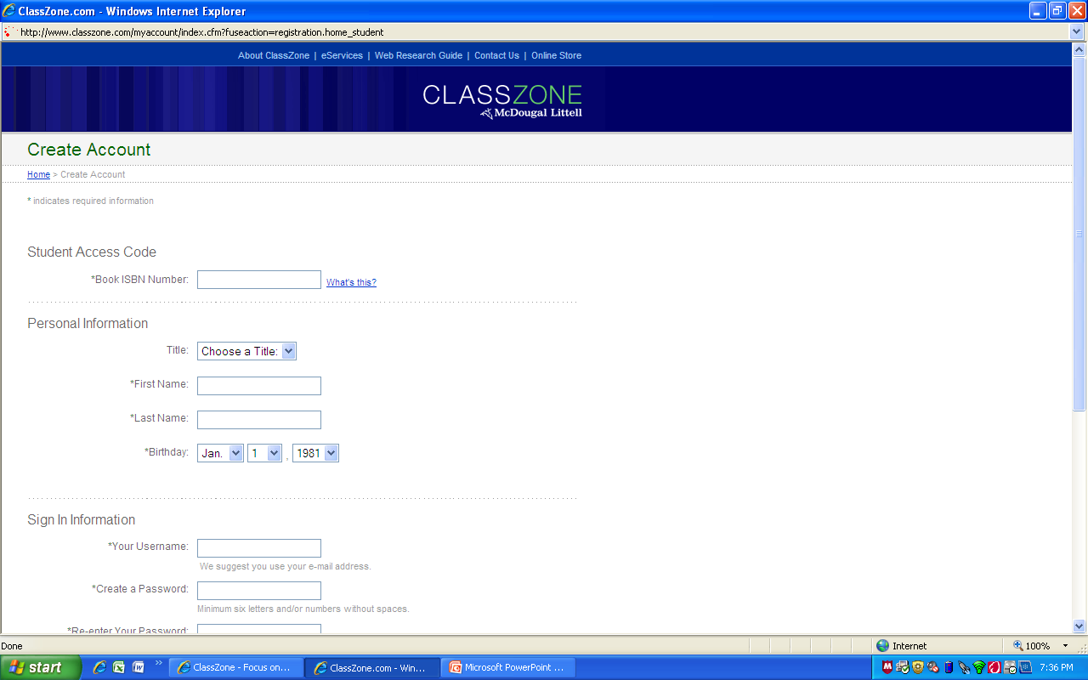
Fill in this page carefully. The first box here requires the textbook ISBN number. Click on ‘What’s this?’ to show which specific number you need from the back cover.

Slide 8
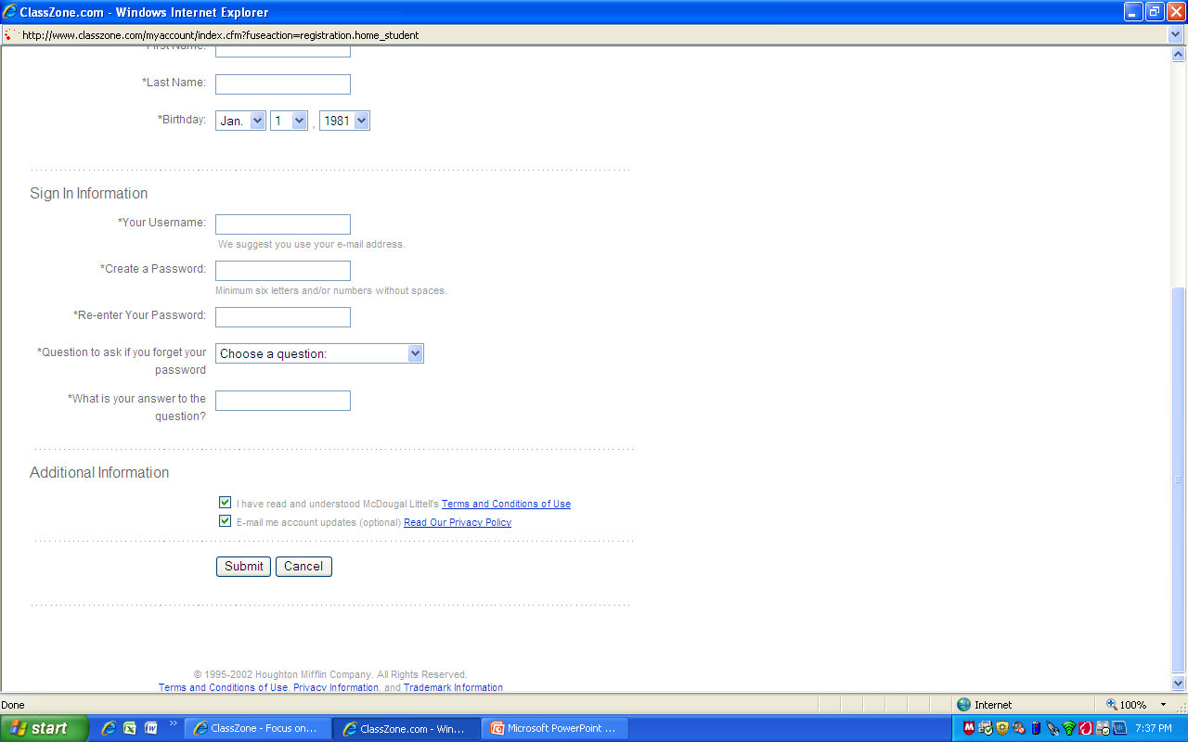
Once you get to the bottom of the page, check your information, then select ‘submit’.

Slide 9
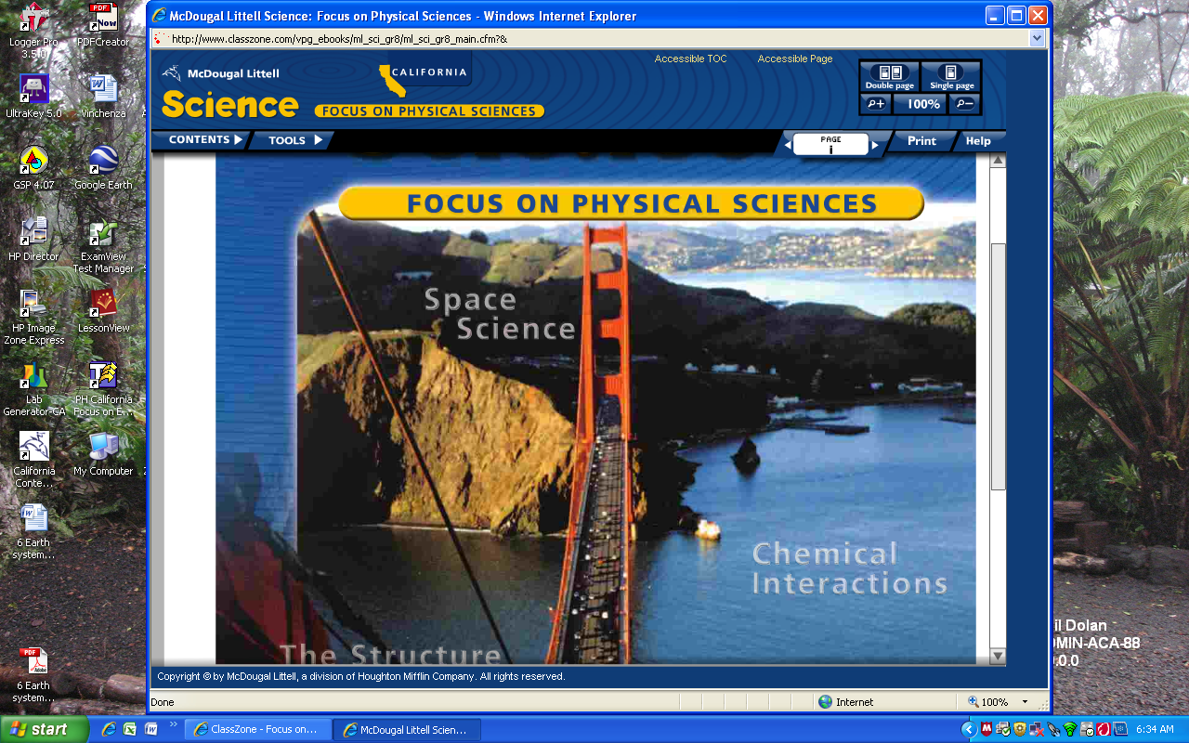
Voila!

