Slide 1
History of the Middle East Conflict

Slide 2
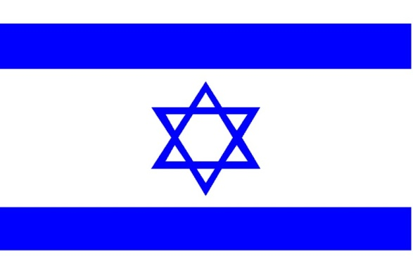
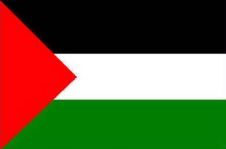
ISRAEL-PALESTINE
IN A NUTSHELL

Slide 3
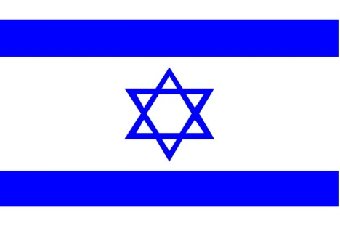
Symbol Key
Jewish Perspective
Palestinian Perspective
Christian Perspective
Notes:
The story of the Levant (the geographical area of eastern Mediterranean -- today, Lebanon, Syria and Israel), a land considered holy by three of the world’s most influential religions, is filled with controversy. For an instructor, teaching the region’s history is deeply problematic since simply outlining events can invite criticism from one group or another. While the facts are indisputable, the significance and interpretations of data may differ widely.
For that reason, we’ve included symbols to indicate perspectives on select slides.

Slide 4
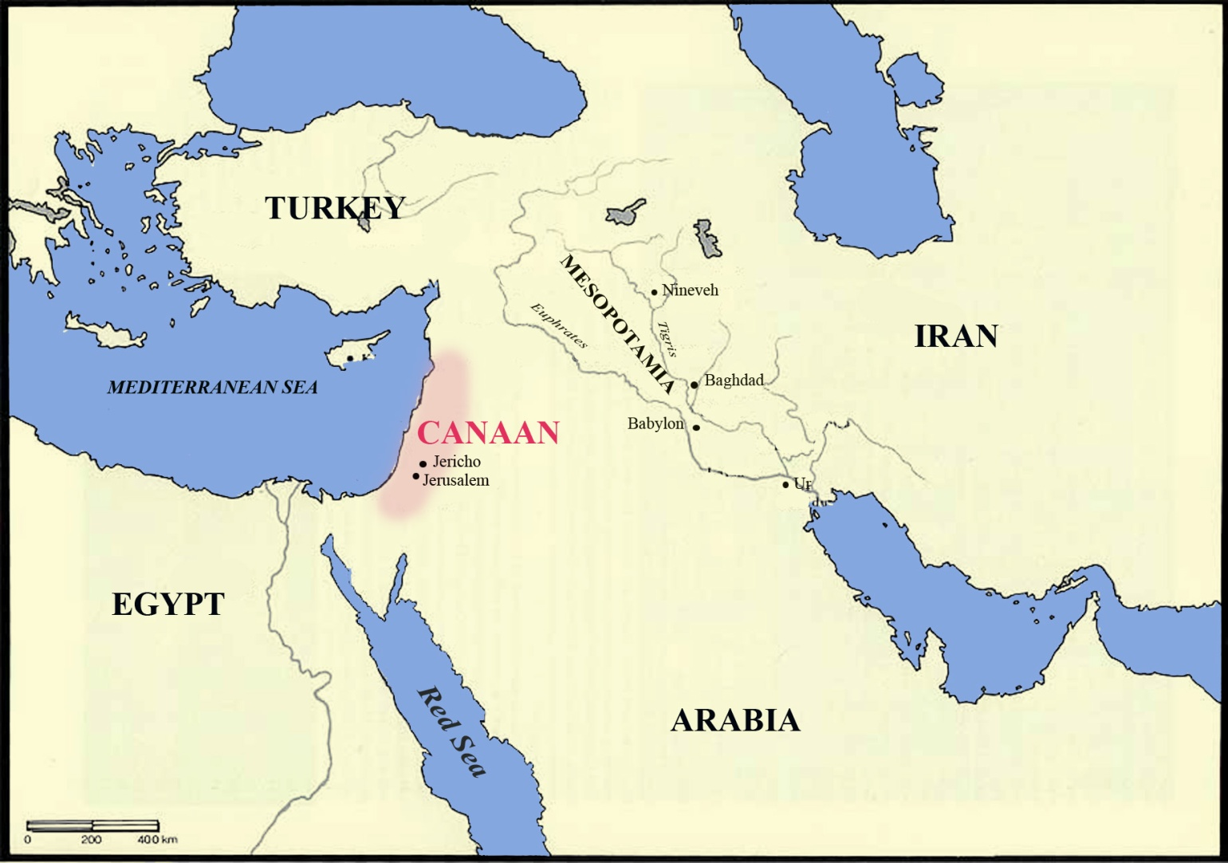
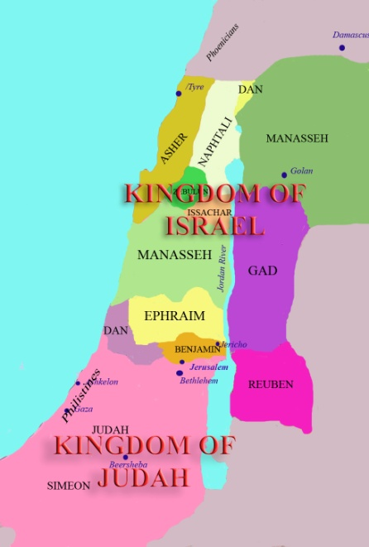
CANAAN
Notes:
ANCIENT HISTORY
Before it was called Palestine or Israel or even Syria and Lebanon, the land between the Jordan River and the Mediterranean Sea was known as Canaan and its inhabitants, Canaanites.
The Canaanites, who had established themselves in the area around the 4th millennium B.C., were a Semitic-people (so called because they spoke a language purportedly shared by descendants of Shem, Noah’s oldest son [Hebrew, Aramaic and Arabic are all “Semitic” languages]). The Canaanites settled in a number of city-states including one of the world’s oldest known towns, Jericho. Around 3000 B.C., one of the Canaanite tribes, the Jebusites, built a settlement which they called Ur-Salem, the “city of peace” or Jerusalem.
For much of its history, Canaan was dominated politically by the Egyptians who were able to repel incursions by Amorites, Hittites and Hurrians. But by the 13th century, Egyptian power began to weaken allowing the land to be invaded by armed bands of Philistines and a confederation of Hebrew-speaking tribes.

Slide 5
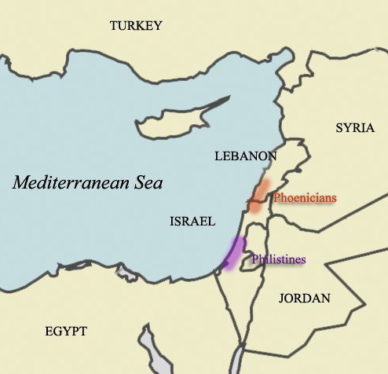
CANAAN
Phoenicians
  Lebanon
  “Phonetic” alphabet
Philistines
  Sea People
  1200 B.C.
  Gaza, Ashkelon, Ashdod
  Philistia or “Palestine”
Notes:
PHOENICIANS AND PHILISTINES
In spite of the invasions, some of the inland Canaanites, like the Jebusites of Jerusalem, remained in the interior of the land. Most of the Canaanites, however, fled to a narrow strip of coastal land in the north – a region that was subsequently known as Phoenicia (in modern-day Lebanon). The “Phoenicians” (the name given to coastal Canaanites by the Greeks) became sea-faring traders and colonized a number of new cities: Tyre (which the Phoenicians called Al-Sur), Sidon, Beirut, Byblos and Ugarit. In order to make it easier to keep merchant records, the Phoenicians simplified the 55-character cuneiform style of writing that had been developed in Mesopotamia in the 4th millennium B.C. into 22 distinct sounds. After alterations by the Greeks and Romans, this “phonetic” alphabet became the precursor of the current English 26-letter alphabet.
The Philistines, who invaded the southern coastal plain of Canaan in about 1200 B.C., were Sea People of Aegean and southeastern European origin. With their iron weaponry and military skills, they swiftly conquered the Hittite Empire, Cyprus, Mycenae, (the most powerful of the ancient Greek kingdoms) and almost defeated Egypt before they settled in Canaan. In their new home, they established five kingdoms: Gaza, Ashkelon, Ashdod, Gath and Ekron, collectively known as “Philistia” or “Palestine” by Herodotus and other Greek and Latin writers.
*Although the Philistines no longer exist, their status as enemies of the Hebrews has seeped into modern vocabulary. The word “philistine” describes someone who is barbaric and indifferent or antagonistic to artistic and cultural values.

Slide 6
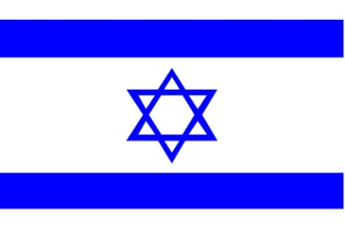
BIBLICAL HISTORY

Slide 7
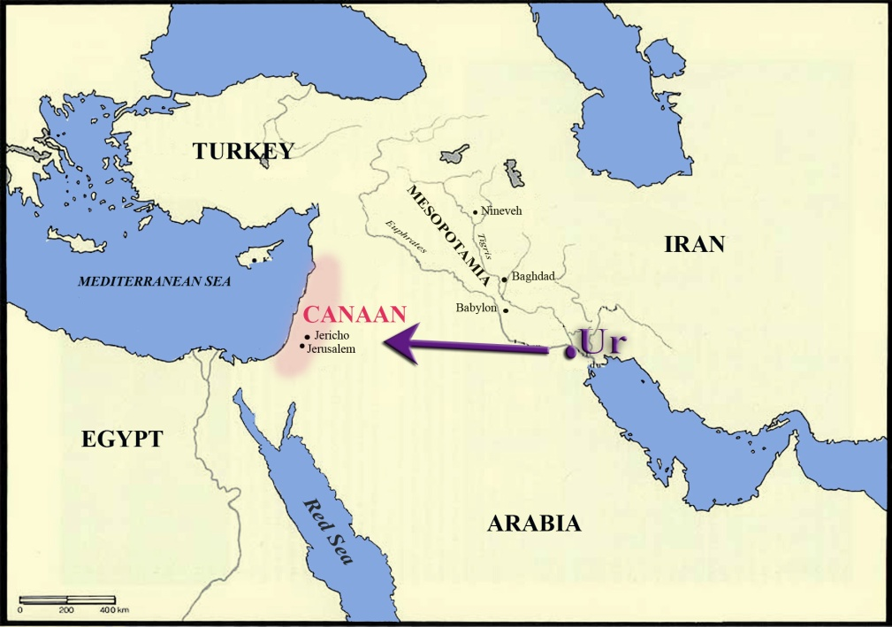
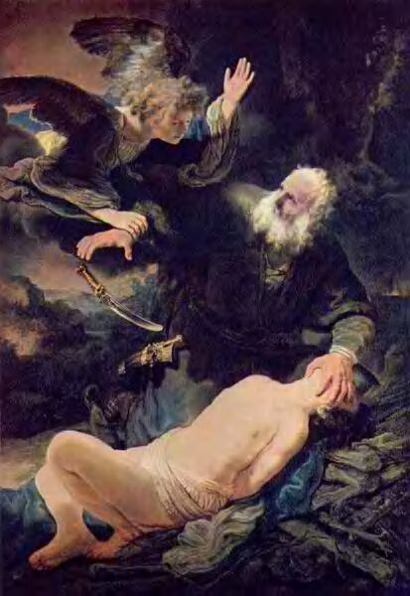
ABRAHAM
Judeo-Christian Perspective
Born in Nur (Iraq)
“Chosen People”
Servant Hagar
  Bore son, Ismail
Wife Sarah
  Bore son, Isaac
Isaac’s descendants
  Esau
  Jacob (“Israel”)
Abraham sacrificing his son, Isaac
By Rembrandt
Notes:
BIBLICAL HISTORY -- ABRAHAM
As told in the first books of the Torah (the Old Testament), the story of Eretz-Israel (the “land of Israel”) began around 1800 B.C. in the town of Ur (in present-day Iraq) with a command and a promise from God to a man called Abraham. At the age of 75, Abraham was instructed to leave the land of his father with his wife Sarah to populate a land where his people could worship God. In return, God promised that Abraham would have many, many descendants -- even though Sarah was barren and long past her childbearing years.
After a period of enslavement and affliction that would last for 400 years, Abraham’s descendants, God’s “Chosen People,” would inherit the land of Canaan from the Nile River (in Egypt) to the Euphrates River (in present-day Iraq) for the rest of time. (Genesis 17:1-8)
As God had commanded, Abraham traveled to Mount Moriah in Jerusalem (the future site of the Temple Mount) where, in order to facilitate God’s promise of a nation created from Abraham’s offspring, Sarah convinced Abraham to be intimate with her Egyptian slave, Hagar. Hagar bore Abraham a son called Ishmael.
Soon after, Sarah, at the age of 90 years, bore Abraham a son of her own who was called Isaac. Although she was the one who had suggested Abraham’s liaison with Hagar, Sarah became jealous of Abraham’s older son, Ishmael, and asked her husband to send the child and his mother away into the desert.
As a test of Abraham’s devotion and trust, God presented Abraham with another command -- to sacrifice his beloved son, Isaac, on top of Mount Moriah. Just as Abraham’s knife was about to cause a fatal wound, God, satisfied with Abraham’s demonstration of loyalty, stopped him. Isaac, saved from death, eventually grew up to father two sons, Esau and Jacob.
Of the two, God favored Jacob and called him “Israel,” meaning “to strive with God and prevail.” It was Jacob’s twelve sons who eventually became the patriarchs of the twelve tribes of Israel (called the “Hebrew Tribes”).

Slide 8
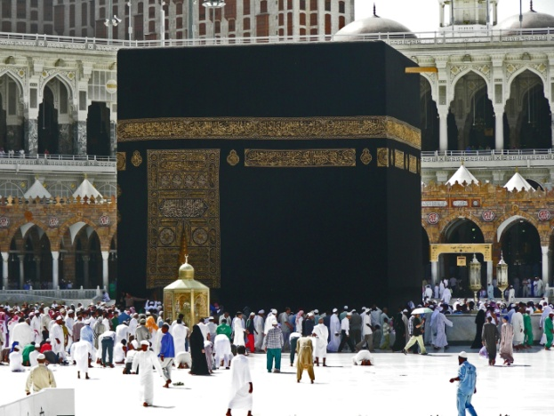
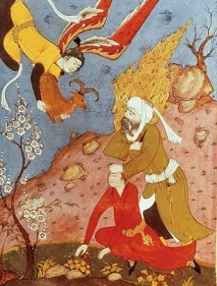
ABRAHAM
Muslim Perspective
Born in Nur (Iraq)
First “Muslim”
Wife Sarah
  Bore son Isaac
Servant Hagar
  Bore son Ishmael (Ismail)
Abraham and Ishmael
  Built Ka’aba in Mecca
Abraham nearly sacrificed Ishmael
Ka’aba
Mecca, Saudi Arabia
Abraham sacrificing
his son, Ishmael
15th Century Miniature
from Iran
Notes:
THE STORY OF ABRAHAM (Muslim Perspective)
The holy books of the Jews, Muslims and Christians agree about most of Abraham’s history although the Torah (or Old Testament to the Christians) and the Quran (Islam’s holy book) differ on the details.
Both the Bible and the Quran agree that Sarah was old and barren and that she offered Abraham her Egyptian servant, Hagar, to bear him children. Both also concur that Hagar and her child Ishmael were sent into the wilderness. But Muslims add that Hagar and Ishmael were sent to Arabia where there were left by Abraham with few provisions. According to Muslim tradition, when their food and water ran out, Hagar ran back and forth in a panic until God caused a small well to appear. The Zam Zam Well provided enough water for the mother and child and soon attracted a number of travelers to the site. When Abraham returned, he found a thriving town.
In the center of the town, today Islam’s holy city of Mecca, Abraham and Ishmael built a cube-like structure in honor of God. After Muhammad (the messenger responsible for the development of Islam) was victorious in the 7th century, the cube or Ka’aba was rededicated to God and remains Islam’s holiest sanctuary today visited by millions of Muslims every year.
Like Jews and Christians, Muslims, too, believe that God had instructed Abraham to sacrifice his son to demonstrate his devotion to God. But unlike the Jews and Christians, Muslims believe he nearly sacrificed Ishmael in Mecca.
Abraham, Muslims claim, apart from being the first to practice monotheism and the ancestor of three great religions, was also the first person to use the word Islam or “submission” when referring to a believer’s relationship to God. Those who submit to the will of God (as Abraham had done in compliance with God’s order to sacrifice Ishmael) are called “Muslims.”

Slide 9
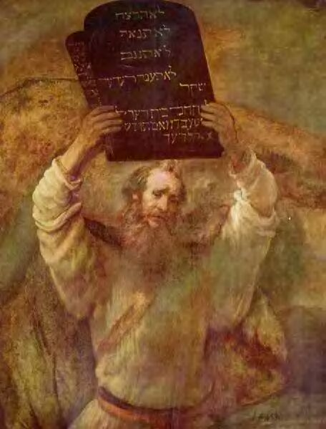
MOSES AND EGYPT
Pharaoh (Egyptian king)
  Enslaved Israelites
Moses
  Led Israelites out of Egypt
  Parted the Red Sea
Mt. Sinai
  Moses received 10 commandments from God
Eretz-Israel
  After 40 years Israelites enter Canaan.
Moses with the 10 Commandments, By Rembrandt
Notes:
BIBLICAL HISTORY – Egypt
One of Jacob’s sons, Joseph, was sold into slavery to merchants on their way to Egypt by his jealous brothers. In Egypt, Joseph won the trust of the Pharaoh and was appointed his minister to rule over the land. When famine hit the land of Canaan, Joseph’s brothers joined him with their families.
After Joseph’s death, Rameses II became Pharaoh and, fearful of their rapid rate of procreation, enslaved the Israelites. Upon hearing a rumor that a savior would be born into the Israeli bloodline, he ordered that all babies born to the enslaved group be killed. But one child escaped his death sentence when his mother placed him in a basket and sent him floating down a river.
The Pharaoh’s daughter found the child and claimed him as her own. The baby was given the Egyptian name of Moses and became a prince of Egypt (circa 1350 B.C.).
Moses, who had been chosen by God to deliver the “chosen people” from Egyptian slavery, finally persuaded the Pharaoh to “let his people go” after Egypt suffered divinely-sent plagues. Pursued by the Pharaoh’s army, Moses led his people across the Sea of Reeds (or “Red Sea”) into Sinai. The Israelites were able to escape the approaching Egyptian forces when God gave Moses the power to separate the waters. After the Hebrews passed through safely, the sea closed again drowning the Egyptian soldiers. For the next 40 years, the people of Israel wandered through the desert on their way back to the land promised to Abraham.
In the course of their journey, the Israelites camped at the foot of Mount Sinai where Moses received an order from God to worship no other god but God himself. At this time, God also presented Moses with ten commandments inscribed on two stone tablets to be observed by all Israelite people and taught him the laws governing religious observance (later compiled in the Torah). The Israelites placed a record of the laws and the tablets in a case called the Ark of the Covenant and carried it with them as they traveled through the desert.
After four hundred years living in a foreign land and forty years wandering in the desert, the Israelites were finally led back into Eretz-Israel by Moses’ assistant, Joshua. Once they re-conquered Canaan from the indigenous population, the land was divided among the Israeli tribes.

Slide 10
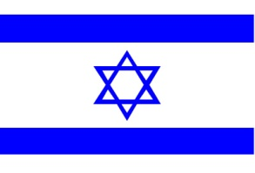
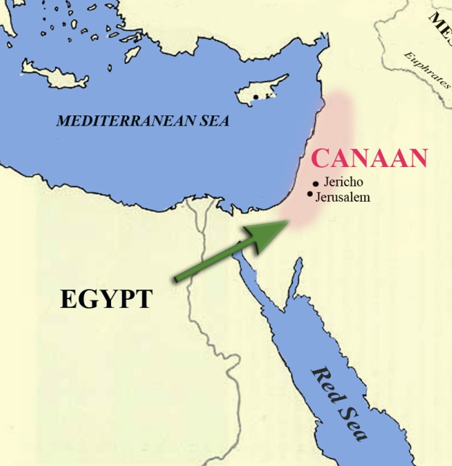
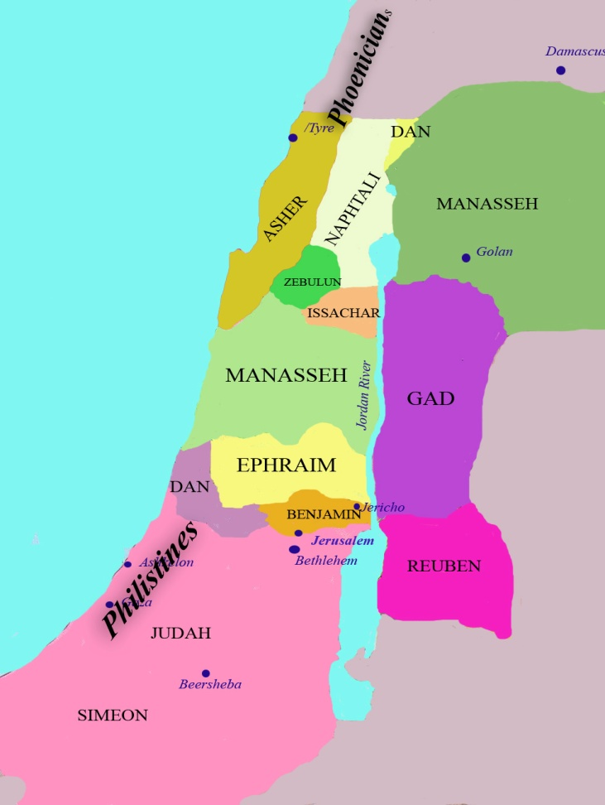
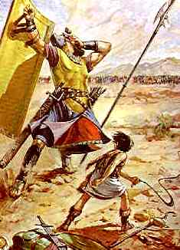
ISRAELITES IN CANAAN
Israelites entered Canaan
United under Saul
David defeated Goliath (representing the Philistines)
David vs. Goliath
Notes:
ISRAELITES ENTER CANAAN (David vs. Goliath)
In 1230 B.C. the Israelites, led by Joshua, conquered the Canaanites and settled in the hill country in the interior of the land. But they could not defeat the superior military organization of the Philistines (symbolized in the Bible as the mighty giant Goliath). After a particularly devastating defeat in Shiloh in 1050 B.C. (during which the Philistines took the Ark of the Covenant, the Israelites most sacred object), the twelve Hebrew tribes decided to unite under an appointed king, Saul. According to Jewish legend, a young boy named David decided to challenge the Philistine giant, Goliath, who was protected by a “helmet of bronze and a coat of chain mail.” With a single stone hurled from a slingshot, David hit Goliath’s forehead, the only vulnerable spot in Goliath’s armor, causing the giant to tumble to the ground. The boy became the Israelites greatest king.
Under David’s command, the Israelites ultimately defeated the Philistines in 1000 B.C. Soon after the conquest, King David captured the city of Jerusalem (then called the City of David) and made it his capital. On the site of Mount Moriah to the north of the city, David’s son, Solomon, built a temple to house the Ark of the Covenant which contained the tablets of the Ten Commandments.

Slide 11
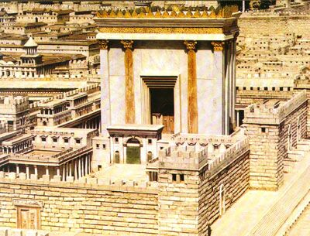
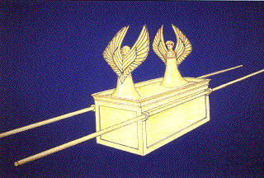
SOLOMON’S
TEMPLE
David’s son, Solomon
Built Holy Temple in Jerusalem
  To house Ark of Covenant
Known as the
First Temple
Period
18th century Dutch woodcut
envisioning Solomon’s Temple
Representation of the Ark of the Covenant
Notes:
SOLOMON’S TEMPLE
David’s son, Solomon, launched an ambitious building program that included constructing a holy Temple that would become the new home for the sacred Ark of the Covenant. This period (known in Jewish history as the First Temple Period) was marked by expansion, trade and development.
Resentment over heavy taxes levied against the Israelites to pay for Solomon’s extensive projects as well as jealousies among the tribes finally led to the empire’s split into a northern Kingdom of Israel (with its capital at Samaria) and a southern Kingdom of Judah which incorporated the holy city of Jerusalem.

Slide 12
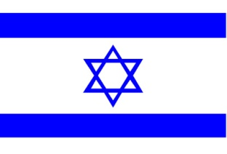

DISINTEGRATION
Split
  Northern Kingdom of Israel
    Capital Samaria
  Southern Kingdom Judah
    Capital Jerusalem
Assyrians (586 B.C.)
  10 Lost Tribes
Babylonian Captivity
Notes:
DISINTEGRATION OF THE EMPIRE
Under Solomon’s rule, the empire’s influence stretched from the Gulf of Aqaba to the Euphrates River. But the united kingdom could not survive Solomon’s death. In 922 B.C., the country of the Israelites was divided into a northern Kingdom of Israel composed of ten of the twelve Hebrew tribes, and a southern Kingdom of Judah which controlled Jerusalem.
ASSYRIANS AND THE TEN LOST TRIBES (586 B.C.)
Weakened by the disintegration of the empire, the northern House of Israel was easily conquered by the Assyrians in 722 B.C. The inhabitants of the kingdom were exiled by the victors and they scattered all over the world. The “Ten Lost Tribes” as they came to be called, so thoroughly assimilated into their foreign habitats that they virtually disappeared from the pages of history.
BABYLONIAN CAPTIVITY
In the south, the two remaining tribes of the house of Judah and Benjamin were spared from exile because they submitted to the Assyrians. They continued to live peacefully in the Kingdom of Judah (later known as Judea under the Romans) for the next 150 years until the Babylonians, under the command of Nebuchadnezzar conquered the Assyrians.
In order to solidify his authority in Palestine, the Babylonian King Nebuchadnezzar deported the most influential Jews (priests, professionals, craftsmen, the wealthy etc.) to his capital of Babylon where they continued to practice their religion.
He then ordered his soldiers to burn Solomon’s temple to the ground and ravaged the city of Jerusalem. The Philistines, who had lost their preeminent position in the territory after the establishment of Israel and Judah, assimilated into the Assyrian and Babylonian cultures.

Slide 13
Under Joshua, Israelites reach and battle for the promised land.
Set up kingdom under the twelve tribes (Judges)
King Saul first king
Pinnacle under King Solomon
King David – Builds Temple in Jerusalem

Slide 14
Troubles developed internally and the kingdom split and weakened.
Sargon II of Assyria wanted Egypt, and Israel was in the way so it was overtaken too.
Later Babylonians under Nebuchadnezzar overtake the area and in 586 BC- exile to Babylonia
Temple destroyed- growth of the synagogues

Slide 15
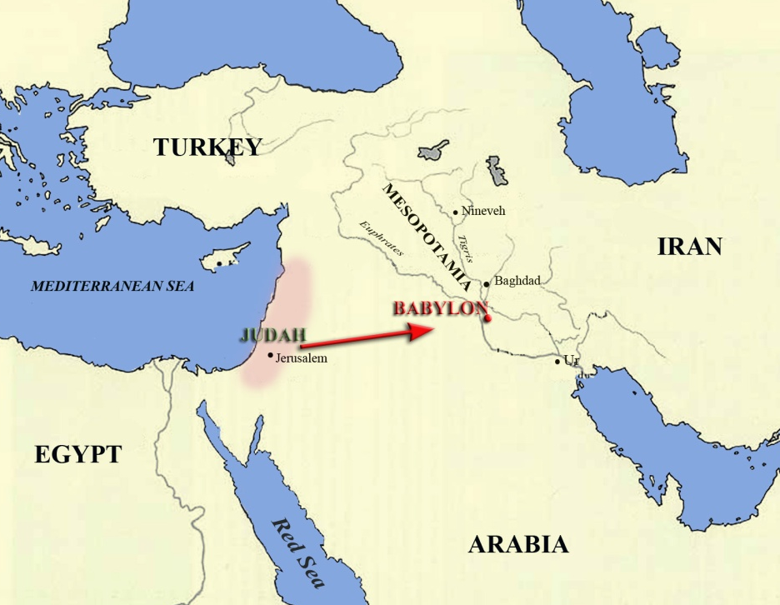
BABYLONIAN
CAPTIVITY
Jehudim (“People of Judah” or “Jews”)
Spiritual growth in Babylon
Prayers directed toward Jerusalem
God (“Yahweh”) more abstract.
Synagogues
Messiah
Notes:
BABYLONIAN CAPTIVITY
Rather than bringing an end to the Israelite people and their monotheistic beliefs, the tragic loss of the temple and the Babylonian Captivity inspired the Jehudim (people of Judah or “Jews”) to reexamine and strengthen their culture. Judaism in captivity enjoyed a period of spiritual growth.
While conditions were tolerable in Babylon -- the cultural capital of the world at that time and the land of Abraham’s birth, the site of the Garden of Eden, the Tower of Babel and the Hanging Gardens -- the Jews yearned to return to their homeland. In a solemn pledge the Jews promised If I forget thee o Jerusalem, let my right hand forget her cunning. If I do not remember thee, let my tongue cleave to the roof of my mouth: if I prefer not Jerusalem above my chief joy. (Psalms 137:5-6).
To reinforce their pledge, all prayers were directed toward Jerusalem (a practice that continues today).
During the Israelites seventy years in captivity, the image of God became more abstract and the law more universal. The Jewish god, Yahweh, was no longer seen as the god of a nation but as the god of mankind who could be worshiped from any point on earth.
Without a central temple the Jews congregated at common gathering places (synagogues) to worship God, and ritualistic customs associated with the Temple (animal sacrifices, for example) were abandoned.
It was during this time that the Israelites decided to compile all the traditions, legends and laws into a full library that would later become the Torah (the Bible) and began to await a Messiah (a savior sent by God and descended form the house of David) who would restore the nation of Israel and redeem the Jewish people.

Slide 16
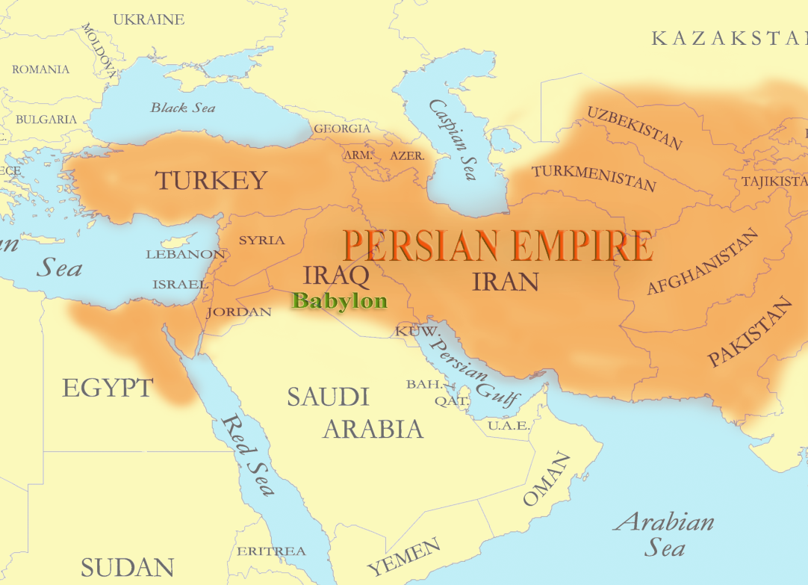
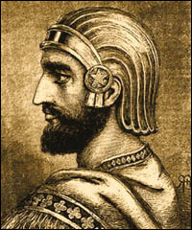
CYRUS THE GREAT
538 B.C.
Persian King, Cyrus the Great
Released Jews from Babylonian Captivity
Temple Rebuilt
  “Second Temple Period”
Cyrus the Great
and the Persian Empire
Notes:
CYRUS THE GREAT AND THE SECOND TEMPLE PERIOD
In 538 B.C., Persian King Cyrus the Great, a friend to the Jews, overthrew the Babylonians.
Influenced by the belief preached by Zarathustra (Zoroaster in Greek) in the 7th century B.C. that the universe was divided into spheres of good and evil, Cyrus was eager to ally himself with the “good” god of the Jews, Yahweh. Good and evil, it was prophesied would soon fight the cosmic battle and Cyrus believed that his Persian Empire could help bring about the triumph of good over evil.
After conquering the Babylonians, he released the Jews from their captivity and encouraged them to return to Jerusalem and rebuild their temple ushering in the Second Temple Period.
For about two centuries, the Jews (or “Hebrews,” those who spoke Hebrew) were allowed to practice their religion freely in Judah under Persian rule until the Persians were defeated by the Greeks under Alexander the Great (356-323 B.C.).

Slide 17
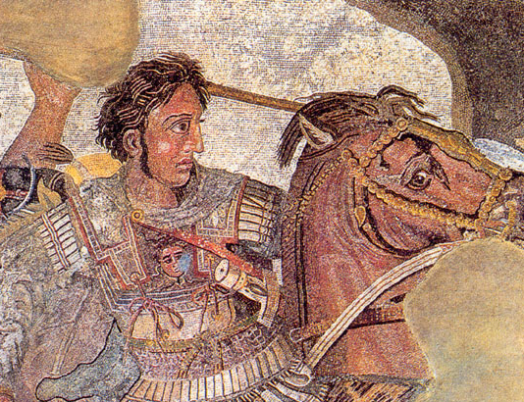
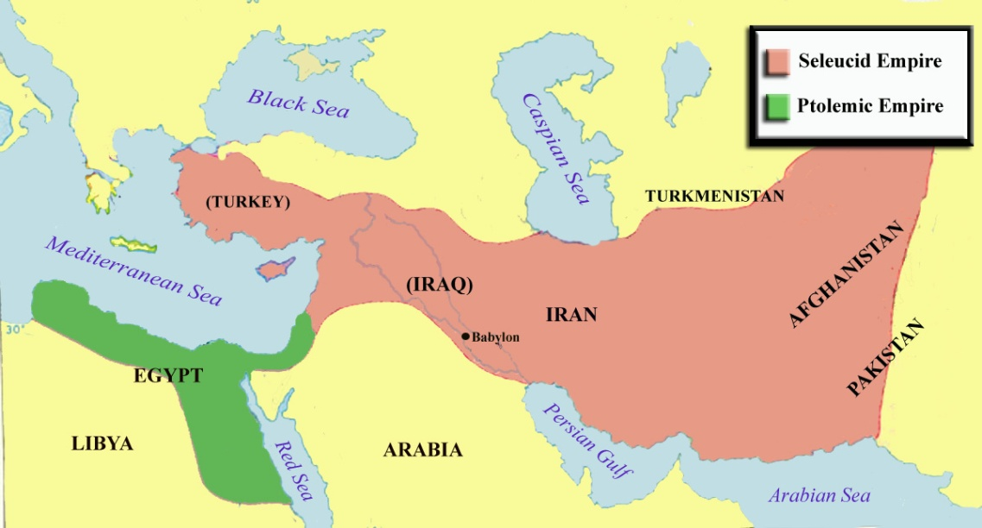
GRECO-ROMAN PERIOD
Alexander the Great (331 B.C.)
Ptolemies
Seleucids
  Antiochus IV Epiphanes
Hellenism
Alexander
the Great
Notes:
GRECO-ROMAN PERIOD
While under the protection of the Persians, the pacifist Jews had no reason to build a military force. When Alexander the Great’s Greek forces marched through Jerusalem in 331 B.C., therefore, the Jews had no other recourse but to submit to the invaders. For the next nine centuries, consequently, Judah became a province of the Greco-Roman Empire.
The Greeks under Alexander the Great admired the Jewish religious traditions and allowed the citizens of Judah to exercise political autonomy. The Torah, the Hebrews’ holy book, was translated into Greek (facilitating the spread of Jewish concepts of God, Mosaic law etc.) and the infusion of Hellenistic (Greek) culture introduced the concepts of reason, logic and dialogue into Hebrew scholarship.
After Alexander’s death, his vast Empire was divided among his generals. General Seleucus controlled Syria and Asia minor, Antigonus ruled Greece and General Ptolemy was granted Egypt and Palestine.
Ptolemies
The Jews and their new overlords, the Ptolemies, enjoyed a relationship of mutual admiration. The Greeks respected Jews for their discipline, laws and literature and, as long as the Jewish subjects paid their nominal tax to the Greek government, they were freely allowed to practice their own religion. As control of Palestine passed to Seleucus in 198 B.C., though, the new leaders abandoned Alexander’s policy of tolerance and attempted to force Hellenism upon the population.
Seleucids
The Seleucids defeated the Ptolemies in 198 B.C. and occupied Judah. Jerusalem, with its rich Temple and valuable synagogues, was seen as a source of great wealth to the new rulers and the Jewish religion was perceived as an obstacle to Alexander the Great’s vision of an empire united by a single culture and a single religion.
Seleucid Emperor Antiochus IV Epiphanes (175-163 B.C.) considered Hellenism (as Greek culture was called) a far superior civilization to that of the Jews and he became impatient with the slow rate of Hellenization of his empire. To move the process along, he outlawed monotheism, persecuted Jews for keeping the Sabbath (the Jewish day of rest and worship), prevented them from performing circumcision and practicing other Jewish customs, and infused the city with Greek symbols. In 168 B.C., Antiochus IV even ordered pagan sacrifices at the holy temple where he had erected an altar to the Greek pagan god Zeus. All of these acts ultimately provoked a Jewish insurrection.

Slide 18
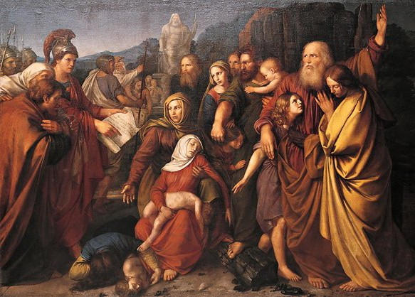
MACCABEAN REVOLT
Judah Maccabee (“The Hammer”)
Revolted against Greeks
Hasmonean Dynasty
Notes:
MACCABEAN REVOLT
Stripped of their religion and furious over the looting and defiling of their sacred places, the Jews rallied around the Hasmonean brothers in what would become known as the Maccabean revolt against the Greeks (named after one of the five brothers, Judah Maccabee [the “hammer”]). After winning a series of victories over the Seleucids, the Jews reclaimed Jerusalem, cleansed the Temple and expanded their authority east to the Jordan River, west to the Mediterranean Sea, north to Galilee and south as far as Rafiah.
Jewish sovereignty under the Hasmonean dynasty lasted more than 100 years until corruption, greed and brutality under the rule of Judah Maccabee’s successors brought the dynasty to an ignoble end.

Slide 19
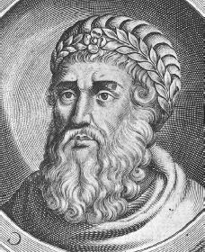
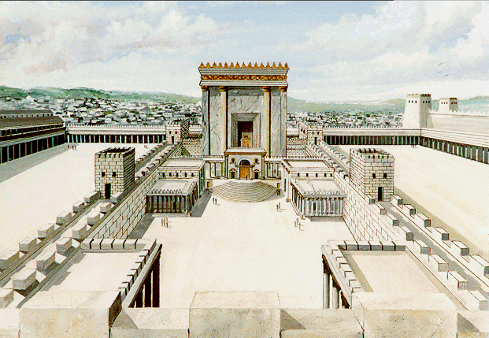
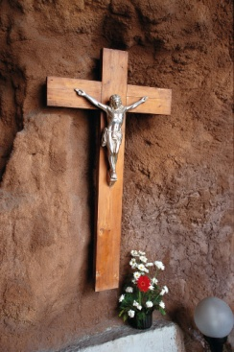
KING HEROD
Romans conquered Greeks (146 B.C.)
Herod appointed king
  Constructed aqueducts, palaces
  Expanded Temple Mount
Herod “crucified” conspirators
King Herod
Herod’s Temple
Notes:
KING HEROD
The Romans, who had conquered the Greeks in 146 B.C., officially took over Judah (now called Judea and made part of the province of Syria) in 37 B.C. To govern the area, the Romans appointed King Herod who ruled as an absolute monarch with ambitions of leaving a great legacy. Through extensive building projects Herod was responsible for the construction of aqueducts, palaces, the impressive Masada fortress, theaters, baths, and, most notably, the expansion and embellishment of the Temple Mount to an unprecedented splendor.
Rather than endearing his subjects to him by improving the city, the heavy taxation Herod levied to pay for his projects along with his ruthless treatment of dissidents alienated the citizens of Judea. The paranoid king had established an enormous secret police force and was responsible for nailing thousands of suspected conspirators to wooden crosses (an act called “crucifixion”).
In the New Testament of the Bible, it was stated that King Herod ordered the death of every infant boy born in Bethlehem after having heard a prophesy that a rival king of the Jews would be born in that city.

Slide 20
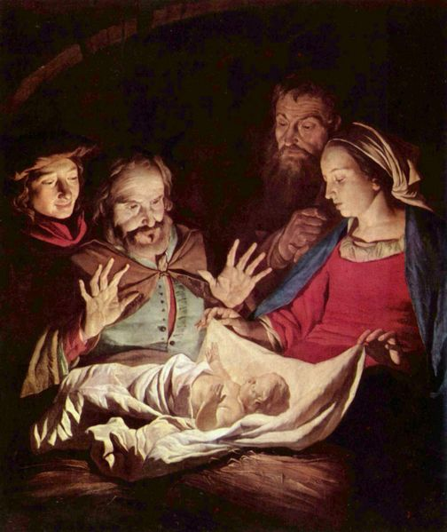
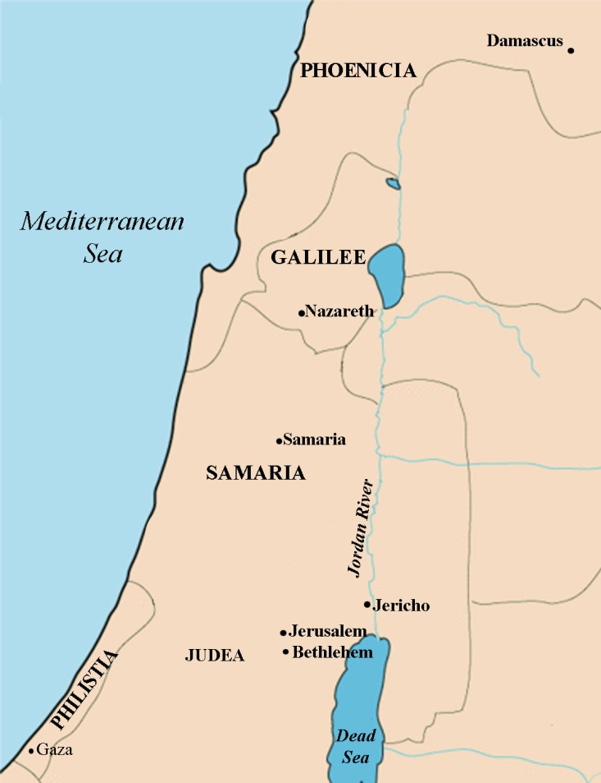
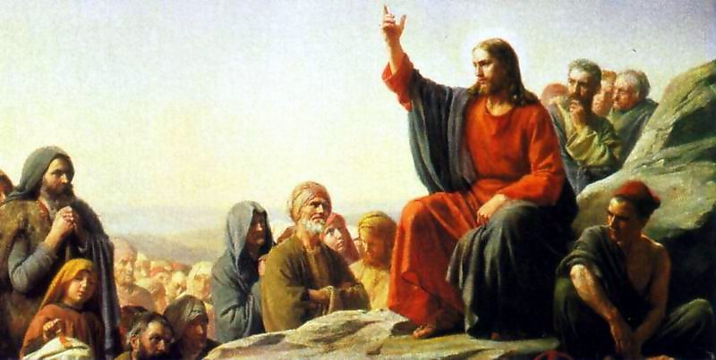
JESUS CHRIST
Jesus of Nazareth
Born in Bethlehem
Jewish
Mary and Joseph
Miracles
Messiah
Notes:
JESUS CHRIST
The birth of Jesus of Nazareth had little influence on the world until the faith that bore his name, Christianity, was adopted by the Roman Emperor Constantine in the 4th century A.D.
Jesus, who was born in the time of King Herod, was a Jew who shared the same contempt of Roman authority as the rest of the Israelites. Little is known about his childhood except that he was born in Bethlehem and, with his virgin mother, Mary, and father, Joseph (whose lineage could be traced to King David) was taken to Egypt to escape Herod’s decree of infanticide. There is little record of his life in the Christian Bible (the New Testament) until the age of 30 when he was baptized by John the Baptist, perhaps an Essene Jew (a mystical sect of Judaism) who believed in purification and rebirth through ritual cleansing.
Preaching and Miracles
It was written that Jesus (called Christ or “anointed one” by his followers), performed a number of miracles: walking on water; turning water into wine; multiplying fish to feed 5,000 people; healing the sick etc., and preached to his disciples and a host of followers. At that time many of his converts were former sinners or the poor who had been shunned by society and Jews who saw him as the promised Messiah (the awaited king and deliverer of the Jewish people).
As the “Messiah,” Jesus prophesied the coming of the “Kingdom of God” as promised in the Torah and instructed Jews to prepare for the event.

Slide 21
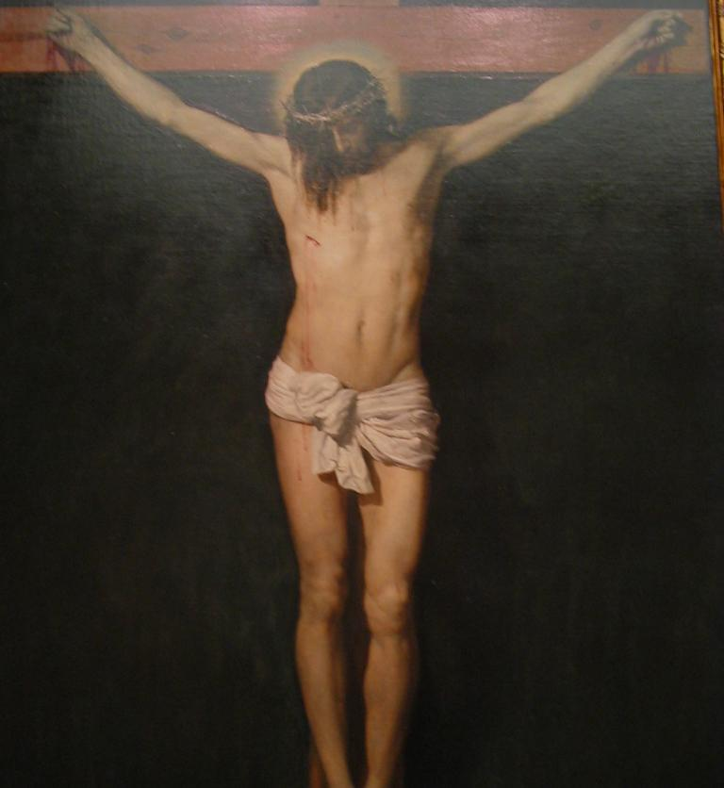
Crucifixion
Pontius Pilate
Crucifixion
Resurrection
  Easter
Paul of Tarsus
  Circulated Jesus’ message throughout Roman Empire
  Many Pagans drawn to Christianity
Jesus on the cross
by Cristo de Velazquez 17th c.
Notes:
ROMANS AND DEATH SENTENCE
But when Jesus began criticizing current religious practices (he railed against the money changers and vendors selling animal sacrifices in the temple, for instance), the Romans saw him as a risk to social order. Furthermore, as the proclaimed “King of the Jews,” (by his followers), the Prophet was also considered a threat to other authority figures. In this age of rebellion, it was not unusual for the Roman leadership to harshly condemn such a dissenter and Jesus Christ was no exception. Roman Procurator, Pontius Pilate, sentenced the “Messiah” to an agonizing death by crucifixion.
According to accounts in the New Testament, Jesus rose from the dead three days later. This miraculous Resurrection is celebrated by Christians on Easter Sunday.
Through his disciples, most notably Paul of Tarsus, Jesus’ message was circulated throughout the Roman Empire attracting pagans (the vast majority of the population who worshiped many gods) and some Jewish converts. Monotheism appealed to many pagans who were drawn to Christianity (as opposed to Judaism) in part because the sole requirement of the new religion was faith. Christianity did not oblige followers to observe the rituals and customs demanded by followers of the Jewish religion (like circumcision, dietary restrictions, etc.). Poor, hungry and suffering converts also were drawn to the promise of a glorious afterlife in heaven. With only faith as a basis for acceptance, moreover, the religion was accessible to all people, not just those deemed “chosen” by God.

Slide 22
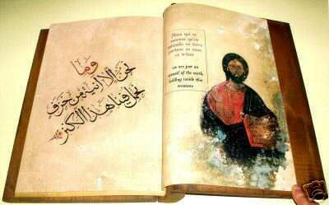
Jesus (“Issa”)
Muslim Perspective
Mary (“Maryam”)
  Miracle, birth from a virgin mother.
  Baby Jesus could speak
Jesus not son of God
  Only a Prophet
Not killed
  Crucifixion was an illusion
  Raised to heaven
  To return on Judgment Day
“Issa Ben Mariam”
“Jesus, Son of Mary”
Notes:
JESUS (“ISSA”): MUSLIM PERSPECTIVE
In the Quran (Islam’s holy book), Mary, the mother of Jesus is revered as the woman whom God (Allah) had “chosen above women of all nations” (3:42). Her importance is so great, in fact, that a Quranic chapter was named after the virgin mother of Jesus (chapter 19 called “Maryam”). While Mary’s background and trials are described in greater detail than they are in the Bible (in order to explain why she had been chosen to be the mother of Jesus) no mention is made of her husband, Joseph. In the Quran, the miracle of Jesus’ birth from a virgin mother is further reinforced by accounts that the baby had the ability to speak from the cradle.
Where the Bible and the Quran greatly differ is in Jesus’ divine status. The biblical claim that Jesus is the son of God is fervently refuted in the Quran. Muslims consider Jesus one of the most important of God’s Prophets – but no more than a prophet along with Abraham, Moses, Muhammad and others.
Muslims also believe that Jesus never actually died. His death by crucifixion, they claim, was only an illusion. Rather, Jesus was raised up to God and will return to earth on Judgment Day to fulfill his mission and fight the anti-Christ.

Slide 23
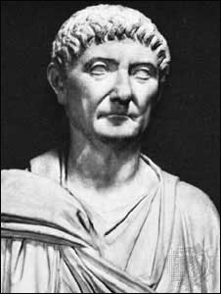
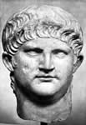
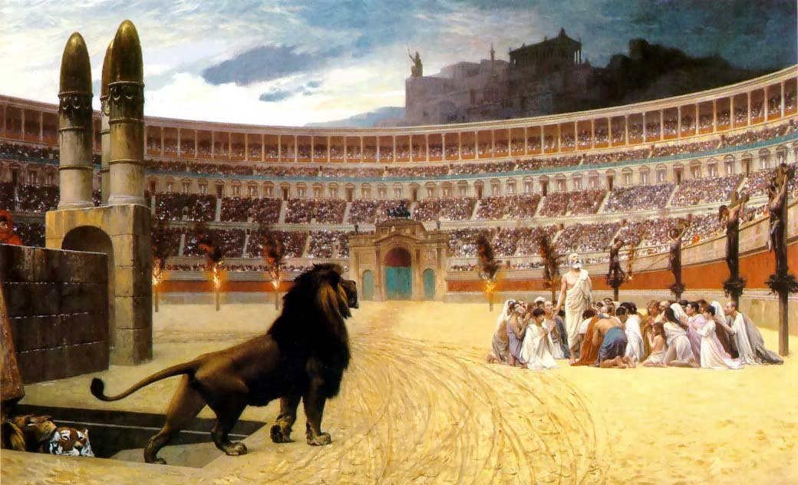
CHRISTIAN
PERSECUTION
Nero
Diocletian
“Edict against Christians”
Nero (r. 54-68)
  Christians fed to the lions
  Jesus’ apostles Peter and Paul killed
Diocletian (245-313)
  Edict against Christians
Christians
fed to Lions
Notes:
PERSECUTION OF CHRISTIANS UNDER THE ROMANS
For centuries after Jesus’ crucifixion, Christians living under Roman rule suffered brutal persecution beginning in the reign of Nero (when Christians were notoriously fed to the lions and Jesus’ disciples, Peter and Paul were believed to have been martyred) and culminating with Diocletian’s February 303 “Edict against the Christians.”
Thousands of Christians were imprisoned, tortured and killed unless they agreed to offer sacrifices to Roman gods and pledge allegiance to the Emperor.

Slide 24
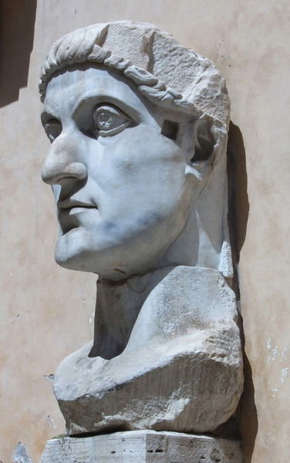
CONSTANTINE
Constantine
  Was pagan
  Battle with Maxentius
  Used Christian symbols
  Christianity declared religion of the Romans
  Circulated the “Edict of Milan”
    Declaring Roman Empire tolerant of all religions
Constantine
Notes:
CONSTANTINE
The persecution of the Christians ended when Constantine came to power in the 4th century A.D. According to legend, before going into battle against his rival Maxentius, whose army far outnumbered his own, Constantine, a pagan at the time, received a vision from God instructing him to use Christian symbols as a safeguard. With crosses on his soldiers’ shields and with the support of Christian troops, Constantine was victorious.
Soon after his victory (A.D. 313), Emperor Constantine circulated a letter dubbed the “Edict of Milan” declaring that the Roman empire would be tolerant of all religions including Christianity.

Slide 25

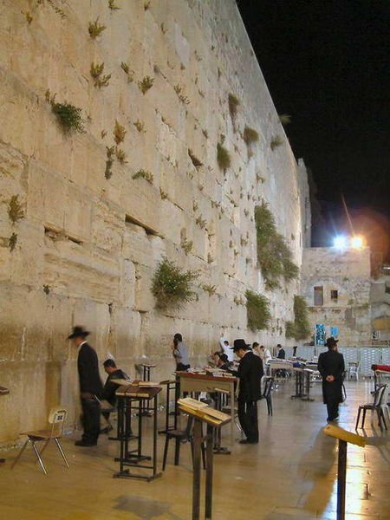
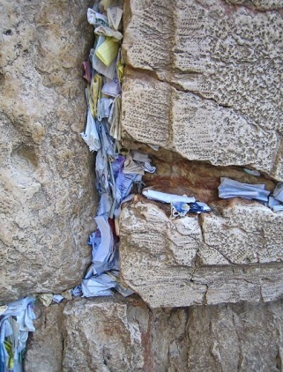
JEWISH PERSECUTION
The Great Revolt (AD 66-73)
Roman Tyranny
Jews revolted in A.D. 70
Romans destroyed Herod’s Temple
  Left only the retaining wall
  Dubbed the “Western” or “Wailing” Wall in the West
  or “Kotel” by the Jews.
Prayers
Jews praying at “Kotel,” the only remaining wall of the Temple Mount
Notes:
ROMAN TYRANNY
Roman tyranny over the Jews in Judea also intensified at the beginning of the 1st century provoking Jewish revolts from A.D. 66-73.
Among the grievances:
1) Financial exploitation – In A.D. 6, Judea was ruled by Roman Procurators whose primary responsibility was to collect taxes for the empire. The tax collectors were permitted to pocket any revenues that exceeded their quota leading to exploitation.
2) High Priest – The same year, the Romans took over the appointment of High Priest whose responsibilities included performing special religious services and offering ritual sacrifices.
3) Caligula – Anti-Roman feeling was particularly intense during the reign of Emperor Caligula. In A.D. 39, the Emperor declared himself a god and ordered temples throughout the Roman Empire to erect statues in his honor. The Jews refused to defile their temples risking death.
Zealots – The capricious demands of Caligula drove some Jews toward radicalization. The resulting sect of rebellious “Zealots” believed that it was the responsibility of all Jews to resort to any means of resistance necessary to attain political and religious liberty, even massacring moderate Jews who stood in their way. The violent determination of the Zealots to prevent Jews from surrendering to the Romans turned to civil war in the 60s.
By the time Vespasian was proclaimed Emperor in A.D. 69, infighting among the Jews had rendered them too weak to resist Roman troops and the Jewish rebellion was crushed. Hundreds of thousands of Jews had been killed and thousands more enslaved as a result of civil war and the Roman siege of Jerusalem in A.D. 70. In order to prevent a resurgence of revolt, the Romans destroyed Herod’s Temple sparing only one section of the retaining wall.*
One small contingent of Jewish zealots held out until against the Romans AD 73 by fortifying themselves in the Masada citadel. When the Roman soldiers breached the walls of the fortress, they found that all 936 inhabitants had committed suicide rather than face capture or death at the hands of their enemies.
* The destruction of the Temple is still commemorated by Jews yearly on Tisha B’Av (the “9th day” of the month of “Av”), a day of fasting and religious restrictions. The remaining temple structure, known to Jews as the Kotel ha-Ma’aravi, the Western or “Wailing Wall” of the ancient Temple Mount has attracted Jews from around the world for centuries. Visitors to the wall frequently place scraps of paper (kvitlach) containing prayers into cracks and crevices on the Western Wall.

Slide 26

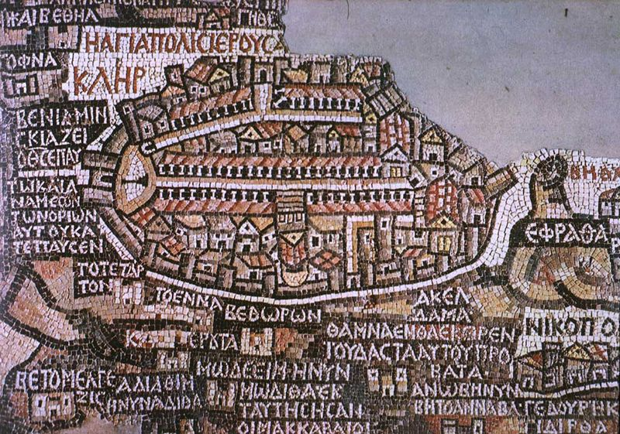
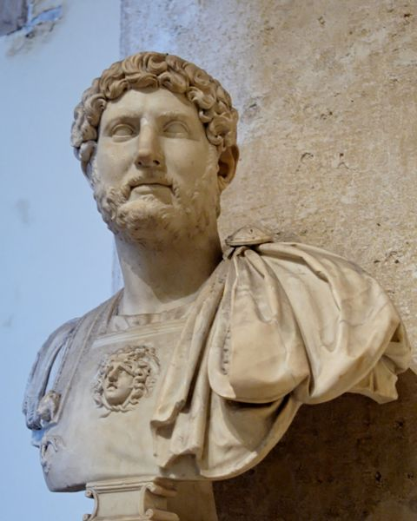
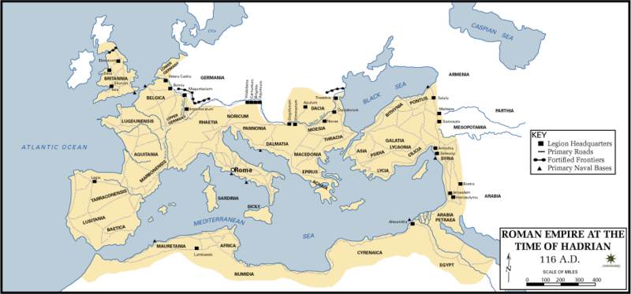
SIMON BAR KOCHBA
Uprising 132
  By Simon Bar Kochba
Uprising was crushed
Hadrian renamed Judea Syria Palestina
  “Palestine”
Jerusalem renamed “Aelia Capitolina”
  Jews forbidden to enter the city
Diaspora
  Jews lived in exile
Emperor Hadrian’s
Empire
Notes:
SIMON BAR KOCHBA
Rumors of the Roman Emperor Hadrian’s plans to build a magnificent Roman city on the ruins of Jerusalem and an altar dedicated to pagan gods on the site of the Temple prompted one last revolt in A.D. 132 led by Simon Bar Kochba. The uprising was brutally suppressed ending with the execution and enslavement of large numbers of Jews and the banishment of others. Christianity was outlawed and Jews, from that point on, were forbidden to enter Jerusalem.
DIASPORA
The crush of this last revolt by the Romans sealed the fate of the Jews until modern times. After the victory, Hadrian’s new pagan town was built as planned and, adding insult to injury, the Romans renamed Judea the province of Syria Palestina or “Palestine” after the Jews former enemies, the Philistines. Jerusalem was renamed “Aelia Capitolina” and dedicated to the Roman God Jupiter Zeus to the Greeks).
For the next two millennia, Jews were destined to live in foreign lands. This exile is known as the “Diaspora” (or “dispersion”).

Slide 27
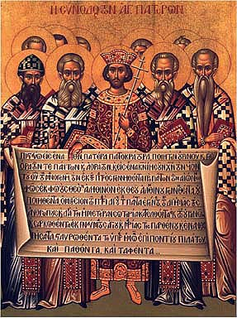
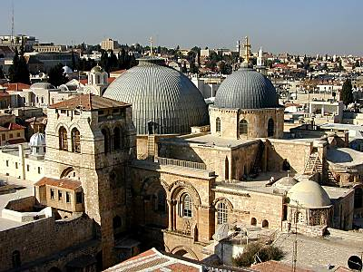
Christianity
Nicene Creed A.D. 325
  Church fell under imperial control
  Common set of beliefs and principles
  Christianity deemed official religion of the Romans
  Jerusalem enjoyed new prestige
    Church of Holy Sepulchre constructed
Bishops holding the
Nicene Creed
Church of the Holy Sepulchre
Notes:
CHRISTIANITY
In 325, Constantine convened and presided over a council of Christian bishops (a Synod) appointed to create a unified set of beliefs and practices for all Christendom. The resulting Nicene Creed signaled the first time the Christian church was subject to imperial control.
From that point forward, Christianity was deemed the official religion of the Romans: Sunday became a day of rest, churches were no longer obligated to pay taxes and the cross became the official symbol of Christianity.
Jerusalem under Constantine enjoyed new prestige as the holiest place in the Christian world. Monuments and churches were erected at the most momentous locations, for example at the location where Jesus had performed the sacraments of the Last Supper, where he had reportedly risen from the dead and the site of Jesus’ crucifixion (memorialized by the Church of the Holy Sepulchre). The new interest in the region inspired pilgrims to make regular trips to the “Holy Land.”

Slide 28
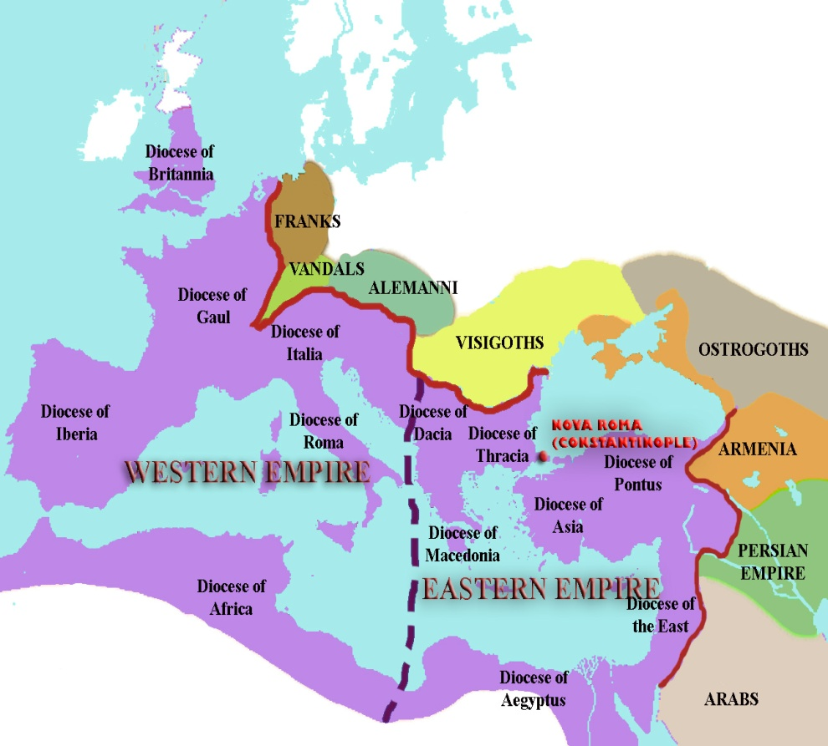
Roman Empire
Byzantium
  Capital of Roman Empire moved to Byzantium (330)
    “New Rome”
    Later called Constantinople
Empire split in 395
  Eastern Byzantine Empire
    Capital was Constantinople
    Greek Orthodox Church
  Western Empire
    Capital Milan and Ravenna
    Future Holy Roman Empire
    Seat of Roman Catholicism
Notes:
CONSTANTINOPLE (formerly Byzantium – today, Istanbul, Turkey)
In A.D. 330, Constantine transferred the Roman Empire’s seat of Government from Rome to a town in the eastern portion of the Empire called Byzantium. (The city was renamed Constantinople after Constantine’s death).
SPLIT OF THE ROMAN EMPIRE
Constantine’s successor Emperor Theodosius (r. 378-392) was the last emperor of both the eastern and western portions of the Roman Empire. When he died, the empire was divided between his two sons Arcadius and Honorius. The western Latin portion became the future “Holy Roman Empire,” the seat of Roman Catholicism. The eastern portion became known as the Byzantine Empire after the original name of its capital, Byzantium, and became the heart of the Greek Orthodox Church.

Slide 29
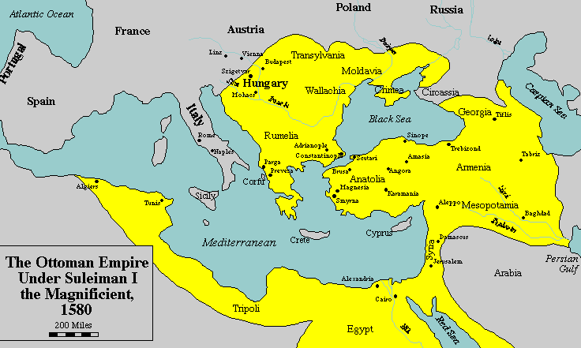

Slide 30
GRECO-ROMAN PERIOD
Alexander the Great (331 B.C.)
Ptolemies
Seleucids
  Antiochus IV Epiphanes
Hellenism
Alexander
the Great
Notes:
GRECO-ROMAN PERIOD
While under the protection of the Persians, the pacifist Jews had no reason to build a military force. When Alexander the Great’s Greek forces marched through Jerusalem in 331 B.C., therefore, the Jews had no other recourse but to submit to the invaders. For the next nine centuries, consequently, Judah became a province of the Greco-Roman Empire.
The Greeks under Alexander the Great admired the Jewish religious traditions and allowed the citizens of Judah to exercise political autonomy. The Torah, the Hebrews’ holy book, was translated into Greek (facilitating the spread of Jewish concepts of God, Mosaic law etc.) and the infusion of Hellenistic (Greek) culture introduced the concepts of reason, logic and dialogue into Hebrew scholarship.
After Alexander’s death, his vast Empire was divided among his generals. General Seleucus controlled Syria and Asia minor, Antigonus ruled Greece and General Ptolemy was granted Egypt and Palestine.
Ptolemies
The Jews and their new overlords, the Ptolemies, enjoyed a relationship of mutual admiration. The Greeks respected Jews for their discipline, laws and literature and, as long as the Jewish subjects paid their nominal tax to the Greek government, they were freely allowed to practice their own religion. As control of Palestine passed to Seleucus in 198 B.C., though, the new leaders abandoned Alexander’s policy of tolerance and attempted to force Hellenism upon the population.
Seleucids
The Seleucids defeated the Ptolemies in 198 B.C. and occupied Judah. Jerusalem, with its rich Temple and valuable synagogues, was seen as a source of great wealth to the new rulers and the Jewish religion was perceived as an obstacle to Alexander the Great’s vision of an empire united by a single culture and a single religion.
Seleucid Emperor Antiochus IV Epiphanes (175-163 B.C.) considered Hellenism (as Greek culture was called) a far superior civilization to that of the Jews and he became impatient with the slow rate of Hellenization of his empire. To move the process along, he outlawed monotheism, persecuted Jews for keeping the Sabbath (the Jewish day of rest and worship), prevented them from performing circumcision and practicing other Jewish customs, and infused the city with Greek symbols. In 168 B.C., Antiochus IV even ordered pagan sacrifices at the holy temple where he had erected an altar to the Greek pagan god Zeus. All of these acts ultimately provoked a Jewish insurrection.

Slide 31
MACCABEAN REVOLT
Judah Maccabee (“The Hammer”)
Revolted against Greeks
Hasmonean Dynasty
Notes:
MACCABEAN REVOLT
Stripped of their religion and furious over the looting and defiling of their sacred places, the Jews rallied around the Hasmonean brothers in what would become known as the Maccabean revolt against the Greeks (named after one of the five brothers, Judah Maccabee [the “hammer”]). After winning a series of victories over the Seleucids, the Jews reclaimed Jerusalem, cleansed the Temple and expanded their authority east to the Jordan River, west to the Mediterranean Sea, north to Galilee and south as far as Rafiah.
Jewish sovereignty under the Hasmonean dynasty lasted more than 100 years until corruption, greed and brutality under the rule of Judah Maccabee’s successors brought the dynasty to an ignoble end.

Slide 32
KING HEROD
Romans conquered Greeks (146 B.C.)
Herod appointed king
  Constructed aqueducts, palaces
  Expanded Temple Mount
Herod “crucified” conspirators
King Herod
Herod’s Temple
Notes:
KING HEROD
The Romans, who had conquered the Greeks in 146 B.C., officially took over Judah (now called Judea and made part of the province of Syria) in 37 B.C. To govern the area, the Romans appointed King Herod who ruled as an absolute monarch with ambitions of leaving a great legacy. Through extensive building projects Herod was responsible for the construction of aqueducts, palaces, the impressive Masada fortress, theaters, baths, and, most notably, the expansion and embellishment of the Temple Mount to an unprecedented splendor.
Rather than endearing his subjects to him by improving the city, the heavy taxation Herod levied to pay for his projects along with his ruthless treatment of dissidents alienated the citizens of Judea. The paranoid king had established an enormous secret police force and was responsible for nailing thousands of suspected conspirators to wooden crosses (an act called “crucifixion”).
In the New Testament of the Bible, it was stated that King Herod ordered the death of every infant boy born in Bethlehem after having heard a prophesy that a rival king of the Jews would be born in that city.

Slide 33
Enter the Romans
Herod made King
Kingdom split among his sons
Many revolts- Jews driven out of Jerusalem by Romans in 125 AD
Rise of Christianity
Christianity grew out of Judaism and became the religion of the empire under Constantine

Slide 34
JESUS CHRIST
Jesus of Nazareth
Born in Bethlehem
Jewish
Mary and Joseph
Miracles
Messiah
Notes:
JESUS CHRIST
The birth of Jesus of Nazareth had little influence on the world until the faith that bore his name, Christianity, was adopted by the Roman Emperor Constantine in the 4th century A.D.
Jesus, who was born in the time of King Herod, was a Jew who shared the same contempt of Roman authority as the rest of the Israelites. Little is known about his childhood except that he was born in Bethlehem and, with his virgin mother, Mary, and father, Joseph (whose lineage could be traced to King David) was taken to Egypt to escape Herod’s decree of infanticide. There is little record of his life in the Christian Bible (the New Testament) until the age of 30 when he was baptized by John the Baptist, perhaps an Essene Jew (a mystical sect of Judaism) who believed in purification and rebirth through ritual cleansing.
Preaching and Miracles
It was written that Jesus (called Christ or “anointed one” by his followers), performed a number of miracles: walking on water; turning water into wine; multiplying fish to feed 5,000 people; healing the sick etc., and preached to his disciples and a host of followers. At that time many of his converts were former sinners or the poor who had been shunned by society and Jews who saw him as the promised Messiah (the awaited king and deliverer of the Jewish people).
As the “Messiah,” Jesus prophesied the coming of the “Kingdom of God” as promised in the Torah and instructed Jews to prepare for the event.

Slide 35
Crucifixion
Pontius Pilate
Crucifixion
Resurrection
  Easter
Paul of Tarsus
  Circulated Jesus’ message throughout Roman Empire
  Many Pagans drawn to Christianity
Jesus on the cross
by Cristo de Velazquez 17th c.
Notes:
ROMANS AND DEATH SENTENCE
But when Jesus began criticizing current religious practices (he railed against the money changers and vendors selling animal sacrifices in the temple, for instance), the Romans saw him as a risk to social order. Furthermore, as the proclaimed “King of the Jews,” (by his followers), the Prophet was also considered a threat to other authority figures. In this age of rebellion, it was not unusual for the Roman leadership to harshly condemn such a dissenter and Jesus Christ was no exception. Roman Procurator, Pontius Pilate, sentenced the “Messiah” to an agonizing death by crucifixion.
According to accounts in the New Testament, Jesus rose from the dead three days later. This miraculous Resurrection is celebrated by Christians on Easter Sunday.
Through his disciples, most notably Paul of Tarsus, Jesus’ message was circulated throughout the Roman Empire attracting pagans (the vast majority of the population who worshiped many gods) and some Jewish converts. Monotheism appealed to many pagans who were drawn to Christianity (as opposed to Judaism) in part because the sole requirement of the new religion was faith. Christianity did not oblige followers to observe the rituals and customs demanded by followers of the Jewish religion (like circumcision, dietary restrictions, etc.). Poor, hungry and suffering converts also were drawn to the promise of a glorious afterlife in heaven. With only faith as a basis for acceptance, moreover, the religion was accessible to all people, not just those deemed “chosen” by God.

Slide 36
Jesus (“Issa”)
Muslim Perspective
Mary (“Maryam”)
  Miracle, birth from a virgin mother.
  Baby Jesus could speak
Jesus not son of God
  Only a Prophet
Not killed
  Crucifixion was an illusion
  Raised to heaven
  To return on Judgment Day
“Issa Ben Mariam”
“Jesus, Son of Mary”
Notes:
JESUS (“ISSA”): MUSLIM PERSPECTIVE
In the Quran (Islam’s holy book), Mary, the mother of Jesus is revered as the woman whom God (Allah) had “chosen above women of all nations” (3:42). Her importance is so great, in fact, that a Quranic chapter was named after the virgin mother of Jesus (chapter 19 called “Maryam”). While Mary’s background and trials are described in greater detail than they are in the Bible (in order to explain why she had been chosen to be the mother of Jesus) no mention is made of her husband, Joseph. In the Quran, the miracle of Jesus’ birth from a virgin mother is further reinforced by accounts that the baby had the ability to speak from the cradle.
Where the Bible and the Quran greatly differ is in Jesus’ divine status. The biblical claim that Jesus is the son of God is fervently refuted in the Quran. Muslims consider Jesus one of the most important of God’s Prophets – but no more than a prophet along with Abraham, Moses, Muhammad and others.
Muslims also believe that Jesus never actually died. His death by crucifixion, they claim, was only an illusion. Rather, Jesus was raised up to God and will return to earth on Judgment Day to fulfill his mission and fight the anti-Christ.

Slide 37
CHRISTIAN
PERSECUTION
Nero
Diocletian
“Edict against Christians”
Nero (r. 54-68)
  Christians fed to the lions
  Jesus’ apostles Peter and Paul killed
Diocletian (245-313)
  Edict against Christians
Christians
fed to Lions
Notes:
PERSECUTION OF CHRISTIANS UNDER THE ROMANS
For centuries after Jesus’ crucifixion, Christians living under Roman rule suffered brutal persecution beginning in the reign of Nero (when Christians were notoriously fed to the lions and Jesus’ disciples, Peter and Paul were believed to have been martyred) and culminating with Diocletian’s February 303 “Edict against the Christians.”
Thousands of Christians were imprisoned, tortured and killed unless they agreed to offer sacrifices to Roman gods and pledge allegiance to the Emperor.

Slide 38
CONSTANTINE
Constantine
  Was pagan
  Battle with Maxentius
  Used Christian symbols
  Christianity declared religion of the Romans
  Circulated the “Edict of Milan”
    Declaring Roman Empire tolerant of all religions
Constantine
Notes:
CONSTANTINE
The persecution of the Christians ended when Constantine came to power in the 4th century A.D. According to legend, before going into battle against his rival Maxentius, whose army far outnumbered his own, Constantine, a pagan at the time, received a vision from God instructing him to use Christian symbols as a safeguard. With crosses on his soldiers’ shields and with the support of Christian troops, Constantine was victorious.
Soon after his victory (A.D. 313), Emperor Constantine circulated a letter dubbed the “Edict of Milan” declaring that the Roman empire would be tolerant of all religions including Christianity.

Slide 39
JEWISH PERSECUTION
The Great Revolt (AD 66-73)
Roman Tyranny
Jews revolted in A.D. 70
Romans destroyed Herod’s Temple
  Left only the retaining wall
  Dubbed the “Western” or “Wailing” Wall in the West
  or “Kotel” by the Jews.
Prayers
Jews praying at “Kotel,” the only remaining wall of the Temple Mount
Notes:
ROMAN TYRANNY
Roman tyranny over the Jews in Judea also intensified at the beginning of the 1st century provoking Jewish revolts from A.D. 66-73.
Among the grievances:
1) Financial exploitation – In A.D. 6, Judea was ruled by Roman Procurators whose primary responsibility was to collect taxes for the empire. The tax collectors were permitted to pocket any revenues that exceeded their quota leading to exploitation.
2) High Priest – The same year, the Romans took over the appointment of High Priest whose responsibilities included performing special religious services and offering ritual sacrifices.
3) Caligula – Anti-Roman feeling was particularly intense during the reign of Emperor Caligula. In A.D. 39, the Emperor declared himself a god and ordered temples throughout the Roman Empire to erect statues in his honor. The Jews refused to defile their temples risking death.
Zealots – The capricious demands of Caligula drove some Jews toward radicalization. The resulting sect of rebellious “Zealots” believed that it was the responsibility of all Jews to resort to any means of resistance necessary to attain political and religious liberty, even massacring moderate Jews who stood in their way. The violent determination of the Zealots to prevent Jews from surrendering to the Romans turned to civil war in the 60s.
By the time Vespasian was proclaimed Emperor in A.D. 69, infighting among the Jews had rendered them too weak to resist Roman troops and the Jewish rebellion was crushed. Hundreds of thousands of Jews had been killed and thousands more enslaved as a result of civil war and the Roman siege of Jerusalem in A.D. 70. In order to prevent a resurgence of revolt, the Romans destroyed Herod’s Temple sparing only one section of the retaining wall.*
One small contingent of Jewish zealots held out until against the Romans AD 73 by fortifying themselves in the Masada citadel. When the Roman soldiers breached the walls of the fortress, they found that all 936 inhabitants had committed suicide rather than face capture or death at the hands of their enemies.
* The destruction of the Temple is still commemorated by Jews yearly on Tisha B’Av (the “9th day” of the month of “Av”), a day of fasting and religious restrictions. The remaining temple structure, known to Jews as the Kotel ha-Ma’aravi, the Western or “Wailing Wall” of the ancient Temple Mount has attracted Jews from around the world for centuries. Visitors to the wall frequently place scraps of paper (kvitlach) containing prayers into cracks and crevices on the Western Wall.

Slide 40
SIMON BAR KOCHBA
Uprising 132
  By Simon Bar Kochba
Uprising was crushed
Hadrian renamed Judea Syria Palestina
  “Palestine”
Jerusalem renamed “Aelia Capitolina”
  Jews forbidden to enter the city
Diaspora
  Jews lived in exile
Emperor Hadrian’s
Empire
Notes:
SIMON BAR KOCHBA
Rumors of the Roman Emperor Hadrian’s plans to build a magnificent Roman city on the ruins of Jerusalem and an altar dedicated to pagan gods on the site of the Temple prompted one last revolt in A.D. 132 led by Simon Bar Kochba. The uprising was brutally suppressed ending with the execution and enslavement of large numbers of Jews and the banishment of others. Christianity was outlawed and Jews, from that point on, were forbidden to enter Jerusalem.
DIASPORA
The crush of this last revolt by the Romans sealed the fate of the Jews until modern times. After the victory, Hadrian’s new pagan town was built as planned and, adding insult to injury, the Romans renamed Judea the province of Syria Palestina or “Palestine” after the Jews former enemies, the Philistines. Jerusalem was renamed “Aelia Capitolina” and dedicated to the Roman God Jupiter Zeus to the Greeks).
For the next two millennia, Jews were destined to live in foreign lands. This exile is known as the “Diaspora” (or “dispersion”).

Slide 41
Christianity
Nicene Creed A.D. 325
  Church fell under imperial control
  Common set of beliefs and principles
  Christianity deemed official religion of the Romans
  Jerusalem enjoyed new prestige
    Church of Holy Sepulchre constructed
Bishops holding the
Nicene Creed
Church of the Holy Sepulchre
Notes:
CHRISTIANITY
In 325, Constantine convened and presided over a council of Christian bishops (a Synod) appointed to create a unified set of beliefs and practices for all Christendom. The resulting Nicene Creed signaled the first time the Christian church was subject to imperial control.
From that point forward, Christianity was deemed the official religion of the Romans: Sunday became a day of rest, churches were no longer obligated to pay taxes and the cross became the official symbol of Christianity.
Jerusalem under Constantine enjoyed new prestige as the holiest place in the Christian world. Monuments and churches were erected at the most momentous locations, for example at the location where Jesus had performed the sacraments of the Last Supper, where he had reportedly risen from the dead and the site of Jesus’ crucifixion (memorialized by the Church of the Holy Sepulchre). The new interest in the region inspired pilgrims to make regular trips to the “Holy Land.”

Slide 42
Roman Empire
Byzantium
  Capital of Roman Empire moved to Byzantium (330)
    “New Rome”
    Later called Constantinople
Empire split in 395
  Eastern Byzantine Empire
    Capital was Constantinople
    Greek Orthodox Church
  Western Empire
    Capital Milan and Ravenna
    Future Holy Roman Empire
    Seat of Roman Catholicism
Notes:
CONSTANTINOPLE (formerly Byzantium – today, Istanbul, Turkey)
In A.D. 330, Constantine transferred the Roman Empire’s seat of Government from Rome to a town in the eastern portion of the Empire called Byzantium. (The city was renamed Constantinople after Constantine’s death).
SPLIT OF THE ROMAN EMPIRE
Constantine’s successor Emperor Theodosius (r. 378-392) was the last emperor of both the eastern and western portions of the Roman Empire. When he died, the empire was divided between his two sons Arcadius and Honorius. The western Latin portion became the future “Holy Roman Empire,” the seat of Roman Catholicism. The eastern portion became known as the Byzantine Empire after the original name of its capital, Byzantium, and became the heart of the Greek Orthodox Church.

Slide 43
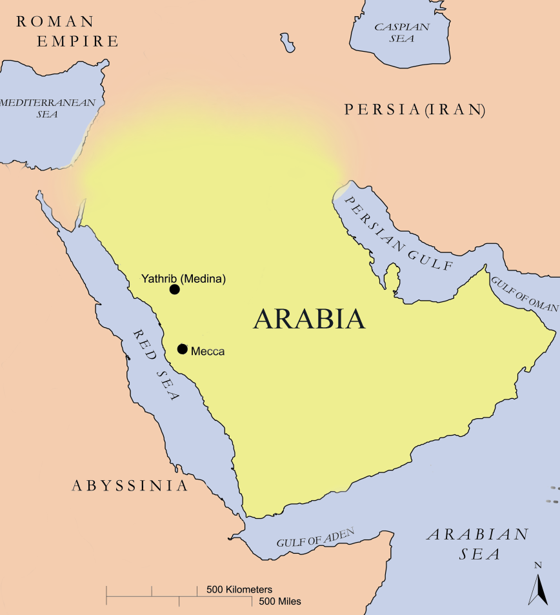

Islam
Prophet Muhammad
Born in Mecca, Arabia in A.D. 577
“Islam” = “submission” to God.
Notes:
ISLAM
In the 7th century A.D., the followers of one man, the future Prophet Muhammad, brought a new faith into the world. In the West, Christianity continued to prevail. In the East, the adherents of “Islam” (meaning “submission” to God) would dominate that part of the world until modern times.
The Islamic religion was based on the same tenets and lessons found in Judaism and Christianity. Muslims considered Prophet Muhammad the last in a long string of prophets to whom God (Allah) had sent his message. The divine significance of his predecessors, Abraham, Moses, Jesus and others, was also recognized by Muslims.
According to Muslim tradition, when Muhammad was 40 years old, he began to receive a series of revelations from God. He recited these messages to his followers who put them to paper soon after his death. The resulting Quran (Islam’s holy book) continued to be read by Muslims worldwide in its original language, Arabic.

Slide 44
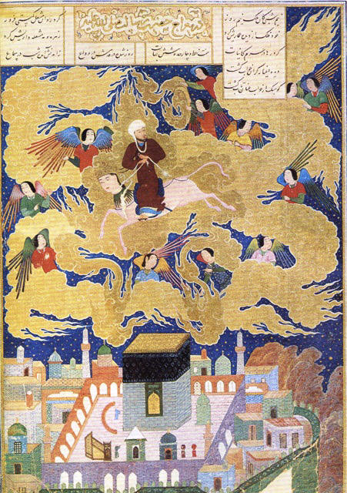
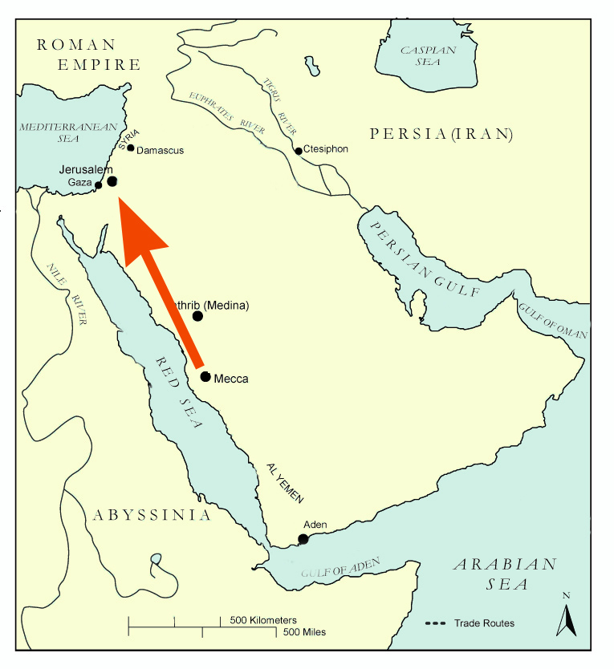
Muhammad’s
“Night Journey”
Muslims believe Muhammad took a “Night Journey”
  In A.D. 619
  From the “nearest mosque (in Mecca)
  To the “farthest”
  or “al-aqsa” mosque (Interpreted to mean Jerusalem)
Depiction of Muhammad’s Night Journey 15th c.
Notes:
MUHAMMAD’S “NIGHT JOURNEY” (Mi’raj) (Quran 17:1-60)
The Muslims believe that in A.D. 619, Prophet Muhammad took a mystical Night Journey from the “nearest mosque” (interpreted to mean Mecca, the land of his birth and home to the holy Ka’aba built by Abraham and his son Ismail) to the “farthest mosque” or “al-aqsa mosque,” interpreted to mean the site of the Temple Mount in Jerusalem. From here, Muhammad was believed to have ascended to heaven accompanied by the angel Gabriel.
In the closest heaven, Muhammad reported that he saw Adam, the first man. In the second heaven, the Prophet met John the Baptist and Jesus who both greeted him warmly. As he rose through the next levels of heaven Muhammad came into contact with the prophets Joseph, Enoch and Aaron. In the sixth heaven, Muhammad was greeted by Moses who wept “after me there has been sent a young man whose followers will enter Paradise in greater numbers than my followers.” Finally, in the seventh heaven, Muhammad met Abraham and from there the Prophet was taken to “the Lote Tree of the utmost boundary” where God advised him and his followers to engage in prayers five times a day.

Slide 45
Muhammad born in Mecca in 570 AD
Age 12 visited Syria- first exposure to Christians and Jews- developed respect for “People of the Book”
Married wealthy widow in the trading business
At age40 on a trade business trip encounter with angel Gabriel with message from Allah.

Slide 46
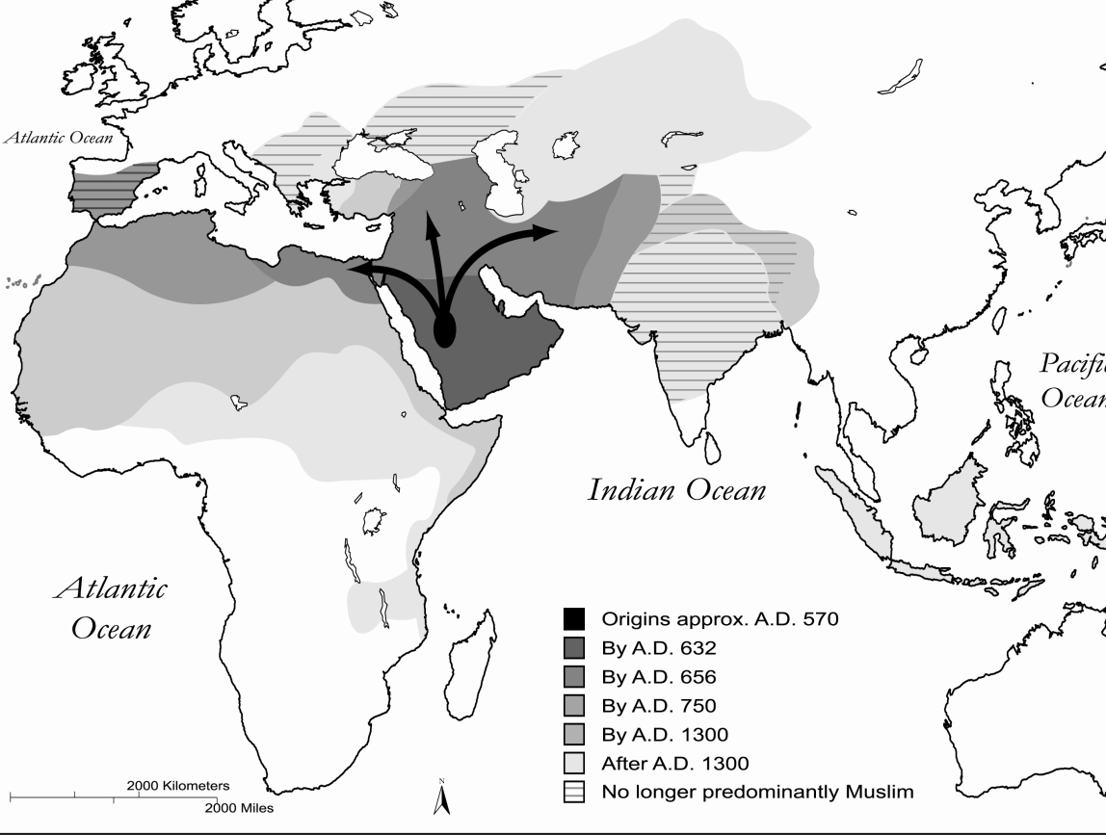
Spread of Islam
Muhammad died A.D. 632
Islam spread from Mecca to Jerusalem and beyond.
Christians and Jews (“dhimmies”) were permitted to practice their religions in the Muslim empire.
Notes:
SPREAD OF ISLAM
After Muhammad's death in A.D. 632, the Islamic faith spread beyond its place of origin in Mecca (in present-day Saudi Arabia) to the rest of the Arabian Peninsula and beyond.
In 638, a Muslim army under Muhammad's third successor or caliph, Umar, swept through Jerusalem bringing Islam and the Arabic language to the region.
The early conquering Muslims did not force conversion of their new subjects but allowed the Jews and Christians (considered dhimmies or “People of the Book”) to practice their religions freely within the Islamic Empire as long as they paid a special tax or jizya. For the first time since the time of Constantine, Jews were allowed to enter Jerusalem. Dhimmies in the Islamic Empire were prohibited from bearing arms, serve in public office or build holy structures larger than Muslim mosques.
.

Slide 47
Spread of Islam
Muhammad did not name a successor
Abu Bakr- one who accompanied Mohammed during the Hegira was chosen- He was given the title of Caliph from Arabic for successor
638 AD Jews of Palestine assisted Abu Bakr in defeating the Persians. Bakr promised to allow them to resettle in Jerusalem and protect them

Slide 48
641 AD Islam had spread to the conquest of most to the Fertile Crescent
Expansion across North Africa
Much of the spread was at the tip of a sword
Overcoming the Byzantine empire (Roman Empire had moved to Constantinople- current day Istanbul, Turkey)

Slide 49
Koran/Quran- believed that God is the author
Islam= surrender (to the will of God/Allah)
5 Pillars of Islam
Profession of faith
Pray 5 times per day
Pay zakat- tax to aid poor
Fast during Ramadan
Make pilgrimage to Mecca once in a lifetime.

Slide 50
622 AD learned of plot to kill him and fled to Medina- trip known as the Hegira
In Medina gained followers and returned to capture Mecca
Pulled away from Jews- shifted direction of prayer from facing Jerusalem to facing Mecca
Sacrifice of Isaac/Ishmael
Muhammad died 632 AD

Slide 51
Tension grew between new converts to Islam and the ones who had close links to Muhammad.
The last of the first four caliphs Ali was killed by a rival

Slide 52


Slide 53


Slide 54


Umayyad Dynasty
Capital of Umayyad Dynasty
  Damascus, Syria
Notes:
ISLAM
The first Islamic dynasty, the Umayyad Dynasty, emerged 23 years after the first Muslims entered Jerusalem. In order to assert Islam’s dominance in the Levant and shift focus away from Islam’s center in Mecca, the Umayyads declared Damascus (in Syria) their capital and built their own religious structures on the remains of the Jewish Temple.

Slide 55
The victors set up a new dynasty-Umayyads Moved center of Islam to Damascus, Syria instead of Mecca and Medina
They stressed the idea of family succession rather than relationship or kinship with the prophet.
This group is better known today as the Sunni
Ali’s ancestors moved to Damascus, Syria
This faction came to be known as shi’at Ali- better known today as the Shiites

Slide 56





Dome of the Rock
Al-Aqsa Mosque
Al-Aqsa Mosque
Dome of the rock
Dome of Rock
  Built over “Noble Rock”
  Site where Muhammad stepped up to heaven
  during “Night Journey”
Angel Israfel
Noble Rock
Notes:
DOME OF THE ROCK AND AL-AQSA MOSQUE
By the end of the 7th century, the Umayyads had built the Dome of the Rock over the Noble Rock (the Foundation Stone to the Jews, see next slide) from which Muhammad was believed to have taken his last step before ascending to heaven with the angel Gabriel (see “Night Journey” in earlier slide). Muslims acknowledge the site of the stone as a holy place where all prophets before Muhammad had prayed to God. They also believe that it is surrounded by tens of thousands of angels and that it will be the location where the archangel Israfil (Raphael) will blow his trumpet to announce the Day of Resurrection.
The Al-Aqsa Mosque (also situated on the platform [the Temple Mount] that used to house Herod’s Temple) was built to serve as a meeting place for pilgrims.
The site of the Noble Rock in Jerusalem (known as “Al-Quds” or “the sacred place”) became the third most holy destination to pious Muslims after Mecca and Medina.

Slide 57


Holy of Holies
(Foundation Rock)
The Foundation Rock
Believed to be the holiest
point of the Temple
  Called the “Holy of Holies”
Belief that God created
man on this spot
And site where
Isaac was nearly
sacrificed
by Abraham
Foundation Rock
Model of Herod’s Temple
Notes:
FOUNDATION STONE (HOLY OF HOLIES)
The Foundation Stone (known as the Noble Rock to Muslims) in Jewish liturgy is believed to be the holiest point of the temple (the Holy of Holies). It is believed that God created man at this spot and that Cain, Abel and Noah offered sacrifices to God here. Jews also believe that this is the spot where Abraham nearly sacrificed his son, Isaac.

Slide 58


Slide 59


Slide 60


Slide 61

Abbasid Dynasty
Abbasids replaced Umayyads in 8th century
Capital moved from Damascus to Baghdad
  Jerusalem lost significance.
Notes:
ABBASIDS
The Levant lost its prominence under the rule of the Abbasids who took control from the Umayyads in the late 8th century and moved the seat of the caliphate (the capital of the Islamic empire) east to Baghdad (in present-day Iraq).
FATIMIDS
In the early 10th century, the Abbasids were, themselves, overthrown by a group of radical Shi’ites who called themselves Fatimids after Muhammad's daughter, Fatima. By 966, the Fatimids had successfully wrested control over Egypt and Palestine and imposed their fundamental beliefs on the population. The Fatimids persecuted non-Muslims (especially Christians) living in their domain, destroyed their holy sites (including the Church of the Holy Sepulchre built on the site where Jesus Christ was believed to have been crucified) and restricted Christian access to the Holy City.

Slide 62


Seljuk Turks
1071 Seljuks captured Jerusalem
  Prohibited Christians from visiting holy sites.
Battle of Manzikert
  Seljuk Turks defeated Byzantines
  Emperor Comnenus asked Pope in Holy Roman Empire for help
Notes:
SELJUK TURKS
In 1071, Turkish Muslim Seljuks captured Jerusalem and the rest of Palestine and prohibited Christians from visiting their holy sites altogether. They then made their way north from Palestine to the city of Manzikert in ancient Armenia (now eastern Turkey) encroaching on the Byzantine capital of Constantinople.
Desperate for reinforcements, Alexius Comnenus, the emperor of the Byzantine Empire, the eastern portion of the Holy Roman Empire, appealed to the Pope in the western portion of the Roman Empire for help. The call for aid set the stage for what would become a violent 200-year crusade to recover Jerusalem from the Muslim “infidels.”

Slide 63
Over the centuries- lots of back and forth struggle between these groups
Other off-shoots of Islam began to develop too.
Outsiders invade too.
Seljuk Turks
Crusaders- Pope Urban II 1099-1189
Saladin- from present day Iraq

Slide 64


Crusades
Pope Urban II
Set out on a “crusade” to liberate the Holy Land from the Muslim “Infidels”
Notes:
CRUSADES
In 1095, Pope Urban II, answered Comemnus’ call for help. Leading such a campaign, Urban II hoped, would strengthen the church’s authority while helping to reunify the Roman Empire.
A campaign to liberate the Holy City from the Muslim “infidels” was enthusiastically embraced by impoverished Europeans who were in the middle of a spiritual revolution of their own and were eager to demonstrate their religious devotion. Stories about Seljuk atrocities and desecrations of holy places from Christian pilgrims who had returned from the Holy Land further aroused an already restive population that was eager to fight their “holy war.” Potential crusaders were drawn by promises that their sins would be forgiven if they participated in the Christian war and would be rewarded with a prosperous future. It was also believed that Christians who died while battling infidels would be honored as martyrs and immediately ascend to heaven.
Financially, the Levant, which was situated strategically between Asia and the West, was a popular commercial center and capitalistic Crusaders intended to cut out the merchant middlemen by occupying the area and engaging in trade themselves.

Slide 65
Ottoman Turks Conquered all of North Africa, and parts of Europe. This Ottoman Empire lasts until 1918 and the end of WWI.
1492- Jews driven out of Spain

Slide 67
Zionism a cure for anti-Semitism
Theodore Hertzl “Father of Zionism”
Lord Balfour’s letter
Arab nationalism emerges

Slide 68
Anti-semitism was rampant throughout Europe.
Murder, extermination, prejudice, restrictions
Many concluded that the only solution was to have a land of their own.
1882- Jewish pioneers depart Europe for Palestine

Slide 69
Hertzl founded the World Zionist Organization which sought world recognition for the Jewish claim to Palestine as its homeland. (other suggestions were Argentina or Uganda) Neither of these were well received by the delegates of the WZO. They maintained that Palestine was the only place.

Slide 70
Zionism- from the word Zion, the original name of the Jebusite stronghold in Jerusalem. Zion became a symbol for Jerusalem during the reign of King David. The goal of Zionism is the political and spiritual renewal of the Jewish people in its ancestral homeland. A Zionist is someone who supports this objective.

Slide 71


Slide 72


Slide 73


Anti-Semitism
Jewish occupations
  Money-lenders
Scapegoats
  Jews accused of ritually killing Christians
  Accused of poisoning wells
  Jews expelled from European countries
Notes:
Jews as money-lenders: The penetration of the Middle East by the Christians opened up trade routes and introduced a new type of economy that required the services of money-lenders (or “usurers”). The pacifist Jews, saddled with discriminatory taxes and becoming increasingly dependent on wealth for their survival (to buy protection from Crusading mobs, for instance), welcomed the opportunity to advance themselves in these occupations. Since the church had banned usury and Judaism didn’t forbid lending money and collecting interest from Christians, the Jews had little competition. Entrepreneurs, emperors and even churches borrowed from the Jews to help pay for the construction of palaces and other projects -- often winning Jews important posts in the courts. But it was their practice of collecting interest from poor debtors who had borrowed money in times of crisis, that was responsible for earning Jewish usurers their bad reputation. Resentment against Jewish creditors underscored many of the pogroms (massacres) that would take place throughout history.
Scapegoats: The alien dress, customs and diets of Jews living in foreign lands also mystified and scared the superstitious locals who often turned them into scapegoats for the problems of the day. Jews were accused of ritually killing Christians (as a supposed expression of their “hatred” for Christ) and using their blood in ceremonies (called “blood libels”). They were also accused of poisoning wells in order to spread diseases within Christian communities and were even held responsible for the Black Death (the bubonic plague) -- an accusation that resulted in Jews being hanged or burned alive by angry mobs.
At different times, almost all the countries of Europe had expelled Jews for religious, superstition and/or economic reasons. In many cases, debts owed to Jews were automatically forgiven once the “usurers” had been driven from England (1290), France (1306 and 1394), Austria (1420) and Spain (1492).

Slide 74



Sephardic Jews
“Spanish” Jews
From al-Andalus
  Spain
Golden Age of Judaism (400 years)
  Ended 1098
Marranos
  Jewish converts to Christianity
Spanish Inquisition (1492)
  Ferdinand & Isabella
Maimonides
Spinoza
Notes:
SEPHARDIC JEWS
Under the Muslims, a large, influential and flourishing Jewish community had developed for centuries in al-Andalus on the Iberian Peninsula (Spain). Jewish tradition in these communities melded with Islamic practices creating a unique form of Judaism practiced by the Spanish Jews (or “Sephardim”). Arabic and Hebrew were both used for prayers in this community and the Sephardim spoke their own Judeo-Spanish language called Ladino.
The 400-year Golden Age of Judaism in Spain ended when the Christians conquered Toledo in 1098 and the rest of Spain by the mid-13th century. In order to homogenize the population under a single faith, the Christians conducted mass conversions of Jews and Muslims. The Jewish converts or Marranos were later accused of practicing Judaism in secret and raising their children according to Jewish custom. Marranos (or “new Christians”) were tortured or killed during the 15th century Spanish Inquisition and, in 1492, King Ferdinand and Queen Isabella expelled all Jews who refused to convert to Christianity. Sephardic Jews, once seen as the elite among Jews, resettled in Muslim countries in the Ottoman Empire or joined fellow Jews in other parts of Europe.

Slide 75






Ashkenazi Jews
“European Jews”
Escaping anti-Semitism in western Europe
Moved to eastern Europe
  Poland, Lithuania, Ukraine, Russia etc.
Albert Einstein
Anne Frank
Sigmund Freud
Karl Marx
Notes:
ASHKENAZIC JEWS
In the late Middle Ages, the expansion of trade and commerce in Europe (especially in Northern Italy) offered new opportunities for Jewish bankers and money-lenders while the Renaissance (a time of “rebirth”) of ideas through the scientific discoveries of Copernicus, Galileo, Newton and others revolutionized man’s understanding of the world.
At the same time, the Christian Church was challenged by reformers who protested against corruption and abuses of power by the church leaders. The “Protestant Reformation” led by Martin Luther (1483-1546) and John Calvin (1509-1564) provoked a counter-reformation by the Catholic Church calling for the moral reform of the clergy and the strengthening of Church structures. In the religious fervor, both the Protestant and Catholic churches became eager to stamp out heresy of every kind and the Jews became targets once again. Jewish texts were censored and by mid-16th century, Jews were segregated into ghettoes.
Many of the Jews who had fled from the Crusaders and the Spanish Inquisitors and were escaping anti-Semitism in Western Europe, found a haven in Poland and other parts of Eastern Europe (Jews from Europe were called Ashkenazim from the Hebrew word for German). Poland, a less-developed frontier, welcomed the Jews for their skills as merchants, craftsmen and financiers. In time, Poland, whose borders in the 16th century stretched from the Baltic to the Black Sea and included present-day Latvia, Lithuania, Belarus and Ukraine, became home to the largest concentration of Jews in Europe and was an important hub for Jewish cultures.

Slide 76



Pale of Settlement
Half of world Jewry
  Lived in Ghettoes in Russia/Eastern Europe
  Called Shtetls
Pogroms
  Massacres of Jews
Shtetl
Notes:
PALE OF SETTLEMENT
After Poland was partitioned in 1795, Russia incorporated the eastern portion of the country and with it, most of the country’s Jews. At least half of world Jewry lived in that pan-Slavic, Eastern Orthodox nation. For centuries Jews had been excluded from most areas of Russian life and now, with the incorporation of more than one million Jews, Russian merchants became concerned about Jewish competition. In answer to popular concerns, Catherine II, Empress of Russia, set out to solve the “Jewish problem” by creating a “Pale of Settlement” which would confine Jewish activity to an area of land that roughly corresponded to districts (made up of Jewish villages or shtetls) already heavily occupied by Jews. Except on rare occasions, Jews were prohibited from traveling or living in cities outside the Pale and suffered hardships, restrictions and special taxation within the settlement.
Every Russian tsar who reigned after Catherine II had his own “solution” for dealing with the large Jewish population living within Russia’s borders: from attempting to force the Jews to assimilate into Russian society and conscripting Jewish boys into the military (Nicholas I decreed that Jewish recruits as young as twelve must serve in the army for a period of no less than 25 years), to officially sanctioned pogroms.*
POGROMS
The first of these pogroms was staged after Tsar Alexander II had slowly begun to allow Jews to settle in Moscow, St. Petersburg and other prominent Russian cites. When the Jews began to excel in mainstream commerce, nationalistic Russians became resentful and accused the “outsiders” of intending to take over the empire.
Hatred of the Jews soared after Alexander II was assassinated and his anti-Semitic son, Alexander III, took the throne. Blamed for the Tsar’s murder and of attempting to create a “state within a state” the Jews became targets of more than 200 deadly pogroms throughout Russia in 1881. “Temporary Laws” enacted in 1882 and lasting until 1914 compelled Jews to return to a now-reduced Pale of Settlement and forced them to obey a number of discriminatory regulations.
Conditions also deteriorated after the discovery of the so-called “Protocols of the Elders of Zion,” a forged document allegedly penned by hard-line Zionists outlining a Jewish plot to dominate the world by stirring social unrest and spreading liberal ideas. The Russo-Japanese war of 1905 further ushered in some of the worst pogroms Russia had seen -- resulting in thousands of Jewish deaths and countless more homeless.
*An organized, often officially encouraged massacre or persecution of a minority group, especially one conducted against Jews.

Slide 77


Dreyfus Affair
Western Europe
  After 1789 French Revolution Jews lived relatively well
Captain Alfred Dreyfus
  Accused of selling state secrets to the Germans
  Found not-guilty by the French court
  But case exposed existing anti-Semitism
Zionists
  Provoked by Dreyfus Affair
Alfred
Dreyfus
Notes:
DREYFUS AFFAIR
West European Jews, meanwhile, had been enjoying much better conditions in an atmosphere of tolerance and liberalism following the French Revolution and the consequent French Declaration of Rights of Man (1789). The capitalist revolution enjoyed in the West opened new doors for Jewish bankers, money-lenders and international traders and brought great wealth to very influential families (most notably the Rothschilds). Jews were even permitted to participate in politics and serve in high posts in the military.
In such a progressive atmosphere it was particularly disturbing to see a Jewish officer convicted for a crime he didn’t commit.
In 1884, a Jewish French Captain by the name of Alfred Dreyfus was accused of selling military secrets to the Germans and sentenced to life in prison. Although new evidence later proved that Dreyfus was innocent, the case generated widespread debate and split the country into separate camps of Dreyfusards (including author Emile Zola) who defended the officer and Anti-Dreyfusards who maintained his guilt, even after another man was convicted. The affair exposed simmering anti-Semitic sentiments in Europe in the 19th century and stirred up a new group of Jews, the Zionists, who began to push for the establishment of a Jewish homeland.

Slide 78

Zionism
Belief that Jews would suffer from anti-
Semitism wherever they lived.
Need to create a homeland for Jews (“Zion”)
Theodore Herzl
  Proposal “Judenstaat” (“Jewish State”)
Theodore Herzl
Notes:
ZIONISM
For thousands of years the Jews anticipated the day when a Messiah sent by God would lead them back to Israel. When the time came, wrote the prophets Isaiah, Jeremiah, Hosea and others, the Temple would be restored, Jerusalem would be established as the center of a world government and Jewish law would become the law of the land. To Orthodox Jews, the divine event would take place when God willed it and only after certain vital preconditions had been met. Eager religious Zionists, though, believed it was up to the Jews to prepare for the “End of Days” by building a devout society in the Promised Land (Israel).
In the 1840s, Judah (or Yehuda Hai) Alkalai, a rabbi from Sarajevo, advocated the formation of a representative assembly of Jewish elders to oversee the establishment of colonies in Israel and recommended the revival of Hebrew as a common language. (At that time, Hebrew was reserved for religious use while the Jews in the Diaspora spoke more than 70 different languages). Zevi (or Zwi) Kalischer, a Polish rabbi, also believed that the redemption of Zion would be stimulated by the actions of the Jewish people and appealed to wealthy Jewish families for help in fulfilling the dream of resettlement.
Abraham Isaac (Rav) Kook further held that the best way for the Jewish people to live pure and authentic lives in accordance with Jewish law (one of the prerequisites for the deliverance of a Messiah), would be through the spiritual force created by a unified Jewish homeland. Such a homeland, wrote Asher Ginsburg (Ahad Ha-am), would also give the Jews a renewed sense of national identity -- which had been absent for 2000 years -- while acting as a spiritual and cultural center of Jewish life.
Secular Zionists saw Israel as a practical haven for Jewish victims of anti-Semitism. Moses Hess, a German Jew, felt that anti-Semitism was deeply and permanently ingrained in the Western psyche. The only way Jews could escape persecution in the Diaspora, where they were perpetually seen as outsiders, would be by creating a Jewish state and embracing a national Jewish character. Leon Pinsker, like many of his contemporaries who lived during the Enlightenment, at first thought that Jews would eventually be accepted in modern society if they assimilated into their foreign environments. After the wave of pogroms in Russia, though, he came to believe that hatred of the Jews would never disappear and sought a more radical solution to endemic anti-Semitism.
By far the most influential Zionist of the 19th century was Theodore Herzl, the son of a rich merchant from Hungary. Like Pinsker, Herzl initially believed Jews could avoid discrimination by assimilating into European culture. After the notorious Dreyfus Affair, though, he too was certain that Jews could only be secure in a sovereign Jewish nation. In a 65-page proposal to the Rothschilds, published as Judenstaat or “Jewish State,” Herzl outlined his plan for the creation of a Jewish commonwealth. With the help of philanthropists and the support of other nations, he reasoned, Jews could settle in a neutral land (preferably in Palestine) and build an infrastructure that would eventually support a gradual stream of Jewish immigrants.

Slide 79


World Zionist Council
World Zionist Council
  Met in 1897
  Herzl became its president
Purpose
  To secure a home for the Jewish people in Eretz Israel (“land of the Jewish people”)
Theodore Herzl
Notes:
WORLD ZIONIST COUNCIL
In 1897, more than 200 people from 17 countries gathered in Basel, Switzerland to attend the first Zionist Congress and named Herzl its first president. At the meeting, the World Zionist Organization (WZO) stated as its aim the establishment of a publicly recognized, legally secured home for the Jewish people in Eretz-Israel.
In order to legally execute the Zionists’ goals, Herzl met with the Sultan of the Turkish Ottoman Empire, which had dominion over Palestine at the time, and Turkey's ally, German Kaiser Wilhelm II, to get permission to form a chartered company for the Jews in Palestine. But the cautious Sultan rejected the proposal fearing the establishment of such a company would lead to widespread settlement in Palestine. The setback was all the more disappointing in light of accelerated pogroms in Russia and Romania.

Slide 80


ALIYAHS
Aliyahs
  Waves of Immigration
  From 1882-1903
Petah Tikva
  First agricultural communal settlement
  Precursor to kibbutzim
Second Aliyah 1904
  Founded Tel Aviv
  First modern Jewish city built on land bought from Ottomans.
Petah Tikva (1914)
Petah Tikva Logo
Notes:
ALIYAHS
While Herzl was trying to secure international recognition for a future Jewish homeland, other organizations, such as BILU 14 and Hovevie Zion (“Lovers of Zion”), labeled “practical Zionists,” were actively establishing communities in Palestine. Through these groups, more than 20,000 Jews (most escaping persecution during Russian pogroms) joined a small group of pioneers living in Palestine in the first of several aliyahs, or waves of immigration, that lasted from 1882-1903.
A second aliyah from 1904 to the start of World War I brought another 40,000 new immigrants from Eastern Europe into Palestine. This group founded Tel Aviv, the first modern Jewish city built on land purchased from Ottoman Turks. Until then, most Jews had settled in agricultural colonies (the first established in 1878 called Petah Tikva) that were the precursors to agricultural communal settlements called Kibbutzim. By the start of World War I in 1914, nearly 100,000 Jews lived in Palestine.

Slide 81




BALFOUR DECLARATION (1917)
Chaim Weizmann
And
U.S. President
Harry S. Truman
British agreed to establish a home for the Jewish people in Palestine.
In exchange for Jewish support during WWI
  Also hoped to win the support of American Jews.
Arthur Balfour
Lord Rothschild
Notes:
BALFOUR DECLARATION
Chaim Weizmann, a Russian-Jewish highly acclaimed biochemist living in England, was instrumental in bringing the cause of Zionism to the attention of the British. Through his contacts in British society, among them British Foreign Secretary Lord Arthur Balfour and Lord of the Admiralty Winston Churchill, Weizmann was able to persuade the British to support the creation of an independent Jewish state in Palestine.
Britain’s sponsorship was outlined in a letter from Lord Balfour to Lord Rothschild (a leading British Zionist) on November 2, 1917.
I have much pleasure in conveying to you, on behalf of His Majesty’s Government, the following declaration of sympathy with Jewish Zionist aspirations which has been submitted to, and approved by, the Cabinet.
His Majesty’s Government view with favour the establishment in Palestine of a national home for the Jewish people, and will use their best endeavours to facilitate the achievement of this object, it being clearly understood that nothing shall be done which may prejudice the civil and religious rights of existing non-Jewish communities in Palestine, or the rights and political status enjoyed by Jews in any other country.
With this declaration, the British hoped to win support of world Jewry during World War I. More importantly, they hoped to persuade the Jews in the U.S. to put pressure on their government to enter the war on Britain’s side and persuade Russia Jews to keep their country in the war. A Jewish nation under British sovereignty in close proximity to the Suez Canal, moreover, would help ensure freedom of access through the Canal, the main passageway to the sea route to India and East Africa.
With the support of a major world power and international recognition through the Balfour Declaration, the Zionists dream of a Jewish homeland in Palestine was close to becoming a reality.

Slide 82

Decline of the
Ottoman Empire
Intellectual/technological stagnation
Higher taxes
Rerouted trade routes
Millets (religious communities)
  Europeans represented interests of religious minorities
    France was protector of Catholics in the Ottoman Empire
    Russians protected Russian Orthodox Christians
    British protected Jews, Druze and Protestants.
Notes:
DECLINE OF THE OTTOMAN EMPIRE
The gradual 300-year decline of the empire began in 1566 with the death of Suleiman, the Ottomans greatest leader. His heirs, who were often mired in successional disputes that frequently involved imprisoning or killing rival family members, were less capable administrators who were usually detached from the populace and unaware of international developments.
Intellectual/Technological Stagnation
While the West experienced a cultural renaissance, the Ottomans stagnated intellectually. Muslim scholars were so convinced of the superiority of the Muslim and Ottoman civilizations that they were closed to new ideas coming from the “infidel” West. The isolation prevented the flow of new ideas, technological developments and scientific discoveries from abroad. While the Western world advanced, the Ottomans were employing ancient agricultural techniques and feudalistic methods. In time, the Ottomans could no longer compete with the West agriculturally and the flood of Western manufactured goods threatened the livelihoods of local craftsmen. The unfavorable trade balanced forced the Empire to deplete its stockpiles of gold -- which, itself, was losing its value because of the influx of cheap silver from the New World (America) by the Spanish.
Higher Taxes
In order to make up for the lost income and the devalued currency, new and heavier taxes were imposed on the people — with the tax burden falling most heavily on the peasants. By this time, the process of tax collecting had become corrupt. Most of the tax-collecting posts had been bought by wealthy officials who, in turn, squeezed extra taxes from the populace for their own gain.
Lure of European commerce
The Ottoman Empire’s economy was also adversely affected when the West began using new trade routes to India and Asia that bypassed the Ottoman Empire. To lure European commerce back to the Empire, the Ottomans offered special trade arrangements (called capitulations) to foreign merchants who granted them financial and judicial privileges that were not bestowed upon the local population. Traders were given the same amount of autonomy as members of the religious millets - which had fallen increasingly under the control of European countries.
Europe influence over millets (religious communities in the Ottoman Empire)
As Ottoman authority weakened, the European states extended their influence in the Empire by claiming to represent the interests of the religious minority groups. France claimed to be the protector of all Catholics living in the Empire, Russia claimed rights of protection over the Orthodox communities and the British claimed to be the protectors of the Jews, Druze (a Muslim sect comprised of followers of Fatimid caliph al-Hakim) and the Protestants.
The trade advantages and protectionist claims gradually transformed into foreign exploitation. Foreign loans granted to the Ottoman Empire were accompanied by stipulations and the European nations gained leverage by claiming that all activity within the Empire was for the sole benefit of their religious protectorates. In time, European countries owned and ran banks, railways, mining companies and other businesses in the Ottoman Empire which, in turn, were falling deeply into debt.

Slide 83

Decline of the
Ottoman Empire
Decline in military strength
Ottoman Empire called the “Sick Man of Europe”
(end 19th c.)
Notes:
Decline in Military Strength
Along with diminished cultural prestige and economic decline, the Ottoman Empire lost its military strength when its Janissaries, once the world’s most effective military unit, became too powerful and turned on their masters. Once composed of young celibate Christian captives, the members of the elite Janissary corps became more and more autonomous until they became a state within a state that was strong enough to stage palace coups and influence governmental policy. The military force was finally disbanded by the Sultan Mahmud II and all the soldiers were either killed or banished. The troops were replaced by local amateur recruits.
Without a reliable military force, the Ottomans were vulnerable to attacks by European armies. As a result, the Empire progressively lost territory to European invaders from the 17th century until its final disintegration after World War I.
The “Sick Man of Europe”
By the end of the 19th century, the Ottoman Empire had become the “sick man of Europe.” All its north African and European territories to the Aegean Sea had been lost and the rest of the Empire was artificially kept intact through intervention by the West. The Empire’s disintegration was inevitable and Britain, France, Russia and other countries were waiting on the sidelines like vultures ready to claim their shares of Ottoman territory once it collapsed.

Slide 84

DISCONTENT IN
OTTOMAN EMPIRE
Crippling taxes
Corruption
Turkification
  Population forced to adopt Turkish customs
  Armenian Genocide
Non-Turks wanted autonomy
Young Turks
Notes:
DISCONTENT IN OTTOMAN EMPIRE
Despite attempts by the Sultans to reform and modernize the Ottoman Empire, they couldn’t compete with liberal and nationalistic ideas that had inspired the breakaway republics to fight for their independence (the Greeks, Macedonians, Balkans etc.) and provoked young Turkish officers and students to rebel against the old order within the Empire.
Young Turks and Turkification
In 1908, a group of students and officers, organized as the “Young Turks” and ruled by the Committee of Union and Progress (CUP), rebelled against the archaic Ottoman ruling class and became the de facto rulers of the Empire. The members of the chauvinistic CUP immediately initiated a program of Turkification (promoting Turkish history, culture and language) in the mostly Arab states, which further alienated a population that was already suffering from economic crises, corrupt local governments and foreign competition.
Armenian Genocide
One of the most tragic acts committed by the leaders of the short-lived “Young Turk” movement was their effort to consolidate and expand Turkish rule by brutally exterminating the Armenian population living in the Turanian lands in the east. Under the Ottomans, the Armenians had become a prosperous minority that challenged the Young Turks’ ambition of being the wealthiest and most powerful ethnic group in the Empire. The Armenians (who were sympathetic to rival Russia) also straddled a strategic territory in the east that the CUP had planned to annex. To rid the country of their competitors the Turks systematically deported and massacred the entire Armenian community from 1915 to 1921 and expropriated the property they left behind. This genocide (which the Turks deny took place) is still commemorated by Armenians worldwide on April 24th as Martyr’s Day.
Discontent
Subjects of the Ottoman Empire, overburdened by crippling taxes, suffering under the corrupt local rulers and resentful of the central government’s sudden effort to impose Turkish culture on its mostly Arab population (Turkification), were prepared to see the Empire carved up into independent states. The Arabs, like the Greeks, Serbs, Armenians, Croats, Albanians and many other nationalist groups before them, wanted the right to decide their own political status and form of government.
Turks ally with Central Powers
By the onset of World War I the Turks had decided to shift allegiances from the Empire’s traditional allies, Britain and France, to the Germans — in part to counter Russian forces. By joining the Central Powers (Germany, Italy and Austria-Hungary) against the Entente Powers (Britain, France and Russia), the Turks gave the British the excuse they needed to finally overthrow the Ottoman Empire.

Slide 85

WORLD WAR I
1914-1918
Entente Powers
  France
  Russia
  Great Britain
  Italy
  U.S. (from 1917)
Central Powers
  Austro-Hungarians
  Germans
  Ottomans
Notes:
CAUSES OF WORLD WAR ONE
Imperialism
With the rise of industrialism, the countries of Europe needed to find new markets and new places to procure natural resources. The British Empire already spanned five continents and France, Germany, Russia and other countries scrambled to acquire colonies.
Alliances
Through the 19th and early 20th centuries, countries had entered into a number of alliances in order to prevent war. Instead, the alliances (Germany, Austria-Hungary, Serbia and Italy against Russia; Britain, France and Russia against Germany and Austria-Hungary) divided the continent into two hostile sides guaranteeing that a small dispute would turn into a large conflict.
Militarism
The alliances and growing divide in Europe led to an arms race. The militaries of France and Germany had doubled in the last four decades and Britain and Germany competed for military dominance over the seas.
Nationalism
The advent of nationalistic ideals after the French Revolution caused a wave of feelings of national pre-eminence in Europe. The French thought they were the strongest and most culturally superior nation as did the Germans, British, Russians, Italians and Austro-Hungarians and they wanted the world to know it. At the same time, smaller ethnic groups that had been engulfed by larger imperialist nations fought for their own independence.
Balkans (Bosnia, Serbia, Herzegovina, Montenegro, Croatia, Bulgaria, Macedonia, Albania, Greece)
The region of southeast Europe was claimed by Russia and Austria and both countries were eager to enforce their authority over the region. At the same time, smaller groups were trying to gain independence from their colonial overlords.
Assassination of Archduke Ferdinand
On June 28, 1914, the Archduke Francis Ferdinand of Austria was assassinated by a Bosnian nationalist while he visited Sarajevo. As a result, the Austrians cut relations with Serbia while the Russians defended Serbia. Soon, Germany had sided with Austria and Britain and France backed Russia and Serbia. The incident had sparked the first World War.

Slide 86



MCMAHON-HUSSEIN
AGREEMENT (1915)
British
  Urged Arabs to revolt against Ottomans
McMahon
  Assured Sherif Hussein of Arabia that his Hashemite clan would rule independent Arab provinces
Lawrence of Arabia
  Was recruited to lead the Arab revolt.
Lawrence of Arabia
Notes:
MCMAHON-HUSSEIN AGREEMENT
In order to bring the Empire to a swift end, the British urged the already disaffected Arabs to stage a revolt against their Turkish rulers with the implication that they would be granted independence once the Empire had collapsed.
In October, 1915, the British High Commissioner, Sir Henry McMahon assured Sherif Hussein bin Ali, patriarch of the Hashemite family and Ottoman governor of Islam’s holiest cities, Mecca and Medina (in the western portion of present-day Saudi Arabia), that the British government was prepared to recognize and support the establishment of an independent Arab state under Hashemite rule in the Arab provinces of the Ottoman Empire in return for Arab support.
To help coordinate the rebellion, the British army sent T.E. Lawrence (better known as Lawrence of Arabia), an intelligence officer who had become an expert on Arab affairs. With Sherif Hussein’s son, Faisal, Lawrence led an Arab army across Arabia to battle the Turkish troops while the British fought them on the western front. After the Turks had been driven out of Jerusalem in the Battle of al-Aqba in 1917, the ragtag Arab army joined the allied forces of General Allenby and flanked the British forces as they moved north to Damascus. In 1918, two days after the siege of Damascus and the installation of Faisal bin Ali as Syria’s king, Lawrence and the Arabs learned that the British had made a conflicting agreement with the French two years earlier regarding the Ottoman territories.

Slide 87

SYKES-PICOT(1916)
Agreement between Britain, France and Russia.
Britain
  Would get Transjordan and southern Iraq
France
  Would get northern Iraq and Syria
Russia
  Would get Constantinople region and Armenia
San Remo Conference (1920)
  Sykes-Picot Agreement was confirmed
Notes:
SYKES-PICOT AGREEMENT
In 1915, Britain, France and Russia agreed to assume control over defined spheres of influence after the expected collapse of the Ottoman Empire. According to the agreement, Britain was to control the area which would become Transjordan and southern Iraq. France would get the northern part of Iraq and Syria. And Russia would control the vilayet of Constantinople (Turkey) and Armenia.
Palestine was to be administered internationally.
The agreement was drawn up by French diplomat Francois Georges-Picot and British political advisor Sir Mark Sykes. It was confirmed at the San Remo Conference attended by Britain, France, Italy and Japan after the war in April 1920.

Slide 88


BRITISH AGREEMENTS
To win victory over Central Powers in WWI the British entered into three contradictory agreements regarding territories of the Ottoman Empire
  McMahon-Hussein Agreement (1915)
  Sykes-Picot settlement (1916)
  Balfour Declaration (1917)
Notes:
CONTRADICTORY AGREEMENTS
To secure its victory over the Central Powers in World War I, Britain entered into three contradictory agreements regarding the territories of the Ottoman Empire.
In the 1915 McMahon-Hussein agreement the British promised that the Arab portions of the Ottoman Empire would become independent under the rule of the Hashemite family in return for launching an Arab revolt against the Ottoman Turks.
In the Sykes-Picot settlement of 1916, the French and the British agreed to divide the territories between them with France exercising control over Syria and Lebanon and Britain dominating Transjordan (Jordan) and Iraq.
In yet another treaty, the Balfour Declaration written in 1917, the British promised the Jews that they would be granted a national homeland in Palestine if they aided the British in World War I.
From the moment Palestine came under British control in December 1917, therefore, the question of entitlement was an issue.

Slide 89



End of WWI
Entente Powers won
Ottoman Empire disintegrated
  Treaty of Sevres
Germans lost colonies
  Poland, Lithuania etc.
  And had to pay large reparations
Notes:
BRITISH FORCES ENTER JERUSALEM
In December 1917, three years after the Ottoman Turks had joined Germany, Austria-Hungary and Bulgaria (the Central Powers) in war against the Entente Forces (which included Britain, France and Russia), British forces led by Sir Edmund Allenby marched victoriously into Jerusalem. Once the Central Powers had been defeated, the spoils of war were divvied up among the victors.

Slide 90

British Palestine Mandate
(1920-1948)
“Mandate”
  Administrative control over a region until a functioning government is installed.
British Mandate
  Palestine (Israel), Transjordan, northern Iraq.
French Mandate
  Lebanon and Syria
Notes:
BRITISH PALESTINE MANDATE (1920-1948)
In 1920, a year after the Entente Powers met at the Paris Peace Conference, Britain was granted mandatory power (or administrative authority) over Palestine (today Israel, Jordan, the Palestinian territories [Gaza and West Bank] and Jordan) to be exercised in accordance with the promises made in the Balfour Agreement of November 1917. (The British also controlled northern Mesopotamia – which would become Iraq – and north Saudi Arabia). The French received a Mandate over Lebanon and Syria.
The British Mandate was in place until Jordan won its independence in 1923 and Israel was created in 1948.

Slide 91

JEWS UNDER
THE MANDATE
British
  incorporated tenets of the Balfour Declaration
Jews aided by Zionist organizations
Jewish Agency
  Represented Jewish interests in Mandate Palestine
Jewish Agency, arm of the World Zionist Organization representing the Jewish community in Palestine during the British Mandate.
Notes:
JEWS UNDER THE MANDATE
When the British took control over Palestine they incorporated the tenets of the Balfour Declaration thereby formally endorsing Jewish settlement of the land. British decrees allowing free exercise of all forms of worship and introducing Hebrew as a state-recognized language attracted hundreds of thousands of Jewish immigrants between 1922 and 1946, nearly tripling the Jewish population from 11% of Palestine’s total inhabitants in the first year of the mandate to 31% two decades later.
Aided by huge grants from wealthy Zionist organizations and supported by the British government, the Jewish immigrants were able to develop institutions to facilitate settlement and govern the new arrivals. Jewish workers were represented by labor unions (in 1920, the Histadrut, the General Federation of Jewish Labor, was created to provide health benefits, pensions and social services to Jewish workers) and Jews from abroad were hired en masse by new Jewish business owners. Hebrew schools were opened and Zionist institutions established hospitals, clinics, pharmacies and other radical programs in cities with high concentrations of Jews.
Political Representation
The British also authorized the establishment of a Jewish Agency to act as the official representative of the Jewish people in dealings with the British administration and world powers. Its primary function was to negotiate on behalf of the Jewish settler community but it gradually acted like a state within a state with its own organized and well-financed political agencies, military and intelligence units and social and economic programs.

Slide 92

ARABS UNDER
THE MANDATE
Arabs poor
  Agricultural workers and tenant farmers were replaced by Jewish employees.
  Became landless and jobless
  Arab shantytowns developed near major cities.
Palestine Congress
  To discuss questions of Zionism and future.
Discontent and demonstrations
Sa’id Shawa, Gaza delegate to the 1st Palestinian Arab Congress held in Jerusalem in 1919.
Notes:
ARABS UNDER THE MANDATE
By contrast, the indigenous Arab-Palestinians,* who still vastly outnumbered the Jewish inhabitants, were losing their homes and jobs as land they had worked on for generations passed into the hands of the new immigrants. Initially, agricultural workers and peasants were retained as tenant farmers by the new landlords, but they were soon replaced by incoming Jewish workers.
Left landless and jobless, many of the displaced Palestinian farmers were forced to look for jobs in the cities where new Jewish-owned businesses offered opportunities for employment. As in the countryside, though, Jewish workers (who were often better educated and better qualified) were hired over Arabs. Arab shantytowns that began to surface around some of the coastal cities, demonstrated the growing disparity between the well-funded Jews arriving from Europe and the indigenous Arab population.
Political Representation
Although the Palestinian Arabs were encouraged by the British to establish an organization similar to the Jewish Agency, they refused since an equivalent agency would imply their acceptance that the Jewish settlers (who still only represented a small fraction of the Palestinian population) had equal rights to the land. A fair governing body, the Arabs contended, would be comprised of a representative body of delegates that would speak for the whole population. Such a government would offer the Palestinians a strong numerical advantage and thus was rejected by the Zionists.
As an alternative, Palestinians from Arab villages and towns convened in 1919 in the first unofficial Palestine Congress held in Jerusalem to discuss the questions of Zionism and the political future of Palestine. Fearing that the Jews planned to create a wholly Jewish nation by displacing all its indigenous inhabitants, the attendees of the Congress sent a memorandum to the Paris Peace Conference (where the Allied Nations were meeting to negotiate the terms ending World War I) opposing the Balfour Declaration and demanding independence as promised in the McMahon-Hussein agreement.
When the wishes of the Palestinians were ignored at the Peace Conference, the Palestinians’ discontent erupted into political demonstrations and riots.
* Before the creation of Israel, the name “Palestine” originally identified Jews in the region to distinguish them from Jews living in the diaspora. The name later identified Arabs from the region.

Slide 93

CHURCHILL WHITE PAPER (1922)
Reaffirmed Balfour Declaration
Denied claims of Sherif Hussein (1915 McMahon-Hussein agreement)
Realized the Jewish home was disturbing the Arab population
  Limited Jewish immigration.
Winston Churchill,
Secretary of State for the Colonies in 1922
Prime Minister of Britain (1951-1955)
Notes:
CHURCHILL
Instead of acceding to the Palestinian demands for recognition of the McMahon-Hussein treaty, the British government issued the Churchill White Paper that reaffirmed the Balfour Declaration and asserting that Palestine west of the Jordan was not among the areas promised to Sherif Hussein in 1915. It did, however, maintain that a Jewish national home in Palestine would not be accomplished at the expense or exclusion of the Arab population and limited Jewish immigration so that it would not “exceed economic capacity of the country at the time to absorb new arrivals.”
Palestinian response
In October 1923, the British once again offered to create an Arab Agency comparable to the Jewish Agency but again the Palestinian leaders refused in favor of an elected representative legislative council that would serve the whole population. Without official status, the Palestinian Arab Executive was limited in its advisory capabilities, and differences within the Committee (between the rival clans of the Husseinis and the Nashashibis) politically paralyzed the Palestinians even more.
The British had named al-Hajj Amen al-Husseini as mufti and president of the Supreme Muslim Council (which administered the Islamic holy sites [waqfs], Sharia courts, mosques, schools etc.). The appointment of Husseini over the Nashashibi candidate provoked the Nashashibis to form competing organizations and sparked the creation of independent peasant parties. Politically divided, the Palestinian community was too disorganized to confront the cohesive Zionists.

Slide 94

WAILING WALL
CRISIS (1929)
Arab peasants - issues
  High taxes
  Displacement by Jews
  Drought, earthquake and locust plague
Wailing Wall Crisis
  Violence
British sent commissions
  Who determined there was not enough land to support continuing Jewish immigration
  Solution: stop Jewish immigration
Wailing Wall c. 1927
Notes:
WAILING WALL CRISIS
While the Palestinian leaders were ineffectually canvassing for better political terms, the impoverished peasants were suffering from high taxation rates, displacement by Jewish immigrants, inadequate educational opportunities and adverse living conditions. Adding to their distress, Palestine was hit with a drought in 1926, an earthquake in 1927 and a plague of locusts in 1928. By the end of the decade, a worldwide depression affected the economies of all countries.
The despair that had been simmering below the surface came to a head in 1929 after a crisis at the Wailing Wall (the only remaining portion of the Solomon Temple and holiest site to the Jews) in Jerusalem. A screen that had been erected at the site by Jews to divide male and female worshippers was seen by Muslims as an alteration of the holy site that was shared by both faiths (the Wailing Wall is also the Western Wall of the Muslim’s Noble Sanctuary). The disagreement erupted into violence that quickly spread to other parts of Palestine.
The British responded by sending commissions to investigate the cause of the conflict. The reports determined that the tension was the result of Western disregard for Arab political and national aspirations, Palestinian fears of economic domination by Jews, who appeared to have unlimited funding from abroad, and contradictory promises made by the British to both Jews and Arabs. They also found that there was not enough land to support continual immigration and a growing Palestine Arab population and recommended that Jewish immigration be stopped.

Slide 95


World War II
Ten million Jews living in Europe in 1939
  British decreed only 75,000 Jews could immigrate to Palestine
Hitler’s army swept through Europe (Blitzkrieg)
Hitler penned his “Final Solution to the Jewish Problem” (1941)
  Mass slaughter of millions of Jews, gypsies, Communists, homosexuals etc. (deemed “enemies of the state”).
Notes:
WORLD WAR II
Close to ten million Jews lived in Europe in 1939 when the British decreed that no more than 75,000 Jews would be allowed to immigrate to Palestine within a 5-year period. That same year, Hitler’s army swept through Europe in a lighting war (blitzkrieg) absorbing Poland and later, Western Russia, incorporating a large swathe of Jewish-populated areas into the expanding Nazi German empire. The Nazis destroyed synagogues and Jewish-owned shops and forced Jews to relocate to heavily guarded Ghettoes where they were brutally subjugated.
In 1941, Hitler outlined his plan to exterminate all Jews. The “Final Solution to the Jewish Problem” was implemented in 1942 with the mass-slaughter of millions of Jews, gypsies (Romas), Communists, homosexuals and other groups deemed “enemies of the state.”
Still the British maintained the immigration quotas stated in the white paper allowing only 1,500 Jews to enter Palestine per month.

Slide 96


Slide 97


Slide 98


Slide 99


Slide 100


Slide 101


Slide 102


Slide 103


Slide 104


Slide 105


Slide 106


Slide 107


Slide 108


Slide 109


Slide 110


Slide 111


Slide 112


Slide 113


Slide 114


Slide 115


Slide 116


Slide 117


Slide 118


Slide 119


Slide 120


Slide 121


Slide 122


Slide 123


Slide 124


Slide 125


Slide 126


Slide 127


Slide 128


Slide 129


Slide 130


Slide 131


Slide 132


Slide 134


Slide 135


Slide 136


Slide 137


Slide 138


Slide 139


Slide 140


Slide 141


Slide 142


Slide 143


Slide 144


Slide 149
ISRAEL-PALESTINE
IN A NUTSHELL

Slide 150
Symbol Key
Jewish Perspective
Palestinian Perspective
Christian Perspective
Notes:
The story of the Levant (the geographical area of eastern Mediterranean -- today, Lebanon, Syria and Israel), a land considered holy by three of the world’s most influential religions, is filled with controversy. For an instructor, teaching the region’s history is deeply problematic since simply outlining events can invite criticism from one group or another. While the facts are indisputable, the significance and interpretations of data may differ widely.
For that reason, we’ve included symbols to indicate perspectives on select slides.

Slide 151
CANAAN
Notes:
ANCIENT HISTORY
Before it was called Palestine or Israel or even Syria and Lebanon, the land between the Jordan River and the Mediterranean Sea was known as Canaan and its inhabitants, Canaanites.
The Canaanites, who had established themselves in the area around the 4th millennium B.C., were a Semitic-people (so called because they spoke a language purportedly shared by descendants of Shem, Noah’s oldest son [Hebrew, Aramaic and Arabic are all “Semitic” languages]). The Canaanites settled in a number of city-states including one of the world’s oldest known towns, Jericho. Around 3000 B.C., one of the Canaanite tribes, the Jebusites, built a settlement which they called Ur-Salem, the “city of peace” or Jerusalem.
For much of its history, Canaan was dominated politically by the Egyptians who were able to repel incursions by Amorites, Hittites and Hurrians. But by the 13th century, Egyptian power began to weaken allowing the land to be invaded by armed bands of Philistines and a confederation of Hebrew-speaking tribes.

Slide 152
CANAAN
Phoenicians
  Lebanon
  “Phonetic” alphabet
Philistines
  Sea People
  1200 B.C.
  Gaza, Ashkelon, Ashdod
  Philistia or “Palestine”
Notes:
PHOENICIANS AND PHILISTINES
In spite of the invasions, some of the inland Canaanites, like the Jebusites of Jerusalem, remained in the interior of the land. Most of the Canaanites, however, fled to a narrow strip of coastal land in the north – a region that was subsequently known as Phoenicia (in modern-day Lebanon). The “Phoenicians” (the name given to coastal Canaanites by the Greeks) became sea-faring traders and colonized a number of new cities: Tyre (which the Phoenicians called Al-Sur), Sidon, Beirut, Byblos and Ugarit. In order to make it easier to keep merchant records, the Phoenicians simplified the 55-character cuneiform style of writing that had been developed in Mesopotamia in the 4th millennium B.C. into 22 distinct sounds. After alterations by the Greeks and Romans, this “phonetic” alphabet became the precursor of the current English 26-letter alphabet.
The Philistines, who invaded the southern coastal plain of Canaan in about 1200 B.C., were Sea People of Aegean and southeastern European origin. With their iron weaponry and military skills, they swiftly conquered the Hittite Empire, Cyprus, Mycenae, (the most powerful of the ancient Greek kingdoms) and almost defeated Egypt before they settled in Canaan. In their new home, they established five kingdoms: Gaza, Ashkelon, Ashdod, Gath and Ekron, collectively known as “Philistia” or “Palestine” by Herodotus and other Greek and Latin writers.
*Although the Philistines no longer exist, their status as enemies of the Hebrews has seeped into modern vocabulary. The word “philistine” describes someone who is barbaric and indifferent or antagonistic to artistic and cultural values.

Slide 153
BIBLICAL HISTORY

Slide 154
ABRAHAM
Judeo-Christian Perspective
Born in Nur (Iraq)
“Chosen People”
Servant Hagar
  Bore son, Ismail
Wife Sarah
  Bore son, Isaac
Isaac’s descendants
  Esau
  Jacob (“Israel”)
Abraham sacrificing his son, Isaac
By Rembrandt
Notes:
BIBLICAL HISTORY -- ABRAHAM
As told in the first books of the Torah (the Old Testament), the story of Eretz-Israel (the “land of Israel”) began around 1800 B.C. in the town of Ur (in present-day Iraq) with a command and a promise from God to a man called Abraham. At the age of 75, Abraham was instructed to leave the land of his father with his wife Sarah to populate a land where his people could worship God. In return, God promised that Abraham would have many, many descendants -- even though Sarah was barren and long past her childbearing years.
After a period of enslavement and affliction that would last for 400 years, Abraham’s descendants, God’s “Chosen People,” would inherit the land of Canaan from the Nile River (in Egypt) to the Euphrates River (in present-day Iraq) for the rest of time. (Genesis 17:1-8)
As God had commanded, Abraham traveled to Mount Moriah in Jerusalem (the future site of the Temple Mount) where, in order to facilitate God’s promise of a nation created from Abraham’s offspring, Sarah convinced Abraham to be intimate with her Egyptian slave, Hagar. Hagar bore Abraham a son called Ishmael.
Soon after, Sarah, at the age of 90 years, bore Abraham a son of her own who was called Isaac. Although she was the one who had suggested Abraham’s liaison with Hagar, Sarah became jealous of Abraham’s older son, Ishmael, and asked her husband to send the child and his mother away into the desert.
As a test of Abraham’s devotion and trust, God presented Abraham with another command -- to sacrifice his beloved son, Isaac, on top of Mount Moriah. Just as Abraham’s knife was about to cause a fatal wound, God, satisfied with Abraham’s demonstration of loyalty, stopped him. Isaac, saved from death, eventually grew up to father two sons, Esau and Jacob.
Of the two, God favored Jacob and called him “Israel,” meaning “to strive with God and prevail.” It was Jacob’s twelve sons who eventually became the patriarchs of the twelve tribes of Israel (called the “Hebrew Tribes”).

Slide 155
ABRAHAM
Muslim Perspective
Born in Nur (Iraq)
First “Muslim”
Wife Sarah
  Bore son Isaac
Servant Hagar
  Bore son Ishmael (Ismail)
Abraham and Ishmael
  Built Ka’aba in Mecca
Abraham nearly sacrificed Ishmael
Ka’aba
Mecca, Saudi Arabia
Abraham sacrificing
his son, Ishmael
15th Century Miniature
from Iran
Notes:
THE STORY OF ABRAHAM (Muslim Perspective)
The holy books of the Jews, Muslims and Christians agree about most of Abraham’s history although the Torah (or Old Testament to the Christians) and the Quran (Islam’s holy book) differ on the details.
Both the Bible and the Quran agree that Sarah was old and barren and that she offered Abraham her Egyptian servant, Hagar, to bear him children. Both also concur that Hagar and her child Ishmael were sent into the wilderness. But Muslims add that Hagar and Ishmael were sent to Arabia where there were left by Abraham with few provisions. According to Muslim tradition, when their food and water ran out, Hagar ran back and forth in a panic until God caused a small well to appear. The Zam Zam Well provided enough water for the mother and child and soon attracted a number of travelers to the site. When Abraham returned, he found a thriving town.
In the center of the town, today Islam’s holy city of Mecca, Abraham and Ishmael built a cube-like structure in honor of God. After Muhammad (the messenger responsible for the development of Islam) was victorious in the 7th century, the cube or Ka’aba was rededicated to God and remains Islam’s holiest sanctuary today visited by millions of Muslims every year.
Like Jews and Christians, Muslims, too, believe that God had instructed Abraham to sacrifice his son to demonstrate his devotion to God. But unlike the Jews and Christians, Muslims believe he nearly sacrificed Ishmael in Mecca.
Abraham, Muslims claim, apart from being the first to practice monotheism and the ancestor of three great religions, was also the first person to use the word Islam or “submission” when referring to a believer’s relationship to God. Those who submit to the will of God (as Abraham had done in compliance with God’s order to sacrifice Ishmael) are called “Muslims.”

Slide 156
MOSES AND EGYPT
Pharaoh (Egyptian king)
  Enslaved Israelites
Moses
  Led Israelites out of Egypt
  Parted the Red Sea
Mt. Sinai
  Moses received 10 commandments from God
Eretz-Israel
  After 40 years Israelites enter Canaan.
Moses with the 10 Commandments, By Rembrandt
Notes:
BIBLICAL HISTORY – Egypt
One of Jacob’s sons, Joseph, was sold into slavery to merchants on their way to Egypt by his jealous brothers. In Egypt, Joseph won the trust of the Pharaoh and was appointed his minister to rule over the land. When famine hit the land of Canaan, Joseph’s brothers joined him with their families.
After Joseph’s death, Rameses II became Pharaoh and, fearful of their rapid rate of procreation, enslaved the Israelites. Upon hearing a rumor that a savior would be born into the Israeli bloodline, he ordered that all babies born to the enslaved group be killed. But one child escaped his death sentence when his mother placed him in a basket and sent him floating down a river.
The Pharaoh’s daughter found the child and claimed him as her own. The baby was given the Egyptian name of Moses and became a prince of Egypt (circa 1350 B.C.).
Moses, who had been chosen by God to deliver the “chosen people” from Egyptian slavery, finally persuaded the Pharaoh to “let his people go” after Egypt suffered divinely-sent plagues. Pursued by the Pharaoh’s army, Moses led his people across the Sea of Reeds (or “Red Sea”) into Sinai. The Israelites were able to escape the approaching Egyptian forces when God gave Moses the power to separate the waters. After the Hebrews passed through safely, the sea closed again drowning the Egyptian soldiers. For the next 40 years, the people of Israel wandered through the desert on their way back to the land promised to Abraham.
In the course of their journey, the Israelites camped at the foot of Mount Sinai where Moses received an order from God to worship no other god but God himself. At this time, God also presented Moses with ten commandments inscribed on two stone tablets to be observed by all Israelite people and taught him the laws governing religious observance (later compiled in the Torah). The Israelites placed a record of the laws and the tablets in a case called the Ark of the Covenant and carried it with them as they traveled through the desert.
After four hundred years living in a foreign land and forty years wandering in the desert, the Israelites were finally led back into Eretz-Israel by Moses’ assistant, Joshua. Once they re-conquered Canaan from the indigenous population, the land was divided among the Israeli tribes.

Slide 157
ISRAELITES IN CANAAN
Israelites entered Canaan
United under Saul
David defeated Goliath (representing the Philistines)
David vs. Goliath
Notes:
ISRAELITES ENTER CANAAN (David vs. Goliath)
In 1230 B.C. the Israelites, led by Joshua, conquered the Canaanites and settled in the hill country in the interior of the land. But they could not defeat the superior military organization of the Philistines (symbolized in the Bible as the mighty giant Goliath). After a particularly devastating defeat in Shiloh in 1050 B.C. (during which the Philistines took the Ark of the Covenant, the Israelites most sacred object), the twelve Hebrew tribes decided to unite under an appointed king, Saul. According to Jewish legend, a young boy named David decided to challenge the Philistine giant, Goliath, who was protected by a “helmet of bronze and a coat of chain mail.” With a single stone hurled from a slingshot, David hit Goliath’s forehead, the only vulnerable spot in Goliath’s armor, causing the giant to tumble to the ground. The boy became the Israelites greatest king.
Under David’s command, the Israelites ultimately defeated the Philistines in 1000 B.C. Soon after the conquest, King David captured the city of Jerusalem (then called the City of David) and made it his capital. On the site of Mount Moriah to the north of the city, David’s son, Solomon, built a temple to house the Ark of the Covenant which contained the tablets of the Ten Commandments.

Slide 158
SOLOMON’S
TEMPLE
David’s son, Solomon
Built Holy Temple in Jerusalem
  To house Ark of Covenant
Known as the
First Temple
Period
18th century Dutch woodcut
envisioning Solomon’s Temple
Representation of the Ark of the Covenant
Notes:
SOLOMON’S TEMPLE
David’s son, Solomon, launched an ambitious building program that included constructing a holy Temple that would become the new home for the sacred Ark of the Covenant. This period (known in Jewish history as the First Temple Period) was marked by expansion, trade and development.
Resentment over heavy taxes levied against the Israelites to pay for Solomon’s extensive projects as well as jealousies among the tribes finally led to the empire’s split into a northern Kingdom of Israel (with its capital at Samaria) and a southern Kingdom of Judah which incorporated the holy city of Jerusalem.

Slide 159
DISINTEGRATION
Split
  Northern Kingdom of Israel
    Capital Samaria
  Southern Kingdom Judah
    Capital Jerusalem
Assyrians (586 B.C.)
  10 Lost Tribes
Babylonian Captivity
Notes:
DISINTEGRATION OF THE EMPIRE
Under Solomon’s rule, the empire’s influence stretched from the Gulf of Aqaba to the Euphrates River. But the united kingdom could not survive Solomon’s death. In 922 B.C., the country of the Israelites was divided into a northern Kingdom of Israel composed of ten of the twelve Hebrew tribes, and a southern Kingdom of Judah which controlled Jerusalem.
ASSYRIANS AND THE TEN LOST TRIBES (586 B.C.)
Weakened by the disintegration of the empire, the northern House of Israel was easily conquered by the Assyrians in 722 B.C. The inhabitants of the kingdom were exiled by the victors and they scattered all over the world. The “Ten Lost Tribes” as they came to be called, so thoroughly assimilated into their foreign habitats that they virtually disappeared from the pages of history.
BABYLONIAN CAPTIVITY
In the south, the two remaining tribes of the house of Judah and Benjamin were spared from exile because they submitted to the Assyrians. They continued to live peacefully in the Kingdom of Judah (later known as Judea under the Romans) for the next 150 years until the Babylonians, under the command of Nebuchadnezzar conquered the Assyrians.
In order to solidify his authority in Palestine, the Babylonian King Nebuchadnezzar deported the most influential Jews (priests, professionals, craftsmen, the wealthy etc.) to his capital of Babylon where they continued to practice their religion.
He then ordered his soldiers to burn Solomon’s temple to the ground and ravaged the city of Jerusalem. The Philistines, who had lost their preeminent position in the territory after the establishment of Israel and Judah, assimilated into the Assyrian and Babylonian cultures.

Slide 160
BABYLONIAN
CAPTIVITY
Jehudim (“People of Judah” or “Jews”)
Spiritual growth in Babylon
Prayers directed toward Jerusalem
God (“Yahweh”) more abstract.
Synagogues
Messiah
Notes:
BABYLONIAN CAPTIVITY
Rather than bringing an end to the Israelite people and their monotheistic beliefs, the tragic loss of the temple and the Babylonian Captivity inspired the Jehudim (people of Judah or “Jews”) to reexamine and strengthen their culture. Judaism in captivity enjoyed a period of spiritual growth.
While conditions were tolerable in Babylon -- the cultural capital of the world at that time and the land of Abraham’s birth, the site of the Garden of Eden, the Tower of Babel and the Hanging Gardens -- the Jews yearned to return to their homeland. In a solemn pledge the Jews promised If I forget thee o Jerusalem, let my right hand forget her cunning. If I do not remember thee, let my tongue cleave to the roof of my mouth: if I prefer not Jerusalem above my chief joy. (Psalms 137:5-6).
To reinforce their pledge, all prayers were directed toward Jerusalem (a practice that continues today).
During the Israelites seventy years in captivity, the image of God became more abstract and the law more universal. The Jewish god, Yahweh, was no longer seen as the god of a nation but as the god of mankind who could be worshiped from any point on earth.
Without a central temple the Jews congregated at common gathering places (synagogues) to worship God, and ritualistic customs associated with the Temple (animal sacrifices, for example) were abandoned.
It was during this time that the Israelites decided to compile all the traditions, legends and laws into a full library that would later become the Torah (the Bible) and began to await a Messiah (a savior sent by God and descended form the house of David) who would restore the nation of Israel and redeem the Jewish people.

Slide 161
CYRUS THE GREAT
538 B.C.
Persian King, Cyrus the Great
Released Jews from Babylonian Captivity
Temple Rebuilt
  “Second Temple Period”
Cyrus the Great
and the Persian Empire
Notes:
CYRUS THE GREAT AND THE SECOND TEMPLE PERIOD
In 538 B.C., Persian King Cyrus the Great, a friend to the Jews, overthrew the Babylonians.
Influenced by the belief preached by Zarathustra (Zoroaster in Greek) in the 7th century B.C. that the universe was divided into spheres of good and evil, Cyrus was eager to ally himself with the “good” god of the Jews, Yahweh. Good and evil, it was prophesied would soon fight the cosmic battle and Cyrus believed that his Persian Empire could help bring about the triumph of good over evil.
After conquering the Babylonians, he released the Jews from their captivity and encouraged them to return to Jerusalem and rebuild their temple ushering in the Second Temple Period.
For about two centuries, the Jews (or “Hebrews,” those who spoke Hebrew) were allowed to practice their religion freely in Judah under Persian rule until the Persians were defeated by the Greeks under Alexander the Great (356-323 B.C.).

Slide 162
GRECO-ROMAN PERIOD
Alexander the Great (331 B.C.)
Ptolemies
Seleucids
  Antiochus IV Epiphanes
Hellenism
Alexander
the Great
Notes:
GRECO-ROMAN PERIOD
While under the protection of the Persians, the pacifist Jews had no reason to build a military force. When Alexander the Great’s Greek forces marched through Jerusalem in 331 B.C., therefore, the Jews had no other recourse but to submit to the invaders. For the next nine centuries, consequently, Judah became a province of the Greco-Roman Empire.
The Greeks under Alexander the Great admired the Jewish religious traditions and allowed the citizens of Judah to exercise political autonomy. The Torah, the Hebrews’ holy book, was translated into Greek (facilitating the spread of Jewish concepts of God, Mosaic law etc.) and the infusion of Hellenistic (Greek) culture introduced the concepts of reason, logic and dialogue into Hebrew scholarship.
After Alexander’s death, his vast Empire was divided among his generals. General Seleucus controlled Syria and Asia minor, Antigonus ruled Greece and General Ptolemy was granted Egypt and Palestine.
Ptolemies
The Jews and their new overlords, the Ptolemies, enjoyed a relationship of mutual admiration. The Greeks respected Jews for their discipline, laws and literature and, as long as the Jewish subjects paid their nominal tax to the Greek government, they were freely allowed to practice their own religion. As control of Palestine passed to Seleucus in 198 B.C., though, the new leaders abandoned Alexander’s policy of tolerance and attempted to force Hellenism upon the population.
Seleucids
The Seleucids defeated the Ptolemies in 198 B.C. and occupied Judah. Jerusalem, with its rich Temple and valuable synagogues, was seen as a source of great wealth to the new rulers and the Jewish religion was perceived as an obstacle to Alexander the Great’s vision of an empire united by a single culture and a single religion.
Seleucid Emperor Antiochus IV Epiphanes (175-163 B.C.) considered Hellenism (as Greek culture was called) a far superior civilization to that of the Jews and he became impatient with the slow rate of Hellenization of his empire. To move the process along, he outlawed monotheism, persecuted Jews for keeping the Sabbath (the Jewish day of rest and worship), prevented them from performing circumcision and practicing other Jewish customs, and infused the city with Greek symbols. In 168 B.C., Antiochus IV even ordered pagan sacrifices at the holy temple where he had erected an altar to the Greek pagan god Zeus. All of these acts ultimately provoked a Jewish insurrection.

Slide 163
MACCABEAN REVOLT
Judah Maccabee (“The Hammer”)
Revolted against Greeks
Hasmonean Dynasty
Notes:
MACCABEAN REVOLT
Stripped of their religion and furious over the looting and defiling of their sacred places, the Jews rallied around the Hasmonean brothers in what would become known as the Maccabean revolt against the Greeks (named after one of the five brothers, Judah Maccabee [the “hammer”]). After winning a series of victories over the Seleucids, the Jews reclaimed Jerusalem, cleansed the Temple and expanded their authority east to the Jordan River, west to the Mediterranean Sea, north to Galilee and south as far as Rafiah.
Jewish sovereignty under the Hasmonean dynasty lasted more than 100 years until corruption, greed and brutality under the rule of Judah Maccabee’s successors brought the dynasty to an ignoble end.

Slide 164
KING HEROD
Romans conquered Greeks (146 B.C.)
Herod appointed king
  Constructed aqueducts, palaces
  Expanded Temple Mount
Herod “crucified” conspirators
King Herod
Herod’s Temple
Notes:
KING HEROD
The Romans, who had conquered the Greeks in 146 B.C., officially took over Judah (now called Judea and made part of the province of Syria) in 37 B.C. To govern the area, the Romans appointed King Herod who ruled as an absolute monarch with ambitions of leaving a great legacy. Through extensive building projects Herod was responsible for the construction of aqueducts, palaces, the impressive Masada fortress, theaters, baths, and, most notably, the expansion and embellishment of the Temple Mount to an unprecedented splendor.
Rather than endearing his subjects to him by improving the city, the heavy taxation Herod levied to pay for his projects along with his ruthless treatment of dissidents alienated the citizens of Judea. The paranoid king had established an enormous secret police force and was responsible for nailing thousands of suspected conspirators to wooden crosses (an act called “crucifixion”).
In the New Testament of the Bible, it was stated that King Herod ordered the death of every infant boy born in Bethlehem after having heard a prophesy that a rival king of the Jews would be born in that city.

Slide 165
JESUS CHRIST
Jesus of Nazareth
Born in Bethlehem
Jewish
Mary and Joseph
Miracles
Messiah
Notes:
JESUS CHRIST
The birth of Jesus of Nazareth had little influence on the world until the faith that bore his name, Christianity, was adopted by the Roman Emperor Constantine in the 4th century A.D.
Jesus, who was born in the time of King Herod, was a Jew who shared the same contempt of Roman authority as the rest of the Israelites. Little is known about his childhood except that he was born in Bethlehem and, with his virgin mother, Mary, and father, Joseph (whose lineage could be traced to King David) was taken to Egypt to escape Herod’s decree of infanticide. There is little record of his life in the Christian Bible (the New Testament) until the age of 30 when he was baptized by John the Baptist, perhaps an Essene Jew (a mystical sect of Judaism) who believed in purification and rebirth through ritual cleansing.
Preaching and Miracles
It was written that Jesus (called Christ or “anointed one” by his followers), performed a number of miracles: walking on water; turning water into wine; multiplying fish to feed 5,000 people; healing the sick etc., and preached to his disciples and a host of followers. At that time many of his converts were former sinners or the poor who had been shunned by society and Jews who saw him as the promised Messiah (the awaited king and deliverer of the Jewish people).
As the “Messiah,” Jesus prophesied the coming of the “Kingdom of God” as promised in the Torah and instructed Jews to prepare for the event.

Slide 166
Crucifixion
Pontius Pilate
Crucifixion
Resurrection
  Easter
Paul of Tarsus
  Circulated Jesus’ message throughout Roman Empire
  Many Pagans drawn to Christianity
Jesus on the cross
by Cristo de Velazquez 17th c.
Notes:
ROMANS AND DEATH SENTENCE
But when Jesus began criticizing current religious practices (he railed against the money changers and vendors selling animal sacrifices in the temple, for instance), the Romans saw him as a risk to social order. Furthermore, as the proclaimed “King of the Jews,” (by his followers), the Prophet was also considered a threat to other authority figures. In this age of rebellion, it was not unusual for the Roman leadership to harshly condemn such a dissenter and Jesus Christ was no exception. Roman Procurator, Pontius Pilate, sentenced the “Messiah” to an agonizing death by crucifixion.
According to accounts in the New Testament, Jesus rose from the dead three days later. This miraculous Resurrection is celebrated by Christians on Easter Sunday.
Through his disciples, most notably Paul of Tarsus, Jesus’ message was circulated throughout the Roman Empire attracting pagans (the vast majority of the population who worshiped many gods) and some Jewish converts. Monotheism appealed to many pagans who were drawn to Christianity (as opposed to Judaism) in part because the sole requirement of the new religion was faith. Christianity did not oblige followers to observe the rituals and customs demanded by followers of the Jewish religion (like circumcision, dietary restrictions, etc.). Poor, hungry and suffering converts also were drawn to the promise of a glorious afterlife in heaven. With only faith as a basis for acceptance, moreover, the religion was accessible to all people, not just those deemed “chosen” by God.

Slide 167
Jesus (“Issa”)
Muslim Perspective
Mary (“Maryam”)
  Miracle, birth from a virgin mother.
  Baby Jesus could speak
Jesus not son of God
  Only a Prophet
Not killed
  Crucifixion was an illusion
  Raised to heaven
  To return on Judgment Day
“Issa Ben Mariam”
“Jesus, Son of Mary”
Notes:
JESUS (“ISSA”): MUSLIM PERSPECTIVE
In the Quran (Islam’s holy book), Mary, the mother of Jesus is revered as the woman whom God (Allah) had “chosen above women of all nations” (3:42). Her importance is so great, in fact, that a Quranic chapter was named after the virgin mother of Jesus (chapter 19 called “Maryam”). While Mary’s background and trials are described in greater detail than they are in the Bible (in order to explain why she had been chosen to be the mother of Jesus) no mention is made of her husband, Joseph. In the Quran, the miracle of Jesus’ birth from a virgin mother is further reinforced by accounts that the baby had the ability to speak from the cradle.
Where the Bible and the Quran greatly differ is in Jesus’ divine status. The biblical claim that Jesus is the son of God is fervently refuted in the Quran. Muslims consider Jesus one of the most important of God’s Prophets – but no more than a prophet along with Abraham, Moses, Muhammad and others.
Muslims also believe that Jesus never actually died. His death by crucifixion, they claim, was only an illusion. Rather, Jesus was raised up to God and will return to earth on Judgment Day to fulfill his mission and fight the anti-Christ.

Slide 168
CHRISTIAN
PERSECUTION
Nero
Diocletian
“Edict against Christians”
Nero (r. 54-68)
  Christians fed to the lions
  Jesus’ apostles Peter and Paul killed
Diocletian (245-313)
  Edict against Christians
Christians
fed to Lions
Notes:
PERSECUTION OF CHRISTIANS UNDER THE ROMANS
For centuries after Jesus’ crucifixion, Christians living under Roman rule suffered brutal persecution beginning in the reign of Nero (when Christians were notoriously fed to the lions and Jesus’ disciples, Peter and Paul were believed to have been martyred) and culminating with Diocletian’s February 303 “Edict against the Christians.”
Thousands of Christians were imprisoned, tortured and killed unless they agreed to offer sacrifices to Roman gods and pledge allegiance to the Emperor.

Slide 169
CONSTANTINE
Constantine
  Was pagan
  Battle with Maxentius
  Used Christian symbols
  Christianity declared religion of the Romans
  Circulated the “Edict of Milan”
    Declaring Roman Empire tolerant of all religions
Constantine
Notes:
CONSTANTINE
The persecution of the Christians ended when Constantine came to power in the 4th century A.D. According to legend, before going into battle against his rival Maxentius, whose army far outnumbered his own, Constantine, a pagan at the time, received a vision from God instructing him to use Christian symbols as a safeguard. With crosses on his soldiers’ shields and with the support of Christian troops, Constantine was victorious.
Soon after his victory (A.D. 313), Emperor Constantine circulated a letter dubbed the “Edict of Milan” declaring that the Roman empire would be tolerant of all religions including Christianity.

Slide 170
JEWISH PERSECUTION
The Great Revolt (AD 66-73)
Roman Tyranny
Jews revolted in A.D. 70
Romans destroyed Herod’s Temple
  Left only the retaining wall
  Dubbed the “Western” or “Wailing” Wall in the West
  or “Kotel” by the Jews.
Prayers
Jews praying at “Kotel,” the only remaining wall of the Temple Mount
Notes:
ROMAN TYRANNY
Roman tyranny over the Jews in Judea also intensified at the beginning of the 1st century provoking Jewish revolts from A.D. 66-73.
Among the grievances:
1) Financial exploitation – In A.D. 6, Judea was ruled by Roman Procurators whose primary responsibility was to collect taxes for the empire. The tax collectors were permitted to pocket any revenues that exceeded their quota leading to exploitation.
2) High Priest – The same year, the Romans took over the appointment of High Priest whose responsibilities included performing special religious services and offering ritual sacrifices.
3) Caligula – Anti-Roman feeling was particularly intense during the reign of Emperor Caligula. In A.D. 39, the Emperor declared himself a god and ordered temples throughout the Roman Empire to erect statues in his honor. The Jews refused to defile their temples risking death.
Zealots – The capricious demands of Caligula drove some Jews toward radicalization. The resulting sect of rebellious “Zealots” believed that it was the responsibility of all Jews to resort to any means of resistance necessary to attain political and religious liberty, even massacring moderate Jews who stood in their way. The violent determination of the Zealots to prevent Jews from surrendering to the Romans turned to civil war in the 60s.
By the time Vespasian was proclaimed Emperor in A.D. 69, infighting among the Jews had rendered them too weak to resist Roman troops and the Jewish rebellion was crushed. Hundreds of thousands of Jews had been killed and thousands more enslaved as a result of civil war and the Roman siege of Jerusalem in A.D. 70. In order to prevent a resurgence of revolt, the Romans destroyed Herod’s Temple sparing only one section of the retaining wall.*
One small contingent of Jewish zealots held out until against the Romans AD 73 by fortifying themselves in the Masada citadel. When the Roman soldiers breached the walls of the fortress, they found that all 936 inhabitants had committed suicide rather than face capture or death at the hands of their enemies.
* The destruction of the Temple is still commemorated by Jews yearly on Tisha B’Av (the “9th day” of the month of “Av”), a day of fasting and religious restrictions. The remaining temple structure, known to Jews as the Kotel ha-Ma’aravi, the Western or “Wailing Wall” of the ancient Temple Mount has attracted Jews from around the world for centuries. Visitors to the wall frequently place scraps of paper (kvitlach) containing prayers into cracks and crevices on the Western Wall.

Slide 171
SIMON BAR KOCHBA
Uprising 132
  By Simon Bar Kochba
Uprising was crushed
Hadrian renamed Judea Syria Palestina
  “Palestine”
Jerusalem renamed “Aelia Capitolina”
  Jews forbidden to enter the city
Diaspora
  Jews lived in exile
Emperor Hadrian’s
Empire
Notes:
SIMON BAR KOCHBA
Rumors of the Roman Emperor Hadrian’s plans to build a magnificent Roman city on the ruins of Jerusalem and an altar dedicated to pagan gods on the site of the Temple prompted one last revolt in A.D. 132 led by Simon Bar Kochba. The uprising was brutally suppressed ending with the execution and enslavement of large numbers of Jews and the banishment of others. Christianity was outlawed and Jews, from that point on, were forbidden to enter Jerusalem.
DIASPORA
The crush of this last revolt by the Romans sealed the fate of the Jews until modern times. After the victory, Hadrian’s new pagan town was built as planned and, adding insult to injury, the Romans renamed Judea the province of Syria Palestina or “Palestine” after the Jews former enemies, the Philistines. Jerusalem was renamed “Aelia Capitolina” and dedicated to the Roman God Jupiter Zeus to the Greeks).
For the next two millennia, Jews were destined to live in foreign lands. This exile is known as the “Diaspora” (or “dispersion”).

Slide 172
Christianity
Nicene Creed A.D. 325
  Church fell under imperial control
  Common set of beliefs and principles
  Christianity deemed official religion of the Romans
  Jerusalem enjoyed new prestige
    Church of Holy Sepulchre constructed
Bishops holding the
Nicene Creed
Church of the Holy Sepulchre
Notes:
CHRISTIANITY
In 325, Constantine convened and presided over a council of Christian bishops (a Synod) appointed to create a unified set of beliefs and practices for all Christendom. The resulting Nicene Creed signaled the first time the Christian church was subject to imperial control.
From that point forward, Christianity was deemed the official religion of the Romans: Sunday became a day of rest, churches were no longer obligated to pay taxes and the cross became the official symbol of Christianity.
Jerusalem under Constantine enjoyed new prestige as the holiest place in the Christian world. Monuments and churches were erected at the most momentous locations, for example at the location where Jesus had performed the sacraments of the Last Supper, where he had reportedly risen from the dead and the site of Jesus’ crucifixion (memorialized by the Church of the Holy Sepulchre). The new interest in the region inspired pilgrims to make regular trips to the “Holy Land.”

Slide 173
Roman Empire
Byzantium
  Capital of Roman Empire moved to Byzantium (330)
    “New Rome”
    Later called Constantinople
Empire split in 395
  Eastern Byzantine Empire
    Capital was Constantinople
    Greek Orthodox Church
  Western Empire
    Capital Milan and Ravenna
    Future Holy Roman Empire
    Seat of Roman Catholicism
Notes:
CONSTANTINOPLE (formerly Byzantium – today, Istanbul, Turkey)
In A.D. 330, Constantine transferred the Roman Empire’s seat of Government from Rome to a town in the eastern portion of the Empire called Byzantium. (The city was renamed Constantinople after Constantine’s death).
SPLIT OF THE ROMAN EMPIRE
Constantine’s successor Emperor Theodosius (r. 378-392) was the last emperor of both the eastern and western portions of the Roman Empire. When he died, the empire was divided between his two sons Arcadius and Honorius. The western Latin portion became the future “Holy Roman Empire,” the seat of Roman Catholicism. The eastern portion became known as the Byzantine Empire after the original name of its capital, Byzantium, and became the heart of the Greek Orthodox Church.

Slide 174
Islam
Prophet Muhammad
Born in Mecca, Arabia in A.D. 577
“Islam” = “submission” to God.
Notes:
ISLAM
In the 7th century A.D., the followers of one man, the future Prophet Muhammad, brought a new faith into the world. In the West, Christianity continued to prevail. In the East, the adherents of “Islam” (meaning “submission” to God) would dominate that part of the world until modern times.
The Islamic religion was based on the same tenets and lessons found in Judaism and Christianity. Muslims considered Prophet Muhammad the last in a long string of prophets to whom God (Allah) had sent his message. The divine significance of his predecessors, Abraham, Moses, Jesus and others, was also recognized by Muslims.
According to Muslim tradition, when Muhammad was 40 years old, he began to receive a series of revelations from God. He recited these messages to his followers who put them to paper soon after his death. The resulting Quran (Islam’s holy book) continued to be read by Muslims worldwide in its original language, Arabic.

Slide 175
Muhammad’s
“Night Journey”
Muslims believe Muhammad took a “Night Journey”
  In A.D. 619
  From the “nearest mosque (in Mecca)
  To the “farthest”
  or “al-aqsa” mosque (Interpreted to mean Jerusalem)
Depiction of Muhammad’s Night Journey 15th c.
Notes:
MUHAMMAD’S “NIGHT JOURNEY” (Mi’raj) (Quran 17:1-60)
The Muslims believe that in A.D. 619, Prophet Muhammad took a mystical Night Journey from the “nearest mosque” (interpreted to mean Mecca, the land of his birth and home to the holy Ka’aba built by Abraham and his son Ismail) to the “farthest mosque” or “al-aqsa mosque,” interpreted to mean the site of the Temple Mount in Jerusalem. From here, Muhammad was believed to have ascended to heaven accompanied by the angel Gabriel.
In the closest heaven, Muhammad reported that he saw Adam, the first man. In the second heaven, the Prophet met John the Baptist and Jesus who both greeted him warmly. As he rose through the next levels of heaven Muhammad came into contact with the prophets Joseph, Enoch and Aaron. In the sixth heaven, Muhammad was greeted by Moses who wept “after me there has been sent a young man whose followers will enter Paradise in greater numbers than my followers.” Finally, in the seventh heaven, Muhammad met Abraham and from there the Prophet was taken to “the Lote Tree of the utmost boundary” where God advised him and his followers to engage in prayers five times a day.

Slide 176
Spread of Islam
Muhammad died A.D. 632
Islam spread from Mecca to Jerusalem and beyond.
Christians and Jews (“dhimmies”) were permitted to practice their religions in the Muslim empire.
Notes:
SPREAD OF ISLAM
After Muhammad's death in A.D. 632, the Islamic faith spread beyond its place of origin in Mecca (in present-day Saudi Arabia) to the rest of the Arabian Peninsula and beyond.
In 638, a Muslim army under Muhammad's third successor or caliph, Umar, swept through Jerusalem bringing Islam and the Arabic language to the region.
The early conquering Muslims did not force conversion of their new subjects but allowed the Jews and Christians (considered dhimmies or “People of the Book”) to practice their religions freely within the Islamic Empire as long as they paid a special tax or jizya. For the first time since the time of Constantine, Jews were allowed to enter Jerusalem. Dhimmies in the Islamic Empire were prohibited from bearing arms, serve in public office or build holy structures larger than Muslim mosques.
.

Slide 177
Umayyad Dynasty
Capital of Umayyad Dynasty
  Damascus, Syria
Notes:
ISLAM
The first Islamic dynasty, the Umayyad Dynasty, emerged 23 years after the first Muslims entered Jerusalem. In order to assert Islam’s dominance in the Levant and shift focus away from Islam’s center in Mecca, the Umayyads declared Damascus (in Syria) their capital and built their own religious structures on the remains of the Jewish Temple.

Slide 178
Dome of the Rock
Al-Aqsa Mosque
Al-Aqsa Mosque
Dome of the rock
Dome of Rock
  Built over “Noble Rock”
  Site where Muhammad stepped up to heaven
  during “Night Journey”
Angel Israfel
Noble Rock
Notes:
DOME OF THE ROCK AND AL-AQSA MOSQUE
By the end of the 7th century, the Umayyads had built the Dome of the Rock over the Noble Rock (the Foundation Stone to the Jews, see next slide) from which Muhammad was believed to have taken his last step before ascending to heaven with the angel Gabriel (see “Night Journey” in earlier slide). Muslims acknowledge the site of the stone as a holy place where all prophets before Muhammad had prayed to God. They also believe that it is surrounded by tens of thousands of angels and that it will be the location where the archangel Israfil (Raphael) will blow his trumpet to announce the Day of Resurrection.
The Al-Aqsa Mosque (also situated on the platform [the Temple Mount] that used to house Herod’s Temple) was built to serve as a meeting place for pilgrims.
The site of the Noble Rock in Jerusalem (known as “Al-Quds” or “the sacred place”) became the third most holy destination to pious Muslims after Mecca and Medina.

Slide 179
Holy of Holies
(Foundation Rock)
The Foundation Rock
Believed to be the holiest
point of the Temple
  Called the “Holy of Holies”
Belief that God created
man on this spot
And site where
Isaac was nearly
sacrificed
by Abraham
Foundation Rock
Model of Herod’s Temple
Notes:
FOUNDATION STONE (HOLY OF HOLIES)
The Foundation Stone (known as the Noble Rock to Muslims) in Jewish liturgy is believed to be the holiest point of the temple (the Holy of Holies). It is believed that God created man at this spot and that Cain, Abel and Noah offered sacrifices to God here. Jews also believe that this is the spot where Abraham nearly sacrificed his son, Isaac.

Slide 180
Abbasid Dynasty
Abbasids replaced Umayyads in 8th century
Capital moved from Damascus to Baghdad
  Jerusalem lost significance.
Notes:
ABBASIDS
The Levant lost its prominence under the rule of the Abbasids who took control from the Umayyads in the late 8th century and moved the seat of the caliphate (the capital of the Islamic empire) east to Baghdad (in present-day Iraq).
FATIMIDS
In the early 10th century, the Abbasids were, themselves, overthrown by a group of radical Shi’ites who called themselves Fatimids after Muhammad's daughter, Fatima. By 966, the Fatimids had successfully wrested control over Egypt and Palestine and imposed their fundamental beliefs on the population. The Fatimids persecuted non-Muslims (especially Christians) living in their domain, destroyed their holy sites (including the Church of the Holy Sepulchre built on the site where Jesus Christ was believed to have been crucified) and restricted Christian access to the Holy City.

Slide 181
Seljuk Turks
1071 Seljuks captured Jerusalem
  Prohibited Christians from visiting holy sites.
Battle of Manzikert
  Seljuk Turks defeated Byzantines
  Emperor Comnenus asked Pope in Holy Roman Empire for help
Notes:
SELJUK TURKS
In 1071, Turkish Muslim Seljuks captured Jerusalem and the rest of Palestine and prohibited Christians from visiting their holy sites altogether. They then made their way north from Palestine to the city of Manzikert in ancient Armenia (now eastern Turkey) encroaching on the Byzantine capital of Constantinople.
Desperate for reinforcements, Alexius Comnenus, the emperor of the Byzantine Empire, the eastern portion of the Holy Roman Empire, appealed to the Pope in the western portion of the Roman Empire for help. The call for aid set the stage for what would become a violent 200-year crusade to recover Jerusalem from the Muslim “infidels.”

Slide 182
Crusades
Pope Urban II
Set out on a “crusade” to liberate the Holy Land from the Muslim “Infidels”
Notes:
CRUSADES
In 1095, Pope Urban II, answered Comemnus’ call for help. Leading such a campaign, Urban II hoped, would strengthen the church’s authority while helping to reunify the Roman Empire.
A campaign to liberate the Holy City from the Muslim “infidels” was enthusiastically embraced by impoverished Europeans who were in the middle of a spiritual revolution of their own and were eager to demonstrate their religious devotion. Stories about Seljuk atrocities and desecrations of holy places from Christian pilgrims who had returned from the Holy Land further aroused an already restive population that was eager to fight their “holy war.” Potential crusaders were drawn by promises that their sins would be forgiven if they participated in the Christian war and would be rewarded with a prosperous future. It was also believed that Christians who died while battling infidels would be honored as martyrs and immediately ascend to heaven.
Financially, the Levant, which was situated strategically between Asia and the West, was a popular commercial center and capitalistic Crusaders intended to cut out the merchant middlemen by occupying the area and engaging in trade themselves.

Slide 183

Crusades
1099
  Crusaders captured Jerusalem
  Massacred the city’s Jewish and Muslim inhabitants
  Mosques and Temples were turned into churches
Muslims took back control under Saladin
  Set off another crusade
Palestine fell to Ottomans
Saladin, King of Egypt and Syria
Notes:
CRUSADES
The Crusaders successfully occupied Jerusalem in 1099 and immediately massacred the city’s Jewish and Muslim inhabitants (Crusaders had already slaughtered thousands of Jews along the way, deeming them “Christ-killers”). Mosques, including the Dome of the Rock, and synagogues were turned into churches and the Church of the Holy Sepulchre was rebuilt.
The victory stimulated trade from Asia to the West and helped introduce a number of Eastern ideas and oriental products into Europe -- forever altering Western culture. The Christian hold over the Holy Land, though, was only temporary.
The Muslims regained control over Jerusalem in 1187 under Saladin, the sultan of Egypt and Syria, and, after another series of crusades, Palestine finally fell into the hands of the Ottomans who would rule the area for the next 1600 years.

Slide 184
Ottoman Empire
Osman
  Turkish chieftain
  From Anatolia (present-day Turkey)
1453 captured Constantinople
  Former capital of the Byzantines
  Renamed the city “Istanbul”
Notes:
OTTOMAN EMPIRE
The Ottoman Empire began as a small confederation of Turkish tribes who had migrated to Anatolia (present-day Turkey) to escape the Mongol invasion. Gathered in northwest Anatolia around a minor chieftain called Osman, these Muslim warriors were dedicated to the fight to capture land for Islam and were eager to expand their territory into the Roman Byzantine Empire across the border. In 1326, the Osmanli (or Ottomans) enjoyed their first victory by capturing the Byzantine town of Bursa.
In 1453, the Ottomans captured the Byzantine capital of Constantinople and renamed it Istanbul. The devastated city was rebuilt into a fabulously wealthy Muslim center.
The city’s capture brought an end to the Byzantine Empire and made the Ottomans the new masters of the lucrative east-west trade routes.

Slide 185

Palestine after the Holocaust
Restrictions on Jewish immigration to Palestine
  British white papers
Zionist groups smuggle in Jews
Exodus
  Ship bringing 4,000 Jewish holocaust survivors from Europe to Palestine
  Denied entry
Exodus
Ship carrying Jewish emigrants
July 11, 1947
Notes:
PALESTINE AFTER THE HOLOCAUST
After Allied victory was declared on May 8, 1945, millions of Jewish survivors, many liberated from Nazi concentration camps, were stranded in Europe. Their homes had been destroyed or occupied, immigration quotas set up in the U.S., Britain and other countries limited international migration and the pall of death and hatred of Jews was still thick in Poland and Germany. The massacre of six million Jews had also severely affected the Jewish psyche. Jews realized that assimilation into foreign cultures would not guarantee Jewish safety and passive acceptance of anti-Semitism could lead to dangerous consequences. The ambitions of the Zionists took on a dramatically new appeal.
To get around British restrictions, Zionists groups after the war set up organizations to help smuggle Jews illegally into Palestine (called the Aliyah Bet or “illegal immigration”). Often sailing aboard dilapidated ships, a few of the Jewish passengers successfully penetrated British blockades set up along the coast of Palestine. Most did not. The ships that were intercepted by the British were redirected to Cyprus where “displaced person” (DP) camps had been set up to house the illegal immigrants until their status was decided.
The story of one of those ships, the Exodus, became the subject of a novel by Leon Uris and a popular film by the same name starring Paul Newman. The Exodus set off from France to Palestine in July 1947 with more than 4,000 Jewish refugees aboard. Before it reached Gaza, though, it was intercepted by the British navy and the passengers were deported -- not to Cyprus, as was the usual policy, but back to Europe. When the Jews refused to disembark in France, the ship was redirected to Hamburg, Germany where the passengers were forcibly dragged from the ships in front of news cameras and interred in DP camps. The incident received international attention and turned public opinion against the British and engendered new sympathy for the Jews.

Slide 186





JEWISH REBELLION
Jewish militants terrorized British
Stern Gang and Irgun
King David Hotel bombed
  British headquarters
Acre Prison
  Prisoners
  released
Irgun emblem
Menachim Begin
Avraham Stern
Stern Gang (Lehi) emblem
Acre Prison
Notes:
JEWISH REBELLION
In Palestine, meanwhile, Jewish militancy was growing uncontrollably. Members of a militant Zionist organization, the Stern Gang, began firing on police and soldiers, burning oil refineries, interrupting transportation and threatening British army installations. The Irgun, under Menachim Begin, also terrorized British soldiers (killing the British minister to Egypt), released prisoners from the impenetrable Acre Prison and bombed the King David Hotel where the British had set up their military and civil administrative headquarters.
.

Slide 187

UN PARTITION PLAN (1947)
UN Partition plan
  Partition of Palestine into Arab and Jewish states
    Jews would get 55% of land
      Including the Negev desert
    Arabs would receive 45%
Independence
  May 14, 1948 David Ben-Gurion declared Israel’s independence from Britain.
Notes:
UNITED NATIONS PARTITION
By February 1947, the British had grown weary of the Palestinian situation and turned to the United Nations for help.
The eleven-member body set up to investigate the situation, the UN Special Committee on Palestine or UNSCOP, recommended an end to the British Mandate and the partition of Palestine into Arab and Jewish states. It also suggested putting Jerusalem, the site of Jewish, Muslim and Christian holy places, under international control. The plan awarded the Jews (31% of the population) 55% of the land while the Arabs received 45%.
The arrangement was greeted positively by most of the Jews, though some, like Menachem Begin and the Irgun members, continued to claim that Eretz-Israel rightfully belonged to the Jewish people in its entirety. The British agreed to leave the country by August 1948.
The Arabs aggressively rejected the decision calling the Jews “imperialistic invaders.” Violence broke out immediately after the UN announced the partition on November 29, 1947 prompting the British to leave four months early.
In the midst of rioting on May 14, 1948, Ben-Gurion and other Israeli leaders signed Israel’s Declaration of Independence.

Slide 188

MIDDLE EAST AFTER WWII
Transjordan
In compensation for McMahon-Hussein agreement
  British granted leadership to Hashemites
  King Abdullah I (son of Sherif Hussein) – King of Jordan
Annexed West Bank after 1948
  Including eastern half of Jerusalem (with Temple Mount)
  Jews forbidden to enter
Notes:
THE MIDDLE EAST AFTER WORLD WAR II
Transjordan
In compensation for the McMahon-Hussein agreement which had granted the Hashemite family authority over the Arab sections of the Ottoman Empire in return for Arab support in World War I, one of Sherif Hussein bin Ali’s sons, Abdullah, was installed as King over the new territory of Transjordan. Transjordan had been created by the British on the east bank of the Jordan River in 1921.
The appointment of an ally in the territory helped the British maintain a strong presence within the land route between the Mediterranean Sea and the Persian Gulf. As an Arabian from the Hejaz (western Arabia) ruling an alien constituency, Abdullah was dependent on Britain’s support to uphold the legitimacy of his rule. The poor nation was also dependent on the West for financial support.
Before the 1948 war, Transjordan had a fairly homogenous population that enthusiastically accepted Abdullah’s rule. After the annexation of the West Bank of the Jordan River after 1948 the situation changed. Along with the territory, Jordan incorporated nearly half a million of the area’s Palestinian inhabitants, most impoverished and many opposed to Hashemite rule because of the family’s association with the hated British.
The annexation of the eastern half of Jerusalem (which included the Old City and the Noble Sanctuary/Temple Mount) into the Hashemite Kingdom of Jordan (as Transjordan was renamed) was also deeply resented by the Jews who were no longer permitted to visit their holy sites.
Despite the friction over Jerusalem, Abdullah maintained relatively good relations with Israel which led some Palestinian extremists to fear that he would make a separate peace with the Jewish nation. On July 21, 1951, Abdullah was assassinated on the steps of the Al Aqsa Mosque by one of these extremists.
He was succeeded, briefly, by his mentally unstable son, Talal, who was then replaced by Abdullah’s more capable grandson, Hussein, who reigned over Jordan from 1952 until his death in 1999.
Tensions between the Jordanian leadership and the Palestinian refugee population continued to escalate until King Hussein was forced to expel the Palestinian Liberation Organization in 1970 (see “Black September”).

Slide 189

MIDDLE EAST AFTER WWII
Syria
“Greater Syria” used to include:
  Jordan, Israel, Lebanon and present-day Syria
Center of Umayyad Dynasty (661)
Sykes-Picot Agreement
  French got control of Syria
Syria became independent in 1946
Notes:
SYRIA
Historically “Syria” included Jordan, Israel, Lebanon as well as modern-day Syria. But because of its strategic location between the Mediterranean Sea and the Eastern deserts, the land was almost continuously dominated by greater powers hoping to take control of the important Middle East corridor.
For a while, Syria enjoyed a “golden age” under the rule of the caliph Mu’awiya who made the city of Damascus the capital of his glorious Umayyad Dynasty in A.D. 661. With the arrival of the Abbasids 100 years later, the center of the Muslim world shifted east to Baghdad and Syria’s wealth and prestige diminished accordingly. Under Turkish Ottoman domination, when Damascus became administrative capital of the vilayet (province) that including the sanjaks (districts) of Gaza, Nablus, Palmyra, Sido, Beirut and Jerusalem, Syria’s status did not improve.
In the 20th century, Syria’s fortunes appeared to turn after the famous British officer T. E. Lawrence and his band of Arabian rebels heroically rode into Damascus in 1918. For the next two years, Syria was ruled as an independent state by Sherif Hussein bin Ali’s son Faisal. As military governor, Faisal convened a General Congress and immediately began to reconstruct the country in Arabian fashion. The Congress declared Syria sovereign and free and, in March 1920, proclaimed Faisal the King of Syria. But independence was short-lived. A month after the Allied Council meeting in San Remo confirmed the terms of the Sykes-Picot agreement, French soldiers marched from Beirut to Damascus to claim the mandate territory that had been granted to them by the Sykes-Picot agreement. Faisal was forced out of Syria and didn’t return to the region until the British made him King of Iraq in 1921.
To solidify their rule in Syria, the French made the franc the basic unit of currency, enforced French as the compulsory language in schools, took control of banking institutions and divided the state into sectarian units.
After a series of local rebellions, the French were finally pressured by the United Nations into withdrawing from the area. On April 17, 1946, Syria officially became independent. Once the French had left, Syria fell into a state of internal disorder with various sectors of society fighting among themselves over commercial, religious and political issues. The government had been rendered virtually ineffective by the quick turnover of leaders who illegally seized power in coups against the state. Only the Ba’athists, a party with pan-Arab, anti-West tendencies, were able to unite the population when they took over the country in 1954.
The Ba’athists were particularly popular among Syrians who harbored deep anti-Western sentiments due to resentment over French occupation of the country and anger over the West’s defense of the state of Israel. As an alternative to the West, Syrians turned to the Soviet Union for aid and relied on support from the greater Arab community.

Slide 190

MIDDLE EAST AFTER WWII
Lebanon
Most Lebanese were Christians (Maronites)
French took control of Syria/Lebanon region
  Muslim Syria was separated from Christian Lebanon
Lebanon became independent 1944
Governance divided by religious groups
  Maronite Christian president
  Sunni Muslim prime minister
  Shi’a Muslim speaker of the assembly.
Notes:
LEBANON
In ancient times, the areas of Lebanon, Syria and Palestine were inhabited by the Canaanites who founded the maritime empire of Phoenicia roughly within the borders of present-day Lebanon. The region had become Christian under Roman rule and, unlike Syria and Palestine, most of the people living in the area that eventually became Lebanon remained faithful to the Maronite Christian Church even after the Muslims conquered the area in the 7th century.
In the 11th century a Muslim sect called the Druze (followers of Fatimid caliph al-Hakim) settled in southern Lebanon and periodically quarreled with their Christian neighbors. Under the Ottomans, the Lebanese enjoyed considerable autonomy and the Maronites, like other Catholic millets (religious minority communities) throughout the empire, were protected by the French who came to their aid in times of conflict. The Maronites frequently clashed with the Muslim Druze who were supported by the British.
When the French won administrative control over Syria (which included the area of Lebanon) after World War I, they separated the Catholic state of Lebanon from the Muslim territory of Syria and enlarged le Grand Liban (as they called it) beyond the borders that had been assigned to the territory by the Ottomans as the Sanjak (district) of Lebanon.
Lebanon became an independent state in 1944 and joined the United Nations the next year. To accommodate the mixed population, authority in Lebanon’s government was distributed among the various religious groups. As a rule, the president of Lebanon was a Maronite Christian, the prime minister a Sunni Muslim and the speaker of the national assembly a Shi’a Muslim. Christians traditionally dominated the country politically and economically.
Differences between the Christian and Muslim Lebanese eventually erupted into a civil war in 1975, which pitted the Christians (organized into the Phalange party) with U.S. and Israeli support, against the Muslims backed by the Palestinian Liberation Organization (PLO). The war lasted until 1990 and left the country in ruins.

Slide 191

MIDDLE EAST AFTER WWII
Egypt
After opening of Suez Canal (connecting Mediterranean Sea and Red Sea)
  British utilized Canal for trade to India
  British took control of government in 1882.
Notes:
EGYPT
In 1859, a French company backed by British investors began digging a 100-mile canal in Egypt that connected the Mediterranean Sea and the Red Sea. Before the canal was built, ships bound from Europe to Asia were forced to navigate around Africa’s Cape of Good Hope.
The opening of the Suez Canal ten years later was highly celebrated — especially by the British who needed the waterway to get to their colony of India in a fraction of the time — and marked the beginning of British dominance over Egyptian affairs. The United Kingdom took control of Egypt’s government in 1882, although in name, it was still considered part of the Ottoman Empire. At the start of World War I, Egypt formally became a British protectorate.
Egypt was declared independent in 1922 but the country’s new King Fuad I and his son and successor Farouk were essentially British puppets.

Slide 192

ISRAEL’S
WAR OF INDEPENDENCE
( May 14, 1948)
David Ben-Gurion declared Israel’s independence
Egypt, Syria and Transjordan, Lebanon and Iraq declared war
Notes:
1948 WAR OF INDEPENDENCE
Just hours after David Ben-Gurion declared Israel an independent state on May 14, 1948, the new state’s Arab neighbors declared war. Egypt, Syria, Transjordan (the predecessor to Jordan), Lebanon and Iraq tested the fledgling nation’s might by invading Israel from all sides. But the largely ill-trained and inexperienced Arab troops were no match for the combined forces of the Haganah (Israel’s de facto army), the Irgun, Stern Gang and more than 20,000 Jewish World War II veterans who fought for Israel’s survival. Although numerically inferior, the Israeli forces were better organized, better equipped and better prepared to repel the military assault of the Arab forces.

Slide 193

AL-NAKBAH (1948)
(“The Catastrophe”)
Arabs united against Israel
Israelis fought back
  Israeli Defense Force
    Including Irgun, Stern Gang and more than 20,000 WWII veterans
UN-sponsored ceasefire declared May 1949
Notes:
AL-NAKBAH (The Catastrophe) 1948
The United States and the Soviet Union recognized the state of Israel almost immediately after Zionist leader David Ben-Gurion declared its independence on May 14, 1948. But “Israel” was not recognized by the Palestinians or the Arab states.
United in their commitment to win independence for all Arabs under alien rule, the independent Arab nations of Egypt, Syria, Lebanon, Jordan, Iraq, Saudi Arabia and Yemen did what they could to prevent the Jewish minority in Palestine from creating a viable Jewish state. By boycotting all Jewish products and companies that did business with Israel, they hoped to cripple the country economically and after Ben-Gurion’s declaration of independence, the Arab states came to the aid of the Palestinians by declaring war on the Zionists.
The combined Arab powers, though, were no match for the highly organized Israeli Defense Force (which had absorbed all the underground forces including the Jewish terrorist militias Irgun and Stern Gang). The Zionists were fully prepared to conduct a full-scale war with unified leadership, general conscription, modern weaponry and air power. The United Arab forces, on the other hand, had no comprehensive strategy, poor and defective weaponry and no overall leadership. Each country was fighting its own war against the Zionist enemies —and in some cases with territorial ambitions in mind.
By the time the UN-sponsored cease-fire was declared in May 1949, the Zionists had conquered territory beyond that which was allocated by the UN partition plan. The acquired land was incorporated into the new borders of the state of Israel.
.

Slide 194

End of War 1949
Armistice
Israel expanded territory
But lost West Bank (Judea & Samaria)
Notes:
WARS END - 1949
By February 1949, Egypt was forced to negotiate an armistice agreement with Israel followed by Lebanon in March, Transjordan in April and Syria in July (Iraq withdrew its forces without signing an agreement.)
As a result of the war, Israel expanded its territory beyond the borders laid out in the UN Partition Plan but lost Samaria and Judea (to be called the West Bank from that point on) and the Old City of Jerusalem (the site of the Wailing Wall and the Al-Aqsa Mosque) to Transjordan.
Nearly 1% of the Palestinian Jewish population had died in the War of Independence and many Jewish villages and synagogues had been destroyed. Israel was now surrounded by hostile Arab states that were bitterly opposed to the creation of a Jewish homeland and it was faced with a total economic embargo imposed by the Arab League. All products manufactured by Israelis were boycotted by all Arab states as were goods sold by companies that did business with the Jewish state. All border crossings in and out of Israel were closed and all planes flying to or from Israel were forbidden from entering Arab air space.
Egypt and Gaza
Initially, the Egyptians refused to negotiate a peace agreement claiming this was not a war against a sovereign state but rather an act of aggression by a terrorist organization against a vulnerable population. After the Israelis seized the Negev desert, though, the Egyptians changed their minds and negotiated for peace on February 24, 1949. In return for the withdrawal of Egyptian troops and a pledge of non-aggression, Gaza would become a part of Egypt.
Jordan
Two months later, Jordan signed an armistice agreement that granted the West Bank (including Eastern Jerusalem) to the Hashemite Kingdom of Jordan under Abdullah in exchange for peace and possession of a few Arab villages in the central part of the state. Syria and Lebanon also signed peace agreements the same year.
Arab Palestinians
In the end, the state of Israel encompassed 77% of Palestine, Egypt had its portion in the Gaza Strip and Jordan occupied East Jerusalem and the West Bank. More than 800,000 Palestinians had become refugees in the course of the war.

Slide 195


ISRAEL’S NEW
GOVERNMENT
First prime minister
  David Ben-Gurion
First president
  Chaim Weizmann
Parliament
  Knesset
Law of Return and Immigration (“Law of Return”)
  Every Jewish person in the world would have the right to become an Israeli citizen
David Ben-Gurion
Israel’s first
prime minister
Chaim Weizmann
Israel’s first
president
Notes:
ISRAEL’S FIRST GOVERNMENT
Even in the midst of such economic and political hostility, Israel managed to create a functional, UN-recognized Jewish state. David Ben-Gurion, former chairman of both the World Zionist Organization and the Jewish Agency, was elected Prime Minister and Chaim Weizmann became the state’s first President (a ceremonial position). A constituent assembly was created in October 1948 (which would become the state’s first legislative branch called the Knesset) and plans were made to draw up a formal constitution.
Law of Return and Immigration
One of the first legislative changes initiated by the new Israeli leaders was the country’s policy on immigration. In 1950, the Knesset passed the Law of Return which granted every Jewish person in the world the right to become an Israeli citizen. The announcement predictably led to a tremendous influx of Jews. Hundreds of thousands of people flooded into Israel nearly doubling the existing Jewish population by 1951 and drawing on the nation’s already limited resources. The emerging state hadn’t yet built a national economy and was not prepared to accommodate the flood of newcomers. Those who had come from poorer nations or had no resources of their own consequently had to live in transit camps until they could be incorporated into Israeli society.
Economic and social discrepancies among the immigrant groups also led to social tensions. The wealthier, more established Jews from Europe (mostly Ashkenazim) rebuffed the poorly educated, welfare-dependent Jews who arrived from countries in the former Ottoman Empire (primarily Sephardic Jews escaping discrimination). Sephardic Jews, in turn, resented the political elitism of the Ashkenazic Jews.

Slide 196


REFUGEES
(Palestinian Perspective)
Reasons Palestinians fled:
  Fear of Jewish terrorism
  To escape violence of war
  Ordered by British
  Ordered by fellow Arabs
Believed they would return
  Key became symbol
Many moved into refugee camps
Resolution 194
  “The Right of Return”
Notes:
REFUGEES
The first Palestinian exodus began after the announcement of the UN partition resolution when Arabs anticipating war temporarily relocated to neighboring countries. After word spread that on April 9, 1948 hundreds of innocent men, women and children were massacred by Jewish terrorists at Deir Yassim (a small strategic village near Jerusalem) masses of Palestinians fled fearing the same fate would befall them. Others feared that they would be caught in the crossfire or become victims of Jewish retaliation after the Arabs left. In some cases, Palestinian inhabitants were encouraged or ordered to leave either by the British, the Jews or other Arabs for their own safety or for strategic reasons (for example Arabs hoped to paralyze cities by evacuating all of the workers). Finally, some Palestinians feared that if they remained in the isolated villages, they would soon be surrounded by enemies or be regarded as traitors if they accepted Jewish protection.
Most of the refugees left their belongings behind believing that they would soon return after the fighting had stopped and combined Arab forces had defeated the Zionists as they had promised. Expecting a speedy homecoming, wealthy Palestinians checked into hotels, took out short-term leases on apartments or visited relatives abroad. The majority, though, took up residence in tent cities just outside Israel’s borders.
Since the camps were initially built as temporary shelters most lacked basic facilities such as running water, waste management, schools etc. Emergency assistance was provided by international organizations such as the International Red Cross and the American Friends Service Committee and in November 1948, the United Nations established the United Nations Relief for Palestinian Refugees (UNRPR) to help coordinate non-governmental relief organizations (NGOs).
When it became apparent that a swift return was not to be forthcoming, the UNRPR was replaced by the United Nations Relief and Works Agency (UNRWA), which set up more permanent services. Far from temporary, the UNRWA was renewed every three years since its establishment in December 1949, and is expected to continue to serve the Palestinian refugees and their descendants as long as they are living in exile
Resolution 194
According to UN General Assembly Resolution 194 issued in December 1948 (called the “Right of Return”), Israel was instructed to “allow refugees to return to their homes at the earliest practical date to live in peace with their neighbors.” Those who chose not to return were entitled to compensation by the Israeli government.
Israelis
But the mass exodus of Palestinians had served the Israelis well as they worked to accommodate an equally large influx of Jewish immigrants eager to settle in their new “homeland.” Jews traumatized by the Holocaust in Europe eagerly took advantage of the new Israeli parliament’s (Knesset) grant of immediate citizenship to any Jew who wanted to live in Israel (called the “Law of Return”). Others immigrated to Israel to avoid discrimination in Arab countries that bitterly opposed the Zionist occupation of Palestine. The number of Jewish immigrants almost matched the number of Palestinians who had fled permanently complicating any plans to repatriate the Palestinians.

Slide 197


Sinai Campaign (1956)
Gamal Abdel Nasser
Egypt’s president (1956-1970)
Gamal Abdul Nasser
  President of Egypt
  Assisted Palestinian guerrillas (fedayeen)
  Nationalized Suez Canal
  Closed Straits of Tiran
British, French and Israelis attacked
UN occupied Egypt
Notes:
SINAI CAMPAIGN 1956
In 1948, the Egyptians joined Syria, Transjordan, Lebanon and other Arab powers in the war against the newly proclaimed state of Israel and agreed to a ceasefire a year later in exchange for control over the Gaza Strip. The defeat against Israel and growing corruption in the hated British-backed Farouk government (the British had installed puppet-regimes in Egypt since the opening of the Suez Canal) stirred Egyptian nationalist sentiments and inflamed hostility against the British presence. In a bloodless coup in July 1952 King Farouk’s unpopular puppet-regime was overthrown by a group of young officers led by Lieutenant-Colonel Gamal Abdul Nasser. Two years later Nasser was declared President and became one of the most influential men in the Middle East.
As President, Nasser stoked Egypt’s confrontation with Israel by building a military arsenal with aid from the Soviet Union and supporting Palestinian guerrillas (fedayeen) in their raids against Israel from bases across the Israeli border. His nationalist reforms were extremely popular within Egypt and his pan-Arab stance attracted devotees from around the Arab world positioning Egypt as the potential center for a greater Arab nation.
One of Nasser’s boldest acts as Egypt’s president was the nationalization of the Suez Canal in July 1956 in order to generate revenues to fund his Aswan Dam project. The move was a last resort after extensive efforts were made to secure foreign capital for the project, but was perceived in the West as a deliberate provocation against the European powers. He also blockaded the Straits of Tiran which cut off Israel’s supply route to Asia. In retaliation, British and French forces joined secretly with the Israelis (who were aggravated by Egypt’s support of fedayeen raids) and attacked Egypt (allied with the Syrians and Palestinian) on October 29, 1956 (called the “Sinai Campaign”).
The combined British, French and Israeli armies were forced to withdraw by the United Nations who installed peacekeeping forces (the UNEF or United Nations Emergency Forces) along the Suez Canal and the Straits of Tiran (the shipping route from the Gulf of Aqaba to the Red Sea). Nasser’s popularity soared when he was credited as the leader who defied the West and Israel.
The Israelis also considered themselves victors in the Sinai Campaign. Although Israel was forced to withdraw its troops from Sinai (which it had occupied temporarily), the UN had been deployed to protect Israeli waterways, the fedayeen raids from Gaza had stopped and Israelis image as a military power had been enhanced. But the relative peace that followed was tenuous.
The state of affairs in Egypt after the 1956 Suez War sowed the seeds for the 1967 Six-Day War.

Slide 198



PLO
Palestine Liberation
Organization
Palestinian refugees
  Were not welcomed in some host countries
Yasser Arafat
  Headed al-Fatah
Palestinian Liberation Organization (PLO)
  Created to support Palestinians living in diaspora
  Headed by Ahmed Shukairy
Ahmed Shukairy
Yasser Arafat
PLO Logo
Notes:
PALESINIANS LIVING IN THE DIASPORA
After the 1948 war, hundreds of thousands of Palestinians had fled Israel and were living as refugees in camps in neighboring countries. As “temporary” shelters, the camps had not been set up with proper sewage systems, electricity, medical facilities, schools and other amenities. Initially, the Palestinians received funding from their host countries (Jordan, Lebanon, Syria, Egypt etc.) but the aid eventually began to dry up.
In most of the neighboring Arab countries, the Palestinians were treated as foreigners whose movements and activities were restricted and opportunities limited. Even in the most accommodating countries (such as Jordan where Palestinians were granted citizenship and the right to work) Palestinians were treated with suspicion and distrust. The collective experiences of displacement, frustration and anger bonded the Palestinians into a strong community with common aspirations and a unique identity. The struggle to reclaim Palestine was iterated on a regular basis by the exchange of the promise “We shall return,” and the pursuit of self-determination colored nearly all activities within the camps.
The liberation of Egypt from the what was seen as British tyranny and Nasser’s nationalist ideals reinforced Palestinian claims to their homeland. And the perceived victory of Egypt against the combined forces of the British, French and Israelis in Sinai in 1956 encouraged the Palestinians to band together militarily and politically.
YASSER ARAFAT – AL-FATAH
One year after the Sinai Campaign, Yasser Arafat, a young Palestinian soldier who had fought with the Egyptians, joined some fellow students to form an underground movement dedicated to reclaiming Palestine. The organization, called al-Fatah (Fatah), established training camps and bases in several Arab countries and launched its first operation on January 1, 1965.
PALESTINIAN LIBERATION ORGANIZATION (PLO)
About the same time that Fatah was developing, Egyptian President Gamal Abdul Nasser called an Arab summit meeting in Cairo, Egypt. The attendees agreed to establish an institution that would represent the Palestinians now living in diaspora (mahaji). In 1964 the Palestinian Liberation Organization was born under the leadership of Ahmed Shukairy, a former Saudi ambassador to the UN.

Slide 199

Aims of the PLO
Articles of Palestinian National Charter (1968)
  Palestinians have unique identity
  Palestinians have a right to a homeland
  Palestinians and their Arab brothers have responsibility to struggle to win back
  Palestinian homeland
PLO
  Had funding but not legitimacy
Fatah
  Had legitimacy but not the money
PLO Umbrella
  PLO became umbrella organization for a
  number of Palestinian groups including Fatah
Yasser Arafat
became
Chairman of PLO
in 1969
Notes:
PLO AIMS (See book enclosed: “Israel-Palestine in a Nutshell,” for a more complete list)
The aims and beliefs of the PLO were outlined in the 33 Articles of the Palestinian National Charter of 1968.
The PLO charter declared that the Palestinians had a unique identity and had a right to a homeland. All Palestinians with the help of all their Arab brothers were encouraged to participate in armed struggle to win back their homeland from the Israeli occupiers (who, the Palestinians say, illegally established the state of Israel). Anything other than the total liberation of Palestine would be rejected. Israel was deemed a geographical base for Zionist world domination and a threat to all Arabs, the Middle East and the whole world.
Fatah vs. PLO
Initially, the younger members of the Fatah organization were wary of the PLO (which was then sponsored by Egypt and attracted an older generation) and feared that it would be used by the Arab regimes to fulfill their own political agendas. But when it became apparent that the Fatah movement lacked the funds it needed to conduct effective attacks on Israel and the PLO (which had been discredited by its performance in the Six-Day War [See “Six-Day War” in following slides]) lacked Fatah’s legitimacy, the organizations joined together.
PLO Umbrella
The PLO eventually became the umbrella organization for a number of Palestinian groups (the Fatah movement being the dominant power in military and political affairs) and established training camps and centers all over the Arab world.
In 1969, Yasser Arafat was elected Chairman of the Executive Committee of the PLO.

Slide 200


Six Day War
Causes
Syrian grievances
  Israel’s acquisition of territory from “Greater Syria”
  Israel’s threat to water supply
  Agriculture in DMZ
Syrians launched attacks
Israeli Defense Force
  Shot down 6 Syrian MiG fighter jets
Notes:
SIX-DAY WAR 1967
The U.N. presence in the Gaza Strip after the Sinai Campaign had temporarily put a stop to fedayeen attacks in Israel but it didn’t solve the mounting problems between Israelis, the Palestinians and the Arab world.
Syria, Israel’s neighbor in the northeast, was one of the country’s most belligerent adversaries. In the eyes of the Syrians, not only had Israel claimed a chunk of land from their ancient territory of “Greater Syria” (which once included Jordan, Lebanon, Israel and modern-day Syria) but it also threatened their water supply. The streams that flowed from the high peaks of the Golan to the Jordan River provided Israel with most of its fresh water supply. In order to bring this water to arid parts of the country the Israeli government built a network of pipes and aqueducts.
The Syrians also objected to Israel’s increased use of land for agriculture in the demilitarized zones (DMZs) that had been set up along the border of Israel and Syria as part of the armistice agreement of 1949. The conflict between Syria and Israel escalated in 1966 when Syrians began to launch attacks on villages and Israeli farmers cultivating land in the DMZ from bases in the Golan Heights high above the border areas.
When the attacks increased, the Israeli military decided to take action. On April 7, 1967, the Israeli Defense Force shot down six Syrian MiG fighter jets supplied by the Soviet Union causing a six-day war that put Israeli-Arab relations into a perilous tailspin.

Slide 201

SIX-DAY WAR (1967)
Egyptians
Egyptians closed Gulf of Aqaba
  And blockaded shipments to and from Israel through Straits of Tiran.
Jordan, Iraq and Lebanon joined Egypt and Syria
Notes:
EGYPT AND ARABS JOIN IN
The Arab state were not prepared to fight an all-out war with Israel but when the Israelis began attacking Syria, they asked the Egyptians (who had signed a defense pact with Syria in 1966) for help.
Because of a false report they received from the Soviet Union, the Egyptians believed that Israeli troops were amassing on their border in preparation for war. In retaliation, the Egyptians deployed troops along the Israeli border, closed the Gulf of Aqaba and ordered a blockade of all shipments to and from Israel through the Straits of Tiran (in direct violation of the armistice agreements drawn up after the Sinai Campaign of 1956).
By the end of May, Jordan, Iraq and Lebanon had joined Egypt and Syria leaving Israel surrounded and outnumbered by belligerent Arab forces.

Slide 202

Six-Day War
Israelis
June 5, 1967
  Israel struck Egypt’s Air Force
  Then turned to Syria and Jordan
Israel took control of:
  Sinai Peninsula, Golan Heights, Gaza Strip, West Bank
Resolution 242
  UN called for “withdrawal of Israeli forces from territories occupied”
Notes:
ISRAELI REACTION
Without help from powerful western allies -- since Britain and France had reneged on their commitment to guarantee the freedom of Israeli navigation and the U.S. was embroiled in its own war in Vietnam -- Israel decided to unilaterally take defensive measures.
On June 5, 1967, Israelis launched a surprise preemptive strike on Egypt’s Air Force while the pilots were eating breakfast. With the Egyptian air force effectively neutralized, the Israelis turned to Jordan where they inflicted the same type of damage on its airfield. For the next five days, Israeli troops fought a ground battle in Sinai and the Golan Heights and recaptured Jerusalem’s Old City from Jordan. For the first time in 2000 years the site of the a Holy Temple was entirely in Jewish hands.
In less than a week, Israel had taken control of the Sinai Peninsula, the Golan Heights, the Gaza Strip, the West Bank and East Jerusalem more than tripling the size of territory under its control before the war and instantly increasing its Arab population by three quarters of a million.
Although by the end of the war Israel’s armies were strong enough to march into the Middle East capitals of Cairo, Damascus and Amman, the government instead declared a cease-fire and exulted in its new prestige as a dominant and permanent military power in the region.
Hundreds of thousands of Israelis moved into the newly acquired territories and celebrations took place at the newly liberated Wailing Wall in East Jerusalem.
National pride, though, was tempered by reality. The entire Arab world was still determined to annihilate the Jewish nation and the superpowers could not always be relied upon to help the Jewish state in times of crisis.
RESOLUTION 242
Soon after the Six Day War (November 22, 1967), the United Nations adopted U.N. Security Council Resolution 242 calling for “the withdrawal of Israeli armed forces from territories occupied in the recent conflict.”

Slide 203
SIX-DAY WAR
Consequences
New wave of Palestinian refugees moved out of new Israeli territories.
  Jewish settlers moved to vacant areas.
War established Israel’s military supremacy
  Israelis didn’t get help from West
  Israelis strengthened their military and became more independent
Palestinians felt they could no longer rely on Arab brothers for help.
  Became more independent
  Arafat took control of PLO (1969)
Notes:
SIX-DAY WAR CONSEQUENCES
Palestinian Refugees
The conquests produced another wave of Palestinian migration out of the zones that had been newly incorporated into Israel (some families moving for the second time after 1948) aggravating the already grave refugee crisis.
Israeli Military Supremacy
The war, which had been won without the help of western allies, had also established Israel’s military supremacy in the Middle East. Without the assurance of western military support in future conflicts, the Israelis became more determined than ever employ military force to defend their borders.
Settlements
To solidify their authority (and in defiance of international law), the Israelis quickly moved hundreds of thousands of Jewish citizens into settlements built in the newly won Arab territories.
Palestinians Become Independent
For the Palestinians, the Arab defeat demonstrated that they could no longer rely on their Arab brothers to help them win back their homes. From that point on, the Palestinians became more organized militarily and politically and began to act independently of their Arab sponsors. The PLO, which up to then had been an Egyptian puppet organization, was taken over by the younger, more militant Palestinians under the command of Yasser Arafat and turned to more aggressive tactics to win back land from the Israelis.

Slide 204




YOM KIPPUR WAR/
RAMADAN WAR (1973)
After 1967 war
  Sinai Peninsula became part of Israel
Anwar Sadat
  Egyptian President was eager to win back Sinai
  Attacked Israel in 1973
  On Yom Kippur
    Holy Jewish holiday
Soviet Union aided Arabs
U.S. aided Israel
  Oil states refused to ship oil to U.S. in retaliation (caused 1973 oil crisis)
Anwar Sadat
No gas in U.S.
Notes:
YOM KIPPUR WAR (Ramadan War, October War) 1973
The 1967 War ended with Israel's acquisition of the Golan Heights, Sinai, the Gaza Strip, the West Bank and East Jerusalem but it only intensified bad relations between Israel and the Arab states. In the years following the Six-Day War, the Jewish people had to contend with a “war of attrition” by Palestinians and their Arab sponsors (Egypt primarily), that aimed at weakening the country financially and politically and undermining Israeli morale. The Egyptians shelled Israeli military targets near the Suez Canal while Palestinian guerrillas terrorized Jews in Israel.
Egyptian premier Abdal Nasser’s successor, Anwar Sadat, was eager to bring Sinai back into Egyptian hands. After a series of threats, Sadat finally acted in 1973. On Yom Kippur, Judaism’s Day of Atonement that is customarily spent fasting and attending synagogue, Egyptian and Syrian troops jointly attacked Israel on two fronts. In the north, Syrian troops pushed their way through the Golan Heights while Egyptian forces attacked the few Israeli troops stationed along the eastern bank of the Suez Canal. Although Israel’s Prime Minister, Golda Meir, had been warned of an impending invasion by Jordan, she had decided not to assemble Israel’s reserve troops. In the first few days of the War (called the Yom Kippur War by Israelis and Ramadan War by Arabs), while most of the country’s soldiers were observing the holy day in the synagogues, the Israelis were easily defeated.
The tide turned once Israel’s Defense Force was fully mobilized. The Israelis drove the Syrians out of the Golan Heights and advanced to the Suez Canal area. The reversal of fortune was troubling to the Soviets (who had been backing the Arabs) leading them to re-supply the Arab troops with armaments. The Soviet involvement in turn provoked the Americans who provided aid to the Israelis. The Arab oil-producing states then imposed oil embargoes against the U.S. to protest America’s support for Israel.
By the time a ceasefire was declared, the Syrian offensive had been repelled and Israeli forces had broken through Egypt’s battle lines and were approaching Cairo. Negotiations between the General Secretary of the Soviet Union, Leonid Brezhnev, and American Secretary of State Henry Kissinger, resulted in the creation of UN Security Resolution 338 which called for dialogue between the warring parties and the implementation of Resolution 242. Israeli and Egyptian military leaders met a few days later to discuss how to disengage their troops.

Slide 205


YOM KIPPUR/RAMADAN WAR
CONSEQUENCES
Anwar Sadat and Menachem Begin
  Negotiated return of Sinai to Egypt
  In exchange for Egypt’s recognition of State of Israel
  Camp David
  Both won Nobel Peace Prize
Anwar Sadat assassinated in 1981
Answar Sadat and Menachem Begin
with U.S. President Jimmy Carter
Notes:
YOM KIPPUR/RAMADAN WAR CONSEQUENCES
Israel Demoralized: The war was terribly demoralizing to Israel. Not only had thousands of troops been killed in the course of the battle but the country’s national self-confidence and reputation as an invincible force had been deeply damaged.
Oil: The war also demonstrated the growing influence of the Arab oil producing states and Israel’s increasing reliance on the United States financially and politically.
Truce: America’s Secretary of State, Henry Kissinger orchestrated the truce between the warring parties through his “shuttle diplomacy” (“shuttling” between Jerusalem and the Arab capitals). U.S. president Jimmy Carter called Egyptian president Anwar Sadat and Israeli Prime Minister Menachem Begin to the bargaining table in 1978. At the peace talks, Sadat claimed to represent the Palestinians and Israel's Arab neighbors when he demanded that Israel withdraw from Gaza and the West Bank and that a Palestinian state be created with its capital in Jerusalem.
Menachem Begin claimed that Judea, Samaria (the West Bank) and the Gaza Strip were not occupied states but rather integral parts of Eretz-Israel that had been liberated by the Israelis during the Six-Day War. Begin had made it one of his priorities to build Jewish settlements on the land that he considered rightly belonging to Israel.
The two parties finally compromised with the agreement that Israel would relinquish the Sinai in return for Egypt’s recognition of Israel’s right to exist -- the first Arab state to do so. Both Sadat and Begin were awarded the Nobel Peace Prize for their cooperation (the peace agreement known as the Camp David accords) but faced criticism in their own countries.
Two years later, Anwar Sadat was assassinated by an Islamic extremist, who accused the Prime Minister of entering into a bilateral agreement with the enemy to secure Egypt’s own interests (the return of Sinai) and ignoring the Palestinian problems in the process.

Slide 206


Black September
1970
Karameh, Jordan
  Headquarters of Arafat’s Fatah movement (1968)
  From there Fatah launched attacks on Israel
Jordan’s King Hussein
  Told militants to obey laws
  Fedayeen continued civil disobedience
September 1970
  Civil war – 3,000 killed
PLO exiled from Jordan
  Moved to Lebanon
King Hussein of
Jordan
Notes:
BATTLE OF KARAMEH
In 1968, the city of Karameh in Jordan served as the political and military headquarters of Yasser Arafat’s al-Fatah movement. Arafat’s men launched attacks on Israel-occupied West Bank from the city, initially with the tacit support of the Jordanian government. Eventually, the Israelis invaded Karameh in search of Palestinian militias forcing the Jordanian government to come to the city’s defense. Arafat considered the battle a victory for the Palestinian militants but the conflict caused a rift between Jordan’s King Hussein and the PLO that would culminate with what was called “Black September.”
BLACK SEPTEMBER
After the 1967 Six-Day War another flood of Palestinian refugees left the West Bank, Gaza Strip and Golan Heights as the territories fell into Israeli hands. Most of the refugees joined their comrades in Jordan’s east bank of the Jordan River where the PLO, which had become radicalized after the Arab defeat, had set up its headquarters. At least seven Palestinian guerrilla organizations were now stationed in Jordan, each embracing different ideologies and each engaging different tactics to accomplish the goal of reclaiming the Palestinian state.
In the beginning, the Jordanians under King Hussein supported the Palestinian struggle by providing training sites and assistance. As the guerrilla groups became wealthier (through funding from other Arab states and the Soviet Empire), and more emboldened, they began to openly flout Jordanian law and defy King Hussein’s authority. The Palestinians had become a virtual state-within-a-state whose agenda had veered from returning to their homeland to expanding their power in exile at the expense of the Jordanian government. The Israelis, meanwhile, launched attacks on a number of Jordanian cities in retaliation for the Karameh conflict and in response to guerrilla activity staged from Jordan against Israeli targets.
In June 1970, King Hussein tried to ease the growing hostility between his government and the fedayeen (Palestinian fighters) by drawing up a conciliatory agreement. The agreement stated that the Jordanian government would allow commandos to move freely within Jordan and cease anti-guerrilla activity in exchange for a pledge by the fedayeen that they would remove bases from Amman and other major cities and respect Jordanian law. The arrangement was quickly ignored by both parties.
The fedayeen called a general strike and continued to carry out civil disobedience campaigns. In the same year, the PFLP (one of the militant Palestinian groups) openly defied Jordanian authority by hijacking foreign planes and forcing them to land in Jordan. In response, King Hussein declared martial law and ordered the fedayeen to lay down their arms and vacate Jordanian cities. For ten days in September, 1970, (“Black September” to the Palestinians), the Jordanian Arab army and the Palestinian Liberation Army (the military branch of the PLO), fought a deadly civil war that drew in the United Stated Navy (supporting the Jordanians) and Syrian forces (supporting the Palestinians). The Israelis were also standing by to deploy aid to King Hussein if needed. By the time a cease-fire was declared on September 25, more than 3,000 people had been killed. When skirmishes started up again at the end of 1970, King Hussein gave the militants three choices, go to jail, peacefully re-enter Jordanian life or relocate. The PLO moved its headquarters to Lebanon in 1971.

Slide 207


Lebanon War 1982
PLO moved to Lebanon
Lebanon balance disturbed
  Christians and Muslims
Fatah guerrillas attacked
Israeli bus (June 1982)
  Israel retaliated
Buffer zone created
Christian Lebanese force (Phalanges)
  Massacred Palestinians in Sabra and Shatila refugee camps
Notes:
LEBANON WAR 1982
Since Lebanon’s Independence in 1941 the country maintained a delicate balance between its Christian citizens (most of them Maronite Christians) and Muslims. With each wave of Palestinian immigrants from Israel, though, the balance was disturbed. Things got even worse when the PLO moved its headquarters from Jordan to Lebanon after Black September and began launching attacks on Israeli targets across the border provoking retaliatory strikes by the Israeli Defense Force. Discontent came to a head in 1975 when the ruling Lebanese Christians (who wanted to maintain power) battled with the Lebanese Muslims who wanted changes in the Lebanese government thrusting the country into a civil war that lasted for decades.
The battle with Israel intensified in 1978 when a group of Fatah guerrillas hijacked an Israeli bus north of Tel Aviv leading to a gun battle that left 32 Israelis dead and 82 wounded. Most of the casualties had been civilians. Days after the hijacking, 20,000 Israeli troops invaded Lebanon, cleared the Lebanese border of fedayeen and created a buffer zone. UN Forces (UNIFIL) were stationed as far north as the Litani River temporarily putting a stop to Palestinian attacks. But violent activity resumed.
An attempted assassination of Israel’s Ambassador to Great Britain by a Palestinian terrorist group on June 3, 1982 led to a final attempt by the Israelis under the command of then-Defense Minister Ariel Sharon to drive the PLO out of Lebanon. In the course of “Operation Peace for Galilee,” Israeli troops with the support of the united Christian Lebanese force (the Phalangists) overran PLO positions in southern Lebanon and engaged the Syrians (who had sided with the PLO) in an air confrontation. The PLO forces retreated to west Beirut (Lebanon’s capital) and eventually agreed to leave Lebanon all together. More than 14,000 guerrillas relocated to other Arab countries or to refugee camps outside of Beirut (particularly to Sabra and Shatila camps) and the PLO headquarters was moved again to the city of Tunis in Tunisia.
Sabra and Shatila Massacre
In mid-September, about the same time Lebanon’s newly-elected Christian president Bashir Gemayal was assassinated, the Israelis decided to establish control over West Beirut and the suburb refugee camps of Sabra and Shatila (which were believed to contain bunkers, arsenals and command centers) by ridding the cities of all terrorists. To accomplish this, the Israelis agreed to surround and close off the Palestinian neighborhoods while Lebanese Christian Phalangists routed out rogue guerrillas. The Phalangists took the opportunity to settle old scores and avenge Gemayal’s murder by engaging in a brutal massacre of hundreds of Palestinian men, women and children. The massacre was heavily criticized internationally with the greatest blame being put on the Israeli soldiers who had failed to prevent the atrocities. News of the onslaught was also met with widespread criticism from within Israel. For the first time in the nation’s history, thousands of Israelis demonstrated against their own government’s actions. As a result of the discord, Menachim Begin, Israel’s Prime Minister since 1977, resigned.

Slide 208




Consequences of the Lebanon War
PLO moved to Tunisia
Far from Palestinians
  PLO lost authority
  Opened way for new militant organizations
  Hezbollah, Hamas, Islamic Jihad
Hamas
Hezbollah
Islamic Jihad (PIJ)
Notes:
CONSEQUENCES OF THE LEBANON WAR
A peace agreement signed on May 17, 1983, ended the war between Lebanon and Israel but it didn’t bring peace to Lebanon or to Israel. Despite the expulsion of the PLO, the Phalangists were not strong enough to end terrorist activity or keep the country’s rival factions from fighting each other. The civil war in Lebanon resumed at the end of the summer and the terrorists, including a new radical Shi’ite organization based in Lebanon called Hezbollah, continued to harass Israel. Israel retained a controversial security zone in south Lebanon as a buffer.
PLO Move to Tunisia
The move to Tunisia, far from their Palestinian constituents, diminished the authority and cohesion of the PLO. In its place, a number of independent militant organization sprang up, among them Hezbollah, Hamas and Islamic Jihad. The Palestinians in the Occupied Areas, meanwhile, began to take matters into their own hands by staging a general uprising or intifada.

Slide 209



First Intifada
(1987-1993)
December 8, 1987
  Palestinians refused to pay taxes, boycotted Israeli products, staged general strike and battled with Israel’s military
  Arafat and PLO joined in
    Arafat said he would recognize Israel’s right to exist
    Hardliners joined Hamas
Notes:
INTIFADA
On December 8, 1987, the simmering frustration felt by Palestinians crowded in the Gaza Strip under Israeli rule came to a head. On that day, an otherwise benign traffic accident, during which four Palestinians were killed in a collision with an Israeli truck, turned into a mass uprising. The incident drew an angry crowd and provoked an 18-year old Palestinian to throw a stone at some Israeli soldiers. When the soldiers fired back, the boy was killed thus inciting greater fury among the local Palestinians. To channel the rage, a group of activists circulated pamphlets calling for insurrection.
The ensuing intifada (“uprising”) provoked Palestinian men, women and children to resist Israeli authority by refusing to pay taxes, boycotting Israeli products, conducting general strikes and, most disturbingly to the Israelis, to battle Israel’s military forces with whatever weapons were available to them (rocks, bricks, molotov cocktails etc.) The intifada quickly spread from the Gaza Strip to the West Bank and was embraced by all sectors of Palestinians from refugee camps in Lebanon, Syria and Jordan as well as within Israel. Although the PLO, then in exile in Tunis, was not the instigator of this rebellion, the organization’s military leaders took control of the uprising and shaped it into a political instrument.
The Israelis found themselves in a difficult position knowing that armed responses to stone-throwers would create unfavorable publicity which they could ill afford after the massacres at Shatila and Sabra in Lebanon. To quell the uprisings, therefore, Israeli soldiers resorted to using tear gas, shooting insurgents with rubber bullets or beating them with clubs or their hands. Still, images of heavily-armed soldiers defending themselves against the aggressions of destitute, young Palestinians severely damaged Israel’s image.
These demonstrations of Palestinian discontent along with the negative press generated over Israel’s harsh reprisals shifted the world’s sympathies in favor of the Palestinians. The newfound support inspired Yasser Arafat to seize the opportunity to advance the PLO’s standing. In order to win international support and recognition, the PLO leader announced that he was ready to recognize Israel’s right to exist and at a UN convention in December 1988 and a U.S. press conference, he declared that the PLO renounced violence in all its forms.
Israel’s leaders, who maintained that they would never negotiate with PLO terrorists, were not swayed -- nor were hard-line Palestinians. Arafat’s declaration was seen as traitorous by members of Palestinian militant organizations, including the newly-formed Hamas organization, which vowed to do whatever it could to sabotage future Palestinian compromises.

Slide 210

HAMAS
Creation
Offshoot of Muslim Brotherhood
Leader Sheikh Ahmad Yassin
Headquarters in Gaza
  PLO in northern Africa
Islamic goals
Said Palestine should not be shared.
Sheikh Ahmad Yassin
Notes:
HAMAS
In the midst of the fiery Intifada grew an Islamic movement that was second only to Fatah in its influence and a serious competitor to the PLO.
Hamas (meaning “zeal” in Arabic and the acronym for Harakat al-Muqawama al-Islamiya or “Islamic Resistance Movement”) was an offshoot of the Muslim Brotherhood (MB), an Egyptian organization espousing Islamic ideals with branches throughout the Arab world. Its leader, Sheikh Ahmad Yassin, (assassinated in March, 2004) ran the Palestinian branch of the Muslim Brotherhood from its base in the Gaza Strip when Gaza was still a part of Egypt. After the 1967 war and the incorporation of Gaza into Israel, Yassin continued to develop the social programs that were the cornerstone of the organization while emphasizing its Palestinian character and patriotism.
When the Intifada began, the Palestinian Muslim Brotherhood changed its name to Hamas and helped fuel the uprising by distributing leaflets and encouraging insurgency. With its headquarters in Gaza, where Palestinian refugees experienced the worst socio-economic hardships, Hamas was able to build a large base of supporters. By contrast, the PLO, based in remote Africa, was distanced from the refugees they claimed to represent. Also, unlike the secular Palestinian Liberation Organization, Hamas members believed that Palestine was an Islamic waqf (property permanently set aside for religious purposes) that could not be divided or shared — although, as a Muslim state, Christians, Jews and other religious minorities would be permitted to peacefully coexist with Muslims and practice their faiths freely.

Slide 211
HAMAS
Ideology
Advocated armed struggle and jihad (“holy war”) to liberate Palestine
  Employed suicide bombs
Charity
  Operated schools, orphanages, health clinics
Funding
  From Muslims worldwide.
Hamas Logo
Notes:
HAMAS
Ideology and Methods: In the battle to liberate Palestine from the Zionists and reestablish it as an Islamic state, Hamas advocated armed struggle and ultimately all-out jihad (holy war). Towards this end, Hamas trained and dispatched an army of “freedom fighters” or mujaheddin (holy warriors) who had been recruited to further the cause by targeting soft Israeli targets — in most cases by detonating explosives strapped to their bodies in public places. Those who died in the name of jihad were lauded in the community as martyrs who deserved a special place in heaven. Families of the fallen “heroes” were also rewarded with large sums of money and honored by their Palestinian neighbors. The bombings, which resulted in the deaths of hundreds of Israeli civilians, earned Hamas a spot in U.S. President George W. Bush’s official list of terrorist groups in November 2001.
Charity: In addition to its military enterprises, Hamas devoted much of its annual budget to extensive social services. The Islamic Charity operated a network of schools, orphanages, health clinics and welfare programs —all sorely needed in the squalid refugee camps. It also ran youth-league volleyball and soccer teams in the Gaza strip and provided food and cash to impoverished Palestinians.
Funding: To fund these programs (which were not offered by the PLO or any other Palestinian groups), Hamas depended on financial aid from abroad. Pious Muslims observing one of the five requirements in Islam, the giving of charity or zakat, eagerly donated money to Hamas to pay for its humanitarian services and a broad network of charity associations were set up around the world to coordinate these financial transactions. Because of Hamas’ charitable nature, U.S. government efforts to freeze the assets of Hamas leaders to curb Hamas-sponsored attacks in Israel were interpreted by some Muslims as acts against Islam.
Hamas and PLO: Since its creation, Hamas was accepted as an alternative organization to the PLO and attracted a number of Palestinians who were drawn by the movement’s benevolent works, emphasis on Islam and perceived dedication to the Palestinian cause. The PLO, conversely, was discredited by many Hamas supporters as a corrupt, secular institution that sold out to the Israelis and the Americans by participating in the peace process. Hamas leaders were violently opposed to the Oslo Accords of 1993 and other compromises with the Israelis which they viewed as furthering the Zionist goal “to expand from the Nile to the Euphrates.”
The popularity of Hamas and its condemnation of the peace process put Yasser Arafat in a difficult position. If Arafat undertook any measures to suppress Hamas activity he risked being accused by Palestinians of doing Israel’s bidding and helping the Zionists undermine the opposition. On the other hand, any association between the PLO leader and the militant organization could derail the peace process (which was predicated on Arafat’s promises to put an end to terrorism in Israel) and threaten his international role as a mediator between the Palestinians and the Israelis. To avoid confrontation, therefore, Arafat maintained a delicate balance between the two poles by simultaneously appeasing the West (by publicly denouncing violence and arresting Hamas leaders) and supporting the Palestinian cause (by releasing Hamas prisoners shortly after they were detained and praising the “martyrs” in Arabic.)
The more moderate Palestinian Authority President Mahmoud Abbas faced a similar dilemma when Hamas won the majority of seats in the January 2006 parliamentary elections.

Slide 212



Gulf War (1991)
Saddam Hussein
  President of Iraq
  Attacked Kuwait
Saddam tried to turn war into Arab-Israeli conflict
  Fired scud missiles at Israel hoping Israel would fight back
Consequences:
  War exposed Israel’s vulnerability
  PLO supporters cut off aid
  Arafat pushed for negotiations with Israel
Saddam Hussein, President of Iraq
Scud Missile
Notes:
GULF WAR
Peace talks between Palestinians and Israelis had been going along slowly until Iraq’s bold attack on its neighbor Kuwait in 1991 pushed the parties into serious negotiations.
On August 2nd, 1990, Iraq’s president, Saddam Hussein, sent his army into Kuwait in hopes that the move would draw attention away from Iraq’s economic problems after years of war with its neighbor, Iran. The move was sorely criticized internationally by Arab as well as Western countries. Saddam’s only supporters, Libya, Sudan and the PLO, were greatly outnumbered by the U.S.-led coalition of 34 countries. In order to maintain goodwill among the coalition states (which included many Arab countries such as Syria, Egypt and Saudi Arabia), Israel was advised by the coalition to stay out of the conflict and to refrain from retaliating if the Iraqis attacked.
In order to win support from the Arab states, Saddam Hussein tried to make his act of aggression appear to be a political attack against Zionist imperialism. In an attempt to provoke Israel into entering the war (which would have immediately turned the battle into an Arab-Israeli conflict the Iraqi president was looking for), Hussein fired a number of random scud missiles at Israel’s largest cities. Israel, as instructed, suffered the blows without returning a single shot - even though at the time, some of the missiles were believed to contain chemical weapons.
Consequences
The war, which ended with Iraq’s defeat in 1991, exposed Israel’s vulnerability to attacks by enemies at a distance as well as near its borders and intensified Israel’s desire for peace. At the same time, the PLO’s ill-fated alliance with Saddam Hussein isolated the organization diplomatically. Some of the PLO’s biggest supporters (Saudi Arabia and Kuwait particularly) cut off financial support and expelled Palestinians living within their borders. After the Gulf War, Yasser Arafat realized it was in his best interest to accelerate negotiations with Israel in order to enhance his own prestige.

Slide 213
PEACE TREATIES

Slide 214

Camp David Accords (1977)
After Yom Kippur/Ramadan War
Anwar Sadat (Egypt)
  Agreed to recognize Israel in exchange for return of Sinai Peninsula
Arab states viewed Egypt’s president as a traitor.
Lt: Egyptian President Anwar Sadat
Rt: Israeli Prime Minister Menachem Begin
Center: Then-US President Jimmy Carter
Notes:
Camp David
After the country’s near defeat in the Yom Kippur War, Israel was eager to make peace with its Arab neighbors. In June 1977, Israeli Prime Minister Menachem Begin called on the leaders of Jordan, Syria and Egypt to discuss an end to the conflict. Only President Anwar Sadat accepted Begin’s olive branch by visiting Israel in November of that year. Sadat realized that Egypt’s ongoing state of war with Israel (which had begun in 1948 and resulted in the loss of the Sinai Peninsula in 1967 and defeat in 1973) was only draining resources from his already poor nation without bringing Israel any closer to collapse. It was this realization coupled with Sadat’s belief that he was championing the cause of all Arab states and the Palestinians which led to the Egyptian president’s historic visit to address the Israeli Knesset (Parliament) on November 19, 1977. Israel’s Prime Minister, Menachem Begin, reciprocated the conciliatory gesture by visiting Egypt.
Peace talks between the two nations were carried out intermittently in 1977 and 1978. When a deadlock was reached, American President Jimmy Carter stepped in to mediate negotiations by inviting the leaders to a summit meeting at Camp David, a presidential retreat in Maryland, U.S.A. The 12-day secret negotiations concluded with the signing of the Treaty of Washington ending the 31-year state of war between Israel and Egypt.
Under the terms of the treaty, Israel agreed to withdraw from the Sinai Peninsula within three years and dismantle military bases near the Gulf of Aqaba and the city of Yamit. Egypt, in return, promised to restore full diplomatic relations with Israel and granted Israeli ships free passage through the Suez Canal, the Tiran Straits and the Gulf of Aqaba. The peace between Israel and Egypt was celebrated in the West and earned the participants (Sadat and Begin) the 1978 Nobel Peace prize. The Arab world, though, criticized Egypt for undermining Arab unity. In opposition, the Arab states suspended Egypt’s membership in the Arab League (a voluntary association of independent Arab-speaking countries) and cut off diplomatic relations.
Without the benefit of Egypt’s military muscle, the balance of power in the Middle East sharply shifted toward Israel as was revealed by Israel’s victory over the Palestinians in Lebanon in 1982 and the subsequent expulsion of the PLO. Lacking the strength of a “united Arab front,” the Palestinians were forced to reformulate their objective from seeking “a national authority” in liberated Palestine to a more diplomatically acceptable goal of establishing an independent Palestinian state in the West Bank and Gaza Strip. The two-state solution indirectly implied Palestinian recognition of the state of Israel.
Arafat and the PLO: As PLO Chairman and with world opinion behind him at the onset of the 1987 Intifada, Yasser Arafat took the opportunity to address the United Nations to announce the PLO’s new stance on the status of Israel as well as the organization’s acceptance of UN resolutions 242 (which called on Israel to withdraw from territories seized in the 1967 war). Arafat also publicly denounced the use of terrorism. Much to the dismay of the Israelis who vowed never to negotiate with known “terrorists,” the U.S. responded to Arafat’s overtures by announcing that the U.S. was ready to conduct talks with the PLO. Relations between the U.S. and the PLO soured, however, in 1990, when the PLO failed to condemn a Palestinian attack in Tel Aviv. It also became clear that the Palestinians would not accept Palestinian autonomy (self-government within Israel) over independent statehood. Arafat’s support for Iraqi dictator Saddam Hussein during the 1991 Gulf War further damaged relations between the Palestinians and the West and isolated Arafat from the rest of the Arab nations who condemned Hussein’s seizure of Kuwait as a violation of that small Arab state’s sovereign rights.

Slide 215




Madrid (1991)
Gulf War (1991)
  Israel felt vulnerable
  PLO ostracized for supporting Saddam Hussein
First Israeli-Arab assembly that included participation of Palestinians as separate entity
Talks came to an impasse
George H. W. Bush
Bill Clinton
Yitzhak Shamir
Yitzhak Rabin
Notes:
MADRID
The damage in Tel Aviv caused by Iraq’s scud missiles in the course of the Gulf War intensified Israel’s feelings of vulnerability and compelled the country’s leaders to revisit the peace process. The PLO had also suffered serious setbacks both internally (with the assassination of two out of three of its top leaders) and internationally due to Arafat’s unpopular support of the Iraqi dictator, Saddam Hussein. For the West, the war highlighted the need to put an end to the Arab-Israeli conflict which lay behind all Middle-East affairs.
Shortly after the 1991 War, U.S. President George H. W. Bush (father of George W. Bush) sent his Secretary of State, James Baker, to the Middle East to persuade Israel and neighboring Arab states to attend a peace conference co-sponsored by the United States and the U.S.S.R. Israeli Prime Minister Yitzhak Shamir agreed to attend the talks on the condition that the PLO would not be permitted to participate. Shamir’s participation also depended on U.S. willingness to guarantee a loan for Israel of ten billion dollars to help deal with the influx of Soviet Jewish immigrants (who flooded Israel after the 1991 collapse of the U.S.S.R.).
The talks were not designed to deal with the refugee problem, promote the creation of a Palestinian state nor did they involve direct participation by the PLO, Arafat encouraged non-PLO Palestinian delegates (pending his personal approval) to attend the negotiations in order to ensure Palestinian representation (absent at the Camp David Accords).
The peace conference began in Madrid, Spain on October 30, 1991, and brought Israel’s Prime Minister together with delegates from Syria, Lebanon, Jordan and Egypt. Most significantly, this was the first Israeli-Arab assembly that including the participation of Palestinians as a separate entity with a unique national identity (as opposed to being represented by Egypt). The talks dragged on for months while Israel and the United States elected new leaders. In October, 1992, the Israelis elected a new Prime Minister, Yitzhak Rabin from the milder Labour Party, who promised to bring peace to Israel within a year. In the U.S., George H. Bush was defeated in the November 1992 presidential elections by Bill Clinton, who was known to have stronger sympathies towards Israel than his predecessor.
Late in 1992, the kidnapping and murder of an Israeli police officer by the militant Palestinian group, Hamas, and Israel’s deportation of 415 suspected Hamas activists in retribution, prompted the Palestinian delegates to walk out of the conference in opposition to Israeli actions. Without Palestinian representatives, the talks came to a standstill. After ten rounds of disrupted negotiations, the delegates had reached an impasse over the most important issues: the status of Jerusalem, Israeli settlements, land and water rights and the fate of the Palestinian refugees. The participants at this point were only going through the motions when another series of secret exploratory talks began to take place in Oslo, Norway.

Slide 216

Oslo (1993)
Began as secret meeting in
Oslo, Norway
Israelis
  Wanted end to violence
  of Intifada
Palestinians after 1991 Gulf War
  Had lost support from Gulf
  States and Soviet Union
Declaration of Principles
  Signed Aug. 11, 1993
  Sealed with handshake at White House
  Yasser Arafat and Shimon Peres awarded Nobel Peace prizes.
Yitzhak Rabin, Bill Clinton, Yasser Arafat
Notes:
OSLO TREATY
The Oslo talks began as a clandestine meeting between a PLO representative, an Israeli professor with connections to Israel’s Labour government and (as a cover) a Norwegian social scientist who assembled to discuss the issues that were sidestepped at the Washington talks. At the first meeting, the delegates agreed to set aside the most difficult issues (for example the status of Jerusalem) until later and immediately focused on less contentious issues. At this meeting, the Israeli delegates agreed to give up control over the volatile Gaza Strip, which the Israelis were happy to surrender. Back at the PLO headquarters in Tunis, Arafat gladly accepted Gaza and asked for the city of Jericho as well (to give him a foothold in the West Bank).
After informing Israel’s Prime Minister, Yitzhak Rabin, that the talks were taking place, the delegates met a second time. At this meeting, the representatives drew up a first draft of the “Declaration of Principles.” Although the initial “Declaration” still required amendments, the relatively rapid progress of the Oslo meetings in comparison to the slow-moving official peace talks taking place in Washington appealed to both the Israelis and the Palestinians who were looking for a timely resolution to the Israeli-Palestinian conflict.
The PLO was suffering economically due to the loss of its biggest benefactors: the Soviet Union, which had collapsed in 1991, and the oil-producing Gulf States that had withdrawn support because of Arafat’s relationship with Saddam Hussein. The PLO was also eager to restore its regional authority which had declined after its failure to turn the Intifada into a powerful political tool and the subsequent rise of competitive Islamic fundamentalists. The Israelis were eager to solve the Palestinian problem and bring an end to the Intifada, which required costly military expenditures to subdue and had cost Israel great amounts of money in lost revenues due to the boycott of Israeli products. They also wanted to prevent a future uprising and to end Israel’s political and economic isolation from the rest of the Arab world.
After a last Oslo session on August 11, 1993 the parties came to a settlement and penned a final “Declaration of Principles” (DOP). A month later, Israeli Prime Minister Yitzhak Rabin and PLO Chairman Yasser Arafat sealed the agreement with a historic handshake in Washington D.C. on the White House lawn. For their efforts, both Arafat and Rabin as well as Israel’s Foreign Minister, Shimon Peres, were awarded Nobel Peace prizes.

Slide 217

Declaration of Principles
Israel agreed to withdraw from the Gaza Strip and Jericho.
Gaza and West Bank were granted self-rule
  Under an Interim Government Authority headed by Yasser Arafat
  Leading to a permanent settlement
Authority transferred to Palestinians
  Education, culture, health, social welfare, taxation and tourism
  Palestinians built a police force
Notes:
DECLARATION OF PRINCIPLES – OSLO ACCORDS
According to the terms of the “Declaration of Principles,” Israel agreed to withdraw from the Gaza Strip and Jericho with further withdrawals to take place within the following five years. Gaza and the West Bank would be granted self-rule under an Interim Government Authority (the Palestinian Authority headed by Yasser Arafat) in the transitional period not to exceed five years, leading to a permanent settlement based on UN Security Council Resolutions 242 and 338.
Along with “the transition of authority from the Israeli military government and its Civil Administration to the authorized Palestinians, authority would be transferred to the Palestinians in the following spheres: education and culture; health; social welfare; direct taxation and tourism.” The Palestinians would also be responsible for building a police force with light weapons (Israel would maintain responsibility for security against external threats) and establishing a number of divisions including: a Palestinian Electricity Authority; a Gaza Sea Port Authority; a Palestinian Development Bank and other offices.
In order to fund these new programs, the United states convened a Donors Conference to solicit contributions which was attended by delegations from 43 nations. Future negotiations were scheduled to begin “no later than the beginning of the third year of the [5-year] interim period” to decide the remaining issues which included: Jerusalem; refugees; settlements; security arrangement; borders and relations with neighboring countries.
The Oslo Accord was celebrated as a first step towards peace in the Middle East and inspired Jordan to sign an agreement ending forty-six years of war; however, it did not bring peace to the area.
.

Slide 218

Declaration of Principles
Conclusion
Israelis
  Didn’t want to relinquish control.
  Feared big cities would be vulnerable
  Feared Islamic radicals would take control from PLO
Palestinians
  Believed two-state compromise would mean accepting Israel’s claim to territory
Baruch Goldstein
  Jewish settler opened fire in Ibrahim Mosque 1994 (29 Muslims killed)
Israelis began to withdraw from Gaza and Jericho May 18, 1994
Arafat and PLO returned to Palestine
  Took control of Palestinian Authority
Baruch Goldstein
Notes:
DECLARATION OF PRINCIPLES - CONCLUSION
Setbacks: The fulfillment of the “Declaration of Principles” was scheduled for 1999 but a number of setbacks delayed its realization. The Israelis were reluctant to relinquish control to the PLO, and Palestinians who opposed the treaty (especially members of the militant groups Hamas and Islamic Jihad) attempted to derail the agreement through violent attacks. Israelis feared that a return to pre-1967 borders would place some of its biggest industries and populated cities just miles away from belligerent Palestinians and the possibility that Islamic radicals could wrest control of the PLO by assassinating Arafat (himself vilified as a terrorist by many Israelis) was also a concern.
Palestinian opponents to the peace treaties believed that Arafat had traded Palestinian rights to Israel to bolster recognition of his own leadership. By agreeing to the two-state compromise, some Palestinians felt Arafat was, in effect, accepting Israel’s claim to land that it had illegally occupied at the expense of hundreds of thousands of refugees. Palestinian anger was further inflamed in 1994 when a Jewish settler (Baruch Goldstein) opened fire in the crowded Ibrahimi Mosque in Hebron killing 29 Muslims as they prayed and wounding more than 100 more. The massacre was immediately followed by riots and PLO rivals who were not bound by the directives of the treaty (which prohibited terrorism) continued to fight for complete control of Palestine. Throughout 1994 and 1995, dozens of Israeli civilians were killed in attacks by extremists from Hamas and Islamic Jihad.
In spite of the bloodshed, the Israelis began to withdraw from Gaza and Jericho on May 18, 1994, and Arafat and the PLO returned to Palestine for the first time in 33 years to take the reigns of the Palestinian Authority. For the next few months, Israel transferred control of education, culture, health care, social welfare, taxation and tourism to the Palestinians (as decreed in the “Declaration of Principles”). Israel moved its troops into Gaza and Jericho to protect the settlements.

Slide 219


Oslo II
(signed Sept. 28, 1995)
Conclusion
  Area of Palestinian self-rule expanded
  Authority ceded to 82-member Palestinian council.
  Special status to Hebron
Yitzhak Rabin assassinated
  By Jewish extremist
Shimon Peres became Prime Minister
Palestinian elections
  Jan. 20, 1996
  Arafat won
Funeral of Yitzhak Rabin
Shimon Peres
Notes:
Oslo II
In September 1995, Israeli and Palestinian delegates returned to the bargaining table to finalize the second round of peace agreements. Oslo II, signed officially in Washington D.C. on September 28, 1995, expanded the area of Palestinian self-rule beyond Gaza and Jericho to include the cities of Bethlehem, Jenin, Nablus, Qalqilya and Tulkarm in the West Bank. The Israeli Civil Administration was to cede authority to an 82-member Palestinian council to be elected for five years, that would govern Gaza and the West Bank. Special status would be granted to the city of Hebron where Israeli soldiers would remain to protect Israeli settlers.
Assassination of Yitzhak Rabin
The peace treaty was criticized by some members of the Israeli right who felt that the Prime Minister was giving away land that Israelis had spent the last half century struggling to reclaim. Two months after signing Oslo II, one of these extremists (Yigal Amir) took matters into his own hands by assassinating Israel's Prime Minister, Yitzhak Rabin, moments after he had attended a peace rally in Tel Aviv. The murder, akin to the killing of American President John F. Kennedy, was a terrible blow not only to Israelis but also to the international community. Rabin’s funeral was attended by statesmen from around the world including American President Bill Clinton, British Prime Minister John Majors, German Chancellor Helmut Kohl, Egyptian President Hosni Mubarak and other European and Arab dignitaries. Even Yasser Arafat and King Hussein of Jordan sent heartfelt condolences.
Rabin’s replacement, Shimon Peres, promised to go forward with the peace plan and fulfill the promises made by his predecessor (including the withdrawal from the Golan Heights on the border with Syria), but his pacifist posture concerned Israeli conservatives.
Palestinian Elections
The Palestinians, meanwhile, held elections on January 20, 1996, to decide who would be the first president of the new Palestinian Authority. Not surprisingly, Yasser Arafat won in a landslide victory. But continued Palestinian attacks in Hebron and the Gaza Strip (including a bomb detonated by a Hamas militant in Jerusalem but that killed 25 people), created doubt among the Israelis that Arafat was capable or willing to reign in Muslim extremists and end the Palestinian violence. In response to the attacks, Peres decided to postpone Israel's withdrawal from the city of Hebron.

Slide 220


Oslo II
Palestinian violence continued
1996 Israelis replaced Peres with Netanyahu
  Extreme right-wing leader
  Critic of Oslo treaty
  Sped up construction of Jewish settlements
Palestinians accused of failing to dismantle radical groups (Hamas).
Benjamin
Netanyahu
Israeli Settlement
Notes:
Violence in Israel, Netanyahu Elected
As Palestinian violence continued, Israelis became increasingly concerned for their safety. In the October, 1996 elections, therefore, voters replaced Peres with a militant politician from the conservative Likud Party, Benjamin Netanyahu. The assumption of power by this extreme right-wing leader and critic of the Oslo treaty, shattered the Palestinians’ hopes of creating an independent Palestinian state in the West Bank and Gaza.
Netanyahu suspended the phased Israeli withdrawal from the West Bank, sped up the construction of Jewish settlements in disputed lands (the Oslo Agreement didn’t include any calls for a freeze on construction of Israeli settlements) and advocated opening a tunnel for archaeological purposes along the western foundation of the sacred Al-Aqsa Mosque. The Prime Minister also ordered the assassination of leaders of Hamas.
In order to help speed up the promised Israeli evacuation from Hebron and other West Bank cities, U.S. Secretary of State Madeleine Albright visited Netanyahu to coerce him into withdrawing from an additional 13% of the West Bank within a predetermined time-frame. To seek leverage with the West by appearing to be the true proponent for peace against the Israeli’s reluctant prime minister, Yasser Arafat agreed to the 13% withdrawal plan. The arrangement was later stymied by members of the U.S. Congress who warned President Clinton that forcing a withdrawal would damage the peace process.
The Palestinians, meanwhile, were accused by Netanyahu of violating the peace agreement themselves by failing to dismantle radical groups like Hamas, not reducing the police force to the level fixed in the Oslo Accords and by stockpiling forbidden weapons (machine guns, anti-tank missiles etc.).

Slide 221




Second (Al-Aqsa) Intifada
Palestinian grievances
  No Palestinian state
  Jewish settlements in Palestinian territory
  Checkpoints
  Unemployment
Ariel Sharon visited Temple Mount (Sept. 28, 2000)
Al Aqsa Martyrs Brigade created
Second intifada
  Violence against Israeli citizens
Ariel Sharon
Temple Mount
Notes:
AL-AQSA INTIFADA
After seven years of negotiations, the Palestinians still didn’t have an independent state and the Israeli settler population in the West Bank, Gaza Strip and East Jerusalem had doubled. None of the most pressing issues – the status of Palestinian refugees, control of Jerusalem, distribution of water resources and permanent borders – had been dealt with (all were relegated to “final status” talks that never occurred), and the living standards in the Palestinian areas had deteriorated to unbearable depths.
Settlements: With the unrestricted construction of Jewish settlements on Palestinian land came a proliferation of security checkpoints that made it increasingly difficult for Palestinians to get to their jobs or attend school. In addition, the Israelis cut down tens of thousands of olive and fruit trees (grown by Palestinian farmers who relied on the fruit for their livelihood) in order to make room for bypass roads built to connect the Israeli settlements to one another. The roads, which dissected Palestinian territory in a crisscross pattern, carved the land into isolated pockets of Palestinian communities.
Unemployment: Adding to the discontent, unemployment in Palestinian territory reached 40% and Israeli-imposed discriminatory policies resulted in cutbacks in water quotas supplying millions of Palestinians.
Defense Minister Ariel Sharon visits the Temple Mount: On September 28, 2000, the flame needed to ignite the tinderbox of discontent was lit by then Defense-Minister Ariel Sharon when he decided to visit the Temple Mount (site of the Dome of the Rock and Al Aqsa Mosque) accompanied by a thousand Israeli police officers. The move was seen as a grave insult by the Palestinians who interpreted the provocative visit as an arrogant demonstration of Israeli sovereignty over the sacred compound. Sharon’s visit was immediately met by angry demonstrations played out in the same manner as the 1987 Intifada. But the Israeli response this time around was much more brutal. Live fire replaced rubber bullets and gun ships and F-16 bombers were used to repel the Palestinian rebels. Curfews and other collective punishments were imposed on Palestinian cities for long periods of time virtually imprisoning people in their homes.
The Palestinians, in turn, responded by deploying their new Palestinian police and security forces armed with Kalashnikov rifles and unleashing the Al-Aqsa Martyrs Brigade – a secular militant organization affiliated with Arafat’s Fatah faction of the PLO aiming to establish a Palestinian state with Jerusalem as its capital.

Slide 222


Road Map for Peace
June 2002
George W. Bush
Attacks on World Trade Center (9/11)
Two States
  Palestine and Israel
New Palestinian leadership
  Mahmoud Abbas -- Palestinian Authority’s first prime minister (Mar. 2003)
Quartet
  U.S., EU, Russia, UN
Notes:
ROAD MAP FOR PEACE
Two years into the deadly conflict between Arafat and the Palestinians and Sharon and his Israeli supporters, American President George W. Bush resumed America’s role as Middle East peace mediator. The attack on New York’s World Trade Center on September 11, 2001 prompted President Bush to declare an international “war on terrorism” and directed worldwide attention once again to the yet unresolved Israeli-Palestinian problem that stood at the core of the unstable relationship between the West and the Arab/Muslim countries.
In a speech on June 24, 2002, Bush stated that it was “untenable for Israeli citizens to live in terror and untenable for Palestinians to live in squalor and occupation.” In lieu of this destructive state of affairs, Bush envisioned the creation of two states (Palestine and Israel) divided along the pre-1967 borders and living side by side in peace and security. The viability of such a Palestinian state, he reasoned, would depend upon the establishment of a new Palestinian leadership based on tolerance and liberty, new courts, new laws, a new constitution and the creation of a Palestinian parliament and, of course, the complete renunciation of terrorism. Israelis would have to cease settlement activity in the occupied areas and help resolve questions concerning the status of Jerusalem and the refugee problem.
These ideas became the principle tenets in a peace plan sponsored by a “quartet” of international entities (the United States, the European Union, Russia and the United Nations). The “Road Map for Peace,” as the treaty was called, was divided into three phases with the ultimate goal of ending the conflict by the year 2005.
Phase I
In the first phase (from October 2002 to May 2003), the Palestinian leadership was reformed with the appointment of a new Palestinian Cabinet, the creation of an election committee and the establishment of an empowered prime minister. Mahmoud Abbas, also known as Abu Mazen, served as the Palestinian Authority's first prime minister from March 2003 until his resignation in September the same year. The Palestinian leadership was also required to issue a statement “reiterating Israel’s right to exist in peace and security and calling for an immediate end to the armed Intifada and all acts of violence against Israelis anywhere.”
The Israelis in the first phase of the peace plan were instructed to improve humanitarian conditions by lifting curfews, allowing ease of movement between Palestinian areas and by freezing all settlement expansions. The Israelis were also required to dismantle settlement outposts that had been erected since Sharon had come to power in 2000.

Slide 223
Road Map for Peace
Plans for Phase I (2002-2003)
  New Palestinian Prime Minister (Mahmoud Abbas)
  End of violence
  Israel to lift curfews, ease movement, freeze and dismantle settlements.
Plans for Phase II (2003)
  Palestinian parliamentary elections
  Creation of Palestinian State
  Links restored between Palestinians and Israelis.
  Talks on water, refugees etc.
Phase III (2004-2005)
  Negotiate final permanent status agreement.
  Final border lines drawn
  Fate of Jerusalem decided
  Palestinian refugees and Israeli settlements
  Palestine recognized by the United Nations.
Notes:
Phase II
Based upon the approval of the Quartet (U.S., E.U., U.N. and Russia) the transitional Phase II (June 2003 - December 2003) would begin with Palestinian elections and end with the possible creation of a Palestinian state with provisional borders in the year 2003. This goal would be accomplished only when the Palestinian people had a leadership that was acting against terror and which was willing and able to build a practicing democracy based on tolerance and liberty. Pre-Intifada links to Israel would then be restored (trade offices etc.) and talks would begin to discuss regional water, environmental issues, economic development, refugees and arms control issues.
Phase III
If all requirements had been met, a meeting would be scheduled in Phase III (2004-2005) to negotiate a final permanent status agreement. At this stage, final border lines would be determined and negotiations would take place to decide the fate of Jerusalem, Palestinian refugees and Israeli settlements. Arab states would then be encouraged to accept normal relations with Israel and the state of Palestine would be accepted in the international community (including possible recognition in the United Nations).

Slide 224


Geneva Plan
Separation barrier built
  Along the Green Line (2002)
Geneva Plan
  Limits on return of Palestinian refugees
  Contiguous Palestinian state in West Bank
    With highway connecting West Bank to Gaza
  End of Israeli occupation of Palestinian lands
  Borders drawn
  Solution for Jerusalem
Separation Barrier
Green Line
Notes:
GENEVA PLAN
Despite efforts by the United states, the United Nations, the European Union and Russia to bring a lasting peace to the region, Israel and Palestine remained in a state of conflict. Israelis continued to colonize Gaza and the West Bank and Palestinian militants (who rejected all negotiated agreements and were beyond the purview of the Palestinian authority) continued to attack Israeli civilians provoking harsh reprisals from Israel. Palestinians upheld their demands that Israel withdraw from all settlements built on Palestinian land, return to the pre-1967 border and permit all refugees to return to the homes they had abandoned in the course of the 1948 and 1967 wars.
Construction of Separation Barrier
Aggravating the conflict in 2002, the Israelis began constructing a separating barrier along the green line dividing Israeli and Palestinian territory. Israelis said the “fence” was designed to keep out suicide bombers. Palestinians claimed the “wall” (which cut deep into territory occupied by Israel in 1967) was built to annex land.
Despite these obstacles, at the end of 2003 a group of influential Israelis and Palestinians (with no official authority) fashioned an alternative treaty to the declining “Quartet” road map that proposed a two-state solution to the Middle East crisis. The plan (called the “Geneva Plan”) suggested imposing strict limits on the number of returning Palestinian refugees, designed a contiguous Palestinian state in the West Bank that would be connected to Gaza by a secure overland highway and advocated the end of excessive Israeli occupation of Palestinian lands while allowing more than half of the Israeli settlers to remain permanently in the West Bank. The plan also included precise border delineations and solutions for the future of Jerusalem and its holy places including unrestricted access to the sites by specific routes.

Slide 225





Arafat and Sharon
Arafat died (Oct. 2004)
Ariel Sharon
  Pulled Israeli troops and settlements out of Gaza Strip (Oct. 2004)
  Sharon fell into coma (Jan. 2006)
Hamas defeated Fatah in elections 2006
Ariel Sharon (in coma)
Arafat’s funeral
Mahmoud Abbas
Fatah
Ismail Haniya
Hamas
Notes:
YASSER ARAFAT AND ARIEL SHARON
By the beginning of 2006, it was clear that the road map had fallen badly off track. Both the signatories had died (Yasser Arafat died in October 2004 of undetermined causes and Israeli Prime Minister Ariel Sharon became incapacitated after suffering a massive stroke in January 2006), a new political party, Kadima, dominated Israel’s government and the militant Islamist group, Hamas, had defeated Arafat’s Fatah party in Palestinian legislative elections in early 2006.
Sharon Pull out of Gaza, Hamas Wins Elections
In partial fulfillment of the road map, Ariel Sharon, before his death, had orchestrated a pull-out of Israeli troops and the dismantlement of settlements in the Gaza Strip. Hamas, Islamic Jihad and other militant groups had also declared a cease-fire. But after Hamas won legislative elections in early 2006 appointing Hamas leader, Ismail Haniya, as the Palestinian Authority Prime Minister (Mahmoud Abbas was elected President of the Palestinian Authority in January 2005), friction between the Palestinians and Israelis heightened.
The Israelis refused to deal with the Hamas-led government and threatened to blacklist international diplomats who met with Hamas leaders unless Hamas agreed to rewrite its 1988 Charter, recognize the existence of Israel, formally renounce violence and observe the peace treaties.
The Israelis also withheld millions of dollars in taxes collected on behalf of the Palestinians accounting for about 70% of the PA’s revenues. The Israelis were followed by Western countries who withheld millions more in grants and aid. For the first few months of its term, the new Palestinian Authority could not afford to pay the salaries of 1000s of government employees and the Palestinian economy was devastated.
Internally, infighting between the secular, PLO-backed Fatah party represented by the PA’s relatively moderate president Mahmoud Abbas (who favored conciliation with Israel and recognized earlier peace treaties) against the hard-line, Islamist government of Hamas represented by PA Prime Minister, Ismail Haniya crippled the Palestinian government.
Taking matters into his own hands, Ariel Sharon’s successor as Israeli Prime Minister, Ehud Olmert, announced in mid-2006 that he planned to unilaterally draw Israel’s borders if conciliation wasn’t accomplished.

Slide 226

Annapolis (2007)
Attendees
  Israeli Prime Minister Ehud Olmert
  Palestinian President Mahmoud Abbas
  U.S. President George W. Bush
  Representatives from
    China, EU, UN, Russia, Arab League
Goals
  Creation of an independent Palestinian state
  Peace
  Resolution on the status of Jerusalem, refugees, borders, settlements, water and security by the end of 2008
Notes:
ANNAPOLIS
On November 27, 2007, Israeli Prime Minister Ehud Olmert, Palestinian President Mahmoud Abbas and U.S. President George W. Bush joined representatives from China, Russia, the European Union, the United Nations and the Arab League in Annapolis, Maryland to discuss peace in the Middle East. The goals of the conference were similar to those of the Roadmap for Peace: the creation of an independent Palestinian state and the end of violence.
The attendees hoped that resolutions would also be made on six central issues: the status of Jerusalem, refugees and the right of return, borders, settlements, water and security by the end of 2008.
Both Abbas and Olmert made joint pledges of good faith in the latest round of negotiations between the Israelis and Palestinians, but skeptics on both sides wondered whether the leaders involved commanded enough political clout to fulfill any promises they make. Host George W. Bush was in his last year of his presidency. Abbas’ authority was greatly contested by the members of Hamas, and Olmert may not have enough authority to convince his government to make significant concessions to the Palestinians.

Slide 227









MAJOR ISSUES
Jerusalem
Refugees
Terrorism
Separation Barrier
Settlements
Water
Notes:
JERUSALEM
Jewish Perspective: The Jews have always considered Jerusalem the uncontested “eternal capital” of Israel and an important part of Jewish identity.
Palestinian Perspective: Muslims also recognize the spiritual significance of Jerusalem as the gathering place for all Prophets who came before Muhammad and value the Temple Mount (site of the Dome of the Rock and Al Aqsa Mosque) as Muhammad’s conduit to the seven heavens.
REFUGEES
Palestinian Perspective: Palestinians were forced to leave their homes in 1948 and again in 1967 when the Israelis took control of Israel and captured the Gaza Strip and West Bank during. Wealthy Palestinians were able to stay with relatives or relocate in other countries but the vast majority were fated to live in temporary refugee camps. The Palestinians decry the theft of their homes by Israelis and hold onto their keys and house deeds in hopes that they will someday return.
Israeli Perspective: Israelis believe that the Palestinians were not all forced to leave Israel but left by choice or per the suggestion of other Palestinians or Arab nations (who refused to allow the Palestinians to immigrate to their countries). If they offered all Palestinians the right to return to their homes in Israel (many of them now occupied by Jewish immigrants), Israel as a Jewish state would cease to exist.
TERRORISM
Palestinian Perspective: Since Palestinians could never win a conventional war against the well-funded, well-equipped Israeli military they resorted to the only form of warfare they could afford, suicide attacks. Suicide bombs are cheap and effective and hit Israel financially as well as emotionally. The bombers believe they are giving their greatest possessions, their lives, in the cause of Palestinian liberation and hope that they acts of martyrdom will eventually drive the Israelis away.
Israeli Perspective: Palestinian suicide bombers target innocent children, women and the elderly in gruesome, deadly attacks creating a persistent state of terror in the country. As long as the barbarian Palestinians engage in violence, the Israelis will only strengthen their resolve, their defenses and their military.
SEPARATION BARRIER
Israeli Perspective: The separation “fence” was constructed to prevent suicide bombers from entering Israel and can be dismantled at any time. As long as there is violence, the Israelis have a right to defend themselves by any means necessary.
Palestinian Perspective: The separation “wall” (or “apartheid wall” as it has been called because it separates races) was erected in order to delineate Israeli borders beyond those outlined in UN Security Resolution 242. The “wall” and slow-moving checkpoints at all the openings also drastically and dangerously upset Palestinian movement between homes, schools, fields, hospitals or workplaces.
SETTLEMENTS
Israeli Perspective: Some Israelis believe that the Jews have a historical right to live in any part of Eretz-Israel. The settlements also serve as a bulwark between the Palestinian territories and Israel proper and act as necessary military outposts in the Palestinian territories.
Palestinian Perspective: The Israelis are illegally building settlements in Palestinian territories in order to claim the land in violation of Resolution 242 (which states that Israelis must withdraw their armed forces from territories occupied in 1967).

