Slide 1
Chapter 12 Europe
Peninsula of Peninsulas

Slide 2
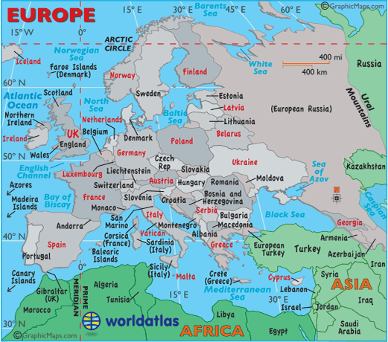

Slide 3
12/1 Landforms and Resources
Northern Peninsulas
  Scandinavian Peninsula- Norway and Sweden
  Fjords- cut by glacial movement millions of years ago
  Jutland- Denmark
Southern Peninsulas
  Iberian Peninsula- Spain-Portugal
  Italian Peninsula- Italy, San Marino, Vatican City
  Balkan Peninsula-Greece, Romania, Bulgaria, European Turkey, Serbia, Montenegro, Albania, Bosnia, +

Slide 4
Islands
Great Britain- England, Scotland and Wales
(note difference between Great Britain and the United Kingdom- England, Scotland, Wales and Northern Ireland)
Ireland- Republic of Ireland and Northern Ireland
Greenland- not technically Europe, but owned by Denmark
Iceland

Slide 5
Smaller Islands
United Kingdom- Channel Islands, Isle of Man(in the Irish Sea)
Denmark- Faroe Islands- north of Scotland
Portugal- Canary Islands (coast of Africa) and Azores- west of Portugal in the Atlantic
Spain- Balearic Islands- in the Mediterranean- Majorca, Menorca, Ibiza
France- Corsica
Italy- Sardinia, Sicily
Greece- hundreds of islands plus Crete (the largest Greek island)

Slide 6
Mountain Ranges
Alps- Switzerland, Germany, Austria, northern Italy- Mt. Blanc- highest point in Europe
Apennine- runs down the length of Italy
Balkan Mountains- cuts off the Balkan Peninsula
Ural Mountains- separates European Russia from Asian Russia
Pyrenees- separates Spain and France
Caucasus Mountains- between Black Sea and Caspian Sea

Slide 7
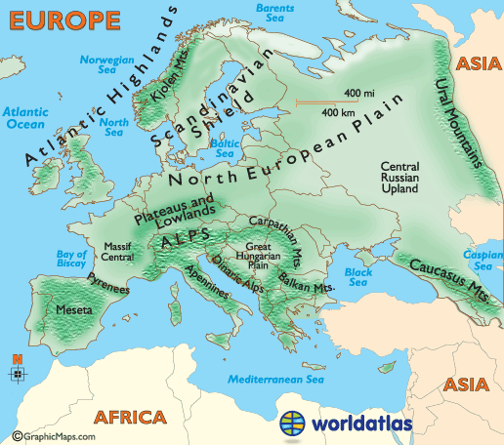

Slide 8
Uplands
Uplands are hills or very low mountains that may also contain mesas and high plateaus.
Not technically mountains but higher altitude areas
Examples:
Scandinavia, Scottish highlands, Brittany in France, central plateau in Spain called Meseta. Massif Central in France and Central Germany.

Slide 9
Rivers
Danube- touches nine countries, links Europe to the Black Sea
Rhine- Germany and more
Seine- France
Rhone- France
Loire- France
Tagus- Portugal and Spain
Tiber- Italy
Thames-England
Po- Italy
Canal Systems link many of these rivers together.

Slide 10
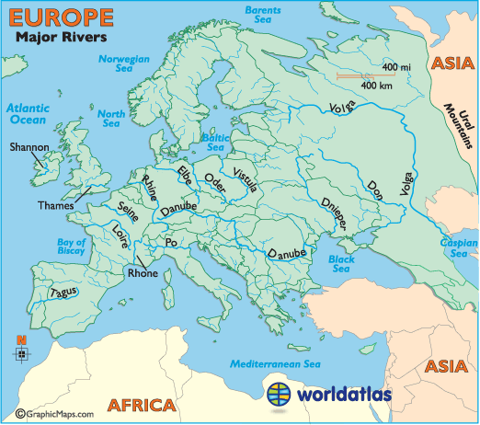

Slide 11
Major bodies of water
Atlantic Ocean
Irish Sea
Norwegian Sea
Baltic Sea
English Channel
Bay of Biscay
Mediterranean
Aegean Sea
Ionian Sea
Black Sea
North Sea
Adriatic Sea
Straits of Gibraltar

Slide 12
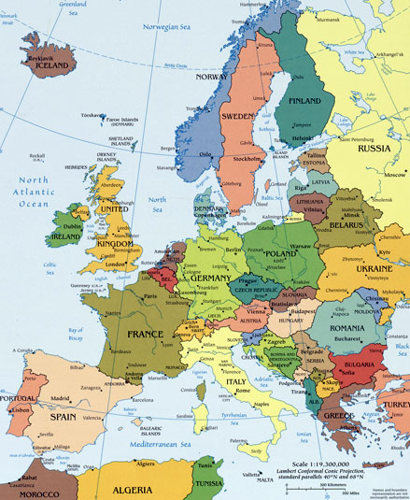

Slide 13
Resources
Coal- most of northern Europe
  Industrialized areas- Ruhr valley- Northern Germany- Alsace-Lorraine- (between Germany and France- and the UK- all have great access to coal and good transportation systems.
Oil and natural gas- North Sea- primarily, UK, Netherland, Denmark, and Norway
33% is also good for agriculture for a variety of crops

Slide 14
Resources shape life
Because Ireland lacks natural energy resources people have for centuries used peat.
Peat is cut from the ground, dried and then used for fuel.

Slide 15
12/2 Climate and Vegetation
Westerly winds warm Europe
Marine west coast climate-
Gulf Stream ( also called the North Atlantic Drift)
No large coastal mountains to block wind so it carries far inland
Also carries moisture so adequate rainfall

Slide 16
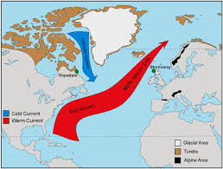

Slide 17
Harsher conditions inland
Areas farther inland have greater extremes of climate
Hotter summers and colder winters- depending on their latitude
Much of eastern Europe is fertile plain grow heartier crops like: wheat, potatoes, rye barley and sugar beets.

Slide 18
Sunny Mediterranean
Mild climate- similar to So. Calif.
Summers are hot and dry
Winters, mild and wet
Special Winds:
Mistral- areas not protected by mountains- cold, dry winds from the north
Sirocco- hot steady wind from North Africa- pick up moisture from the Med and dust from North Africa

Slide 19
Tourism
Mediterranean climate attracts many tourists from all over Europe and the world.
Land of the Midnight Sun
Northern Scandinavia, along the Arctic Circle lies a tundra climate: Permafrost no trees, moss and lichen.
In winter the nights are long
In summer, the days are long

Slide 20
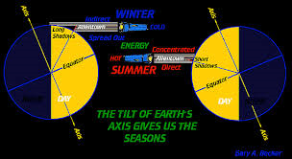

Slide 21
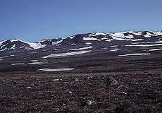
Typical Tundra landscape

Slide 22
12/3 Human-Environment Interaction
Polders- land from the sea via a system of dikes and drainage-
Growing population created need for more land
40% of the Netherlands is reclaimed land.
Seaworks- structures that are used to control the sea
Terpen- dikes and high earthen platforms that provide places of safety during floods and high tides.

Slide 23
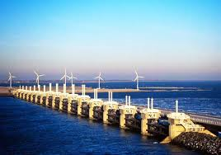

Slide 24
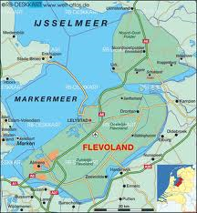

Slide 25
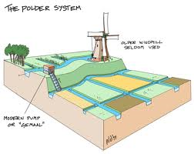

Slide 26
1400s- Use of windmills to move water
Zuider See- was a branch of the North Sea- System of dams cut it off and now it is a fresh water lake- (called Ijsselmeer) also added hundreds of square miles of land to Holland
Waterways for commerce- Venice
120 island, 150 canals- North end of the Adriatic Sea at the Po River delta
Venice is gradually sinking

Slide 27
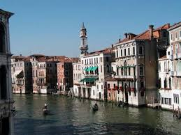

Slide 28
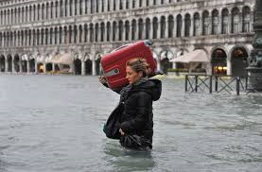

Slide 29
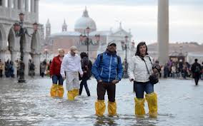

Slide 30
Deforestation
Intentional deforestation- building materials, to make charcoal
Acid Rain in modern times

