Slide 1
Chapter 11
The Civil War Begins

Slide 2
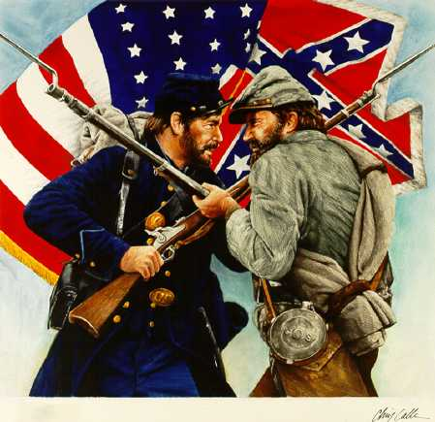

Slide 3
Section One- The Civil War Begins
Seven Confederate states had already seceded
By March 4 1861 (Lincoln’s inauguration) Confederates had taken over almost all federal institutions in the south except two major forts.
The most important was Ft. Sumter, Charleston, SC Under the command of Major Anderson

Slide 4
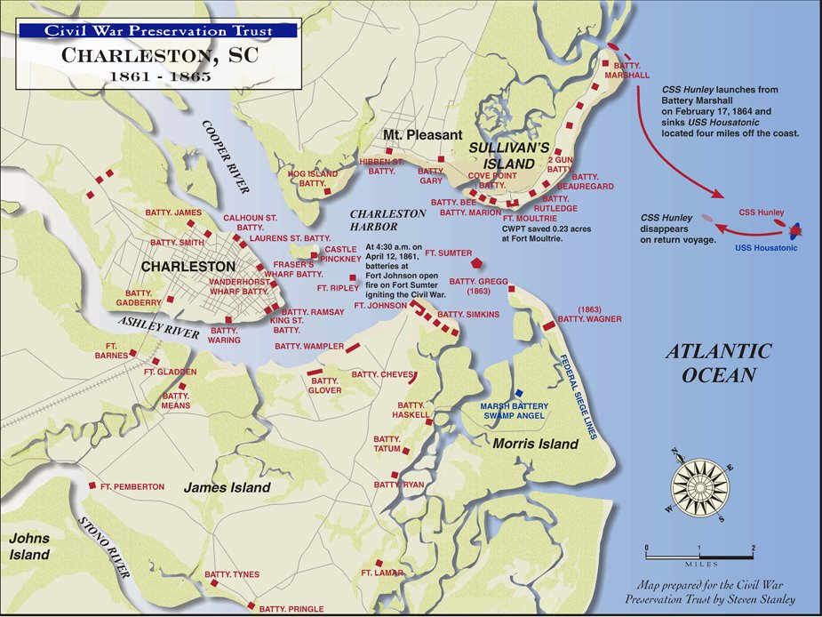

Slide 5
Lincoln’s dilemma
If Lincoln ordered the navy to shoot its way into Charleston, he would be responsible for the hostilities and other slave states might join the confederacy.
If he evacuated the fort, it would be seen as recognizing the Confederacy as a legitimate nation. This would anger his fellow Republicans

Slide 6
Davis’ dilemma
If he attacked the fort, he would be accused of starting the war.
If he did nothing, he would be seen as weak and that the confederacy would not be seen as a sovereign nation.
Davis chose war.

Slide 7
Lincoln chooses another approach:
Rather than evacuate, he chose merely to resupply the fort by sea.
April 12 1861- Confederates began the bombardment of Ft. Sumter
Major Anderson was forced to surrender.

Slide 8
Virginia Secedes
With the news of the fall of Ft. Sumter, Lincoln called up 75,000 volunteers to serve for three months.
On April 17, Virginia seceded from the Union. (direct result of this call up of 75,000 men)
Big blow to the Union. Va. Was most populous, industrialized and powerful state in the south.

Slide 9
In May, Arkansas, Tennessee and North Carolina followed bringing the number in the Confederacy to 11.
The western portion of Virginia was very anti-slavery and seceded from Virginia. It was admitted as a state in 1863 as West Virginia.
Four remaining slave states remained in the Union- Missouri, Kentucky, Delaware, and Maryland.

Slide 10
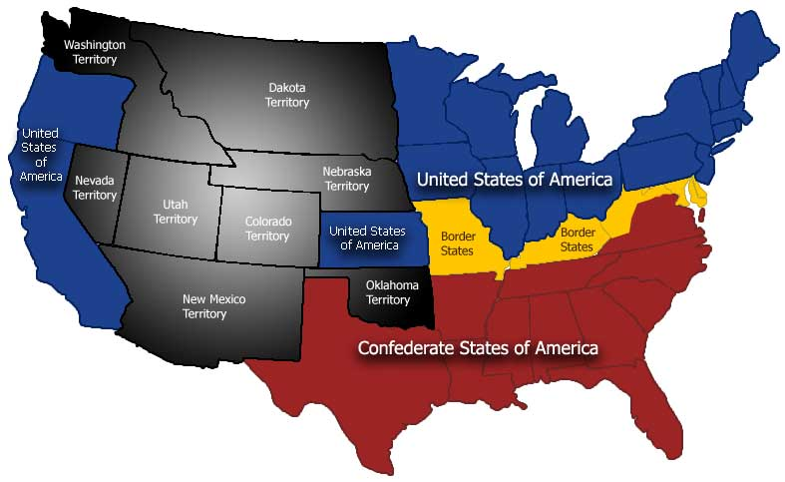

Slide 11
Americans Expect a Short War
On paper: Union had great advantage
Railroads, canals, industry, population, food production
The south did have cotton which was the greatest cash crop
The war would have to be fought in the south if the north was to win. Southerners would be defending their homes.
Most expected it to be over in a few months

Slide 12
Different Strategies
South- Developed strictly a defensive strategy
North- ‘Anaconda Plan’
Blockade southern ports
Gain control of the Mississippi River
Capture Confederate capital of Richmond, VA

Slide 13
Bull Run
About three months after Ft. Sumter fell, Union army tried to take Richmond. About 25 miles south of DC. is Manassas, Va- First big battle of the war and the south wins. General Stonewall Jackson gained his fame here. Union retreated in panic to DC
Many thought that this would be the end of the war, but in reality it was just beginning.

Slide 14
Union Armies in the West
After this defeat at Bull Run Lincoln called for enlistment of 500,000 men for three years.
Lincoln also appointed General George McClellan to lead the Union army.
Union army under U. S. Grant invaded western Tennessee- Within eleven days he captured two key Confederate forts- Ft. Henry and Ft. Donelson- on Rivers which led to the Mississippi.

Slide 15
Shiloh
Confederates attacked Union troops at Shiloh Church.
Sent a message that this was going to be a long and blood war. Of the 100,000 troops who fought, one fourth were killed.
Sent a message to the Generals that they needed to fight in a different was than in the past.

Slide 16
A Revolution in Warfare
Ironclads
Monitor (Union) and Merrimack (Confederate- renamed the Virginia)
Rifles-
Minie ball
Breach loading
Shovel

Slide 17
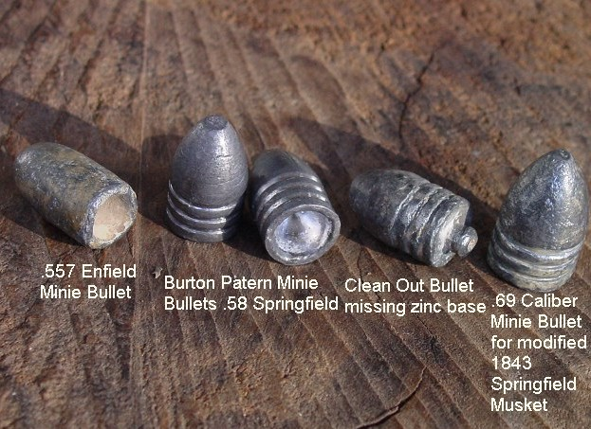

Slide 18
The War for the Capitals
Remember Washington and Richmond are only 100 miles apart.
Northern plan
  Blockade ports- done
  Gain access to Mississippi and control it- partly done
  Part three- capture Richmond- next part of the plan.

Slide 19
On to Richmond
Robert E. Lee gains command of the Confederate army after Gen. Johnstone was wounded.
Lee was offered command of all Union army forces by Lincoln, but declined saying that he could not fight against Virginia.
“Seven Days Battles”- indecisive McClellan abandoned attack on Richmond and moved down the peninsula to the sea.

Slide 20
Lee now moves against Washington
Lee and the Confederates win a second battle at Bull Run (Manassas)
Lee crosses into Maryland to the west of Washington.
Found copy of orders letting know that Lee’s army and Jackson’s army were separated at the moment
McClellan attacked Lee at Antietam (Sharpsburg) Bloodiest day in US military history- more than 26,000 men

Slide 21
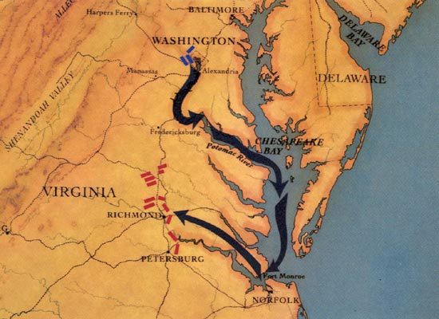

Slide 22
Instead of pressing this advantage and possibly ending the war, McClellan did nothing.
The next day, Lincoln fired him. (McClellan’s indecisiveness and cautiousness were his major faults)

Slide 23
Section Two- The Politics of War
Britain remains neutral
Britain previously dependent on southern cotton, now had sources in Egypt and India.
Britain had become more dependent on Union food resources.
The Trent Affair- British Ship Trent on its way back to Britain, carried two confederate diplomats who were trying to forge an alliance with GB. The two men were taken, Britain threatened war, Lincoln freed the two prisoners to avoid conflict.

Slide 24
Lincoln’s view on slavery
Personally, Lincoln did not like slavery
But, he did not believe that the Federal government had to power to abolish it where it already existed.
Lincoln used his powers as commander-in-chief to aid in ending slavery.
If we can seize Confederate property as a legitimate part of war, then he could free the slaves of the Confederacy.
For Lincoln, Emancipation was not a moral issue it was a weapon of war.

Slide 25
1 January 1863- Lincoln issues his Emancipation Proclamation.
No immediate effect because it freed slaves only in the Confederate states outside of Union control and it did not apply to the slave states who had remained in the Union. (the border states)
Not everyone in the north approved of it.
Democrats said it would prolong the war.
Obviously, most southerners were outraged.

Slide 26
Both sides face political problems
Baltimore crowd attacted a union regiment one week after Ft. Sumter- Lincoln suspended habeas corpus in Maryland. He later used it in other states to prevent dissent.
He seized telegraph offices to prevent dissent and subversion- Chief Justice Taney said he did not have the power. Lincoln did not respond.
Copperheads- Northerners who advocated peace with the south. Ohio congressman Clement Vallandigham- tried in military court for urging Union soldiers to desert and pushing for peace.

Slide 27
Jefferson Davis did similar things in the south even though at first he denounced Lincoln’s actions.
He suspended habeas corpus
***Since this time presidents have cited national security as a pretext to suspension of civil rights.

Slide 28
Conscription
At first, both sides relied on volunteers
As the war moved on and with the number of casualties, the needed to draft people into military service.
In the south: exempt were
Planters, those who owned more than 20 slaves
Obviously, this angered southerners were not rich
African-Americans were prohibited from serving until almost the end of the war.

Slide 29
In the North: Similar issue:
Could pay a fee of $300 to avoid conscription
African Americans could serve but in separate units commanded by whites. Of the two million who served in the union army, 180,000 were African-American

Slide 30
Draft Riots
1863 New York City riots. Poor people were living in slums, crime, disease. Poor whites, especially the Irish immigrants thought that it was unfair that they should fight to free slaves who would then compete for the few jobs that were available.
Rioters attacked any well dressed male who they thought able to pay the $300 fee.
The union army was called and over 100 people were killed in the riots

Slide 31
Section 3 Life During Wartime
Economic impact of inflation in the south ruined many established families and made life very difficult for the rest of the people.
African Americans during the war:
Neither side at first utilized them.
After Emancipation Proclamation- many joined the Union army. One percent of the northern population, but ten percent of the army.
In the south, not until the very end were African Americans utilized to fight.

Slide 32
Mortality rates for African Americans was higher than whites, but mainly because of disease.
Confederates would not treat African Americans as POWs. They were executed on the spot. Ft. Pillow Tennessee, 200 killed in mass execution.

Slide 33
Slave Resistance in the Confederacy
Many fled beyond the Union lines for freedom.
Those who remained engaged in slow downs, sabotage etc.
When owners fled further south, many slaves refused to be dragged along.
Only isolated slave uprisings occurred, but the plantation system was at an end.

Slide 34
The War Affects Regional Economies
Confederacy faced food shortages:
Drain of man power into the army
Union occupation of food growing areas
Loss of slaves to work in the fields.
Food prices skyrocketed- riots ensued
Jefferson Davis had to intervene to stop riots by threats

Slide 35
Northern Economic Growth
Wages did not keep up with prices
Most industries boomed because of the war and war needs:
  Rifles, Boots, Uniforms, coal,
Because so many went to the army, many labor saving devices like the reaper, steel plow etc. contributed to the economic growth.
Women replaced men in many jobs and retained them after the war.

Slide 36
Many became very rich because of the war.
In 1863 the government implements the first income tax to help finance the war.
Soldiers suffer on both sides
  Hygiene was poor
  Diet was insufficient- beans, bacon, hardtack
  Confederates- “cush” mixture of cubes of meat, corn bread and bacon grease.

Slide 37
Battlefield Medicine
Effects of Minie ball and rifles
Effects of bacteria not yet known
Most who survived initially, died of infection rather than the wound itself.
US Sanitation Commission-
Improve sanitation of Army camps
Recruit and train nurses

Slide 38
Two most famous:
  Dorthea Dix- First Superintendent of Nurses
  Clara Barton- cared for Union soldiers on the front line
As a result of their work, the death rate decreased.
Confederates did the same:
  Sally Tompkins worked on the front lines and was eventually commissioned as a Captain

Slide 39
Prisons
Confederate prison at Andersonville , Georgia was infamous.
33,000 men into 26 acres. No shelter, no sanitation
One third of the prisoners died from either starvation, disease or a combination of the two.
Henry Wirz- commander of the camp was eventually executed by the North as a war criminal

Slide 40
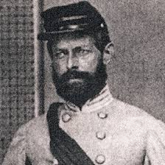
Henry Wirz- Commander of Andersonville

Slide 41
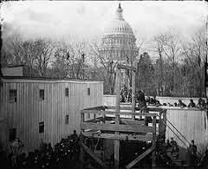
Execution of Henry Wirz- Commander of Andersonville

Slide 42
Union prison camps: Elmira NY and Camp Douglas, IL
Slightly better than in the south, but not much
They did have barracks for sleeping and adequate food.
No heat so many died of pneumonia
15% of prisoners in Southern prisons died
12% of prisoners in Northern prisons died

Slide 43
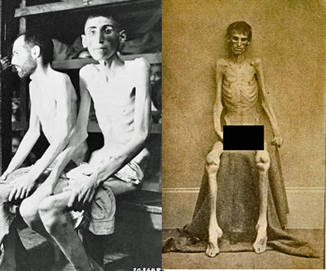
Andersonville Survivors

Slide 44
Section 4 -The North Takes Charge
Prelude to Gettysburg:
1863- a good year for the south
Defeated north at the Battle of Chancellorsville- (Lee defeats Hooker)
Stonewall Jackson wounded by one of his own men. His left arm amputated. Contracted pneumonia and died a few days later. (buried at VMI)
To pull troops away from Vicksburg, MS (under siege by Grant’s army)- Lee decides to invade the north

Slide 45
Gettysburg
Most decisive battle of the war- three days
Accidental meeting
A.P. Hill went there to get shoes for his men and to link up with Lee.
He ran into Union cavalry
Both sides sent for reinforcements
Day two- 90,000 Union and 75,000 Confederates

Slide 46
Lee orders attack on Cemetery Ridge- (high ground to the south of Gettysburg)
Union soldiers ran out of ammunition and attacked the Confederates with bayonets.
Confederates retreated.
The Third Day-
Lee orders artillery to hit center of Union lines and follows it with General Pickett’s charge.
It failed. The Confederates were forced to retreat back to the south. Never to attack in the north again.

Slide 47
More than 30% casualties
Union- 23,000 killed or wounded
Confederates- 28,000 killed or wounded
While this was happening: Grant had forced the Confederates at Vicksburg to surrender the next day.
These two events doomed the south to defeat.

Slide 48
Grant wins at Vicksburg
Vicksburg, MS. was one of two Confederate strongholds on the Mississippi River.
  Grant tried two frontal assaults on Vicksburg, both of which failed.
  Grant settled on a siege- (surround the city and let nothing in or out)
  July 4, 1863- Vicksburg surrendered
  Five days later, Port Hudson, LA also surrendered.
*This completed one part of the Anaconda Plan

Slide 49
Gettysburg Address
Confederacy Wears Down
Confederate Morale-
Deteriorated
Planters were encouraged to plant food crops rather than cotton- they resented this.
Many soldiers deserted
Leaders fought among themselves- Gov. SC didn’t want soldiers from his state fighting in another state

Slide 50
Soon, widespread clamor for peace in the south.
Grant appoints Sherman-
Grant wanted to tie up Lee’s army while Sherman ravaged Georgia. North could afford losses, South could not. Goal: destroy the south’s will to fight.

Slide 51
Sherman’s March
Sherman intentionally left his supply lines.
Intent was to live off the land.
They ravaged everything. Captured and burned Atlanta and anything else in his march to the sea. Eventually into South Carolina where it all began
He then turned north to join Grant in defeating Lee.
As he entered NC. he stopped destroying and began handing out food to the locals.

Slide 52
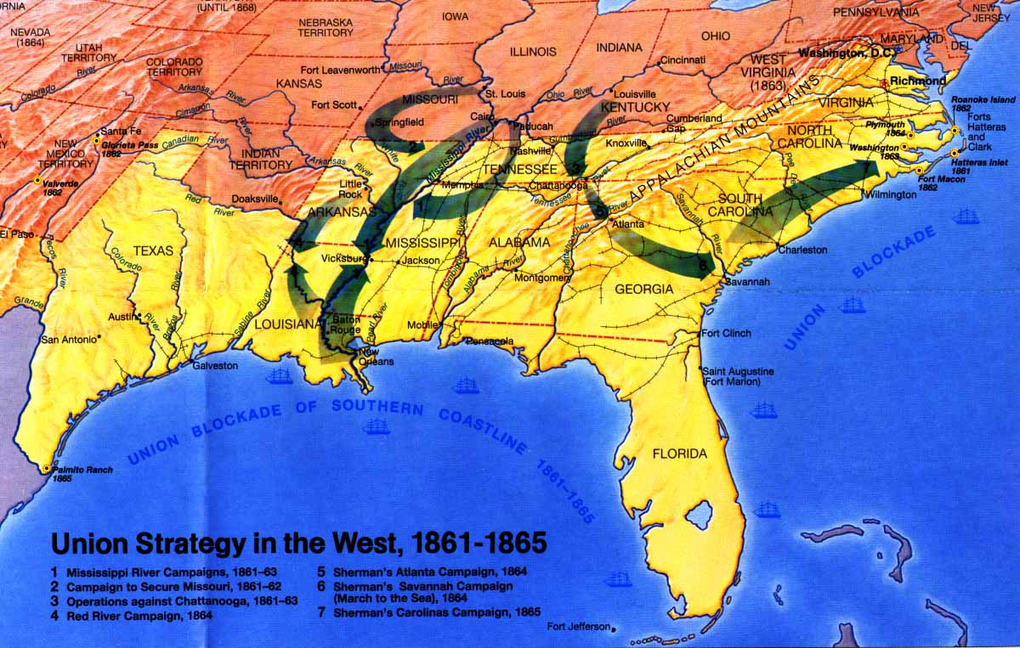

Slide 53
Election of 1864
Lincoln faced heavy opposition
Northern and Southern Democrats joined to nominate General George McClellan- platform- immediate armistice
Radical Republicans- favored a harsher punishment of the south in return for re-admittance to the union- Formed a third party- nominated John C. Fremont
Republicans dropped the Republican name and changed to: National Union Party.
Chose Andrew Johnson a pro-union southerner as his running mate.

Slide 54
Lincoln predicted defeat
But a series of victories changed the outcome of the election.
  David Farragutt- defeats Confederate navy on Mobile Bay (AL)
  Sherman captures Atlanta
  Sheridan drives Confederates out of Shenandoah Valley
  Lee surrenders to Grant at Appomattox Court House, VA

Slide 55
Surrender at Appomattox
Lee and his troops had been driven out of Petersburg, VA (just south of Richmond) Large railhead and source of southern supplies to the capital.
Jefferson Davis and his government had abandoned Richmond and fled south. Southerners burned Richmond to keep it out of the hands of the Union
At the surrender- Lee was offered very generous terms.
Fighting would be over in just a few months.

Slide 56
Section 5- Legacy of the War
War Changes a Nation
Federal gov’t emerged assuming supreme authority- no more secession.
Before war, Fed. Gov’t had little impact on the life of individuals. Most gov’t was local
During war:
  Fed required money (income tax)
  Draft-
  Required people to accept new currency

Slide 57
Economic Changes
National Banking Act of 1863- Set up a national banking system- bank inspections- requirements for loans- standardized currency
The northerners who grew rich from the war had more money to invest
In the south, war took away cheap labor (slaves) and wiped out 40% of other resources
Economic gap between north and south grew

Slide 58
Costs of War
360,000 Northerners died
260,000 Southerners died
Economic costs would last for more than two decades
New Birth of Freedom
Lincoln believed that only a Constitutional amendment would truly abolish slavery
  Thirteenth Amendment passes

Slide 59
Mathew Brady- most famous photographer of the Civil War era.
Assassination of Lincoln
April 14, 1865
Ford’s Theater- “Our American Cousin”
John Wilkes Booth- 26 actor from Maryland
Lincoln died the next morning
Booth was trapped a few days later in a barn and killed

Slide 60
Lincoln’s body traveled to Springfield, IL on a fourteen day journey.
New problems emerge for the new president Andrew Johnson.
  How do we reintegrate the south into the union?
  How do we integrate four million newly freed African Americans into the national life?

