Slide 1
Biology Keystone Review
Module 1

Slide 2
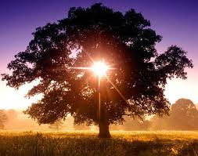
Topics Covered
Cells
  Prokaryotic
  Eukaryotic
Organelles
Plant vs. Animal Cells
Membrane Transport
Photosynthesis
Cellular respiration

Slide 3
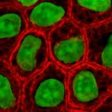
What is a cell?
The basic unit of structure and function for all living organisms.
All cells have 3 common
components:
  Genetic material (DNA)
  Cell membrane
  Cytoplasm

Slide 4
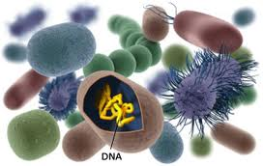
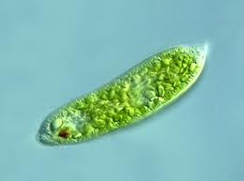
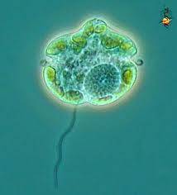
Prokaryotic vs. Eukaryotic Cells
Prokaryotic
Eukaryotic
Do not have a membrane bound nucleus
Single cell (unicellular)
Bacteria are examples of prokaryotic organisms
Have a nucleus (and usually lots of organelles)
Unicellular or multicellular
Protista are usually unicellular
  Amoeba, dinoflagellates, algae
Animal and plant cells are part of multicellular organisms.
Notes:
http://www.diffen.com/difference/Eukaryotic_Cell_vs_Prokaryotic_Cell

Slide 5
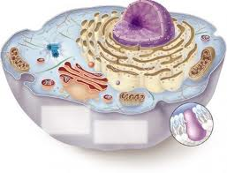
Organelles
Nucleus
Lysosomes
Ribosomes
Cytoplasm
Cell/Plasma Membrane
Mitochondria
Endoplasmic Reticulum
Golgi Apparatus
Vacules

Slide 6
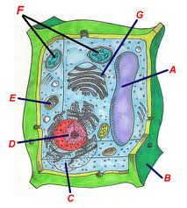
Plant Cells
Central Vacuole *
Cell Wall *
Rough Endoplasmic Reticulum
Nucleus
Mitochondria
Chloroplasts *
Golgi Apparatus

Slide 7
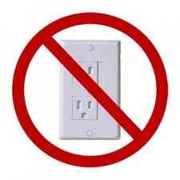
Passive Transport
Definition:
  The transport of materials across the plasma/cell membrane without using cellular energy.
  Diffusion
  Osmosis
  Facilitated Diffusion

Slide 8
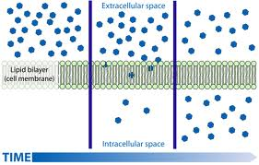
Diffusion
The movement of particles from an area of high concentration to low

Slide 9
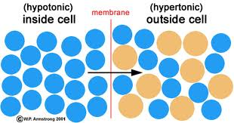
Osmosis
The movement of water (solvent- blue) from an area of higher water concentration to an area of lower water concentration
Hypotonic- deficient (solute- tan)
Hypertonic- excessive (solute- tan)

Slide 10
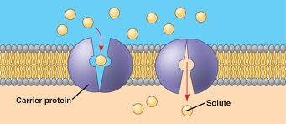
Facilitated Diffusion
The movement of particles across the plasma membrane with the assistance of special transport/carrier proteins

Slide 11
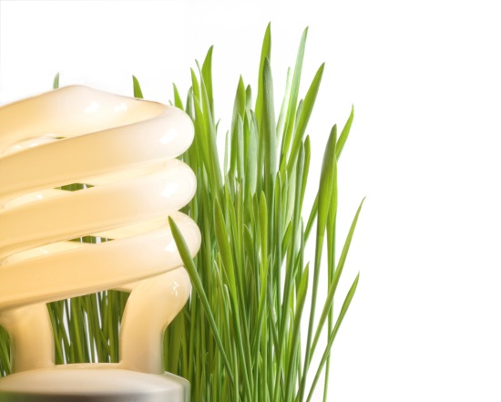

Active Transport
Definition
  The movement of particles from an area of low concentration to an area of high concentration that uses energy
  Pumps
  Endocytosis
  Exocytosis
ATP

Slide 12
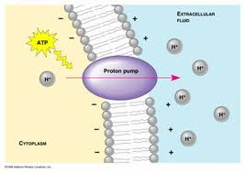
Active transport pumps
Ion or molecular pumps transport ions or molecules across plasma membranes with the use of energy from ATP

Slide 13
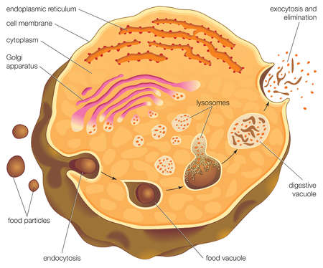
Endocytosis and Exocytosis
Endocytosis
Exocytosis
Bringing material into the cell by engulfment
The exit of material from the cell by fusing membranes

Slide 14
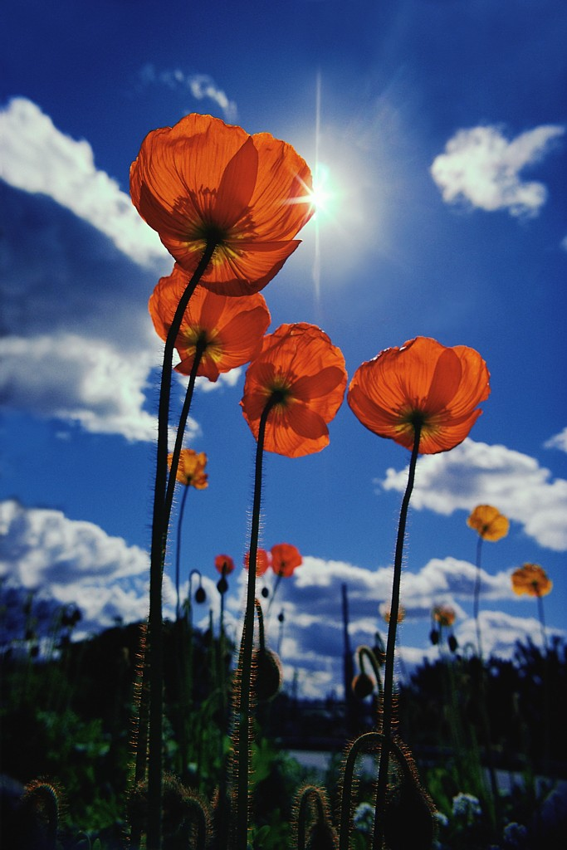
Keystone Definition of Photosynthesis
A process in which solar radiation is chemically captured by chlorophyll through a set of controlled chemical reactions resulting in the potential chemical energy in the bonds of carbohydrate molecules

Slide 15
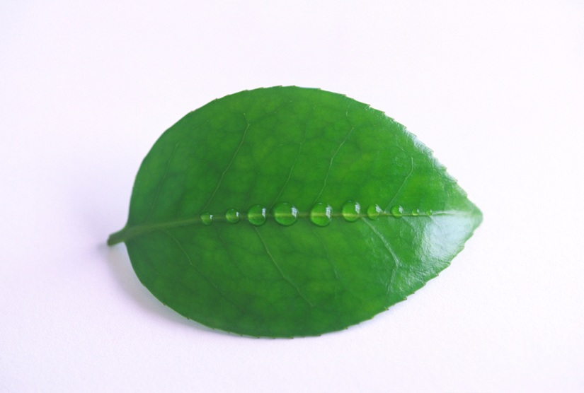
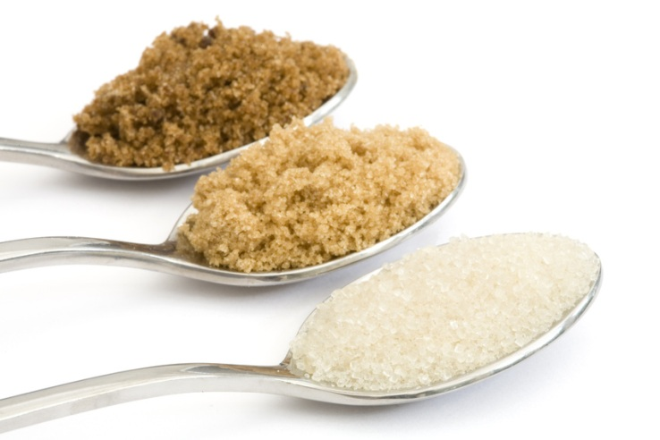
What?
Solar radiation- sunlight
Chlorophyll- the green pigment in plants that absorbs the energy from the sun and converts it to carbohydrates
Carbohydrates- sugar- glucose, or starch
Potential energy- stored energy to be used later

Slide 16
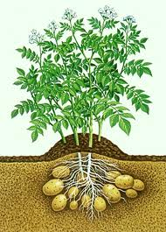
Sugar, Starch, and Oxygen
The light energy gathered by chlorophylls is converted to adenosine triphosphate (ATP).
This is the energy that is used to remove electrons from water.
These electrons are then used in the reactions that turn carbon dioxide into carbohydrates- sugar and starch, and release oxygen back into the air.
carbon dioxide + water + light energy → carbohydrate + oxygen

Slide 17
ATP synthesis
Adenosine Triphosphate, ATP, is the universal energy currency of life!
All organisms produce ATP either by photophosphorylation using sunlight for photosynthetic organisms or cellular respiration for non-photosynthetic organisms (such as people)

Slide 18
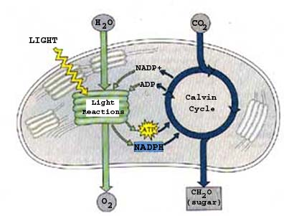
ATP and sugar from sunlight
Light Dependent Reaction
Light Independent Reaction
Notes:
Sunlight is absorbed by the chloroplasts. In the chloroplasts are sacs called thylakoids that are filled with chlorophyll and proteins. The chlorophyll and proteins capture high energy electrons and pass them through the electron transport chain generating energy to move hydrogen atoms into the thylakoid. The hydrogen atoms want to get out and they can do so by exiting the thylakoid through the enzyme ATP synthase. As they exit, the enzyme rotates generating the energy needed to convert ADP into ATP. The hydrogen atoms bind with NADP to make NADPH. The ATP and NADPH generated are used by the plant to convert CO2 into Sugar in a process know as the calvin cycle. The plant then uses the sugar for energy, or stores it in the form of starch.

Slide 19
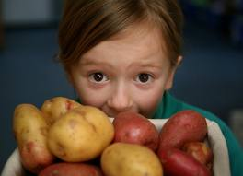
Cellular Respiration
Our bodies breakdown starch to form glucose using an enzyme found in the mouth and gut.
Glucose to ATP in 3 Steps:
  Glycolysis
  Krebs Cycle (citric acid cycle)
  Electron transport chain
Glucose (sugar) + Oxygen → Carbon dioxide + Water + Energy (as ATP)

Slide 20
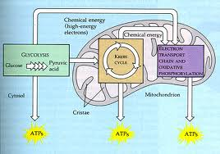
Cellular Respiration
Glucose is converted to acetyl-CoA in the cytoplasm, and then the Krebs cycle proceeds in the mitochondrion. Electron transport and chemiosmosis result in energy release and ATP synthesis.

