Slide 1

Objectives
List the characteristics that biologists use to distinguish between abiotic and biotic factors.
Identify the characteristics used to classify kingdoms.
Differentiate bacteria from archaebacteria.
Contrast the terms colony and aggregate.

Slide 2
III. Characteristics of Living Things
Anything that possesses all of the characteristics of life is known as an organism
Living things are:
  made up of cells
  Reproduce
  Based on a universal genetic code
  Grow and develop
  Obtain and use materials and energy
  Respond to their environment
  Maintain a stable internal environment
  As a group: change over time

Slide 3
IV. The Three Domains of Life
Biologists have adopted a classification system that divides all organisms into three domains.
The domain thought to be the oldest is Bacteria, which is composed of the organisms in the kingdom Eubacteria.
Archaea is the second prokaryotic domain and is also composed of a single kingdom, Archaebacteria.
A third domain, Eukarya, contains all four of the eukaryotic kingdoms: Animalia, Fungi, Plantae, and Protista.

Slide 4
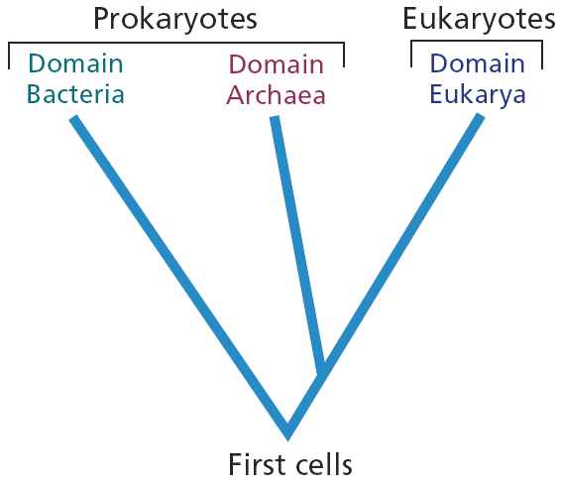
Three Domains of Living Organisms

Slide 5
V. The Six Kingdoms of Life
Living organisms are divided into 6 kingdoms and are grouped according to their cell type, complexity, and method for obtaining nutrition.
Organisms are either prokaryotes, which have prokaryotic cells, or eukaryotes, which have eukaryotic cells.
The cells of the organisms in 5 kingdoms have a cell wall, which may be composed of different materials. The cells of the organisms in one kingdom do not have a cell wall.
Organisms are either unicellular or multicellular.
Many organisms are autotrophs.
Many other organisms are heterotrophs.

Slide 6
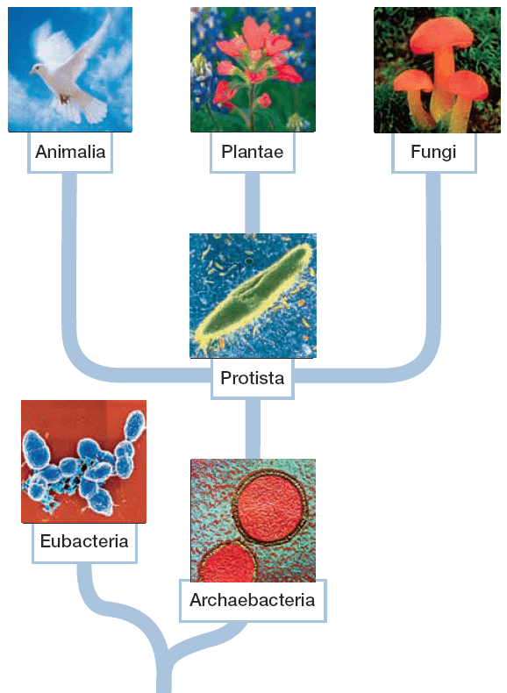
Six Kingdoms

Slide 7
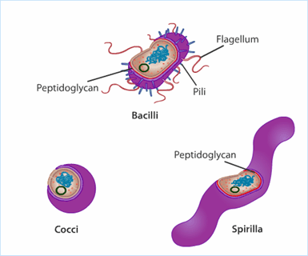

Bacteria

Slide 8
VI. The Domain Bacteria
Characteristics of Bacteria
  Bacteria have strong exterior cell walls made of peptidoglycan, a weblike molecule complex made of carbohydrate strands cross-linked by short peptide bridges.
  Unlike the genes of eukaryotes and archaebacteria, bacterial genes have no introns.
  The amino acid sequences of the ribosome proteins and RNA polymerases found in bacteria differ from those found in eukaryotes or in archaebacteria.

Slide 9
b. Kinds of Bacteria
Bacteria are the most abundant organisms on Earth.
Some bacteria cause disease. Other bacteria are used by humans to process foods. Bacteria are used to control agricultural pests, to produce various chemicals, and to perform genetic engineering.
Some bacteria are chemoautotrophs, some are photosynthetic, and others are heterotrophic.

Slide 10
VII. The Domain Archaea
Characteristics of Archaebacteria
  The cell walls of archaebacteria do not contain peptidoglycan, as the cell walls of bacteria do.
  Archaebacteria contain lipids very different from those of bacteria or eukaryotes.
  As with the genes of eukaryotes, the genes of archaebacteria are interrupted by introns.

Slide 11
b. Kinds of Archaebacteria
Methanogens obtain energy by combining hydrogen gas, H₂, and carbon dioxide, CO₂, to form methane gas, CH₄.
A group of extremophiles called thermophiles lives in very hot places—up to 106ºC. Halophiles inhabit very salty lakes that can be three times as salty as seawater.
Nonextreme archaebacteria grow in all the same environments that bacteria do.

Slide 12
VIII. The Domain Eukarya
Characteristics of Eukarya
  All eukaryotes have cells with a nucleus and other internal compartments.
  True multicellularity, in which the activities of individual cells are coordinated and the cells themselves are in contact, occurs only in eukaryotes.
  Eukaryotes have a life cycle that involves sexual reproduction.

Slide 13
b. Kinds of Eukarya
Protista contains both unicellular and multicellular organisms, many of which are aquatic.
Fungi are a group of heterotrophs that are mostly multicellular. Fungi are composed of cells with cell walls of chitin.
Almost all plants are autotrophs and have cells with cell walls composed of cellulose.
All animals are heterotrophs composed of cells that do not have cell walls.

Slide 14
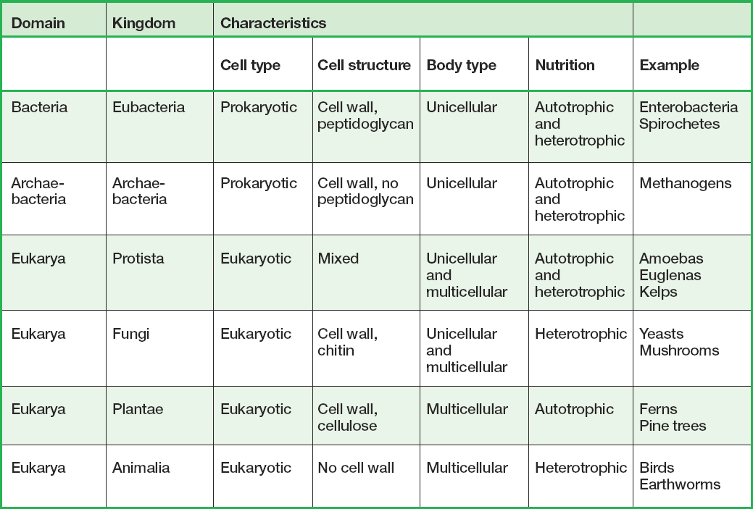
Kingdom and Domain Characteristics

Slide 15
IX. The Many Forms of Multicellularity
Colonies
  Occasionally, the cell walls of bacteria adhere to one another.
    These formations cannot be considered truly multicellular, however, because few cell activities are coordinated.
    Such bacteria may properly be considered colonial.
  A colonial organism is a group of cells that are permanently associated but that do not communicate with one another.

Slide 16
b. Aggregations
An aggregation is a temporary collection of cells that come together for a period of time and then separate.
For example, a plasmodial slime mold is a unicellular organism that spends most of its life as single-celled amoebas. When starved, however, these cells aggregate into a large group.
This weblike mass produces spores, which are then dispersed to distant locations where there may be more food.

Slide 17
c. True Multicellularity
A multicellular organism is an organism composed of many cells that are permanently associated with one another.
Multicellularity enables cells to specialize in different functions.
These cells grow and undergo differentiation, the process by which cells develop a specialized form and function.

Slide 18
d. Complex Multicellularity
The specialized cells of most plants and animals are organized into structures called tissues and organs.
A tissue is a distinct group of cells with similar structure and function.
Different tissues may be organized into an organ, which is a specialized structure with a specific function.
Various organs that carry out a major body function make up an organ system.

Slide 19
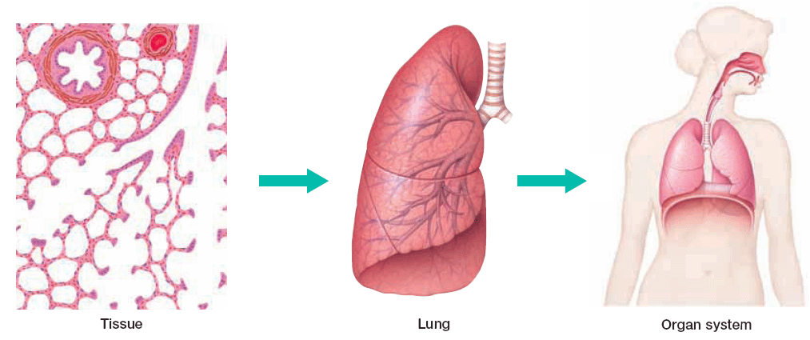
Specialized cells form tissue that makes up an organ called the lung. The lungs and other organs constitute an organ system.

