Slide 1
Solubility Equilibria
Will it all dissolve, and if not, how much?

Slide 2
Solubility Product Constant, K_{sp}
Application of the equilibrium law to the equilibrium that exists between a slightly soluble solid and its ions in a saturated solution.
K_{sp} can be used to determining whether a precipitate forms when solutions are mixed, calculating ionic concentrations and solubilities.

Slide 3
All dissolving is an equilibrium.
If there is not much solid it will all dissolve.
As more solid is added the solution will become saturated.
Solid ↔ dissolved
The solid will precipitate as fast as it dissolves .
Equilibrium

Slide 4
General equation
M⁺ stands for the cation (usually metal).
Nm⁻ stands for the anion (a nonmetal).
M_{a}Nm_{b}(s) ↔ aM⁺(aq) + bNm⁻ (aq)
K = [M⁺]ª[Nm⁻]^{b}/[M_{a}Nm_{b}]
But the concentration of a solid doesn’t change.
K_{sp} = [M⁺]ª[Nm⁻]^{b}
Called the solubility product for each compound.

Slide 5
Value of K_{sp}
K_{sp} < 1 it means that little of the solid will dissolve. An equilibrium is established.
K_{sp}> 1, it means the salt is soluble and will all dissolve.

Slide 6
Type 1 problems
Given concentrations, find K_{sp}
Write a dissolving equation.
Write the equilibrium law expression.
Calculate the molarity of the dissolved salt.
Determine equilibrium concentrations of the ions.
Substitute the molarity values and solve.

Slide 7
Type 2 Problems
Given K_{sp}, determine the concentration of the ions.
Write the dissolving equation.
Find the initial and equilibrium concentrations.
Solve for the unknown molarity using the equilibrium law expression.
Convert molarity to grams if requested.

Slide 8
Relative solubilities
Ksp will only allow us to compare the solubility of solids the at fall apart into the same number of ions.
The bigger the Ksp of those the more soluble.
If they fall apart into different number of pieces you have to do the math.

Slide 9
Precipitation
Ion Product, Q =[M⁺]ª[Nm⁻]^{b}
If Q>Ksp a precipitate forms.
If Q<Ksp No precipitate.
If Q = Ksp equilibrium.

Slide 10
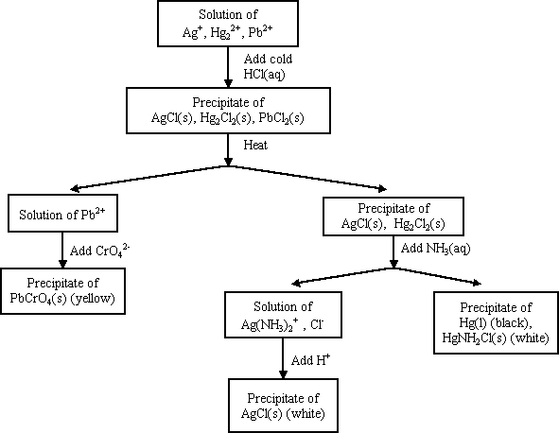
Precipitation and Qualitative Analysis

Slide 11
Common Ion Effect
Common ion effect is a shift in equilibrium that occurs because the concentration of an ion that is part of the equilibrium is changed.
The presence of a common ion lowers the solubility of a sparingly soluble substance.

