Slide 1
CHEMICAL EQUILIBRIUM

Slide 2
HC₂H₃O₂ + H₂O ⇔ H₃O⁺ + C₂H₃O₂⁻
Equilibrium occurs when two opposing processes occur at the same RATE.
The rates are equal in both directions.
Once equilibrium is reached, the concentrations don’t change, but the reaction constantly takes place.
Almost all systems come to equilibrium.
Composition of the equilibrium mix does not depend on which side of equation we begin.

Slide 3
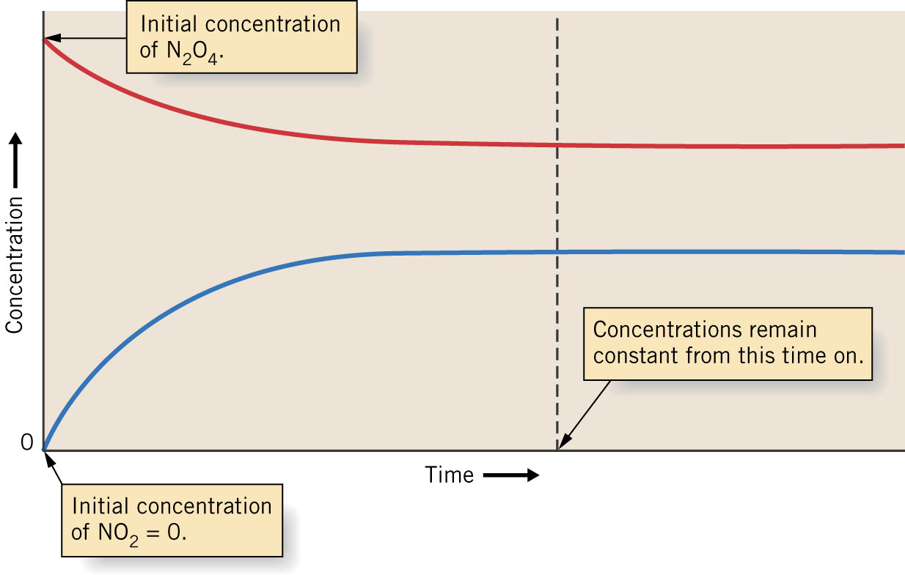
Graph of Equilibrium

Slide 4
The mass action expression equals
[Products]^{x}/[Reactants]^{y} . This manner of expression is a convention.
[ NaCl] indicates concentration of NaCl.
The equilibrium constant (K_{c}) is the value of the mass action expression when equilibrium concentrations are used. It is only valid at a given temperature.

Slide 5
K_{eq}
Consider the general chemical equation
The exponents in the mass action expression are the same as the stoichiometric coefficients

Slide 6
Various operations can be performed on equilibrium expressions
  Changing the direction of equilibrium – when the direction of an equilibrium is reversed, the new equilibrium constant is the reciprocal of the original

Slide 7
  Multiplying the coefficients by a factor – when the coefficients in an equation are multiplied by a factor, the equilibrium constant is raised to a power equal to that factor

Slide 8
  Adding chemical equilibria – when chemical equilibria are added, their equilibrium constants are multiplied

Slide 9
Reaction Quotient (Q)
The reaction quotient (Q) is the value of the mass action expression when nonequilibrium concentrations are used.
If Q < K_{c}, products will form
If Q> K_{c}, reactants will form
If Q = K_{c}, reaction is at equilibrium

Slide 10
MEANING OF K_{eq} VALUES
K is very large -- reaction proceeds far to completion; position of equilibrium is far toward product side.
K = 1 -- Concentration of products & reactants about same at equilibrium; equilibrium is midway between products & reactants.
K is very small -- little product formed; position of equilibrium is far toward reactants.

Slide 11
HETEROGENEOUS EQUILIBRIUM
When more than one phase exists in a reaction, it is called a heterogeneous reaction.
The concentration of a pure solid (sodium carbonate) or a pure liquid (water) is a constant.
Equilibrium law expressions are written without concentration of pure solids and liquids.

Slide 12
K_{c} and K_{p}

Slide 13
What if Equilibrium concentration is not given?
Size of K determines approach to take.
In the case of large K (>100) or the case of small K ( <.01), this allows us to make simplifying assumption.
Just use ICE.
Rule of thumb is that if the value of x is <55 of all other concentrations, our assumption is valid.

Slide 14
ICE CHART
Concentration must be in moles/L
Concentration must be at equilibrium
In the change row products and reactants must have opposite signs.
In the change row products and reactants are in the same ratio as the coefficients for the reaction’s equation.

Slide 15
Midrange K
If the value is .01 < K < 100, no simplification.
We solve using the quadratic equation.

