Slide 1
Developmental Psychology
Andy Filipowicz
AP Psychology
Ocean Lakes High School
Virginia Beach, VA

Slide 2
Thinking Question :
Do you think sexual orientation is more nature or nurture? Why/how does this develop?
Can people become heterosexual or homosexual or bisexual or asexual?
It is commonly argued that women’s sexual orientation is more fluid than men’s during adolescence? Do you agree? Y/Ynot?

Slide 3
Thinking Question?
Harris poll of 2306 American adults:
“If you could stop time and live forever in good health at a particular age, what age would it be?
18-24 year olds: 27
25-29 year olds: 31
30-39 year olds: 37
40-49 year olds: 40
50-64 year olds: 44
65+: 59

Slide 4
Thinking Question
From where did/does your sense of morality develop? What sources have contributed to your sense of morality
Summarize your basic moral system and give some examples of when you have used it to make morally based decisions.

Slide 5
Thinking Question
Other than in your sleep when you’re old, If you could choose how you will die, how would it be?
How would you least want to die?

Slide 6
How Children Think…
EVIL EYE
3 year olds and Monsters

Slide 7
3 Big Issues
Nature vs. Nurture – I hope we understand this one by now!
  Video: Moving Images: Sex Reassignment
  Story of David Reimer Part 1
Continuity vs. Stages
  Smooth transitions with malleable boundaries? Or
  Distinct transitions with firm boundaries?
Stability vs. Change
  Does IQ vary with age?

Slide 8
Remember as many of these as possible…
HGE
BNP
WQA
GHL
VJT
DRW
ASD
BSN
WEC
ZEK
DBB
WDB
AQL
EMB
SBV
EWC
JHO
SWE

Slide 9
Okay, which of these were on the previous screen?
A) AQL
B) PKA
C) WRT
D) BSN
E) EWC
F) VJT
G) UYR
H) JHO
I) JSX
J) GTY

Slide 10
Correct Answers
A) AQL
D) BSN
E) EWC
F) VJT
H) JHO
Ms. Vakos, Mr. Hales, Mr. Harcourt, Mr. Mainor, all got 1 right
Not really, I’m making this up.

Slide 11
What would each design show us?
(cohorts)
Adolescents vs. Elderly
Conclusion: adolescents have a better short term memory than elderly
PROBLEM: Maybe something else is going on…
  What if memorization was emphasized more in the 20 year old group? 70 year old group?
  So, are differences due to age or different styles of education? It’s impossible to tell because we can’t control for this!

Slide 12
Research Design
Longitudinal = same people over time
  Strengths: change over time
  Weaknesses: time, shrinking sample size, expensive
Cross-sectional = different cohorts @ one time
  Teenagers vs. Middle Age
  Asians vs. Hispanics
  Strengths: quick
  Weaknesses: shared cultural events may play a role in development (is it experience or the aging process itself?)
Sequential = combo of both

Slide 13
Prenatal Influences
Psych Sim 5: Conception to Birth
http://www.youtube.com/watch?v=aR-Qa_LD2m4
http://www.youtube.com/watch?v=KXRbV33J5qk

Slide 14
Homer Sperm
http://www.youtube.com/watch?v=OX1XAmDpKqo&feature=related

Slide 15
Teratogens
Correlates of Schizophrenia
  Flu
    2nd trimester = 8x more likely
  Rubella (German Measles) = 10-20x more likely
Alcohol = Fetal Alcohol Syndrome
  Small, malformed skulls
  Leading cause of mental retardation today
  Lesser version = fetal alcohol effect → learning disabilities and behavioral problems, but not as severe as the syndrome

Slide 16
Motor / Sensory Development
Real Babies Speak More Googoogagas
Rooting (gone by 4 months)
Babinski(gone by 1 year)
Sucking (gone by 2 months, becomes voluntary)
Moro (gone by 2 months)
Grasping (gone by 6 months)

Slide 17
When Can Babies…
Laugh?
Sit without support?
Recognize & smile at mom/dad?
Crawl?
Stand?
Think about stuff not there?
Walk by themselves?
Feel ashamed?
Stand on 1 foot for 10 seconds?

Slide 18
When Can Babies…
Laugh? 2 mos
Recognize & smile at mom/dad? 4-5 mos
Sit without support? 5-6 mos
Crawl? = 5.5 mos
Stand? = 8-9 mos
Think about stuff not there? 12mos
Walk by themselves? = 15 months
Feel ashamed? = 2 yrs
Stand on 1 foot for 10 seconds? = 4.5 yrs

Slide 19
Infancy and Childhood –
Piaget’s Cognitive Theory

Slide 20
The Senses at Birth
The BIG PICTURE: A LOT of our senses’ development are complete or near complete during the prenatal period
The Mind – 2-13: Capabilities of the Newborn (4 minutes)
Sensitivity to Touch → The 1st sense; by 32 weeks, nearly every part of the body is sensitive to a light stroke of a single hair
Movement → all movement possible by 14 weeks
Tasting → 14 weeks
  Love sugar
  Basic food preferences in place
Smelling → nose btwn 11 & 15 weeks
Hearing → reactive listening 16 weeks
  Babies will turn head towards mother’s voice
  Our most dominant sense at birth
Vision → most predominant sense in our life, but NOT at birth
  Can see 8-12 inches in front, but beyond that it’s a blur
  Normal vision by 12 months
  Enjoy looking at faces and face-like objects more than other objects

Slide 21
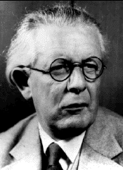

Jean Piaget (1896-1980) – Cognitive Development
It takes cognitive development to do this...
Psych Sim 5.0: Cognitive Development
Schemas
Assimilation
Accommodation
Notes:
Schema = furry, 4 legged creatures are “doggies” →
Assimilation = Child sees a cat and calls it “doggie”
Accommodation = People will say, “No, that’s NOT a doggie,” so schema for dog gets modified to restrict it to certain types of 4 legged creatures

Slide 22
Piaget’s Cognitive Development
The Mind: 2-14: Infant Cognitive Development
STAGE 1: Sensorimotor Stage (birth – 2 years)
  Object permanence (by 8 months, it begins)
  Stranger Anxiety → cry at the sight of strangers
  Separation Anxiety is closely related…it shows the child has a clear memory of mom / dad and doesn’t like when it’s not present
  0-1 months: reflexes
  1-4 months: primary circular reactions (suck thumb)
  4-12 months: secondary circular reactions (squeeze duck)
  12-24 months: tertiary circular reactions (hit drum = cool, so now I will hit table with stick = sounds cool, too)
  1.5 years: mental representation
Notes:
STAGE 1: Sensorimotor Stage (birth – 2 years)
0-1 months: reflexes
1-4 months: primary circular reactions (suck thumb)
4-12 months: secondary circular reactions (squeeze duck)
12-24 months: tertiary circular reactions (hit drum = cool, so now I will hit table with stick = sounds cool, too)
1.5 years: mental representation
Object permanence (by 8 months, it begins)
Stranger Anxiety → cry at the sight of strangers
Separation Anxiety is closely related…it shows the child has a clear memory of mom / dad and doesn’t like when it’s not present

Slide 23
Piaget’s Cognitive Development
STAGE 2: Preoperational Stage (2-6)
Egocentrism = sees things through 1 POV
  Homer Simpson
  Ego
Lack of Conservation
  http://video.google.com/videoplay?docid=7120969848896411546
  http://www.youtube.com/watch?v=ML6M5U1yLo8
Begin forming Theory of the Mind
  Psych through Film: 7: False Belief Test
Notes:
STAGE 2: Preoperational Stage (2-6)
Represent things with words and images, but lacking logical reasoning
Pretend Play → broom = horse
Role Playing → “mommy” “doctor”
Understanding of Past and Future
“Remember when you fell down?” = sad face
“Mommy will be home soon.” = stop crying
Egocentrism = sees things through 1 POV
Homer Simpson

Slide 24
Piaget’s Cognitive Development
STAGE 3: Concrete Operations Stage (7-11)
Conservation and reversibility are realized
STAGE 4: Formal Operations Stage (12+)
Not all adults reach this stage!
Hypothesis testing – “How would you be different if you lived on planet where there was no light?”
Metacognition – ability to think about how we think
SUMMARY
Handout 4-12; ME → pg. 22

Slide 25
Critique of Piaget’s Theory
Underestimates children’s abilities
Overestimates age differences in thinking
Tests may have relied too much on language use, thus biasing results in favor of those children with more language skills
Do our cognitive skills develop more continuously than Piaget said—stages?
Vagueness about the process of change
Underestimates the role of the social environment
Finally, the info-processing model is a more continuous alternative to Piaget – research shows attention spans gradually increase with age – this could explain many of Piaget’s tests’ results

Slide 26
Social Development
Notes:
http://psychology.about.com/od/loveandattraction/ss/attachmentstyle_2.htm

Slide 27
Attachment – John Bowlby (1969)
“lasting psychological connectedness between human beings”
4 Characteristics of Attachment:
Proximity Maintenance - The desire to be near the people we are attached to.
Safe Haven - Returning to the attachment figure for comfort and safety in the face of a fear or threat.
Secure Base - The attachment figure acts as a base of security from which the child can explore the surrounding environment.
Separation Distress - Anxiety that occurs in the absence of the attachment figure.

Slide 28
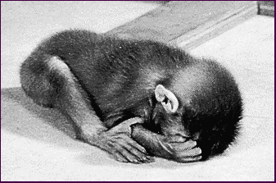
Harry Harlow
Wire mother who feeds the monkey
VS.
Cloth mother who does NOT feed the monkey
Who does the baby monkey go to?
Monkeys raised by artificial mothers were terror-stricken when placed in strange situations without their surrogate mothers.

Slide 29
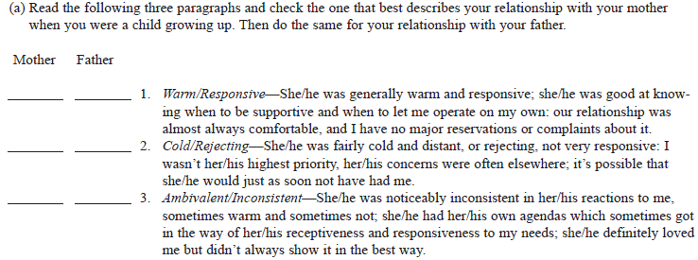
Attachment Styles to Your Parents
(15-16)

Slide 30
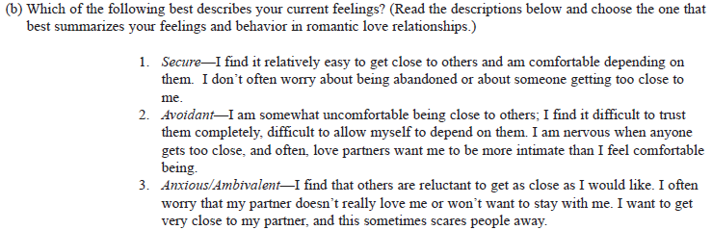

Slide 31
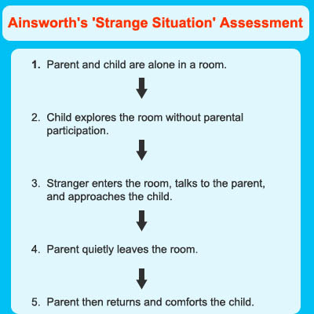
Mary Ainsworth’s
Strange Situation (1978)
12-18 month olds
Starts at about 2:30
another

Slide 32
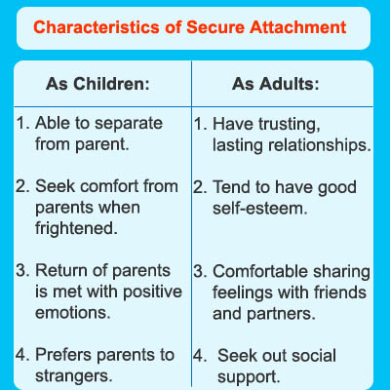
Ainsworth’s Conclusions – Secure
Secure Attachment (66%)
Confidently explore environment while parents are present
Distressed when parents leave
Come to parents when they return

Slide 33
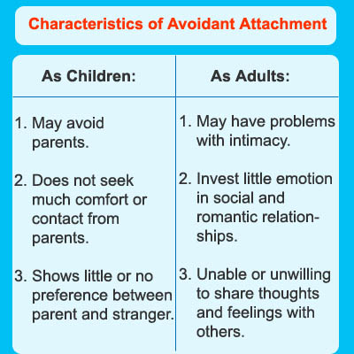
Ainsworth’s Conclusions – Avoidant
21%
Resist being held by parents
Explore novel stimuli regularly
Do not go to parents for comfort upon returning from an absence

Slide 34
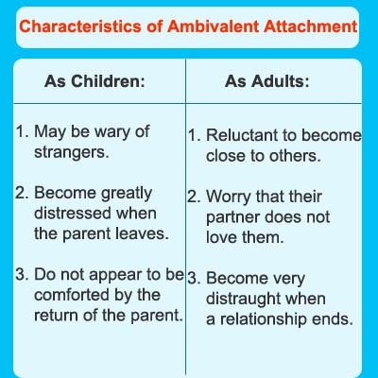
Ainsworth’s Conclusions – Anxious/Ambivalent
12%
Extreme stress when parents leave
Resist comfort upon return

Slide 35
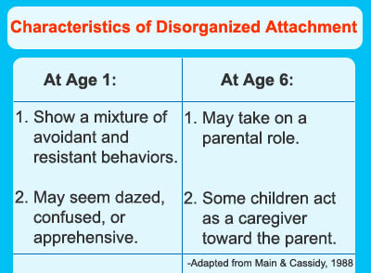
Ainsworth’s Conclusions – Confused / Disorganized
Confused attachment (1%)
Causes:
  Inconsistent parental behavior
  Parents who act as sources of both fear and reassurance
  Main & Solomon (1986)
  Main & Hesse (1990)

Slide 36
Predictive Value to
Attachment Styles
Any predictive value to attachment styles?
  Erik Erikson says basic trust—world is predictable and reliable
  Romantic love seems to reflect our styles as children
  Some decent correlation between murderers and abusive pasts…not causative!
  30% of those abused, abuse their children (4x higher than the national average)
  Trauma can leave footprints!

Slide 37
Still Face Experiment
Still Face Experiment

Slide 38
Parenting Styles – Baumrind (1991)
Authoritarian – “because I said so”
Highly demanding and directive, but not responsive
Strict standards
Punishments enforced for violations
Obedience valued more than rational discussion about rationale

Slide 39
Parenting Styles – Baumrind (1991)
Permissive (aka “indulgent”)
More responsive than demanding
Nontraditional, lenient – sure, you can do drugs
Do not require mature behavior – sure you can have a huge 100 person party at our house
Allow considerable self-regulation – sure, you find out if drugs are bad or not
Avoid confrontation – will clean up the mess after the party!

Slide 40
Parenting Styles – Baumrind (1991)
Authoritative – the one you want!
Demanding and responsive
Monitor and impart clear standards for their children’s conduct
Assertive, yet not intrusive and restrictive
Discipline is supportive, rather than punitive

Slide 41
Parenting Styles – Baumrind (1991)
Uninvolved
Low responsiveness and demandingness
Rejecting or neglecting behaviors

Slide 42
Handout 4-8
ME → 18
Permissive: 1,6,10,13,14,17,19,21,24,28
Authoritarian: 2,3,7,9,12,16,18,25,26,29
Authoritative: 4,5,8,11,15,20,22,23,27,30

Slide 43
Adolescent Development

Slide 44
Do parents matter? Moving Images 6

Slide 45
Pre-Test
Puberty = sexual maturation
  Boys: 13, girls: 11
BIG EVENTS:
Girls:
Breasts: 10
First menstrual period (menarche) (meh-NAR-key):12
  Almost all adult women recall it and remember it with mixed feelings (pride, excitement, embarrassment, apprehension, most discuss with mothers, but not fathers…if prepared for it, experience it as a positive life transition)
Boys:
  First ejaculation (spermarche): 14; most men remember it, usually occurring while sleeping

Slide 46
Lawrence Kohlberg’s Theory of Moral Development
The Dilemma

Slide 47
Moral Dilemma?
Should Heinz Steal the Drug? You discuss.
Level 1, Stage 1 – Obedience & Punishment Orientation
  It’s against the law
  It’s bad to steal b/c you’ll get punished
  PUNISHMENT “PROVES” DISOBEDIENCE IS WRONG
Level 1, Stage 2 – Individualism and Exchange
  There is more than 1 right view handed down by authorities; Diff ppl have diff views
  So, what is right? What meets self-interest?
  PUNISHMENT IS SIMPLY A RISK THAT ONE NATURALLY WANTS TO AVOID
Notes:
Handout: Kohlberg’s Stages of Moral Development

Slide 48
Level 2, Stage 3: Good Interpersonal Relationships
  “He was a good man for wanting to save her.”
  “No husbands should sit back and let their wives die.”
  Druggist was “greedy” and “selfish”
Level 2, Stage 4: Maintaining the Social Order
  From the perspective of society as a whole

Slide 49
Level 3, Stage 5: Social Contract and Individual Rights
  “What makes for a good society?” step back from their own society and consider what rights ought to be upheld
  Laws are social contracts, but the wife’s right to live is a moral right that must be protected
  Even if it was a stranger, same conclusion b/c it’s the “save a life” part that is most salient

Slide 50
Level 3, Stage 6: Universal Principles
  Take on the “veil of ignorance” of John Rawls
  More likely to condone civil disobedience in stage 6 than stage 5 b/c a commitment to justice makes the rationale for CD stronger and broader

Slide 51
Criticisms
Based on responses of boys = disregards gender differences in moral development
Carol Gilligan =
  Boys: more absolute view of what is moral
  Girls: pay more attention to situational factors
Gilligan’s ideas are not supported by the latest research

Slide 52
Sigmund Freud –
Psychosexual Development

Slide 53
Freud is Gross – Acronym??
ORAL (0-2) = pleasure = sucking; babies eat everything!
  Fixation = overeat, smoke, childlike dependence
ANAL (2-4)= control of elimination is pleasurable; toilet training
  Fixation = anal retentive or expulsive
PHALLIC (4-6)= genital stimulation is pleasurable; realization of gender
  Oedipus Complex = boys jealous of father’s relationship with mother
  Electra complex = girls jealous of mother’s relationship with father
  Fixation = problems in relationships
LATENCY (6-puberty)= calm, low psychosexual anxiety
GENITAL (puberty-adulthood)= maturation of sexual interests; sexual pleasure focused on genitals…fixation here is normal according to Freud

Slide 54
Erik Erikson’s –
Psychosocial Lifespan Development
The Goal is to “Resolve” each issue in a positive way

Slide 55
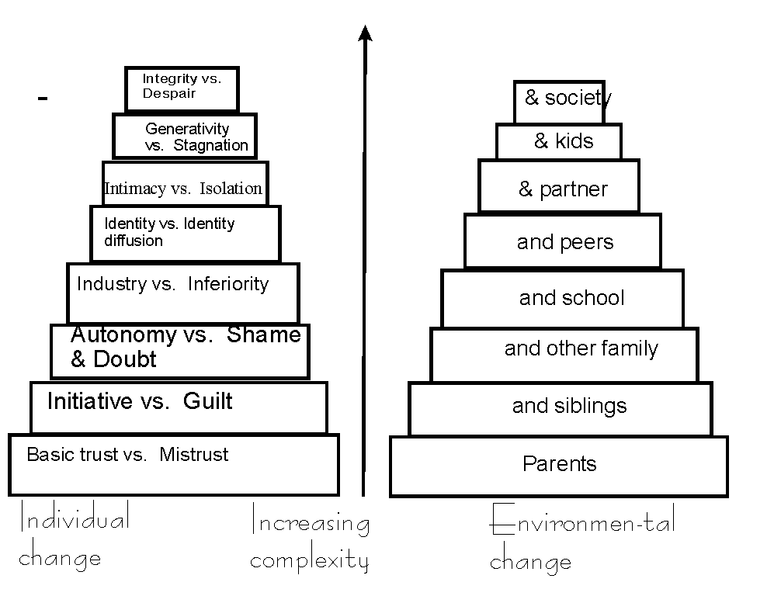
Switch autonomyshamedoubt and initiative vs. guilt

Slide 56
Stage 1 (birth - 1)
Infancy
Trust vs. Mistrust
Infants rely on others
Consistent = trust
Inconsistent = mistrust

Slide 57
Stage 2 (1-3 years)
Toddler
Autonomy vs. Shame and Doubt
Searching for Independence
Given the chance = sense of autonomy
Overly restrained or punished = shame and doubt

Slide 58
Stage 3 (3-5 years)
Preschool
Initiative vs. Guilt
Exposure to the broad social world
Accomplishment = initiative
Anxious or Irresponsible = guilt

Slide 59
Stage 4 (6 years – puberty)
Elementary School
Industry vs. Inferiority
Mastery of knowledge and intellectual skills
competence and achievement = leads to industry
incompetence and “nonproductivity” = inferiority

Slide 60
Stage 5 (teens – 20s)
Adolescence
Identity vs. Confusion
A sense of who one is
Positive identity
OR
identity confusion / negative identity

Slide 61
Stage 6 (20s to 40s)
Young Adulthood
Intimacy vs. Isolation
Sharing oneself with another
Commitment = intimacy
Failure to establish / keep commitments = isolation

Slide 62
Stage 7 (40s – 60s)
Middle Adulthood
Generativity vs. Stagnation
Caring for others in family, friends and work = contribution to later generations (Generativity)
Boredom and meaninglessness = Stagnation (stuck in life)
Daniel Levinson: 40s = mid-life crisis

Slide 63
Stage 8 (late 60s and up)
Late Adulthood
Integrity vs. Despair
Life has been good (all previous steps successfully resolved) = Integrity
Life has been incomplete = Despair

Slide 64
Handout 4-13: Erikson’s Stages
1 = reversed, then add it to 2, 3, 4, 5
7, 8, 9 all reversed, then add it to 6,10
12, 15 reversed, add to 11, 13, 14
16, 18, 19 reversed, add to 17, 20
21, 25 reversed, add to 22, 23, 24
26, 28, 30 reversed, add to 27, 29
31, 33 reversed, add to 32, 34, 35

Slide 65
Marcia’s Identity Formation
Handout 4-14

Slide 66
Gender and Development
(BRIEFLY, for real!)

Slide 67
Biopsychological (neuropsychological) Model
Nature vs. Nurture
Obvious biological differences between sexes
Some differences between male and female brains exist
  Corpus callosum is larger in women on average

Slide 68
Psychodynamic Theory
Gender Development = COMPETITION
Boys compete with fathers for mom’s attention
Girls do the same
Proper development = child realizes she or he cannot hope to beat same-sex parent at this competition, and SO identifies with that person (role modeling)
Impossible to verify empirically

Slide 69
Social-Cognitive Theory (Bandura)
Gilligan: Children’s play:
  boys in large groups with little intimate discussion, more competitive, avoid answering tough questions like “Do you have any idea why the sky is blue? (the male answer syndrome)
  girls in small groups, often with 1 friend, less competitive, more open to feedback
Teens
  Girls: more time with friends, less time alone, interdependence, use conversation more to explore relationships
  Boys: use conversation to communicate solutions

Slide 70
Adulthood

Slide 71
Life Expectancy:
  1949: 49 years 1960 – 70
  1995 – 75 2007 – 78 (M=75.6, 80,7)
  Along with declining BR = larger % of total pop
Ratios:
  Embryos: 126 males: 100 females
  Birth: 105 males: 100 females
  Women outlive men by 4 years worldwide, and by 5-6 years in Canada, U.S., and Australia
  By age 100, females outnumber males 5 to 1
Notes:
http://en.wikipedia.org/wiki/List_of_countries_by_life_expectancy

Slide 72
WHY do we age??
1 theory: evolutionary explanation
  Once we have fulfilled our gene-reproducing task, there are no natural selection pressures against “genes that cause degeneration” later in life

Slide 73

Conflicting Results
24
20
In a study by Schonfield & Robertson (1966), the ability to recall new information declined during early and middle adulthood, but the ability to recognize new information did not.
Number
Of words
remembered
Number of words
recognized is
stable with age
16
12
8
Number of words
recalled
declines with age
4
0
20
30
40
50
60
70
Age in years

Slide 74
Conflicting Results
Cross-sectional method
suggests decline
60
Reasoning
ability
score
55
50
Longitudinal method
suggests more stability
45
40
35
25
32
39
46
53
60
67
74
81
Age in years
Cross-sectional method
Longitudinal method

Slide 75
Adulthood- Cognitive Development
105
Verbal scores are
stable with age
Intelligence
(IQ) score
100
95
90
85
Nonverbal scores
decline with age
80
75
20
25
35
45
55
65
70
Verbal scores
Age group
Nonverbal scores

Slide 76
Kubler-Ross’s
Death and Dying Stages

Slide 77
1969 – On Death and Dying
Denial --
Anger – Why me? It's not fair!" "NO! NO! How can this happen!"
Bargaining – "Just let me live to see my children graduate."; "I'll do anything, can't you stretch it out? A few more years."
Depression
Acceptance

Slide 78
Death and Dying
Kubler-Ross’s stages
Misconceptions…the following are facts:
  Strong grief early DO NOT purge their grief more quickly
  After a death, men are more at risk for ill-health than women, but not b/c women are better at expressing their grief
  Terminally ill ppl DO NOT go through predictable stages
Erikson: integrity…

Slide 79
Psych Sim 5.0
Who Am I?
Aging

Slide 80
The Difference between attachment and bonding
http://video.google.com/videoplay?docid=4722233896848153892&q=Attachement+Theory&total=19&start=0&num=10&so=0&type=search&plindex=3

