Slide 1
After Previous Test
Freud’s Interpretation of Dreams (video/book)…so, let’s watch the movie!!!
Sleep Log: stuff to put in one:
http://www.alive.com/3649a1a2.php?subject_bread_cramb=128
SLEEP LOG HANDOUT:
https://www.healthatoz.com/ppdocs/us/cns/content/atoz/tl/misc/sleeplog.pdf

Slide 2
Thinking Question:
Which drugs, if any, should be illegal? What characteristics of a particular drug or its use do you believe push it over the edge into the illegal range?

Slide 3
Thinking Question:
Describe your sleeping habits…
What is the average amount of sleep (in hours) that you get during a weeknight? weekend?
When you crawl into bed, how long does it take on average before you fall asleep?
Do you nap? How frequently? How long?
What else can you say about your sleeping habits?

Slide 4
Thinking Question:
Do you believe that hypnosis is for real? Explain what happens / why it happens in your own words.
Do you have any personal experiences with hypnosis or other “mind control” techniques?

Slide 5
Levels of Consciousness Sleep, Hypnosis, Drugs
Andy Filipowicz
AP Psychology
Ocean Lakes High School

Slide 6
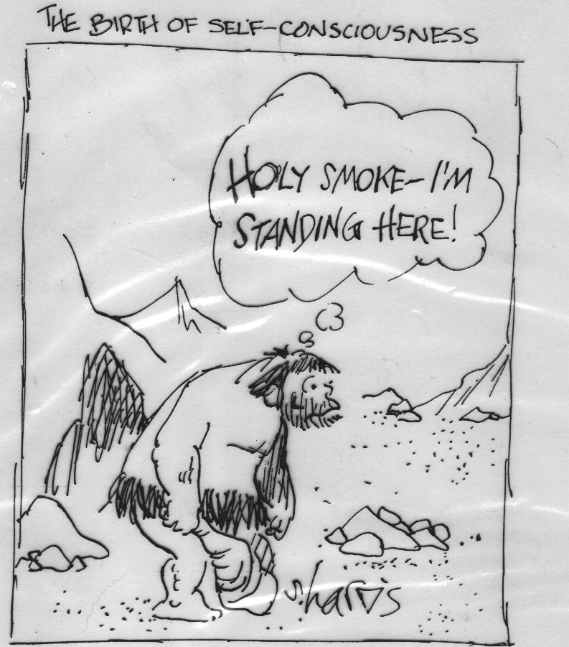

Slide 7
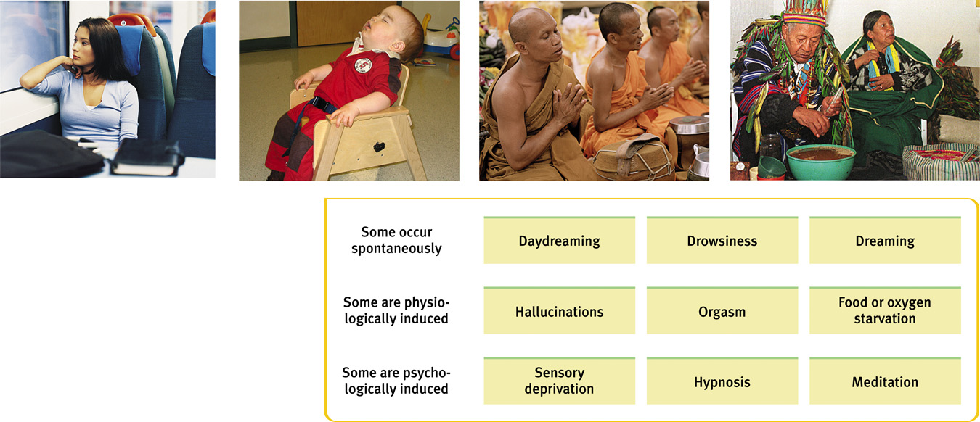
Consciousness and Information Processing

Slide 8
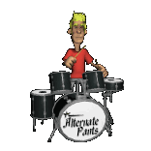
5 Levels of Consciousness
Conscious– What I say, do, think, perceive, feel RIGHT NOW
Nonconscious– heartbeat, respiration, digestion
Preconscious– info about you and environment that you are NOT currently aware of, but could be…
“What was your favorite childhood toy?” that preconscious memory could be brought into your conscious level
Subconscious– info we are not currently aware of but know must exist
Priming – why do we like a list of words presented earlier (mere exposure effect)
Blindsight…think back to perception…?
THE MIND #9 – Studying Unconscious Through Subliminal Perception
Unconscious– psychoanalytic term for the events and feelings that are unacceptable to our conscious mind and that are repressed into this storage area

Slide 9

Sleep & Dreams
Biological Rhythms
The Rhythm of Sleep
Why do We Sleep?
Sleep Disorders
Dreams

Slide 10
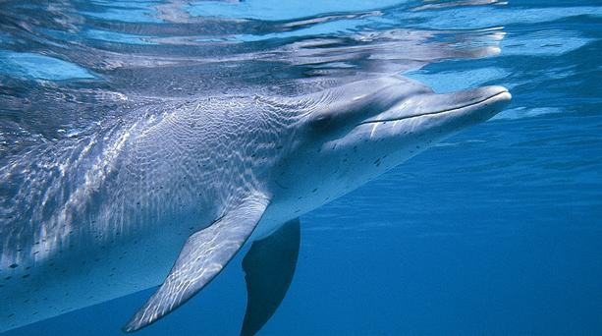
Fig. 7.1 Not all animals sleep, but like humans, those that do have powerful sleep needs. For example, dolphins must voluntarily breathe air, which means they face the choice of staying awake or drowning. The dolphin solves this problem by sleeping on just one side of its brain at a time! The other half of the brain, which remains awake, controls breathing (Jouvet, 1999).

Slide 11



Circadian (roughly 24hr cycle) Rhythms
Circa Diem in Latin = “about a day”
With light & alarm clocks, about 24 hours; otherwise, it’s 25 hours (so, our bodies naturally respond to the cues of the sun and tend to work on a 24 cycle…but if isolated from light and other cues, we would revert to a 25 hour schedule of sleep)
(http://healthlink.mcw.edu/article/922567322.html, 2007)
Most people experience at least two peaks in mental alertness:
morning around 9:00 or 10:00 and 8:00 or 9:00 PM. (take tests here!)
Slumps in your mental alertness occur at about 3:00 PM and 3:00 AM.
DEFINED: Natural variations we experience daily in our consciousness as a part of our sleep-wake cycle.
Brain 13: “Sleep and Circadian Rhythms”
?What might be some other circadian rhythms besides sleep?

Slide 12
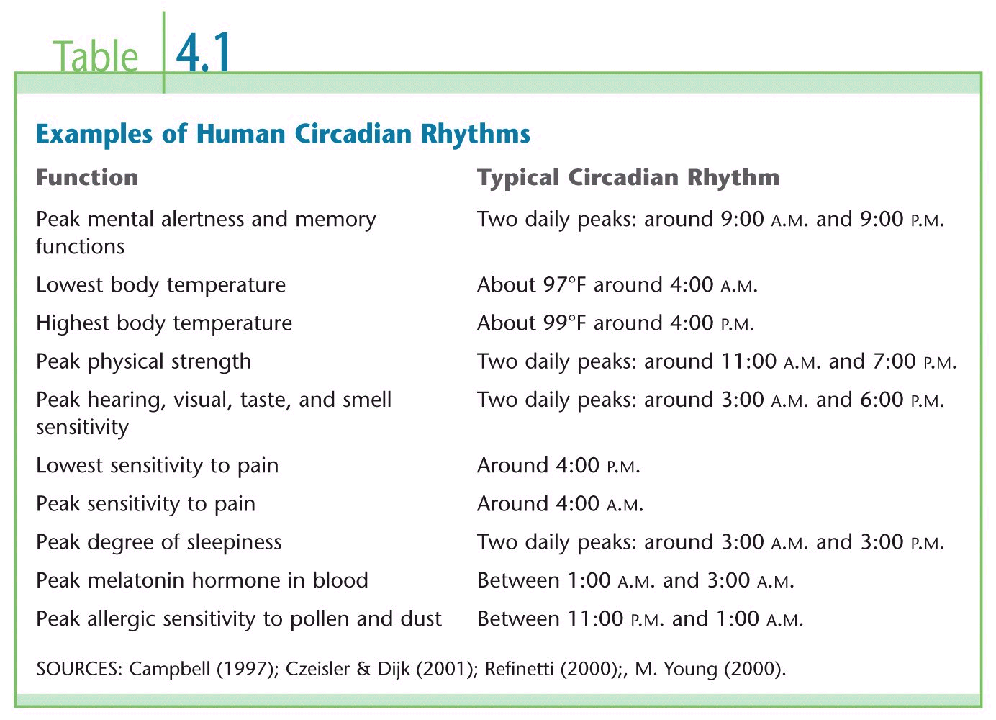



Slide 13
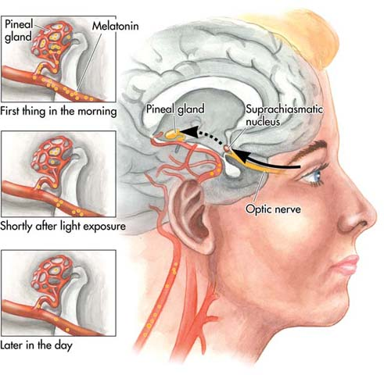
The Body’s Clock
Suprachiasmatic nucleus (SCN)—cluster of neurons in the hypothalamus that governs the timing of circadian rhythms
Melatonin—hormone of the pineal gland that produces sleepiness

Slide 14
The Body’s Clock: How it works
Special photoreceptors in the retina regulate the effects of light on the body’s circadian rhythms
In response to morning light, signals from these special photoreceptors are relayed via the optic nerve to the suprachiasmatic nucleus.
In turn, the suprachiasmatic nucleus causes the pineal gland to reduce the production of melatonin, a hormone that causes sleepiness.
As blood levels of melatonin decrease, mental alertness increases.
Daily exposure to bright light, especially sunlight, helps keep the body’s circadian rhythms synchronized and operating on a 24-hour schedule.

Slide 15
How Melatonin works:
More melatonin = sleepy and reduce activity levels (between 1-3 AM)
Less Melatonin = more alert and active. Body stops produced melatonin shortly before sunrise and sunlight suppresses melatonin levels throughout the day
Jet Lag – Since your body is still operating on the time you left from, your melatonin levels will be off causing a disruption in your circadian rhythms and making you mentally fatigued, depressed, irritable and have problems sleeping.
Worse when flying from west to east (if waking at 7am in Virginia, it’s like 4am to your body if you’re from California)
Rotating shifts is similar, better to rotate forwards – work 0800 -1600 the first week, then 1600-2400 the next week, then 0000-0800 the third week)
Night workers will always have some problems due to sunlight resetting their biological clock. Some major health issues could occur
See Article: “Surviving the Night Shift” & “How to Beat Jet Lag”

Slide 16

Sleep Patterns
Afternoon Naps:
Americans average 1-2 naps/week
¼ never nap, 1/3 nap 4-5/week
Most common among college students and retirees (schedules allow it!)
Between 30-90 minutes
Pons regulates sleep cycles; serotonin involved
Might be natural to nap
Isolated volunteers slept 2x a day
At night
12 hours after their heaviest sleep of the night

Slide 17
Waves
Alpha = awake, relaxed, eyes closed, not engaged in focused thought
High amplitude, regular waves
Beta = focused thinking, perception, arousal
Irregular, fast, low amplitude
Delta = Stage ¾
Slow, irregular, high amplitude

Slide 18
Stage One
This is experienced as falling to sleep and is a transition stage between wake and sleep.
It usually lasts between 1 and 5 minutes and occupies approximately 2-5 % of a normal night of sleep.
eyes begin to roll slightly.
brief periods of alpha waves, similar to those present while awake
Hallucinations can occur and feeling of falling.

Slide 19
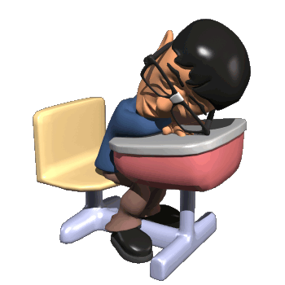
Stage Two
This follows Stage 1 sleep and is the "baseline" of sleep.
This stage is part of the 90 minute cycle and occupies approximately 45-60% of sleep.

Slide 20
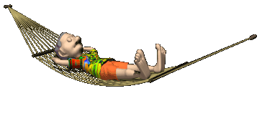
Stage Three & Four
Stages three and four are "Delta" sleep or "slow wave" sleep and may last 15-30 minutes.
It is called "slow wave" sleep because brain activity slows down dramatically from the "theta" rhythm of Stage 2 to a much slower rhythm called "delta" and the height or amplitude of the waves increases dramatically.

Slide 21
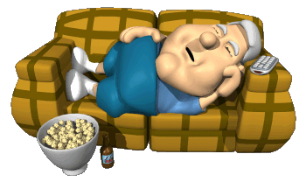
Stage Three and Four (continued)
Contrary to popular belief, it is delta sleep that is the "deepest" stage of sleep (not REM) and the most restorative.
It is delta sleep that a sleep-deprived person's brain craves the first and foremost.
In children, delta sleep can occupy up to 40% of all sleep time and this is what makes children unawake able or "dead asleep" during most of the night.

Slide 22

REM SLEEP
REM: Rapid Eye Movement
This is a very active stage of sleep.
Composes 20-25 % of a normal nights sleep.
Breathing, heart rate and brain wave activity quicken.
Vivid Dreams can occur.
1, 2, 3, 4, 3, 2, REM … 2, 3…

Slide 23

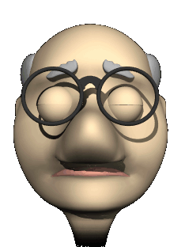
REM
Body is essentially paralyzed during REM.
Genitals become aroused. Erections and clitoral engorgement.
“Morning Erections” are from final REM stage.
A typical 25 year old man has an erection during half of his sleep.
A 65 year old- one quarter.

Slide 24
Brain Control of Sleep Patterns
Anterior Hypothalamus
Electrical stimulation → causes alert animals to fall asleep
Lesions → prevent sleep, eventual death
Pons
Initiates shifts between Deep Sleep and REM
Lesions will cause cats to move around, strike, and bite during REM

Slide 25
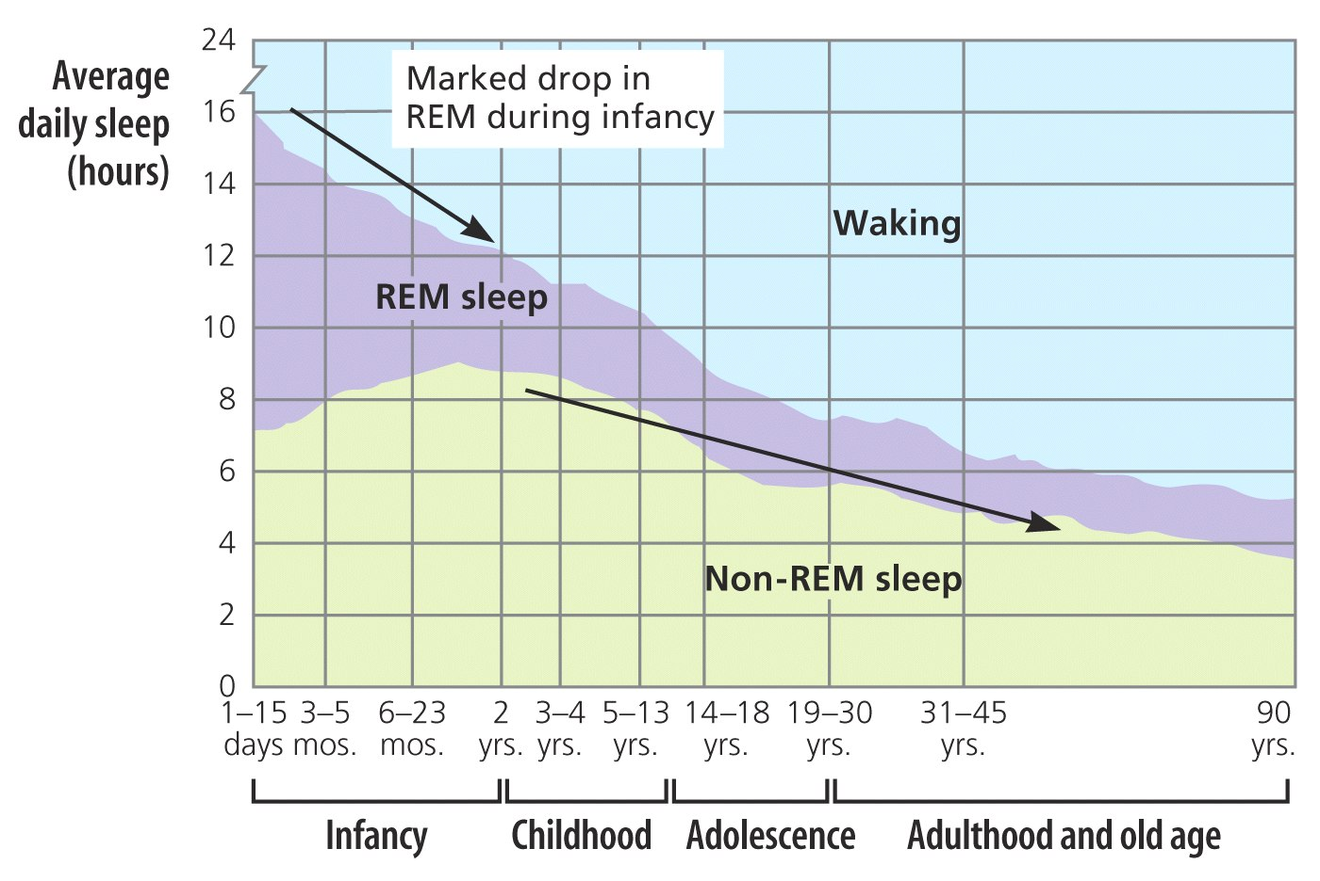
Sleep Changes through Life
NEED2KNOW:
There is a negative correlation between time spent in REM sleep and age.

Slide 26
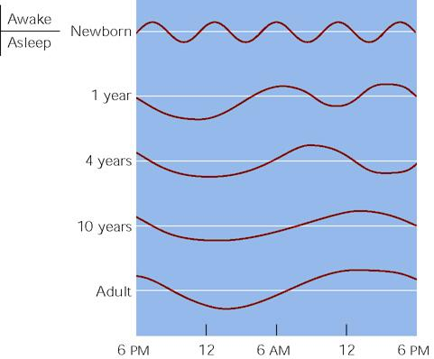
Fig. 7.3 Development of sleep patterns. Short cycles of sleep and waking gradually become the night-day cycle of an adult. While most adults don’t take naps, mid-afternoon sleepiness is a natural part of the sleep cycles. (After Williams et al., 1964.)

Slide 27
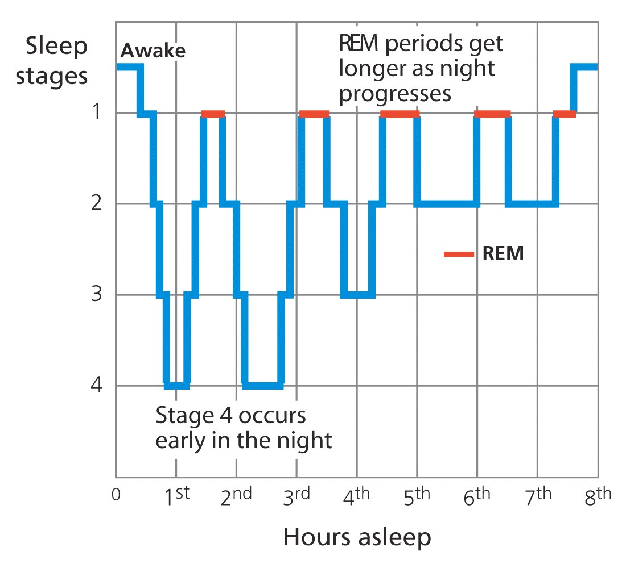
Stages of Sleep
Psych Sim 5: Stages of Sleep (start at 7)
Handout Stages of Sleep
Overhead of EEGs
REM vs. NREM
90 minute cycle, repeated 5-6/night
1,2,3,4,3,2,REM, 2,3,4,3,2,REM
REM aka “Paradoxical Sleep”
Brain 14 “Brain Functions”

Slide 28
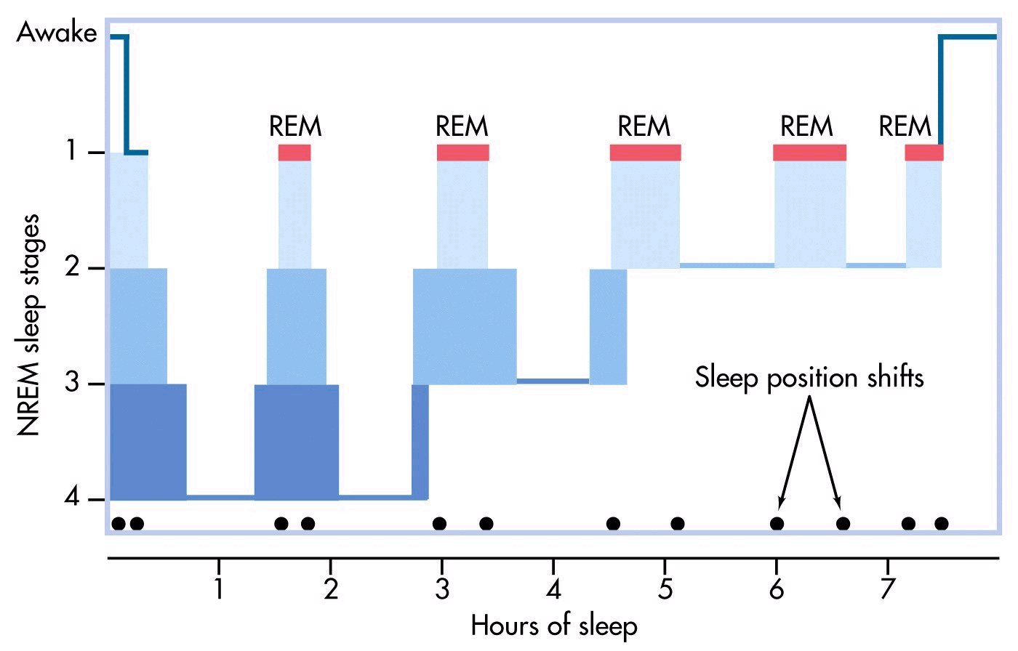
Notice the Sleep Position Shifts
Notes:
DiscPSY Figure 4.2 p. 132

Slide 29
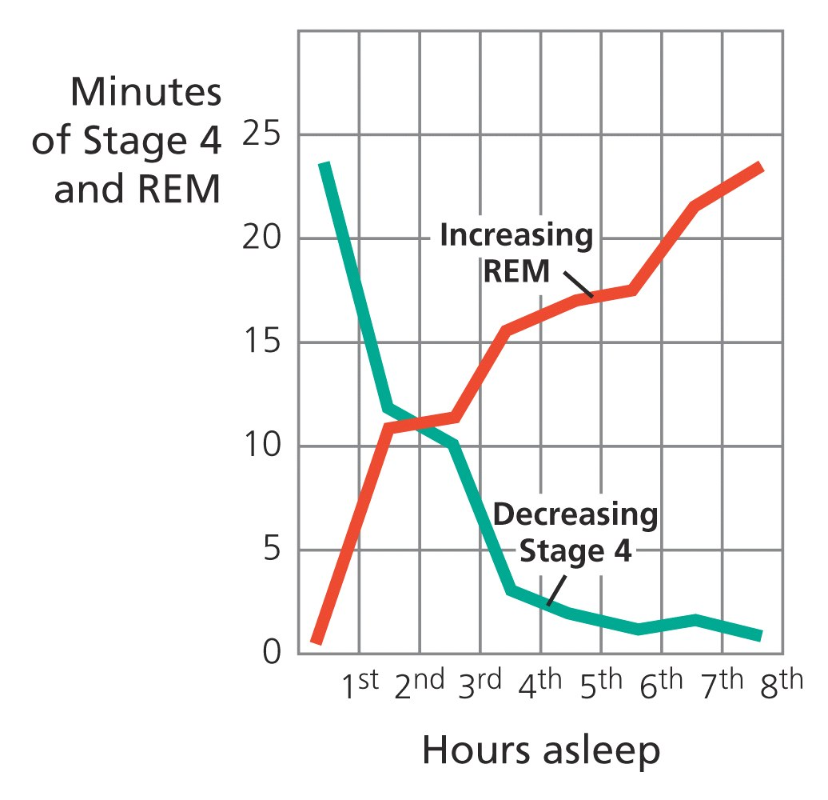
Stage 4/REM Changes

Slide 30

Why Do We Sleep?
Roughly 1/3 of our lives sleeping (25 years)
Most people need 8-8.5 hours of sleep to function but most Americans sleep 7-7.5 hours. Almost 1/3 of Americans get less than 6 hours. 74% women sleep less than 8 hours a night.
Article: “Are you a Walking Zombie?’
Most teens need 9 hours and 15 minutes of sleep a night. Average teenager's biological clock doesn't prepare them to awaken until 8 or 9 AM. This can interfere with memory and learning.
UH-OH!!! What does this mean for YOU!
Students who sleep the most do better on grades & exams.

Slide 31
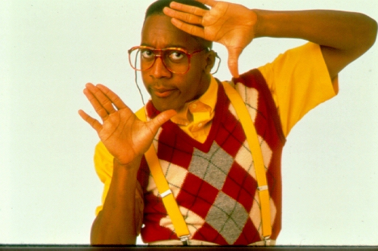
Purpose of REM / Sleep
All mammals require sleep…
All Animals?
Mammals and Time Spent in “Sleep”
Dreams occur here in more detail than any other stage
Seems to consolidate memory
REM deprivation will cause subjects to have REM rebound in which they spend more time in REM sleep in an effort "catch up."
more Daily Stress = more REM
Bolsters immune system by increasing antibodies
Endocrine system replenishes hormones (pituitary gland)
Article: “Sleepless society…”
Read Articles:
“Sleep Deprived Children…”
“Sleep Deprivation can Pack on the Pounds”

Slide 32
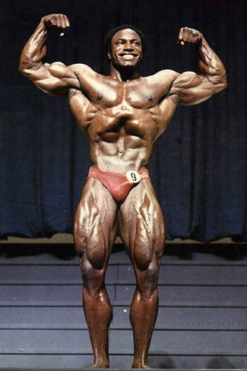
Functions of Sleep
Restoration theory—body wears out during the day and sleep is necessary to put it back in shape
NREM sleep sees increases in the release of growth hormone, testosterone, prolactin.
REM sleep plays a role in rate of brain development that occurs in the early stages of the lifespan.
Exercising of neural circuitry not used during the day
Evidence for consolidation of perceptual-motor (nonverbal) memories
Adaptive theory—sleep emerged in evolution to preserve energy and protect during the time of day when there is little value and considerable danger
Hibernation occurs during the time of year most hazardous to the animal.
Counter Argument: Animals with few natural predators sleep the most while animals with many sleep less.
New Ideas – Creative thinking
Notes:
Keywords: restoration theory, preservation and protection theory

Slide 33
How Long Can Humans Stay Awake?
About 11 days! – 17 year old in 1965 science fair project
Deprivation = Progressive, significant deterioration in concentration, motivation, perception, other higher mental processes
Article: “Sleep Deprivation can Pack on the Pounds”
No serious medical / psychiatric problems
All recovered to normal functioning within a day or two
Rats sleep deprived for 2 weeks die
FFI (11)

Slide 34
Sleep and Memory
Group | Trained | Tested | Performance
Control | 9am | 10am | 54%
Exp 1 (sleep after testing) | 9am | 9pm | 10%
Exp 2 (sleep after training) | 9pm | 9am | 19%
Exp 1AGAIN |  | 9am next day | 19%!
What can we conclude from this? (10-11, Wehr)

Slide 35
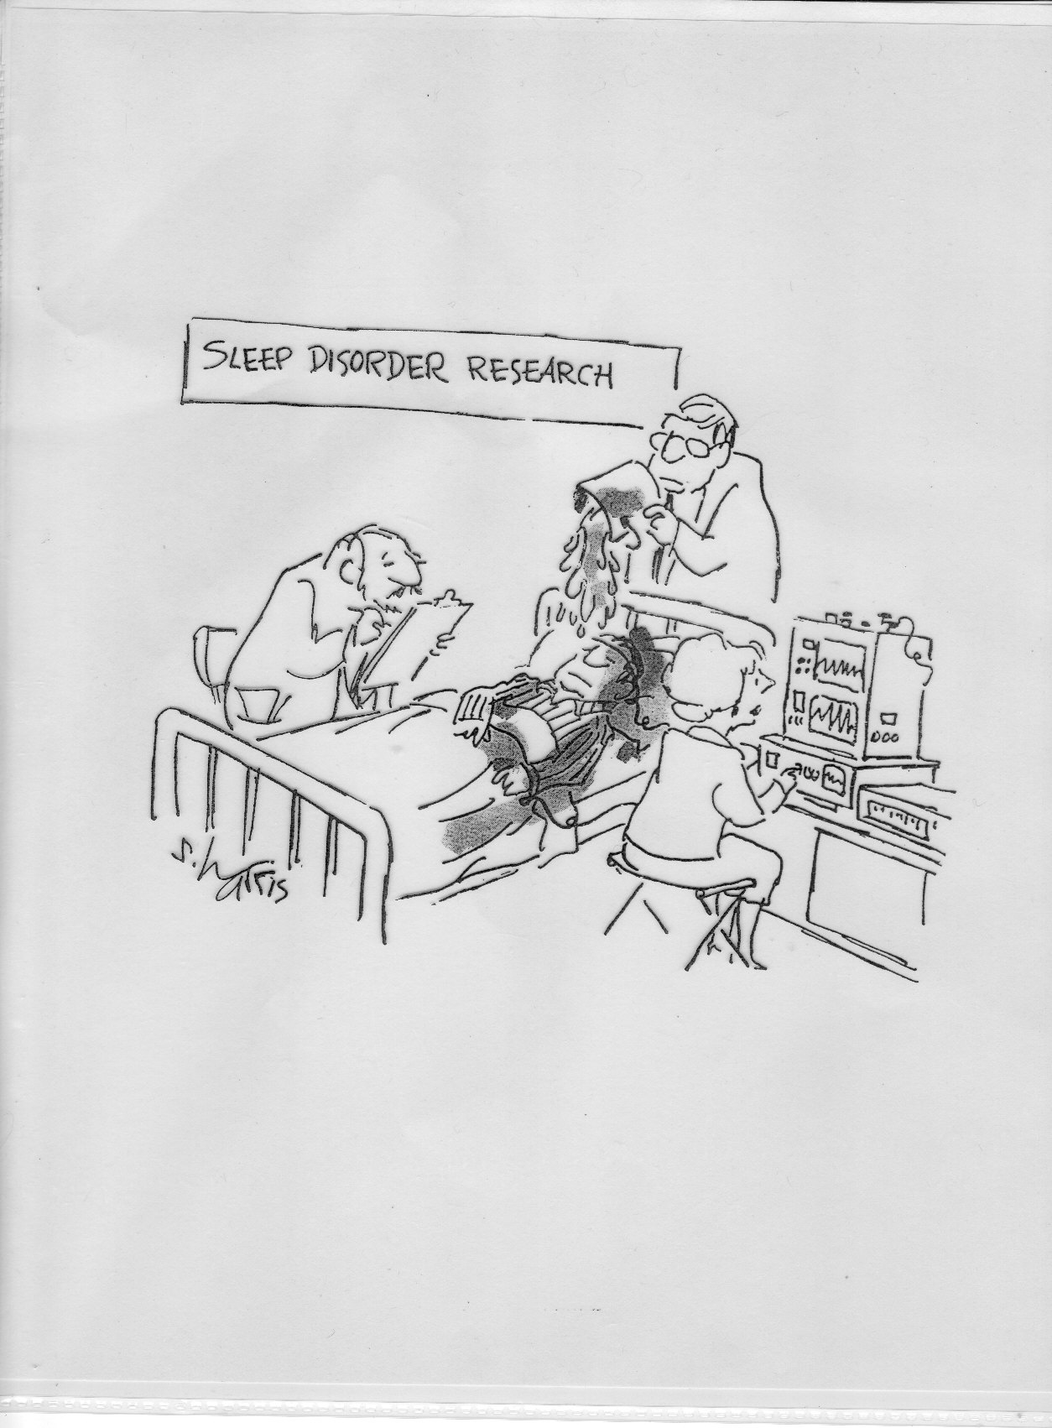
Notes:
http://www.sleepdisordersguide.com/ ← Great resource for many more sleep disorders as well.

Slide 36
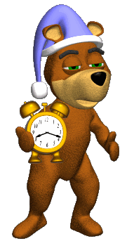
Sleep Disorders – Insomnia
DEFINED – trouble falling or staying asleep
Causes of cases:
50% = chronic anxiety, depression, situational stress, and stimulus overload
10% = drugs (caffeine, alcohol, nicotine)
10% = medical problems (emphysema)
30% = no apparent reason…treat with behavioral techniques, sometimes meds
2000-2006 = 60% inc in sleeping pills
Reduces REM sleep
Notes:
http://www.webmd.com/sleep-disorders/guide/parasomnias

Slide 37
Restless Leg Syndrome
Usually the calf area, but anywhere
Creates an urge to walk around or move the legs, impairing one’s ability to sleep
RLS Foundation
Statistics

Slide 38
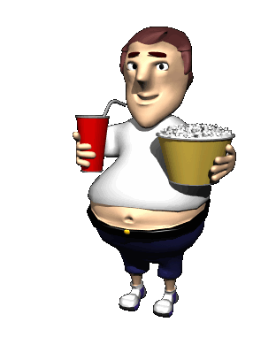
Sleep Disorders – Sleep Apnea
“cessation of respiration”
2 Forms:
Obstructive Sleep Apnea: breathing blocked by loss of muscle tone in the tongue, throat, and larynx (more common)
Central Sleep Apnea: diaphragm stops moving b/c brain stops sending impulses to control it
Excessive, un-patterned snoring, elevated blood pressure
May awaken up to 500x in a night!
SIDS might be the same thing
Occurs mostly in men
Many don’t even know they have it
Main symptom: excessive daytime sleepiness
Others: morning headaches, trouble concentrating, forgetfulness, mood or behavioral changes, anxiety, depression,

Slide 39
Sleep Disorders – Night Terrors
occur within 2 or 3 hours of falling asleep, during Stage 4
high arousal-- appearance of being terrified, about 10-30 minutes on average, potentially longer (40 minutes)
NOT “dreaming”, no memory afterwards
Trace memory maybe, feeling of being chased, trapped
Seems to run in families (sleepwalking goes hand in hand)
20/20 Video on Night Terrors
Article: “Night Terrors: Recognizing…”
Ages 4-6 most prone, 1-8 is general range
As many as 15% of children experience this at least once, low estimate is 2%
Correlates = stress, lack of sleep
Harmless generally, episodes will end on their own
Like a fight or flight response while sleeping
Trying to wake child not advised, b/c it tends to prolong it
Can determine when they most likely occur, wake child 15 minutes prior to this, then return to bed

Slide 40
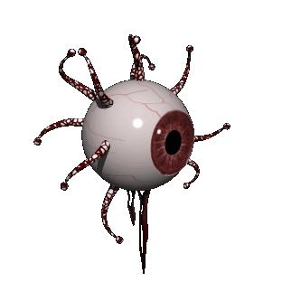
Sleep Paralysis
Aka “Incubus attack” or the “Hag Phenomenon
Up to 20-40% of people experience at least 1 episode
Usually less than 2 minutes

Slide 41
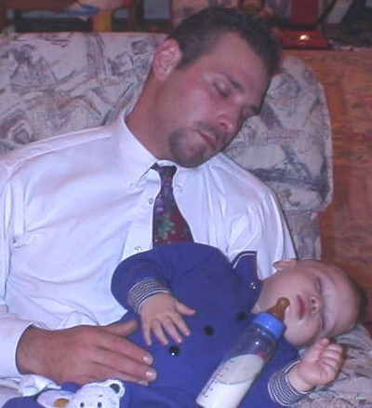
Sleep Disorders – Narcolepsy
uncontrollable sleep attacks
See Narcolepsy
0.03-0.16 % of the population / 1 in 2000
1st episode between ages 15-30, affects men and women equally
Suddenly fall into REM sleep can be treated with medication (SSRIs, modafinil for EDS) and changing sleep patterns (take naps at regularly scheduled times of day)
Cataplexy (sudden loss of muscle tone), vivid hallucinations upon wakening
Usually not diagnosed until 10-15 years after 1st episode
Tends to decrease in severity after age 60
75% of patients reported falling asleep while driving at least once
Obvious problems with memory and attention
Correlates = migraines, obesity, depression (30-57%)
Cause = abnormal NT, hypocretin/orexin (working in the hippocampus), damage to amygdala,

Slide 42
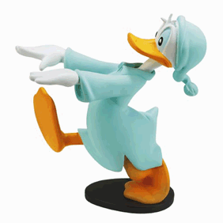
Sleepwalking (Somnambulism)
Sleepwalking is a sleep disorder affecting an estimated 10 percent of all humans at least once in their lives.
Another study – 17% in children, peaks at age 12
Another study – 4% in adults
Slightly more common in boys
Sleep walking most often occurs during deep non-REM sleep (stage 3 or stage 4 sleep) early in the night.
Avg of 1-30 minutes
Cause – unknown
Correlates = pregnancy, menstruation

Slide 43
Of What Do We Dream?
1650 College students
Commonplace
Familiar settings
In the company of someone they know
Aggressive > Friendly
Misfortune/failure > Success
Apprehension is the most common emotion
Sexual content in only 12% of males and 4% of females
See my page. 14
US. vs. Argentinean, Brazilian
Americans: more on animals and food,
South Americans: more on sexual and emotionally-related stuff
Regionally
NE = images of time, activity, streets, architecture
Southerners = nature, good fortune, emotion, family members
Gender Gaps
Men: aggression, tools
Women: children, clothes, food, friendly interactions
CONCLUSION = Dreams reflect our waking lives

Slide 44
Why do we Dream?
Three Theories

Slide 45
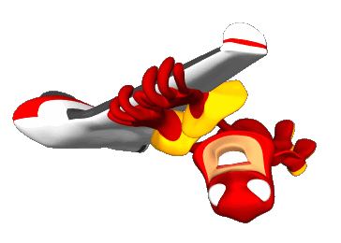


Dreams: Freud
Sigmund Freud--The Interpretation of Dreams (1900)
Dreams are the “ROYAL ROAD TO THE UNCONSCIOUS”
wish fulfillment – satisfaction of libido, other desires
discharge (release) otherwise unacceptable feelings

Slide 46
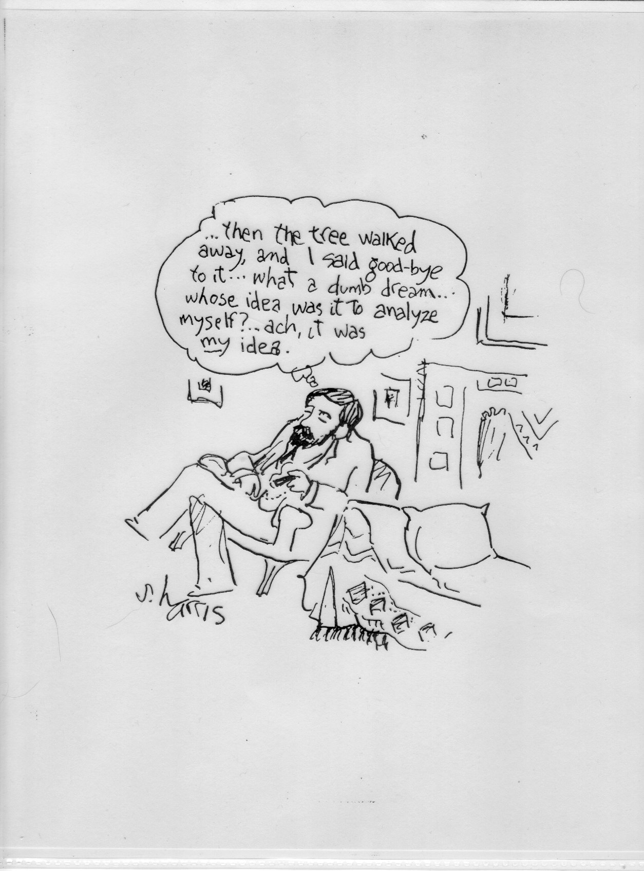

Slide 47
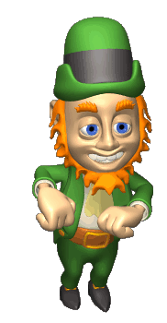
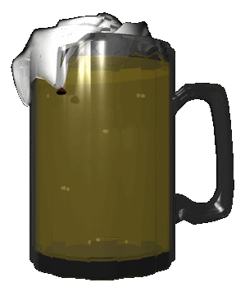
Freud’s Wish-Fulfillment Theory
Dreams are the key to understanding our inner conflicts.
Ideas and thoughts that are hidden in our unconscious.
Manifest and latent content

Slide 48
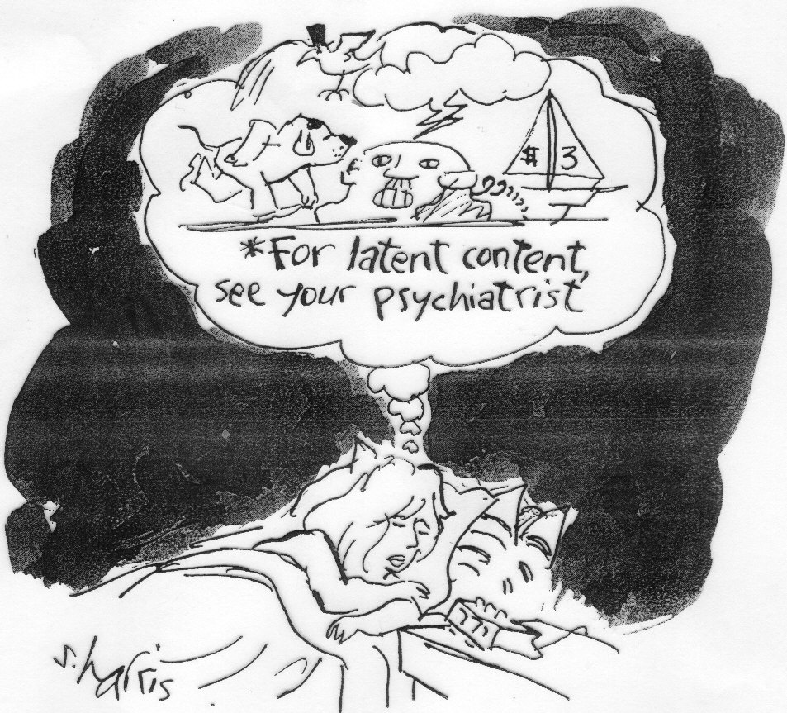

Slide 49
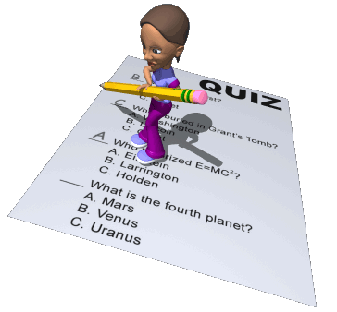
Information-Processing Theory
Dreams act to sort out and understand the memories that you experience that day.
REM sleep does increase after stressful events.

Slide 50
Dreams -- As Information Processing
helps facilitate memories
Stress = larger # of and intensity of dreams
Dreams seem to relate to daily concerns
Brain is basically dealing with stress during REM dreams
Mind integrates info from the day into our memories
Babies need more sleep b/c of all the new info they get every single day
REM Rebound
REM sleep increases following REM sleep deprivation

Slide 51
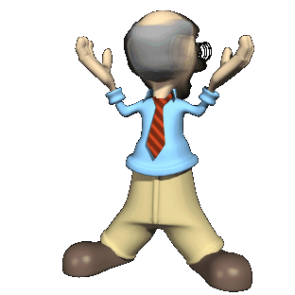
Physiological Function Theories
Activation-Synthesis Theory:
during the night our brainstem produces random neural activity, dreams may be a way to make sense of that activity.

Slide 52
Assignment
Handout 7-10 (my page 16):
DO NOT LOOK AT…
15 minutes b4 bed LOOK and attempt to solve…
ONLY 15 minutes and no more…
then go to sleep
If you haven’t solved it, try again for another 15 minutes the next morning when you wake up.
Come to class ready to talk about your experience

Slide 53
Hypnosis

Slide 54
Hypnosis
Highly focused attention (on hypnotist)
Increased responsiveness to suggestion
Vivid imagery
Willingness to accept distortions of logic
People do NOT lose control of their behavior. Instead, they remain aware of where they are, who they are, and what is transpiring.

Slide 55
Hypnosis – Role Theory
Hypnosis is not an altered state of consciousness at all
Aka Social Influence Theory
Some people are more susceptible to hypnosis than others
Richer fantasy life
Follow directions well
Able to focus intensely on a single task for a long period of time
Perhaps then people are acting out the role of a hypnotized person

Slide 56
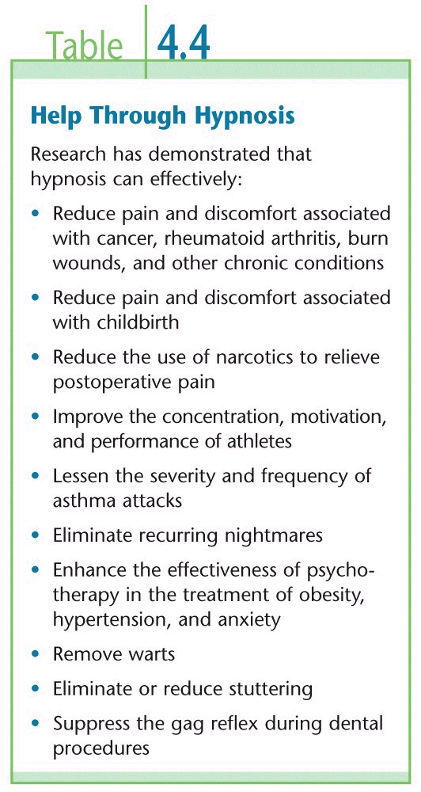
Hypnosis – State Theory
More or less aware of our environments
Dramatic health benefits possible (pain control, specific ailments)

Slide 57

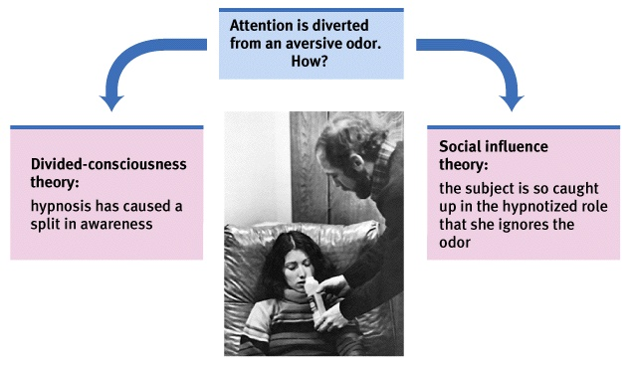
Explaining Hypnosis

Slide 58
Hypnosis – a 3rd Way
Dissociation
a split in consciousness
allows some thoughts and behaviors to occur simultaneously with others
The Mind #2 – Hypnotic Dissociation and Pain Relief
Hilgard’s Dissociation Theory
Hidden Observer
Hilgard’s term describing a hypnotized subject’s awareness of experiences, such as pain, that go unreported during hypnosis
Causes our consciousness to divide voluntarily
1 part responds to hypnotist
1 part retains awareness of reality
Put your arm in an ice bath…if hypnotized, will not report pain, but if asked to raise index finger if pain is felt, most will

Slide 59
Some Conclusions
Experiencing hypnosis does not mean you are gullible or weak
Participants retain ability to control their behavior during hypnosis…they are aware of their surroundings
Spontaneous posthypnotic amnesia is rare
It is not dangerous
It does not increase the accuracy of memory
It does not foster a literal re-experiencing of childhood events

Slide 60
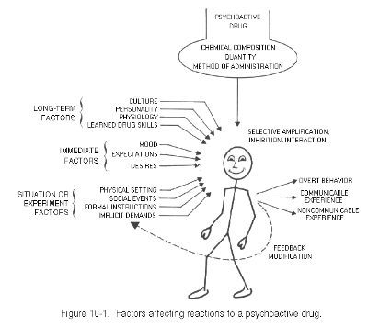


Drugs
Notes:
http://www.whitehousedrugpolicy.gov/publications/factsht/druguse/
Survey:
http://whqlibdoc.who.int/offset/WHO_OFFSET_50.pdf

Slide 61
The Blood Brain Barrier
Blood vessels deliver stuff to the brain
Blood vessels are made from semi-permeable flat, thin, living tissue (endothelial cells…skinnish)
Vessels are leaky enough to let out certain stuff (anything under 500 Daltons)
The BBB is a collection of these endothelial cells folded on themselves (“tight junctions”)
H2O is 18 Daltons, Insulin is 5,000 Daltons
So, big chemicals, viruses, bacteria generally don’t get in
98% of all known CNS drugs actually weigh more than 500 Daltons, so we have a big problem!!
We have drugs that we can’t use for Alzheimer’s, Huntington’s, strokes, brain cancers
We have drugs we CAN use for epilepsy, chronic pain, schizophrenia, mood disorders such as depression
All the psychoactive drugs we know about happen to get through!
(http://www.abc.net.au/science/k2/moments/s981339.htm , 2007)

Slide 62
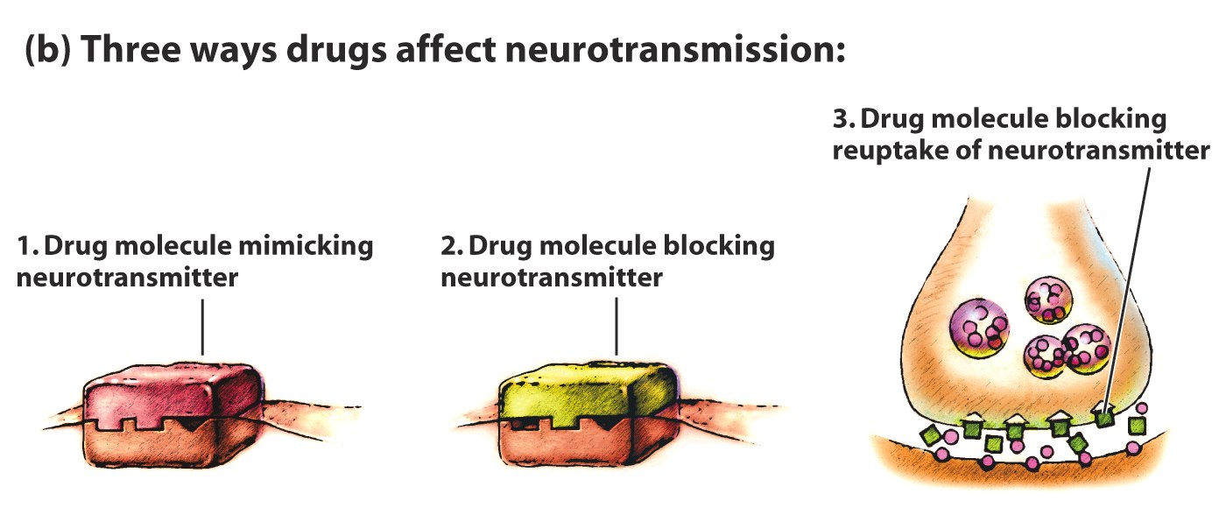
How Them Drugs Do Their Thing?
Binding with receptor sites (mimics)* = AGONIST
Blocking receptor site = ANTAGONIST
Blocking neurotransmitters’ reuptake*
WHICH 2 OF THESE INCREASE THE
LIKLIHOOD OF RECEIVING NEURON FIRING?

Slide 63
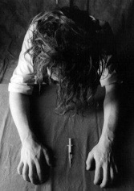
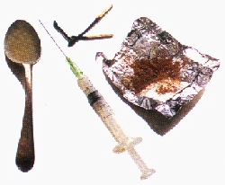
Dependence and Addiction
Big
effect
Tolerance
diminishing effect with regular use
Reverse tolerance – some drugs stay in body for weeks (hallucinogens)…2nd dose may be less than the 1st, but may produce same or greater effects
Withdrawal
discomfort and distress that follow discontinued use
Drug
effect
Response to
first exposure
After repeated
exposure, more
drug is needed
to produce
same effect
Little
effect
Small
Large
Drug dose

Slide 64
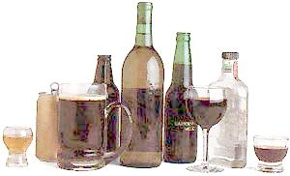
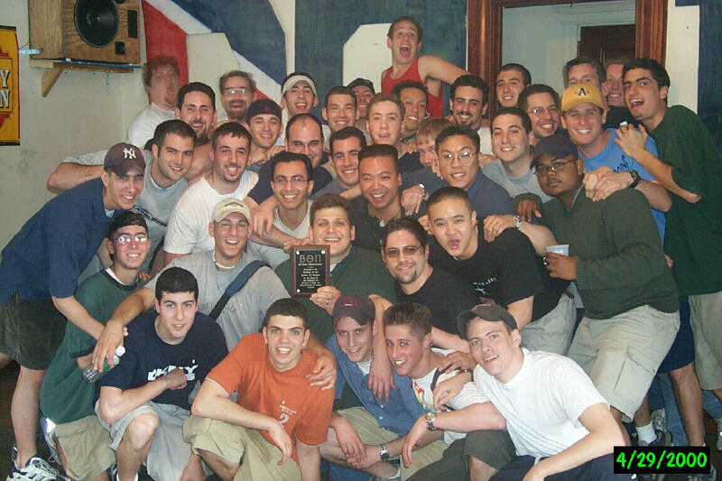
Depressants: Alcohol
Slows down sympathetic nervous system.
Disrupts memory processing.
Reduces self-awareness.
Involved in up to 60% of all crimes.
The worst drug from a macro perspective out there.

Slide 65
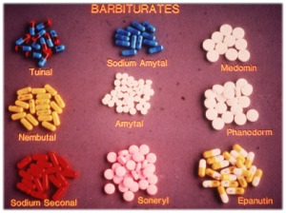
Depressants : Barbiturates
Barbiturate Names
Generic Name | Street Name
Amobarbital | Downers, blue heavens, blue velvet, blue devils
Pentobarbital (euthanasia) | Nembies, yellow jackets, abbots, Mexican yellows
Phenobarbital (for insomnia) | Purple hearts, goof balls
Secobarbital | Reds, red birds, red devils, lilly, F-40s, pinks, pink ladies, seggy
Tuinal | Rainbows, reds and blues, tooies, double trouble, gorilla pills, F-66s
1950-70s, prescribed for anxiety, insomnia, seizures
Increases GABA
EX: Phenobarbitol = used as an anticonvulsant
Effects = similar to alcohol
Proper dose difficult to predict, overdose is common (comas and death easy to induce)
If you want to kill yourself, this is your drug, i.e….
Uses: anxiolytic, hypnotic, anesethesia, anticonvulsant, alcohol detox
Notes:
http://metrohealthanesthesia.com/edu/ivanes/barbiturates1.htm

Slide 66
Depressants: Benzodiazepines
Used for insomnia, anxiety, alcohol withdrawal, seizures, muscle relaxation, inducing amnesia during medical procedures,
Examples: Xanax, Valium (diazepam), Librium, Diazepam
15% of pop uses Benzos a year; 16% of users abuse
Increase the amount of GABA which itself is inhibitory…so = hyper-activating of inhibition
Increase GABA enough = shut down of brain
Cross-tolerance with alcohol & opiates = dangerous to drink / take pain killers while on these bad boys
Severe withdrawal b/c of long half-life
Uses: panic disorder, GAD, Insomnia, seizures, alcohol detox, other anxiety disorders
Acute panic from hallucinogen intoxication
Side-Effects: anterograde amnesia, lower IQ, lower verbal ability, paradoxical rxns in <1% (though frequent in borderline personalities)
Notes:
http://www.emedicinehealth.com/benzodiazepine_abuse/article_em.htm

Slide 67
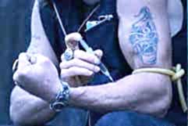
Depressants : Opiates
Feelings of warm flushing of the skin, 45 second sensations in the lower abdomen similar to orgasms
Tolerance is likely with repeated use
Intoxication: constricted pupils, marked sedation, slurred speech, impairment in attention or memory
Withdrawal: 10 hours after last ingestion: flu-like symptoms
opium and its derivatives (morphine, heroine, codeine: OxyContin, Demerol)
opiates depress neural activity, temporarily lessening pain and anxiety (specifically works in cerebrum and medulla)
Chemically almost identical to endorphins
Attach to opioid receptors in CNS, thereby blocking the transmission of pain
Suppress “cough center”, codeine is really good at this, which is why it is a main ingredient in cough suppressant medicine
Methadone = very addictive, but does not bind to pleasure sites to create a high…used for opiate addiction
Heroine = produces huge addiction b/c opiates keep receptors constantly full; also desensitization occurs, making the person crave larger and larger doses
1977 showed 2-3% of young adults had tried it once
During peak (1970-1973), 500,000 users
Notes:
http://www.elmhurst.edu/~chm/vchembook/674narcotic.html

Slide 68
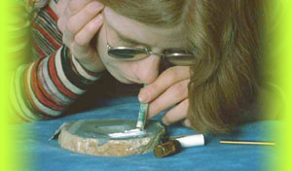
Stimulants: Cocaine
Cocaine
Blocks the reuptake of dopamine, serotonin, and norepinephrine = excess of these NTs = flooding of our pleasure receptors…but then the body runs out of these NTs and we crash
Works in the limbic system
Works in the reward system
Which is normally activated by natural reinforcers like water, sex
Increase effect of Dopamine at the mesolimbic system which originates in the ventral tegmental area and terminates in the nucleus accumbens
Addicts will ingest every 30-40 minutes (Wesson et al., 1977); rats will continually press a bar that delivers cocaine until death

Slide 69
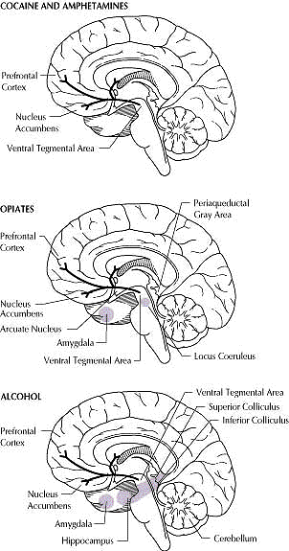

Slide 70
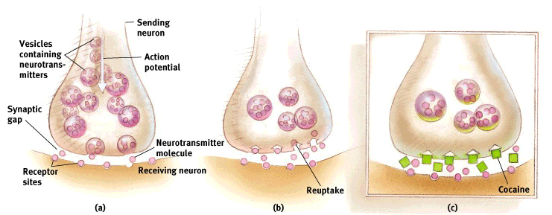

Slide 71
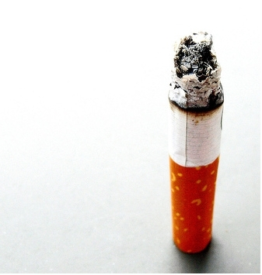
Stimulants: Nicotine
1 cig = 1mg of nicotine
Reaches the brain within 8 seconds
Half life is 30-60 minutes
Stimulates the release of endorphins
Approximately 30% of smokers make an attempt to quit smoking each year.
8% of these attempts succeed.
More than 90% of successful quitters do so on their own without participating in an organized cessation program.
Smokers who quit "cold turkey" are more likely to remain abstinent than those who gradually decrease their daily consumption of cigarettes, switch to cigarettes with lower tar or nicotine, or use special filters or holders.
Quit attempts are nearly twice as likely to occur among smokers who receive nonsmoking advice from a physician

Slide 72
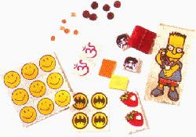
Hallucinogens: LSD (C₂₀H₂₅N₃O )
Lysergic acid diethylamide
0.5-1.0 micrograms per kg of body weight = hallucinogenic effects
150lbs = 1/20000 of a gram will have an effect
Only 1% reaches the brain
Discovered accidentally by chemist Albert Hofmann
Attempting to prevent nausea in people taking ergot to control migraine pain
Oscar Janiger studies it in 1954 by giving it to everyday people and interviewing them
See book
Blind people on LSD? Visual hallucinations!
Harvard psychologist Timothy Leary advocated his students try it…he was released thereafter
LSD becomes illegal to sell and manufacture in 1965; 68 it’s a felony to sell it; 70 it’s a Schedule 1 drug (drug of abuse with no medicinal value)

Slide 73
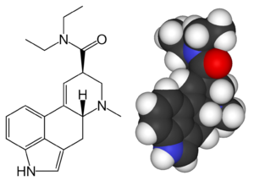
LSD -- AKA acid
LSD Use by Students 2008 Monitoring the Future Survey
Not as toxic as some other drugs, but deaths occur from accidents, homicides, or suicides
Alterations in perceptions, thinking, emotion, arousal, self-image, time is slowed/distorted, sensory input intensifies, enhanced power to visualize, decreased logical thought, colored visions, distorted images, vivid images/shapes, colors heard, sounds seen, huge mood swings
Cross tolerance with other psychedelics
No physical dependence (lab animals do not self-admin it)
Adverse Rxns: chronic psychotic state, major affective disorder, disruption of personality
How many Americans have tried it (2007)?
9.1% -- LSD (22.7million people)
 | 8th Grade | 10th Grade | 12th Grade
Lifetime*** | 1.9% | 2.6% | 4.0%
Past Year | 1.3 | 1.8 | 2.7
Past Month | 0.5 | 0.7 | 1.1
Notes:
3 phases: my page 347

Slide 74
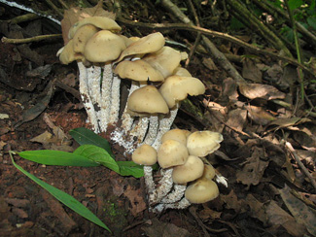
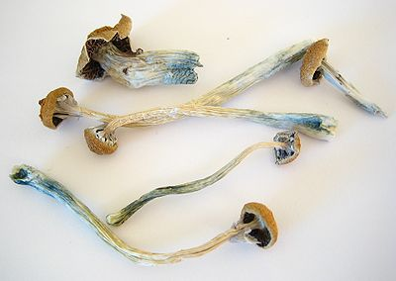
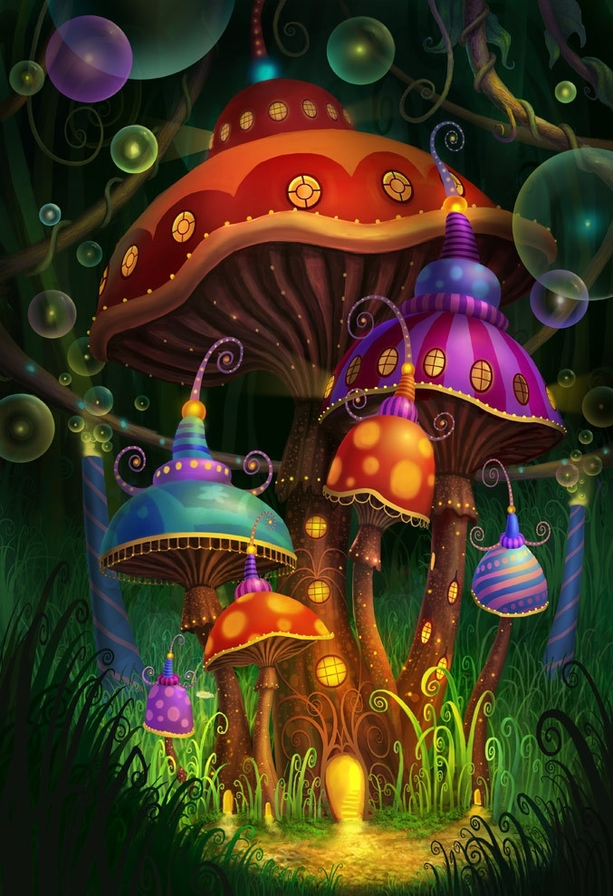
Hallucinogens: Psilocybin
Found in hundreds of mushroom species; difficult to tell apart…different species have different amounts
On average, 1/200 as potent as LSD
Induces a schizophrenic-like psychosis
No known deaths, though…
W/Lithium = seizures
<1 hour for effects, lasts 1-8 hours
Similar to LSD in psychological and physiological effects
Notes:
Description: My Page 352 (resembles LSD)

Slide 75
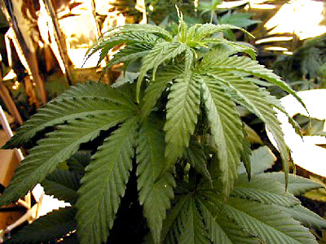
Tough to Classify: THC
the major active ingredient in marijuana
triggers a variety of effects, including mild hallucinations
Read my page 301 History
Cannabinoid receptors found on pre-synaptic nerves terminals, act to inhibit calcium ion flux…stimulation of these inhibits the release of other NTs = psychoactive effects
Ingestion: marijuana cigarette: ¼ to ½ the amount of THC present is actually available in the smoke
Heart rate, blood pressure up, skin temp decreases
THC is absorbed and distributed to fatty parts of the body = readily penetrates the BBB of the brain; readily crosses placental barrier and reaches fetus
Urine tests test for the metabolites of THC (lasts in body for about a month after)
66 million Americans had tried marijuana at least once in their lifetime (Adams et al., 1990). Surveys reveal that 31% of teenagers, 40% of young adults, and 10% of older adults have tried Marijuana. It is generally acknowledged that marijuana use among adolescents peaked in the 1970s. Daily users of marijuana dropped from 10.2 percent in 1978 to 5 percent in 1984 (Centers for Disease Control 1991; Frances and Franklin 1988).

Slide 76
Trends
http://www.whitehousedrugpolicy.gov/publications/factsht/druguse/

Slide 77
Effects of THC
Disruption of memory (reduction of hippocampus) – encoding and retrieval
Works as a analgesic in the brain or at peripheral terminals of nociceptive neurons
Decreases aggression, ability to perform complex behavioral tasks, induces hallucinations, temporal distortions, increases social interactions in monkeys, lowers female sex hormones, decreases ovulation, decreases sperm production, induces overeating in rats

Slide 78
PCP
PCP
Initially used for animal surgery anesthesia
Slurred speech, numbness of extremities
Hallucinogenic
Extremely wide range of subjective effects
Increased sensitivity to stimuli, sense of intoxication, delirium, delusional mood, flashback disorders

Slide 79

Psychoactive Drugs

Slide 80
A Brief Note on Addiction
Handout 7-12 (My pages 20-21)
Stats about college and alcohol
Page 23
If time…http://www.factsontap.org/factsontap/marijuana/index.htm
← a little biased

Slide 81
Think About This
http://www.factsontap.org/factsontap/drugs/the_challenge.htm
If time…discussion on drugs…
“Should drugs be legalized?”
“Should marijuana be legal for medicinal purposes?”
“Is drug addiction a choice?”
“Are too many children receiving Ritalin?”
“Does drug abuse treatment work?”

Slide 82
Want to Try Some “Relaxation Exercises?”
http://www.choosehypnosis.com/sleep_easy.htm
http://www.hypnosis.com/scripts.aspx?section=2

