Slide 1



Slide 2
Vocabulary

Slide 3
Map
Skills

Slide 4
Our
Southeast
Region

Slide 5
The
Mighty
Mississippi

Slide 6
States
&
Capitals

Slide 7
More
States &
Capitals

Slide 8
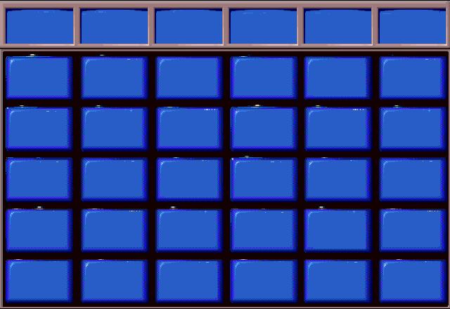
Vocabulary
Map
Skills
Our
Southeast
Region
The
Mighty
Mississippi
States
& Capitals
More
States
& Captitals
$100
$100
$100
$100
$100
$100
$200
$200
$200
$200
$200
$200
$300
$300
$300
$300
$300
$300
$400
$400
$400
$400
$400
$400
$500
$500
$500
$500
$500
$500

Slide 9
Beaches along the
southeast coast
attract these.

Slide 10
tourists

Slide 11
Some children
worked in these
in the early 1900s

Slide 12
Coal
mines

Slide 13
Farming and raising livestock is all part of ?

Slide 14
Agriculture

Slide 15
A river that flows into a much larger river is a…?

Slide 16
tributary

Slide 17
The Mississippi flows into the Gulf of Mexico at an area called a?

Slide 18
delta

Slide 19
On a map, what uses a unit of measurement to show a real distance on earth?

Slide 20
A map
scale

Slide 21
What kind of map shows a large area with very few details?

Slide 22
A small
scale
map

Slide 23
What does a
large scale
map show?

Slide 24
It shows a
lot of details
on a smaller area.

Slide 25
Turn to pg 136
in your book.
Tell me the approximate
distance between
Orlando & Tampa.

Slide 26
75
miles

Slide 27
On pg 127,
tell me the distance
between the airport
and Coffeeville.

Slide 28
12
miles

Slide 29
Which river is longer,
the Ohio River,
Colorado River,
or Mississippi river?

Slide 30
The
Mississippi
River

Slide 31
Why are oranges and
cotton grown in the Southeast
but not in the Northeast?

Slide 32
These crops need
a longer growing season,
and the Northeast doesn't
have as many frost-free days
as the Southeast.

Slide 33
What made coal
easier to buy
after 1830?

Slide 34
The building of railroads and more trains.

Slide 35
How does
silt change
a river?

Slide 36
Silt forms islands,
sand bars,
and river bends.

Slide 37
Which two states in the Southeast region supply most of our nation’s coal?

Slide 38
West Virginia
&
Kentucky

Slide 39
Where is the
source of the
Mississippi River?

Slide 40
Lake Itasca,
Minnesota

Slide 41
In which state
is the mouth
of the Mississippi
located?

Slide 42
Louisiana

Slide 43
What type of
transportation
moves goods along
the Mississippi?

Slide 44
barges

Slide 45
Why would people
choose to settle
on a large river?

Slide 46
to be near
transportation
and trade

Slide 47
Name three ways
the river affects
the Southeast
environment

Slide 48
The river provides
water, rich soil,
and transportation of goods.
(also, animal habitat)

Slide 49
How many states
are in the
Southeast region?

Slide 50
12

Slide 51
What is the
capital
Georgia?

Slide 52
Atlanta

Slide 53
What is the
capital of
Alabama?

Slide 54
Montgomery

Slide 55
Little Rock is the capital of which state?

Slide 56
Arkansas

Slide 57
Spell the capital
of Florida.

Slide 58
Tallahassee

Slide 59
Daiily
Double!!

Slide 60
What is the
capital of
Virginia?

Slide 61
Richmond

Slide 62
Nashville is the
capital of which
state? (Give the
abbreviation too!)

Slide 63
Tennessee
TN

Slide 64
What is the
capital of
Mississippi?

Slide 65
Jackson

Slide 66
Charleston is the
capital of which
state? (Give the
abbreviation too!)

Slide 67
West Virginia
WV

Slide 68
Name the capital of
North Carolina.

Slide 69
Raleigh

Slide 70
In which capital city
would one find his
‘ol Kentucky home’ ?

Slide 71
Frankfort

